Slide 1

Grant Proposal Groundwork
Office of Sponsored Programs

Slide 2
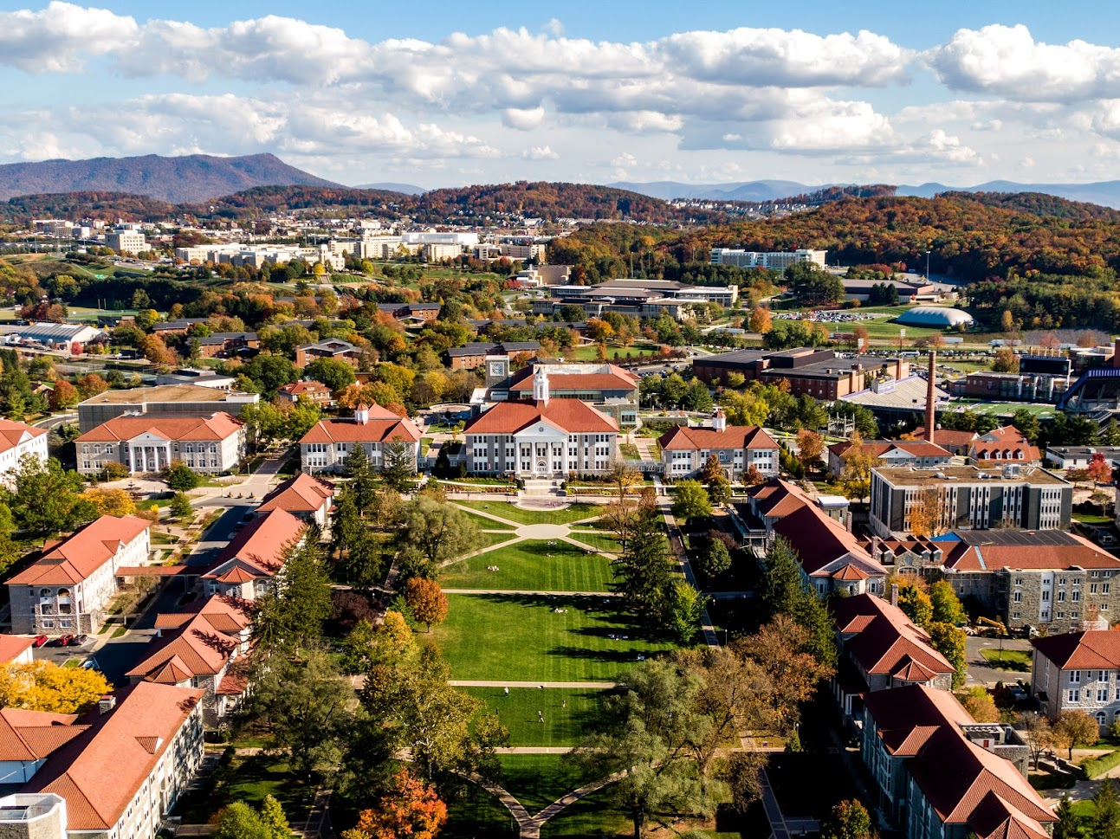
Objectives
After this workshop, learners will be able to:
Accurately plan a project
Search for potential sponsors
Draft and polish the proposal
Notes:
Three bullet points; appear with clicks

Slide 3







Sponsored Programs Basic Functions
Proposal Stage
Disseminate Funding Opportunities
Build
Compliant Budgets
Review
Agency Guidelines to Ensure Compliance
Complete
Sponsor Forms
Prepare Certifications
&
Facilitate University Approval
Submit
Proposals
<div>Icons made by <a href="https://www.freepik.com" title="Freepik">Freepik</a> from <a href="https://www.flaticon.com/" title="Flaticon">www.flaticon.com</a></div>
Notes:
Click each hexagon for text about that topic. Hexagon on far right moves to next topic.

Slide 4





Sponsored Programs Basic Functions
Award Stage
Review
Terms and Conditions for Acceptability
Negotiate
Terms if Needed
Work With
PI to Revise Budgets
Sign & Accept
Award Materials
Process
Sub-awards
Track
All Deliverables
<div>Icons made by <a href="https://www.freepik.com" title="Freepik">Freepik</a> from <a href="https://www.flaticon.com/" title="Flaticon">www.flaticon.com</a></div>
Notes:
Click each hexagon for text about that topic. Hexagon on far right moves to next topic.

Slide 5

Sponsored Programs Basic Functions
Post-Award Stage
Seek
Prior Approvals from Sponsor
Serve
As Liaison Between PI and Sponsor
Perform
Budget Revisions
Complete
Closeout Documents
<div>Icons made by <a href="https://www.freepik.com" title="Freepik">Freepik</a> from <a href="https://www.flaticon.com/" title="Flaticon">www.flaticon.com</a></div>
Notes:
Click each hexagon for text about that topic. Hexagon on far right moves to next topic.

Slide 6

Sponsored Programs Basic Functions
Miscellaneous
Write and Execute
NDA, MOU,
MOA, MTA and
Entity Agreements
Process
All W-9 Requests
Provide
Activity Reports for
PIs, Deans, and Department Heads
<div>Icons made by <a href="https://www.freepik.com" title="Freepik">Freepik</a> from <a href="https://www.flaticon.com/" title="Flaticon">www.flaticon.com</a></div>
Notes:
Click each hexagon for text about that topic. Hexagon on far right moves to next topic.

Slide 7

Planning a Project
Develop an Idea
Project Measures & Applications
Outline
Align with Funding
Soft Approvals
Identifies main ideas or goals
Helps to avoid getting off track
Allows for easy “scaling” the project/proposal
Reduces omissions (Assessment, Broader Impacts, Sustainability)
Notes:
Click each arrow to see slide about that topic. Invisible button on bottom left takes you back to Planning a project home.
Writing a successful proposal is not easy! There are lots of tips, tricks, and ideas for approaching grant writing. There is no “right” way to construct a proposal, but there are things that you can do to improve your chances.

Slide 8
Develop An Idea
Formulate an Idea
Define the Problem
Identify the Need
What is the problem?
What are the objectives?
What are the activities?
What knowledge will the project yield?
Why is your project important?
What is unique about your idea?
Notes:
Click Hexagons for text (click same hexagon again to make text disappear); Invisible button on bottom left takes you back to Planning a project home.

Slide 9
Project Measures & Applications
Evaluation and Assessment
What must you measure?
How will you measure results?
Who will measure results and impact?
Notes:
Click for bullet points to appear. Click again to progress to next slide.

Slide 10
Project Measures & Applications
Broader Impacts and Intellectual Merit
How does the project have a larger impact on society?
How will the project contribute to knowledge within the field?
How will you keep it going once the grant or contract ends?
Notes:
Click for text; Invisible button on bottom left takes you back to Planning a project home.

Slide 11
Align with Funding
Key Question to Answer
How do your proposed activities fit with the sponsor’s objectives?
How does the proposal meet the stated goals of the solicitation?
How are you and your team uniquely qualified to solve the problem without duplication of other efforts?
Notes:
Click to progress to next slide.

Slide 12
Align with Funding
Continue Development
Search for projects the sponsor has supported
Review previously successful proposals
Conduct a literature review
State the obvious – reiterate known problems
Notes:
Invisible button on bottom left takes you back to Planning a project home.

Slide 13
Soft Approvals
Inform Superiors
Identify Resources
Contact OSP
Discuss the concept of your project with your department head and dean before the formal approval process begins
Are there resources you will need that do not presently exist (space, personnel, equipment?)
What existing university resources will you require?
Let them know you are planning on submitting a proposal
Provide them with the guidelines and an overview of your project

Slide 14
Searching for Sponsors
Ask
Successful Researchers
Use the Web
Grants.gov
Agencies’ web sites
Grant Resource Center
OSP’s Website
Browse
Technical Publications
<div>Icons made by <a href="https://www.freepik.com" title="Freepik">Freepik</a> from <a href="https://www.flaticon.com/" title="Flaticon">www.flaticon.com</a></div>
Notes:
Click to progress to next slide

Slide 15


Selecting the Appropriate Opportunity
After creating your project plan and potential sponsors, consider:
Your Skill Level
&
Available Resources
Type of Organization
JMU is a 501(c)3 non-profit, a State Agency, and an Institution of Higher Education
Awards are made to the institution, not the individual
Available Timeframe
For proposal submission
Expected Award Amount and Duration
<div>Icons made by <a href="https://www.freepik.com" title="Freepik">Freepik</a> from <a href="https://www.flaticon.com/" title="Flaticon">www.flaticon.com</a></div>
Notes:
Click for bullets to appear (4 total). Click again to progress.

Slide 16
After Selecting a Funding Opportunity
Contact OSP
Contact Collaborators
Learn About the Sponsor
Read the Guidelines
Send a copy of the guidelines to jmu_grants@jmu.edu,or call at 8-6872
Are your collaborators available and interested?
What can they contribute?
What have they previously funded?
Are there examples of successful proposals anywhere?
Re-read, highlight, and become extremely familiar with the guidelines
Notes:
Click each Hexagon for text to appear, can click on hexagon again for text to disappear. Click outside hexagons to progress to next slide.

Slide 17



Writing the Proposal
Speak to the Sponsor
Align Your Proposal With Their Goals
Use Their Language
Be Excited
Meet a Funding Priority
University/Industry Collaboration
Use of Students
Underserved Populations
<div>Icons made by <a href="https://www.freepik.com" title="Freepik">Freepik</a> from <a href="https://www.flaticon.com/" title="Flaticon">www.flaticon.com</a></div>
Notes:
Click SPEAK TO SPONSOR to reveal text. Then click on one of the other hexagons to jump to that topic.

Slide 18
Writing the Proposal
Components
Abstract or Executive Summary
Introduction
Cover Page
Table of Contents
Narrative/ Project Description
Background/Literature Review
Methodology
Outcomes/Deliverables
Written in Laymen’s Terms
Evaluation Plan
Dissemination Plan
Timeline
Budget & Budget Narrative
Logic Model
Data Management Plan
Resume/
CV/
Biosketch
Notes:
Click to COMPONENTS Hexagon to reveal text (2 additional chunks of info). Click FORMAT to jump to that topic.

Slide 19
Writing the Proposal
Components
DO
DO
NOT
Follow the required format, including fonts and margins
Use jargon
Apply section headings and bullets
Exceed maximum page limits
Use language from solicitation and “buzz-words”
Overuse underlining or highlighting
Define acronyms when mentioned for the first time
Employ excessive appendices
Notes:
Click FORMAT to reveal additional text. Click outside Hexagons to progress.

Slide 20

Budget Preparation
Budgets Are Not An Afterthought
Effective Budgets
Reasonable
Feasible
Realistic
Think in Narrative Terms
OSP Will Assist With The Budget
<div>Icons made by <a href="https://www.freepik.com" title="Freepik">Freepik</a> from <a href="https://www.flaticon.com/" title="Flaticon">www.flaticon.com</a></div>
Notes:
Click to reveal text (3 chunks). Click anywhere to progress.

Slide 21
Other Budgetary Considerations
Cost Share or Match
Participant Support Costs
Indirect Costs
The university discourages voluntary match
Those who take part in the project for personal gain
(trainees/conference attendees)
Overhead or Facilities and Administration
This is not “profit” for JMU
Notes:
Click anywhere to progress.

Slide 22
Notes:
Click to progress

Slide 23
Distribution of Indirect Costs
Notes:
The returned IDC is intended to be used as seed money for the development of research on the JMU campus consistent with the mission of the University. The funds can be allocated to the use of the originator (principal investigator) of the grant whose sponsored program acquisition gained the indirect funds or to other faculty members to seek external funding. The administration of all funds must adhere to the financial procedures of James Madison University; Office of Management and Budget (OMB) 2 CFR 200, Uniform Administrative Requirements, Cost Principles, and Audit Requirements for Federal Awards.
Click to progress

Slide 24
Finalizing the Proposal
Complete
Sponsor Forms
*OSP will Assist
Obtain
Formal Departmental &
Dean Approval
Submit
Final Items to OSP for Review and Submission
Final items due 5 business days before submission deadline
<div>Icons made by <a href="https://www.freepik.com" title="Freepik">Freepik</a> from <a href="https://www.flaticon.com/" title="Flaticon">www.flaticon.com</a></div>
Notes:
Click to progress

Slide 25


Email: jmu_grants@jmu.edu
Phone: (540)-568-6872
Address:
Foundation Hall
Harrison Street, MSC 5728
https://www.jmu.edu/sponsoredprograms
Contact Us
Email: hatchtt@jmu.edu
Phone: (540)-568-2350
Address:
Foundation Hall
Harrison Street, MSC 5728
https://www.jmu.edu/sponsoredprogramsaccounting
Tamara Hatch, Director Sponsored Programs
Notes:
Click to progress.

