Slide 1
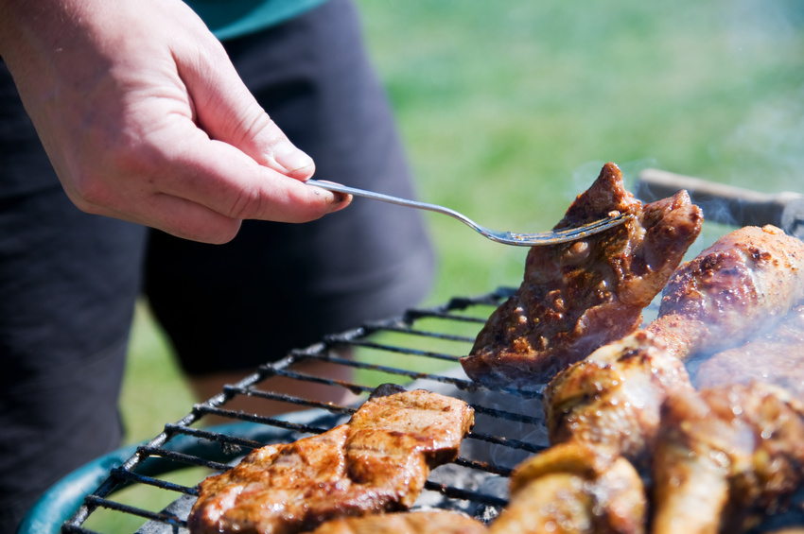
Grilling Safety Tips
JMU Department of Risk Management
www.jmu.edu.riskmgmt

Slide 2
GRILLING SAFETY TIPS Download these NFPA safety tips on grilling. (PDF, 427 KB) file:///C:/Users/dayat/Downloads/grilling_safety_tips.pdf Fire in the grill, under hot dogs and burgers, is a welcome sight at the family cookout. But fire anywhere else can make your summer kick-off barbecue memorable for all the wrong reasons. To keep you and your family safe while grilling, follow these general guidelines: General grilling tips Propane and charcoal BBQ grills should only be used outdoors. The grill should be placed well away from the home, deck railings and out from under eaves and overhanging branches. Keep children and pets away from the grill area. Keep your grill clean by removing grease or fat buildup from the grills and in trays below the grill. Never leave your grill unattended.

Slide 3
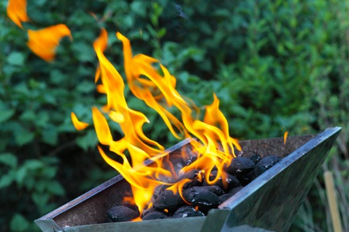
Video: Guy Colonna, NFPA Division Manager, Industrial ＆ Chemical Engineering, gives some basic tips on how to prepare your grill before your first cookout of the season.
Click the link below to watch the video.
https://youtu.be/mpDhUssEgP0

Slide 4
Before you use your grill:
Check the major connection points between the gas (propane) tank hose and the regulator and cylinder, and where the hose connects to the burners. Tighten if loose.
Check the gas (propane) tank hose for the potential (gas) leaks. To do that:
Apply a light soap and water solution to the hose using a brush or spray bottle.
Turn the propane tank on. If there is a gas leak, the propane will release bubbles around the hose (big enough to see).
If there are no bubbles, your grill is safe to use.
If there are bubbles, turn off the tank and check connections, then have your grill serviced by a professional before using it again.
If the leak doesn’t stop, call the fire department immediately.
When the grill is on:
As you are cooking, if you smell gas, turn off the gas tank and burners.
If the leak stops immediately, get the grill serviced by a professional before using it again.
If the smell continues, move away from the grill and call the fire department immediately. Do not move the grill.

Slide 5
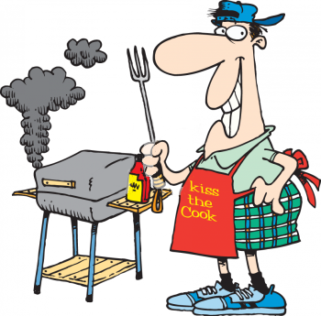
Charcoal grills
There are several ways to get the charcoal ready to use. Charcoal chimney starters allow you to start the charcoal using newspaper as a fuel.
If you use a starter fluid, use only charcoal starter fluid. Never add charcoal fluid or any other flammable liquids to the fire.
Keep charcoal fluid out of the reach of children and away from heat sources.
There are also electric charcoal starters, which do not use fire. Be sure to use an extension cord for outdoor use.
When you are finished grilling, let the coals completely cool before disposing in a metal container.

