Slide 1
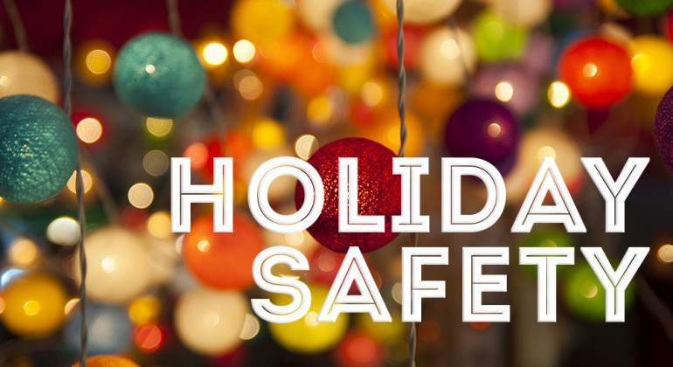
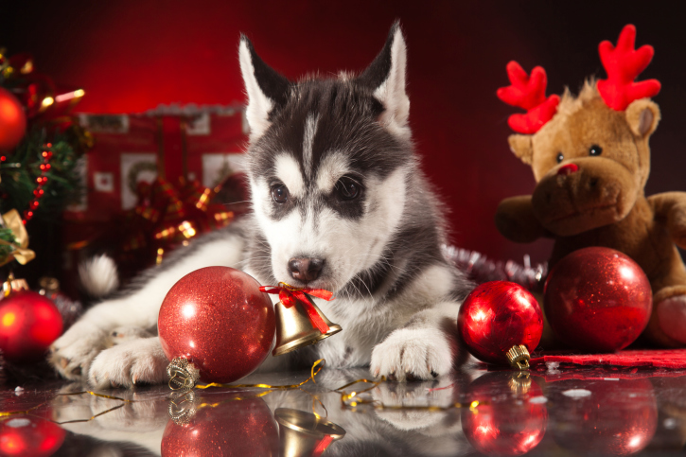
A wealth of safety information to help ensure the holiday season is a safe one.
Happy Holidays
Department of Risk Management
James Madison University
http://www.jmu.edu/riskmgmt/

Slide 2
Festive celebrations, flickering lights and winter greens are hallmarks of the holiday season, but they also present fire risks that can quickly turn this festive time of year into a devastating one. NFPA’s Project Holiday campaign works to educate the public about potential fire risks during the holidays, offering tip sheets, videos, and other resources to help everyone safely enjoy the season.
Winter holiday fires by the numbers
Electrical distribution or lighting equipment was involved in two out of every five (40%) home Christmas tree fires.
More than one-third (37%) of home Christmas tree fires started in the living room, family room, or den. All of the fatalities and roughly three-quarters (72%) of the injuries resulted from fires started in this area.
The top three days for home candle fires were Christmas, New Year’s Day and New Year's Eve.

Slide 3
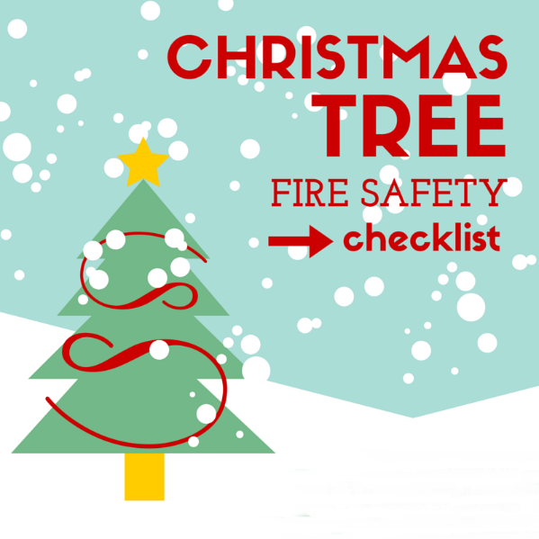
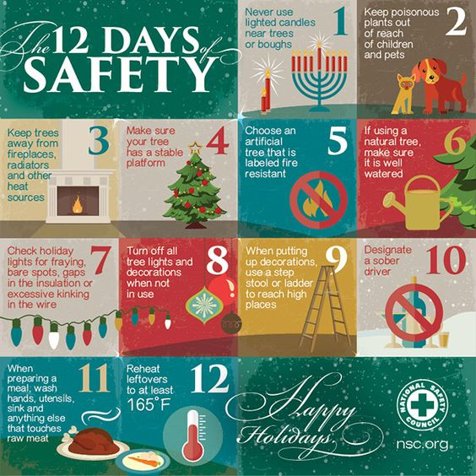
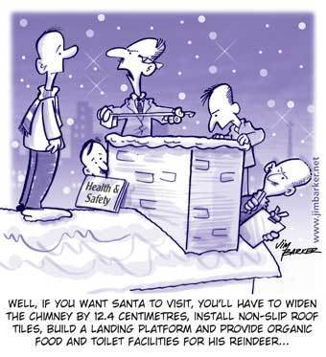
Christmas tree & decoration fires
Carefully decorating your home can help make your holidays safer. Between 2009-2014, U.S. fire departments responded to an average of 210 home fires that started with Christmas trees per year. U.S. fire departments responded to an estimated average of 860home structure fires per year that began with decorations, excluding Christmas trees.
In the throes of holiday shopping and decorating? Check out the 9 Ways You’re a Holiday Decorating Disaster.
Christmas tree disposal
Christmas trees are combustible items that become increasing flammable as they continue to dry out in your home. Nearly 40 percent of home fires that begin with Christmas trees occur in January. Although Christmas tree fires are not common, when they do occur they’re much more likely to be serious.

Slide 4
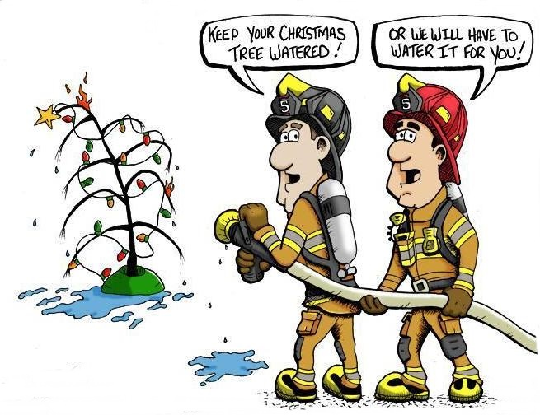
Click on the tree for a fire safety video

