Slide 1
August Safety Back to School Edition
Department of Risk Management
James Madison University

Slide 2
Happy August Everyone
We hope you all are staying cool and hydrated this hot month! We hope you are staying inside with the fans blowing and the AC kicking! That is why this month we wanted to highlight technology safety and back to school safety.
Do your children use the internet? Do you know who they are talking to on Facebook? Many teens do not like to share their passwords with their parents to their email, Facebook and Twitter accounts. But as a parent, we need to keep them safe. There are many online monitoring programs available, and should only be used as a precaution. There is a fine line between snooping and trust issues. Learn to talk with your kids first before going through their emails.
http://kidshealth.org/en/parents/net-safety.html
Before you allow them to connect, know the facts!
Facebook "admins" can log into any profile, anywhere and see all those "deleted“messages and photos!
Cyber bullying is very real and going on everywhere!
Just because some things are set "private" does not keep people away. 10% of sex offenders use the internet for meeting people.

Slide 3
Cell Phone Safety
Most teenagers now have cell phones as well. Too often parents ask how to monitor where their children are. There are phone Apps available like Life360! https://www.life360.com/ It offers family maps, family chats and GPS. All for free - and all by invite only.
"Do your kids have your phone numbers and addresses memorized?" Most people now have the numbers in their phones and never have to “dial” the number and if their phone gets lost they have no way to contact their someone. It’s good to know at least one number in case of an emergency.

Slide 4
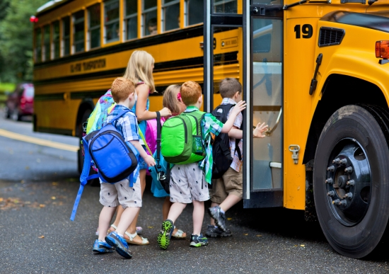
School Bus Safety
Please make sure you have scanned your child's schoolbus stop, walking route and school neighborhood for sex offenders! Some may have moved and you should be up-to-date with who can come into contact with your children.
Talk with your children. Learn your surroundings. If you are unsure of a new neighborhood, research it. You can never be too safe. Awareness is your best defense.

Slide 5
To avoid tragic incidents in coming weeks as school buses become more plentiful on Virginia roadways, we have provided a list of safety points to remember while driving:
Never pass a school bus while it is stopped for students to get on or off – this will be identified by yellow and red lights flashing, as well as a stop sign that extends from the side of the bus. It is not hard to identify when a bus has children entering or exiting, so pay attention and abide by the law – do not pass.
When children are boarding or exiting a school bus, you must stop your vehicle no matter what direction you’re traveling and regardless of your schedule. Children are not always looking for vehicles, as they expect them to stop as they navigate the bus. It is your responsibility to follow the rules of the road and stop any time a bus signals.
Your vehicle should never come within 10 feet of a school bus – whether children are outside it or not. Leaving extra room prevents two-vehicle crashes from becoming three-or-more-vehicle crashes.
Stay on the lookout for school zones and bus zones. These areas are likely to have pedestrians nearby. There’s a reason the speed limit is lowered in these areas, so follow that directive as well.
If a school bus is attempting to merge into traffic, allow them to do so with plenty of space. These large vehicles are not easy to navigate and drivers have a lot of distractions – merging shouldn’t be one of them.

Slide 6
Think Safe!
Stay Safe!

