Slide 1
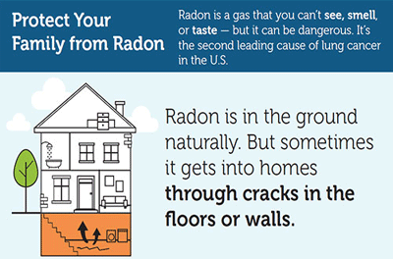
Learn about Risk From Radon You can’t see, smell or taste radon, but it could be present at a dangerous level in your home. Radon is the leading cause of lung cancer deaths among nonsmokers in America and claims the lives of about 21,000 Americans each year. In fact, the EPA and the U.S. Surgeon General urge all Americans to protect their health by testing their homes, schools and other buildings for radon. Exposure to radon is a preventable health risk and testing radon levels in your home can help prevent unnecessary exposure. If a high radon level is detected in your home, you can take steps to fix the problem to protect yourself and your family.

Slide 2
Take Action in January Radon Leaders Saving Lives Campaign is an online learning and action network supporting the Radon Leaders Saving Lives Campaign hosted by the Conference of Radiation Control Program Directors, or CRCPD, with contributions from industry and EPA. If you would like to organize an event in your neighborhood, download the NRAM Event Planning Kit

Slide 3
Five Things You Can Do During National Radon Action Month
Test your home - EPA and the U.S. Surgeon General recommend that all homes in the U.S. be tested for radon. Testing is easy and inexpensive.
Learn more about testing your home, including how to obtain an easy-to-use test kit.
Attend a National Radon Action Month event in your area - Look for radon events in your community.
Spread the word
Spend time during National Radon Action Month encouraging others to learn about radon and test their homes.
Tell your family and friends about the health risk of radon. Encourage them to test their homes.
Plan an activity EXIT in your community to help raise awareness.
Write an op-ed or letter to the editor using samples from the event planning resources.
Attract media attention by working with a local official to get a radon proclamation.
View or order EPA's free radon publications.
Buy a radon-resistant home - Read more about radon-resistant new construction, "Building Radon Out: A Step-by-Step Guide to Build Radon-Resistant Homes".
Build Green: It's Easy to Build New Homes Radon-Resistant ..."The good news is you can build your customers a safer, healthier, radon-resistant home. The techniques to prevent radon from entering a home are practical and straightforward for any builder. It’s an inexpensive way to offer families a benefit that could reduce their risk of lung cancer. And it’s a smart way to build trust between you and your customer." Fuad Reveiz, Member of the National Association of Home Builders

Slide 4
Special Radon Messages
As you conduct radon outreach throughout the year, consider incorporating messages to test for radon, fix radon problems and build radon resistant homes with other environmental health messages and special events. The following are some examples of seasonal messages you can use at different times of the year:
February – Protect Your Loved Ones. Test for Radon. (Valentine’s Day)
April – Don’t Be Foolish. Test Your Home for Radon. (April Fool's Day)
May/August – Breathe With Ease. Fix Your Home By Reducing Radon Gas. (Clean Air Month)
June – Living Green is Healthier. Build Radon-Resistant Homes. (Home Safety Month)
October – Protect Your Children From Radon. Test Your Home. (Children’s Health Month)
November – Radon is the Leading Cause of Lung Cancer Among Non-Smokers. (Lung Cancer Awareness Month)
December – Give the Gift of Health. Protect Loved Ones by Reducing Radon in Your Home. (Holiday Season)

Slide 5
James Madison University
Department of Risk Management
www.jmu.edu.riskmgmt

