Slide 1
Laboratory Safety
Notes:
Laboratory Safety
James Madison University

Slide 2

The Laboratory Environment
Laboratories are places where scientists, students, and technicians come together to conduct experiments and develop new technologies
Due to the unique nature of the laboratory environment, each lab carries with it special safety concerns and health hazards
These risks can be largely reduced by following the lab safety rules and learning how to recognize potential safety hazards
Ultimately, you have the responsibility of ensuring your own safety and the safety of those around you
So, don’t be afraid to ask questions and be sure to speak up if you see something that is unsafe
Notes:
The Laboratory Environment
Laboratories are places where scientists, students, and technicians come together to conduct experiments and develop new technologies
Due to the unique nature of the laboratory environment, each lab carries with it special safety concerns and health hazards
These risks can be largely reduced by following the lab safety rules and learning how to recognize potential safety hazards
Ultimately, you have the responsibility of ensuring your own safety and the safety of those around you
So, don’t be afraid to ask questions and be sure to speak up if you see something that is unsafe

Slide 3

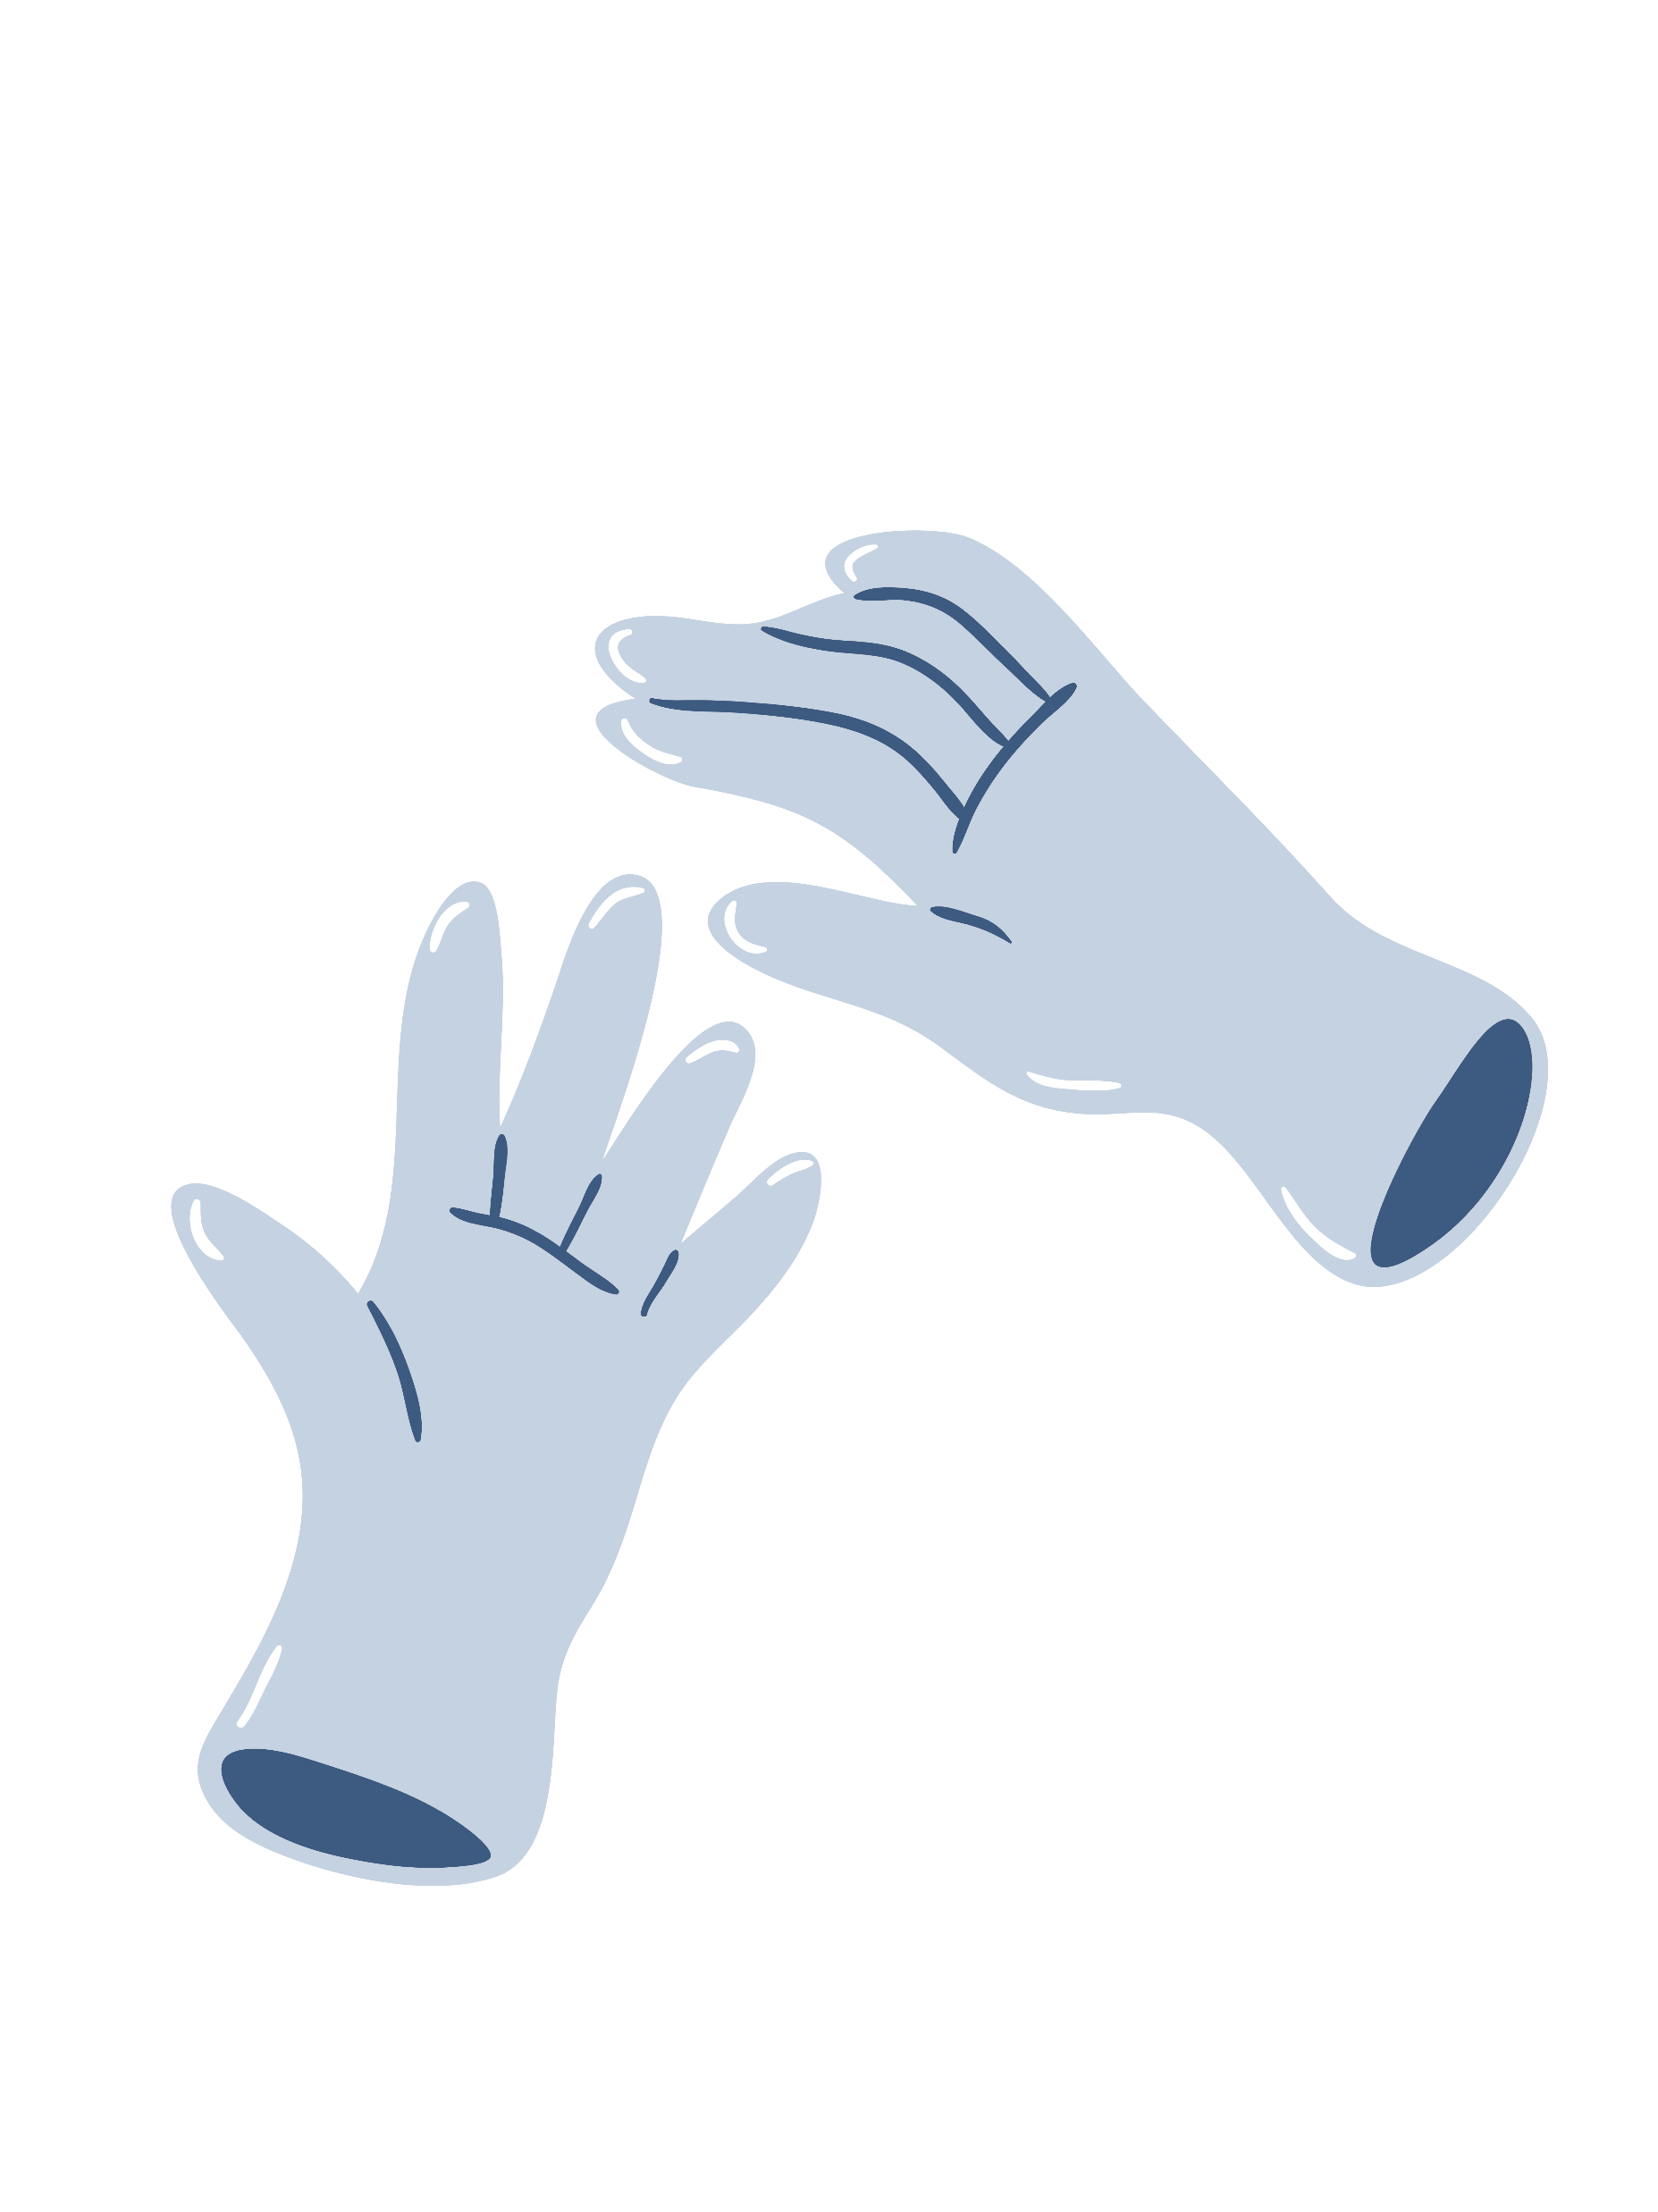

Good Laboratory Practices
Be sure to read and follow all safety instructions and guidelines
Always wear the proper clothing, closed-toed shoes, and use the appropriate personal protective equipment (PPE)
Recognize no gloves protect against all chemicals, so you must make sure they're appropriate for the task at hand
Remember to tie long hair back and remove jewelry
Never bring food or drinks into the lab
Maintain neat and organized workspaces at all times
Identify where the safety equipment is located and know how to use it
FLAMMABLE/COMBUSTIBLES
When working with chemicals, you must use safety goggles!
(not safety glasses)
Notes:
Good Laboratory Practices
Be sure to read and follow all safety instructions and guidelines
Always wear the proper clothing, closed-toed shoes, and use the appropriate personal protective equipment (PPE)
Recognize no gloves protect against all chemicals, so you must make sure they're appropriate for the task at hand
Remember to tie long hair back and remove jewelry
Never bring food or drinks into the lab
Maintain neat and organized workspaces at all times
Identify where the safety equipment is located and know how to use it

Slide 4






Potential Lab Risks
CHEMICAL HAZARDS
BIOLOGICAL HAZARDS
PHYSICAL HAZARDS
FIRE
ELECTRICITY
RADIATION
Notes:
Potential Lab Risks
Chemical Hazards
Fire
Physical Hazards
Radiation
Biological Hazards
Electrical Shock

Slide 5

Chemical Hazards
Chemicals can cause serious injury or illness if not handled properly
Exposure can cause acute and chronic health effects
These hazards can also lead to fires, explosions, and other safety risks
When working with any hazardous chemicals in a lab, it is important to:
  Follow all safety protocols and lab practices
  Read the label and safety data sheet (SDS) before working with any chemical
  Use the appropriate PPE including safety goggles, gloves, face shield, and lab coat
  Avoid contact with the skin, eyes, or mucous membranes
  Maintain good housekeeping practices
  Ensure chemicals are safely stored, handled and disposed of
  Preform manipulations of chemicals in a fume hood
  Report any spills or leakage to supervisors immediately
FLAMMABLE/COMBUSTIBLES
Notes:
Chemical Hazards
Chemicals can cause serious injury or illness if not handled properly
Exposure can cause acute and chronic health effects
These hazards can also lead to fires, explosions, and other safety risks
When working with any hazardous chemicals in a lab, it is important to:
Follow all safety protocols and lab practices
Read the label and safety data sheet (SDS) before working with any chemical
Use the appropriate PPE including safety goggles, gloves, face shield, and lab coat
Avoid contact with the skin, eyes, or mucous membranes
Maintain good housekeeping practices
Ensure chemicals are safely stored, handled and disposed of
Preform manipulations of chemicals in a fume hood
Report any spills or leakage to supervisors immediately

Slide 6









GHS Pictograms
There are lot of different types of chemical hazard types to be aware of
The following GHS pictograms are internationally used to communicate the potential hazards of chemicals
FLAMMABLE/COMBUSTIBLES
FLAMMABLE
EXPLOSIVE
CORROSIVE
HARMFUL/ IRRITANT
DANGER FOR THE ENVIRONMENT
GHS stands for Globally Harmonized System of Classification and Labeling of Chemicals
COMPRESSED GAS
OXIDIZING
TOXIC
HEALTH HAZARD
Notes:
GHS Pictograms
There are lot of different types of chemical hazard types to be aware of
The following GHS pictograms are internationally used to communicate the potential hazards of chemicals
- Flammable
- Explosive
- Corrosive
- Harmful/Irritant
- Danger For The Environment
- Compressed Gas
- Oxidizing
- Toxic
- Health Hazard

Slide 7
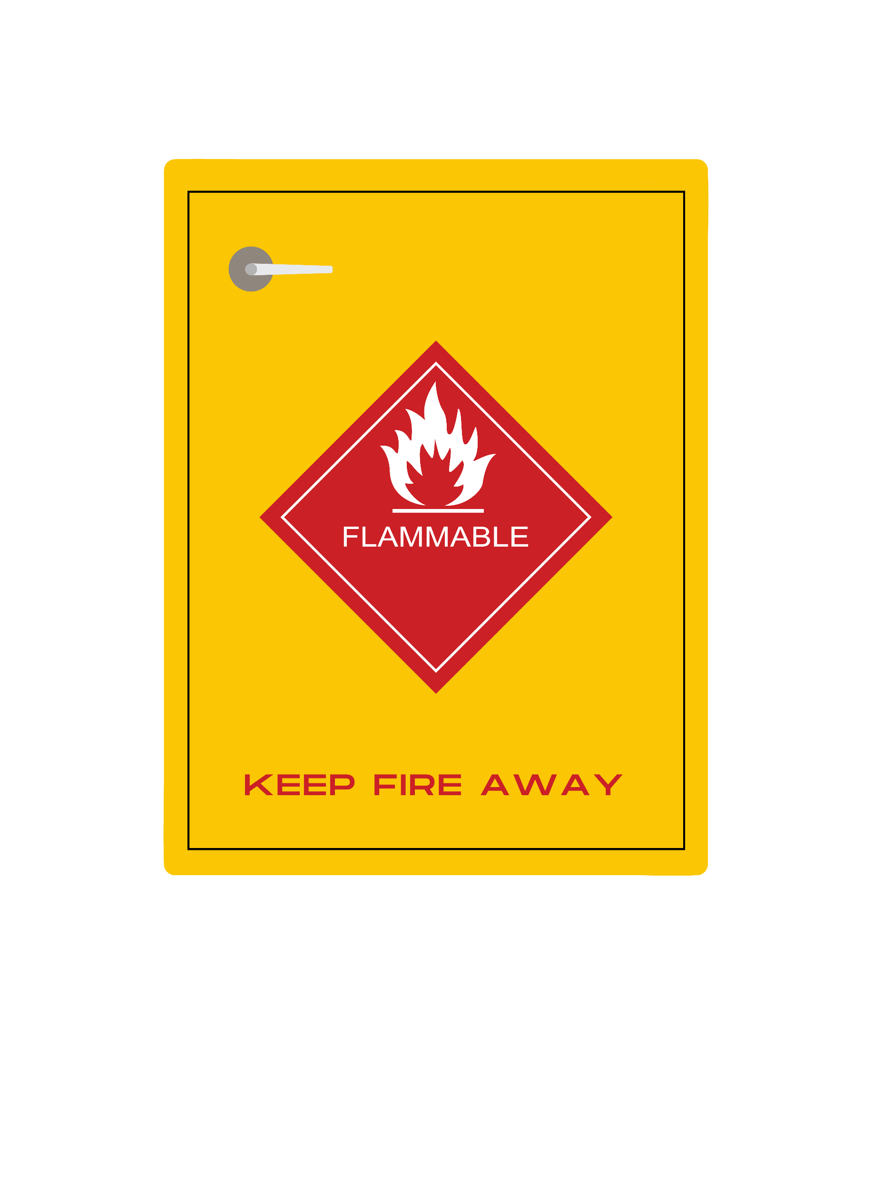
Flammable/Combustible Chemicals
Any materials that have a potential to catch on fire, such as:
  Fuels
  Pyrophorics
  Self-heating substances
  Organic peroxides
  Oxidizers
  Explosives
Flammable/combustible materials can be found in a gases, aerosol, liquid, or solid state
Flammable liquids produce flammable vapors. The flammable vapors mixed with air are what burn, rather than the liquid
The temperature at which a flammable liquid produces enough vapors to become ignitable is called its flashpoint
Flammables should be clearly labeled and kept in proper containers
Store flammables in a flame cabinet or explosion proof refrigerator
FLAMMABLE/COMBUSTIBLES
Notes:
Flammable/Combustible Chemicals
Any materials that have a potential to catch on fire, such as:
Fuels
Pyrophorics
Self-heating substances
Organic peroxides
Oxidizers
Explosives
Flammable/combustible materials can be found in a gases, aerosol, liquid, or solid state
Flammable liquids produce flammable vapors. The flammable vapors mixed with air are what burn, rather than the liquid
The temperature at which a flammable liquid produces enough vapors to become ignitable is called its flashpoint
Flammables should be clearly labeled and kept in proper containers
Store flammables in a flame cabinet or explosion proof refrigerator

Slide 8

Explosive Chemicals
Substances that have the potential to undergo a rapid chemical reaction that produces a large amount of energy in the form of heat, light, sound, and pressure
When handling explosive materials, be sure to familiarize yourself with the specific properties and hazards of the materials before handling
Follow all safety precautions to prevent any accidents
Always wear protective clothing and equipment
Make sure that the area is well-ventilated
Keep the explosives away from flames, sparks, heat sources and light
Store explosive materials in a secure, dry location away from any sources of ignition sources
Explosives should not be stored in a flame cabinet, as these are meant for flammable materials
Notes:
Explosive Chemicals
Substances that have the potential to undergo a rapid chemical reaction that produces a large amount of energy in the form of heat, light, sound, and pressure
When handling explosive materials, be sure to familiarize yourself with the specific properties and hazards of the materials before handling
Follow all safety precautions to prevent any accidents
Always wear protective clothing and equipment
Make sure that the area is well-ventilated
Keep the explosives away from flames, sparks, heat sources and light
Store explosive materials in a secure, dry location away from any sources of ignition sources
Explosives should not be stored in a flame cabinet, as these are meant for flammable materials

Slide 9
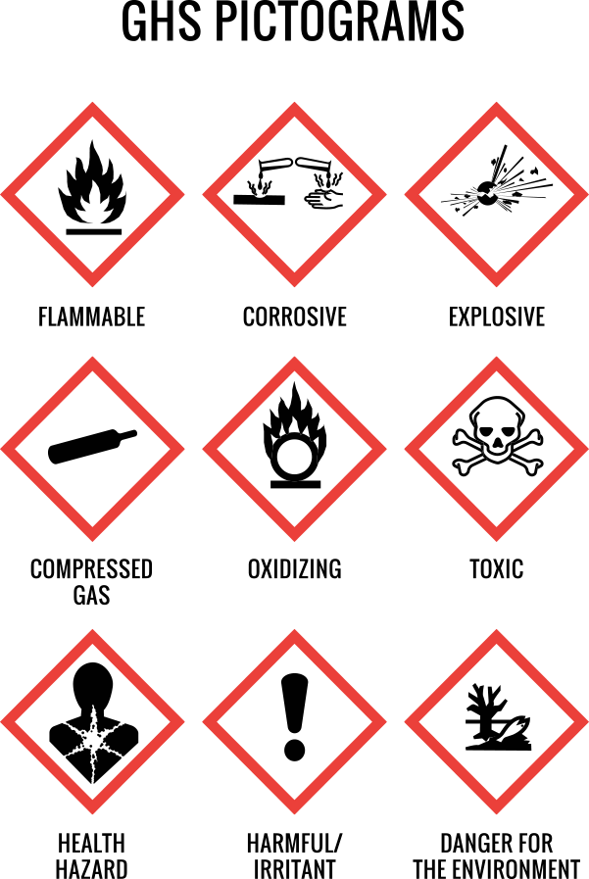

Corrosive Chemicals
Corrosives can cause severe damage to human tissue and certain storage containers
Generally, include acids and bases
The damage depends on the chemical’s strength and length of exposure
If a corrosive, or any other chemical, gets on your skin or in your eyes, flush the area with clean, running water or saline solution for at least 15 minutes, then seek medical advice
Never try to neutralize an acid with a base, or vice versa. The acid-base reaction could cause additional burns
Notes:
Corrosive Chemicals
Corrosives can cause severe damage to human tissue and certain storage containers
Generally, include acids and bases
The damage depends on the chemical’s strength and length of exposure
If a corrosive, or any other chemical, gets on your skin or in your eyes, flush the area with clean, running water or saline solution for at least 15 minutes, then seek medical advice
Never try to neutralize an acid with a base, or vice versa. The acid-base reaction could cause additional burns

Slide 10
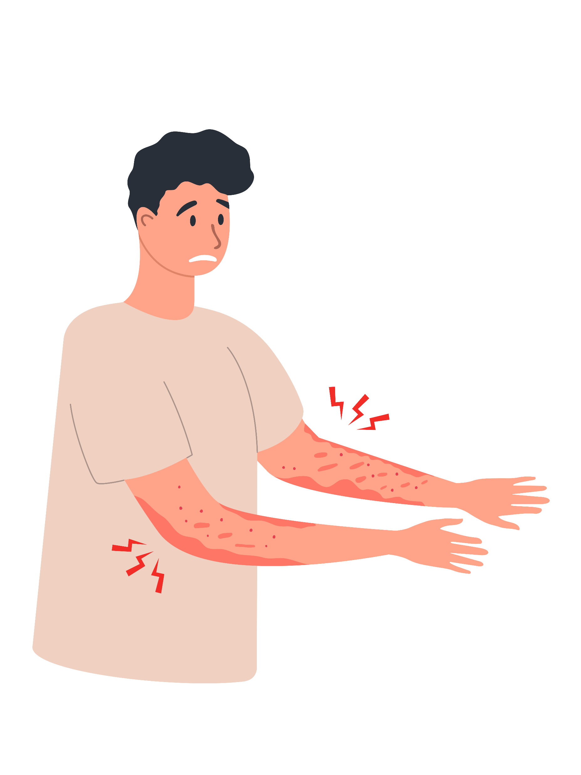
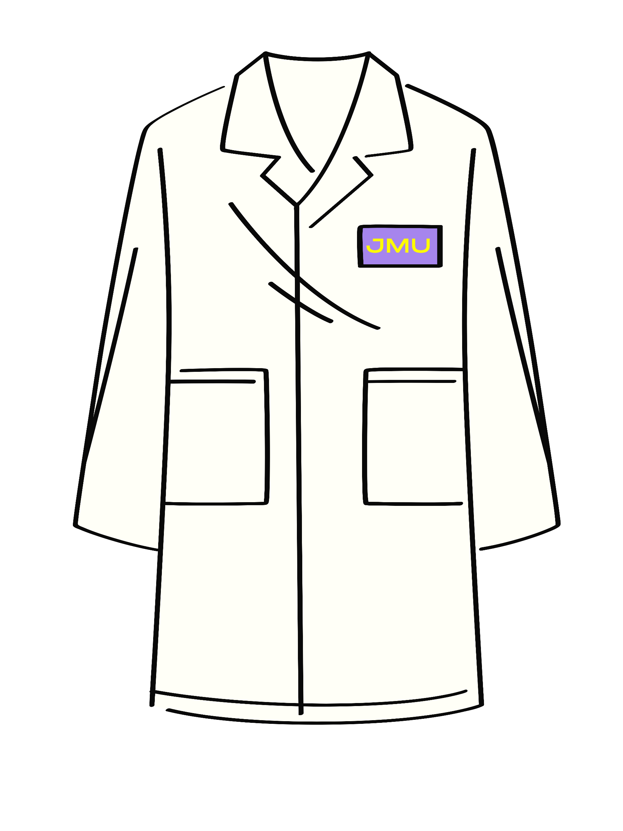
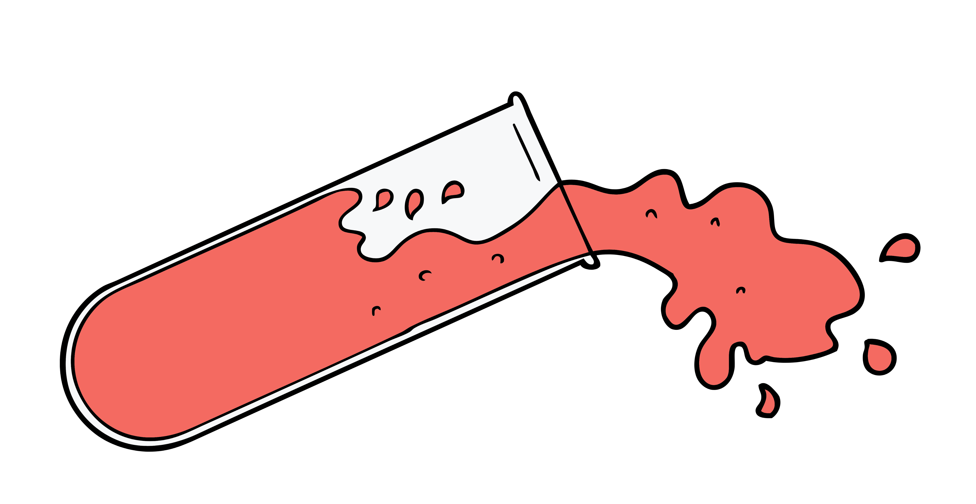
Harmful/Irritant
Products that can cause inflammation through immediate, prolonged or repeated contact with skin or a mucous membrane
Remember to always use the appropriate PPE when working with any chemical including gloves, safety goggles, face shield and lab coat
Notes:
Harmful/Irritant
Products that can cause inflammation through immediate, prolonged or repeated contact with skin or a mucous membrane
Remember to always use the appropriate PPE when working with any chemicals including gloves, safety goggles, face shield and lab coat

Slide 11
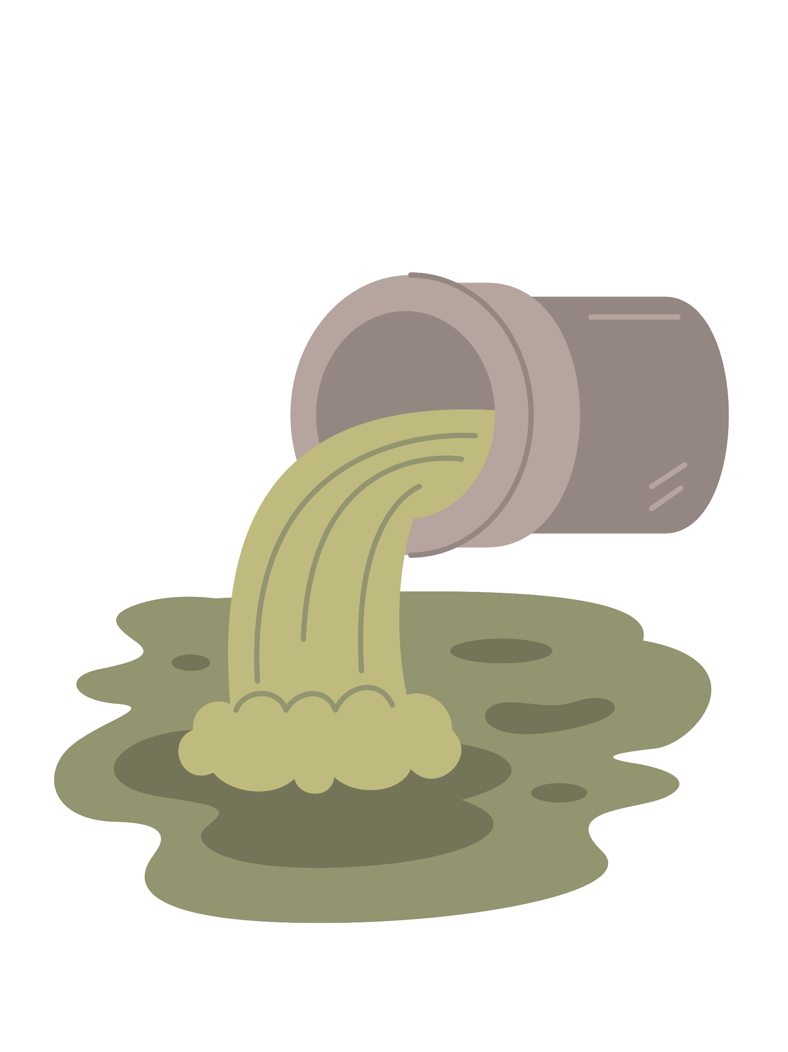



Environmental Danger
Chemicals that are hazardous to aquatic environment or the ozone
Be sure to follow all safety precautions when handling and disposing of environmentally hazardous chemicals
Acutely hazardous chemicals:
  Organic solvents
  Heavy metals
  Pesticides
  Hydrocarbons
Chronically hazardous chemicals:
  Phosphates
  Nitrates
  Perchlorates
  Ammonia
  Chlorinated hydrocarbons
FLAMMABLE/COMBUSTIBLES
Notes:
Danger For The Environment
Chemicals that are hazardous to aquatic environment or the ozone
Be sure to follow all safety precautions when handling and disposing of environmentally hazardous chemicals
Acutely hazardous chemicals:
Acutely hazardous chemicals:
Organic solvents
Heavy metals
Pesticides
Hydrocarbons
Chronically hazardous chemicals:
Phosphates
Nitrates
Perchlorates
Ammonia
Chlorinated hydrocarbons

Slide 12
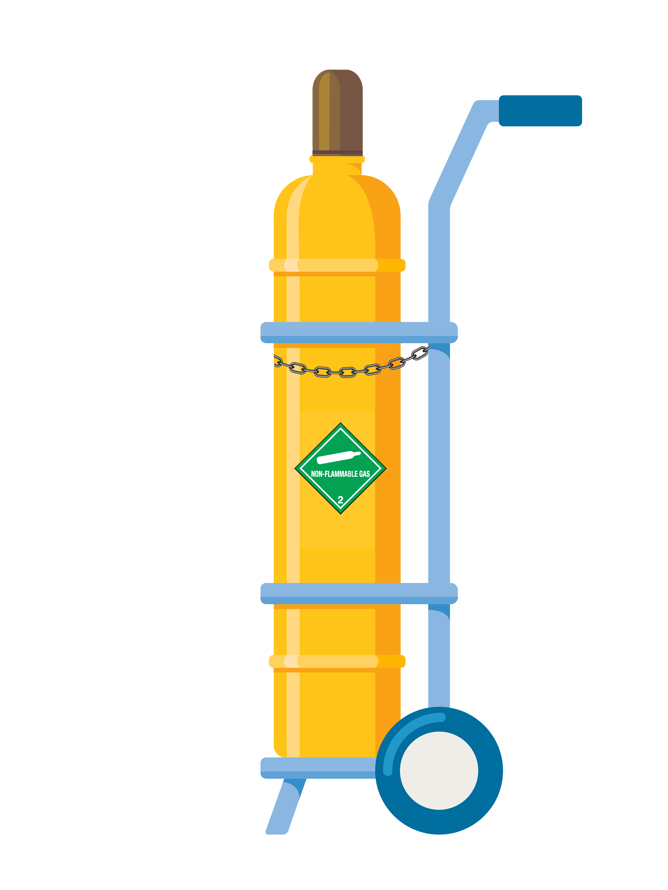
Compressed Gas
The dangers of compressed gas cylinders include fire or explosion, asphyxiation, exposure to toxic or corrosive gases, and physical injuries
Recognize that different types of gases have varying levels of toxicity and flammability, and it is important to store and handle them appropriately
  All cylinders must be stored in an upright position and secured to prevent them from tipping over
  Wear the appropriate PPE and use a gas cylinder dolly or cart to move compressed gas cylinders
  Ensure that the cylinder is securely fastened to the dolly
  Never transport a cylinder without the valve cap on
  Move the cylinder slowly and carefully, and avoid sudden starts, stops, or changes in direction
  Keep cylinders at least 20 feet away from combustible materials
  Know that a build up of gas can displace oxygen, leading to asphyxiation
FLAMMABLE/COMBUSTIBLES
Notes:
Compressed Gas
The dangers of compressed gas cylinders include fire or explosion, asphyxiation, exposure to toxic or corrosive gases, and physical injuries
Recognize that different types of gases have varying levels of toxicity and flammability, and it is important to store and handle them appropriately
All cylinders must be stored in an upright position and secured to prevent them from tipping over
Wear the appropriate PPE and use a gas cylinder dolly or cart to move compressed gas cylinders
Ensure that the cylinder is securely fastened to the dolly
Never transport a cylinder without the valve cap on
Move the cylinder slowly and carefully, and avoid sudden starts, stops, or changes in direction
Keep cylinders at least 20 feet away from combustible materials
Know that a build up of gas can displace oxygen, leading to asphyxiation

Slide 13
Oxidizing Chemicals
When thermodynamically favorable, oxidizers can react with combustible materials or most other oxidizing agents to generate heat or fire
During this reaction, oxygen is often released which can cause combustible materials to ignite or burn more vigorously
Oxidizing materials can become unstable or self-reactive when subject to shock, friction, pressure, temperature, or even light
Take caution when handling:
  Organic peroxides
  Water reactives
  Pyrophorics
  Explosives
FLAMMABLE/COMBUSTIBLES
Remember, chemicals can have multiple hazard classes
I
W
Notes:
Oxidizers
When thermodynamically favorable, oxidizers can react with combustible materials or most other oxidizing agents to generate heat or fire
During this reaction, oxygen is often released which can cause combustible materials to ignite or burn more vigorously
Oxidizing materials can become unstable or self-reactive when subject to shock, friction, pressure, temperature, or even light
Take caution when handling:
Organic peroxides
Water reactives
Pyrophorics
Explosives

Slide 14
Toxic Chemicals
Can cause damage to living tissue, impairment of the central nervous system, severe illness or death when ingested, inhaled or absorbed by the skin
Some substances are toxic in relatively small amounts, can have a rapid onset of effects, and/or cause irreversible damage
Be extremely careful when working with or around toxic chemicals, especially:
  Mutagens – cause damage to DNA
  Teratogens – cause reproductive harm or birth defects
  Carcinogens – cause cancer
Notes:
Toxic Chemicals
Can cause damage to living tissue, impairment of the central nervous system, severe illness or death when ingested, inhaled or absorbed by the skin
Some substances are toxic in relatively small amounts, can have a rapid onset of effects, and/or cause irreversible damage
Be extremely careful when working with or around toxic chemicals, especially:
Mutagens – cause damage to DNA
Teratogens – cause reproductive harm or birth defects
Carcinogens – cause cancer

Slide 15
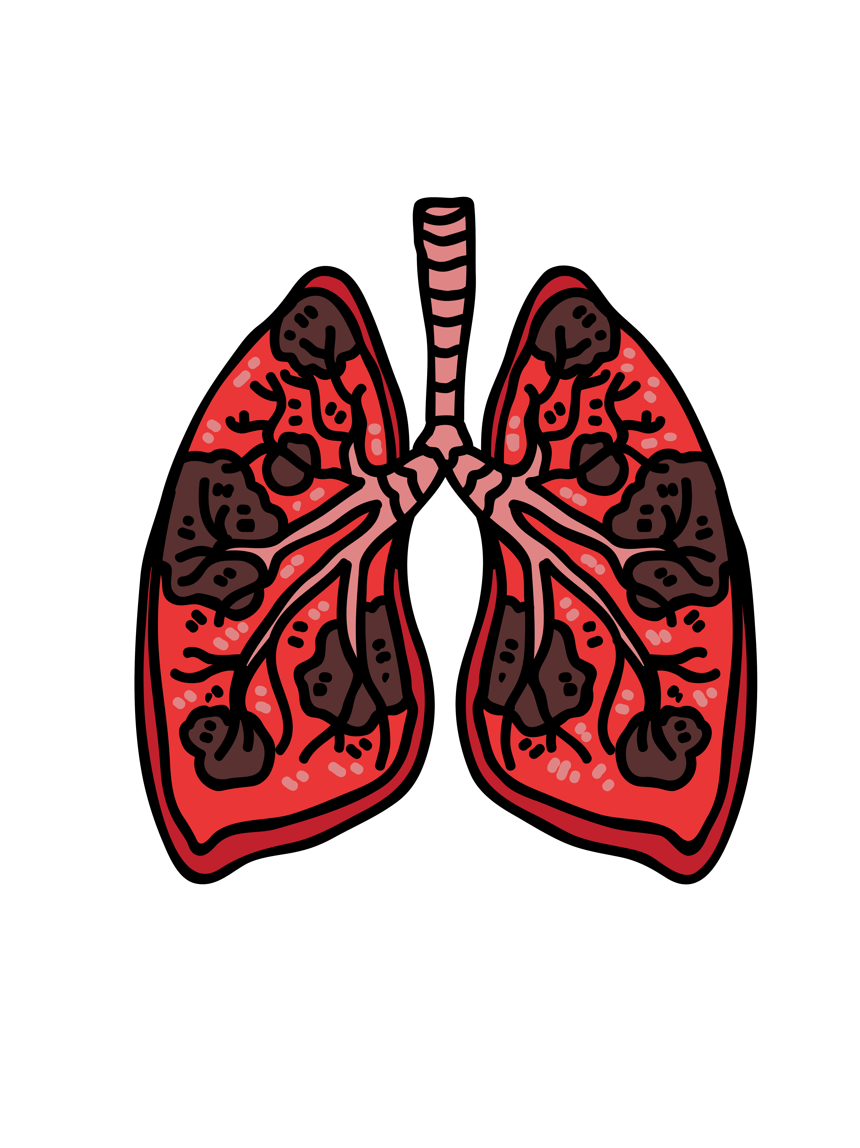
Health Hazard
Materials that are harmful to living organisms
Health hazards can be of varying severity, from mild to severe, and can be either acute or chronic in nature
The effects can be caused by direct or indirect contact, or inhalation of the chemical
Use caution when working with hazardous chemicals as they can cause adverse health effects including:
  Skin, eye & respiratory irritation
  Cancer
  Organ damage
  Reproductive effects
Notes:
Health Hazard
Materials that are harmful to living organisms
Health hazards can be of varying severity, from mild to severe, and can be either acute or chronic in nature
The effects can be caused by direct or indirect contact, or inhalation of the chemical
Use caution when working with hazardous chemicals as they can cause adverse health effects including:
Skin, eye & respiratory irritation
Cancer
Organ damage
Reproductive effects

Slide 16


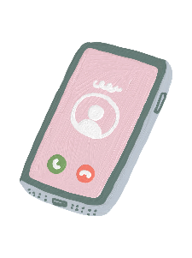

Safety Data Sheet (SDS)
To view detailed information about a chemical, use either option:
COMPUTER
MOBILE DEVICE
FLAMMABLE/COMBUSTIBLES
Visit:
jmu.kha.com
Username:
jmu@sdsmobile.app
Password:
jmusds2019
Notes:
Safety Data Sheet (SDS)
To view detailed information about a chemical, use either option:
COMPUTER
- Visit:
jmu.kha.com
MOBILE DEVICE
- Username:
jmu@sdsmobile.app
- Password:
jmusds2019

Slide 17
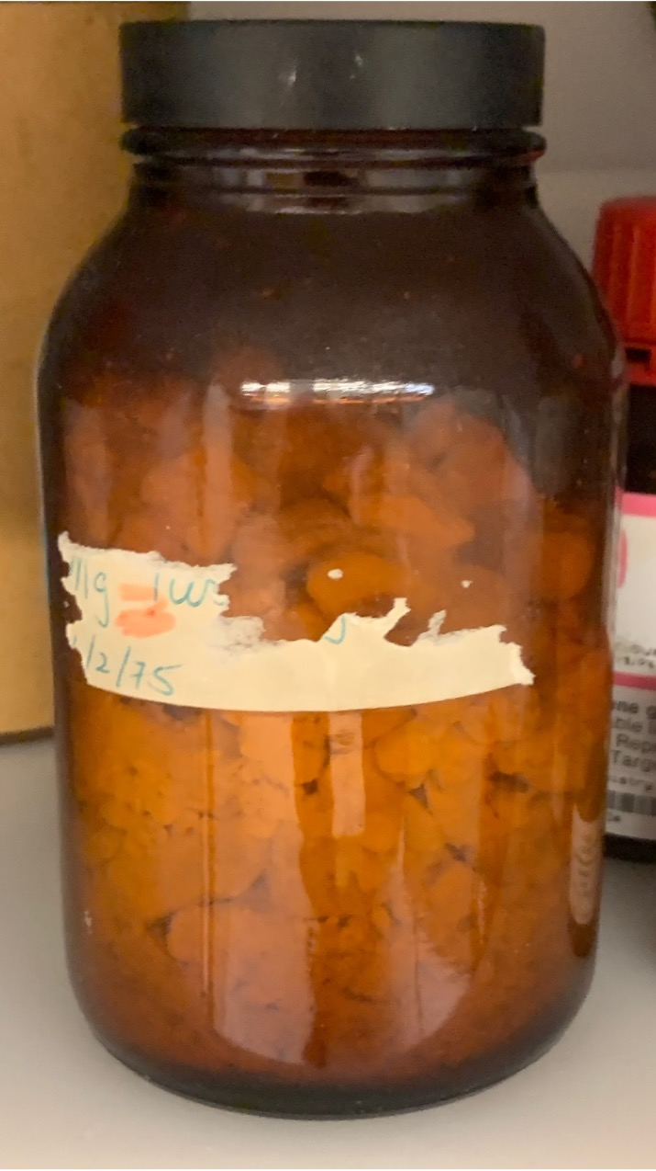
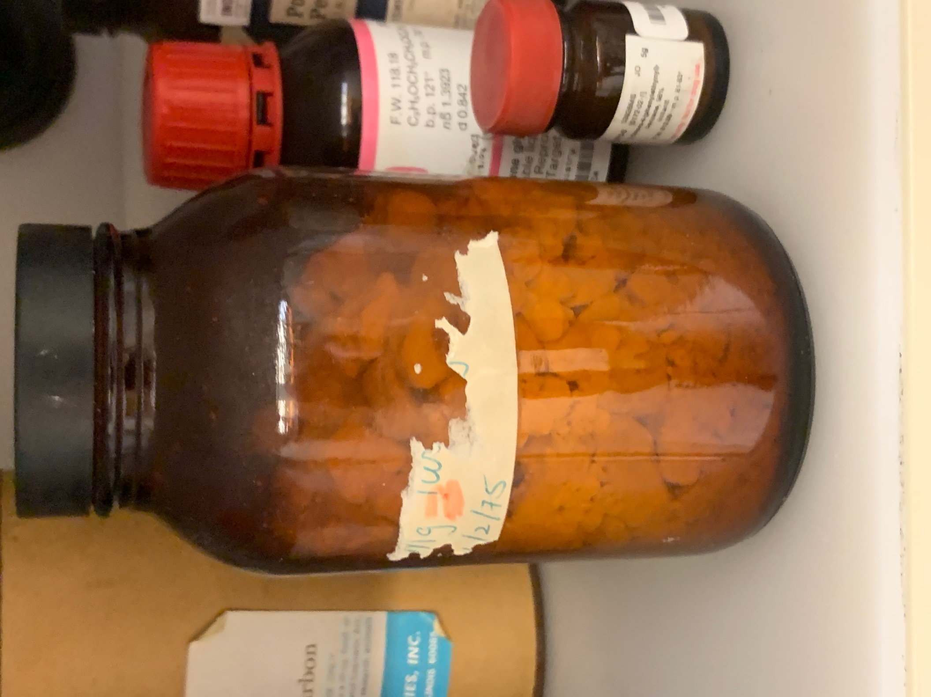
Labeling Chemicals
All chemicals must have a label
At a minimum, the label must contain the:
  Identity of the chemical
  Hazard warning
  Manufacturer information
The label must be legible and visible when stored
It is also good practice to initial and date the bottle when the chemical is opened
Magnesium
FLAMMABLE SOLID
Flinn Scientific
JM 2/1975
Notes:
Labeling Chemicals
All chemicals must have a label
At a minimum, the label must contain the:
Identity of the chemical
Hazard warning
Manufacturer information
The label must be legible and visible when stored
It is also good practice to initial and date the bottle when the chemical is opened

Slide 18
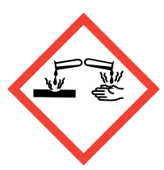



Chemical Storage
Store chemicals according to hazard class
Keep acids, bases, fuels and oxidizers separate
FLAMMABLE/COMBUSTIBLES
FLAMMABLE/COMBUSTIBLES
ACIDS
FLAMMABLES
BASES
OXIDIZERS
Notes:
Chemical Storage
Store chemicals according to hazard class
Keep acids, bases, fuels and oxidizers separate
- Acids
- Bases
- Flammables
- Oxidizers

Slide 19





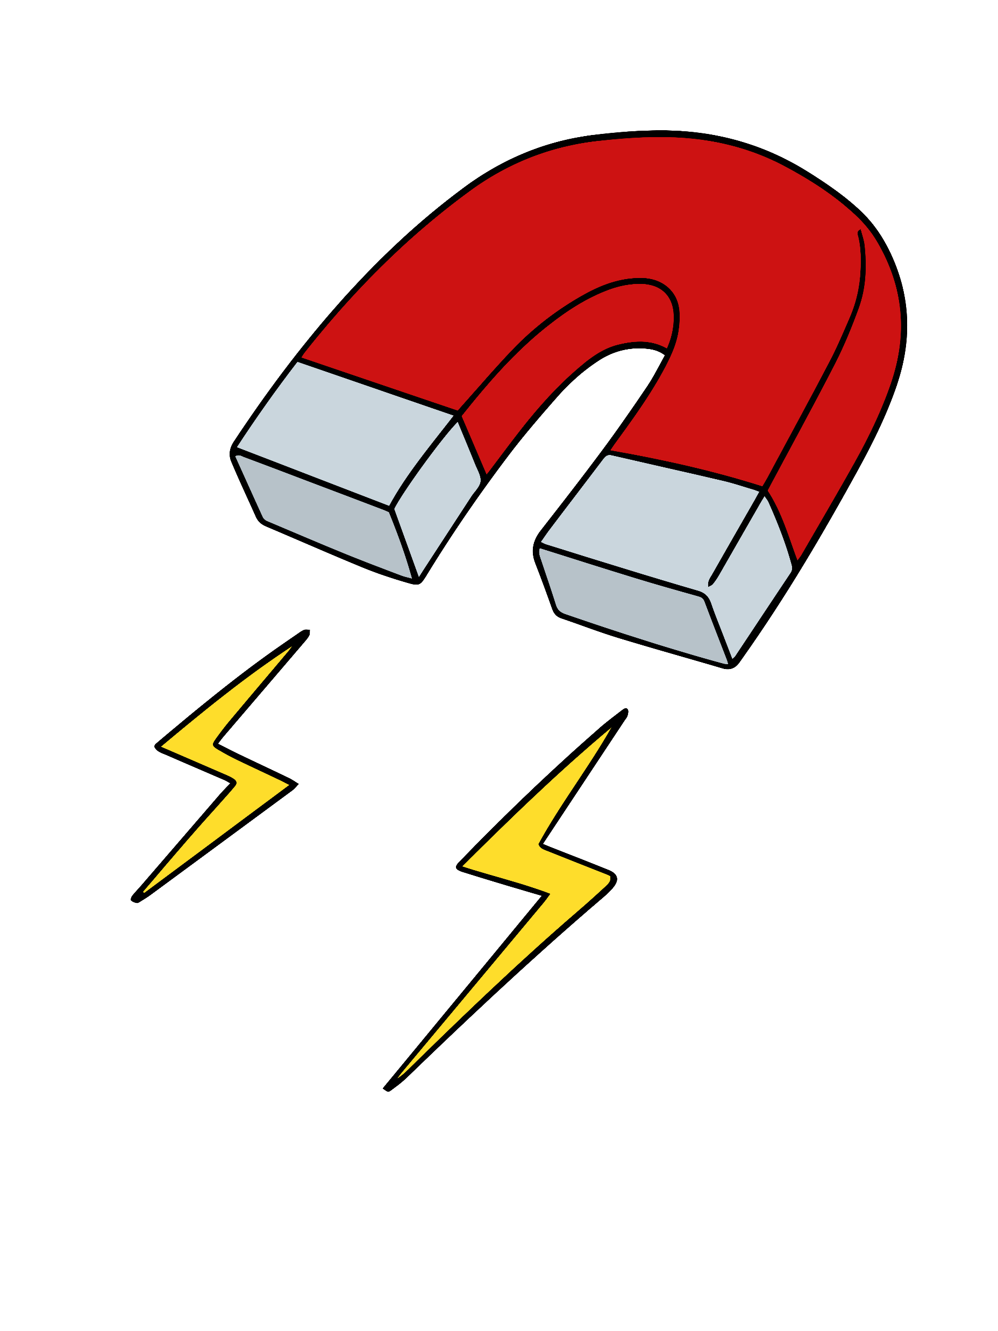
Physical Hazards
Remember, each laboratory is different and can have various types of hazards to be aware of, such as:
  Sharp objects
  Slip, trip & fall risks
  Burn hazards (fire/steam)
  Electrical shock
  Compressed gas cylinders
  Loud noises
  Cryogens
  Lasers
  Magnetic field hazards
  Ionizing radiation
Never pick up broken glass with your bare hands!
Use a broom/dustpan or puncture-resistant gloves.
<
Notes:
Physical Hazards
Remember, each laboratory is different and can have various types of hazards to look out for including:
Sharp objects
Slips, trips, & falls
Burn hazards (fire/steam)
Electrical shock
Compressed gas cylinders
Loud noises
Cryogens
Lasers
Magnetic field hazards
Ionizing radiation

Slide 20

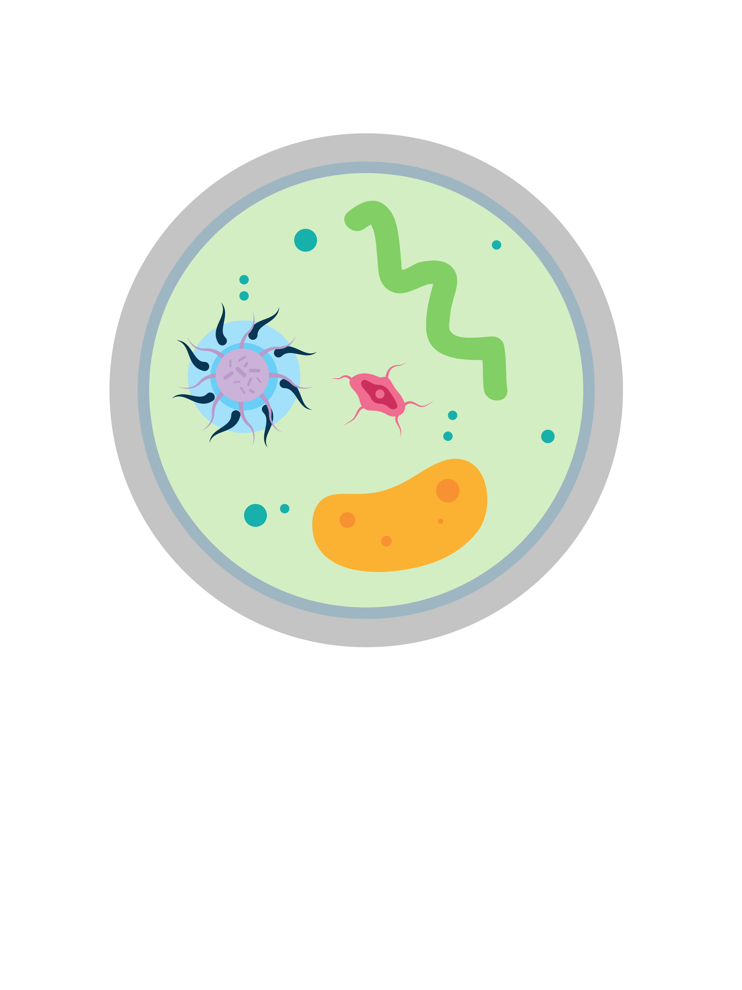
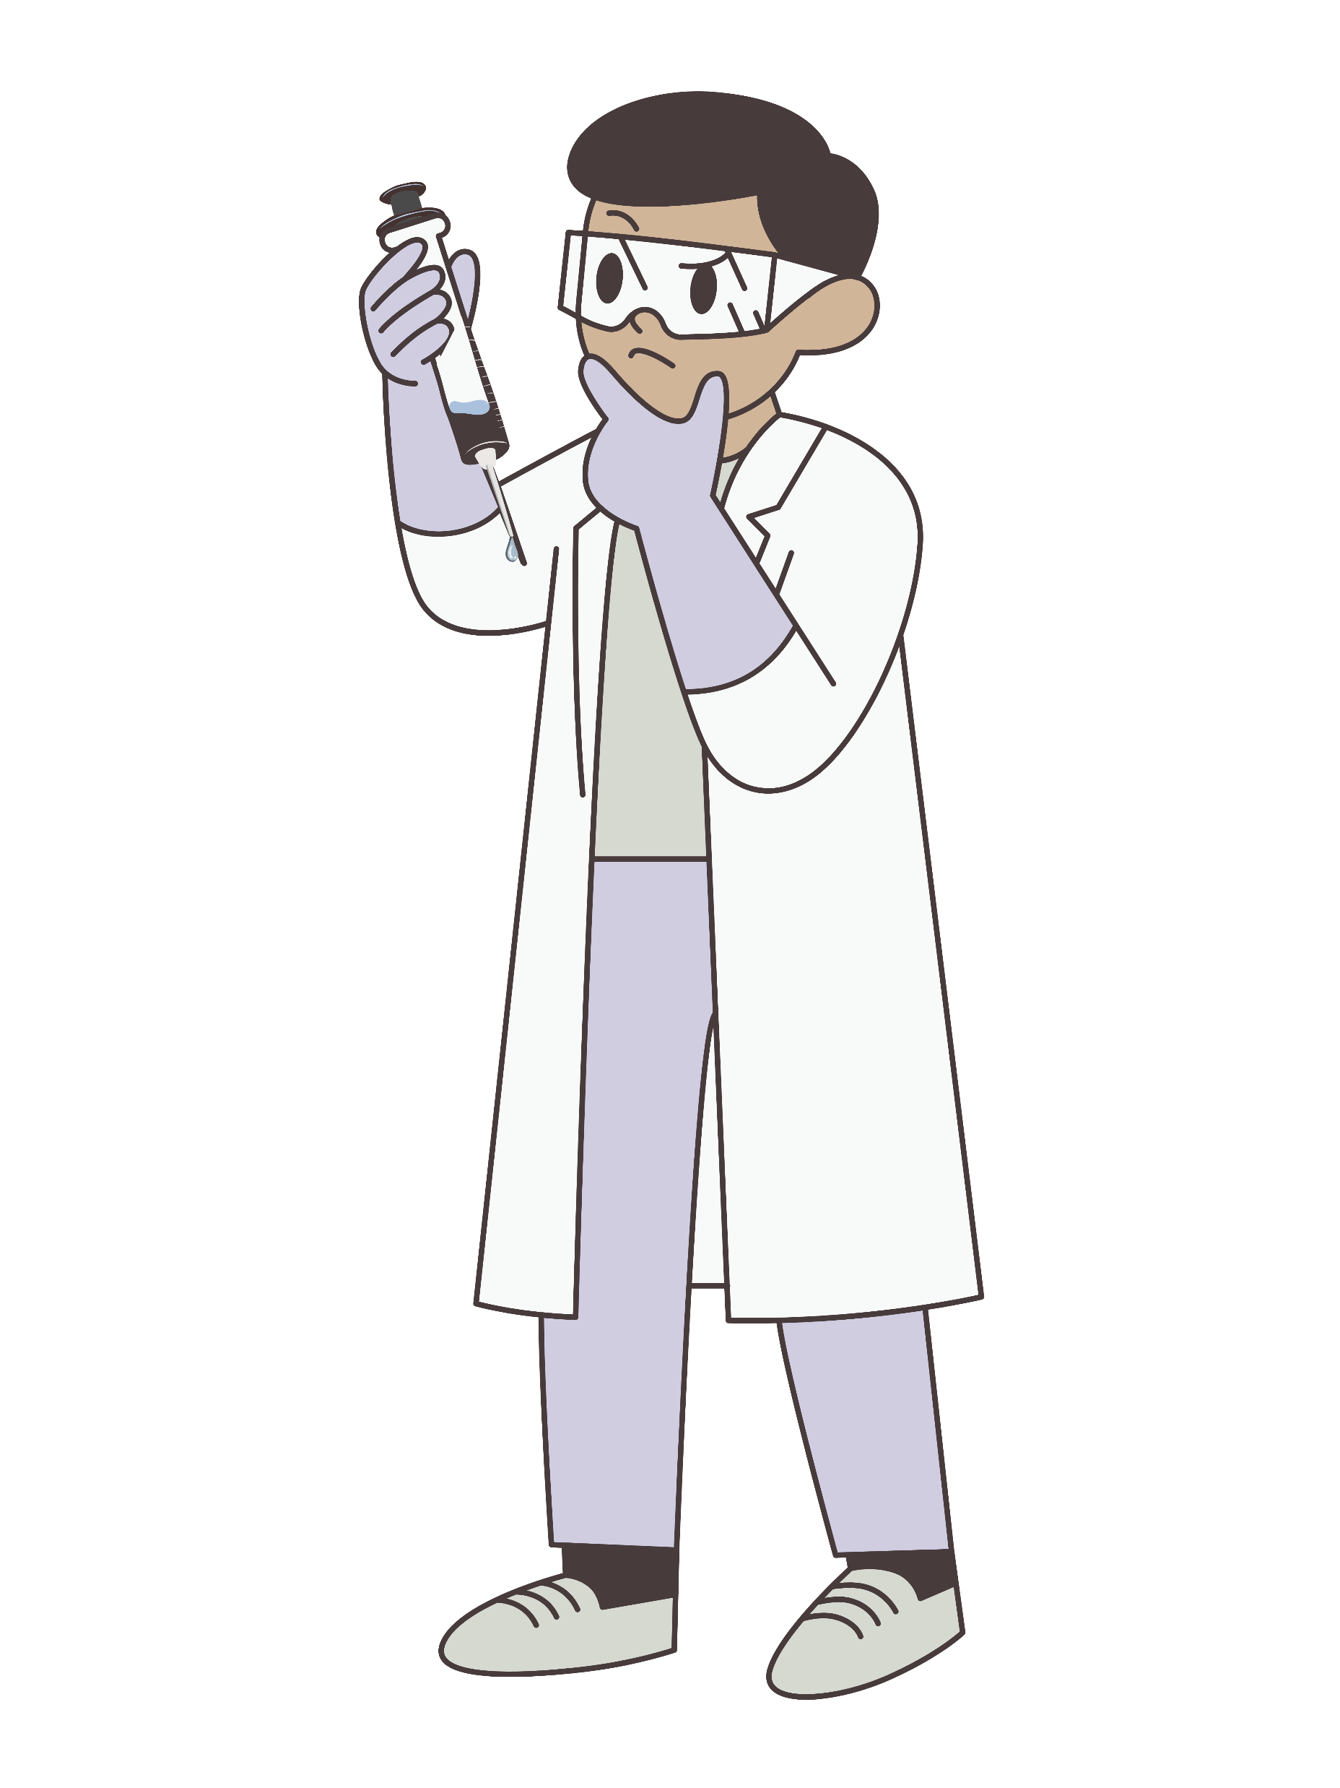



Biological Hazards
Remember to place sharps in a sharps disposal bin and never recap needles!
If the lab conducts biological research, you may encounter:
  Viruses
  Bacteria
  Fungi
  Prions
  Recombinant DNA
  Viral vectors
  Transgenic plants & animals
  Human/primate cells, tissues, & body fluids
  Bloodborne pathogens (BBPs)
When working with or around anything that is considered a hazardous biological material:
  Follow all instructions and safety measures closely
  Wear the appropriate PPE
  Use a biosafety cabinet when working with any potentially infectious agents
<
SHARPS
Notes:
Biological Hazards
Viruses
Bacteria
Fungi
Prions
Recombinant DNA
Viral vectors
Transgenic plants and animals
Bloodborne pathogens (BBPs)
Human and primate cells, tissues and body fluids are all considered hazardous biological materials.

Slide 21

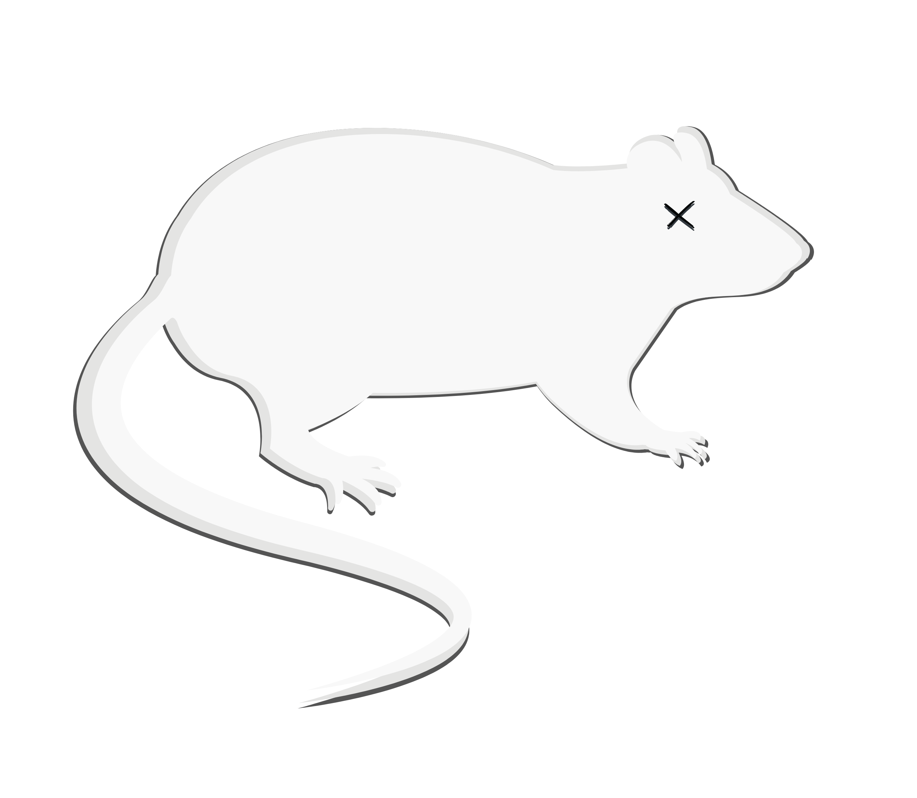
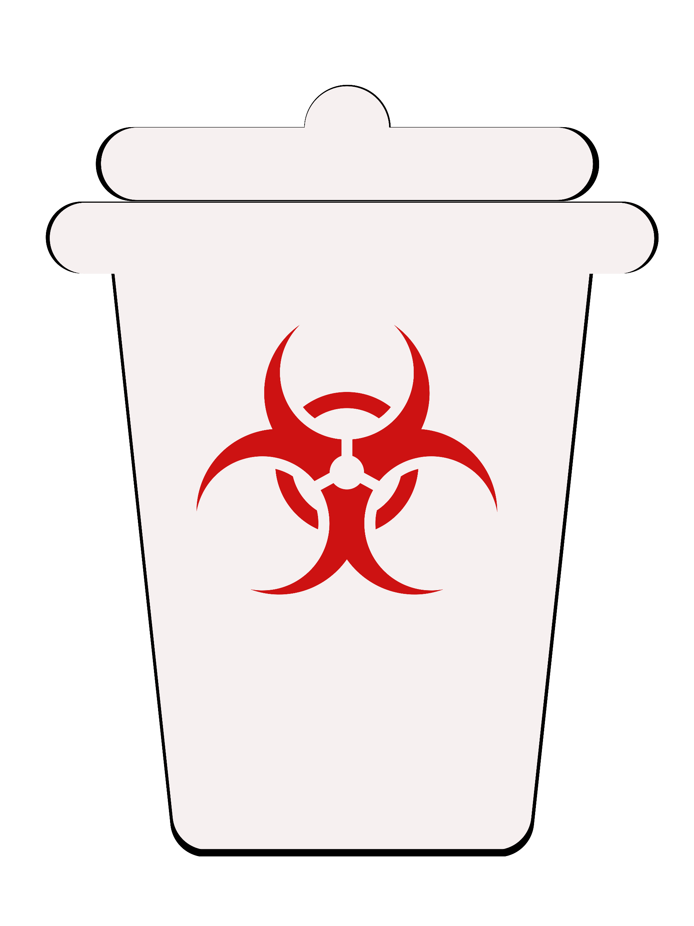
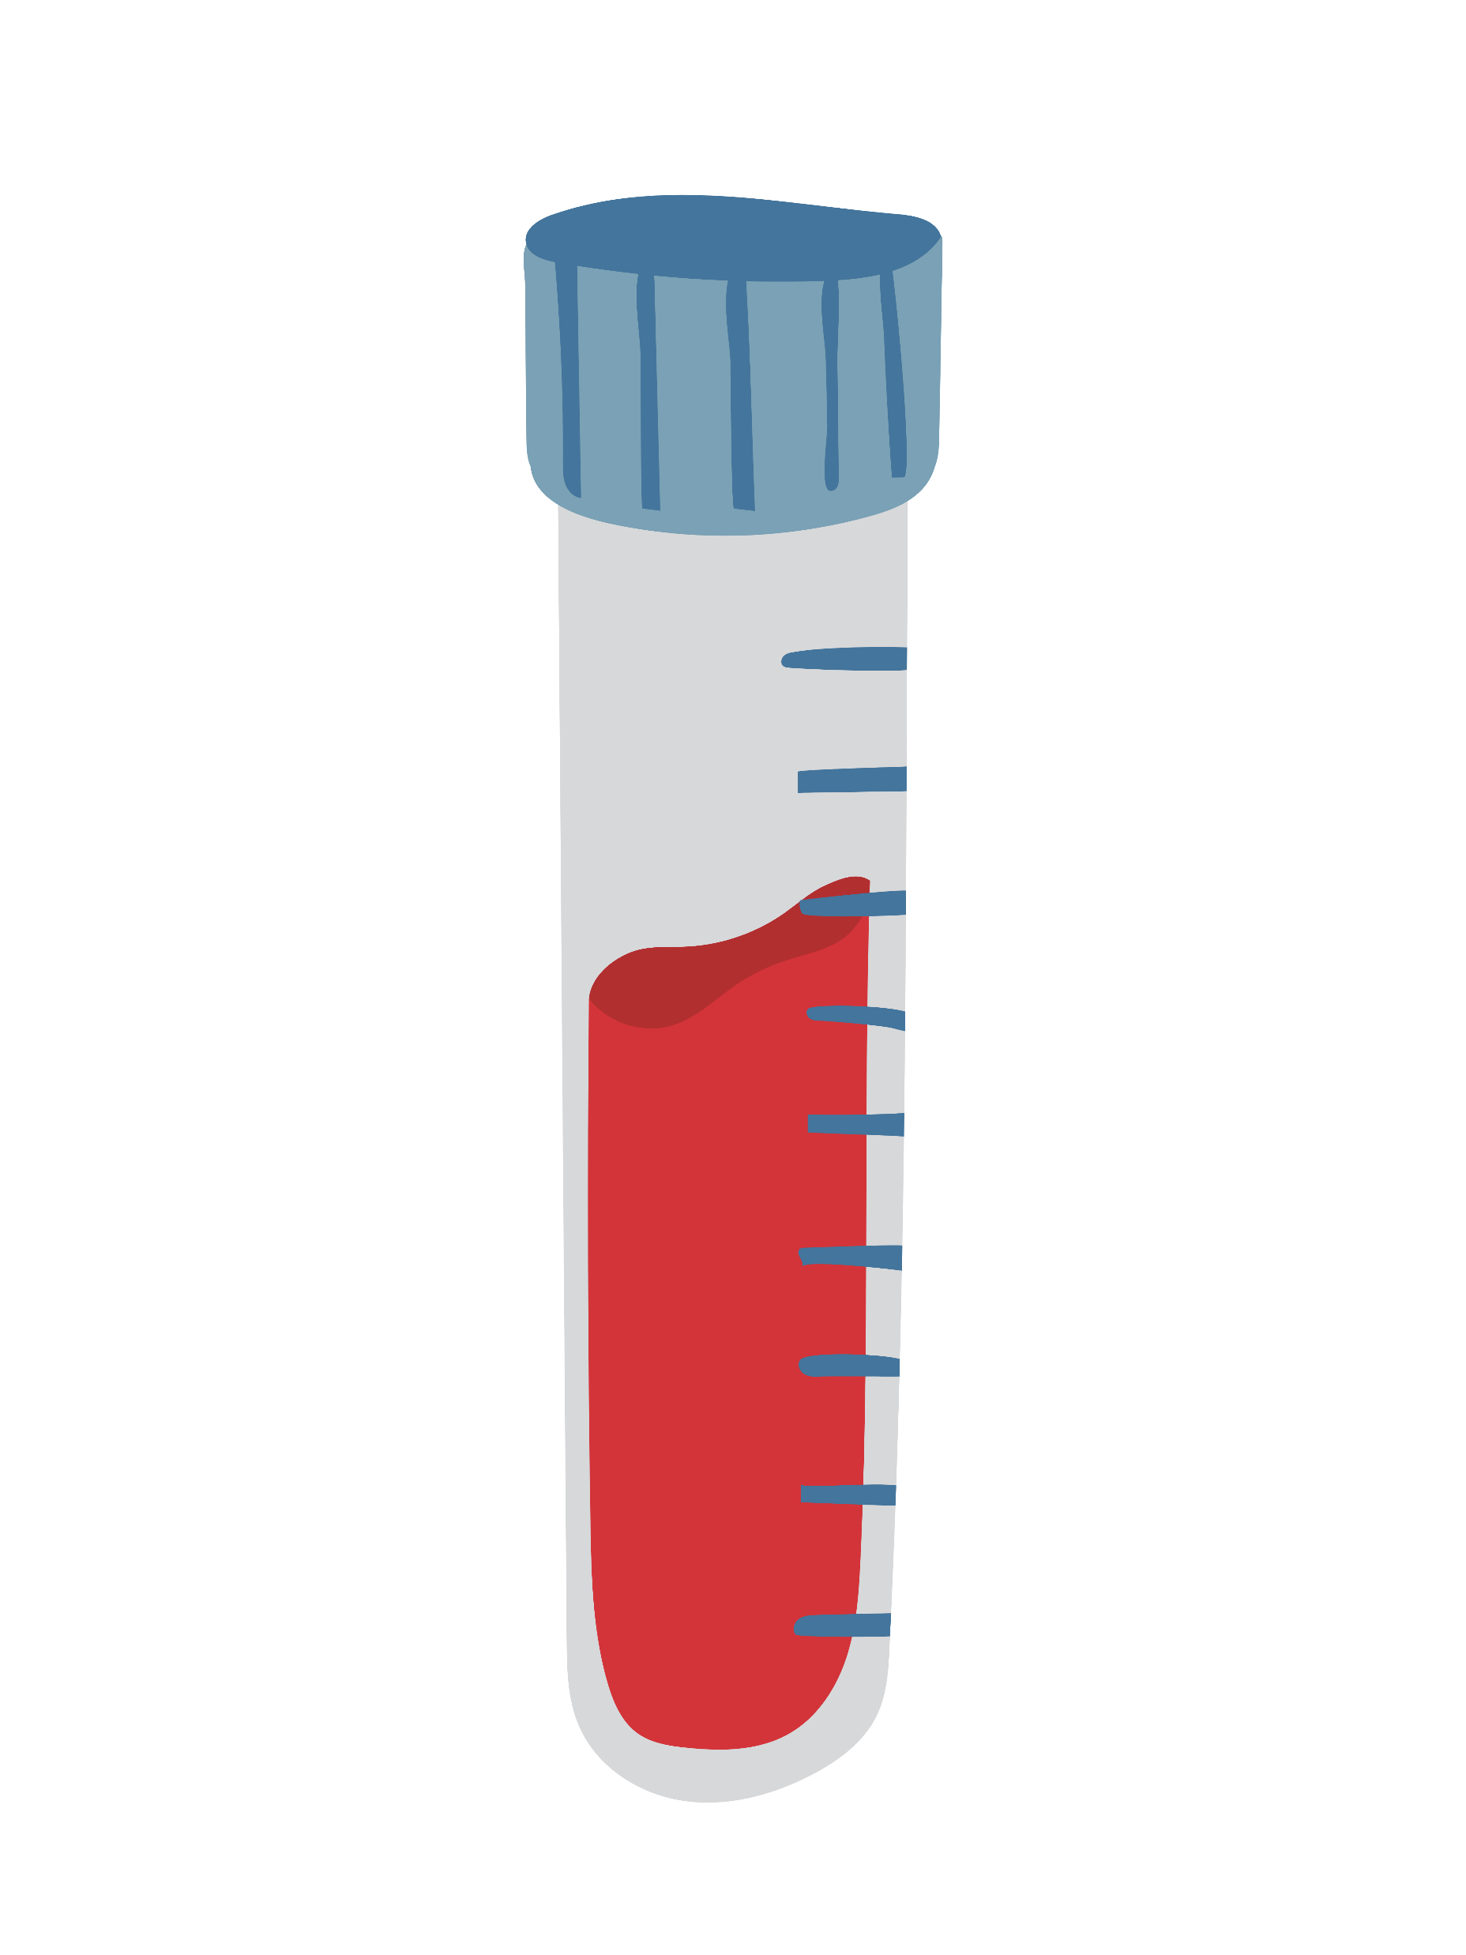


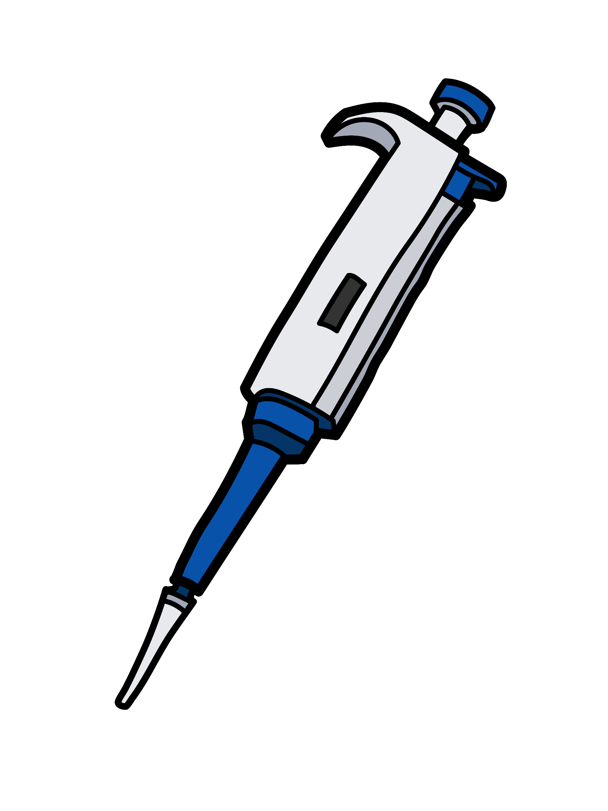

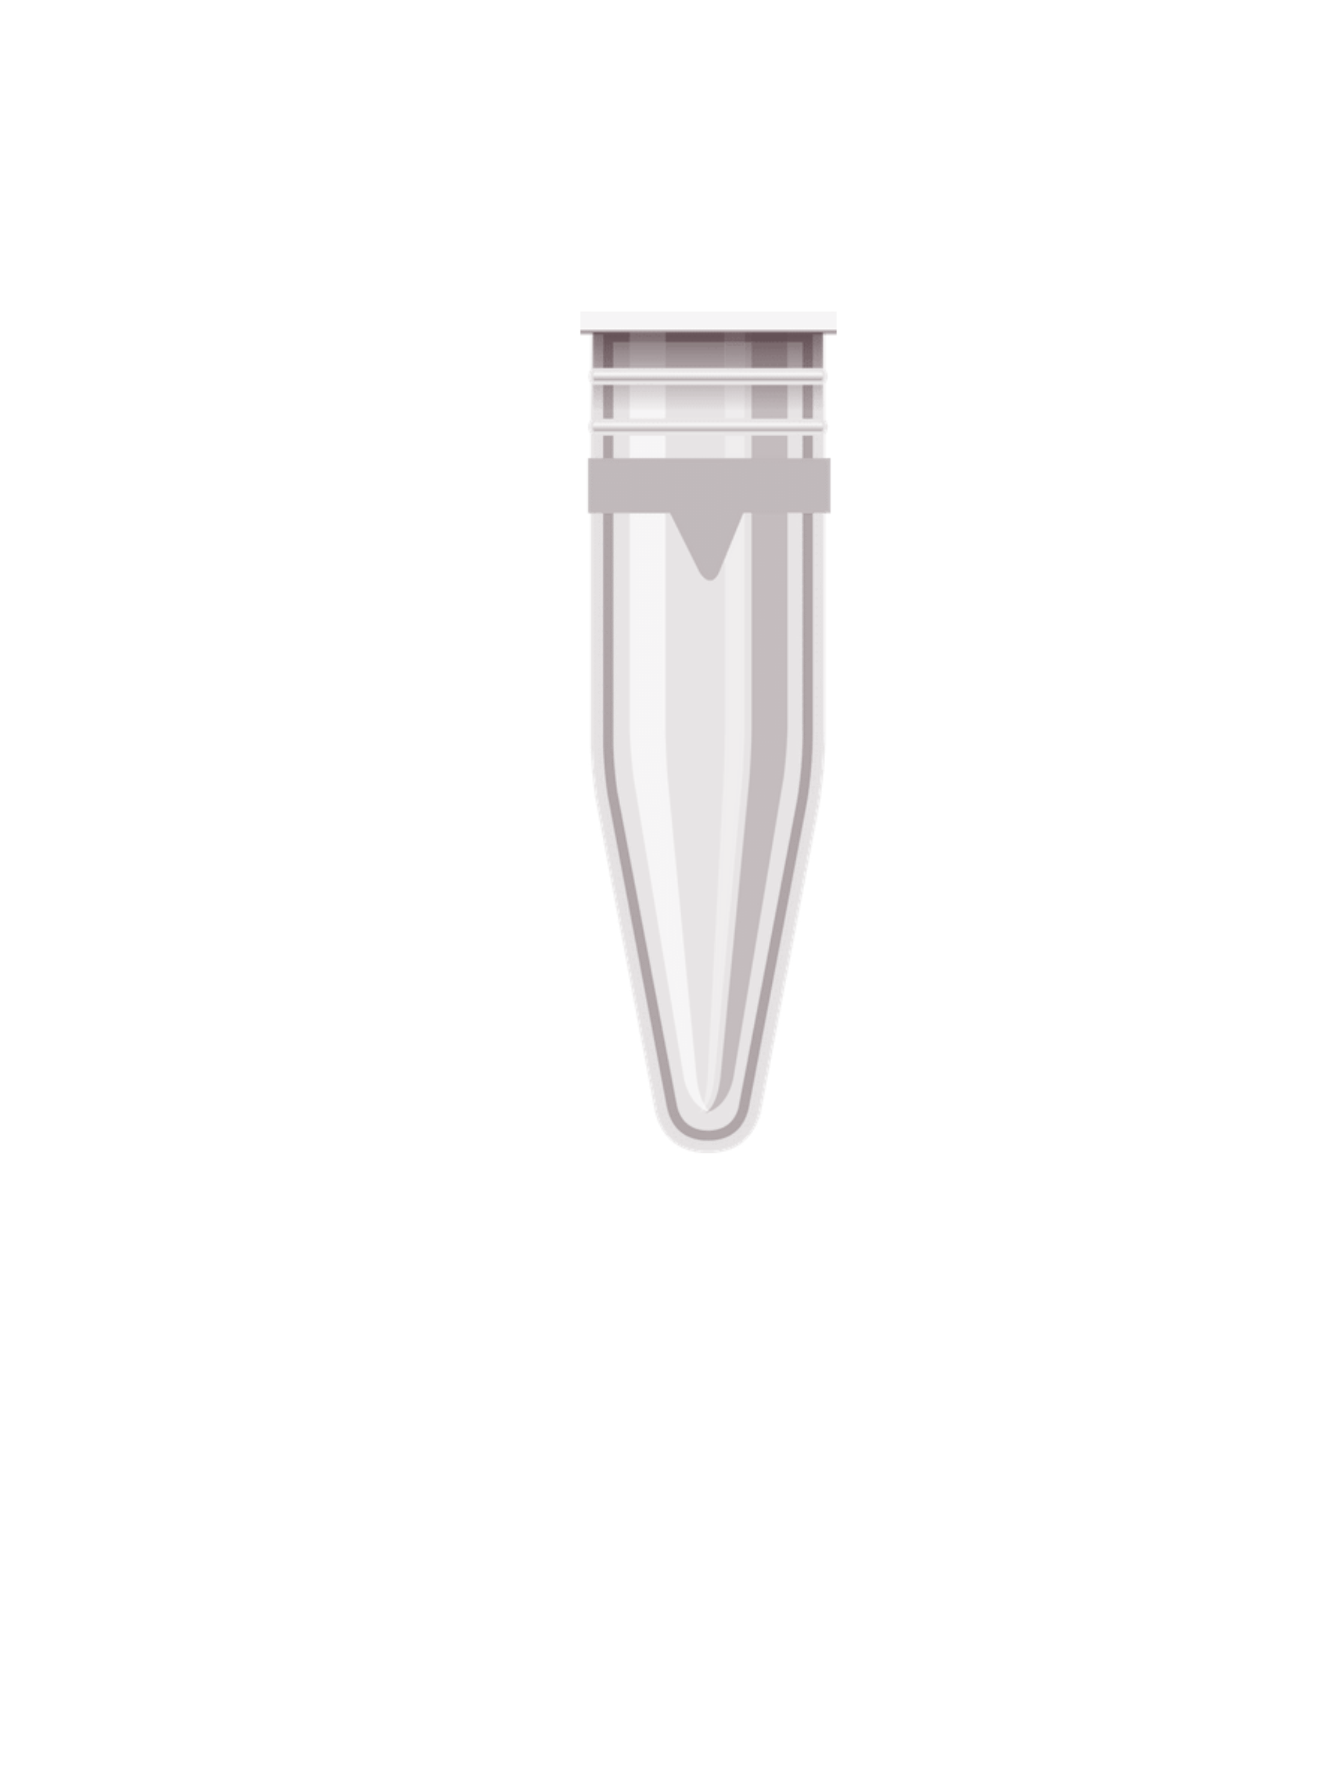
Hazardous Waste
Be sure to follow all applicable regulations for the collection, storage, and disposal of hazardous materials
  Always wear the appropriate personal protective equipment
  Dispose of waste in designated containers
  Ensure bottles are clearly labeled with the date, contents and quantity of materials
  Properly segregate hazardous waste into compatible categories including chemicals, biological waste, glass, and sharps
  Close containers of waste tightly when not in use
  Never fill waste containers more than 90%
  Store full containers in the designated hazardous waste area
  Regularly inspect the hazardous waste area for leaks, spills, and other hazards
  Keep hazardous waste storage and disposal records for at least
  three years
Notes:
Hazardous Waste
Be sure to follow all applicable regulations for the collection, storage, and disposal of hazardous materials
Always wear the appropriate personal protective equipment
Dispose of waste in designated containers
Ensure bottles are clearly labeled with the date, contents and quantity of materials
Properly segregate hazardous waste into compatible categories including chemicals, biological waste, glass, and sharps
Close containers of waste tightly when not in use
Never fill the container more than 90%
Store full containers in the designated hazardous waste area
Regularly inspect the hazardous waste area for leaks, spills, and other hazards
Keep hazardous waste storage and disposal records for at least three years

Slide 22

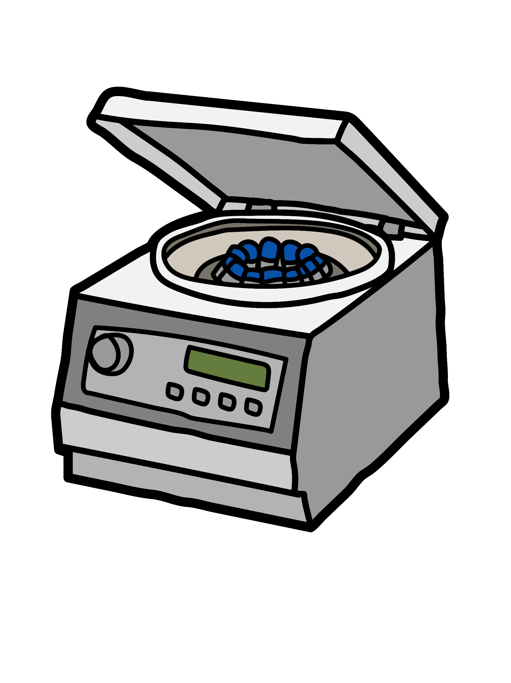



Centrifuges
It is important to exercise caution when using centrifuges due to risk of serious injury, property damage, and even death
  Before use, carefully read and understand the manufacturers instructions and safety guidelines
  Check to ensure the rotor is securely attached to the centrifuge head
  Make sure the rotor is balanced and that the centrifuge is set to the right speed
  Use the appropriate PPE including chemical-resistant gloves, safety glasses/goggles, and lab coat
  Avoid overloading the centrifuge
  Only use a centrifuge that is integrated with an interlock
  Do not open the lid until it has stopped spinning
  Clean the centrifuge after every use
  Record all information in the logbook
  Immediately stop the centrifuge and unplug it if any abnormal noise or activity is observed
FLAMMABLE/COMBUSTIBLES
Notes:
Centrifuges
Caution should be exercised when using centrifuges due to risk of serious injury, property damage, and even death
Before using a centrifuge, you should carefully read and understand the manufacturers instructions and safety guidelines
Make sure the rotor is securely attached to the centrifuge head
Ensure that the rotor is balanced
Check to see if the centrifuge set to the right speed
Wear the right PPE such as gloves, safety glasses/googles, and lab coat
Avoid overloading the centrifuge
Only use a centrifuge that is integrated with an interlock
Do not open the lid until it has stopped spinning
Clean the centrifuge after every use
Record all information in the logbook
Immediately stop the centrifuge and unplug it if any abnormal noise or activity is observed

Slide 23
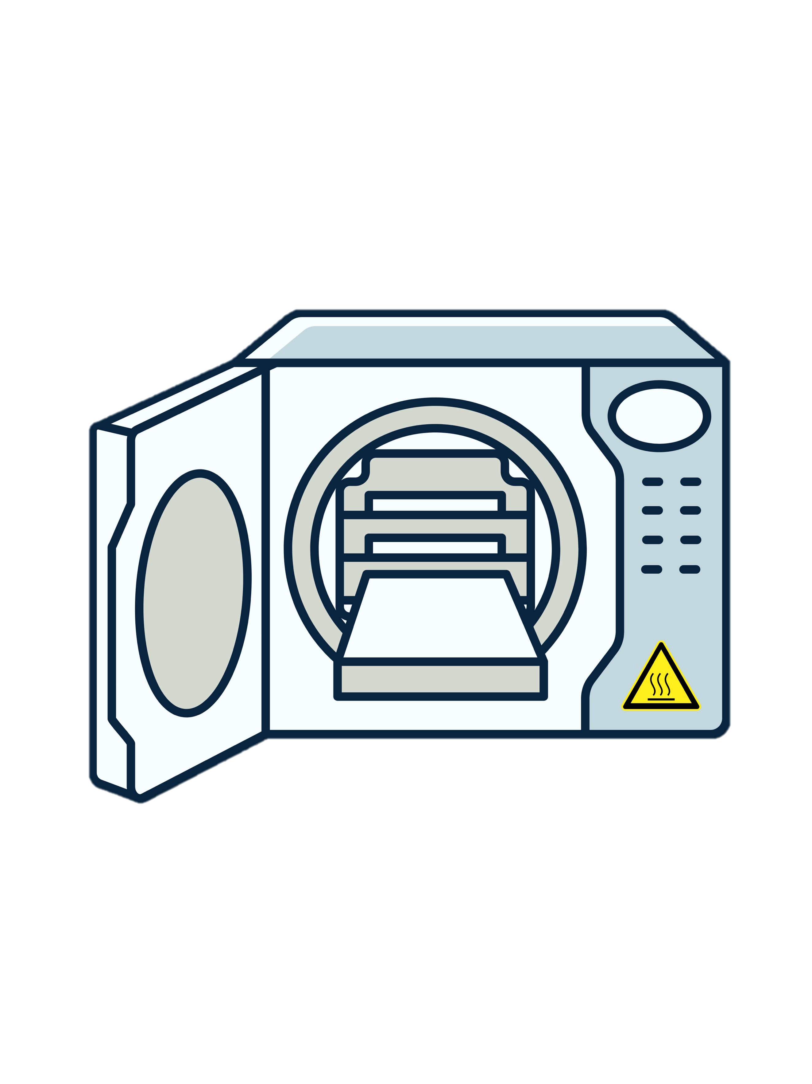

Autoclaves
Use caution when operating autoclaves because there is a potential for severe burn and cuts
  Follow the manufacturer's directions for use
  Always wear the appropriate PPE including a lab coat, heat-resistant gloves, and safety glasses/goggles
  Never put items containing corrosives oxidizers, solvents, volatile substances, or radioactive materials in an autoclave
  Make sure items are in appropriate containers before placing them into the autoclave, as non-heat-resistant plastics and glass will melt or shatter
  Ensure that the door is closed and locked before beginning the cycle
  Do not overload the autoclave because it can cause over-pressurization, resulting in a dangerous explosion hazard
  Open the door slowly to allow steam to escape gradually and do not remove items from an autoclave until they have cooled
  Avoid handling the sharp ends of instruments and use forceps or other tools to remove sharp instruments
  Regularly test the autoclave to make sure that it meets the sterilization requirements
  Keep track of all information in the record book
Notes:
Autoclave Safety Precautions
Use caution when operating autoclaves because there is a potential for severe burn and cuts
Follow the manufacturer's directions for use
Always wear the appropriate PPE, including a lab coat, heat-resistant gloves, and safety glasses
Make sure items are in appropriate containers before placing them into the autoclave, as non-heat-resistant plastics and glass will melt or shatter
Never put items containing corrosives oxidizers, solvents, volatile substances, or radioactive materials in an autoclave
Ensure that the door is closed and locked before beginning the cycle
Do not overload the autoclave. Overloading can cause over-pressurization, resulting in a dangerous explosion hazard
Do not remove items from an autoclave until they have cooled
Avoid handling the sharp ends of instruments and use forceps or other tools to remove sharp instrument
Regularly test the autoclave to make sure that it meets the sterilization requirements
Keep track of all information in the record book

Slide 24
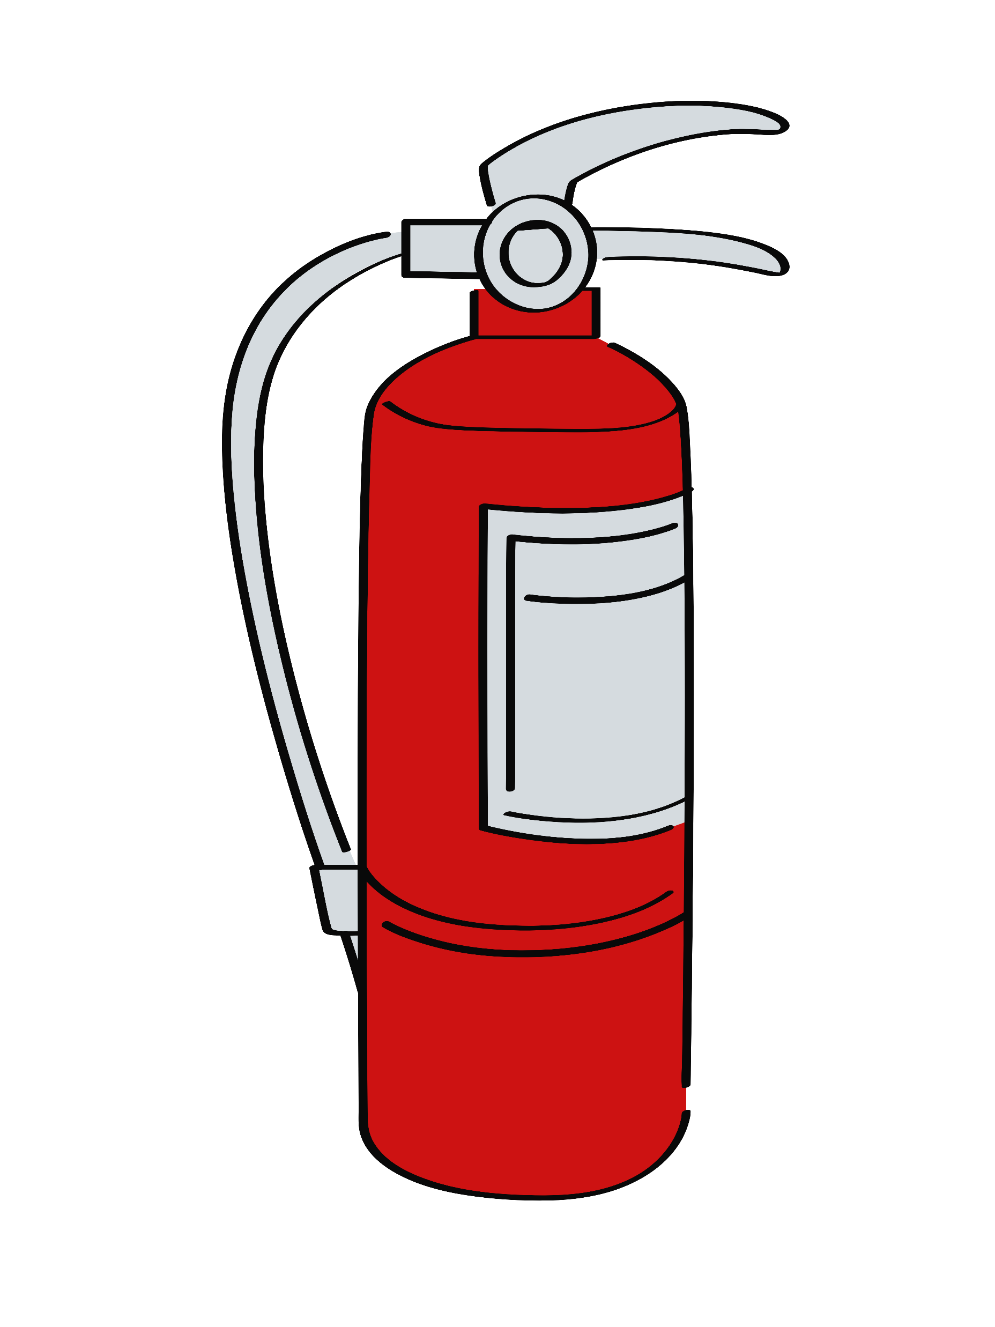
Emergency Procedures
Be aware of the laboratory’s emergency procedures and follow them in the event of an emergency
  Know where the emergency contact information is located so that the appropriate personnel and emergency services can be quickly notified
  Identify the location of emergency exits, fire extinguishers and other safety equipment
  Report all spills, accidents, and injuries to the laboratory supervisor immediately
  Take appropriate steps to minimize the risk of the situation
  Only use a fire extinguisher if there is a clear path to the exit, you have been trained to use, and feel safe doing so
  Evacuate the area to a safe distance
  Activate the emergency alarm and close the door when leaving
  Meet at the designated evacuation area
  Do not reenter the lab until it is deemed safe by the appropriate personnel
  Ensure emergency drills are practiced on a regular basis
FLAMMABLE/COMBUSTIBLES
Notes:
Emergency Procedures
Be aware of the laboratory’s emergency procedures and follow them in the event of an emergency
Know where the emergency contact information is located so that the appropriate personnel and emergency services can be quickly notified
Identify the location of emergency exits, fire extinguishers and other safety equipment
Report all spills, accidents, and injuries to the laboratory supervisor immediately
Take appropriate steps to minimize the risk of the situation
Only use a fire extinguisher if there is a clear path to the exit, you have been trained to use, and feel safe doing so
Evacuate the area to a safe distance
Activate the emergency alarm and close the door when leaving
Meet at the designated evacuation area
Do not reenter the laboratory until it is deemed safe by the appropriate personnel
Ensure emergency drills are practiced on a regular basis

Slide 25

Training Requirements
PIs must provide lab-specific training to all students and personnel at the beginning of the semester and whenever a new hazard is introduced into the lab
After completing the training and demonstrating competency, each individual must sign a form with their name, the date, and the type of training received
- Training records must be maintained for 4 years
Be sure to create a culture where people feel it’s okay to ask questions about how to be safe
Encourage participation in the safety program by giving students the opportunity to gain hands-on experience and earn more responsibilities
Notes:
Training Reminders
PIs must provide lab-specific training to all students and lab personnel at the beginning of the semester and whenever a new hazard is introduced into the lab
After completing the training and demonstrating competency, each individual must sign a form with their name, the date, and the type of training received
- Training records should be maintained for 4 years
Be sure to create a culture where individuals feel it’s okay to ask questions about how to be safe!
Encourage participation in the safety program by giving people the opportunity to gain hands-on experience and earn more responsibilities

Slide 26


Reminder
FLAMMABLE/COMBUSTIBLES
Notes:
Reminder
No lesson is so important and no task so urgent that we cannot take time to teach, learn and practice science safely!

Slide 27
Thank You!
Lab safety starts with you!
Contact us with questions or comments:
Office of Research Integrity
Foundation Hall | MSC 5738
Office: 540-568-3669
FLAMMABLE/COMBUSTIBLES
Notes:
Thank You!
We could not do this without you!
Contact us with questions or comments:
Office of Research Integrity
Foundation Hall | MSC 5738
Office: 540-568-3669
Sources:
ACS: Identifying and Evaluating Hazards in Research Laboratories
American Chemical Society
Autoclave Safety
Biosafety in Microbiological and Biomedical Laboratories (BMBL)
Centrifuge Safety
Chemical Safety Board Laboratory Safety
CRC Handbook of Laboratory Safety
General Precautions for Handling Compressed Gases
Guidelines for Chemical Laboratory Safety in Academic Institutions
Laboratory Safety Handbook
NIOSH Chemicals: Managing Chemical Safety in the Workplace
NIOSH Directory of Personal Protective Equipment
OSHA Fire Extinguisher Use
OSHA Laboratories Safety Culture
OSHA Laboratory Safety Guidance
Preventing Cuts and Punctures in the Laboratory
Prudent Practices in the Laboratory: Handling and Disposal of Chemicals
School Chemistry Laboratory Safety Guide
Sharps Safety
UNC Compressed Gas Safety

