Slide 1

How to Operate your HVAC system
Treehouses & Greek Row
Run PowerPoint as a Slideshow to hear audio from certain slides

Slide 2

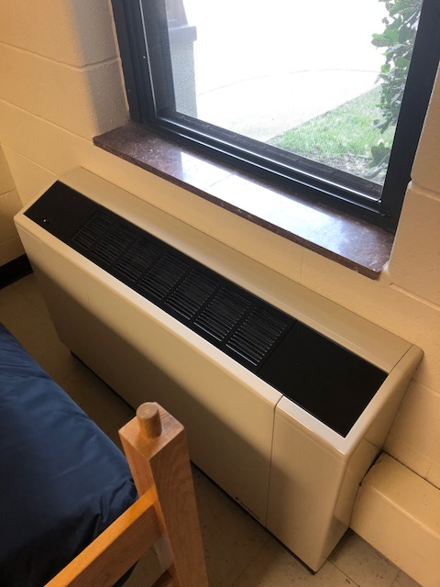

Avoid Restriction of Air Flow
NOT THIS!
THIS!

Slide 3
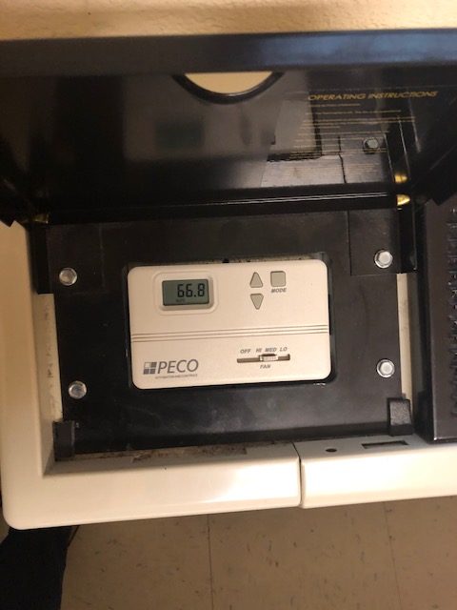
Setting your HVAC System

Slide 4



Temperature Regulations
Above 60 degrees
Below 60 degrees

Slide 5

How to report a non-functioning unit…
To fill out a maintenance request to fix the unit visit: http://www.jmu.edu/orl/maintenance/
An air conditioning unit that is not functioning properly is not considered an emergency. It may take 3 to 5 business days for the unit to be serviced.
Only non-functioning heating units are an emergency.

Slide 6
THANK YOU!
We look forward to seeing you on campus!
GO DUKES!

