Slide 1

How to Operate your HVAC system
Bluestone Area
Run PowerPoint as a Slideshow to hear audio from certain slides

Slide 2

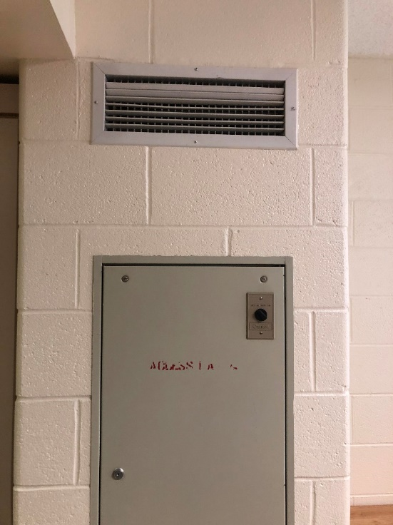
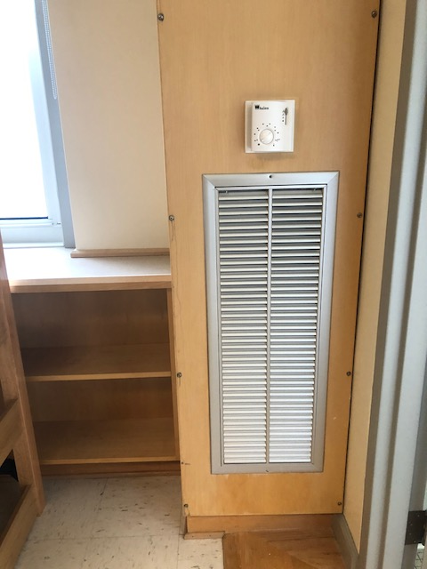
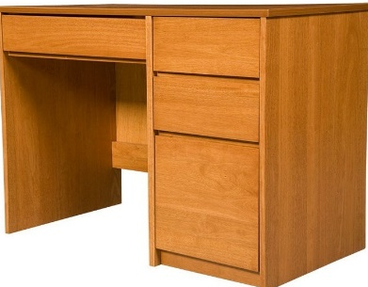
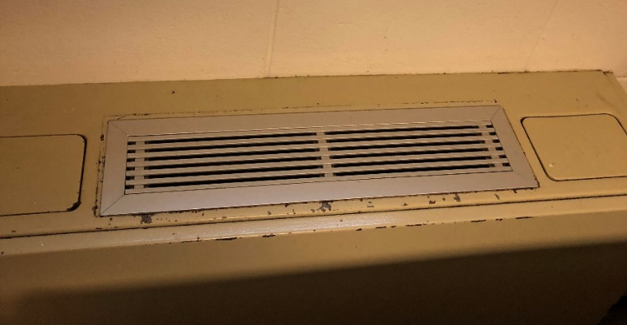
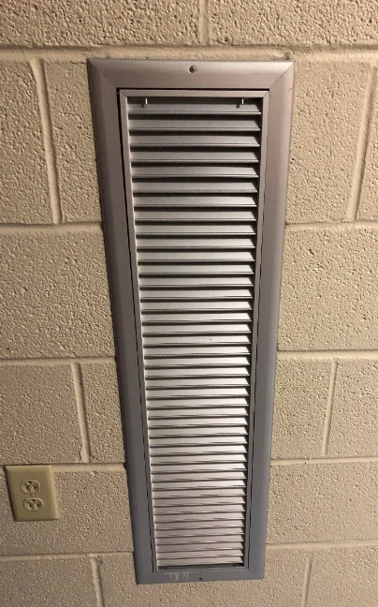


Avoid Restriction of Air Flow
THIS!
You will have one of the following units in your residence hall.
THIS!
NOT THIS!
NOT THIS!

Slide 3
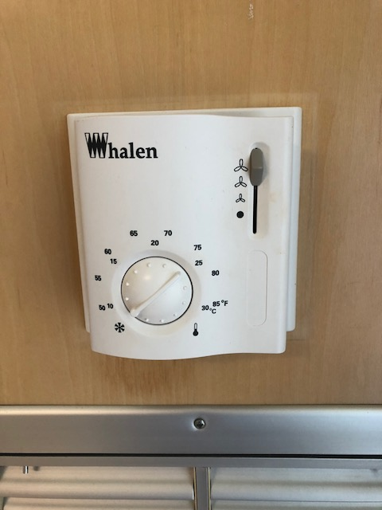
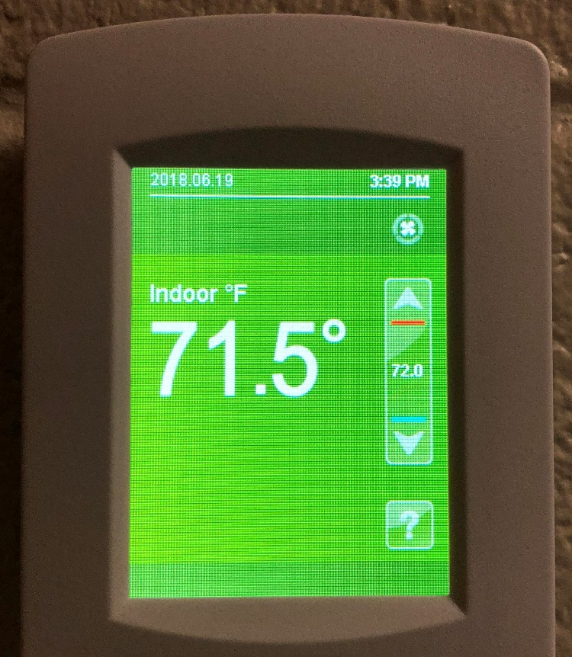
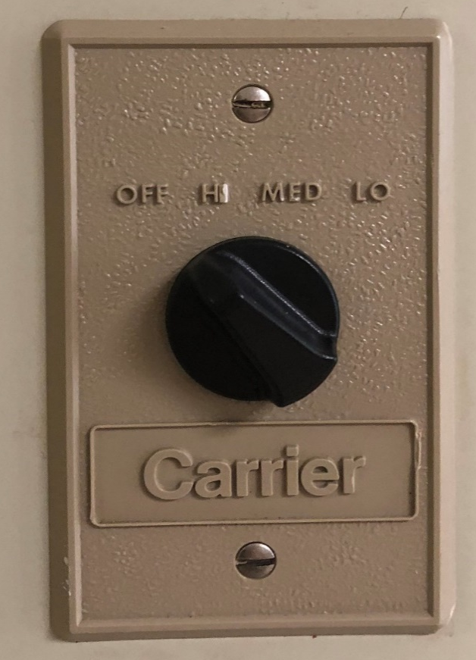
Setting your HVAC Unit
Turn me!

Slide 4
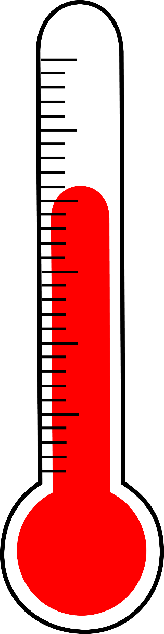


Temperature Regulations
Above 60 degrees
Below 60 degrees

Slide 5
HVAC Operation Tips
Keep WINDOWS CLOSED when cooling
Do not set temperature below 70 degrees when cooling
Do not place furniture or other items on top or within 12 inches of the unit
Report leaks, moisture intrusion and/or signs of microbial growth on our online work order system

Slide 6

How to report a non-functioning unit…
To fill out a maintenance request to fix the unit visit: http://www.jmu.edu/orl/maintenance/
An air conditioning unit that is not functioning properly is not considered an emergency. It may take 3 to 5 business days for the unit to be serviced.
Only non-functioning heating units are an emergency.

Slide 7
THANK YOU!
We look forward to seeing you on campus!
GO DUKES!

