Slide 1
SCOM Basic Course
Final Video Review
Chapters: 9

Slide 2
Instructions:
Take out a piece of paper and a writing utensil
Press “Slide Show” to watch it as a presentation
On each slide, click on the videos to play it.
After every video, write down your answers
When you are done, click “exit”
Check your answers in the “notes” section. Additionally, the rational is also stated in the “notes” section.
Good Luck!

Slide 3
Chapter 9: Interpersonal Conflict Management

Slide 4
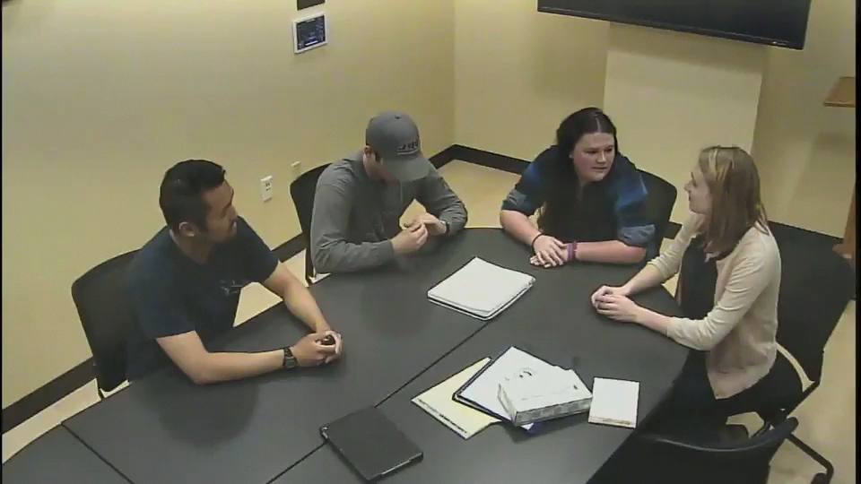
What conflict negotiation strategy is being utilized in this clip?
Accommodating
Avoiding
Controlling
Compromising
Collaborating
Notes:
Answer: a. Accommodating
Why: Unlike compromising where each party gets something and makes concessions, this is accommodating because the majority of the group is adjusting to suit the needs of one individual.

Slide 5
Good Job! You have completed the review.
Now, please check your answers by exiting out of the “slide show” and look at each slide’s “notes” section.
If you need more assistance, make an appointment with the communications center: http://www.jmu.edu/commcenter/appointments.shtml
Thank you!

