Slide 1
SCOM Basic Course
Final Video Review
Chapters: 15

Slide 2
Instructions:
Take out a piece of paper and a writing utensil
Press “Slide Show” to watch it as a presentation
On each slide, click on the videos to play it.
After every video, write down your answers
When you are done, click “exit”
Check your answers in the “notes” section. Additionally, the rational is also stated in the “notes” section.
Good Luck!

Slide 3
Chapter 15: Persuasive Speaking

Slide 4
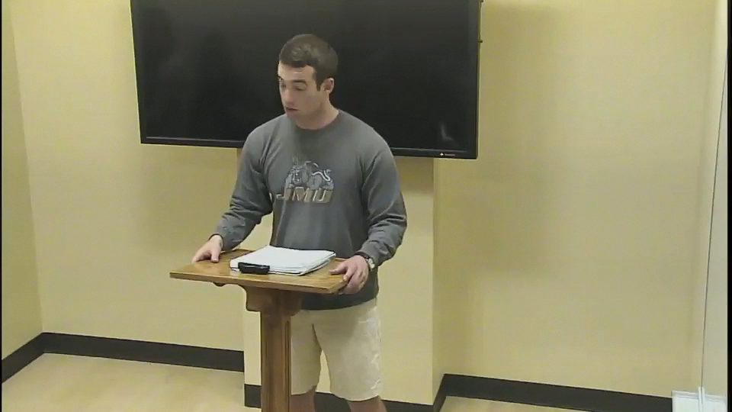
What Aristotelian proof is seen in this speech?
Inartistic proof
Logos
Pathos
Ethos
Notes:
Answer: d. Ethos
Reason: The speaker uses previous experience to build credibility in the subject area.

Slide 5
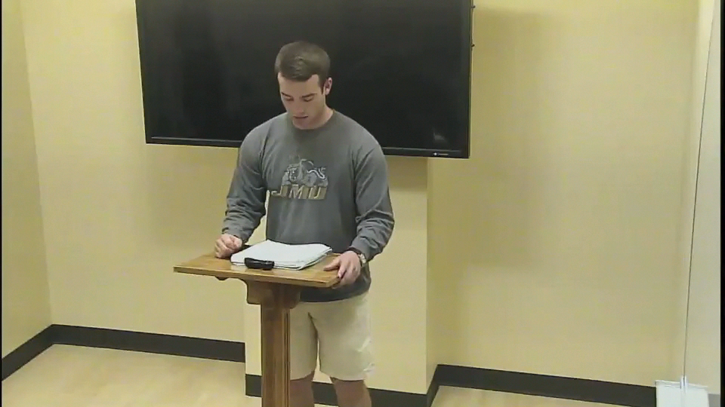
What type of proposition is exemplified in this clip?
Fact
Value
Policy
None of the above
Notes:
Answer: c. Policy
Why: The speaker is clearly calling for a change in the way JMU uses its funding.

Slide 6
Good Job! You have completed the review.
Now, please check your answers by exiting out of the “slide show” and look at each slide’s “notes” section.
If you need more assistance, make an appointment with the communications center: http://www.jmu.edu/commcenter/appointments.shtml
Thank you!

