Slide 1
SCOM Basic Course
Final Video Review
Chapters: 13-14

Slide 2
Instructions:
Take out a piece of paper and a writing utensil
Press “Slide Show” to watch it as a presentation
On each slide, click on the videos to play it.
After every video, write down your answers
When you are done, click “exit”
Check your answers in the “notes” section. Additionally, the rational is also stated in the “notes” section.
Good Luck!

Slide 3
Chapter 14: Informative Speaking

Slide 4
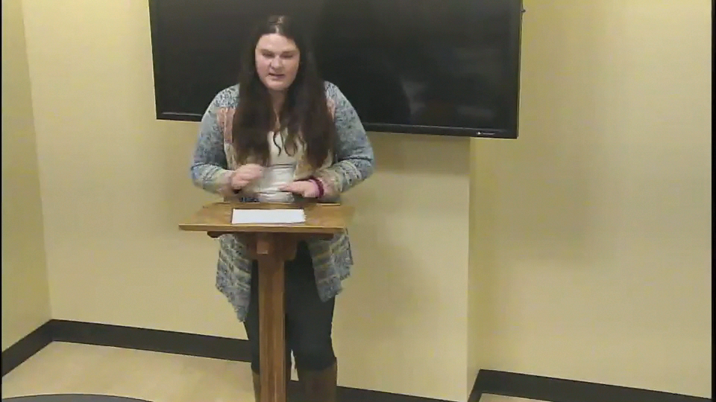
What type of speech is featured in the following clip?
Informative
Persuasive
Impromptu
Sales Pitch
Notes:
Answer: A. Informative
Why: The goal of the speech was to inform the audience about animal captivity.

Slide 5
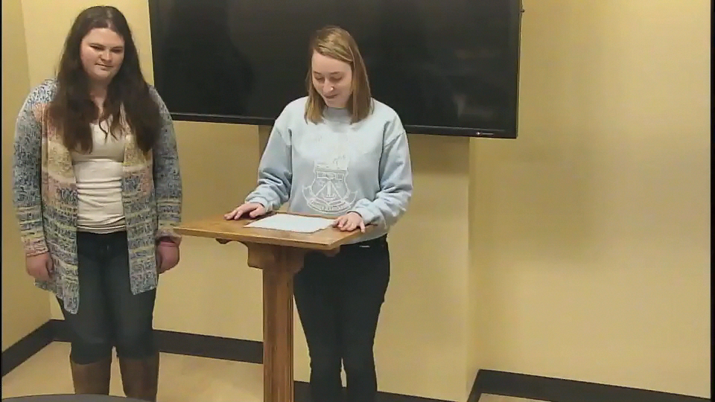
What element of good speech giving is absent?
Missing transition
Attention getter
Preview of points
A and C
Notes:
Answer: A. Missing transition
Why: After the introduction, the second speaker immediately jumps into her section without connecting it to the introduction.

Slide 6
Good Job! You have completed the review.
Now, please check your answers by exiting out of the “slide show” and look at each slide’s “notes” section.
If you need more assistance, make an appointment with the communications center: http://www.jmu.edu/commcenter/appointments.shtml
Thank you!

