Slide 1
SCOM Basic Course
Final Video Review
Chapters: 13-14

Slide 2
Instructions:
Take out a piece of paper and a writing utensil
Press “Slide Show” to watch it as a presentation
On each slide, click on the videos to play it.
After every video, write down your answers
When you are done, click “exit”
Check your answers in the “notes” section. Additionally, the rational is also stated in the “notes” section.
Good Luck!

Slide 3
Chapter 13: Presenting Speeches

Slide 4
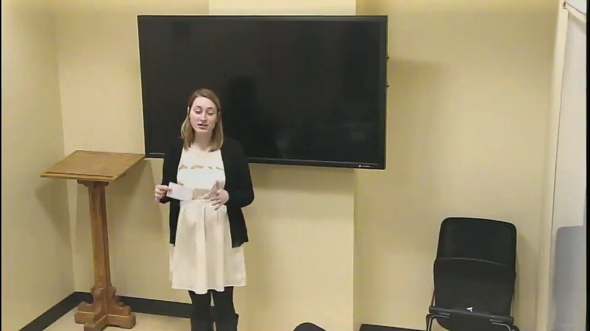
What part of the following video is not considered an element of a good conclusion?
Introduction of new material
Review of points
Cliff hanger
Call to action
Notes:
Answer: a. Introduction of new material.
Why: In the concussion, it is important to review and emphasize the main points that you have already discussed. You should not be introducing new material. In this video, the conclusion added an extra source.

Slide 5
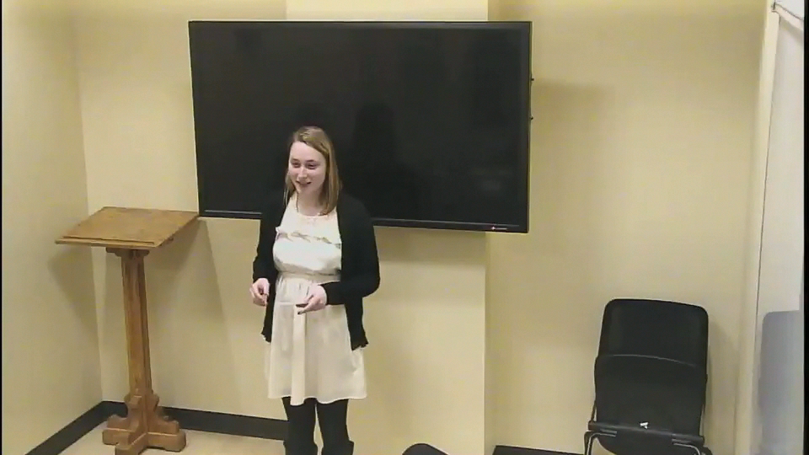
What delivery style is seen in this clip?
Memorized
Extemporaneous
Impromptu
Manuscript
Notes:
Answer: B. Extemporaneous
Why: The speaker had note cards but only referenced them as a guide throughout the introduction. The majority of the time, the speaker was speaking directly to the audience

Slide 6
Good Job! You have completed the review.
Now, please check your answers by exiting out of the “slide show” and look at each slide’s “notes” section.
If you need more assistance, make an appointment with the communications center: http://www.jmu.edu/commcenter/appointments.shtml
Thank you!

