Slide 1
SCOM Basic Course
Final Video Review
Chapters: 12

Slide 2
Instructions:
Take out a piece of paper and a writing utensil
Press “Slide Show” to watch it as a presentation
On each slide, click on the videos to play it.
After every video, write down your answers
When you are done, click “exit”
Check your answers in the “notes” section. Additionally, the rational is also stated in the “notes” section.
Good Luck!

Slide 3
Chapter 12: Preparing Speeches

Slide 4
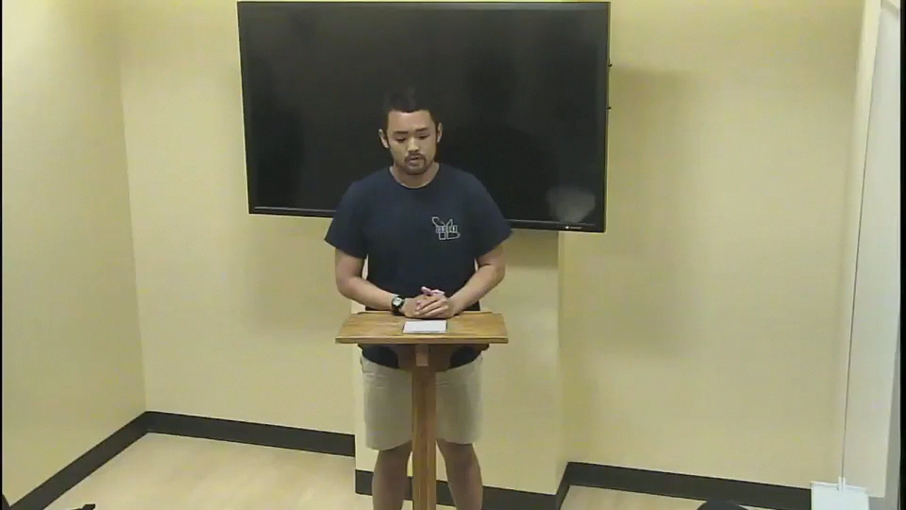
Identify which organizational patterns was used in this speech.
Topical
Chronological
Spatial
Problem-Solution Pattern
Notes:
Answer: B. Chronological
Why: This speaker introduces the life of James Madison in the sequence of events they happened.

Slide 5
Good Job! You have completed the review.
Now, please check your answers by exiting out of the “slide show” and look at each slide’s “notes” section.
If you need more assistance, make an appointment with the communications center: http://www.jmu.edu/commcenter/appointments.shtml
Thank you!

