Slide 1
SCOM Basic Course
Final Video Review
Chapters:10

Slide 2
Instructions:
Take out a piece of paper and a writing utensil
Press “Slide Show” to watch it as a presentation
On each slide, click on the videos to play it.
After every video, write down your answers
When you are done, click “exit”
Check your answers in the “notes” section. Additionally, the rational is also stated in the “notes” section.
Good Luck!

Slide 3
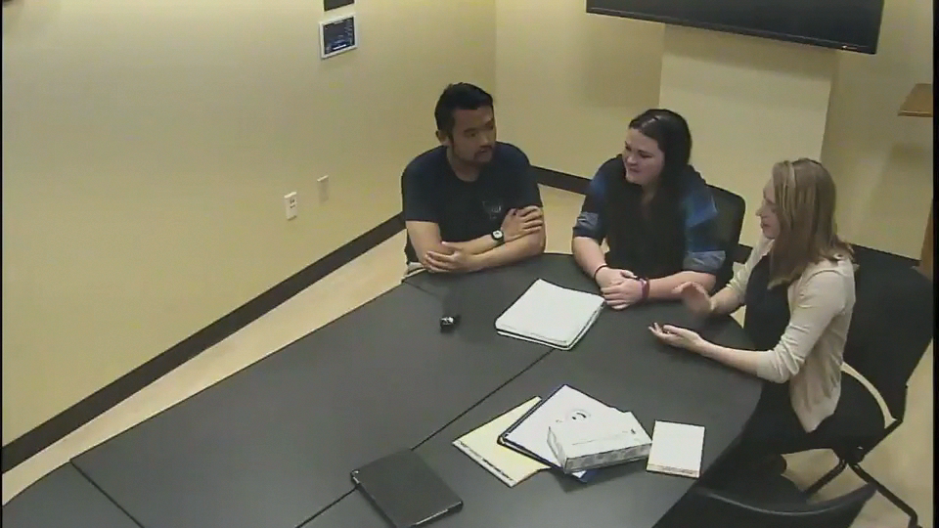
What type of leadership is seen in this clip?
Directive
Laissez-faire
Situational
Participative
Notes:
Answer: d. Participative
Why: The leader of the group is making the effort to get everyone involved and sharing thoughts and concerns

Slide 4
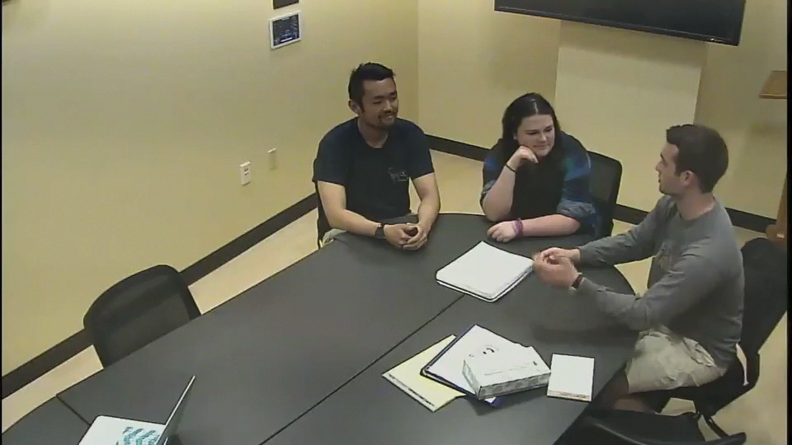
What type of informal group role is seen in this clip?
Task
Maintenance
Disruptive
None of the Above
Notes:
Answer: b. Maintenance
Why: This person is taking the needed steps in organizing group communication and establishing group cohesiveness.

Slide 5
Good Job! You have completed the review.
Now, please check your answers by exiting out of the “slide show” and look at each slide’s “notes” section.
If you need more assistance, make an appointment with the communications center: http://www.jmu.edu/commcenter/appointments.shtml
Thank you!

