Slide 1
SCOM Basic Course
Final Video Review
Chapters: 1,2,3

Slide 2
Instructions:
Take out a piece of paper and a writing utensil
Press “Slide Show” to watch it as a presentation
On each slide, click on the videos to play it.
After every video, write down your answers
When you are done, click “exit”
Check your answers in the “notes” section. Additionally, the rational is also stated in the “notes” section.
Good Luck!

Slide 3
Chapter 1: Competent Communication

Slide 4
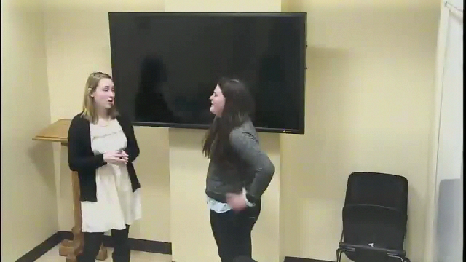
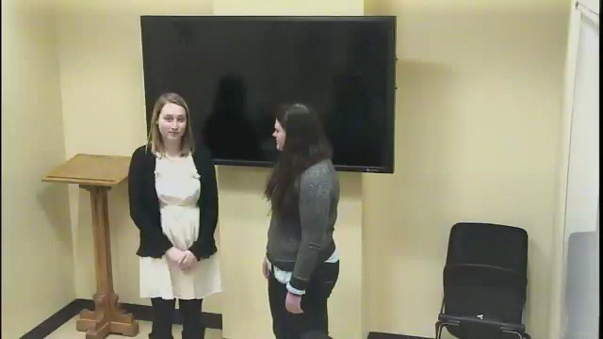
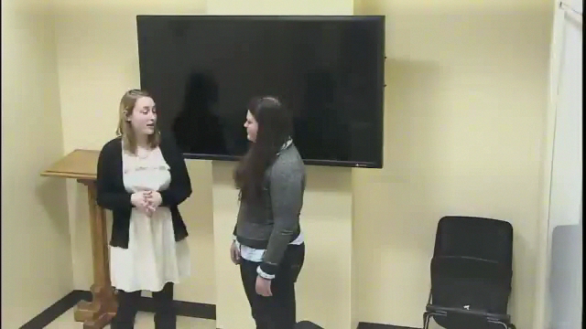
Which video correctly portrays a destructive communication environment?
a
c
b
d. A and B
Notes:
Answer: d. videos a and b
Why: Both videos a and b display a destructive communication environment because speaker 1 demonstrates a pattern of unwillingness to communication with others. Additionally, video c displays a constructive communication environment because speaker 1 demonstrates willingness to communicate with person 2 and person 1 shows a pattern of supportiveness.

Slide 5
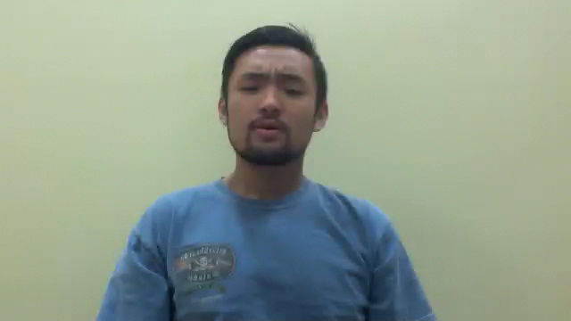
What common myth about communication is displayed in the video?
Communication is a cure all
Communication is common sense
The quantity of communication equals the quality of communication
All of the above
Notes:
Answer: b. Communication is common sense
Why: In the video, the speaker assumes that “everyone knows how to talk.” which suggests that he thinks that communication is common sense

Slide 6
Chapter 2: Perception of Self and Others

Slide 7
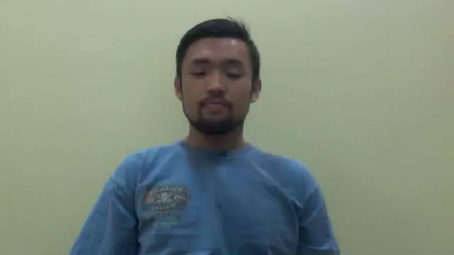
In the video, what sort of knowledge does the speaker share?
a. Breadth
b. depth
c. Self Disclosure
d. Self-serving bias
Notes:
Answer: a. Breadth
Why: The speaker shares a wide range of information but doesn’t go into detail about any specific thing.

Slide 8

Between these two people, how are they building trust in their relationship?
Reflected appraisal
Reciprocal Sharing
Attribution
Noise in the Channel
Notes:
Answer: b. Reciprocal Sharing
Why: After Person 1 shared a sensitive topic, Person 2 displayed sympathy by disclosing equally sensitive news. By participating in reciprocal sharing, these two individuals were able to strengthen their relationship.

Slide 9
Chapter 3: Culture and Gender

Slide 10
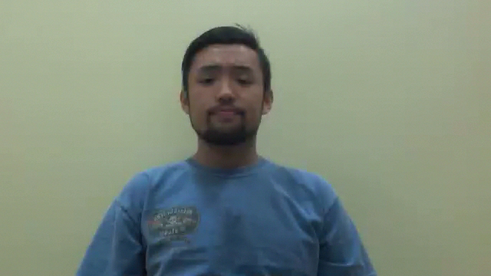
What communication term regarding culture is demonstrated in the video?
a. Ethnocentrism
b. Cultural Relativism
c. Multiculturalism
d. None of the above
Notes:
Answer: a. Ethnocentrism
Why: The speaker suggests that American culture is superior to any other culture because he is American.

Slide 11
Good Job! You have completed the review.
Now, please check your answers by exiting out of the “slide show” and look at each slide’s “notes” section.
If you need more assistance, make an appointment with the communications center: http://www.jmu.edu/commcenter/appointments.shtml
Thank you!

