Slide 1
The Möbius Strip:
A Twist in Thinking about Leader-Follower Relationships
Prepared and Presented by
Eric K. Kaufman, Austin D. Council, I. Dami Alegbeleye, and Perry D. Martin
Notes:
The Möbius strip is one of the most curious shapes, and there is value in using it as a metaphor for the leader-follower relationship. The creation and exploration of a Möbius strip promotes a sensemaking process for understanding the dual leader-follower identity necessary for effectiveness in both leader and follower roles. Furthermore, the Möbius strip can help guide thinking about healthy mentoring relationships and the ideal flow between what may seem to be contrasting priorities or styles. This paper explores practical insights from research on middle managers, experience with student programming, and historical analysis of community cultures. The exploration highlights the importance of humility in leadership and surfaces a variety of questions for further consideration.
Keywords: leadership, followership, mentoring, humility, Möbius strip

Slide 2
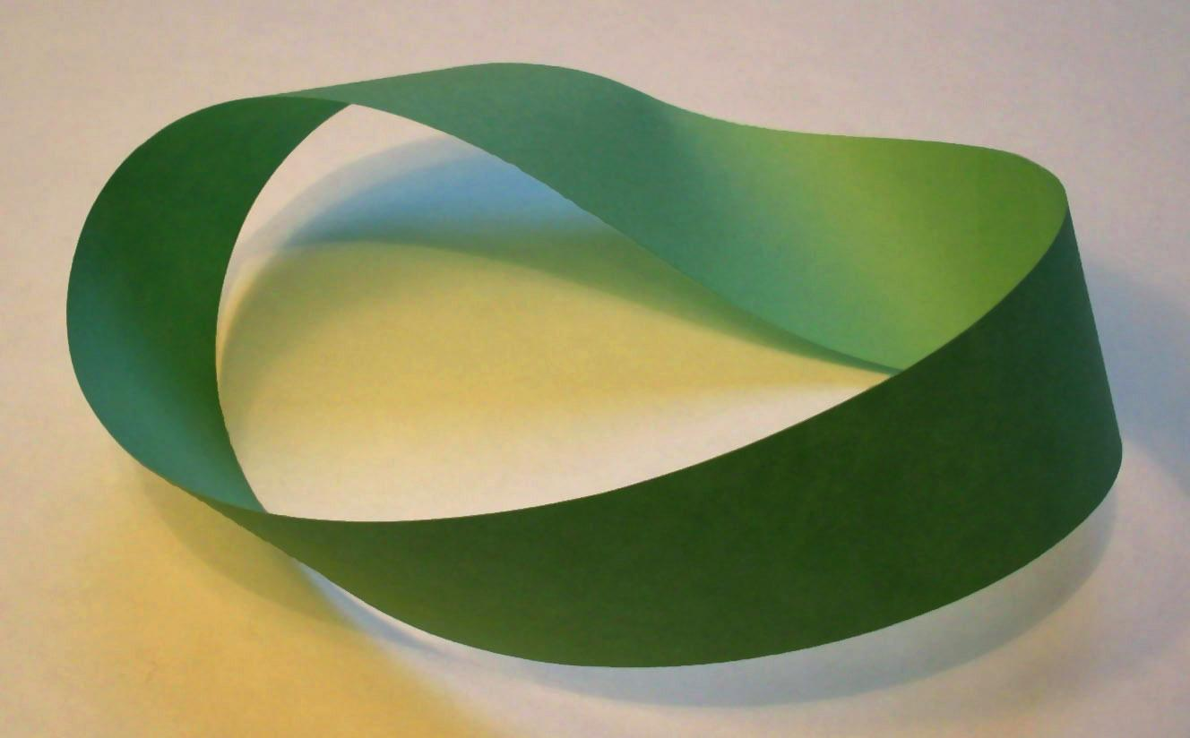
Surprise of the Möbius Strip
“Möbius strips are unique because of their one sidedness. Rather than having two sides and two edges, with a simple twist, a piece of paper has one side and one edge. Inner and outer become one” (Byrnes, 2012, p. 23).
Notes:
Discovered in 1858, the Möbius strip is one of the most curious shapes in mathematics; it is non-orientable (Buckley, 2007). As can be seen in Figure 1, “Möbius strips are unique because of their one sidedness. Rather than having two sides and two edges, with a simple twist, a piece of paper has one side and one edge. Inner and outer become one” (Byrnes, 2012, p. 23).
Popularity raised through Avenger’s End Game: https://www.youtube.com/watch?v%3D5h3G4vKCiFE

Slide 3
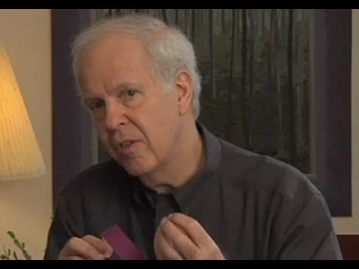
Life on the Möbius Strip
Backstage vs. Onstage
“I have to keep repeating, ‘what seems to be’ because there is no ‘inside’ or ‘outside’ on the Möbius strip—the two apparent sides keep co-creating each other.” (Palmer, 2004)
Notes:
While the Möbius strip may be best known in mathematics, particularly within the field known as topology (Gunderman & Gunderman, 2018), others have found value in the Möbius strip as a metaphor for relationships that flow into one another. Reflecting upon the curious shape, Parker Palmer (2004) mused:
I have to keep repeating, “what seems to be” because there is no “inside” or “outside” on the Möbius strip—the two apparent sides keep co-creating each other. The mechanics of the Möbius strip are mysterious, but its message is clear; whatever is inside us continually flows outward to help form, or deform, the world—and whatever is outside us continually flows inward to help form, or deform, our lives. (p. 47)
Recognizing the potential for insight, the Unitarian Universalist Association presented the Möbius strip as a representation of the relationship between faith and wholeness, acknowledging the seamless transition between our inner thoughts and outward actions (Dana & Jaeger, 2010). Furthermore, educational leaders have presented a coaching model that uses the Möbius strip to convey the “dance” between instructional (i.e., directive) and facilitative coaching behaviors (Bloom et al., 2005). Some executive education firms have cited the Möbius strip as inspiration for understanding the transformative conversations that are needed (Chabon, 2016; Mobius, 2019; Mobius Executive Leadership, 2021). Indeed, the willingness to enter into difficult conversations in an organization, to provide space for diversity of thought and honest disagreement, is an outcome of what the Möbius strip symbolizes since it invokes the practice of relational integrity (Francis, 2018).
https://www.youtube.com/watch?v=Qo00-zidiTQ

Slide 4
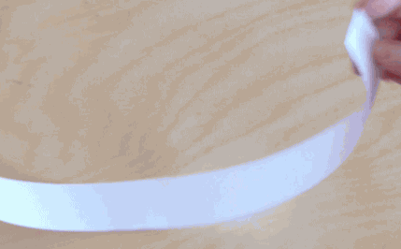
Creating a Möbius Strip
Notes:
As noted by Lamb (2016), “You can make a Möbius band in the comfort of your own home by taking a strip of paper or pasta dough, putting a half twist in it, and taping (paper) or squishing (pasta) the ends together.” Accordingly, the Möbius strip makes for an inexpensive visual aid that can be incorporated into workshops or presentations. Hurwitz and Hurwitz’ (2015) offer some helpful guidance through FliPskills (Figure 2).
Note. Images produced by FliPskills. Reprinted from Cayman Islands Institute of Professional Accountants (https://www.ciipa.ky/resources/Pictures/2016%20Professional%20Development%20Week%20training%20materials/leadership%20is%20half%20the%20story%20CAYMAN%20_HURWITZ.pdf). CC BY-SA 2.6.
GIF source: brilliant.org
Cited at https://www.bbvaopenmind.com/en/science/mathematics/mobius-and-impossible-objects/

Slide 5
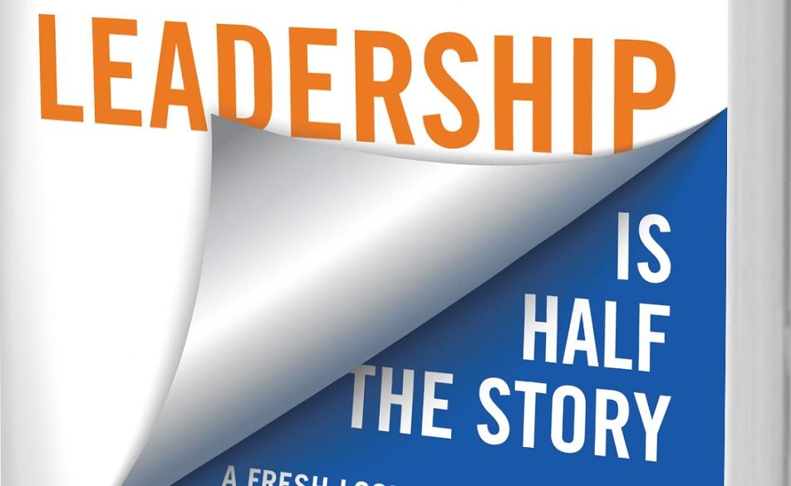
Leader/Follower Relationships
Leadership success depends on flexibility and awareness in leader-to-follower transitions (Falls & Allen, 2020).
“Leader and follower roles may be adopted flexibly by the same individual because in some cases it pays to be a leader and in others to be a follower” (Van Vugt et al., 2008, p. 186).
Many individuals are faced with the challenge of “simultaneously filling the roles of leader and follower” (Greer, 2014, p. 156).
“Leadership cannot be studied apart from followership” (Van Vugt et al., 2008, p. 193).
Notes:
Within the context of leadership, one of the more intriguing applications of the Möbius strip is in Hurwitz and Hurwitz’ (2015) description of the complementary relationship between leadership and followership. While individuals may be reluctant to embrace a follower self-concept, the reality is that leadership success depends on flexibility and awareness in leader-to-follower transitions (Falls & Allen, 2020). As noted by Van Vugt et al. (2008), “leader and follower roles may be adopted flexibly by the same individual because in some cases it pays to be a leader and in others to be a follower” (p. 186). Adding to the challenge, Greer (2014) noted that many individuals are faced with the challenge of “simultaneously filling the roles of leader and follower,” resulting in conflicting expectations (p. 156). The relational views of leadership and followership recognize the fluid nature of the experience (Uhl‐Bien et al., 2014) and conclude that “leadership cannot be studied apart from followership” (Van Vugt et al., 2008, p. 193). Indeed, “if we are going to study the leadership process we need to stop relying on our broad labels of leader and follower and better understand the nature of leading and following” (Uhl‐Bien et al., 2014, p. 96). The Möbius strip can help us recognize and explore this relationship.

Slide 6
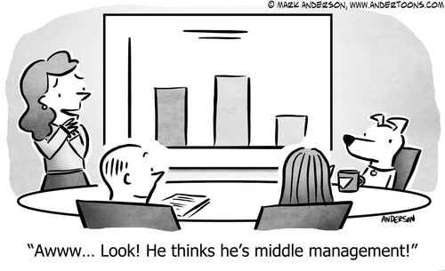
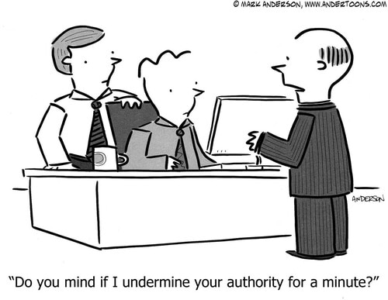
Middle Manager Applications
Some roles require dual functions of leading and following (Alegbeleye & Kaufman, 2020).
Möbius strip allows seamless flow from one behavior and function to the other, eliminating the need for distinctions.
Notes:
Eric
Considering the Möbius strip as both a metaphor and physical representation of the leader-follower relationship, it allows us to engage in a sensemaking process for developing the dual leader-follower identity necessary for effectiveness in both leader and follower roles. The seamless flow between a leader role/behavior to a follower role/behavior and vice-versa is exemplified by middle managers, who by virtue of their roles function simultaneously as leaders and followers (Alegbeleye & Kaufman, 2020). The Möbius strip helps demystify how middle managers lead their direct reports and follow their top-level managers.
We generally like to think of the leadership development process as existing on a spectrum, where one progresses from a follower to a leader over a period of time, based on some acquired leadership competencies from leadership training and/or experiences. With this unilateral perspective, people tend to believe that leadership precludes them from followership (i.e., they stop being followers once they have become leaders). However, the Möbius strip offers a new way of thinking about the leadership development process. The Möbius strip helps us view the leader and follower as essentially the same entity, who flows from a follower role/behavior to a leader role/behavior and vice-versa.
In practice, the Möbius strip was recently incorporated into an interview presentation as a metaphor to explicate the relationship between leader identity development and mentoring. The presentation was to a group engaged in a leadership mentoring program, where freshmen and sophomore college students are paired with middle to high school students. The metaphor of the Möbius strip was presented as a contrast to a spectrum. To view leadership (and leadership development) as a spectrum, is to suggest that leadership is linear—that is, one progresses from the lower end (i.e., follower or awareness stage; see Komives et al., 2009.) to the upper end of the leadership spectrum (mature leader or synthesis stage), with no chance to go back to being a follower again. However, this is devoid of reality, as people are constantly switching between these leader-follower roles/behaviors in real life. In contrast, by conceptualizing leadership (and leadership development) as a Möbius strip, we provide people with the opportunity to be leaders and followers simultaneously, flowing from one role/behavior to the other, depending on the situation. In the case of the mentoring program, college student mentors can function as both a leader (i.e., mentor) to middle and high schoolers, while also being a follower (i.e., mentee) to their staff mentor.

Slide 7
Considerations for Community Cultures
The Möbius strip suggests there is more to consider with regard to longevity and the sustainment of the organizational or community culture.
Our hunter-gatherer heritage reflects prioritizing an egalitarian ethos, practicing a system of “reverse dominance” preventing power-grabs (Gray, 2011).
Society’s infatuation with the “ladder of success” and “moving up in the world” implies a shift away from this heritage.
Notes:
Perry
The Möbius strip is also presenting insights on community cultures. Our natural tendency may be to look for discernable points that initiate a twist from leader to follower and back. However, pointing to an individual decision or an exchange between individuals may not fully capture the lesson of the Möbius strip. The strip suggests there is more to consider with regard to longevity and the sustainment of the organizational or community culture. The Möbius strip might be viewed as a reflection of how cultures (micro and macro) sustain themselves. As an example, we can consider our origins as a society of hunters and gatherers. In many respects, hunter-gatherers maintained an egalitarian ethos, practicing a system of "reverse dominance" that prevented anyone from assuming power over others (Gray, 2011). This heritage reflects priorities for the sustainment of human culture, and there are advantages of exploring continuance of the same approach today. Agriculture and mechanization are new concepts in human evolution, and these advancements come with the advent of division of roles. Strata are formed. Phrases such as “ladder of success” or “moving up in the world” imply a move away from the egalitarian approaches that defined much of early human culture to one where higher is better. This ascension of the individual invites tensions from others. From a community perspective, experience with local government (e.g., county board of supervisors) reveals advantages of simultaneously embodying leader and follower personas in that the distance between the representative and those represented is closer than any other form of government. Discourse on community matters frequently transcends the realm of formal meetings to informal communication among neighbors.

Slide 8
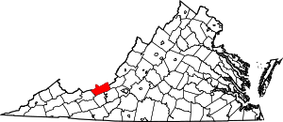
Considerations for Community Cultures
Giles County, Virginia
Notes:
Perry
The Möbius strip is also presenting insights on community cultures. Our natural tendency may be to look for discernable points that initiate a twist from leader to follower and back. However, pointing to an individual decision or an exchange between individuals may not fully capture the lesson of the Möbius strip. The strip suggests there is more to consider with regard to longevity and the sustainment of the organizational or community culture. The Möbius strip might be viewed as a reflection of how cultures (micro and macro) sustain themselves. As an example, we can consider our origins as a society of hunters and gatherers. In many respects, hunter-gatherers maintained an egalitarian ethos, practicing a system of "reverse dominance" that prevented anyone from assuming power over others (Gray, 2011). This heritage reflects priorities for the sustainment of human culture, and there are advantages of exploring continuance of the same approach today. Agriculture and mechanization are new concepts in human evolution, and these advancements come with the advent of division of roles. Strata are formed. Phrases such as “ladder of success” or “moving up in the world” imply a move away from the egalitarian approaches that defined much of early human culture to one where higher is better. This ascension of the individual invites tensions from others. From a community perspective, experience with local government (e.g., county board of supervisors) reveals advantages of simultaneously embodying leader and follower personas in that the distance between the representative and those represented is closer than any other form of government. Discourse on community matters frequently transcends the realm of formal meetings to informal communication among neighbors.

Slide 9
Relevance to Humility
Do our historical, cultural or dualistic notions of leadership lead to leader-follow conflict?
Framing the leader-follow relationship with the Möbius Strip suggests a sharing of work, elevating equality over power-dynamics.
In order to make this shift, a removal of one’s ego is required, which will enforce the sustainment of the group, individual, and the larger organizational or cultural context (i.e., humility definition).
Notes:
Austin
This invites a great question as to whether culturally our dualistic notions of leadership (i.e., “leader” and “follower”) are new concepts that elevate and ultimately overstress the individual leading to conflicts that follow both leaders and followers. Möbius strips suggest a sharing of work that elevates the equality and value of individuals as contributors – lines are blurred for the good of the group and individual achievement is expected to be tempered with the virtue of humility, which, in its essence involves a removal of the ego. Sowcik, Andenoro and Council (2017) defined humility as “the ability of an individual to have a proper perspective of themselves, their relationship with others, and of their place in the larger environment” (p. 170). This humility was likely enforced for the sustainment of both the group and the individual, and perhaps, the larger organizational or cultural context. Culture recognized survival as dependent on the sharing or work and therein the sharing of the role of leading the work.

Slide 10
Humility Definition
Sowcik, Andenoro and Council (2017) defined humility as “the ability of an individual to have a proper perspective of themselves, their relationship with others, and their place in the larger environment” (p. 170).
Li (2016) argued that humility is valued in Eastern cultures that emphasize collectivism more so than Western ones which value individualism.

Slide 11
Ongoing Questions
In what ways can the Möbius strip help us reframe perspectives on power, including the simultaneous presence of leadership and followership within us all?
How can we transform relationships in ways that better distribute authority and responsibility, thus reducing the strain on particular individuals?
How might we help others abandon the false dichotomy that is often used to describe leader-follower roles?
What role could the virtue of humility play in this process?
Notes:
Austin
The ultimate power of the Möbius strip may be that it leaves us with more questions than answers. Here are some of the lingering questions worthy of ongoing attention:
In what ways can the Möbius strip help us reframe perspectives on power, including the simultaneous presence of leadership and followership within us all?
How can we transform relationships in ways that better distribute authority and responsibility, thus reducing the strain on particular individuals?
How might we help others abandon the false dichotomy that is often used to describe leader-follower roles?
What role could the virtue of humility play in this process?

