Slide 1
Leadership in an Artificial Intelligence Era
Tatjana Titareva,
School of Strategic Leadership Studies (SSLS),
James Madison University
E-mail: titaretn@dukes.jmu.edu

Slide 2
Abstract (1)
Literature review
Intersection of «leadership» and «Artifical intelligence» (leadership in Industry 4.0 with dominance of AI)
Three directions of the scholarly and practitioner research:
1) AI as an additional assistance to current leadership functions (enhancement perspective);
2) AI to replace followers and leaders (replacement perspective);
3) AI as “an oversold idea” (skeptical perspective).

Slide 3
Introduction (1)
Leadership researched > 100 years
Key terms associated with AI: big data, automation, and machine learning, Industry 4.0, etc.
AI is used in fields: entertainment, healthcare, service industry (such as finance, marketing, logistics, e-commerce, agriculture, and accounting), education, etc.
“Leadership in an Artificial Intelligence based economy” (Moldenhauer & Londt, 2019, p. 155).

Slide 4
Introduction (2)
As per Naqvi and Munoz (2018), the issue is that “the cognitive transformation is sweeping through the global economy, and it is not like anything traditional leaders have ever experienced before” (p. 1).
A survey by Accenture (2017, as cited in De Cremer, 2019): 85% of questioned executives were planning to extensively invest in AI-related technologies in the period of the next 3 years.
Thus, the author raises the questions whether AI-based technologies implementation will influence the heart of the organizations – their leadership, and whether today’s leadership will be relevant in the future.

Slide 5
Definitions of AI
“The science and engineering of making intelligent machines.” (John McCarthy, 1956) | “The capacity for machines to employ algorithms with data to make choices similar to those of a human being.” (Yao, Jia, and Zhou, 2018)
“A computer program combined with real-life data, which can be trained to perform a task and can become smarter about its users through experience with its users.” (Arney, 2017) | “A science dedicated to the study of systems that, from the perspective of an observer, act intelligently.” (Bernardini, Sônego, & Pozzebon, 2018)
“The broad collection of technologies, such as computer vision, language processing, robotics, robotic process automation and virtual agents that are able to mimic cognitive human functions.” (Bughin & Hazan, 2017)

Slide 6
Synthesis of the main research directions

Slide 7
Enhancement perspective: AI as an additional assistance to current leadership functions

Slide 8
Enhancement perspective (1)
Jones (2018): “Leadership as a principal does not change” (p. 60). All the types identified by the leadership community in the last decade (transformational, transactional, situational, contingent, etc.) will stay. Technologies are simply something additional that will change the landscape, but not the definition of leadership and need for human leaders.

Slide 9
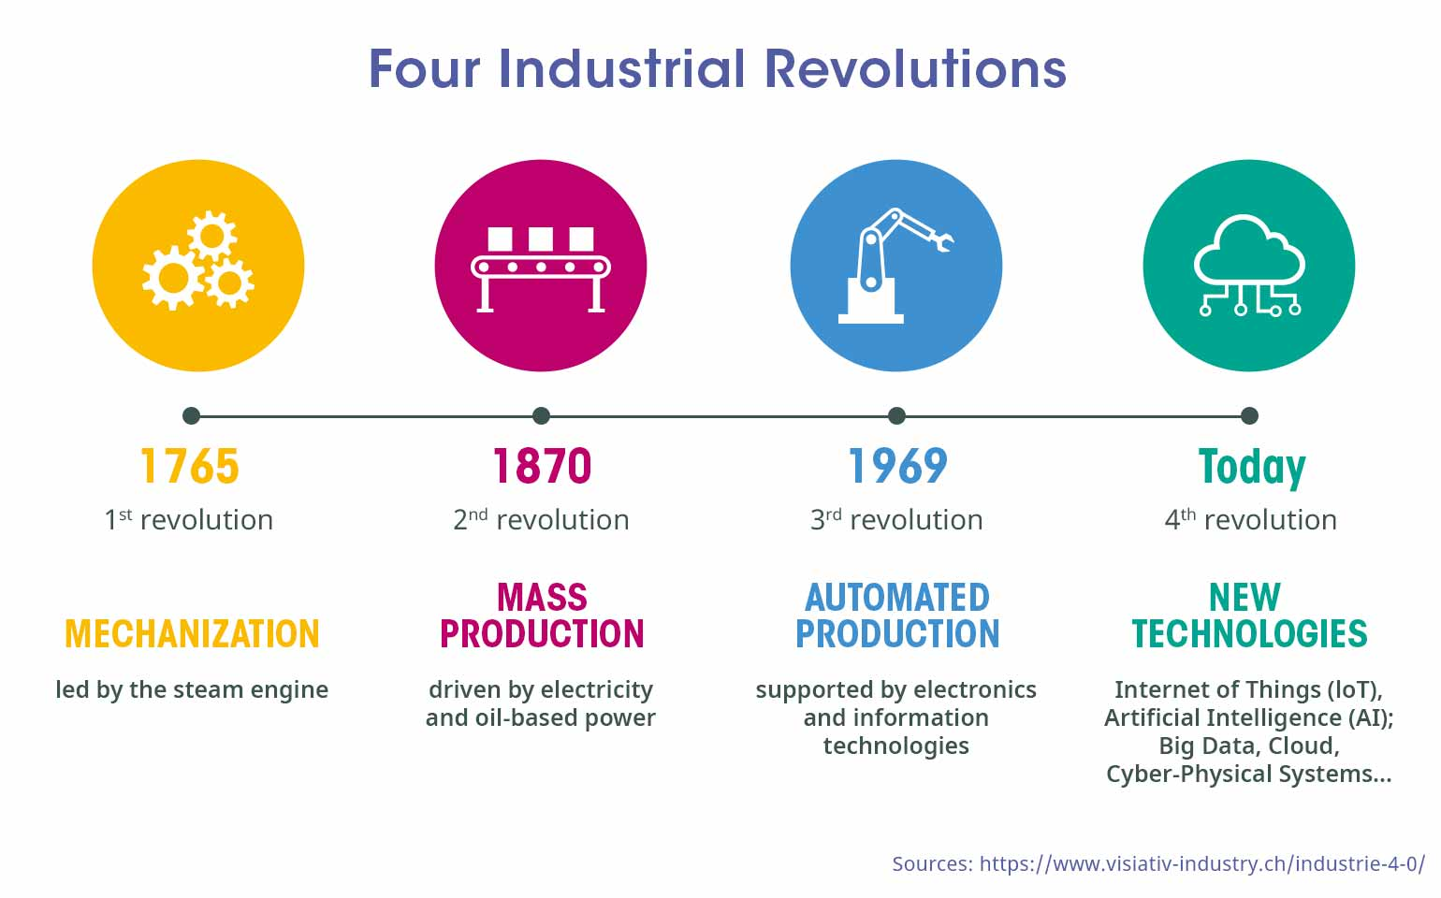
Enhancement perspective (2)

Slide 10
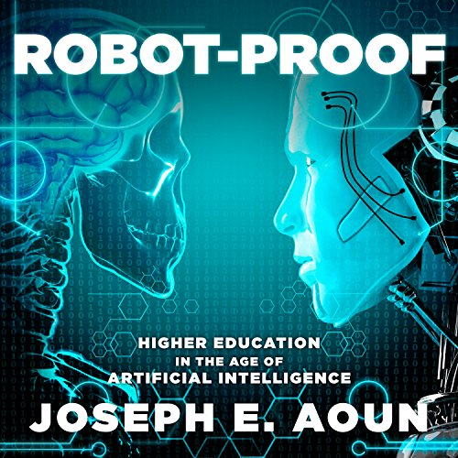
Enhancement perspective (3)
Main idea:
AI is going to assist organization leaders in decision-making by providing more data (both in terms of the amount and in-depth) and analysis for faster and data-driven decisions, as well as free their employees from routine/monotonous work by giving more time and space for creative work.
Source: Amazon Audible

Slide 11
Replacement perspective: AI will replace followers and leaders

Slide 12
Replacement perspective (1)
World Economic Forum’s Global Agenda Council’s survey on “The Future of Software and Society” (2015), the results indicate that: “people expect AI machines to be part of a company’s board of directors by 2026 and algorithms are thus expected to take up leadership roles in the future” (De Cremer, 2019, p. 82).
Source: Stanford University MS&E 238 Blog

Slide 13
Replacement perspective (2)
Smith and Green (2018) elaborate that “AI follower” will inevitably replace human employees due to the rise in retired-age individuals and the aging population in the Western world and China – the power houses of AI innovations.
Samani et al. (2012) proposed that, “the technological ecosystem not only is suited for machines to assume leadership positions but rather is inherently headed towards it” (p. 158), such robot decision-makers could prevent tragic instances similar to the Great Recession of 2008, crash of Air France flight 447.
Source: Outlook India
Source: Financial Times

Slide 14
Replacement perspective (3)
Main ideas:
AI futurists from the business world, e.g., Ray Kurzweil, Elon Musk, who develop and commercialize AI products, are warning: humanity should be ready in terms of ethical behavior and leadership, when the day of robots as leaders and decision makers come.
Discussions about robot management and leadership should continue, not only from the technological point of view, but also and largely from the ethical perspective, and considering what consequences this type of non-human leadership and management can bring.

Slide 15
Skeptical perspective: AI is “an oversold idea”

Slide 16
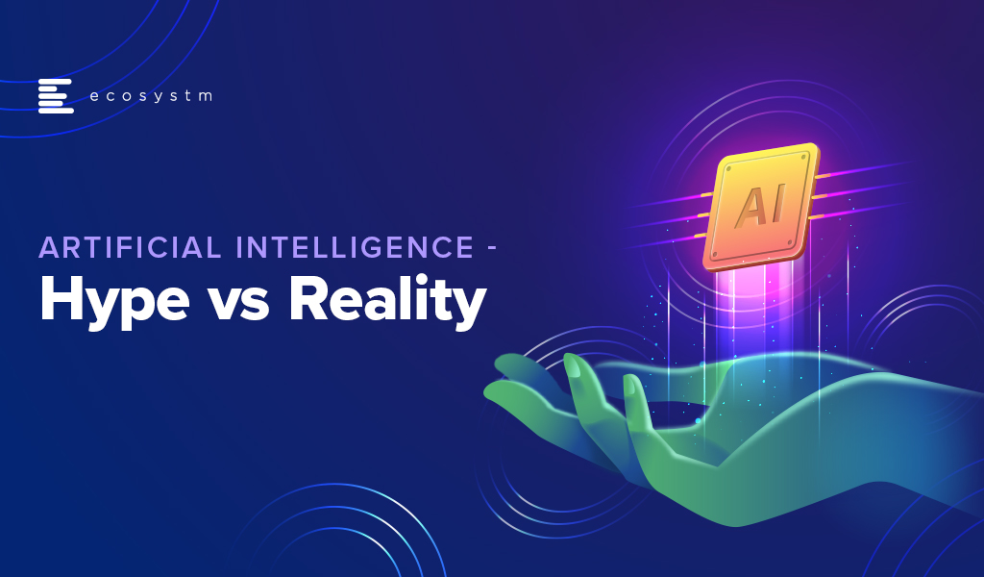
Skeptical perspective (1)
Watkins (2018): AI hype “is an oversell” the same as with the popularity and predictions about the big data that “has been sold as another golden egg that will serve humanity faithfully” (p. 75).
De Cremer (2019): “Realizing that organizations today need to take up wise and responsible leadership to integrate the interests of all stakeholders, AI should not be considered to replace humans in their leadership role” (p. 82).
Source: Ecosystm Blog

Slide 17
Skeptical perspective (2)
Main ideas:
The main idea is that the possibilities and influence of AI in the modern world, including leadership and management, is an exaggerated idea, and it must be considered and evaluated critically.
Decision-making is a much more complex process than looking at data and making rational decisions. Human part and qualities of leaders should stay as part of important business decisions and actions.

Slide 18
Future Research
The future research in leadership in Industry 4.0 with disruptive and continuous technological developments of AI will concentrate on research of how leaders will lead alongside AI and what capabilities should be added to the currently required leadership skills in order to be effective leaders in an AI era.
More theoretical frameworks and empirical studies are required.

Slide 19
Discussion points
Petrucci and Rivera (2018) state that leaders in Industry 4.0 “will need to use proven leadership concepts in an integrated manner with technology" (p. 55).
Still mainly speaking and using weak AI.
Ethical and legal implications should be on the agenda of the policy makers, businesses, programmers and other stakeholders embracing the AI revolution.
Open question where and how this area of research could match the leadership studies till now: e-leadership (Antonakis & Atwater, 2002; Avolio & Kahai, 2003; Avolio, Kahai, & Dodge, 2000) or separate, new direction, e.g. AI leadership.

Slide 20
Q & A

Slide 21
Paper: Leadership in an Artificial Intelligence Era
Tatjana Titareva,
School of Strategic Leadership Studies (SSLS)
James Madison University
E-mail: titaretn@dukes.jmu.edu ; titaretn@jmu.edu

Slide 22
Abstract (2)
RQ: "What are the main perspectives of the scholarly and practitioner research directions in the period 2010-2020 in the field of Leadership in an Artificial Intelligence era?”
The literature review addresses a lack of substantial literature review and empirical data providing a balanced view of different perspectives on AI-based technologies’ influence on the leadership of modern organizations.
Possible contribution of this paper is that identified perspectives could become a basis for future empirical research by scholars and practicioners.

Slide 23
Methodological approach
Databases: Business Source Complete and Google Scholar
Keywords: “Artificial Intelligence” and “Leadership”
Academic (peer reviewed) articles
41 full articles and over 184 article abstracts
2010 - 2020

Slide 24
Summary about types of publications
Summary of practitioner and academician views and theory building papers
More and most cited: 2018-2020
Journals:
Technological (e.g. International Journal of Information Management, IT Professional);
Leadership (e.g. Leadership Quarterly, Journal of Leadership Studies, Strategy & Leaderships);
Consulting and practicioner field (e.g. McKinsey Quarterly, Harvard Business Review).

