Slide 1
Updates to the OSHA Hazard Communication Standard
Safety Data Sheets (SDS), Labels, & Pictograms

Slide 2
Background
OSHA’s Hazard Communication Standard (29 CFR 1910.1200) was re-issued in 2012 to bring it into alignment with the United Nation’s Globally Harmonized System of Classification and Labeling of Chemicals (GHS)
The revisions include more structured requirements for labeling and formatting Safety Data Sheets (SDS, previously called MSDS)
The updated labels and SDSs more quickly and clearly convey hazard information so that the users are informed about how to protect themselves.

Slide 3
Safety Data Sheets
New format requires 16-sections
Sections 1-8 contain general information about the chemical’s identity, hazards, safe handling, and emergency control measures.
Sections 9-11, and 16 contain technical and specific scientific information including physical and chemical properties, exposure control and toxicological information, and stability and reactivity guidance.
Sections 12-15 contain information regulated by DOT, EPA and other agencies as well as the date of preparation or last revision of the SDS.

Slide 4
SDS—Know the sections
Section 1-Identification
Section 2-Hazards
Section 3-Ingredients and Composition
Section 4-First Aid Measures
Section 5-Fire Fighting Measures
Section 6-Accidental Release Measures
Section 7-Handling and Storage
Section 8-Exposure Controls/PPE
Section 9-Physical & Chemical Properties
Section 10-Stability & Reactivity
Section 11-Toxicological Information
Section 12-Ecological Information
Section 13-Disposal Considerations
Section 14-Transport Information
Section 15-Regulatory Information
Section 16-Other, including SDS date

Slide 5
Labels
New Manufacturer Labels must include the following:
Product Identifier
Signal Word
Pictogram
Hazard Statements
Precautionary Statements
Name, address, & phone number of chemical manufacturer, distributor or importer

Slide 6
Product Identifier
Can be name, code number, batch number or whatever manufacturer chooses.
The same identifier will appear on the label and the SDS

Slide 7
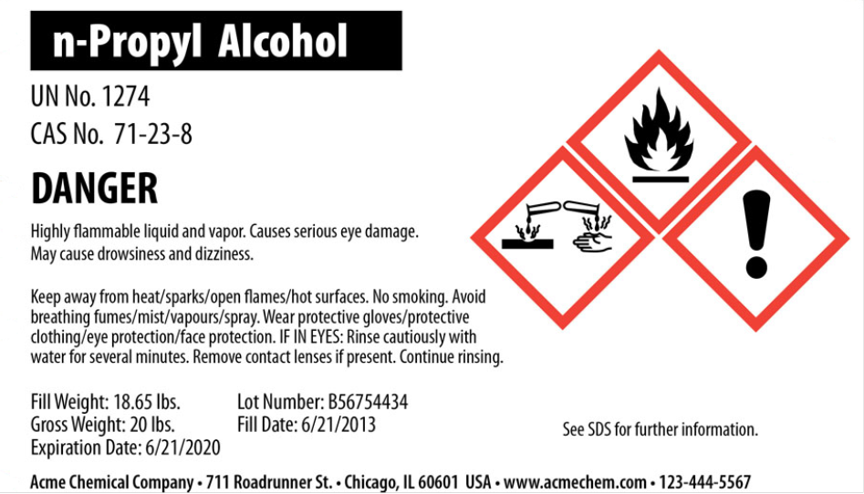
Signal Word
Only one of two choices will be used: WARNING or DANGER
Used to alert relative severity of hazard
DANGER indicates a greater hazard than WARNING

Slide 8


Pictograms
Requirements:
-Red square set on a point
-Black hazard symbol
-White background.
OSHA has designated 9 different pictograms in the Haz Com standard to indicate hazard category.

Slide 9
OSHA Pictograms
Hazards at a Glance

Slide 10
Hazard statements
Describe the nature of the hazard and degree of the hazard.
Specific to the hazard classification.
Always the same for the same hazard, regardless of the chemical.

Slide 11
Precautionary statements
Describe recommended measures to minimize or prevent adverse effects resulting from exposure, improper storage, or improper handling of a chemical. There are 4 types:
Prevention
Response
Storage
Disposal
They can be combined for readability and to conserve space or, when similar, the most stringent statement utilized on the label.

Slide 12
Precautionary statements
Combined and formatted to conserve space

Slide 13
Name, Address, and Telephone number
Chemical Manufacturer, importer, or other responsible party

Slide 14
Sds and labels
Information must be in English, but can also be in other languages
Precautionary statements on the label and SDS will be the same
Labels can include additional supplemental information
Information on the label can be used to ensure proper storage and provide immediate guidance for emergency response personnel.
The Hazard Communication Standard STILL requires that SDSs be readily accessible for all hazardous chemicals in the workplace.

Slide 15

Questions?
If you have any questions regarding this training, the updated Hazard Communication Standard or need additional information on SDSs or labels, contact the Environmental Health Coordinator.
Marcella Mullenax
mullenmr@jmu.edu
Please proceed to the quiz for the updated Hazard Communication Standard. A minimum score of 80% must be achieved for successful completion of the training.

