Slide 1
CommUnity
Notes:
Misty
How did you define it?
What service experience have you had in the past?
What was good? Anything not so good? What makes it memorable?

Slide 2
Community captured in words…
A unified body of individuals
A group of people with common interests living in a particular area
A group of people with a common characteristic or interest living together within a larger society
A body of persons with common and especially professional interests scattered through a larger society
A body of persons or nations having a common history or common social, economic, and political interests
A group linked by a common policy
An interacting population of various kinds of individuals
A social state or condition
Joint ownership or participation
Common character
Society at large
Definitions from good ol’ Merriam-Webster Dictionary
Notes:
Jamie

Slide 3
Harrisonburg
Notes:
What do you know about it?

Slide 4
Stats & Facts as of 2015
Population: 51,388
Harrisonburg’s population is growing
Approximately 64% of households are renting
26% of the population lives in poverty
39% of the population earns more than the Federal Poverty Level, but less than the basic cost of living for the county
85% of residents have some form of Healthcare 6.5% unemployment rate (state average: 5.5%)
Immigrants make up 9.7% of the overall population
7.8% of this group are refugees
Top 5 countries of origin of immigrants living in H’burg
Mexico, Honduras, El Salvador, Iraq, and China
Information provided by NAE, American Community Survey and United Way ALICE Report
Notes:
Jamie
65% of the population is living at least below the basic cost of living for the county. However, if heads of households under 25 years old are removed from the dataset this number changes to 58%. This is in an effort to mitigate the impact JMU students living off campus being factored into this report.
H’burg ranks in the top fifty for the poorest city in VA out of 552.

Slide 5
Harrisonburg, VA
Statistics provided by www.usa.com
Notes:
Misty
What can we tell by looking at this bar graph?
What do you think may influence the accuracy?

Slide 6
Statistics provided by www.usa.com
Notes:
Jamie
How do you think the presence of students in Harrisonburg may impact this information?
Why does it matter to consider the external factors that may be influencing the information we are reviewing?

Slide 7
Statistics provided by www.usa.com
Notes:
Misty

Slide 8
Notes:
Jamie
Who has seen this sign?
Who knows the story behind it?

Slide 9
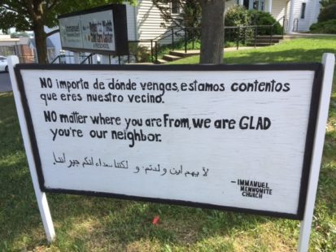
“The message of the sign speaks for itself and is not associated with any one political, religious or civic group or ideology. The idea is to express welcome and appreciation to all the members of our local communities regardless of their ethnicity, language, or country of origin.”
Notes:
Misty
This sign originated in Harrisonburg at the Immanuel Mennonite Church in August 2015.
Today, the sign is available for purchase in at least 16 different languages and can be seen across the nation and has even been reported to be posted in parts of Canada and Liberia.
When these signs are purchased through the “Welcome Your Neighbors” website, the proceeds go back into furthering the message it conveys as well as towards local non-profits in Harrisonburg.

Slide 10
Preparation
Logistics
Information about content
Information about broader issues
Explores expectations about assumptions of the participants
Notes:
Jamie
1. Good communication with the community partner
Details to share with those who will participate
Lots of great questions-can you give any examples?
2. Content
Will there be any sort of orientation? How do we best prepare for the actual work we will be doing? Is there any training we should/could do to plan ahead? What can my class do to prepare with our specific skills sets? How should we dress, what should we expect, have we looked into the website of the organization?
3. Broader social issues (Orientation)
What do we know about the community we’ll work in? What about the population?
4. Establish expectations (education)
Do we have any conscious or unconscious biases? How has privilege and oppression already impacted this community?

Slide 11
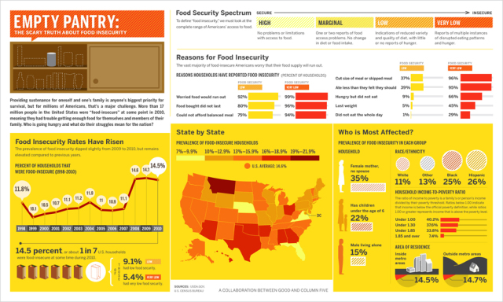
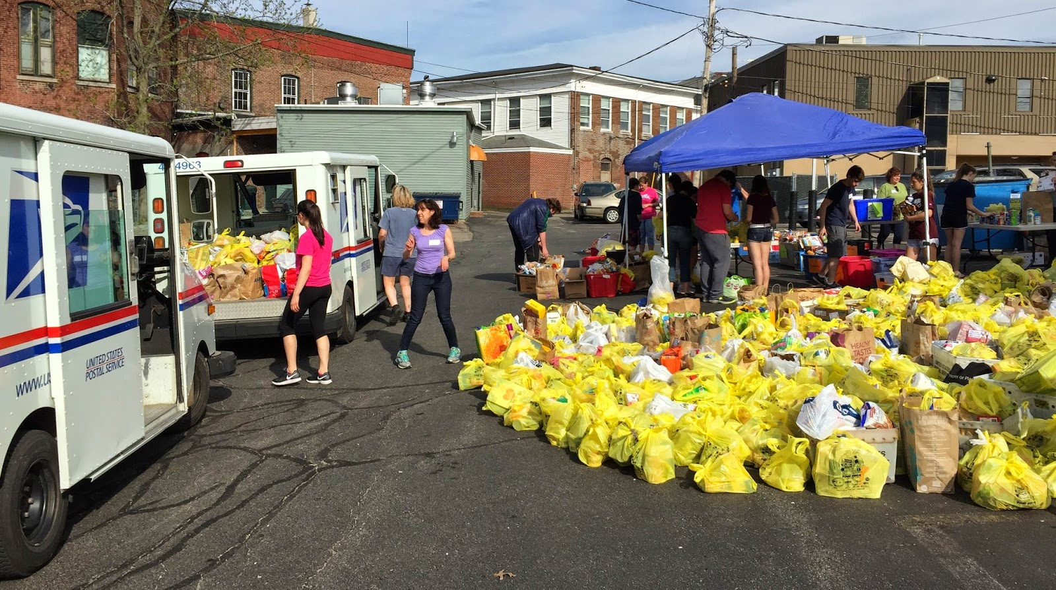
Types of Service
Direct
Indirect
Non-direct/Advocacy
Notes:
Misty

Slide 12
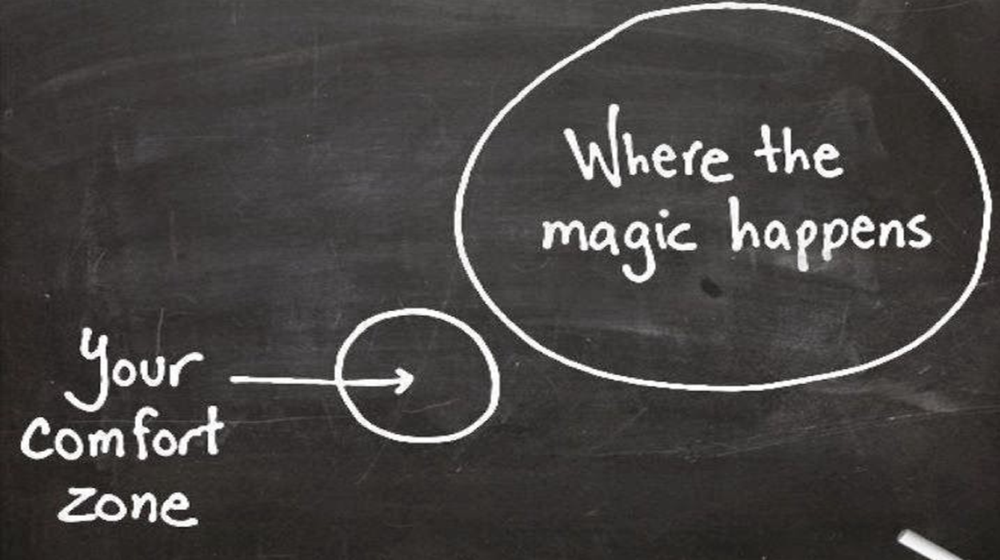
Ethical, Meaningful Service
Addresses a community-identified goal/need or ABCD
Willingness to be flexible
Aims to do good and no harm
Photography, full engagement, etc
Expands comfort zone
Challenges biases/prejudices
Promotes respect and social justice
Notes:
Jamie
What do I mean by “No Harm”

Slide 13
Ethical Photography
Notes:
Jamie
Were you given permission to take the photos?
Are the photos capturing the mutually beneficial relationship?
How are you using these photos?
What story are the photos telling?
Are the photos objectifying, reinforcing stereotypes, or sensationalizing a situation?
How would you feel if your story was on the other side of the lense?

Slide 14
SYNTHESIZE
Notes:
Misty

Slide 15
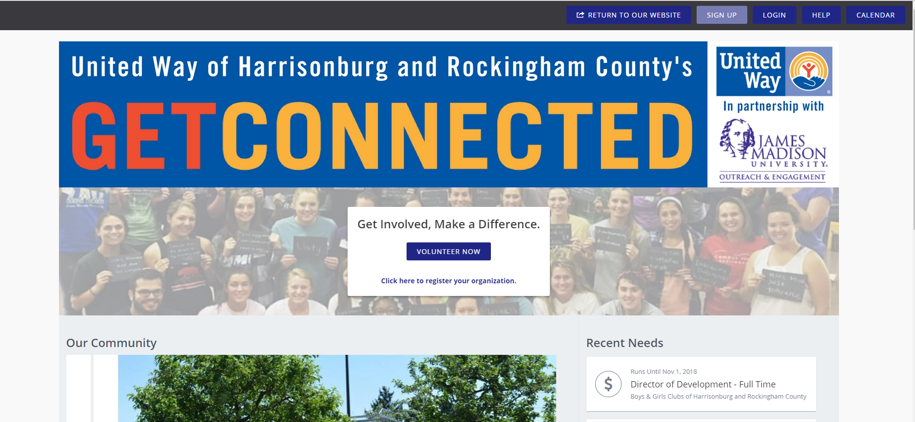
Notes:
Jamie
http://getconnected.uwhr.org/

Slide 16
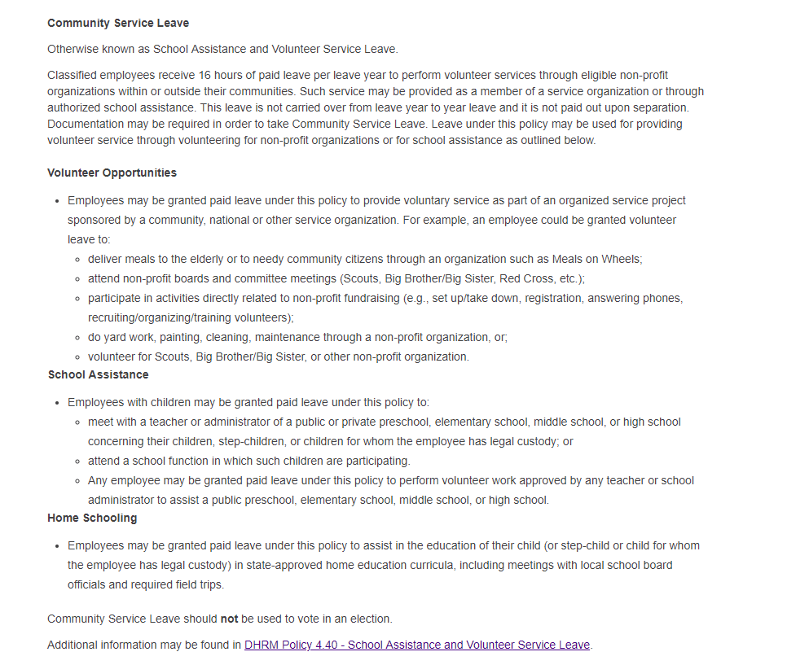
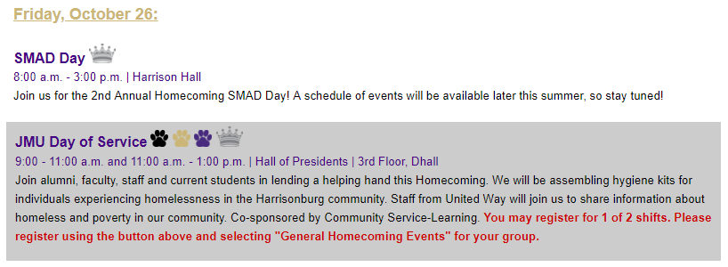
Notes:
Misty
https://www.jmu.edu/humanresources/benefits/leave/ft-classified.shtml#Set-1-A-volunteer

Slide 17
Questions?
Misty Newman & Jamie Williams
2100 Student Success Center
Community Service-Learning
540.568.6366
csl@jmu.edu
Notes:
Misty

