Slide 1
Postsecondary Administrative Leadership and Educational AI: An Ethical Shared Approach
PRESENTERS: Benjamin Selznick, Tatjana Titareva
SCHOOL OF STRATEGIC LEADERSHIP STUDIES (SSLS)

Slide 2
Introduction
While serving as a postsecondary administrative leader is never an easy job, those performing such responsibilities in the coming decade and beyond will need to engage challenges both perennial and novel; respond to capital constraints both financial and human; and navigate unpredictable political, ecological, demographic and technological shifts (Kezar & Posselt, 2020).
Artificial intelligence (AI) will increasingly feature in the many decisions facing administrative leaders in higher education (Hinojo-Lucena et al., 2019).

Slide 4
Objectives
To engage a leadership studies paradigm to outline and address the current and projected future realities of AI with respect to effective postsecondary administrative leadership.

Slide 5
Three Leadership Perspectives

Slide 6
Leadership Perspectives (book ch. in 2022)
Administrative. Administrative leaders must work to build consensus through channels of influence and communication within “organizational cultures that frequently combine bureaucratic, collegial, political, and symbolic dynamics” (p. 85) across unit-level subcultures (e.g., Manning, 2018).
Ethical. Patterns of decisions, practices and behaviors that intentionally and morally fulfil the mission of postsecondary institutions to interactively enact social responsibility (Hall & Tandon, 2021).
Shared. Essential to this approach is its interactivity and dynamism; its emphasis on “capitalizing on the importance of leaders throughout the organization, not just those in positions of authority” while also “creating an infrastructure so that organizations can benefit from the leadership of multiple people” (Kezar & Holcombe, 2017, p. v).

Slide 7
Adding a component of Technology Leadership in HE

Slide 8
Technology Leadership Perspective
Technology Leadership (TL) in Education:
Originally, Anderson and Dexter (2005) defined educational technology leadership as a construct that “represents the organizational decisions, policies, or actions that facilitate effective utilization of information technology throughout the educational institution” (p. 80).
Additionally, Yuting et al. (2022) developed and tested the scale of technology leadership in higher education in China (adopted from ISTE Standards for Education Leaders (ISTE, 2018), where educational technology leadership has the following subscales: equity and citizenship advocate, visionary planner, empowering leader, systems designer and connected learner showing that educational technology leaders have to know not only technology, but also possess leadership qualities and skills relevant to the 21st century.

Slide 9
Our Theoretical Framework

Slide 10
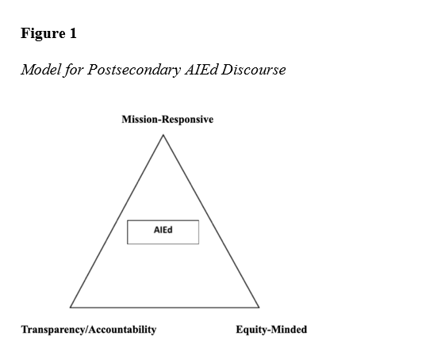
New Theoretical Framework

Slide 11
New Theoretical Framework

Slide 12
New Theoretical Framework
Mission-responsive. We propose that one foundational pillar for considering AI in higher education is to actively consider the extent to which applications ideally are aligned with and possibly even serve to enhance mission delivery.
2) Transparent/Accountable. Transparency refers non-discrimination, empowerment and legality, including privacy related questions for the type of personal data obtained and shared and mitigation of algorithmic bias (Baker & Hawn, 2021).
3) Equity-Minded. Bensimon et al. (2016) succinctly define as “accounting for differences in individual attributes and experiences for the purposes of achieving equal outcomes” (para. 7) – in discourse concerning ethical applications of artificial intelligence in higher education.

Slide 13
Implications for a Shared Ethical AIEd Leadership
Taskforces and Knowledge Sharing. The authors offer the importance of creating, in university settings, AIEd task forces that guide university senior leadership on how to operationalize such technologies responsibly (e.g., use of learning analytics; see Siemens et al., 2013).
Educational Policy Making. Policy making should involve multiple actors from government, higher education, commercial, and ICT sectors to critically discuss the barriers for establishing national and institutional analytics policies and strategies (Siemens et al., 2013).
Centering Students and Adopting an Ethic of Care. Keeling (2014) offers as an ‘ethic of care’ in higher education. Much as administrative leaders have a profound responsibility toward ensuring the ethical implementation of AI practices (Dignum, 2020), they also and simultaneously have a responsibility toward promoting student development, success, and well-being.
.

Slide 14
“Zeros and ones, if we are not careful, could deepen the divides between haves and have-nots, between the deserving and the undeserving -- rusty value judgements embedded in shinty new systems” (Benjamin, 2019, pp. 62-63).

Slide 15
Conclusions
Across AIEd applications, the authors see opportunities for enhancement in terms of learning quality, administrative-decision making, and optimizing the infrastructures - both digital and physical. We also, of course, see opportunities for destruction; possibilities for humans to function subordinately to algorithms; instances where the exploitation could easily, and perhaps even unintentionally, occur.
A touchstone is that higher education holds as its mission to be an ethical, human endeavor and must remain such when making choices relative to considering and implementing technologies (Alexander, 2020).
We state that administrative leaders must drive decisions about AI technologies rather than AI technologies drive the decisions of administrators.

Slide 16
References
Berger, J., & Milem, J. (2000). Organizational behavior in higher education and student outcomes. In J. C. Smart (Ed.), Higher education: Handbook of theory and research (Vol. 15, pp. 269–338). Agathon.
Cox, A. M. (2021). Exploring the impact of Artificial Intelligence and robots on higher education through literature-based design fictions. International Journal of Educational Technology in Higher Education, 18(1), 1-19. https://doi.org/10.1186/s41239-020-00237-8
Dignum, V. (2020). Responsibility and artificial intelligence. In M. D. Dubber, F. Pasquale, & S. Das (Eds.), The Oxford Handbook of Ethics of AI (pp. 215-232). Oxford University Press.
Kezar, A., & Posselt, J. (Eds.). (2020). Higher education administration for social justice and equity: Critical perspectives for leadership. Routledge.
Southgate, E. (2020). Artificial intelligence, ethics, equity and higher education: A ‘beginning-of-the-discussion' paper. National Centre for Student Equity in Higher Education.

Slide 17
Thank you!
Dr. Benjamin Selznick
Associate Professor and Advisor of Postsecondary Analysis and Leadership
School of Strategic Leadership Studies (SSLS)
James Madison University (JMU)
selznibs@jmu.edu
Tatjana Titareva
Doctoral Assistant at Research, Economic Development, and Innovation (REDI) (Formerly known as R&S)
School of Strategic Leadership Studies (SSLS)
James Madison University (JMU)
titaretn@jmu.edu

