Slide 1
SMART CITY, ONE WORLD: SINGAPORE’S RESPONSE TO AI RESPONSIBILITY
Philip L. Frana, Ph.D.
James Madison University
Interdisciplinary Studies & Independent Scholars
https://sites.lib.jmu.edu/artificialother/
2nd Annual Beitzel Symposium
Sept. 27-28, 2023

Slide 2
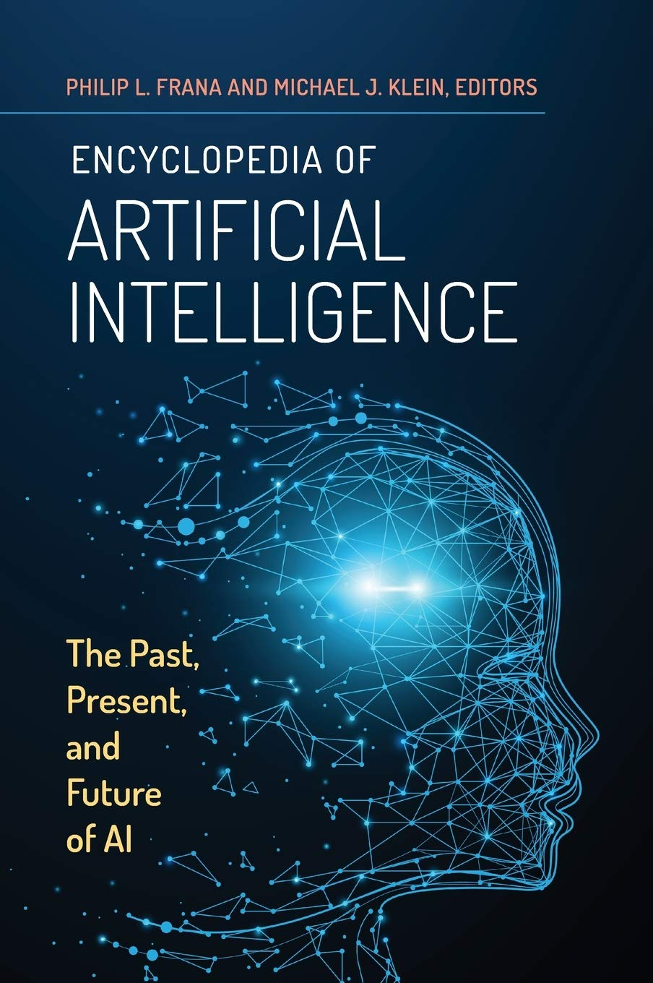
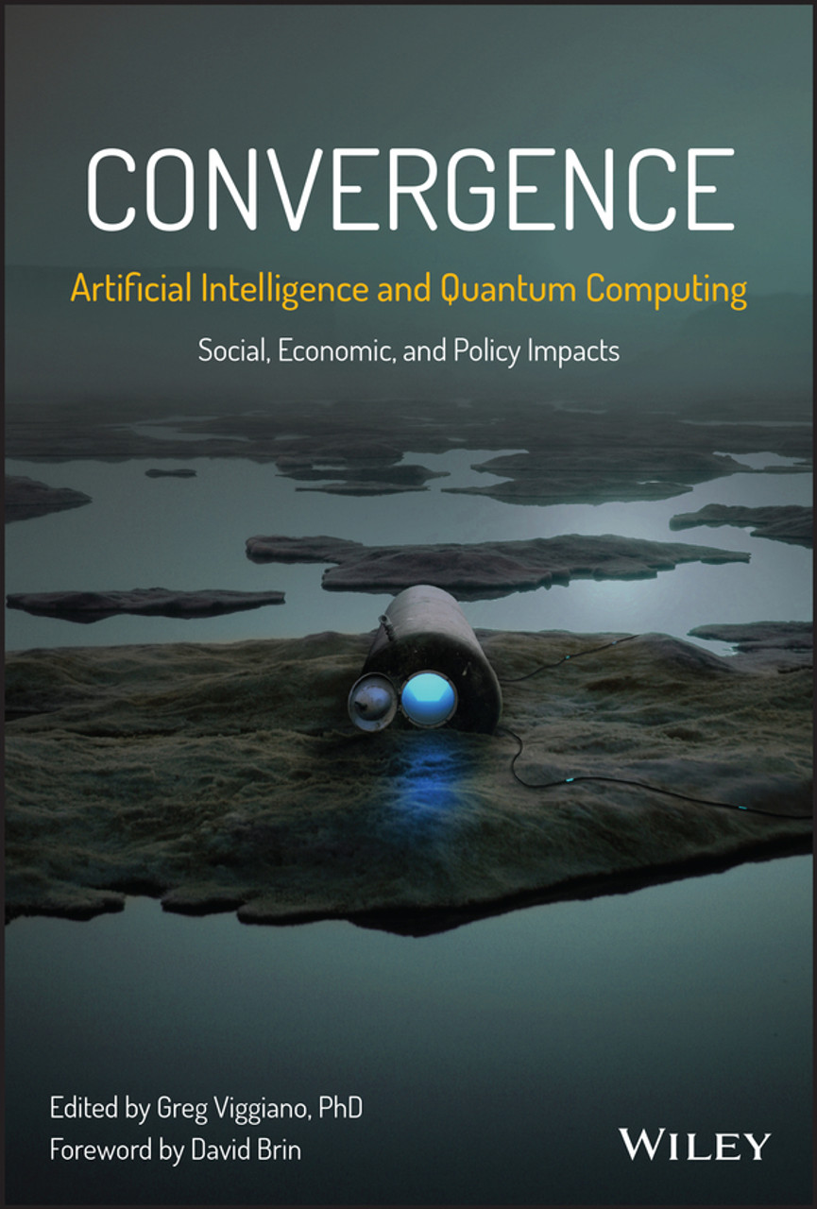
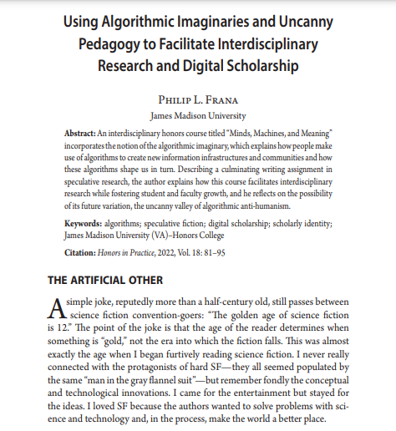
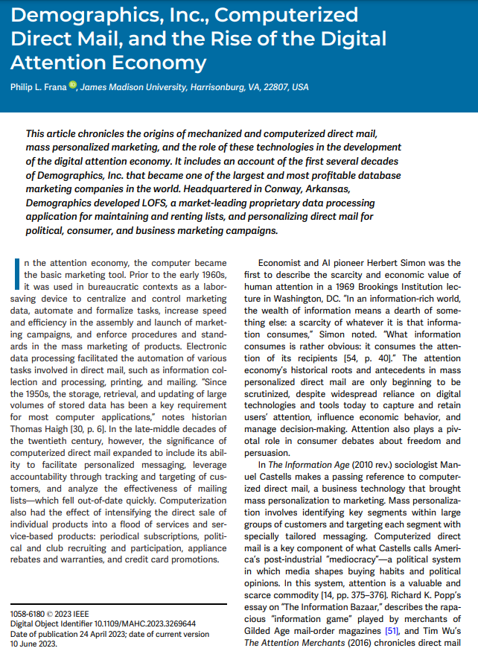
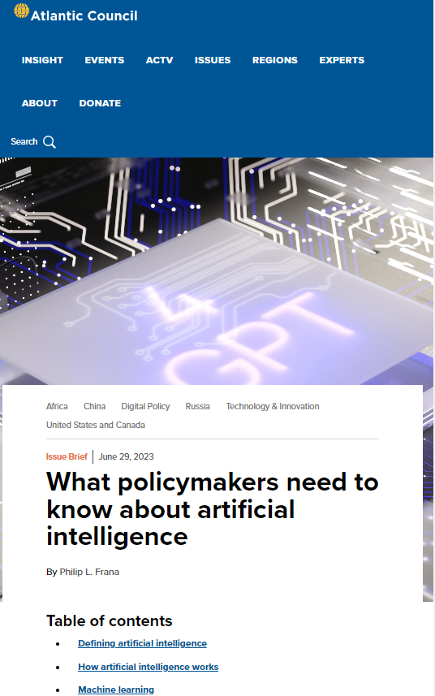
@ArtificialOther

Slide 3
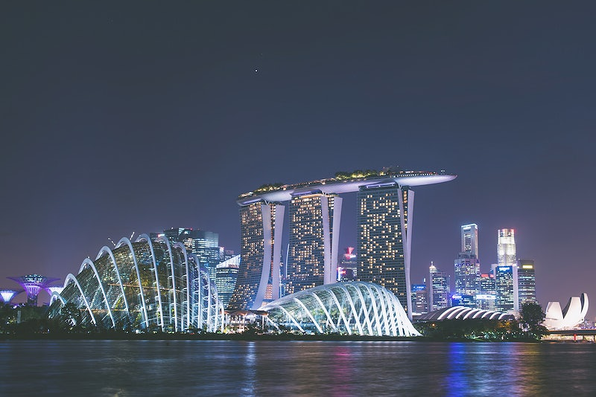
FAST FACTS ON SINGAPORE
CC0 1.0 Universal (CCO 1.0) Public Domain

Slide 4
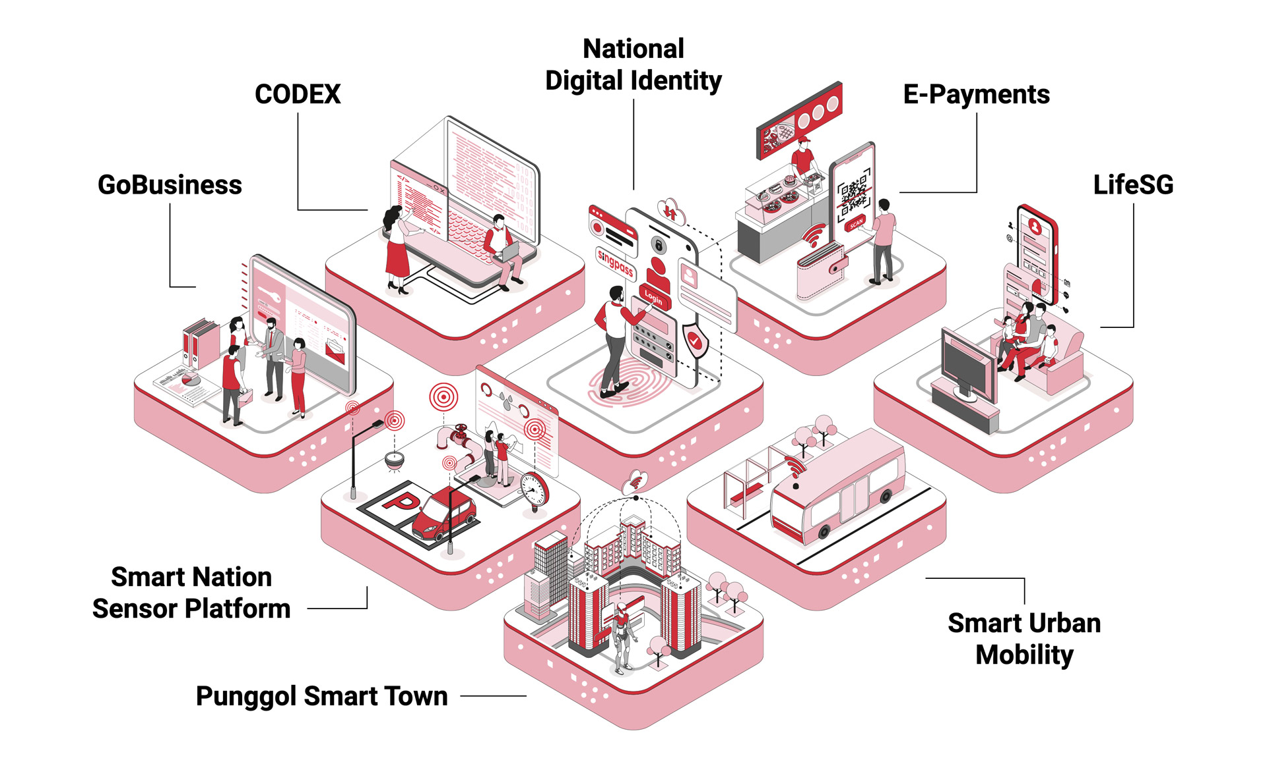

Slide 5
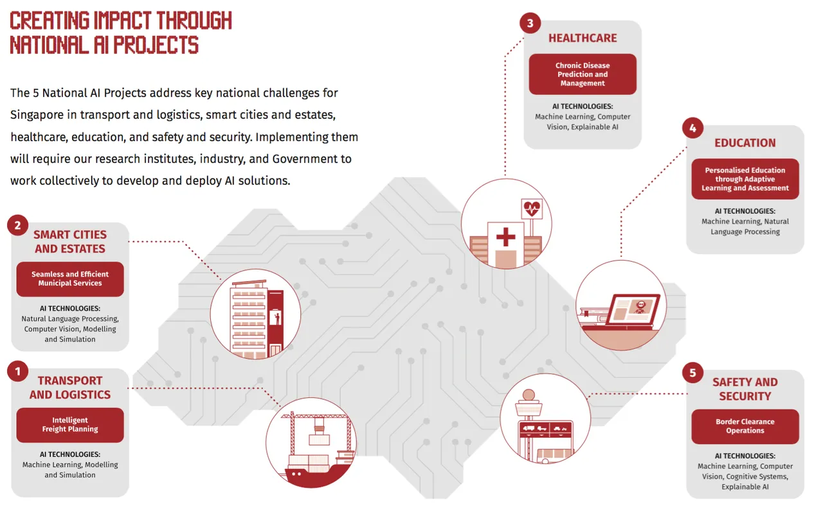
NATIONAL ARTIFICIAL INTELLIGENCE STRATEGY

Slide 6
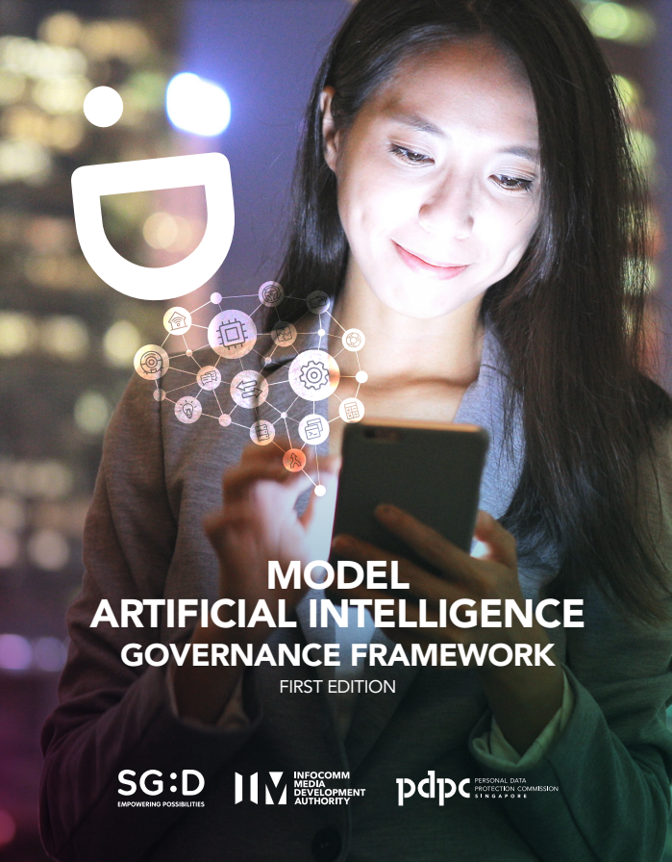
SG MODEL AI GOVERNANCE FRAMEWORK

Slide 7
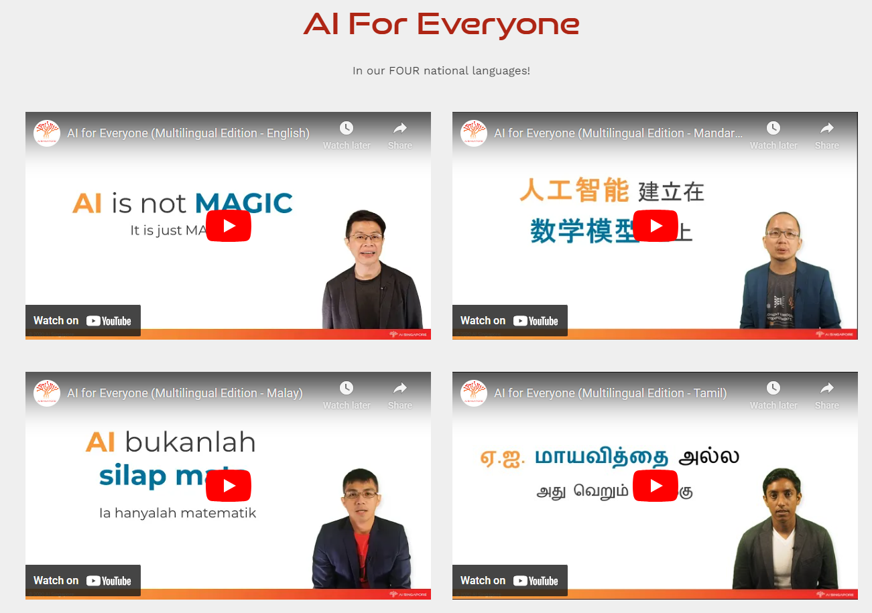
HUMAN-CENTRICITY

Slide 8
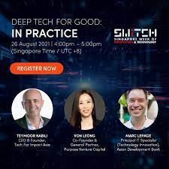
Deep Tech for Good

Slide 9
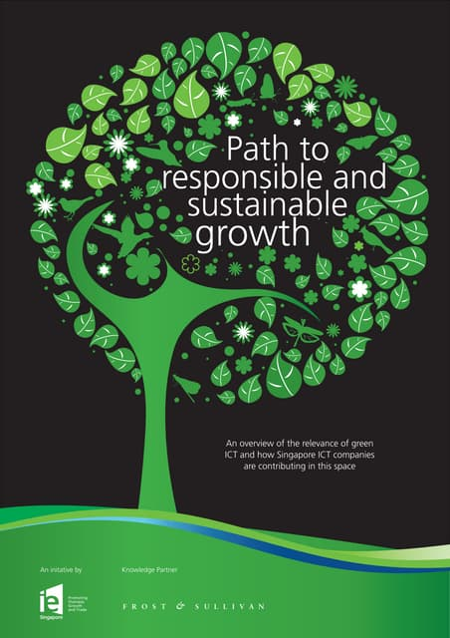
GREEN AI & ICT - INFOCOMM TECHNOLOGIES

Slide 10
Protection from Online Falsehoods and Manipulation (“Fake News”) Act
Invoked ~100 times since 2019 by all 14 Ministries
Correction notices and rebuttal letters accusing news media of misinformation and disinformation
Most notices are responses to criticism of government
Activist Jolovan Wham convicted and sentenced to jail time for posting:
“Malaysia’s judges are more independent than Singapore’s for cases with political implications”
Prime Minister Loong’s nephew fined $11,000 USD for making a private Facebook post that Singapore’s government is “very litigious and has a pliant court system”

Slide 11
IS SINGAPORE A MODEL TO FOLLOW?
YES
National AI Strategy
National Framework for Responsibility
AI for Everyone (AI4E)
Human-Centricity
Deep Tech for Good
Green ICT (InfoComm Tech)
NO
State Capitalism
Centralized Approach to AI Development, Innovation & Responsibility
State Regulation of Speech and Expression
Is the Smart City-State a Blueprint for an Intelligent Nation?

