Slide 1
Financial Aid
JMU 101 Session

Slide 2
Office of Financial Aid and Scholarships
Adrianna Penn
Steven Cox

Slide 3
2024-2025 FAFSA Delays
Brand new FAFSA for 2024-25!
Federal Student Aid (FSA) has experienced challenges and delays in implementation
Some students and parents cannot complete the FAFSA at this time due to ”bugs” in the application
If you have not been able to submit the FAFSA, please continue attempting to do so at www.studentaid.gov
Check the FAFSA Alerts Website for resolutions or “work arounds” to problems you may be experiencing
The process to make corrections to submitted FAFSA’s will be available sometime in March

Slide 4
2024-2025 FAFSA Delays
Any financial aid program with a “need” component in the eligibility criteria cannot be offered until FAFSA’s are received and processed
Federal, state, and institutional grants
Work-Study
Need-based loans
Need-based scholarships
Scholarships with combined merit and need components
This does not impact institutional merit-based scholarships

Slide 5
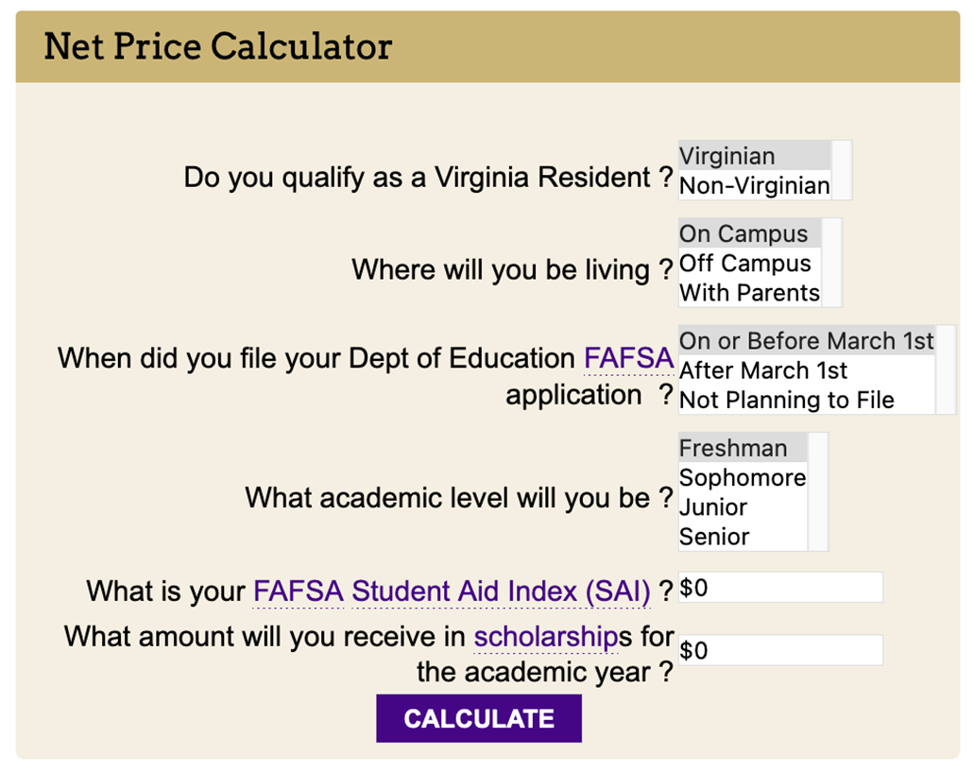
Net Price Calculator (NPC) Pathway: https://www.jmu.edu/financialaid/calculators/undergraduate.shtml
If you have a Student Aid Index (SAI) from a submitted 2024-25, you can use this tool
Your current SAI may not be accurate due to changes being made by FSA (the reason for the March delays)
Updated SAI’s will likely decrease (benefit the student) not increase
The NPC will give you an estimate of what your non-scholarship financial aid eligibility could be
The calculator does not include potential scholarship eligibility
This not a financial aid offer, but a tool to give you some insight into potential non-scholarship financial aid eligibility

Slide 6
Preliminary Aid Offer
Based on FAFSA Delays, we anticipate Preliminary Aid Offers to be available early to mid-April.
Will be emailed to the same e-mail address Admissions used to notify the student of their acceptance to JMU.
This is an estimate, as the 2024-2025 tuition/fees and room/board figures may not be set at the time the award is generated.
Students and parents cannot accept aid based on this offer
The offer will contain tentative eligibility for aid from:
Federal aid programs
State aid programs
JMU Scholarships (if you also have FAFSA related offers)
Official JMU scholarship notifications will come from individual campus departments
In late spring/early summer, preliminary financial aid offers will be canceled
New JMU students will receive:
Verification request to secure additional information to complete a final FAFSA review (generally in May), or
Official Financial Aid Offer (generally begins around the middle to end of June)

Slide 7
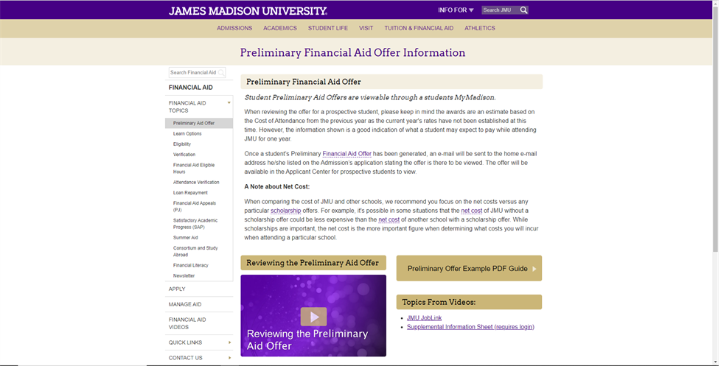
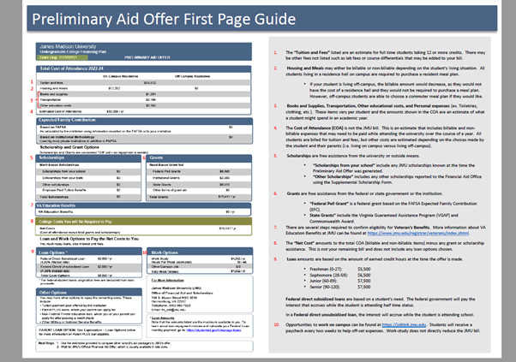
Preliminary Aid Offer
Pathway: www.jmu.edu/financialaid/learn/prelim-aid-offer.shtml

Slide 8
Special/Unusual Circumstances (Professional Judgement)
Special or Unusual Circumstances are situations where your life today looks very different than what is represented on the FAFSA (due to unexpected events)
Common situations include:
Loss or Change of Employment and/or Income
Abuse or abandonment
Large out-of-pocket medical expenses
Others
More can be found on our Financial Aid Appeals (Professional Judgment) website
Due to the impact of the FAFSA delays, we anticipate the earliest we may be able to start reviewing appeals is the end of May

Slide 9
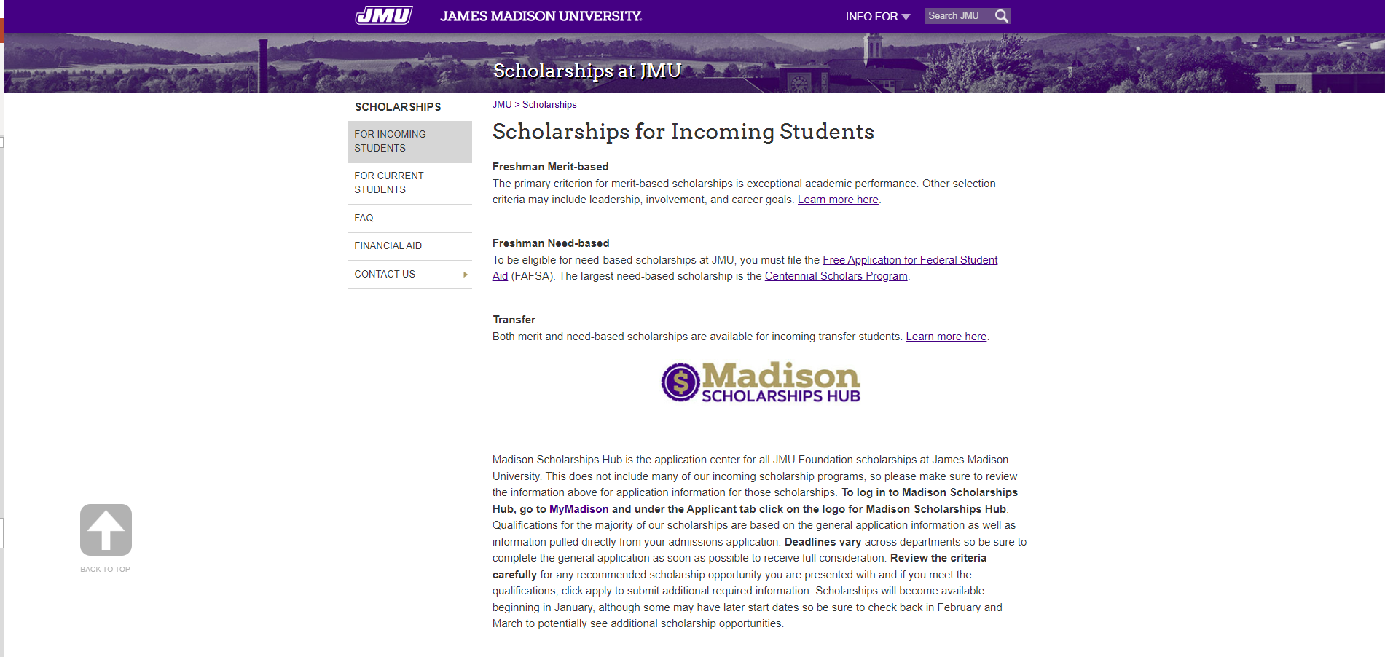
Scholarships
Official notification of scholarships offered by a University department will be sent to the student by that department
If you applied for financial aid using the FAFSA, the scholarship will be displayed on your Preliminary Financial Aid Offer as well
Scholarships offered through the Financial Aid Office will be displayed on the Preliminary Financial Aid Offer when it is generated
Scholarship selections for awards that have ”need” as any part of the criteria will be made after JMU begins receiving FAFSA data (anticipate sometime in March)

Slide 10
Private Scholarships
Private scholarships can originate from any non JMU source
You can find some private scholarship searches at www.jmu.edu/scholarships
If you receive a private scholarship, complete an online Supplemental Information Sheet to inform the financial aid office regarding your good fortune
According to state and federal regulations, we must consider outside sources of financial assistance when awarding aid

Slide 11
Timeline & What's Next
If you have not already done so, complete the 2024-2025 FAFSA asap!
Until Preliminary Aid Offers are available, use the Net Price Calculator for an estimate of non-scholarship financial aid.
Per FSA, schools should begin receiving FAFSA data in March.
Scholarship selections for awards with any "need" component will begin late March/Early April.
Preliminary Aid Offers sent to accepted students mid-April.

Slide 12
Contact Information
Office of Financial Aid and Scholarships
fin_aid@jmu.edu
540.568.7820
On the web at www.jmu.edu/financialaid

Slide 13
Questions?

