Slide 1
CHOICES Office of Financial Aid & Scholarships (April 2024)
PHONE: 540-568-7820
EMAIL: fin_aid@jmu.edu
Fax: 540-568-7994

Slide 2
2024-25 FAFSA Delays
Brand new FAFSA for 2024-25!
Federal Student Aid (FSA) has experienced challenges and delays in implementation
If you have not been able to submit the FAFSA, please continue attempting to do so at www.studentaid.gov
Check the FAFSA Alerts Website for resolutions or “work arounds” to problems you may be experiencing
ED stated the process for students to make corrections to submitted FAFSA’s will be available in “early April” (no timeline for school corrections)
Get your FSA ID at www.studentaid.gov a few days before you go to complete the FAFSA (it will make the completion process easier for many applicants)

Slide 3
March 1st FAFSA Priority Filing Date
JMU’s FAFSA Priority Filing Date is March 1st
This is a priority date, not a deadline
We encourage FAFSA completion as early as possible, even after March 1st
The number of applicants and fund availability will play a role in determining the types of financial aid awards we can offer to applicants who apply before or after March 1st
Certain types of aid will be offered as long as funds remain available to do so

Slide 4
2024-25 FAFSA Timeline
FAFSA is generally available October 1st (not until December 30th for 2024-25)
FSA was scheduled to send completed FAFSA’s to schools by the end of January
FSA changed the schedule to “first half of March” for schools to receive completed FAFSA’s
FSA has begun the process of sending FAFSA’s to schools
After they are caught up, should be on a normal timeline for processing

Slide 5
2024-25 FAFSA Delay Implications
Any financial aid program with a “need” component in the eligibility criteria cannot be offered until FAFSA’s are received and processed
Federal, state, and institutional grants
Work-Study
Need-based loans
Need-based scholarships
Scholarships with combined merit and need components
This does not impact institutional merit-based scholarships

Slide 6
JMU Free Application for Federal Student Aid (FAFSA) Changes Website
Federal Student Aid (FSA) Message about FAFSA delays
Net Price Calculator link
FAFSA Pro Tips
FAFSA Simplification Page
FSA ID Guidance
Frequently Asked Questions
Much more!

Slide 7
Preliminary Financial Aid Offer
Normally made in early February…based on FAFSA delays we anticipate this will be mid-April for 2024-25
E-mailed to the same e-mail address Admissions used to notify the student of his/her acceptance to JMU
This is an estimate, as the 2024-25 tuition/fees and room/board figures may not be set at the time the award is generated
Students and parents cannot accept aid based on this offer
Verification will not have been conducted

Slide 8
Preliminary Financial Aid Offer
The offer will contain tentative eligibility for aid from:
Federal aid programs
State aid programs
JMU Scholarships (if you also have FAFSA related offers)
Official JMU scholarship notifications will come from individual campus departments
In late spring/early summer, preliminary financial aid offers will be canceled
New JMU students will receive:
Verification request to secure additional information to complete a final FAFSA review (generally in May), or
Official Financial Aid Offer (generally begins around the middle to end of June)

Slide 9
Net Price Calculator (NPC) (Until Preliminary Aid Offers can be generated)
If you have a Student Aid Index (SAI) from a submitted 2024-25, you can use this tool
Your current SAI may not be accurate due to changes being made by FSA (the reason for the March delays)
Updated SAI’s will likely decrease (benefit the student) not increase
The NPC will give you an estimate of what your non-scholarship financial aid eligibility could be
The calculator does not include potential scholarship eligibility
This not a financial aid offer, but a tool to give you some insight into potential non-scholarship financial aid eligibility

Slide 10
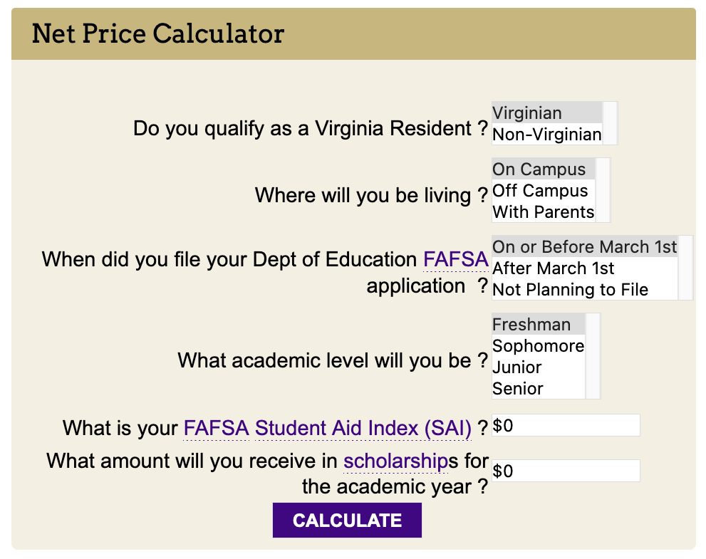
Net Price Calculator
If you are unable to complete a FAFSA at this time to receive a Student Aid Index (SAI), you can go to https://studentaid.gov/aid-estimator/ to get an estimated SAI to use in the Net Price Calculator.

Slide 11
Net Costs Are Important
Once you begin to receive aid offers from institutions, the comparison process begins!
Pay close attention to net costs versus focusing on dollar amount of the grants or scholarships
The lower the net costs, the less expensive the institution

Slide 12
Special/Unusual Circumstances (Professional Judgment)
Special or Unusual Circumstances are situations where your life today looks very different than what is represented on the FAFSA (due to unexpected events)
Common situations include:
Loss or Change of Employment and/or Income
Abuse or abandonment
Large out-of-pocket medical expenses
Others
More can be found on our Financial Aid Appeals (Professional Judgment) website
Due to the impact of the FAFSA delays, we anticipate the earliest we may be able to start reviewing appeals is the end of May

Slide 13
Prospective Student Scholarships www.jmu.edu/scholarships
Admissions & University Departments
Dingledine-Bluestone Scholarship for Achievement in Academics and Service
Madison Award for Academic Excellence
Second Century Scholars Scholarship Program
Centennial Scholarship Program
Foundation Scholarships
Departmental Scholarships
Financial Aid
Various scholarships using The Madison Scholarships Hub

Slide 14
Scholarship Notification
Official notification of scholarships offered by a University department will be sent to the student by that department
If you applied for financial aid using the FAFSA, the scholarship will be displayed on your Preliminary Financial Aid Offer as well
Scholarships offered through the Financial Aid Office will be displayed on the Preliminary Financial Aid Offer when it is generated
Early Action students selected for a merit-based scholarship will have been notified by the end of February
Scholarship selections for awards that have ”need” as any part of the criteria will be made after JMU begins receiving FAFSA data (anticipate sometime in March)

Slide 15
Private Scholarships
Private scholarships can originate from any non JMU source
You can find some private scholarship searches at www.jmu.edu/scholarships
If you receive a private scholarship, complete an online Supplemental Information Sheet to inform the financial aid office regarding your good fortune
According to state and federal regulations, we must consider outside sources of financial assistance when awarding aid

Slide 16
Official Financial Aid Offer
In the middle to end of June, we anticipate sending committed students an Official Financial Aid Offer (after the preliminary process)
These offers are sent electronically to the student’s JMU e-mail address (note the change from the Preliminary process)
Parents will receive a separate offer regarding Parent PLUS Direct Loan eligibility
These offers are sent to the parental e-mail address listed on the FAFSA
Each offer will contain instructions for how to accept or decline the offered aid
Students will do this through MyMadison
Parents will do this through www.studentaid.gov, after receipt of the Official Offer

Slide 17
Timeline Summary Based on FAFSA Delays
Get FAFSA completed asap!
Use the Net Price Calculator for an estimate of non-scholarship financial aid
Merit-based scholarship notifications sent to Early Action students by the end of February
Schools are receiving FASFA’s now (extensive testing being conducted)
Scholarship selection for awards with any sort of “need” component will begin in mid-April
Anticipated timeline to send preliminary financial aid offers to accepted students is mid-April

Slide 18
Helpful Tools www.jmu.edu/financialaid
“Choices – Financial Aid Presentation”
”Prospective Student Scholarships” video
Quick Links - Terms & Conditions – Consumer Information”
Review information under the “Learn” section
FAFSA Changes Website link

Slide 19
Questions?
If you have any questions, please do not hesitate to contact our office via one of the following methods:
In person on the 5th floor of the Student Success Center
By phone at (540) 568-7820
Email: fin_aid@jmu.edu
On the web at www.jmu.edu/financialaid

