Slide 1
JMU U. S. Bank Prepaid Card Programs
Training for JMU Employees
April 2024

Slide 2

Acronyms and Definitions
Approving Authority – President, VP, AVP, Dean, Asst/Assoc Dean, Director or AUH for that DeptID
CI – Cash and Investments Office
EC – Event Coordinator
FPM – Financial Procedures Manual
PI – Principal Investigator
OSP – Sponsored Programs/Financial Services
SC – Study Coordinator
UBO – University Business Office

Slide 3
Participant Payments by card are more efficient
JMU maintains balance with US Bank
Cards issued to Participants
Payment issued directly to card

Slide 4
Shared Responsibilities
EC/PI/SC
Obtains participant information
Delivers Cards – only request cards distributed in person
CI
Assigns unfunded cards to Research/Event Managers
Funds payment requests to cards
UBO
Issues cards assigned by CI to Research/Event Manager
Accepts unused cards from Research/Event Manager back in to inventory
Communicates participation/payment request to CI
Point of contact for campus card programs
Maintains funding balance with US Bank and card inventory
Requests cards from CI and picks up from UBO [cannot approve own orders]
Manages card inventory and payment requests

Slide 5
JMU U.S. Bank Corporate Rewards Prepaid Card
Research, Prize, Incentive Participant Payments and one-time student per diems for travel.

Slide 6
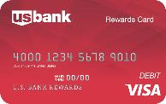
JMU U.S. Bank Corporate Rewards Card Program
Single Use Cards.
No ATM/cash access.
CI Processing deadline is 11am daily.
Mailed cards sent by bank [only] to cardholder – JMU employees DO NOT mail cards.
Minimum load $10.
Cards funded upon receipt of the JMU Prepaid Card Order Form and the U.S. Bank Corporate Rewards Load Spreadsheet. Log also required when cards are distributed in person.
Funds belong to the cardholder and cannot be removed by JMU once loaded.
Cardholder activates their own card. JMU employees do not open card envelopes.

Slide 7
Process - Incentives
Complete this training and related survey.
JMU Prepaid Payment Card Order Form completed and submitted for incentives.
CI reviews order.
CI notifies Requestor and UBO of scheduled card distribution date in UBO.
Requestor picks up cards from UBO & maintains control of card inventory.)
Requestor distributes cards and completes appropriate log.
Requestor completes Load Spreadsheet(s) and submits to CI to facilitate card funding and/or ordering of personalized cards to be mailed by bank.
  Departments are not to mail cards directly to recipients.
  Requestor submits completed card log(s) and W-9’s and/or W-8’s to CI. These are required each time a recipient receives $100 or more regardless of whether or not the recipient has previously completed a W-9.
CI reviews for completeness and funds cards.
DeptID# charged for total of cards funded by CI.
  Copy of accounting voucher charging department is provided to requestor.
    Requestor to share this information with appropriate departmental fiscal admin.

Slide 8
Process – Student Per Diems
JMU US Bank Corporate Rewards Prepaid Payment Card form is completed and submitted for student per diems (submit to prepaidcards@jmu.edu).
CI reviews order.
CI notifies Requestor and UBO of scheduled card distribution date in UBO.
Student receiving per diem funding picks up their own card (NO EXCEPTIONS).
  Pick up is within (5) days of travel and no later than 11am (1) business day before departure date.
UBO advises CI when cards are picked up.
CI reviews for completeness and funds cards.
DeptID# charged for total of cards funded by CI.

Slide 9
Completed Prepaid Payment Card Order Form
Complete all fields.
Do NOT alter forms, altered forms will not be accepted.
If working off-campus, include phone # where you can be reached.
Be sure to enter IRB approval date and IRB protocol #, if applicable.
Enter specific card request date. Allow five business days for order fulfillment (from time received by Cash & Investments).
EC/PI/SC obtains applicable OSP Financial Services and FAO approvals.
Request cards for only one participant payment type, Instant Issue or Personalized Rewards cards, and one event/project per form. Personalized cards are not issued with this request.
  This order alerts Cash & Investments that the JMU U.S. Bank Corporate Rewards Load Spreadsheet requesting personalized cards to be funded and mailed is pending.
Cards requested and funded that are not used as expected will require reimbursement from non-state/university funds. Be sure to review procedures first.
Direct all prepaid card order questions/communications to prepaidcards@jmu.edu.
This form is used for the Rewards Visa Card and the Focus Blue Reloadable Visa Card (not used for per diem funding).

Slide 10
Completed Departmental Prepaid Card Log (U. S. Bank Rewards Cards only)
Provided by CI when cards are picked up from UBO.
IRB/Event name and ATTMID will be prefilled.
Complete all remaining fields.
The second ‘Received by’ column requires signature of participant receiving card.
All signatures required.
Direct all prepaid card order questions/communications to prepaidcards@jmu.edu.
This form is used for the Rewards Visa Card only.
Do NOT alter forms, altered forms will not be accepted.

Slide 11
Complete JMU U.S. Bank Corporate Rewards Load Spreadsheet
Complete all required fields.
Do NOT alter forms, altered forms will not be accepted.
If working off-campus, include phone # where you can be reached.
Be sure to enter IRB protocol # or event name.
Submit a separate form per event/project. This form is to request funding of cards you have received and distributed and/or cards to be mailed to recipients.
Submit completed card log and W-9’s and/or W-8’s to CI with the load spreadsheet. W-9’s are required each time a recipient receives $100 or more.
Direct all prepaid card order questions and communications to prepaidcards@jmu.edu.
This form is used for the Rewards Visa Card (one-time funding) only.
  Funding for anonymous cards distributed in person and for personalized cards to be mailed by the bank are requested with this form.

Slide 12
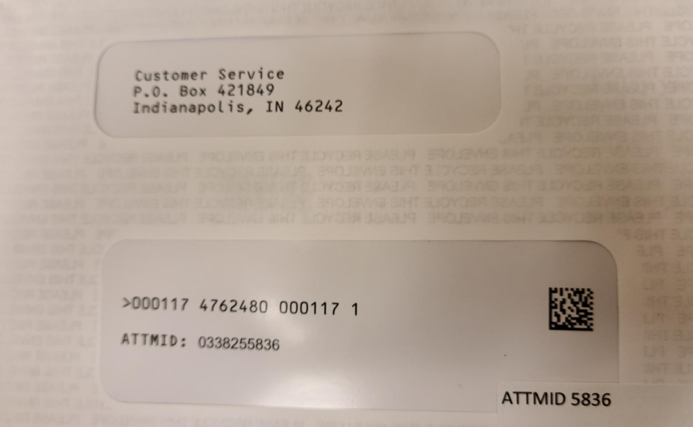
Important Detail: Customer ID
Customer ID is NOT the Prepaid Card Number. Customer ID = the ATTMID.
ATTMID is located on the front of the envelope that holds the card. (Sticker at bottom of address window.)
JMU staff will not have access to the Prepaid Card Number. (Do not open the envelope.)

Slide 13
JMU Prepaid Card Monthly Reconciliation
This form is used for the Rewards Visa Card and the Focus Blue Reloadable Visa Card.
Use separate form for each type of prepaid program.
Complete all fields.
Do NOT alter forms, altered forms will not be accepted.
Subject to audit at any time.
Submit annually to Cash and Investments within 10 business days of closing event or by July 15th for the previous fiscal year.
Direct all prepaid card order questions/communications to prepaidcards@jmu.edu.

Slide 14
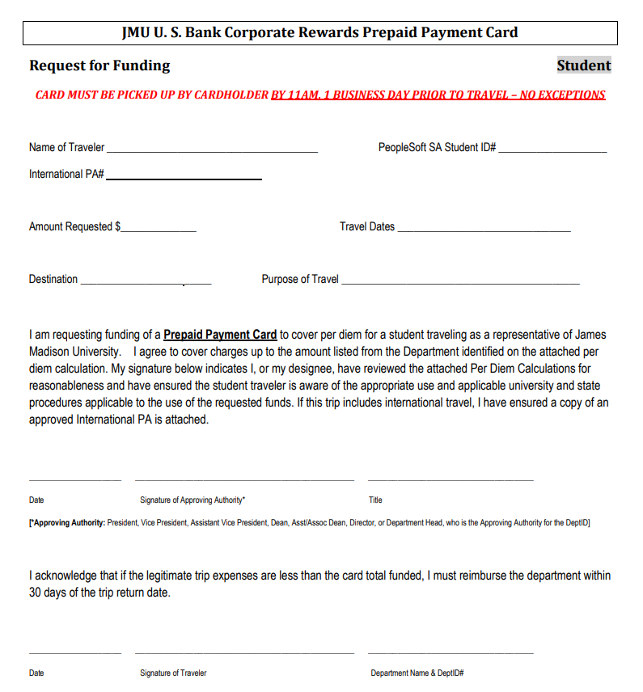
Student Per Diem Card Funding
Completed Request for Funding required for each student receiving per diem card.
Due no less than 5 business days prior to travel date. Card must be picked up no later than 11am one business day prior to departure date.
Cards may only be picked up by student receiving funding (no exceptions).

Slide 15
U.S. Bank Focus Blue Reloadable Visa Card
Research incentives for recurring participation/payment milestones and recurring per-diems for student groups in travel status (only for established student teams involving recurring travel per diems and with advanced approval from Cash and Investments).

Slide 16
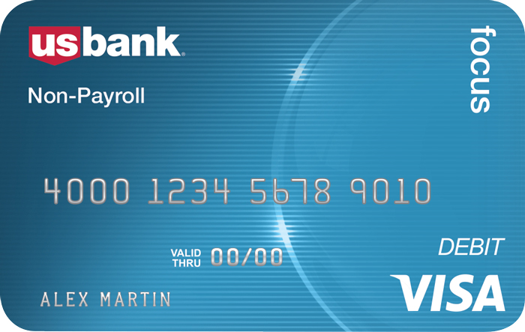
Prepaid Card Program Details:
JMU U.S. Bank Focus Blue Reloadable Card Program
Reloadable
ATM/cash access
Mobile banking and alerts available.
CI Processing deadline is 11am daily.
All research incentive cards must be distributed in person.
Minimum load $10.
Date of birth (cardholder) required.
Cards funded upon receipt of the JMU U.S. Bank Focus Blue Fund/Order Spreadsheet.
Funds belong to cardholder and cannot be removed by JMU once loaded.
Cardholder activates their own card. JMU employees do not open card envelopes.

Slide 17
Process
EC/PI/SC completes this training and related survey.
JMU Prepaid Payment Card Order Form completed and submitted.
CI reviews order.
CI notifies EC/PI/SC and UBO of scheduled card distribution date in UBO.
EC/PI/SC picks up cards from UBO. (EC/PI/SC maintains control of card inventory.)
EC/PI/SC distributes cards and completes appropriate log.
EC/PI/SC completes Fund/Order Spreadsheet and submits to CI.
ED/PI/SC submits completed W-9’s and/or W-8’s (W-9 required each time a recipient receives $100+ and Foreign Nationals require completed W-8 regardless of incentive amount, each time).
CI reviews for completeness and funds cards.
DeptID# charged for total of cards funded by CI.

Slide 18
U.S. Bank Focus Blue Reloadable Visa Card – Individuals (Research, Team Per diems and Incentives)
Personalized and Reloadable
  Used for study’s with participation/payment milestones or incentives for on-going participation programs.
  Personalized (Anonymous available for limited circumstances)
    Distributed in person PI/SC.
    EC requested cards may be mailed by bank depending upon program scenario.
  Date of Birth (DOB) required to ensure cardholder security.
  Disclosure required for research participants (Provided by CI).
Card orders due ten days prior to requested card pick-up date.
Cards loaded upon receipt of Funding Request (within one business day).
Funds belong to cardholder and cannot be removed by JMU once loaded.

Slide 19
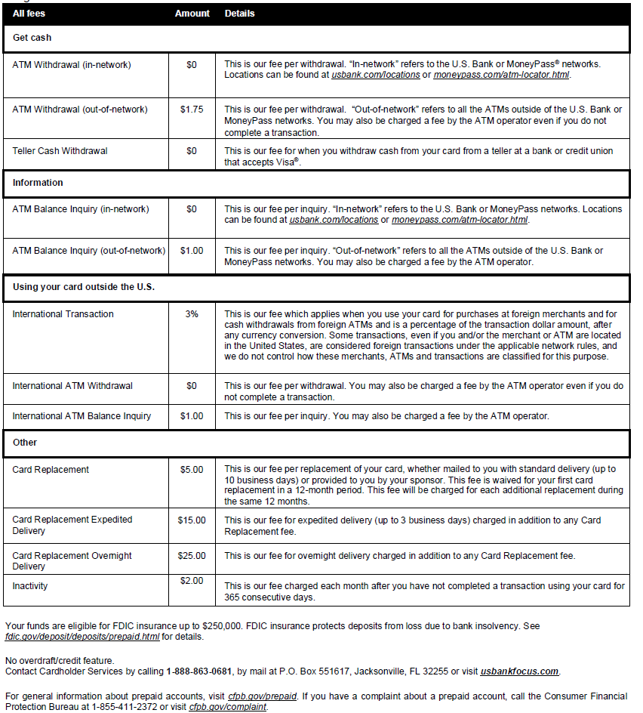
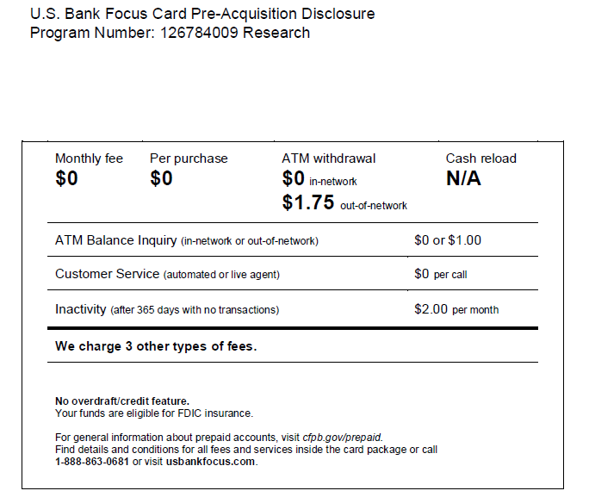
Disclosure distribution required for cardholders participating in research studies. Provided by CI.

Slide 20
Completed Prepaid Payment Card Order Form
Complete all fields.
If working off-campus, include phone # where you can be reached.
Be sure to enter IRB approval date and IRB protocol #, if applicable.
Enter specific card request date. Allow five business days for order fulfillment.
Obtain applicable OSP Financial Services and FAO approvals.
Request cards for only one participant payment type, Focus Blue Reloadable cards, and one event/project per form.
Cards requested and funded that are not used as expected will require reimbursement from non-state/university funds. Be sure to review procedures first.
Direct all prepaid card order questions/communications to prepaidcards@jmu.edu.
This form is used for the Rewards Visa Card and the Focus Blue Reloadable Visa Card.

Slide 21
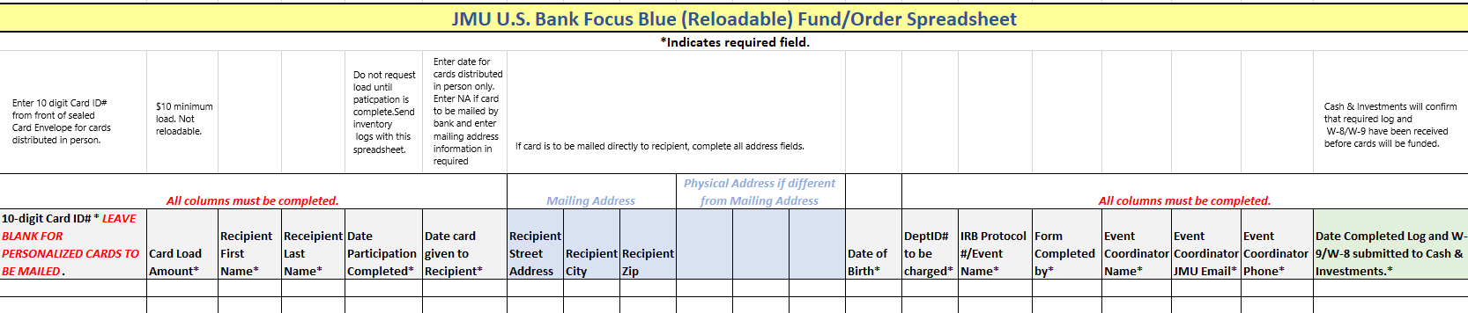
Completed Prepaid Payment Card Order Form
Complete all required fields and do not modify form.
If working off-campus, include phone # where you can be reached.
Be sure to enter IRB protocol # or event name.
Submit one form per event/project per form. This form is to request funding of cards you have received and distributed and/or cards to be mailed to recipients.
Direct all prepaid card order questions and communications to prepaidcards@jmu.edu.
This form is used for the Focus Blue Card (reloadable) only.

Slide 22
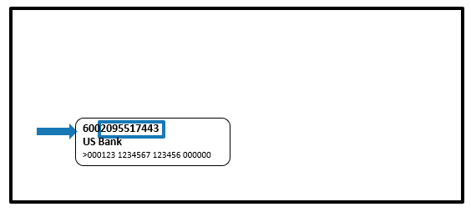
Card information for funding requests
Card ID# is NOT the number embossed on the card
Card ID# is located on the front of the envelope that holds the card. (Last 10 digits of the 13 digit number at top of envelope window.)
JMU staff will not have access to the embossed card number. Do not open envelope.
  10-digit Card ID: Used for card funding requests
    Anonymous cards – last 10 digits as shown below
    Personalized cards – CI provides this information to the contact person for use on the Focus Blue Fund/Order Spreadsheet once the cards have been created.

Slide 23
Completed Departmental Prepaid Card Log (U. S. Bank Focus Blue Cards only)
Provided by CI when cards are picked up from UBO.
Complete all fields.
The first ‘Date and Received by’ column requires signature of the JMU employee picking up the cards and the second ‘Date and Received by’ column requires signature of the recipient.
Do NOT alter forms, altered forms will not be accepted.
All signatures are required to be complete.
Direct all prepaid card order questions/communications to prepaidcards@jmu.edu.
This form is used for the Focus Blue Cards only.

Slide 24
JMU Prepaid Card Monthly Reconciliation
This form is used for the Rewards Visa Card and the Focus Blue Reloadable Visa Card.
Use separate form for each prepaid program.
Complete all fields.
Subject to audit at any time.
Submit annually to Cash and Investments within 10 business days of closing event or by July 15th for the previous fiscal year.
Direct all prepaid card order questions/communications to prepaidcards@jmu.edu.

Slide 25
U.S. Bank Focus Blue Reloadable Visa Card – Team Use with approval from Cash & Investments
Personalized and Reloadable
  Used for approved teams and student groups requiring per diem cards (with advanced approval). Contact the Cash & Investments Director at leethtc@jmu.edu or 568.3205.
  Card order and funding process differs for team use. Ordering/Funding templates will be provided on a team by team basis.
  Personalized
    In-person card distribution is preferred.
    Cards may be mailed by bank depending upon program details and upon receipt of required cardholder agreement.
    Date of Birth (DOB) required to ensure cardholder security.
Used in accordance with the JMU FPM subsection 4215.530: https://www.jmu.edu/financemanual/procedures/4215.shtml#.530-payment-by-u.-s.-bank-focus-blue-prepaid-card---team-travel
Card orders are due at least 10 business days prior to requested card pick-up date.
Cards are loaded within one business day, upon receipt of completing funding template (template provided by Cash & Investments).
Funds belong to cardholder once loaded.

Slide 26
Thank you for completing the JMU U.S. Bank Prepaid Card Training
All EC/PI/SC’s must complete survey at link below before requesting U.S. Bank prepaid cards:
https://jmu.questionpro.com/t/AQkuQZy2WT
Cash and Investments will confirm this requirement has been satisfied before processing card orders.
Questions? Please contact prepaidcards@jmu.edu and someone from Cash and Investments will reach out to you.

