Slide 1
JMU U. S. Bank Corporate Rewards Prepaid Card Program
Prepaid Rewards Card - Training for JMU Employees
June 2023

Slide 2

Acronyms and Definitions
Approving Authority – President, VP, AVP, Dean, Asst/Assoc Dean, Director or AUH for that DeptID
CI – Cash and Investments Office
EC – Event Coordinator
FPM – Financial Procedures Manual
PI – Principal Investigator
OSP – Sponsored Programs/Financial Services
SC – Study Coordinator
UBO – University Business Office

Slide 3
Participant Payments by card are more efficient
JMU maintains balance with US Bank
Cards issued to Participants
Payment issued directly to card

Slide 4
Shared Responsibilities
EC/PI/SC
Obtains participant information
Delivers Card – only request cards distributed in person, mailed cards will be mailed by bank to cardholder
CI
Assigns unfunded cards to Research/Event Managers
Funds payment requests to cards
UBO
Issues cards assigned by CI to Research/Event Manager
Accepts unused cards from Research/Event Manager back into inventory
Communicates participation/payment request to CI
Point of contact for campus card programs
Maintains funding balance with US Bank and card inventory
Requests cards from CI and picks up from UBO (except student per diem cards which must be picked up in person by the student from UBO).
Manages card inventory and payment requests

Slide 5
JMU Procedure
EC/PI/SC reviews and complies. Failure to do so will delay/cancel requests.
FPM 4205.390-4205.395: https://www.jmu.edu/financemanual/procedures/4205.shtml#.390-miscellaneous-payments-to-individuals/participant-payments {Incentives/Prizes]
FPM 4215.540: https://www.jmu.edu/financemanual/procedures/4215.shtml#.540-payment-by-prepaid-payment-card [Student Travel Per diem Cards}
EC/PC/SC requesting cards is responsible for following procedures, maintaining control of card inventory and ensuring all involved complete training prior to managing cards. {Incentives/Prizes]
EC/PI/SC expected to coordinate with OSP Financial Services for Sponsored Program funding.
EC/PI/SC expected to coordinate with Financial Aid Office as appropriate.
EC/PI/SC expected to obtain and submit completed W-9’s as required.
EC/PI/SC cannot approve their own order(s).

Slide 6
Responsibilities – Incentive/Prizes
EC/PI/SC and Approving Authority acknowledge and agree to maintain control and limited access of requested cards, inventory of cards and to timely submission of completed log(s).
All parties agree to request/authorize only the appropriate quantity of cards reasonably expected to be distributed within 60 days, and to return cards not distributed within 10 business days of end date stated on the Prepaid Payment Card Order Form or 60 days after receipt, to the UBO.
  Departments agree to work with CI to resolve errors
CI will audit card inventory and control procedures as appropriate.
Departments failing to comply may not be eligible for future prepaid card orders/funding.

Slide 7
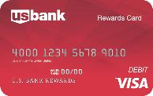
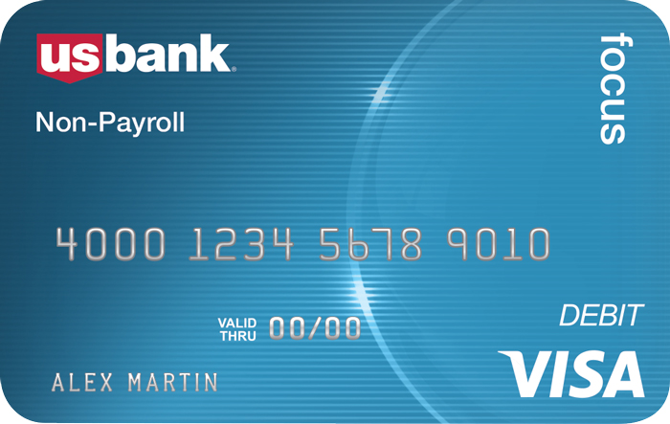
Prepaid Card Program Details:
JMU U.S. Bank Corporate Rewards Card Program
JMU U.S. Bank Focus Blue Reloadable Card Program
Reloadable
ATM/cash access
Mobile app and alerts available
CI Processing deadline is 11am daily.
Mailed cards sent by bank [only] to cardholder.
Minimum load $10
Date of birth (cardholder) required.
Cards funded upon receipt of the JMU U.S. Bank Focus Blue Fund/Order Spreadsheet.
Funds belong to cardholder and cannot be removed by JMU once loaded.
Cardholder activates their own card. JMU employees do not open card envelopes.
Single Use Cards
No ATM/cash access
CI Processing deadline is 11am daily.
Mailed cards sent by bank [only] to cardholder.
Minimum load $10
Cards funded upon receipt of the JMU U.S. Bank Corporate Rewards Load Spreadsheet or the Request for Funding (individual student per diem cards only).
Funds belong to cardholder and cannot be removed by JMU once loaded.
Cardholder activates their own card. JMU employees do not open card envelopes.

Slide 8
Process – Incentives & Prizes
EC/PI/SC completes this training and related survey.
JMU Prepaid Payment Card Order Form completed and submitted for incentives.
CI reviews order.
CI notifies EC/PI/SC and UBO of scheduled card distribution date in UBO.
EC/PI/SC picks up cards from UBO. (EC/PI/SC maintains control of card inventory.)
EC/PI/SC distributes cards and completes appropriate log.
EC/PI/SC completes Load Spreadsheet and submits to CI to facilitate card funding and/or ordering of personalized cards to be mailed by bank.
ED/PI/SC submits completed card log and W-9’s and/or W-8’s to CI
CI reviews for completeness and funds cards.
DeptID# charged for total of cards funded by CI.

Slide 9
Process – Student Per Diems
EC/PI/SC completes this training and related survey.
Request for Funding completed and submitted for student per diems.
CI reviews order.
CI notifies EC/PI/SC and UBO of scheduled card distribution date in UBO.
Student receiving per diem funding picks up their own card (NO EXCEPTIONS).
UBO advises CI when cards are picked up.
CI reviews for completeness and funds cards based on travel dates indicated on Request for Funding.
DeptID# charged for total of cards funded by CI.

Slide 10
JMU U.S. Bank Corporate Rewards Prepaid Card
Research, Prize, Incentive Participant Payments and one-time student per diems for travel (if no other option available).

Slide 11
JMU U.S. Bank Corporate Rewards Prepaid Card
Two options:
  Instant Issue, Anonymous cards distributed in person by EC/PI/SC, one-time funding only. (Preference for student travel per diems is via Chrome River reimbursement, however per diem cards for student travel are distributed by UBO to each individual student and cannot be mailed.)
  Personalized, Mailed to recipient directly from U.S. Bank.
    Delivered within 7-10 business days.
Used for Incentives in accordance with the JMU FPM subsections 4205.390-4205.395 https://www.jmu.edu/financemanual/procedures/4205.shtml#.390-miscellaneous-payments-to-individuals/participant-payments
Used for student per diems in accordance with JMU FPM subsection FPM 4215.540: https://www.jmu.edu/financemanual/procedures/4215.shtml#.540-payment-by-prepaid-payment-card
Card orders due five days prior to requested card pick-up date.
  Only EC/PI/SC are authorized to pick up incentive cards.
Incentive cards funded upon receipt of the JMU U.S. Bank Corporate Rewards Load Spreadsheet and applicable W-9/W-8’s (within one business day).
Student per diem cards funded to correspond with departure date and only when picked up by 11am one business day prior to departure date.
Funds belong to cardholder and cannot be removed by JMU once loaded.

Slide 12
Completed Prepaid Payment Card Order Form
Complete all fields. This form is not required for student per diem card requests.
Do NOT alter forms, altered forms will not be accepted.
If working off-campus, include phone # where you can be reached.
Be sure to enter IRB approval date and IRB protocol #, if applicable.
Enter specific card request date. Allow five business days for order fulfillment (from time received by Cash & Investments).
EC/PI/SC obtains applicable OSP Financial Services and FAO approvals.
Request cards for only one participant payment type, Instant Issue or Personalized Rewards cards, and one event/project per form. Personalized cards are not issued with this request.
  This order alerts Cash & Investments that the JMU U.S. Bank Corporate Rewards Load Spreadsheet requesting personalized cards to be funded and mailed is pending.
Cards requested and funded that are not used as expected will require reimbursement from non-state/university funds. Be sure to review procedures first.
Direct all prepaid card order questions/communications to prepaidcards@jmu.edu.
This form is used for the Rewards Visa Card and the Focus Blue Reloadable Visa Card.

Slide 13
Completed Departmental Prepaid Card Log (U. S. Bank Rewards Cards only)
Provided by CI when cards are picked up from UBO.
IRB/Event name and ATTMID will be prefilled.
Complete all remaining fields.
The second ‘Received by’ column requires signature of participant receiving card.
All signatures required.
Direct all prepaid card order questions/communications to prepaidcards@jmu.edu.
This form is used for the Rewards Visa Card only.
Do NOT alter forms, altered forms will not be accepted.

Slide 14
Complete JMU U.S. Bank Corporate Rewards Load Spreadsheet
Complete all required fields.
Do NOT alter forms, altered forms will not be accepted.
If working off-campus, include phone # where you can be reached.
Be sure to enter IRB protocol # or event name.
Submit a separate form per event/project. This form is to request funding of cards you have received and distributed and/or cards to be mailed to recipients.
Submit completed card log and W-9’s and/or W-8’s to CI with the load spreadsheet.
Direct all prepaid card order questions and communications to prepaidcards@jmu.edu.
This form is used for the Rewards Visa Card to fund Participant and Incentive (one-time funding) only.
  Funding for anonymous cards distributed in person and for personalized cards to be mailed by the bank are requested with this form.

Slide 15
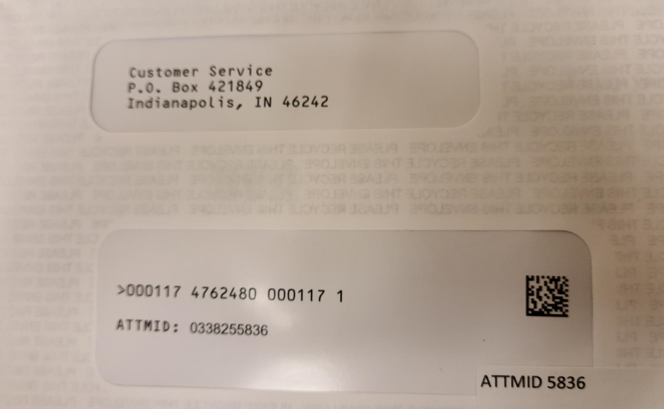
Important Detail: Customer ID
Customer ID is NOT the Prepaid Card Number. Customer ID = the ATTMID.
ATTMID is located on the front of the envelope that holds the card. (Sticker at bottom of address window.)
JMU staff will not have access to the Prepaid Card Number. (Do not open the envelope.)

Slide 16
JMU Prepaid Card Monthly Reconciliation
This form is used for the Rewards Visa Card and the Focus Blue Reloadable Visa Card (not used for student per diem cards).
Use separate form for each type of prepaid program.
Complete all fields.
Do NOT alter forms, altered forms will not be accepted.
Subject to audit at any time.
Submit annually to Cash and Investments within 10 business days of closing event or by July 15th for the previous fiscal year.
Direct all prepaid card order questions/communications to prepaidcards@jmu.edu.

Slide 17
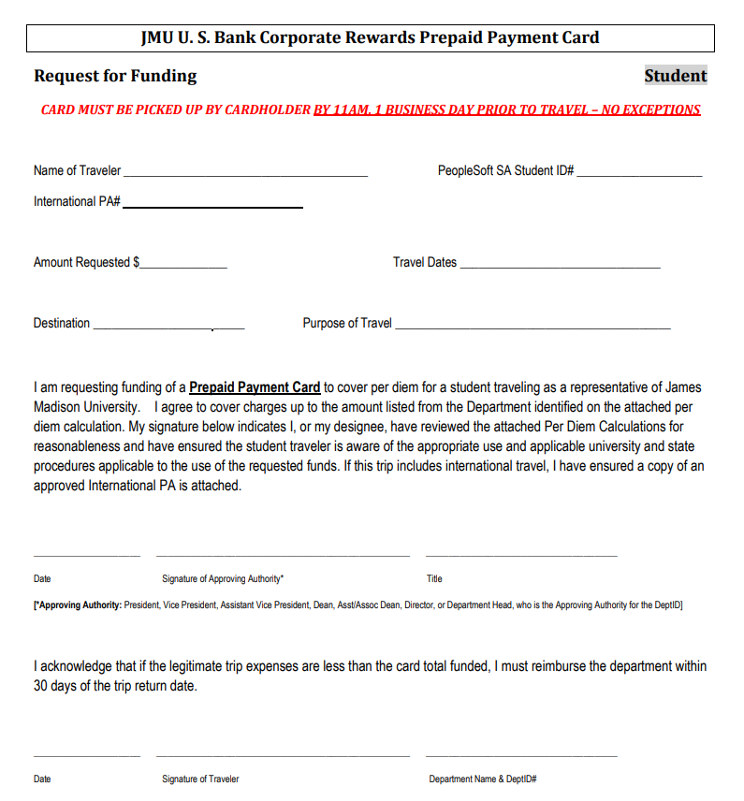
Student Per Diem Card Funding
Completed Request for Funding required for each student receiving per diem card.
Due no less than 5 business days prior to travel date. Card must be picked up no later than 11am one business day prior to departure date.
Cards may only be picked up by student receiving funding.
Do not submit any other Incentive/Prize related forms for per diem funding requests.

Slide 18
Thank you for completing the JMU U.S. Bank Corporate Rewards Prepaid Card Training
All EC/PI/SC’s must complete survey at link below before requesting U.S. Bank Rewards prepaid cards:
https://jmu.questionpro.com/t/AQkuQZy2WT
Cash and Investments will confirm this requirement has been met before processing card orders.
Questions? Please contact prepaidcards@jmu.edu and someone from Cash and Investments will reach out to you.

