Slide 1
JMU U. S. Bank Prepaid Focus Blue Card Program
Training for JMU Employees
August 2023

Slide 2
Acronyms and Definitions
Approving Authority – President, VP, AVP, Dean, Asst/Assoc Dean, Director or AUH for that DeptID
CI – Cash and Investments Office
EC – Event Coordinator
FPM – Financial Procedures Manual
PI – Principal Investigator
OSP – Sponsored Programs/Financial Services
SC – Study Coordinator
UBO – University Business Office

Slide 3
Participant Payments by card are more efficient
JMU maintains balance with US Bank
Cards issued to Participants
Payment issued directly to card

Slide 4
Shared Responsibilities
EC/PI/SC
Obtains participant information
Delivers Card – only request cards distributed in person, mailed cards will be mailed by bank to cardholder
CI
Assigns unfunded cards to Research/Event Managers
Funds payment requests to cards
UBO
Issues cards assigned by CI to Research/Event Manager
Accepts unused cards from Research/Event Manager back in to inventory
Communicates participation/payment request to CI
Point of contact for campus card programs
Maintains funding balance with US Bank and card inventory
Requests cards from CI and picks up from UBO
Manages card inventory and payment requests

Slide 5
JMU FPM Procedures
EC/PI/SC reviews and complies. Failure to do so will delay/cancel requests.
FPM 4205.390-4205.395: https://www.jmu.edu/financemanual/procedures/4205.shtml#.390-miscellaneous-payments-to-individuals/participant-payments
EC/PI/SC expected to coordinate with OSP Financial Services for Sponsored Program funding.
EC/PI/SC expected to coordinate with Financial Aid Office as appropriate.
EC/PI/SC expected to obtain and submit completed W-9’s as required.
EC/PI/SC cannot approve their own order(s).

Slide 6
JMU FPM Procedures continued
EC/PI/SC and Approving Authority acknowledge and agree to maintain control and limited access of requested cards, inventory of cards and to timely submission of completed log(s).
All parties agree to request/authorize only the appropriate quantity of cards reasonably expected to be distributed within 60 days, and to return cards not distributed within 10 business days of end date stated on the Prepaid Payment Card Order Form or 60 days after receipt, to the UBO.
CI will audit card inventory and control procedures as appropriate.
Departments failing to comply may not be eligible for future prepaid card orders/funding.

Slide 7
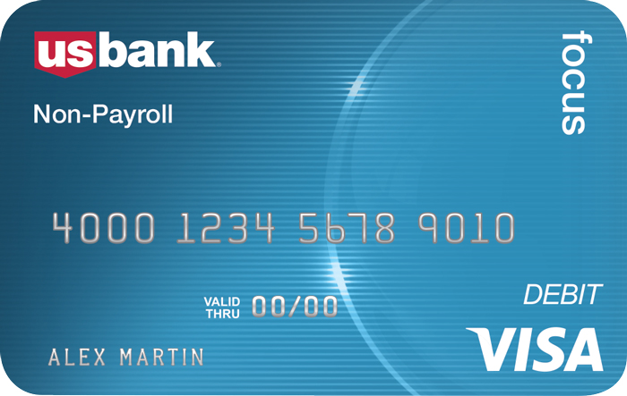
Prepaid Card Programs
U.S. Bank Rewards Visa Card
U.S. Bank Focus Blue Reloadable Visa Card
Departments agree to work with CI to resolve errors
Card funding completed daily by CI
Funding cutoff for all programs is 11am daily
$10 minimum load

Slide 8
Prepaid Card Programs
U.S. Bank Rewards Visa Card
U.S. Bank Focus Blue Reloadable Visa Card
Go-live date: July 10th 2023
Single Use Cards
Administrative fee assessed 12 months after issue date
Card replacement fee assessed to cardholder by bank
No ATM/cash access
CI Processing deadline is 11am daily.
Mailed cards sent by bank to cardholder (address required).
Minimum load $10
Cards funded upon receipt of the JMU U.S. Bank Corporate Rewards Load Spreadsheet (within one business day).
Funds belong to cardholder and cannot be removed by JMU once loaded.
Go-live date: August 15th 2023
Reloadable
Card replacement fee assessed to cardholder by bank
ATM/cash access
Mobile app and alerts available
CI Processing deadline is 11am daily.
Mailed cards sent by bank to cardholder (cardholder information required).
Date of birth (cardholder) required.
Minimum load $10
Cards funded upon receipt of the JMU U.S. Bank Focus Blue Fund/Order Spreadsheet (within one business day).
Funds belong to cardholder and cannot be removed by JMU once loaded.

Slide 9
Process
EC/PI/SC completes this training and related survey.
JMU Prepaid Payment Card Order Form completed and submitted.
CI reviews order.
CI notifies EC/PI/SC and UBO of scheduled card distribution date in UBO.
EC/PI/SC picks up cards from UBO. (EC/PI/SC maintains control of card inventory.)
EC/PI/SC distributes cards and completes appropriate log.
EC/PI/SC completes Fund/Order Spreadsheet and submits to CI.
ED/PI/SC submits completed W-9’s and/or W-8’s ($100+ W-9 required, all Foreign Nationals require completed W-8)
CI reviews for completeness and funds cards.
DeptID# charged for total of cards funded by CI.

Slide 10
U.S. Bank Focus Blue Reloadable Visa Card
Research incentives for recurring participation/payment milestones and recurring per-diem for individual students in travel status (for established student programs involving recurring travel per diems and with advanced approval from Cash and Investments).

Slide 11
U.S. Bank Focus Blue Reloadable Visa Card – Individuals (Research and Incentives)
Personalized and Reloadable
Used for study’s with participation/payment milestones or incentives for on-going participation programs.
Personalized (Anonymous available for limited circumstances)
Distributed in person PI/SC.
EC requested cards may be mailed by bank depending upon program scenario.
Date of Birth (DOB) required to ensure cardholder security.
Disclosure required for research participants (Provided by CI).
Used for Incentives in accordance with the JMU FPM subsections 4205.390-4205.394 https://www.jmu.edu/financemanual/procedures/4205.shtml#.390-miscellaneous-payments-to-individuals/participant-payments
Card orders due ten days prior to requested card pick-up date.
Cards loaded upon receipt of Funding Request (within one business day).
Funds belong to cardholder and cannot be removed by JMU once loaded.

Slide 12
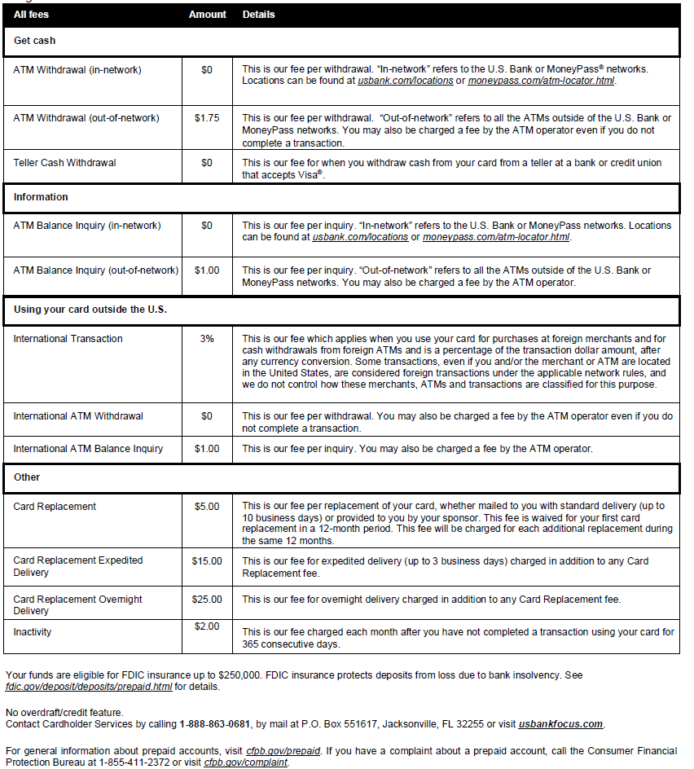
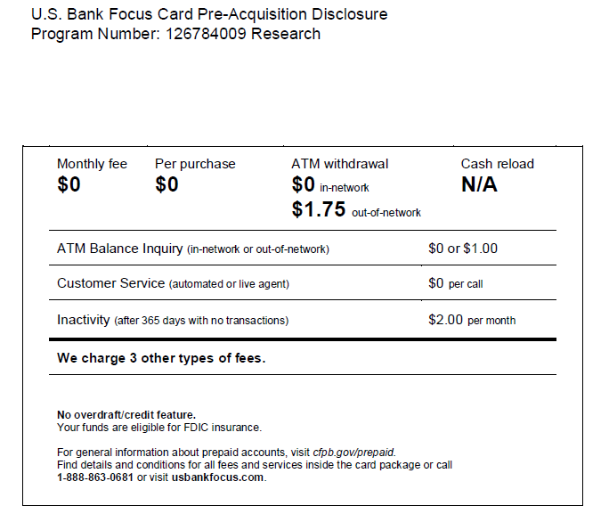
Disclosure distribution required for cardholders participating in research studies.

Slide 13
U.S. Bank Focus Blue Reloadable Visa Card – Team Use
Personalized and Reloadable
Used for approved teams and student groups requiring per diem cards (with advanced approval). Contact the Cash & Investments Director at leethtc@jmu.edu or 568.3205.
Card order and funding process differs for team use. The online forms/processes may not apply.
Personalized
In-person card distribution is preferred
Cards may be mailed by bank depending upon program details and upon receipt of required cardholder agreement.
Date of Birth (DOB) required to ensure cardholder security.
Used in accordance with the JMU FPM subsection 4215.530: https://www.jmu.edu/financemanual/procedures/4215.shtml#.530-payment-by-u.-s.-bank-focus-blue-prepaid-card---team-travel
Card orders due at least 10 business days prior to requested card pick-up date.
Cards loaded upon receipt of Funding Request (within one business day).
Funds belong to cardholder once loaded.

Slide 14
Completed Prepaid Payment Card Order Form
Complete all fields.
If working off-campus, include phone # where you can be reached.
Be sure to enter IRB approval date and IRB protocol #, if applicable.
Enter specific card request date. Allow five business days for order fulfillment.
Obtain applicable OSP Financial Services and FAO approvals.
Request cards for only one participant payment type, Focus Blue Reloadable cards, and one event/project per form.
Cards requested and funded that are not used as expected will require reimbursement from non-state/university funds. Be sure to review procedures first.
Direct all prepaid card order questions/communications to prepaidcards@jmu.edu.
This form is used for the Rewards Visa Card and the Focus Blue Reloadable Visa Card.

Slide 15
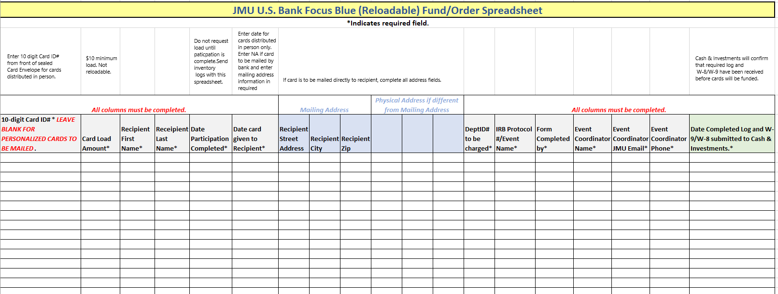
Completed Prepaid Payment Card Order Form
Complete all required fields.
If working off-campus, include phone # where you can be reached.
Be sure to enter IRB protocol # or event name.
Submit one form per event/project per form. This form is to request funding of cards you have received and distributed and/or cards to be mailed to recipients.
Direct all prepaid card order questions and communications to prepaidcards@jmu.edu.
This form is used for the Focus Blue Card (reloadable) only.

Slide 16
Card information for funding requests
Card ID# is NOT the number embossed on the card
Card ID# is located on the front of the envelope that holds the card. (Last 10 digits of the 13 digit number at top of envelope window.)
JMU staff will not have access to the embossed card number.
10-digit Card ID: Used for card funding requests
Anonymous cards – last 10 digits as shown below
Personalized cards – CI provides this information to the contact person for use on the Focus Blue Fund/Order Spreadsheet once the cards have been created.

Slide 17
Completed Departmental Prepaid Card Log (U. S. Bank Focus Blue Cards only)
Provided by CI when cards are picked up from UBO.
Complete all fields.
The ‘Received by’ column requires signature of recipient.
Do NOT alter forms, altered forms will not be accepted.
All signatures required to be complete.
Direct all prepaid card order questions/communications to prepaidcards@jmu.edu.
This form is used for the Focus Blue Cards only.

Slide 18
JMU Prepaid Card Monthly Reconciliation
This form is used for the Rewards Visa Card and the Focus Blue Reloadable Visa Card.
Use separate form for each prepaid program.
Complete all fields.
Subject to audit at any time.
Submit annually to Cash and Investments within 10 business days of closing event or by July 15th for the previous fiscal year.
Direct all prepaid card order questions/communications to prepaidcards@jmu.edu.

Slide 19
Please complete this two question survey to confirm completion of Focus Blue prepaid card training:
https://jmu.questionpro.com/t/AQkuQZy2Wy

