Slide 1
Cash and Investments Office
Contact: appa@jmu.edu
BANK OF AMERICA
WORKS RECONCILIATION
SPCC Cardholder Training Presentation

Slide 2
Cash and Investments Office
Contact: appa@jmu.edu
Table of Contents
Bank of America WORKS
Cardholder Reconciliation
Approvals
Monthly Reconciliation Report
Additional Information

Slide 3
Cash and Investments Office
Contact: appa@jmu.edu
Bank of America WORKS
General Information
Website Hyperlink
Login Screen

Slide 4
Cash and Investments Office
Contact: appa@jmu.edu
Bank of America WORKS
General Information
Beginning January 3rd, 2022, Small Purchase Charge Card transactions will be reconciled in the Bank of America WORKS system. The reconciliation process will be completely electronic allowing cardholders to allocate charges, upload receipts and approvers to approve transactions all within the Bank of America WORKS system.
Charges will be available to reconcile as soon as the vendor posts the charges to the card. Cash and Investments will process a daily journal to post all transactions that have been reconciled and approved. Every cardholder will have access to WORKS and can assign a proxy reconciler to their card to reconcile charges on the cardholder’s behalf. All transactions will be required to be reconciled within Bank of America WORKS.

Slide 5
Cash and Investments Office
Contact: appa@jmu.edu
Bank of America WORKS
Website Hyperlink
The Bank of America WORKS system can be found here:
https://payment2.works.com/works/home
For cardholders, this is assigned when you receive your Small Purchase Charge Card or SPCC.
For approvers, this is assigned during implementation or when a new approver’s duties are assigned.
For reconcilers, this is assigned during implementation or when a cardholder submits a manage reconciler form in PeopleSoft Finance to add a new reconciler.

Slide 6
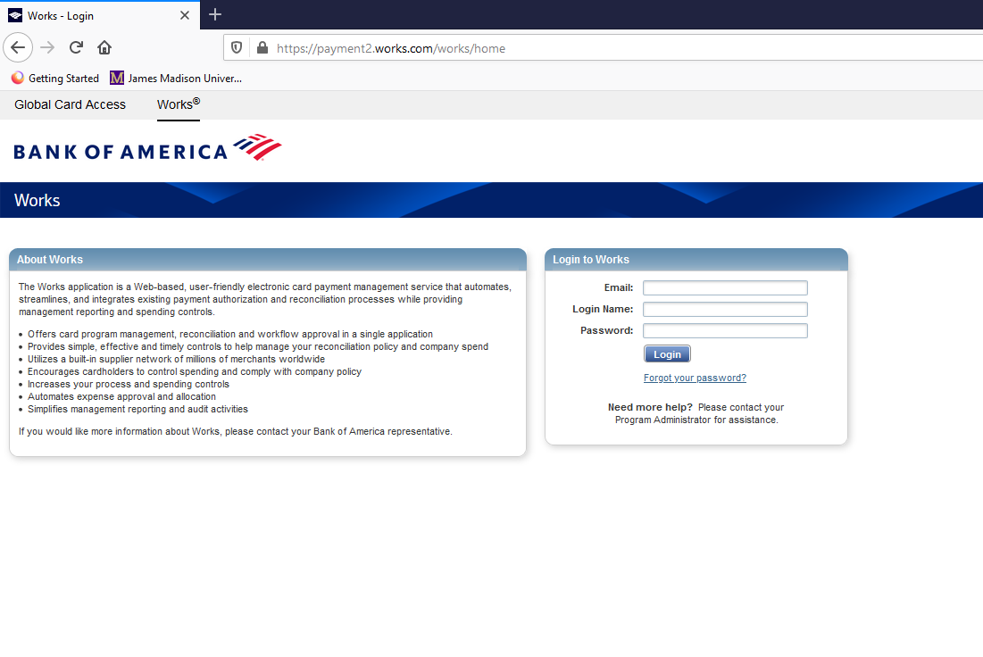
Cash and Investments Office
Contact: appa@jmu.edu
Bank of America WORKS
Login Screen
The user sets the password.
If you need your password reset, you may contact the Cash and Investments Office at appa@jmu.edu

Slide 7
Cash and Investments Office
Contact: appa@jmu.edu
Reconciliation Dates
Cardholder Reconciliation
Cardholder Home Page
Reconciliation Process
Charging One Department and Account Code
Charging Multiple Departments and Account Codes
Uploading Receipt Images
Sign Off Transactions
Flagged Transactions
Multiple Cardholder

Slide 8
Cash and Investments Office
Contact: appa@jmu.edu
Cardholder Reconciliation
Reconciliation Dates
Charges can be reconciled anytime during a billing cycle as they are posted to the card. Any charges available to be reconciled will show under pending.
Billing cycles will end around the 15th of each month and all charges need to be reconciled and approved by the 5th of the next month (example charges on the April 15th billing cycle must be reconciled and approved by May 5th).
Charges will be posted within 1-2 business days to departmental budgets once reconciled and approved.

Slide 9
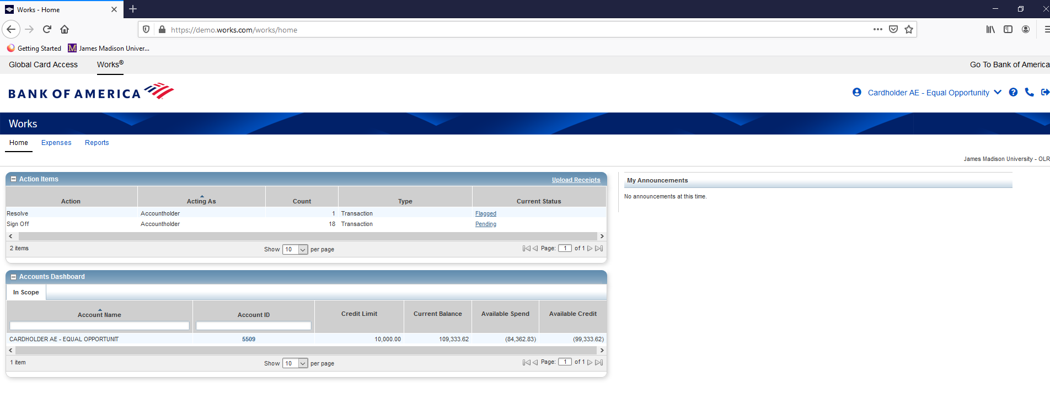
Cash and Investments Office
Contact: appa@jmu.edu
Cardholder Reconciliation
Cardholder Home Page
When a cardholder logs into WORKS, this will be their home page.

Slide 10
Cash and Investments Office
Contact: appa@jmu.edu
Cardholder Reconciliation
Cardholder Home Page
Under Action Items, the cardholder will see how many pending transactions they have to reconcile.

Slide 11
Cash and Investments Office
Contact: appa@jmu.edu
Cardholder Reconciliation
Cardholder Home Page
Under Accounts Dashboard, the cardholder will see their basic card information including their Account Name (Cardholder’s Name), Account ID, Credit Limit (Monthly), Current Balance, Available to Spend and Available Credit.

Slide 12
Cash and Investments Office
Contact: appa@jmu.edu
Cardholder Reconciliation
Reconciliation Process
To begin the reconciliation process, the cardholder will click on the hyperlink under current status that says Pending.

Slide 13
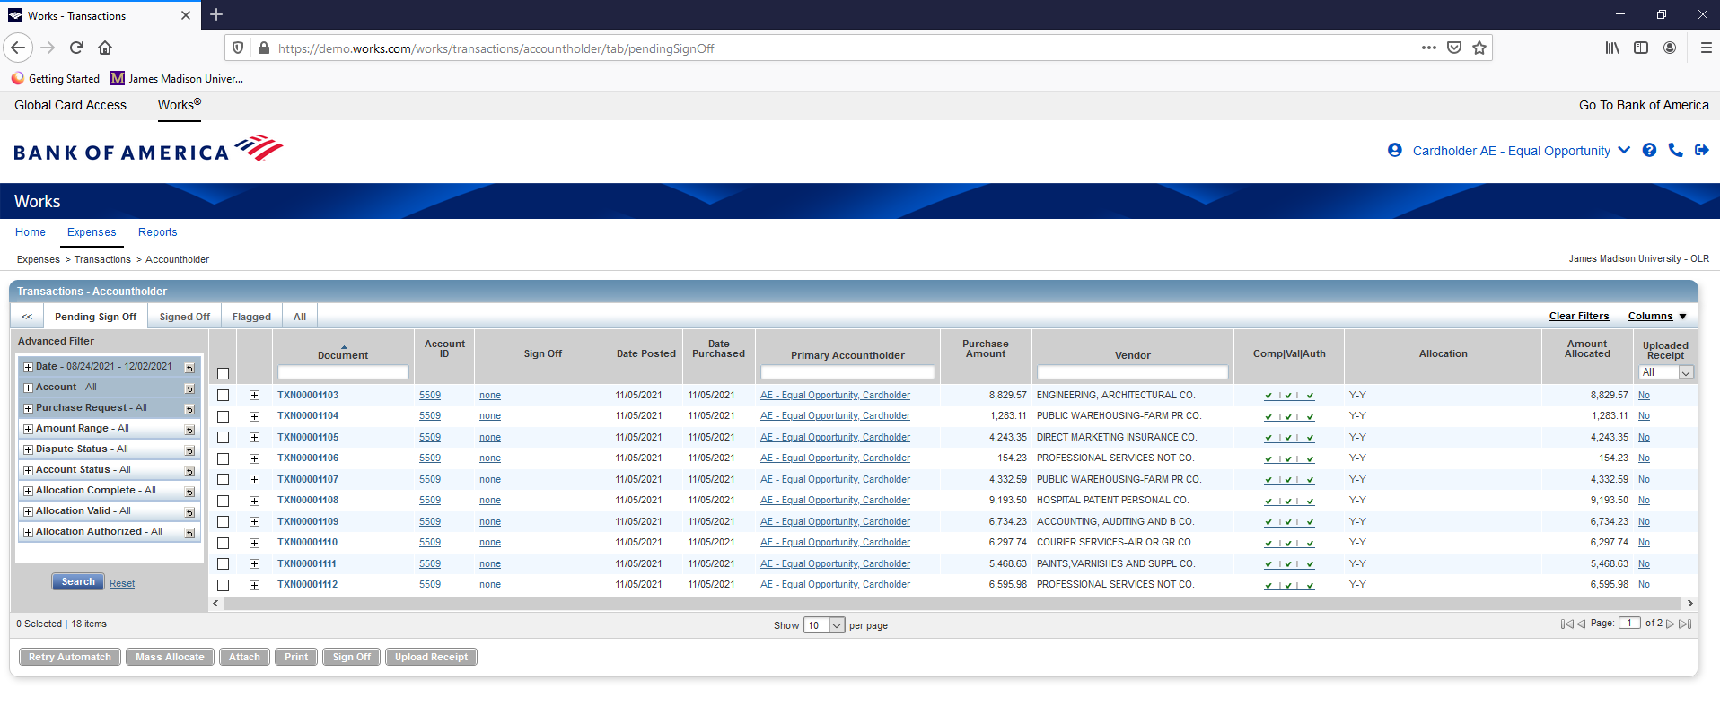
Cash and Investments Office
Contact: appa@jmu.edu
Cardholder Reconciliation
Charging One Department and
Account Code
Once a cardholder clicks on the Pending hyperlink, they will go to the Transactions-Accountholder page. This page will allow them to reconcile their charges.

Slide 14
Cash and Investments Office
Contact: appa@jmu.edu
Cardholder Reconciliation
Charging One Department and Account Code
By selecting the small down arrow, the number of transactions on each page can be changed.

Slide 15
Cash and Investments Office
Contact: appa@jmu.edu
Cardholder Reconciliation
Charging One Department and Account Code
The page number can also be changed by selecting the page in the bottom right corner.

Slide 16
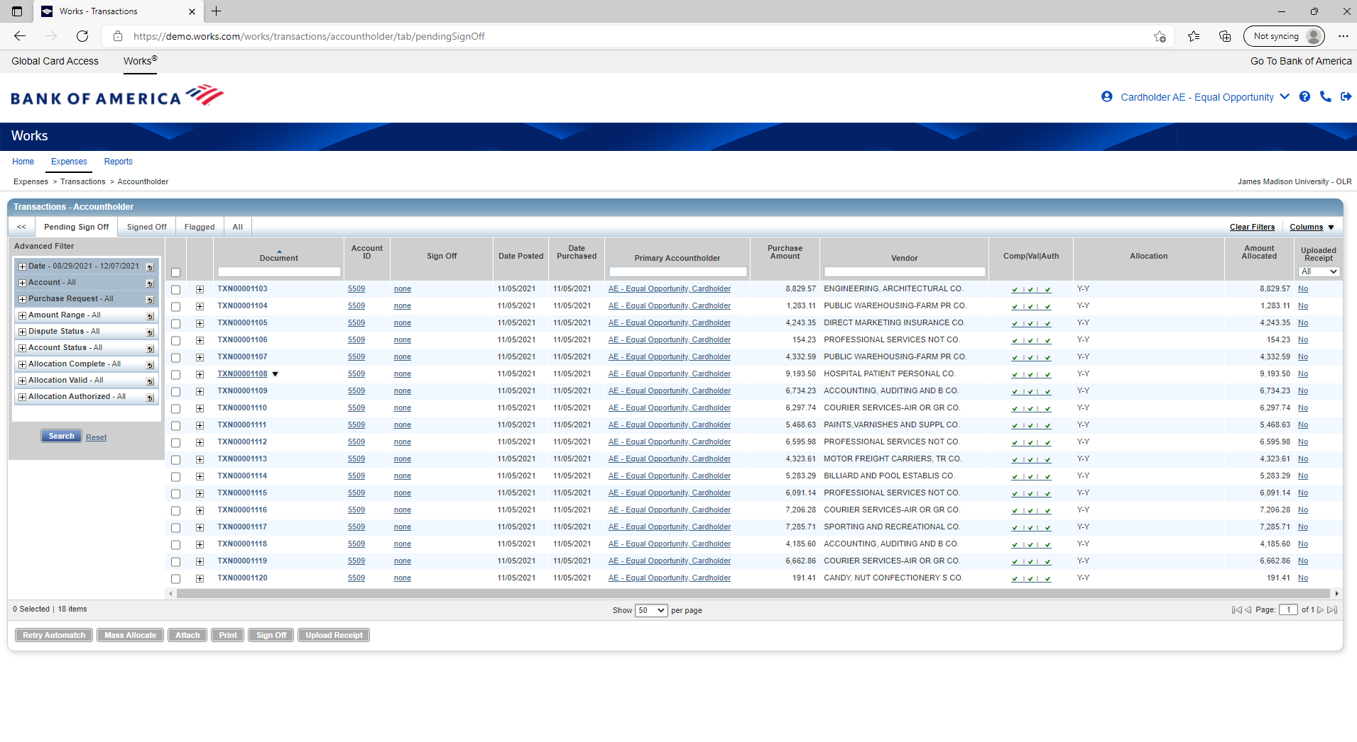
Cash and Investments Office
Contact: appa@jmu.edu
Cardholder Reconciliation
Charging One Department and
Account Code
To select a transaction, hover over
it within the document column
until the black arrow appears.
Then, click on the black arrow.

Slide 17
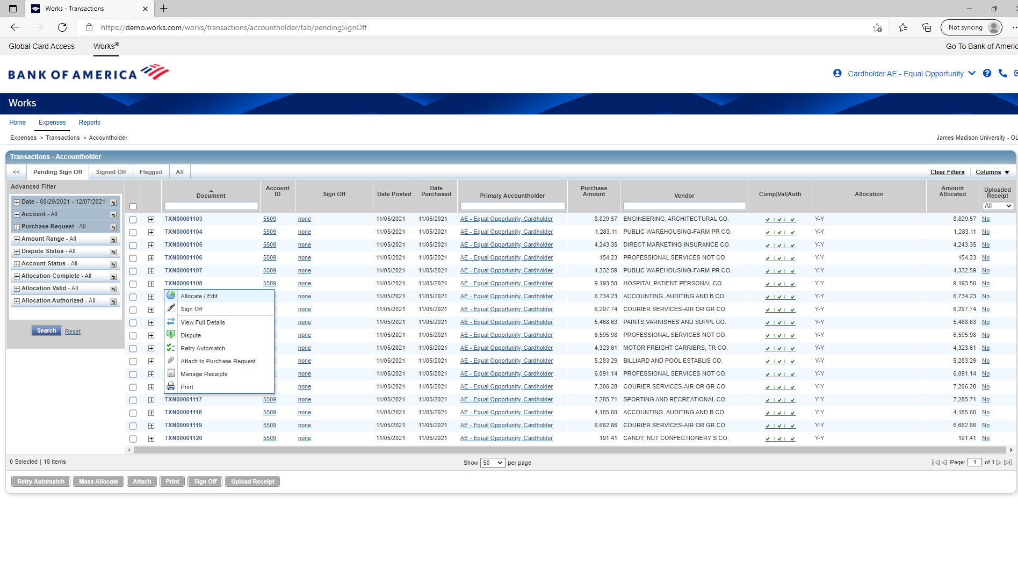
Cash and Investments Office
Contact: appa@jmu.edu
Cardholder Reconciliation
Charging One Department and Account Code
After that, the cardholder should select Allocate/Edit from the pop up box.

Slide 18
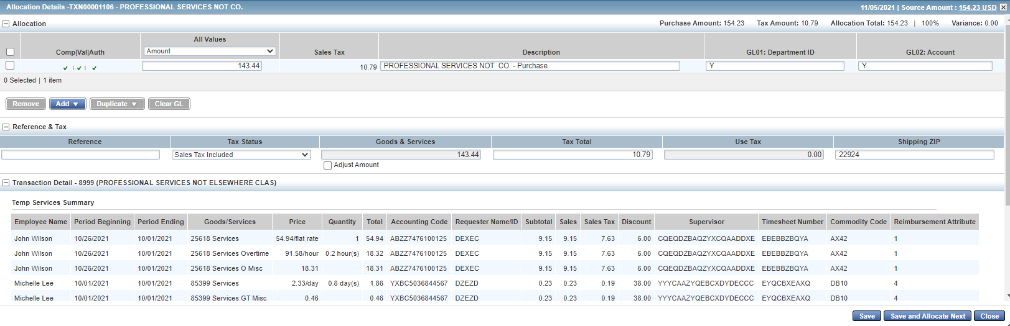
Cash and Investments Office
Contact: appa@jmu.edu
Cardholder Reconciliation
Charging One Department and Account Code
Once Allocate/Edit has been selected, this box will appear.

Slide 19
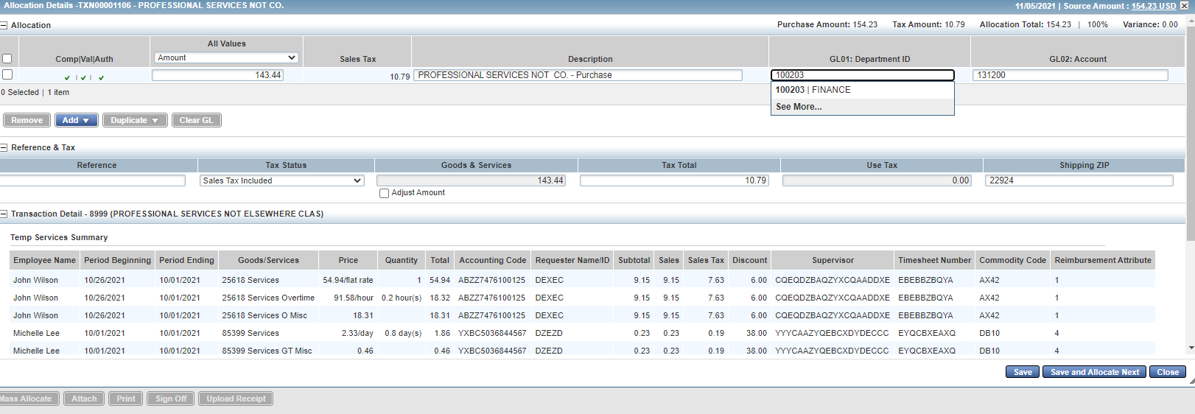
Cash and Investments Office
Contact: appa@jmu.edu
Cardholder Reconciliation
Charging One Department and Account Code
The cardholder should enter the correct department ID number.

Slide 20
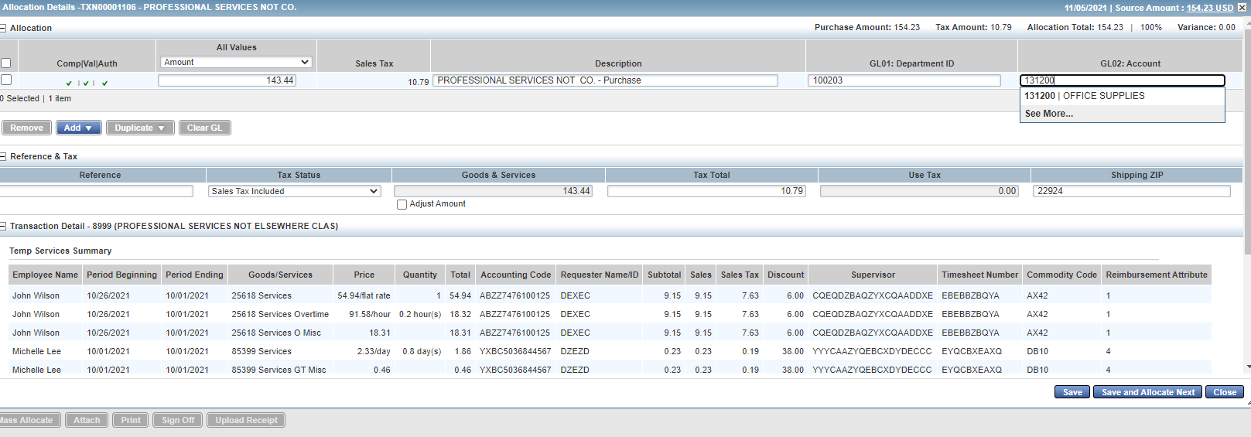
Cash and Investments Office
Contact: appa@jmu.edu
Cardholder Reconciliation
Charging One Department and Account Code
Then, the cardholder should enter the correct account number.

Slide 21
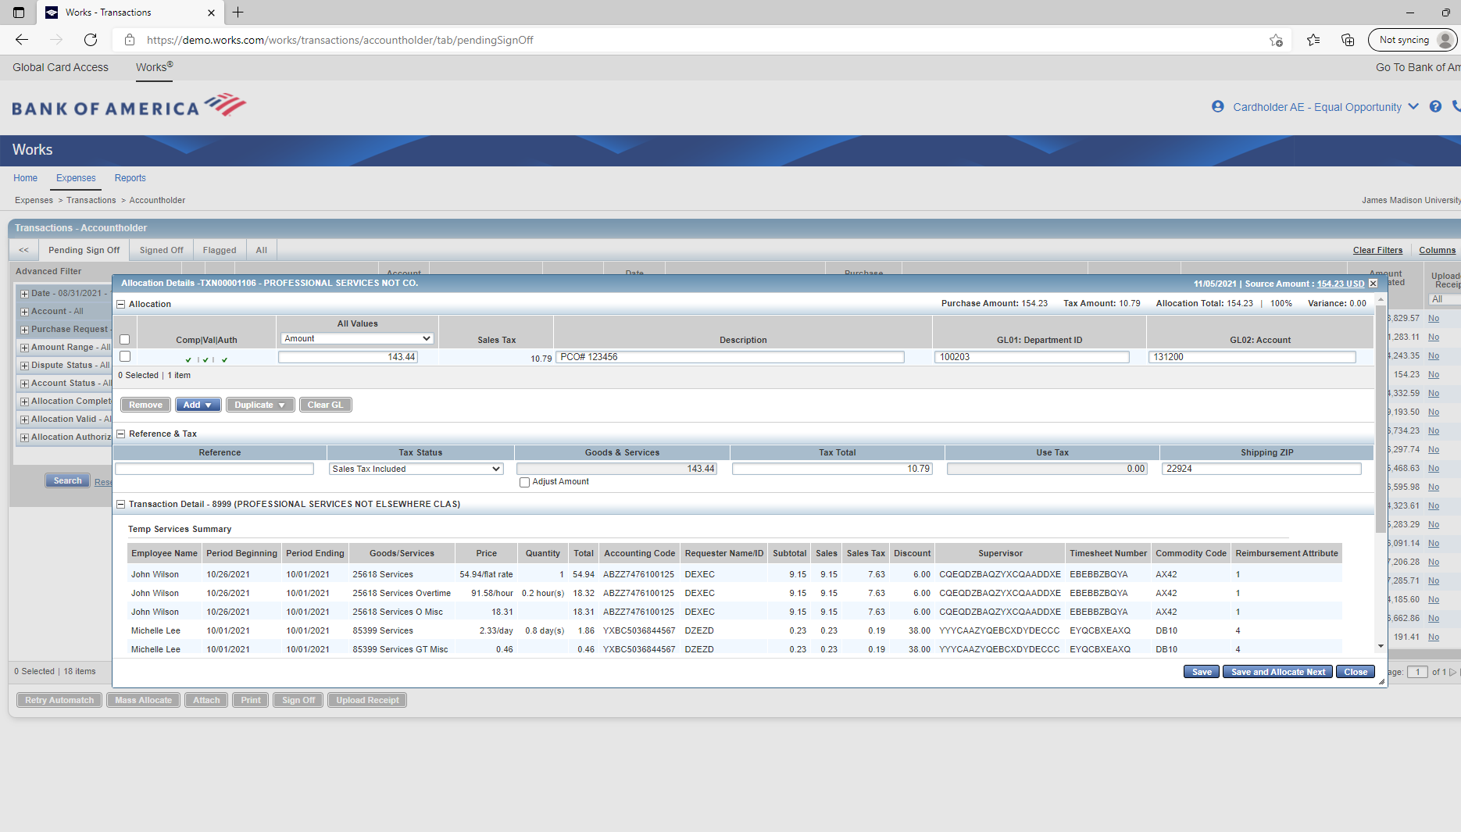
Cash and Investments Office
Contact: appa@jmu.edu
Cardholder Reconciliation
Charging One Department and Account Code
After that, the cardholder should enter a description with the relevant eVA information.

Slide 22
Cash and Investments Office
Contact: appa@jmu.edu
Cardholder Reconciliation
Charging One Department and Account Code
Once those boxes have been filled, the cardholder should select save.
*This is not the end of the reconciliation process. Transactions must be signed off on and an invoice uploaded.

Slide 23
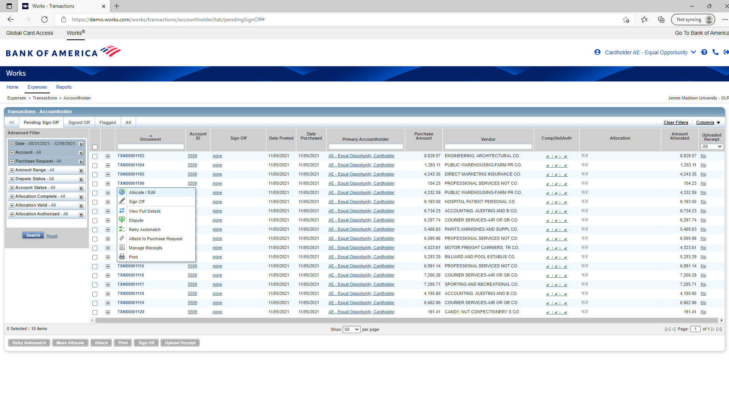
Cash and Investments Office
Contact: appa@jmu.edu
Cardholder Reconciliation
Charging Multiple Departments and Account Codes
If a cardholder wants to charge multiple departments and account codes, again select Allocate/Edit from the pop up box.

Slide 24
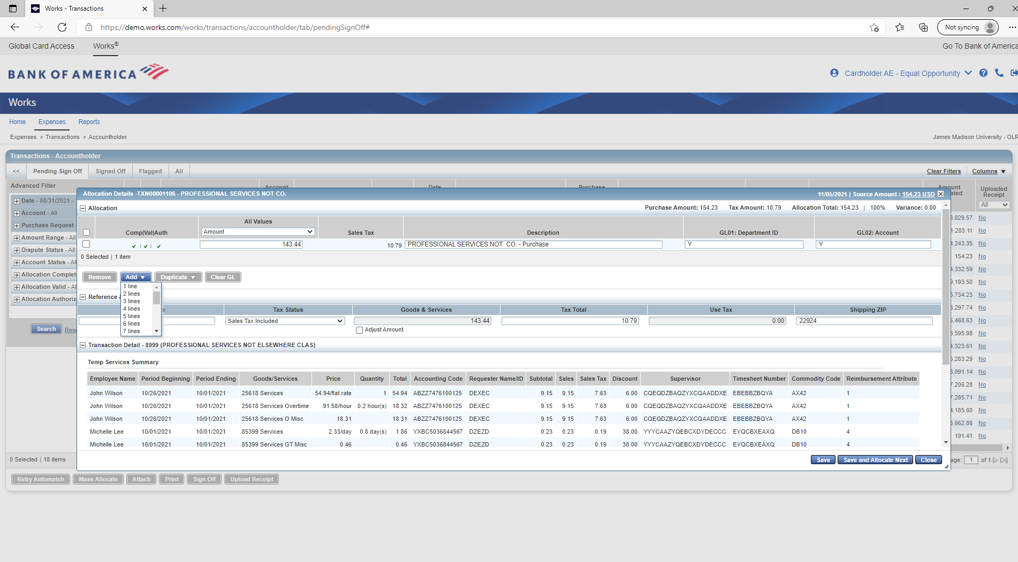
Cash and Investments Office
Contact: appa@jmu.edu
Cardholder Reconciliation
Charging Multiple Departments and Account Codes
Then, a cardholder should select Add and the number of lines to add.

Slide 25
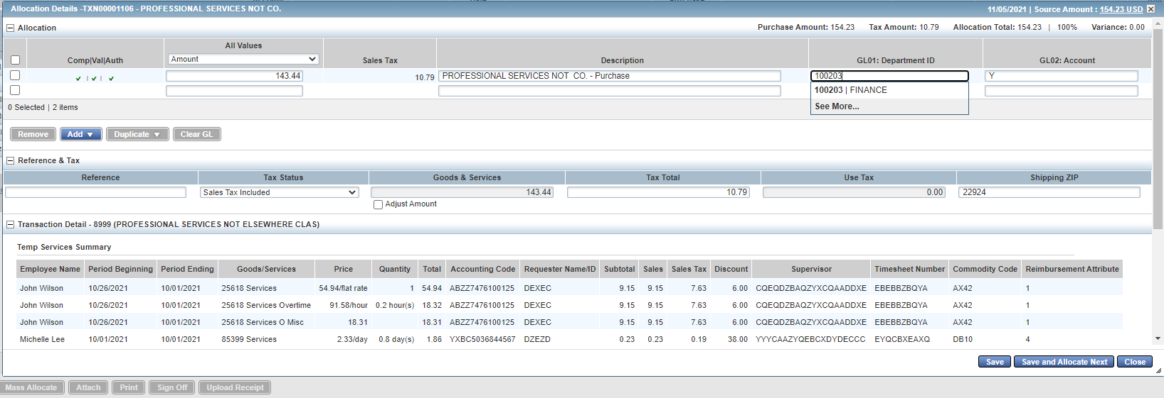
Cash and Investments Office
Contact: appa@jmu.edu
Cardholder Reconciliation
Charging Multiple Departments and Account Codes
The cardholder should enter the correct department ID number in the first line.

Slide 26
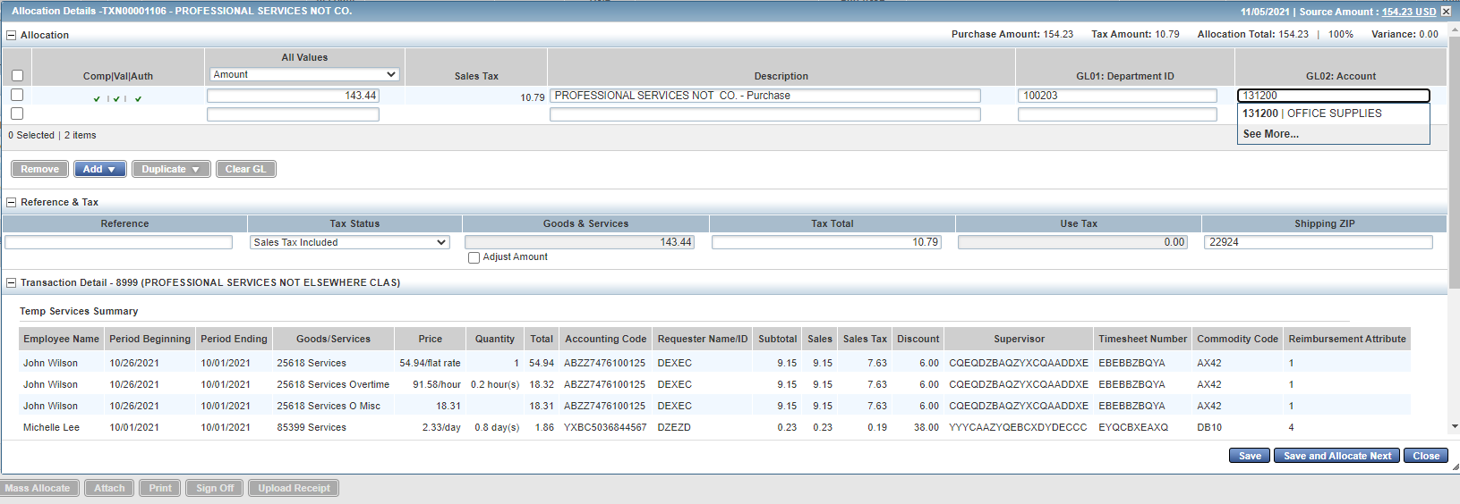
Cash and Investments Office
Contact: appa@jmu.edu
Cardholder Reconciliation
Charging Multiple Departments and Account Codes
Then, the cardholder should enter the correct account number in the first line.

Slide 27
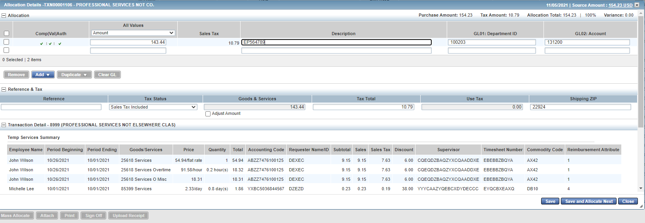
Cash and Investments Office
Contact: appa@jmu.edu
Cardholder Reconciliation
Charging Multiple Departments and Account Codes
After that, the cardholder should enter a description with the relevant eVA information in the first line.

Slide 28
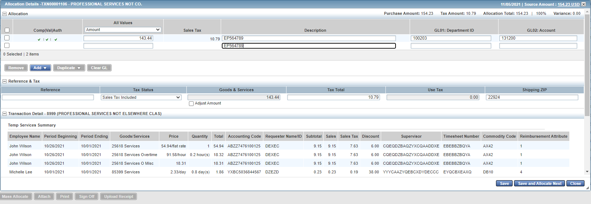
Cash and Investments Office
Contact: appa@jmu.edu
Cardholder Reconciliation
Charging Multiple Departments and Account Codes
Then, the cardholder should enter a description with the relevant eVA information in the second line.

Slide 29
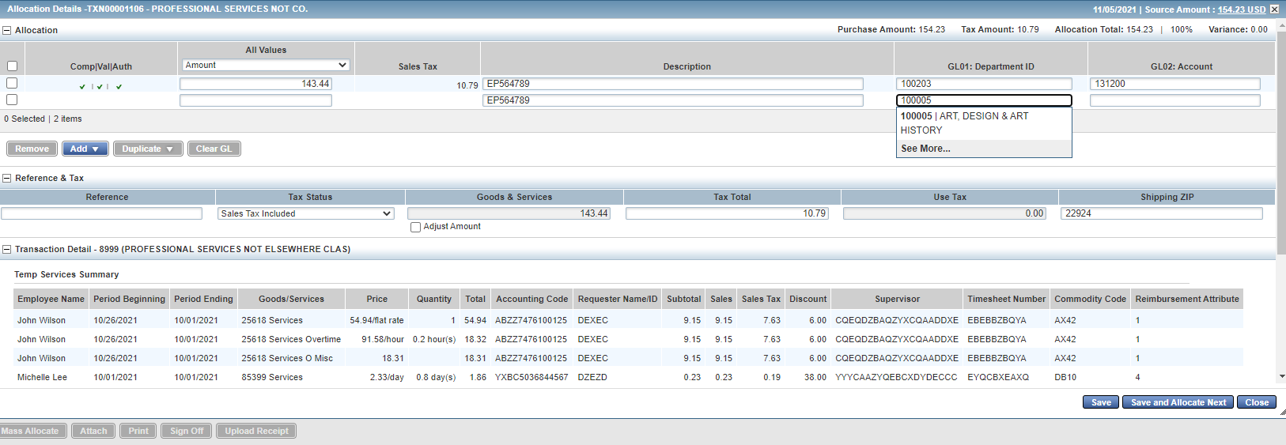
Cash and Investments Office
Contact: appa@jmu.edu
Cardholder Reconciliation
Charging Multiple Departments and Account Codes
After that, the cardholder should enter the correct department ID number in the second line.

Slide 30

Cash and Investments Office
Contact: appa@jmu.edu
Cardholder Reconciliation
Charging Multiple Departments and Account Codes
Once the department ID is complete, the cardholder should enter the correct account number in the second line.

Slide 31
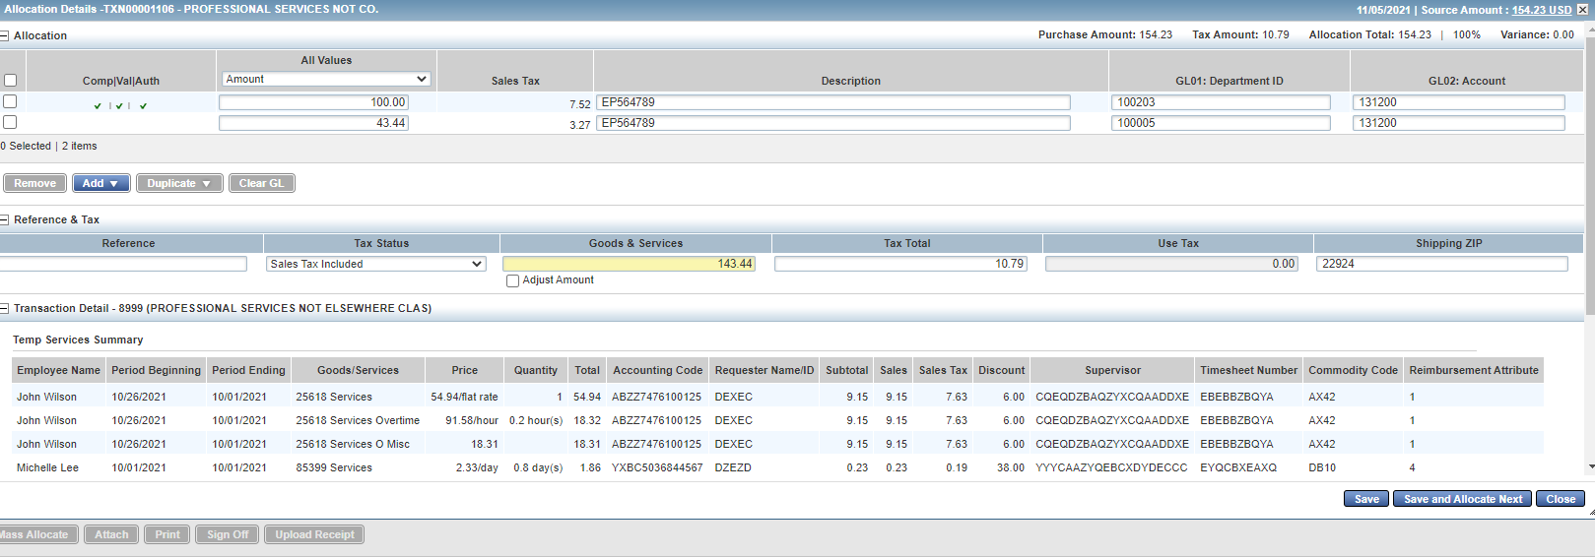
Cash and Investments Office
Contact: appa@jmu.edu
Cardholder Reconciliation
Charging Multiple Departments and Account Codes
When both lines are filled in, the cardholder can select the value. The first value is by amount.

Slide 32
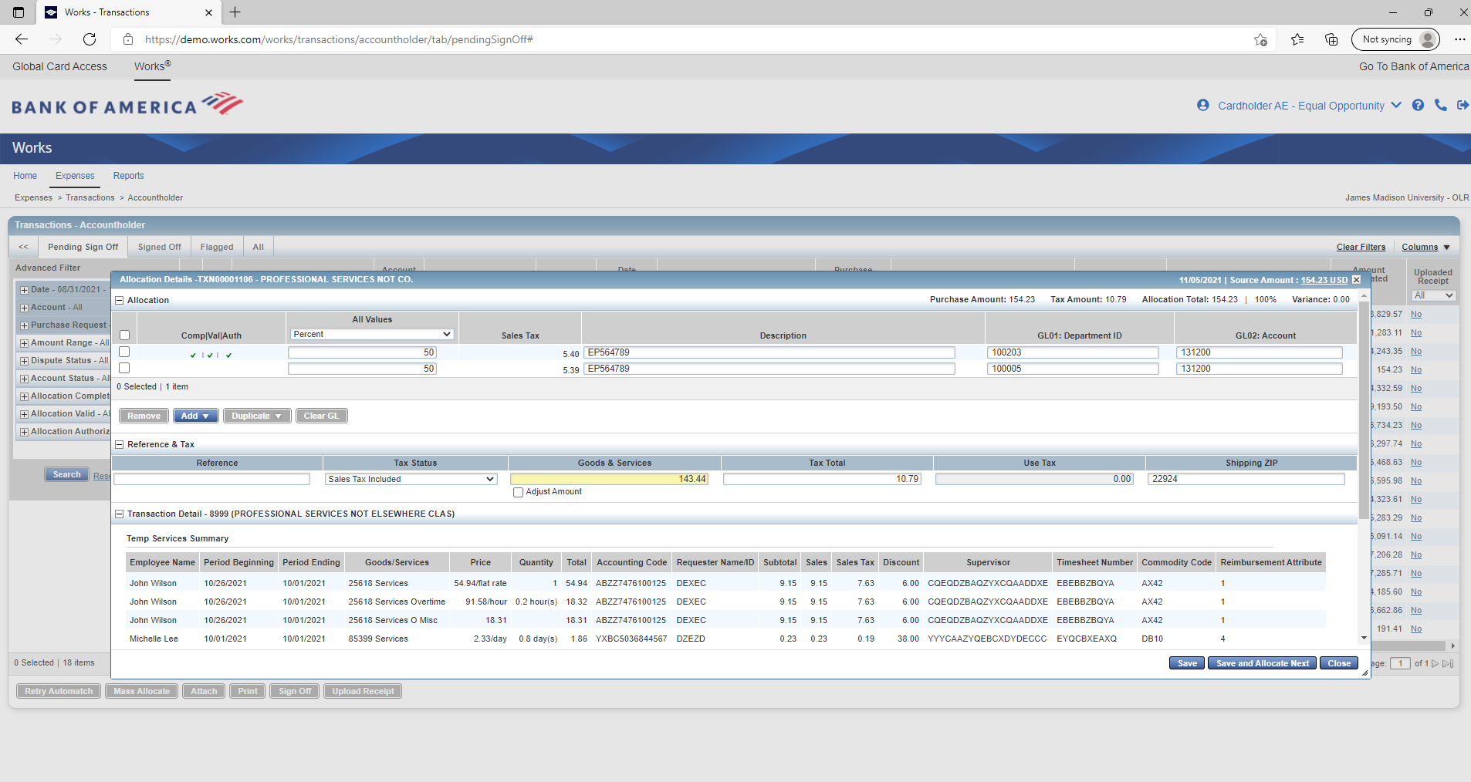
Cash and Investments Office
Contact: appa@jmu.edu
Cardholder Reconciliation
Charging Multiple Departments and Account Codes
The second value is by percent. Either can be used.

Slide 33
Cash and Investments Office
Contact: appa@jmu.edu
Cardholder Reconciliation
Charging Multiple Departments and Account Codes
After filling in the values, the cardholder should select Save.
*This is not the end of the reconciliation process. Transactions must be signed off on and an invoice uploaded.

Slide 34
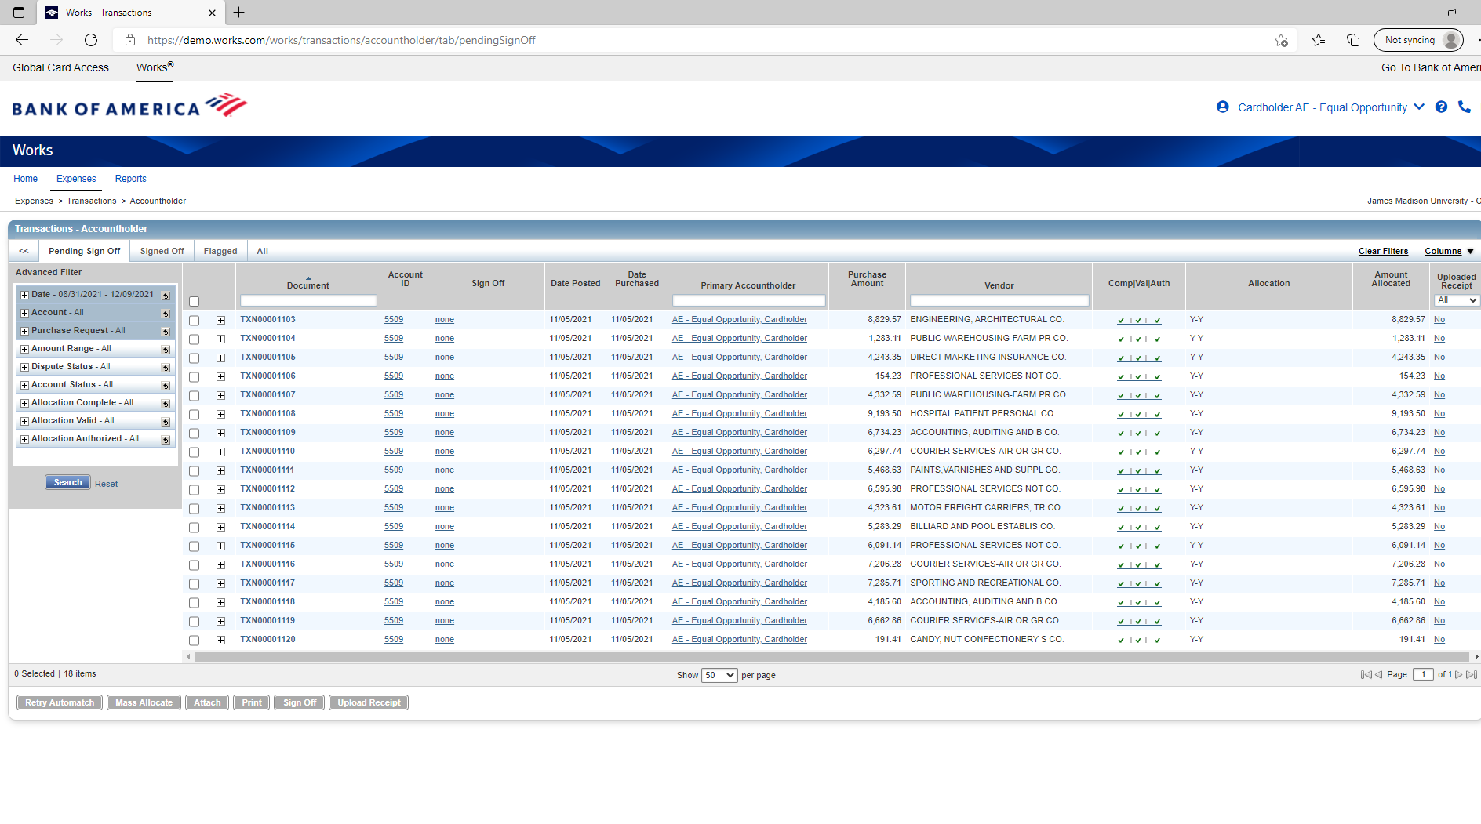
Cash and Investments Office
Contact: appa@jmu.edu
Cardholder Reconciliation
Uploading Receipt Images
If a cardholder wants to upload a receipt image, click on the No hyperlink.

Slide 35
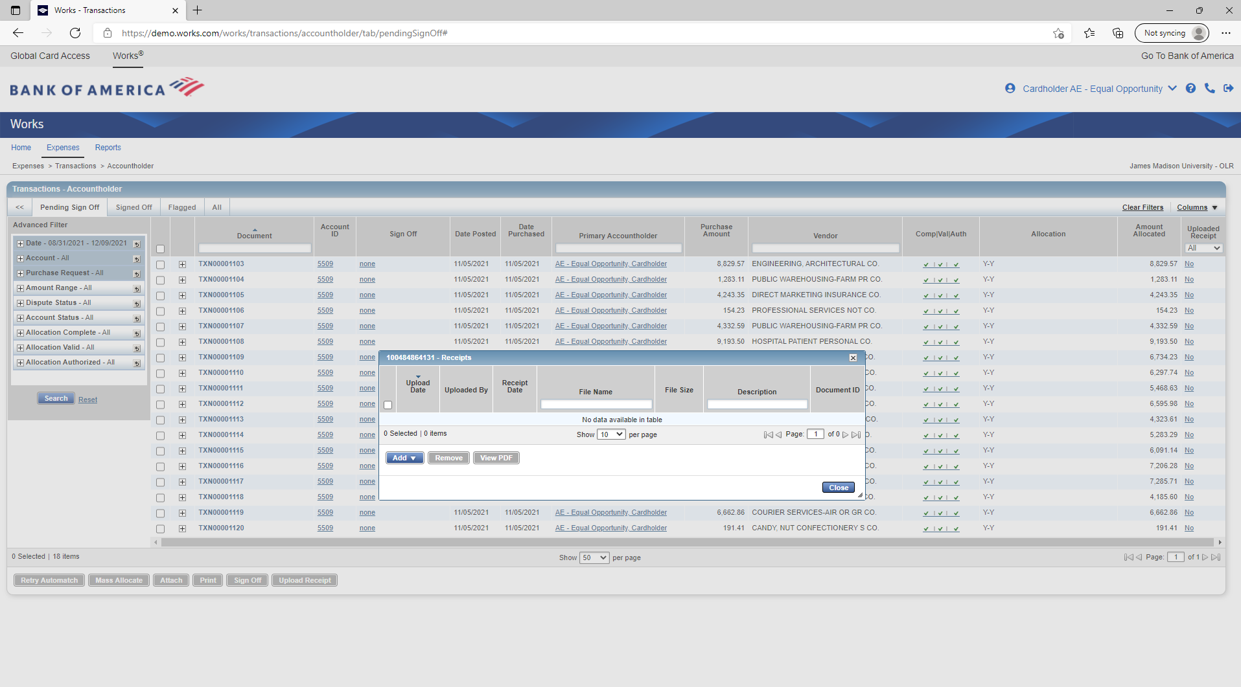
Cash and Investments Office
Contact: appa@jmu.edu
Cardholder Reconciliation
Uploading Receipt Images
This pop up box will appear. The cardholder must selected Add to upload their receipt.

Slide 36
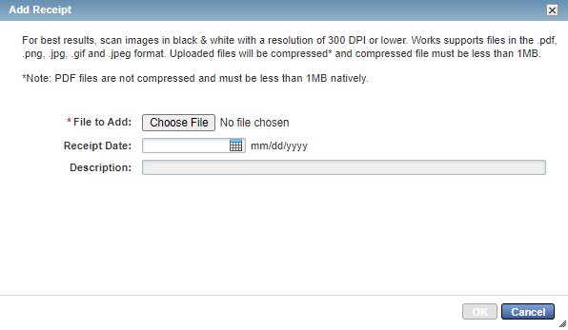
Cash and Investments Office
Contact: appa@jmu.edu
Cardholder Reconciliation
Uploading Receipt Images
This pop up box will appear. The cardholder should select Choose File.

Slide 37
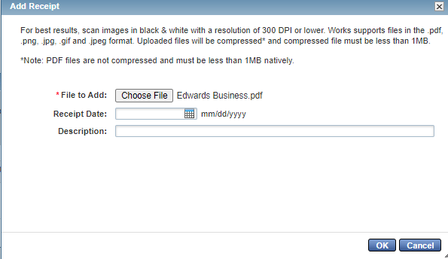
Cash and Investments Office
Contact: appa@jmu.edu
Cardholder Reconciliation
Uploading Receipt Images
After the cardholder uploads the file, it will be listed next to the Choose File box. The cardholder will then select OK. The receipt date and description are not required.

Slide 38
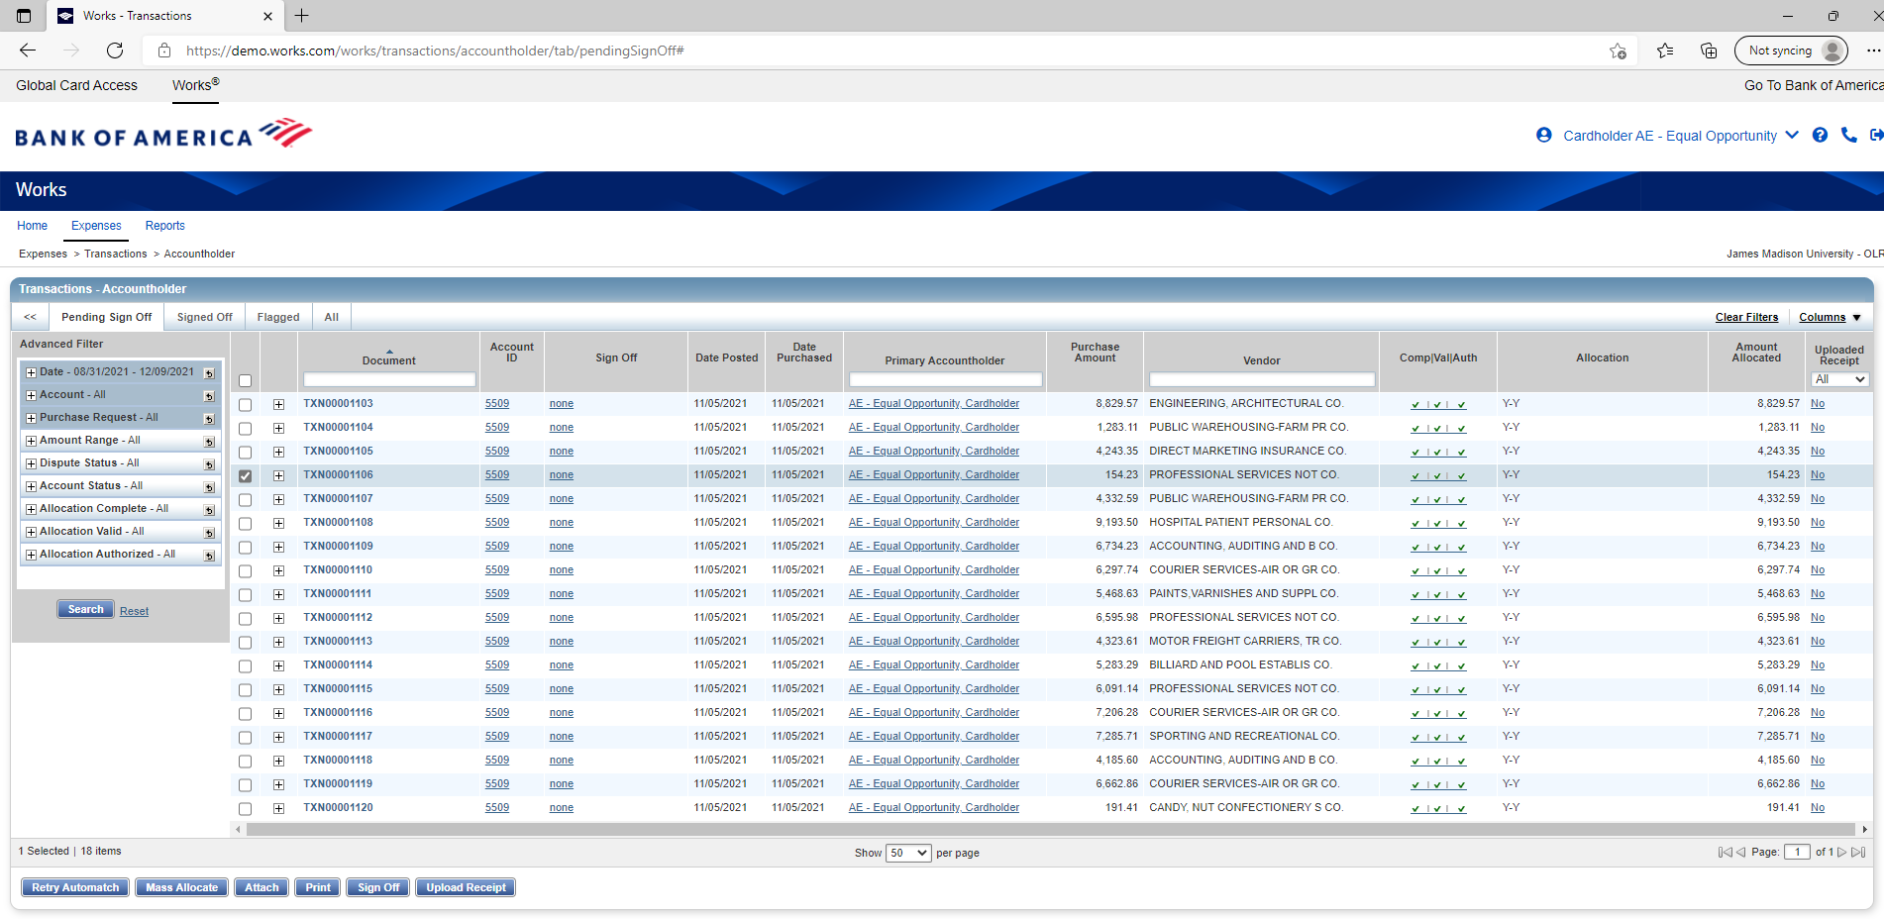
Cash and Investments Office
Contact: appa@jmu.edu
Cardholder Reconciliation
Sign Off Transactions
Once the correct departments/expenditure account codes are charged and an invoice is uploaded, transactions will need to be signed off on to complete the reconciliation process. This will begin on the Transactions-Accountholder page.

Slide 39
Cash and Investments Office
Contact: appa@jmu.edu
Cardholder Reconciliation
Sign Off Transactions
First, the cardholder must select the completed transactions that need to be signed off by checking the box of the transaction(s).

Slide 40
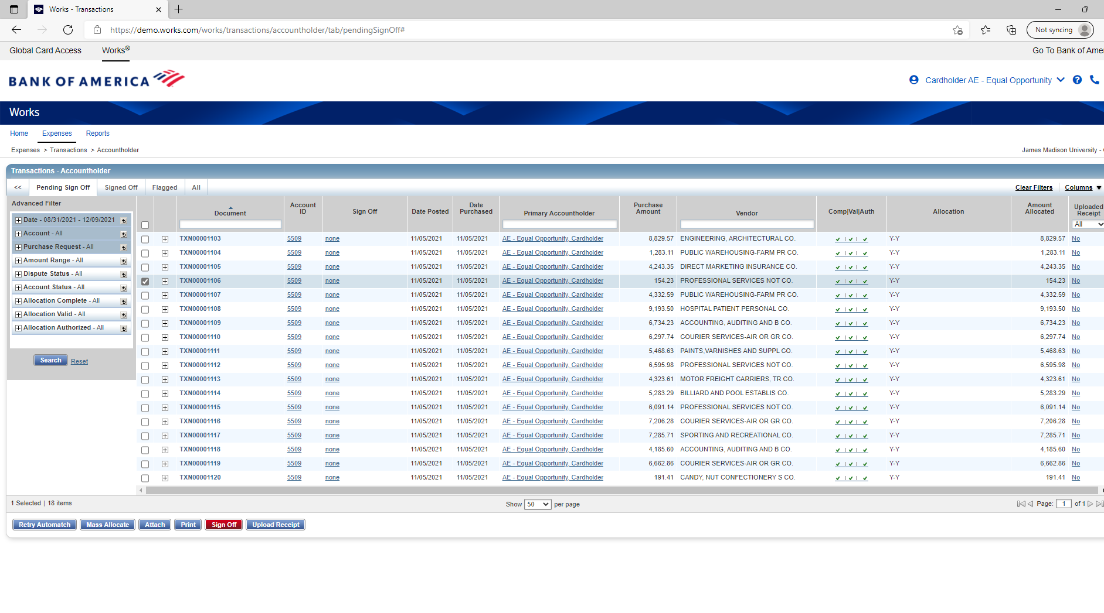
Cash and Investments Office
Contact: appa@jmu.edu
Cardholder Reconciliation
Sign Off Transactions
After the transactions have been selected, the cardholder will complete the transaction by selecting Sign Off.

Slide 41
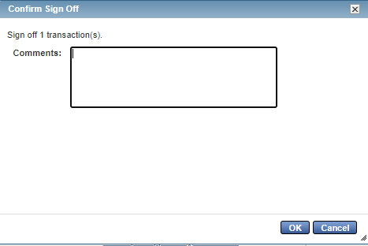
Cash and Investments Office
Contact: appa@jmu.edu
Cardholder Reconciliation
Sign Off Transactions
A pop up box will appear with the number of transactions completed to sign off. In the comments, the cardholder may add a comment. However, it is not required. When finished, the cardholder will select OK. The cardholder reconciliation process is now completed until modified by the approver.

Slide 42
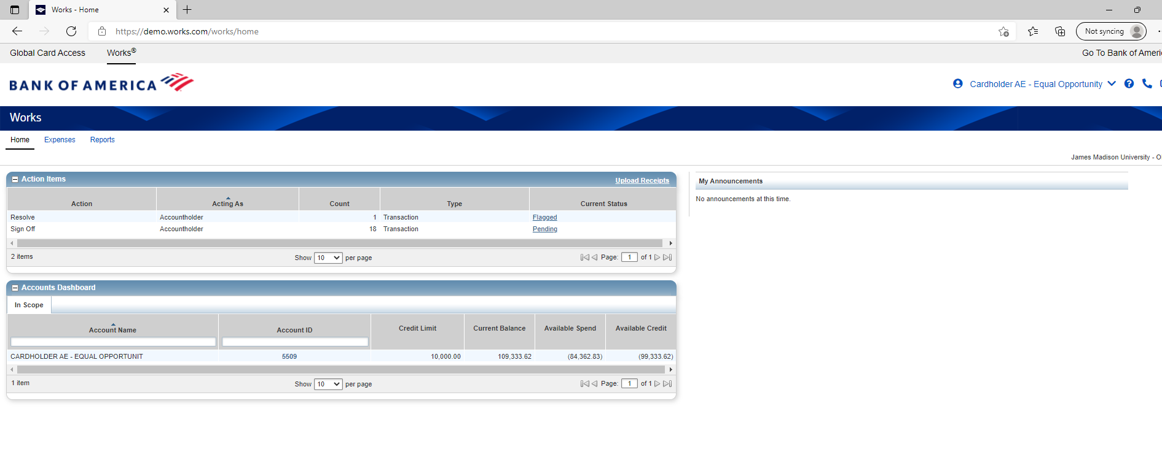
Cash and Investments Office
Contact: appa@jmu.edu
Cardholder Reconciliation
Flagged Transactions
If the approver reviews a transaction and finds an error, the transaction will be flagged. It will be listed under Action Items for the cardholder to correct.

Slide 43
Cash and Investments Office
Contact: appa@jmu.edu
Cardholder Reconciliation
Flagged Transactions
The cardholder should click on Flagged to view the transaction.

Slide 44
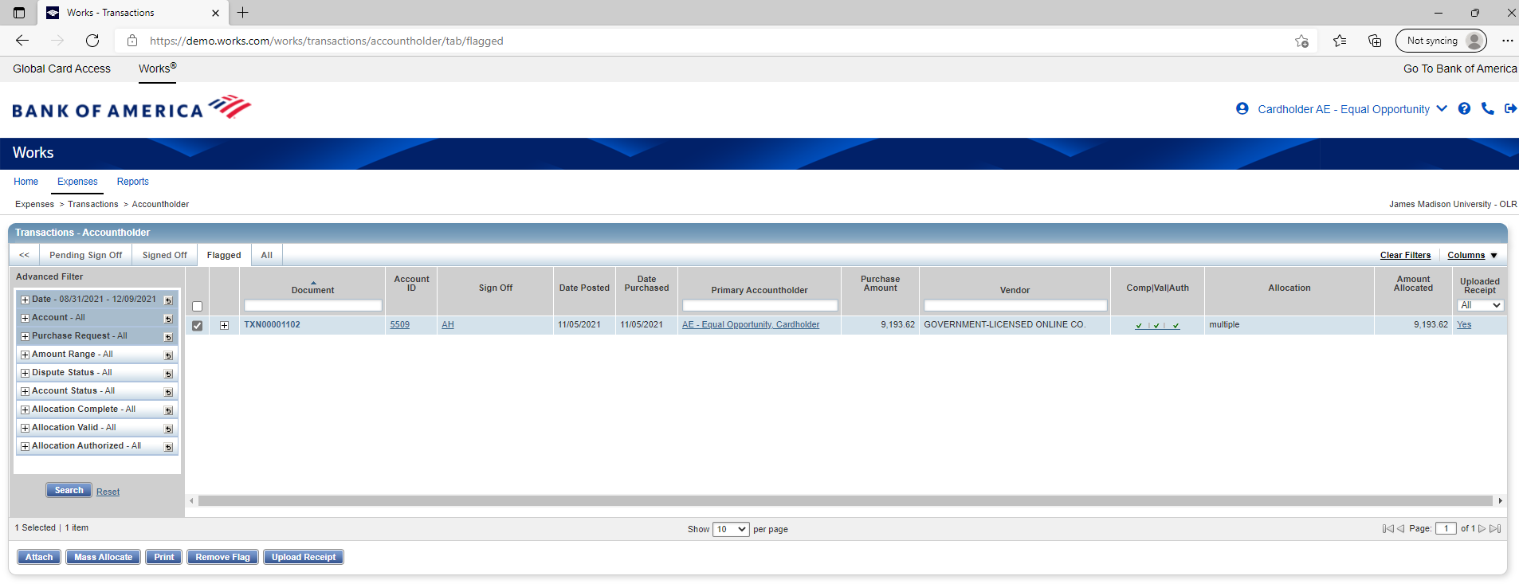
Cash and Investments Office
Contact: appa@jmu.edu
Cardholder Reconciliation
Flagged Transactions
The Transactions-Accountholder page will appear with the flagged tab.

Slide 45
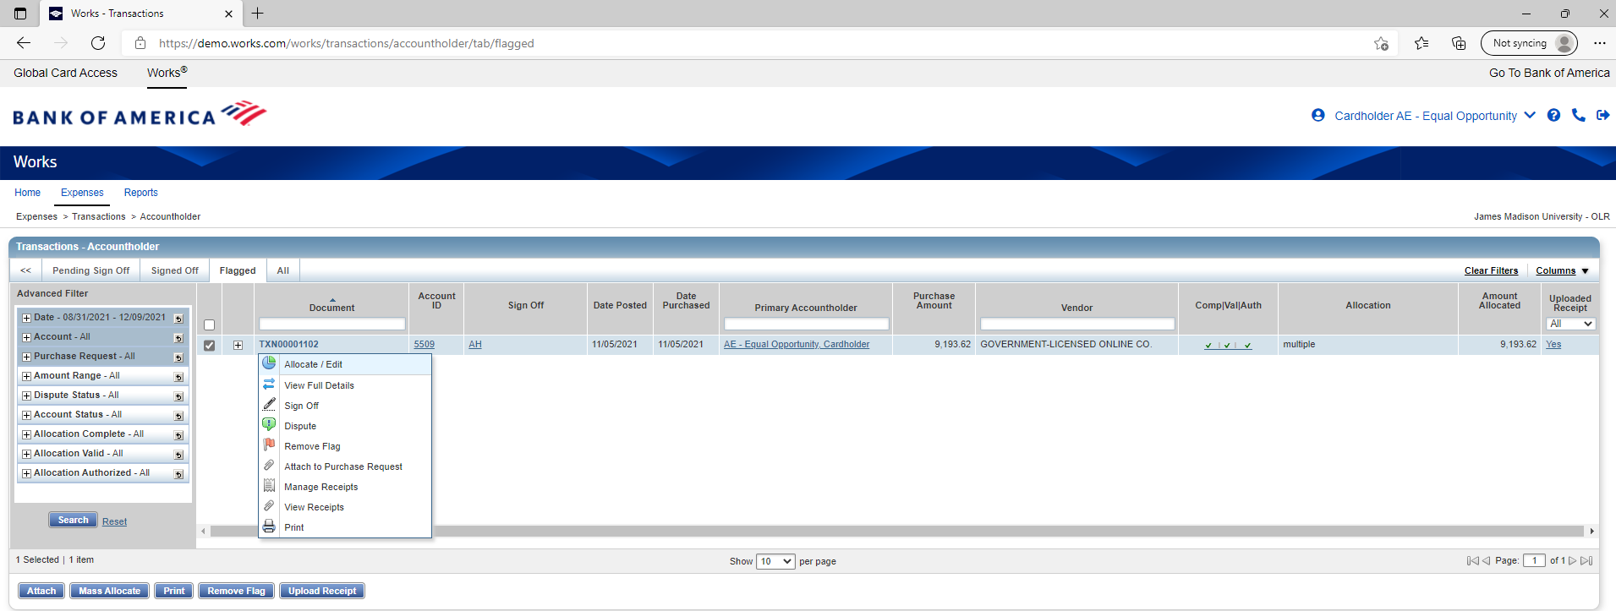
Cash and Investments Office
Contact: appa@jmu.edu
Cardholder Reconciliation
Flagged Transactions
The cardholder should hover over the transaction until the black arrow appears to open the pop up box. After that, select Allocate/Edit.

Slide 46
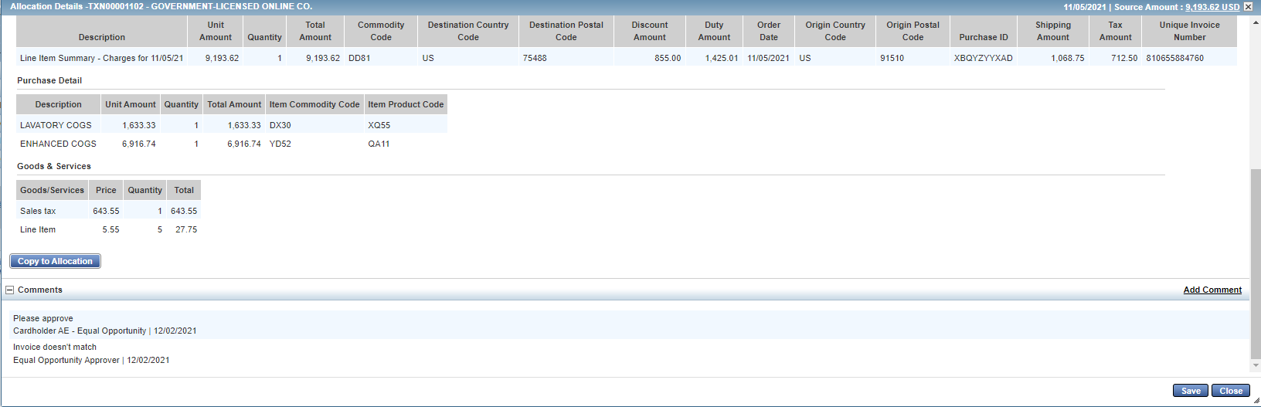
Cash and Investments Office
Contact: appa@jmu.edu
Cardholder Reconciliation
Flagged Transactions
This will bring up the allocation details where the cardholder can see the approver’s comment. After correcting the issue, the cardholder will select Save.

Slide 47
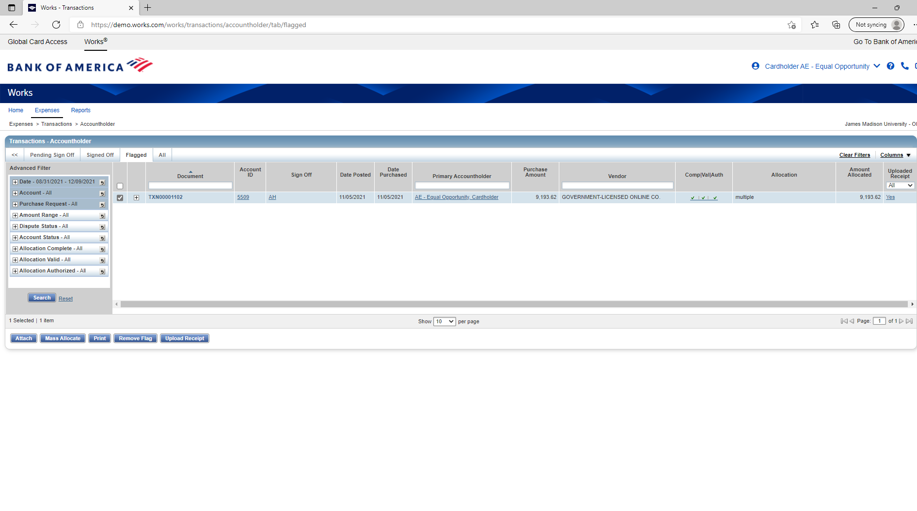
Cash and Investments Office
Contact: appa@jmu.edu
Cardholder Reconciliation
Flagged Transactions
This will take the cardholder back to the Transactions-Accountholder page and the flagged tab. If all items have been corrected, the cardholder can select Remove Flag.

Slide 48
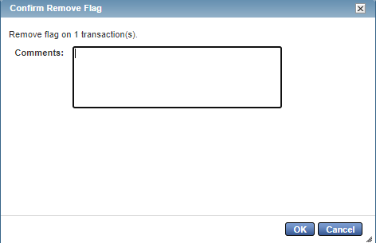
Cash and Investments Office
Contact: appa@jmu.edu
Cardholder Reconciliation
Flagged Transactions
A pop up box will appear where the cardholder should make a comment letting the approver know of the corrections made. Once written, select OK.

Slide 49
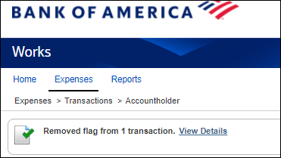
Cash and Investments Office
Contact: appa@jmu.edu
Cardholder Reconciliation
Flagged Transactions
Then, a message box will appear indicating the flag has been removed. The transaction is now routed back to the approver.

Slide 50
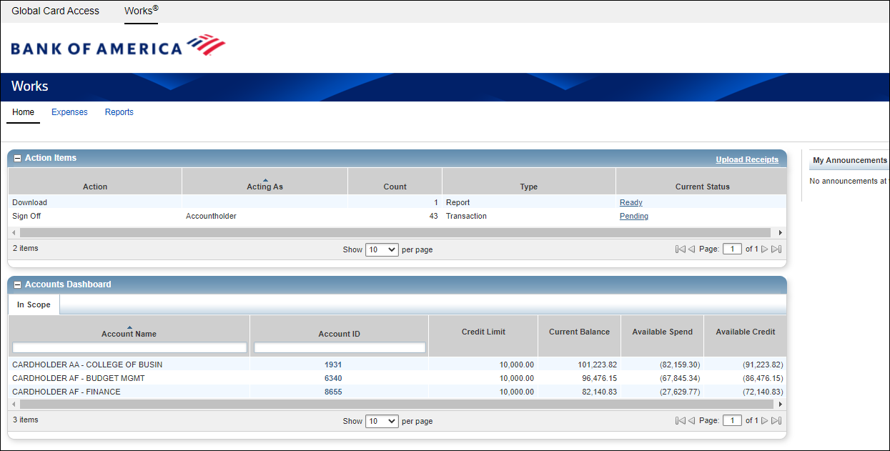
Cash and Investments Office
Contact: appa@jmu.edu
Cardholder Reconciliation
Multiple Cardholder
If the cardholder has access to multiple cards, those cards will be listed under the Accounts Dashboard. If a card is not listed that the cardholder needs to reconcile, a Manage Reconcilers form must be completed in PeopleSoft Finance.

Slide 51
Cash and Investments Office
Contact: appa@jmu.edu
Cardholder Reconciliation
Multiple Cardholder
Under Action Items, the cardholder should select Pending.

Slide 52
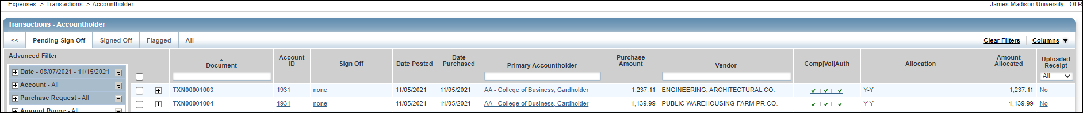
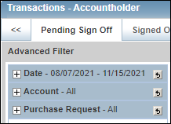
Cash and Investments Office
Contact: appa@jmu.edu
Cardholder Reconciliation
Multiple Cardholder
All the charges for each card will be displayed. The cardholder can look at one card at a time by selecting the + button next to Account.

Slide 53
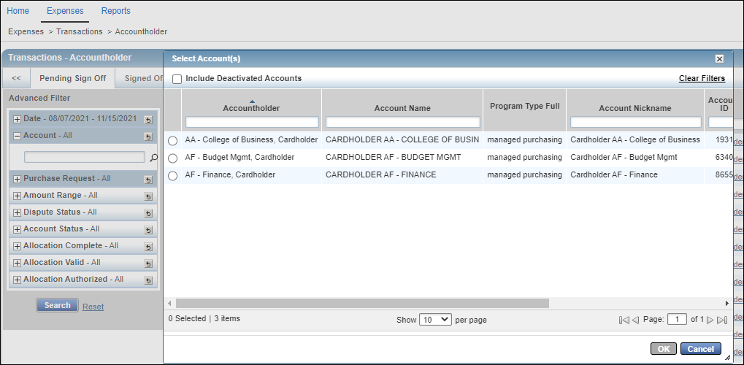
Cash and Investments Office
Contact: appa@jmu.edu
Cardholder Reconciliation
Multiple Cardholder
Then, a magnifying glass will appear. The cardholder should select the magnifying glass to see each of the cards. The cardholder can check the bubble next to the corresponding card. From there, the reconciliation process will begin.

Slide 54
Cash and Investments Office
Contact: appa@jmu.edu
Approvals
Information Review
Approving One Transaction
Approving Multiple Transactions
Flagging a Transaction

Slide 55
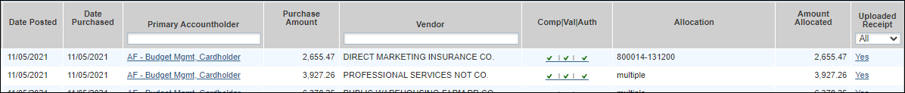
Cash and Investments Office
Contact: appa@jmu.edu
Cardholder Reconciliation
Information Review
Date Posted | Date Purchased | Primary Accountholder | Purchase Amount | Vendor | N/A | Allocation | N/A | Uploaded Receipt
This is the date the transaction posted to the cardholder’s card. It is also the first date the transaction was eligible to be reconciled in WORKS. | Date the transaction was made. | Cardholder name. | The amount of the transaction. | The name of the vendor where the purchase was made. | N/A | Department Number (first number) and Expenditure Account Code (second number) the charge has been allocated to. If the description says multiple, that means more than one department number of expenditure account code was used during reconciliation. You will need to click on the transaction for more details. Instructions on this will begin on page: *Make sure the allocation is correct, department numbers are not restricted by cardholder. | N/A | The hyperlink should also say Yes, click on the hyperlink to view a copy of the documentation submitted with the charge. The approver should assure the documentation matches the charge.

Slide 56
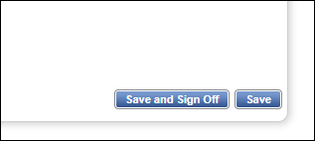
Cash and Investments Office
Contact: appa@jmu.edu
Cardholder Reconciliation
Approving One Transaction
From the transaction details page, click on Save and Sign Off.

Slide 57
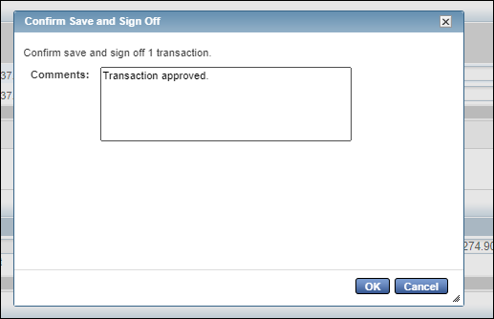
Cash and Investments Office
Contact: appa@jmu.edu
Cardholder Reconciliation
Approving One Transaction
After, a pop up box will appear. In the comments, the approver may add a comment. However, it is not required. When finished, the approver will select OK.

Slide 58
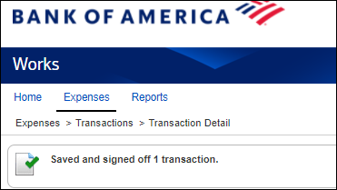
Cash and Investments Office
Contact: appa@jmu.edu
Cardholder Reconciliation
Approving One Transaction
Once the transaction is approved, the approver will see a message that the transaction was saved and signed off on.

Slide 59
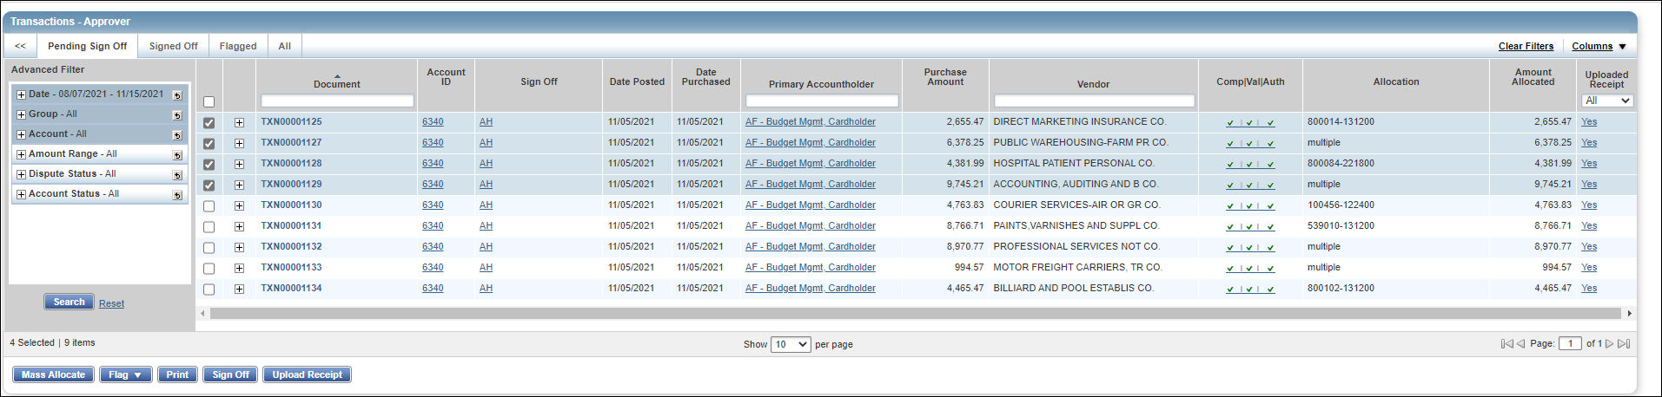
Cash and Investments Office
Contact: appa@jmu.edu
Cardholder Reconciliation
Approving Multiple Transactions
From the Transactions-Approver page and the Pending Sign Off tab, the approver will click on the boxes of the transactions to be approved. Next, the approver will select Sign Off.

Slide 60
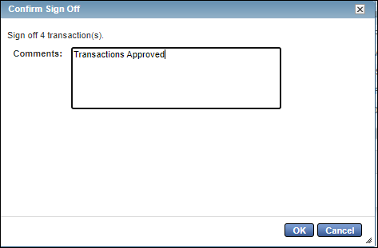
Cash and Investments Office
Contact: appa@jmu.edu
Cardholder Reconciliation
Approving Multiple Transactions
After, a pop up box will appear. In the comments, the approver may add a comment. However, it is not required. When finished, the approver will select OK.

Slide 61
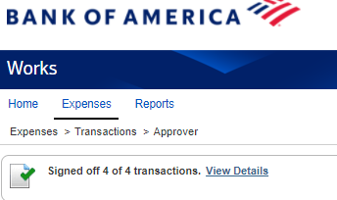
Cash and Investments Office
Contact: appa@jmu.edu
Cardholder Reconciliation
Approving Multiple Transactions
Once complete, a message box will appear that says the transactions are signed off.

Slide 62
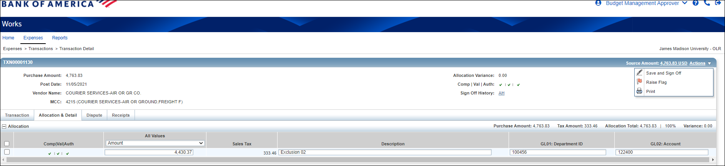
Cash and Investments Office
Contact: appa@jmu.edu
Cardholder Reconciliation
Flagging a Transaction
If a transaction is missing information or is incorrect, an approver may flag that transaction. This means that the transaction will be sent back to the cardholder to correct the information with a note from the approver. Once the information is corrected, it will be signed off and sent back to the approver. To flag a transaction, the approver must select Raise Flag from the Transaction Detail page.

Slide 63
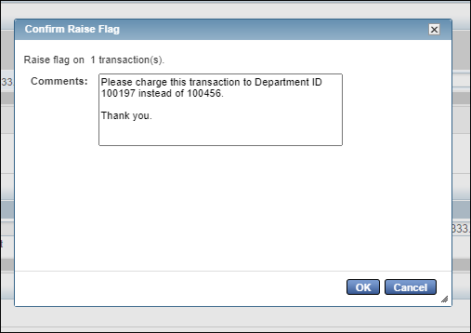
Cash and Investments Office
Contact: appa@jmu.edu
Cardholder Reconciliation
Flagging a Transaction
A pop up box will appear. The approver should make a comment to let the cardholder know why the transaction is being sent back for a correction. After the approver has made a comment, select Ok.

Slide 64
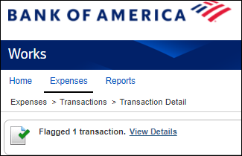
Cash and Investments Office
Contact: appa@jmu.edu
Cardholder Reconciliation
Flagging a Transaction
Then, a message box will appear indicating that the transaction has been flagged.

Slide 65
Cash and Investments Office
Contact: appa@jmu.edu
Monthly Reconciliation Report
General Information
Running Report

Slide 66
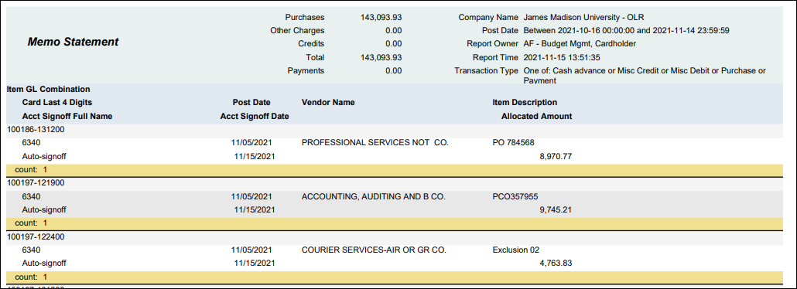
Cash and Investments Office
Contact: appa@jmu.edu
General Information
The cardholder will run the Memo Statement monthly to keep with SPCC records.
The report must be run after all charges are reconciled for the billing cycle and kept with SPCC records for the current and past fiscal year.

Slide 67
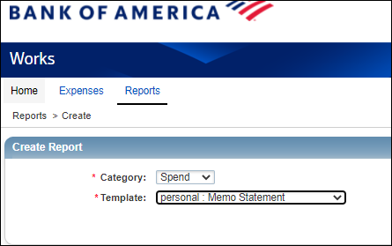
Cash and Investments Office
Contact: appa@jmu.edu
Running Report
From the WORKS report page, the cardholder will choose Reports and Create. The category will be Spend. The template is the Memo Statement.

Slide 68
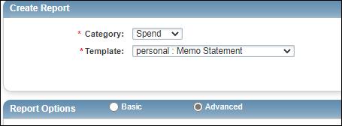
Cash and Investments Office
Contact: appa@jmu.edu
Running Report
The cardholder should make sure that on the Report Options, Advanced is selected.

Slide 69
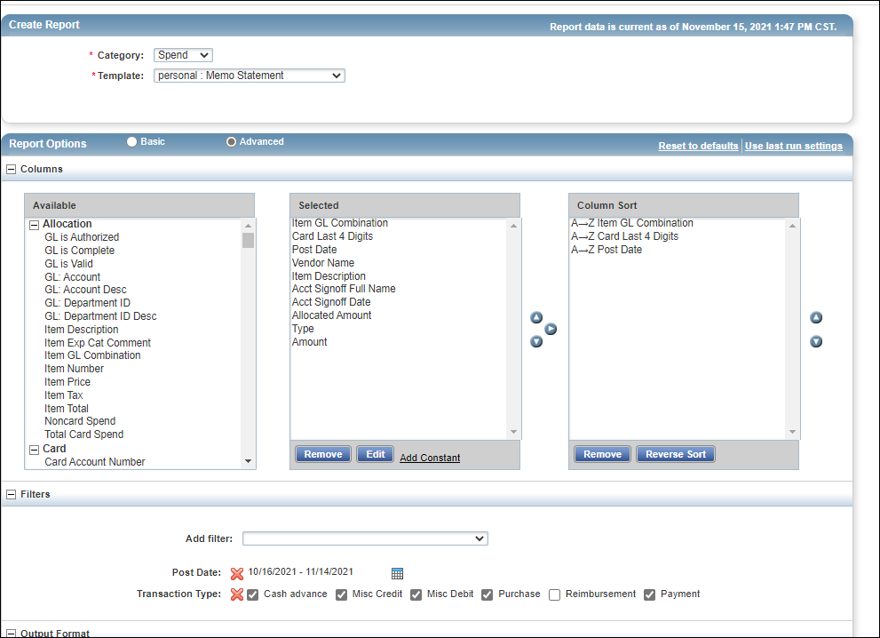
Cash and Investments Office
Contact: appa@jmu.edu
Running Report
In the Filters, the cardholder will select the calendar.

Slide 70

Cash and Investments Office
Contact: appa@jmu.edu
Running Report
After the pop up box appears, the cardholder should make sure that Previous Cycle is selected and select Ok.

Slide 71

Cash and Investments Office
Contact: appa@jmu.edu
Running Report
The cardholder should make sure to select PDF and Full Details. After that, select Submit Report.

Slide 72
Cash and Investments Office
Contact: appa@jmu.edu
Running Report
Once the Complete Reports page appears, the cardholder should select PDF to view the report.

Slide 73
Cash and Investments Office
Contact: appa@jmu.edu
Additional Information
Bank of America WORKS FAQS
Contact Information

Slide 74
Cash and Investments Office
Contact: appa@jmu.edu
Bank of America WORKS FAQS
Q: When will reconciliation in WORKS begin?
Reconciliation in WORKS will began after Winter Break on Monday January 3, 2022. The January 15, 2022 billing cycle is the first billing cycle in the Bank of America WORKS reconciliation process.
Q: When will reconciliation in People Soft Finance end?
The last billing cycle reconciled in PeopleSoft Finance was the December 15, 2021 billing cycle.

Slide 75
Cash and Investments Office
Contact: appa@jmu.edu
Bank of America WORKS FAQS
Q: Will training be offered for the Bank of America WORKS reconciliation?
Yes, there is monthly training offered by the Cash & Investments Office. A training schedule can be found on the SPCC website: Finance Office: Small Purchase Charge Card Program - JMU
Q: Will cardholders need to do anything to move their current reconcilers in PeopleSoft to have the ability to reconcile their transactions in WORKS?
No, all current reconcilers on active cards will be moved into WORKS.
Q: Are all transactions required to be reconciled in WORKS?
Yes, all transactions should be reconciled in WORKS by the closing date each month.
Q: Are all transactions required to be approved in WORKS?
Yes, all transactions should be approved in WORKS by the closing date each month.

Slide 76
Cash and Investments Office
Contact: appa@jmu.edu
Bank of America WORKS FAQS
Q: Who will approve my transactions in WORKS?
Approval structures for each department were developed during implementation. Approvers are based on cardholder and not department ID being charged.
Q: Will there still be a coversheet to print and approve monthly?
No, all transactions will be approved in WORKS electronically.
Q: Are approvers required to take additional training?
No this is not required; however, approvers can attend one of the training sessions in December 2021. There will also be training guides available on the Cash and Investments website.
Q: Are reconcilers required to take training before getting access to works?
No this is not required; however, approvers can attend one of the training sessions in December 2021. There will also be training guides available on the Cash and Investments website.

Slide 77
Cash and Investments Office
Contact: appa@jmu.edu
Bank of America WORKS FAQS
Q: Will all cardholders have the ability to reconcile their transactions in WORKS?
Yes, all cardholders are given access to WORKS when they apply for a card. Cardholders will have the ability to reconcile their transactions; they can also establish a reconciler to reconcile on their behalf.
Q: How do cardholders give access to someone to reconcile their card in WORKS?
Cardholders will continue to complete the Manager Reconcilers form in PeopleSoft Finance to add reconcilers to their card.
Q: Am I required to put my eVA information in during reconciliation?
Yes, there is a description field in WORKS that will require you to put either your eVA order number of exclusion number. The transaction will not move to your approver unless there is information placed in this field. If you do not put eVA information in or put NONE your department will be charged a 2% non-compliance fee.

Slide 78
Cash and Investments Office
Contact: appa@jmu.edu
Bank of America WORKS FAQS
Q: Is a statement required to be run for each cycle?
Yes, the Memo Statement within WORKS that is required to be run monthly.
Q: Are images of receipts required to be uploaded in WORKS during reconciliation?
Yes, each transaction will require a copy of the receipt before it will be moved to the approvers profile for review and approval.
Q: Do I still need to keep physical copies of receipts once I have uploaded them into WORKS?
Physical copies of receipts and Memo Statements need to be kept for the current and previous fiscal year for transactions reconciled in WORKS.
Q: When is the last day I can reconcile a charge for a billing cycle in WORKS?
Transactions will need to be reconciled and approved in WORKS for each billing cycle by the 5th of the next month. Example: Billing cycle ends January 15th transactions need to be reconciled and approved by February 5th.

Slide 79
Cash and Investments Office
Contact: appa@jmu.edu
Bank of America WORKS FAQS
Q: Will WORKS reconciliation change the audit process?
If a transaction has been reconciled completely in WORKS Cash and Investments will review those charges before emailing weekly and monthly audit requests. If a transaction is reconciled and appears on an audit report Cash and Investments will only contact the cardholder if there are additional questions or documentation needed. Weekly audit reports are created about 2 weeks after a charge posts.
Q: When will SPCC transactions post to my departmental budget?
Once a transaction has been reconciled and approved the expectation is that it will be posted to your departmental budget within the next 1-2 business days, depending on time of month the transaction is reconciled and approved.

Slide 80
Cash and Investments Office
Contact: appa@jmu.edu
Contact Information
Cash & Investments: appa@jmu.edu (Departmental mailbox monitored during business hours)
SPCC Program Administrators
Jennifer Hart Barb 568-7396 hartjd@jmu.edu
Racheal Estep 568-6771 esteprm@jmu.edu
Kristin Johnston 568-8061 john32km@jmu.edu
Tish Leeth 568-3205 leethtc@jmu.edu

