Slide 1
Connecting with Student Affairs Resources
Dean of Students, Office of Disability Services, Counseling Center

Slide 2
Dean of Students
Gloria Mast & Dom Rodriguez

Slide 3
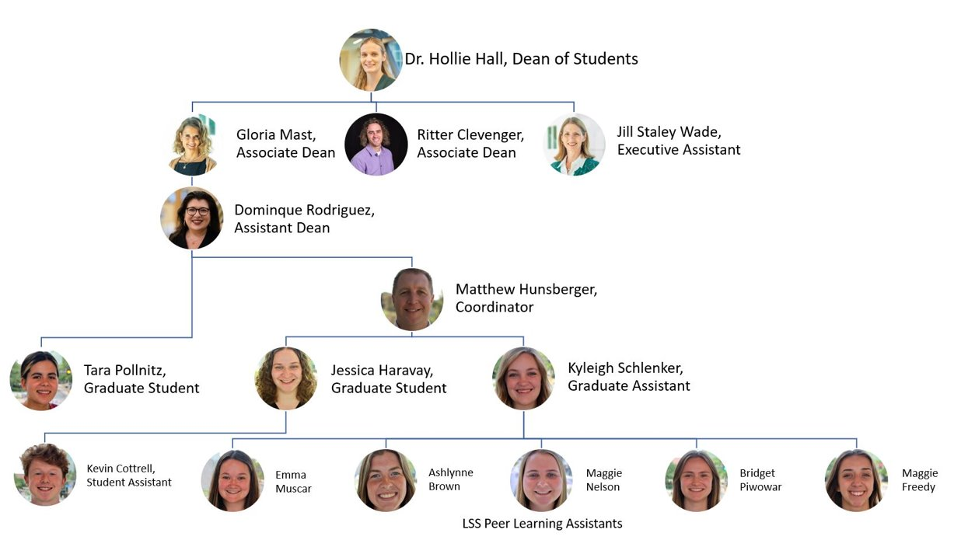

Slide 4
madisoncares@jmu.edu
MadisonCares
Helping students experiencing a variety of challenges while at JMU
Connect students with the resources they need and provide advocacy during times of need
Provide consultation to faculty, staff, students, family members, etc. on how to navigate concerning situations
Be a support for students in distress before situation could escalate
NOT first responders, should not be used for emergency situations
Notes:
Dom

Slide 5
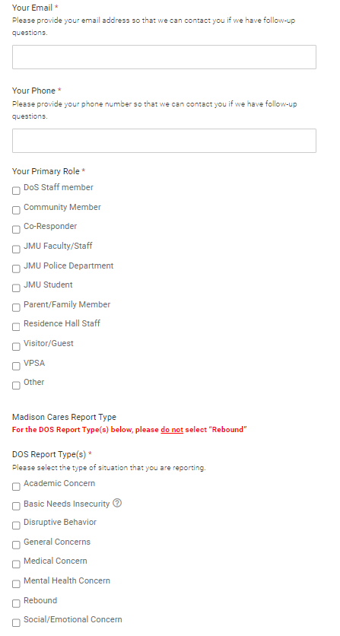
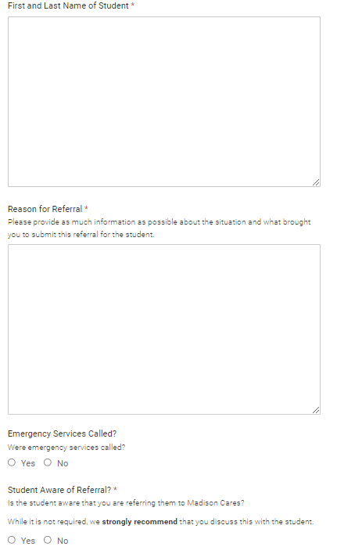
Notes:
Dom

Slide 6
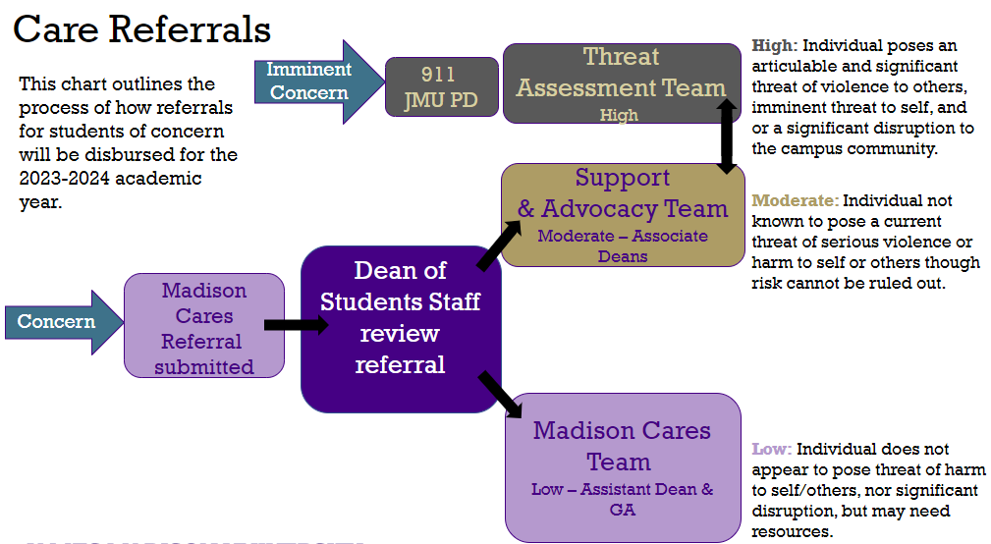
Notes:
Dom
We've mentioned a few different teams and assigning a "level of risk" to a situation. We thought showing you a visual of how our system currently functions would help explain these further.
If you start on the left hand side of the screen you will notice that for our process to begin someone needs to notice a concern. If that concern is imminent (threat of violence to self or others, significant disruption), that is not something our office responds to. 911/Campus Police are to be called and they are to respond. A Madison Cares referral can still be submitted but it should be after emergency services have intervened. Dean of Students are not first responders and this distinction has now clearly been made. The Threat Assessment Team is chaired but Threat Assessment Analyst housed out of JMU Police which helps with this distinction. There was an expectation in the past that DOS was first responders and available to respond to emergent situations. This is no longer the expectation.
All other concerns will follow the other path on the screen. Someone notices a concern, they submit a Madison Cares referral on our website, Dean of Students staff review the referral and then assign it to the proper staff member/team. The way we make these assignments is by using a Low, Moderate, or High distinction.
These are defined as:
High – individual poses an articulable and significant threat of violence to others, imminent threat to self, and/or a significant disruption to the campus community – goes to Police/TAT
Moderate – individual not known to pose a current threat of serious violence or harm to self or others though risk cannot be rules out – goes to Associate Deans/SAT
Low – individual does not appear to pose threat of harm to self/others nor significant disruption but may need resources – goes to Assistant Dean/MC

Slide 7
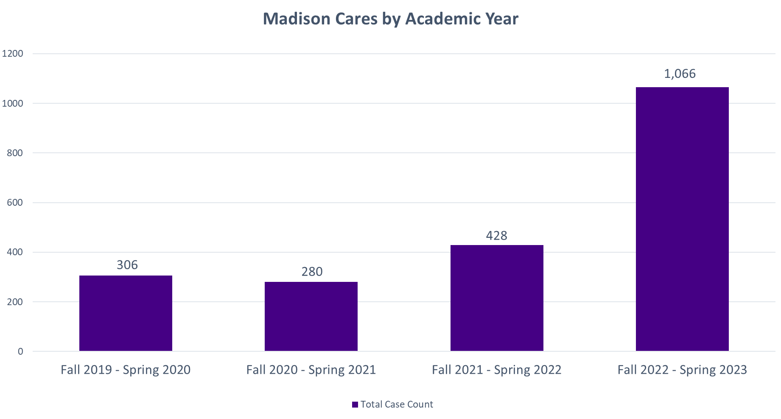
Notes:
Dom
The reason we are here with you today is to talk about how we have managed and maintained the growth of Madison Cares, so let's get into that.
This past academic year we saw our number of referrals more than double. With the growth in number of referrals and complexity of issues Madison Cares was receiving, our team needed to make changes to our process in order to not only remain efficient and provide the best service possible to our community, but to also maintain an amount of work that was sustainable for the staff we have. We knew the answer was not going to be "let's hire more staff".
The main question we usually receive when we show people this chart is what changed between the 2021-2022 school year and the 2022-2023 school year. We think we can attribute this increase to 2 different things.
First, our staff was able to start intentionally marketing Madison Cares to specific populations. For example, Madison Cares was highly emphasized to all families who attended summer 2022 orientation with their incoming student, and HDs were trained on how to properly use Madison Cares during their August 2022 training. Second, 2022 was year 4 of the existence of Madison Cares, this means that with the exception of the incoming first year class/ new transfers, all JMU students have been with us since Madison Cares started. We reached a point in the existence of this program that it was becoming part of the campus culture.
I will also mention that in speaking with other universities who manage very similar programs, they have seen a similar change in their referral numbers over the past year and are also in the process of updating their procedures as well.

Slide 8
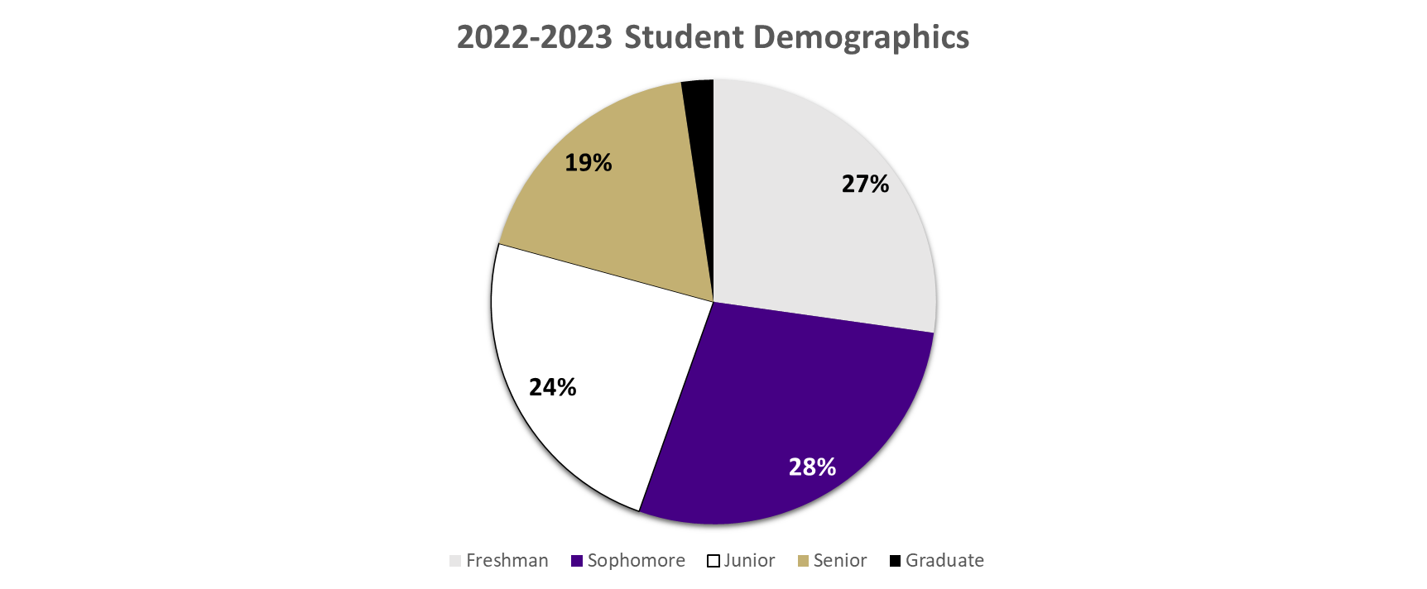
Notes:
It can be easy to assume that this program would mainly be serving our first year students, however, our data has consistently shown us that students in all years are referred to Madison Cares. While Graduate students are the clear outlier with about 2% of our total cases from the 2022-2023 academic year, there is a fairly even distribution across all undergraduate years. This shows that Madison Cares is a resource for ALL students.

Slide 9
Office of Disability Services
Valerie Schoolcraft
Schoolvl@jmu.edu

Slide 10
Disability Services Overview
Function to support JMU with compliance with ADA mandates and in support of the mission to create accessible environments that are inclusive for people with disabilities.
Academic accommodations
Process for students
Communication with faculty
Accommodate
Accommodate Portal - JMU

Slide 11
Disability Services Program Areas
Exam Accommodations
Accessible media and technology (i.e. audio text, captioning and more)
ASL Interpreters
Housing
Marketing and communication – messaging in publications
Programming and outreach

Slide 12
Demographics
Increasing numbers of students seeking accommodations
Trend lines: more students, more complicated cases
Admissions shared with ODS that 517 students in the incoming class reported disability and associated accommodations in high school. Only approximately 100 (20%) of those have connected with ODS to date

Slide 13
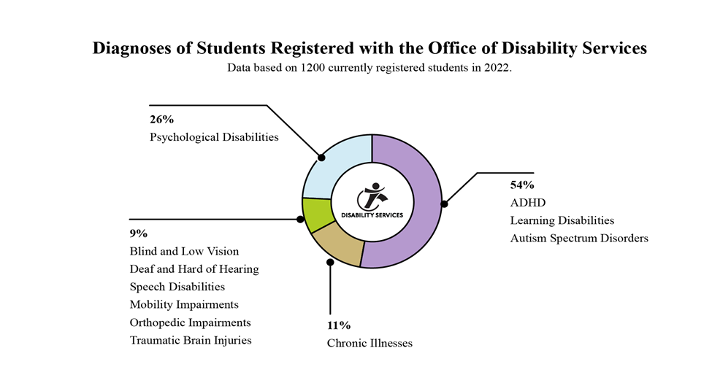

Slide 14
Topics of Discussion
On-line learning requests / "Remote Participation"
Need to continue deliberative process and reviews to determine whether the request presents a challenge such as a fundamental alteration
Exams and Finals: ODS expanded support with space and proctors

Slide 15
New This Year for ODS
ODS will be hiring a new Associate Director
Clinical coordination and support
ODS is working to expand and improve outreach to Faculty
Faculty Liaison Lori Hostetler
Upcoming opportunities: CFI Faculty Welcome
Presentation for departments / Listening to faculty

Slide 16
Counseling Center
David Onestak
Onestadm@jmu.edu

Slide 17
Counseling Center (CC) Overview
The CC provides free, confidential counseling and psychiatric services to JMU students, and we consult with others, including JMU faculty and staff members, who are concerned about a student.
Anyone who follows media reports has seen headlines suggesting that a mental health crisis exists at U.S. colleges and universities, and that it is worsening.
The CC is experiencing extremely high levels of acuity:
270 crisis intakes
65 post-intake crisis appointments
30 referrals for psychiatric hospitalization

Slide 18
CC Overview Cont'd
The CC provides students with individual counseling to assist them with a variety of personal and interpersonal concerns that are impacting their quality of life and their academic performance.
Last year, 80% of students report that our services helped them to both improve their academic performance and to remain in school. The CC is one of JMU’s most important academic support resources.
The CC operates under a short-term treatment model under which the student and the counselor collaboratively identify and address the student’s primary concerns within a limited number of sessions, normally 3 to 5 sessions.

Slide 19
CC Overview Cont'd
The CC has a very active group counseling program, and each semester, students have the opportunity to participate in small group experiences (6 – 8 students) on issues related to their needs.
The CC has two psychiatric providers who prescribe medications that may be helpful to students dealing with psychological issues.
The CC also staffs a well-developed emergency services model, with 24/7 services in place to help students experiencing a serious crisis such as threat of harm to themselves or to others or a recent sexual assault.
After hours, faculty should call the CC at (540) 568-6552 and press “1”

Slide 20
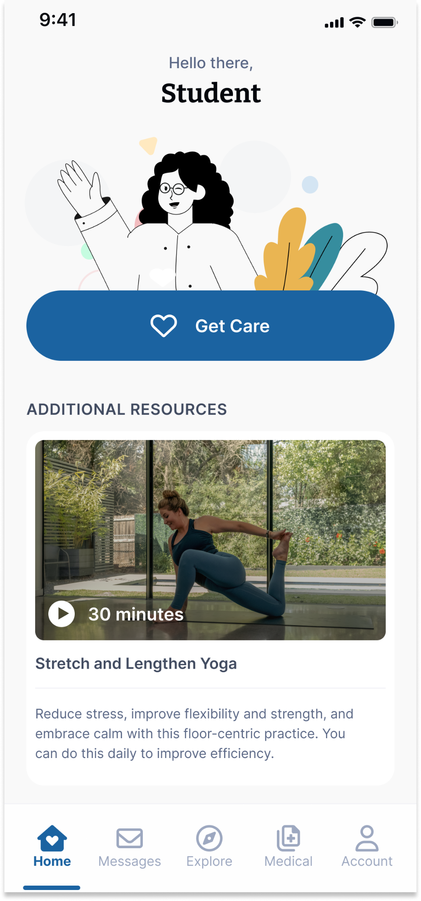
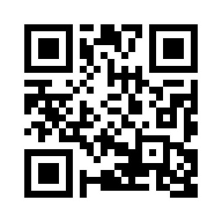
Student Virtual Health and Well-Being Resources
Available on the TimelyCare app or timelycare.com/jmu
TalkNow
24/7, on-demand emotional support to talk about anything
Scheduled Counseling
Choose your preferred day, time, and mental health provider.
Psychiatry
Appointments available through referral.
Self-Care Content
Visit the explore page for guided self-care content.
Faculty/Staff Consultation
Via phone regarding how to support a student in distress.
Scan the QR Code to access care.
QR CODE HERE
It’s for Students.
FOR FREE.

Slide 21
Questions?

