Slide 1

Work-Based Learning Experiences
(WBLEs) at JMU
Libby Westley
University Career Center
Steve Whitmeyer
College of Science and Math
Siân White
College of Arts and Letters
Notes:
We want to thank Elizabeth and all of you for allowing us to come speak to you about our work on WBLES.
Introduce self and Libby, Steve
We're excited to bring this to you
Haven't had the chance to present our work
Welcome your feedback and hope you'll want to be involved

Slide 2

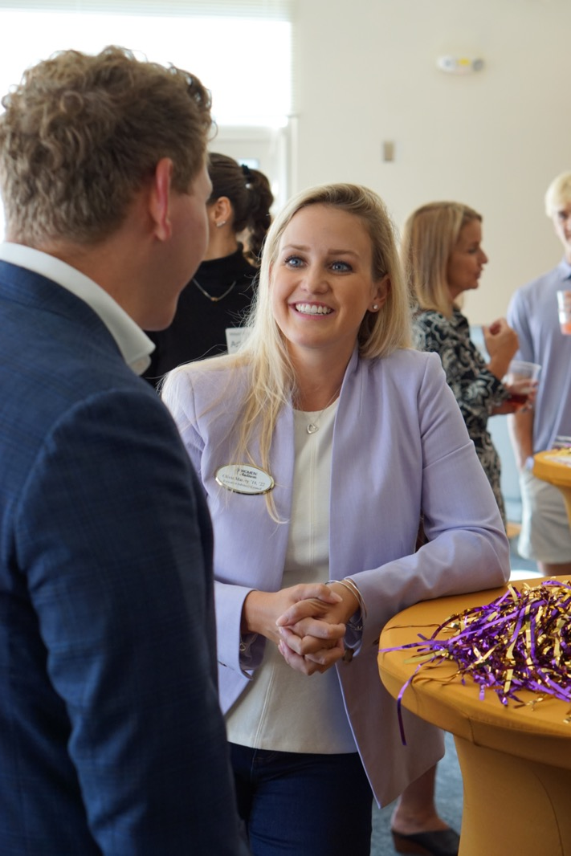
Agenda
WBLE Task Force 2022-2024
  Definition
  In the Curriculum
  Data
  Recommended Structure
WBLEs and the Commonwealth
Our Requests to You
Notes:
[ANIMATE] WBLE Task Force 2022-2024:
Joint Academic and Student Affairs (overview)
Gathering information about current WBLE landscape at JMU, compared to peer institutions
Representatives from all colleges, Institutional Research (PAIR), the Provost's Office, REDI, VIEW, CEVC, CGE, PCE, the Registrar, etc
[ANIMATE]
WBLE Definition
WBLEs in the Curriculum
WBLE Data – to establish baseline of experiences, what’s being done, who’s doing it
WBLE Recommendations
publicly available Report and White Paper: QR code on last slide
WBLEs and the State/Commonwealth
Our Requests to You
NEXT SLIDE: introduce our WBLE definition

Slide 3
What is a WBLE?
A work-based learning experience incorporates hands-on work in an applied context that increases knowledge and skills necessary for discipline-focused career readiness
Experiences can be paid or unpaid, for-credit or not, in-person or virtual
WBLE examples: internships, practicums, clinicals, research experiences, student teaching, and others.
Notes:
SOURCES
-- Distillation of common elements from multiple definitions, including from
Amer Assoc Colleges & Universities,
National Association of Colleges and Employers,
SCHEV,
Virginia Dept of Ed,
Indeed.com
PRIMARY DEFINITION
NEXT SLIDE: operational definition

Slide 4
What is a WBLE?
Work-Based Learning Experiences must:
Increase field-related knowledge and skills that are identified at the beginning of the experience.
Be supervised by a professional in the field who provides oversight and guides the student’s experience.
Occur in a context beyond a class.
This can include experiences like:
Research or teaching assistant work with faculty supervision.
Courses with a semester-long project for external partners or companies.
Notes:
OPERATIONAL DEFINITION
To be a WBLE, the experience must:

Slide 5

WBLEs in the Curriculum
Tagging WBLE courses
New question in Modern Campus Curriculum
Experiences Not For Credit
Notes:
Tagging WBLE Courses – Advantage:
Registrar can run a query and drill down in a number of ways (Libby will talk about)
Will need to be updated regularly
New Question in Modern Campus Curriculum (formerly Curriculog)
Current Approver is Arin Hawse, in consultation with others
Will need to develop a process for capturing and evaluating Experiences Not taken for credit
A menu of ways we can imagine, early conversations
NEXT SLIDE: to Libby for some data

Slide 6
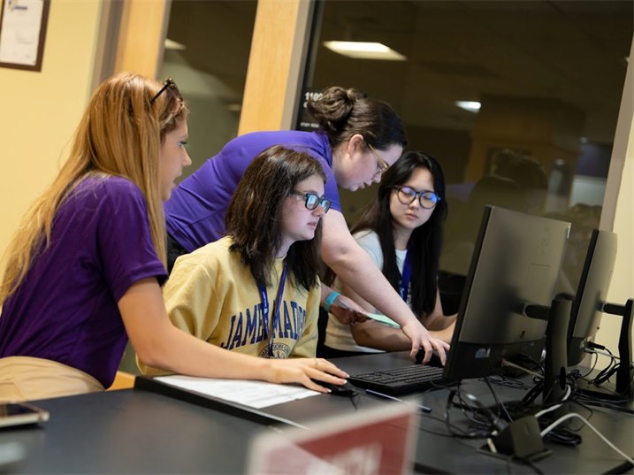
WBLE Data:
WBLEs in the Curriculum
Fall 2022, Spring 2023 & Summer 2023
279
Unique courses with WBLEs
2,093
Sections of courses with WBLEs
5,812
Completed WBLE course
30%
Of enrolled students completed a WBLE designated course

Slide 7
WBLE Data
Student Survey Spring 2024
42.4% Reported a Work-Based Learning Experience
WBLE Type | # with WBLE
Internship | 39.4%
Student Teaching | 13.6%
Undergraduate Research | 11.8%
Practicum | 10.0%
Clinicals | 7.7%
1,452 Responses
Notes:
42.4% reported a WBLE experience between Summer 2023 and Spring 2024. We had the highest number of responses from CHBS (481), CAL (287) and COB (258)

Slide 8
WBLE Data
Career Outcomes Survey
69.9% of Bachelor's-Degree Recipients had at least 1 WBLE
N=2,419 (Number of bachelor’s-degree recipients for whom we have internship completion knowledge)
¹Graduates on the First Destinations Survey responded to the question “How many internships did you complete during your time at JMU? (This can also include student teaching, fellowships, practicum, fieldwork, externships, clinicals.)” Additional information from LinkedIn Profiles with the job titles like “Internship” are included in this category.
Notes:
Updated 6/8 3:45pm

Slide 9
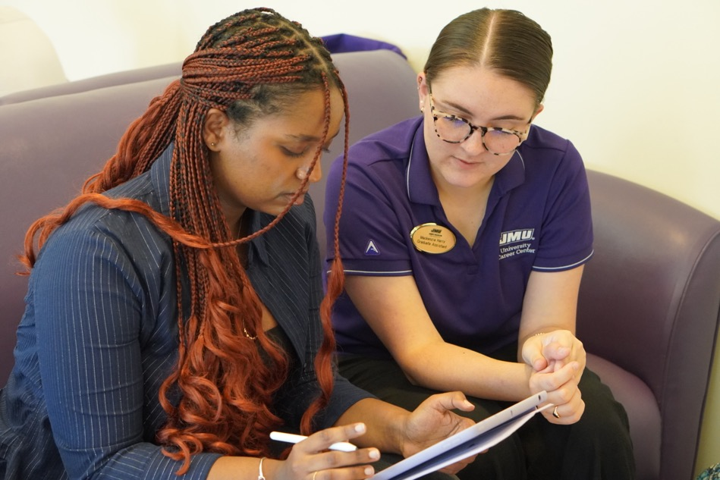
WBLE Data
New Initiatives
Senior Compass
12Twenty
Notes:
Three current sources [Libby]:
WBLE Courses – Registrar Query (already discussed above)
Career Center Outcomes Survey – sent to recent grads, did you have a WBLE?
WBLE Student Survey – current students: what type did you have and where
Need to know about not-for-credit experiences, still need a process for students to evaluate, reflect, and report on their WBLEs
New Initiatives:
Senior Compass (required for students graduating) *important to this work as a final metric at graduation
12Twenty – need to gather info in one place during a student’s JMU career
Clearing house for students, faculty, and employers
both have basic reflection and evaluation prompts, but not like for-credit experiences [does this go in the how you can help slide?]
Our hope – to survey students before they are graduating so we can get them the experiences and track them while they’re here
NEXT SLIDE: to steve to talk about WBLE TF Recommendations for structure

Slide 10


WBLE Recommendations: Structure
President-Level Oversight Committee
Provides strategic guidance and oversight of WBLE initiatives
Serves in an advisory capacity to WBLE coordinating groups across campus
Establishes work groups to address challenges or accomplish tasks
Notes:
Our SUPPORT-STRUCTURE RECOMMENDATIONS [Steve]
President-level Oversight Committee

Slide 11
WBLE Recommendations: Structure
Presidential WBLE Committee 2024-25
Chairs
Academic Affairs: Siân White, Steve Whitmeyer
Student Affairs: Libby Westley
Members
Advancement: Carrie Combs, Caitlyn Reed
Office of the President: Kara Dillard, Brandi Duncan, Chris Orem
Student Affairs: Myles Surrett
Research, Economic Development & Innovation: Mary Sullivan (VTOP-VIEW)
Ex-Officio: Malika Carter-Hoyt
Notes:
Compositions of President-level Committee [Steve]
Virginia Internship Experience Workgroup (VIEW):
Virginia Talent and Opportunities Pathways initiative to expand paid and credit-bearing student internships and other work-based learning opportunities in collaboration with Virginia employers.

Slide 12

WBLE Recommendations: Structure
Implementation Committees
  Cultivating Opportunities
  Supporting Stakeholders
  Operations
WBLE Office (in University Career Center)
  Employer Services Staff
  Career Advising Staff
  Operations Staff
Notes:
Our SUPPORT-STRUCTURE RECOMMENDATIONS [Steve – briefly]
Presidential WBLE Committee would oversee and coordinate:
Three Implementation committees (Opportunities, Supports, Operations)
A new WBLE Office (ultimately with three teams/staff that map onto above governing committees)

Slide 13
WBLE Recommendations: Structure
Implementation Committees
Cultivating Opportunities: Maintain existing and generate new partnerships for curricular and non-curricular WBLEs.
Supporting Stakeholders: Support students looking for WBLEs and support faculty maintaining or generating opportunities, coordinating or supervising WBLEs.
Operations: Track and assess the quality and impact of WBLEs, reporting.
Notes:
Our SUPPORT-STRUCTURE RECOMMENDATIONS [Siân]
Implementation Committees
bring together constituencies from across the university, including in WBLE Office
Cultivating Opportunities: Maintain existing and generate new partnerships for curricular and non-curricular WBLEs.
Include Economic Devt folks in REDI, VIEW Region 8, Community Engagement Volunteer Center, Student Employment, Corporate and Foundation Relations, academic units (colleges)
Supporting Stakeholders: Support students looking for WBLEs and support faculty maintaining or generating opportunities, coordinating or supervising WBLEs.
Operations: Track and assess the quality and impact of WBLEs and address barriers to WBLE completion.
Faculty assess learning outcomes according to our own disciplines
This assessment is for career readiness reflection

Slide 14
WBLE Recommendations: Structure
Establish a WBLE Office
Serves as a WBLE hub for employers, students, faculty & staff
Coordinates WBLEs, including with College- and Dept-level experts
Assesses the effectiveness of WBLEs
Tracks completion of WBLEs
Collaborates with Implementation committee members
Staffed by director and dedicated staff for employer services, career advising and operations
Notes:
Our SUPPORT-STRUCTURE RECOMMENDATIONS [Libby]
WBLE Office

Slide 15
WBLEs and the Commonwealth
VA SB 1280 (2023): require all students to have a WBLE without extending time to degree
  SCHEV Working Group convened; final report submitted June 2024
Our Previous and Current SCHEV Grant-Funded Projects:
  Planning Grant for Task Force (2023-2024)
  Student Internship Support (Summer & Fall 2024)
  Data Collection and Analysis Grant (2024-2025)
Notes:
WBLES & Commonwealth [STEVE]
SB1280 – require all students to have one experience without extending time-to-degree
SCHEV working group logistical and fiscal viability
Statewide consensus – not possible by stated goal of Fall, 2025
Not enough employers
Not enough money to build out supports
All kinds of student reasons (tuition, geography, transportation, housing, paid/unpaid, specific populations)
Grants we’ve already earned (students doing stuff right now)
Planning Grant for Task Force (2023-2024) – $25K
Student internship Support (Summer & Fall 2024) – unpaid internship grants
Data Collection and Analysis Grant (2024-2025):

Slide 16
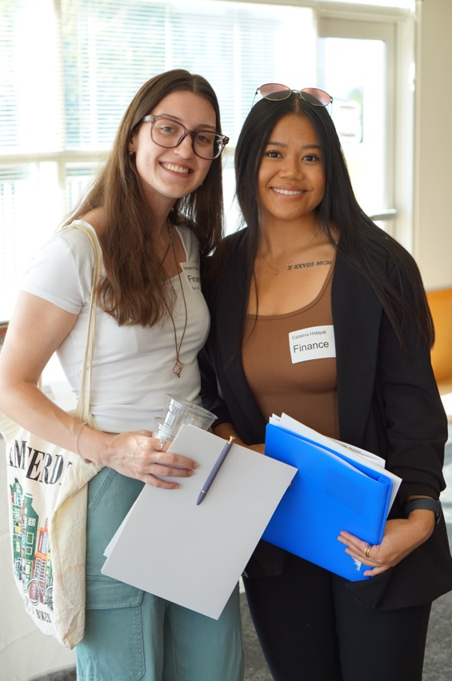
New Grant Initiatives
Capacity-Building Grant ($150,000)
  Submission deadline: October 22, 2024
  Duration: 1 year (2025)
  Proposed support:
    Establish WBLE office
    Support tracking efforts; 12twenty software
    Student interns to help with data analysis
    Faculty support to develop/encourage WBLEs
    Outreach to faculty and students
Scaling Grant ($250,000)
  2-year award, plan to apply for grant in Fall 2025

Slide 17

Our Requests to You
Support Data-Collection Efforts
  Senior Compass
  12Twenty
Respond to Registrar and Student Data Intern Requests
Share your ideas:
  Students: Encouraging Survey Responses & 12Twenty Input
  Faculty: Communicating with and Incentivizing Participation
Share Obstacles You Anticipate
Notes:
Our Requests to You [Siân]
Support and Spread the Word about data-collection efforts:
Senior Compass – support, spread the word
12Twenty: 12Twenty as clearing house for broad coordination (Students, Faculty, Employers) – directing to clearing house
Collecting information about experiences; encourage students to enter their information (someone in WBLE Center approves for now)
reminder: want to be able to help them before they are graduating
Respond to Registrar and Student Data Intern Requests
They might contact you: they're with us!
One Student data analyst, currently contacting departments to learn who students are working with for WBLE courses (internships, external partners with courses, research supervisors, etc)
Another intern is formatting Spring 2024 WBLE Survey Data, for inputting to 12Twenty
He’ll then will input Shree’s info about WBLE courses
Share your ideas:
Students: Encouraging Survey Responses & 12Twenty Annual Input
Faculty: Communicating with and Incentivizing Participation
to supervise experiences (including over the summer)
to attend a training or workshop about developing WBLE classes,
incorporating classroom-to-career reflection into courses
Serving on a committee to evaluate and approve not-for-credit experiences
Serve on Workgroup to develop shared learning objectives and best practices for MOUs/evaluation/reflection
Share obstacles you can anticipate

Slide 18
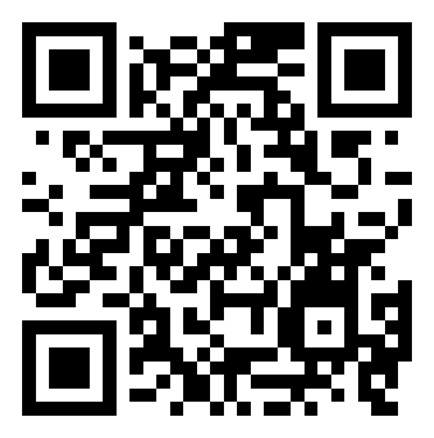
Libby Westley
Director, University Career Center
westleek@jmu.edu
Siân White
Associate Dean, College of Arts and Letters
white2se@jmu.edu
Steve Whitmeyer
Associate Dean, College of Science and Math
whitmesj@jmu.edu
Notes:
QR Code to the Task Force Final Report in the Spring
Appendix C is the White Paper beginning on page 27

