Slide 1
Maximizing Student Success
JMU crm adoption
Mymadison connect

Slide 2
overview
Reengineering Madison
  Implementing CRM Platform
    360 View of Student Experience
    Student-Centered Communication Strategy
    Proactive Academic Advising

Slide 3
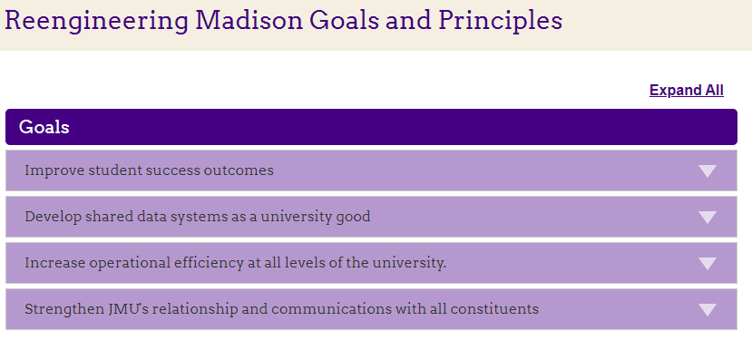

Slide 4
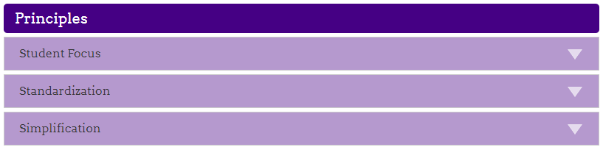

Slide 5

CRM ADOPTION TOOLKIT
Resources Available to Assist with CRM Adoption
  TEAM CRM Advising Support Channel
  Academic College/Department CRM Presentations and Set Up Workshops
  CRM Virtual Office Hours and Sandbox Opportunities
  CRM Instructional Short Videos
  Online CRM Quick Start Guide

Slide 6

CONGRATULATIONS!!!
Who Has Adopted Completely?
  College of Business
  College of Education
  University Advising
  Pre-Professional Health Advising
  Honors College
  Transfer Student Initiatives
  Department of History
  Department of Kinesiology
  Department of Nursing
  Department of Psychology
  Department of Computer Science
  Department of Musical Theatre

Slide 7

CALL TO ACTION
Who Has Partially Adopted by Major?
  College of Health and Behavioral Studies (45%)
  College of Arts and Letters (31%)
  College of Integrated Science and Engineering (14%)
  College of Science and Math (13%)
  College of Visual and Performing Arts (22%)

Slide 8

Call to action
Who is in the process of adopting?
  Communication Studies
  Media Arts and Designs
  Health Sciences
  Health Services Administration
  School of Art Design and History
  School of Theatre and Dance

Slide 9

CALL TO ACTION
Who do I still have the opportunity to meet with to schedule a CRM presentation/implementation?
  College of Science and Math (excluding Biology)
  College of Integrated Science and Engineering (excluding Computer Science)
  Communication Sciences and Disorders
  Dietetics
  Social Work
  Accounting
  College of Arts and Letters (excluding SCOM, Justice Studies, Political Science)

