Slide 1
The ABC’s of AI
AUH’s and Directors
7 Sept. 2023
Bob Kolvoord

Slide 2
Before we start
A couple of key ideas:
AI is not sentient – the Computer Overlords are not (yet) on our doorstep
AI is fundamentally about really good guessing

Slide 3
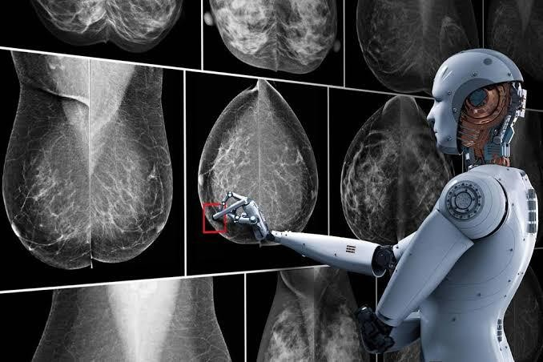
Key Terms
Machine Learning
Definition: computer systems that learn and adapt without following explicit instructions by analyzing and drawing inferences from patterns in data.
Example: an algorithm that picks out possible instances of breast cancer in a mammogram without human intervention.

Slide 4
Key Terms
Artificial Intelligence
Definition: computer systems that can perform taks that typically require human intelligence – vision perception, speech recognition, decision-making, etc. AI requires a lot of machine learning.
Example: Autonomous vehicle driving

Slide 5
Key Terms
Generative Artificial Intelligence
Subfield of AI where algorithms are used to generate text, imagery, speech that is human-like (and can be hard to distinguish)
Simple example – Using a tool like ChatGPT to generate text. Students using ChatGPT to write an essay.

Slide 6
Example
Prompt - Write a one paragraph biography of Sharon Simmons, CS AUH
Dr. Sharon Simmons is an accomplished academic leader and a prominent figure in the field of computer science, currently serving as the Academic Unit Head of Computer Science at James Madison University. With a distinguished career spanning over two decades, Dr. Simmons has made significant contributions to both academia and industry. Her research interests encompass a wide range of topics, from artificial intelligence and machine learning to cybersecurity and software engineering. Driven by a passion for education and innovation, she has not only guided her department towards excellence but also inspired countless students to pursue careers in technology. Under her leadership, James Madison University's Computer Science program has flourished, earning a reputation for cutting-edge research and fostering the next generation of computer scientists. Dr. Simmons continues to be a trailblazer in her field, shaping the future of computer science education and research.

Slide 7
Example
Prompt - Write a one paragraph biography of Bayo Ogundipe, AUH, Engineering
Dr. Adebayo Ogundipe is a distinguished academic and engineering leader, currently serving as the Academic Unit Head of Engineering at James Madison University. With an illustrious career spanning over two decades, Dr. Ogundipe has been at the forefront of engineering education and research. His expertise lies in various engineering disciplines, from mechanical and electrical to civil and environmental engineering, reflecting his broad academic interests and contributions to multidisciplinary research. Driven by a deep commitment to fostering innovation and preparing future engineers for the challenges of the modern world, he has played a pivotal role in advancing engineering programs at James Madison University. Under his guidance, the engineering department has thrived, producing talented graduates and groundbreaking research. Dr. Ogundipe's unwavering dedication to the field and his commitment to excellence continue to shape the future of engineering education and research at the university.

Slide 8
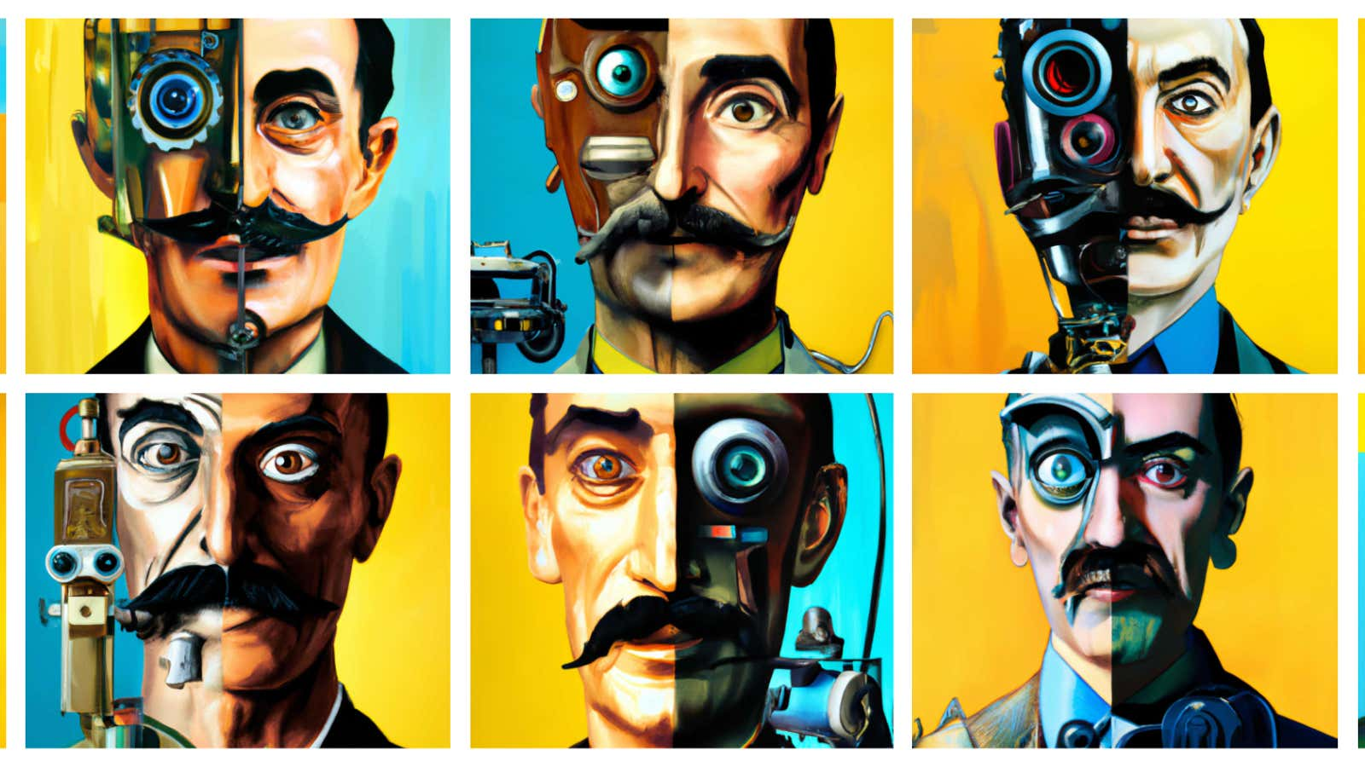
Not Just Text!
DALL-E

Slide 10
Videos
https://www.youtube.com/watch?v=JkUF40kPV4M

Slide 11
Audio
https://welcome.ai/solution/prime-voice-ai

Slide 12
Key Points for Us to Consider
These technologies are in their infancy
They’re already being used by faculty, staff and students
Like all technologies, the ethics of their use depends on their users
The legal framework will always be well behind the front edge of the technology (and in this case, the trailing edge as well!)
These technologies scrape the entire Internet, capturing both the positive and the negative
Is this the “calculator” moment for writing?
How do we manage/lead staff/student/faculty use?
Where should we focus?

Slide 13
What’s Coming Next
AI Task Force
Potential Focus Areas:
Authorship and academic integrity (students and faculty)
The student experience
New contexts and meaning
Administrative applications

