Slide 1
The Breeze
Fall 2015
nine-ad series on ethical reasoning in action

Slide 2
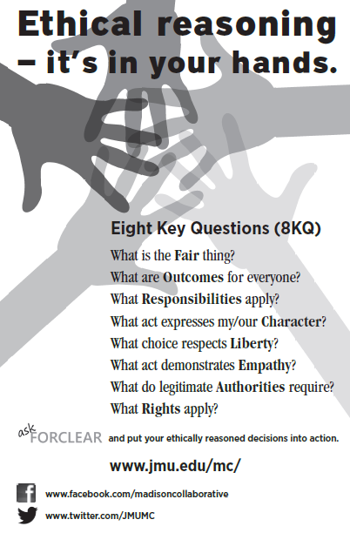

Slide 3
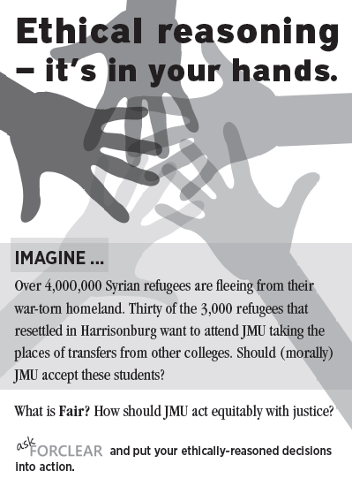

Slide 4


Slide 5


Slide 6


Slide 7
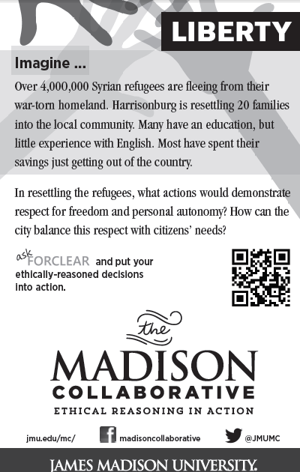

Slide 8


Slide 9


Slide 10


