Slide 1



Slide 2
welcome
Excel for OOA – February 2014

Slide 3
Excel For OOA
4- 28 Location, location, location
29-41 Giving it structure (formatting)
42-78 Formulae (math) or formulas (text)

Slide 4
12. Formula Bar
below the ribbon, to the left
can enter/show the formula for selected cell
can type directly into it
type into the cell
(the formula appears in the bar)

Slide 5
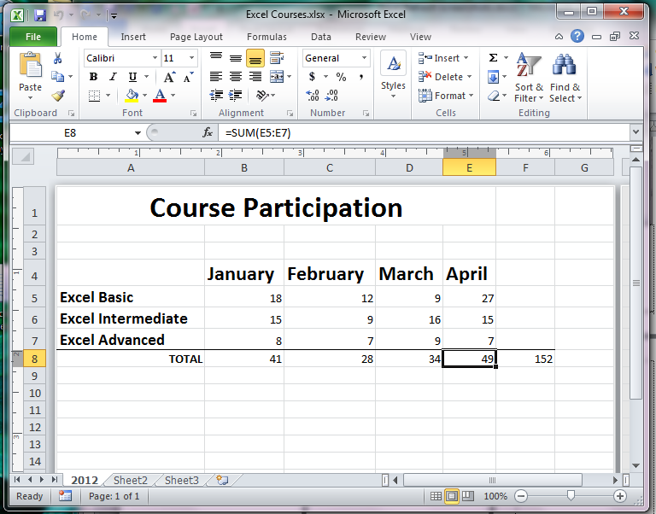
12. Formula Bar
cell for which the formula is shown

Slide 6
17. Error Indicator
green triangle at top-left corner of a cell
indicates an error may exist
click to see information about the error

Slide 7
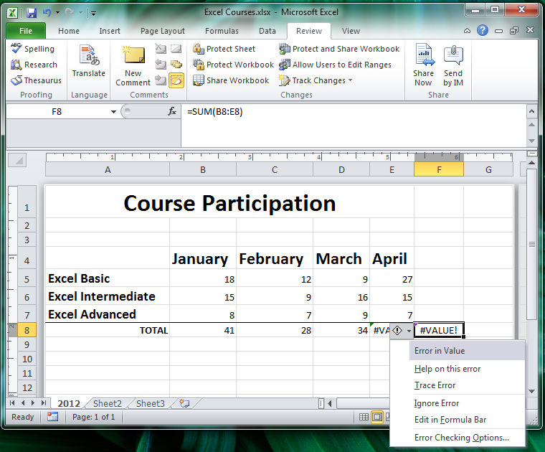

Error Indicator is the tiny green triangle in the upper left corner of a cell with an error
17. Error Indicator
Error Indicator dropdown

Slide 8
18. Filter Indicator
symbol at the label of a column of cells
indicates data is filtered
click it to see the filter components
(data must be formatted as a table to have filters)

Slide 9
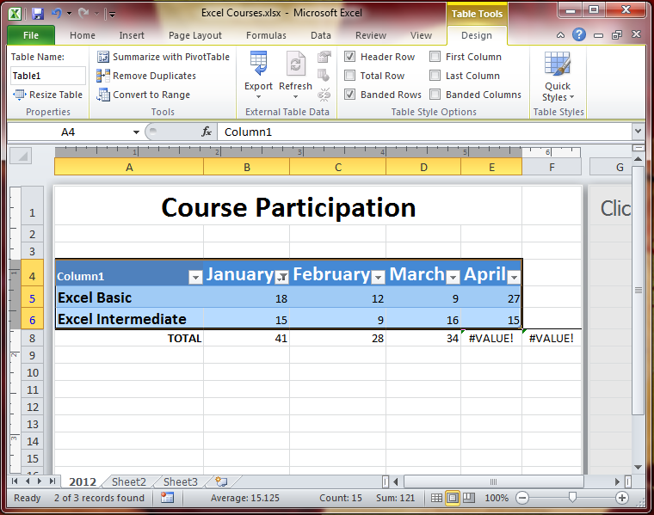

18. Filter Indicator

Slide 10
19. Five kinds of Cursor
ribbon pointer or arrow
plus-sign
open-plus
4 arrows
2 lines with 2 arrows

Slide 11
21. Select adjacent cells
select and drag through adjacent cells
OR
select first cell,
then hold Shift while selecting last cell
OR
select last cell,
then hold Shift while selecting first cell

Slide 12
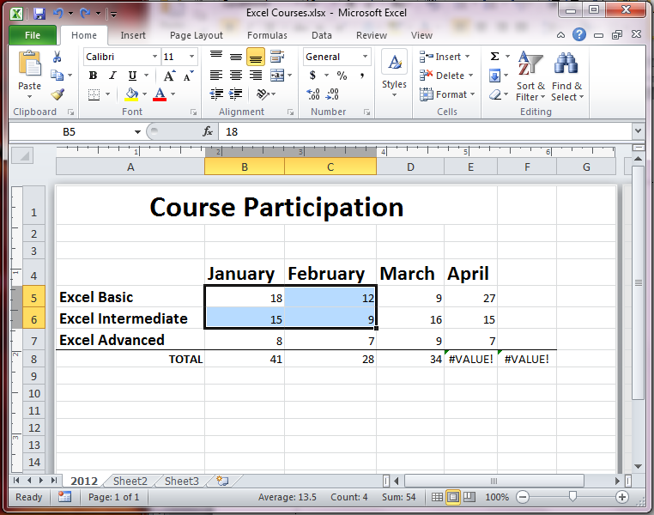
21. Select Adjacent
Select B5
Shift+Select C6

Slide 13
22. Select nonadjacent cells
hold Ctrl while selecting different cells

Slide 14
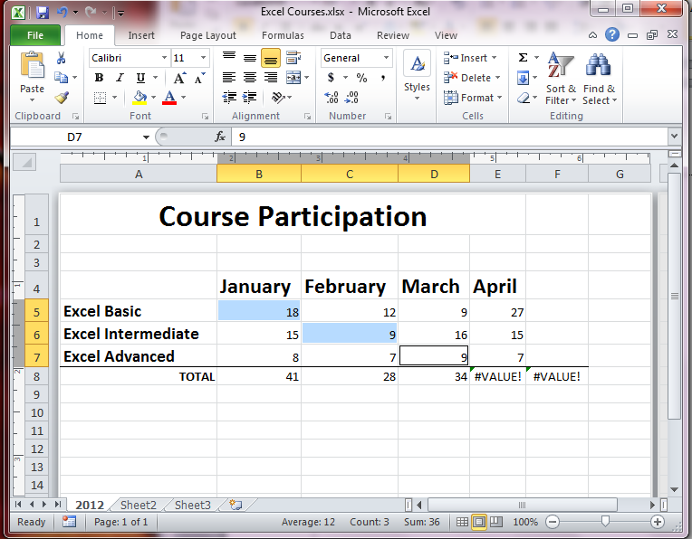
22. Select
Non-Adjacent
Cells
Ctrl+Select B5,
C6,
D7

Slide 15
23. Select an entire column
go up to the column’s Alpha label
point until arrow appears
then Click

Slide 16
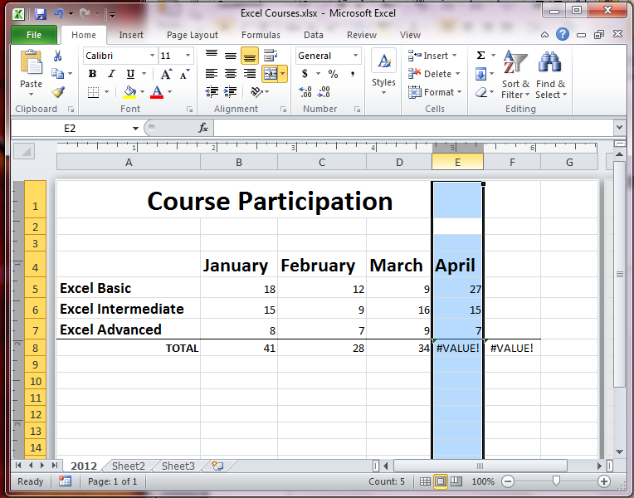
23. Select entire
Column
Click on Column ID

Slide 17
24. Select an entire row
go left and point to the row #
point until arrow appears
then Click

Slide 18
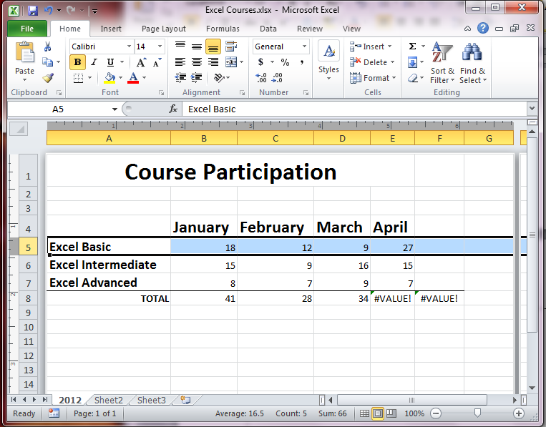
23. Select entire Row
Click on Row ID

Slide 19
29. AutoFill handle
right bottom corner of a cell
use the Fill handle to repeat
use two cells to fill numbers or dates
that are gapped/apart (e.g. 10, 20)

Slide 20
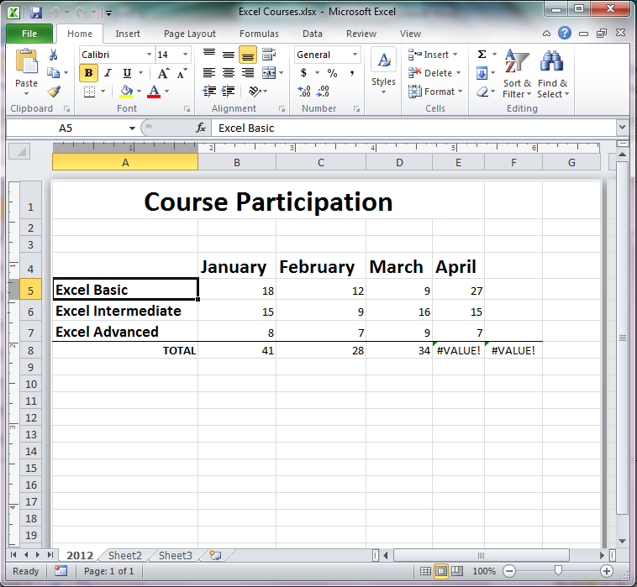

29. AutoFill Handle
AutoFill Handle
(square at the lower right corner of a cell; hover over it until a + appears, then click and drag to autofill)

Slide 21
30. AutoFill a Series
using pre-recorded series like months
type first entry
use fill handle to fill-drag series into cells

Slide 22
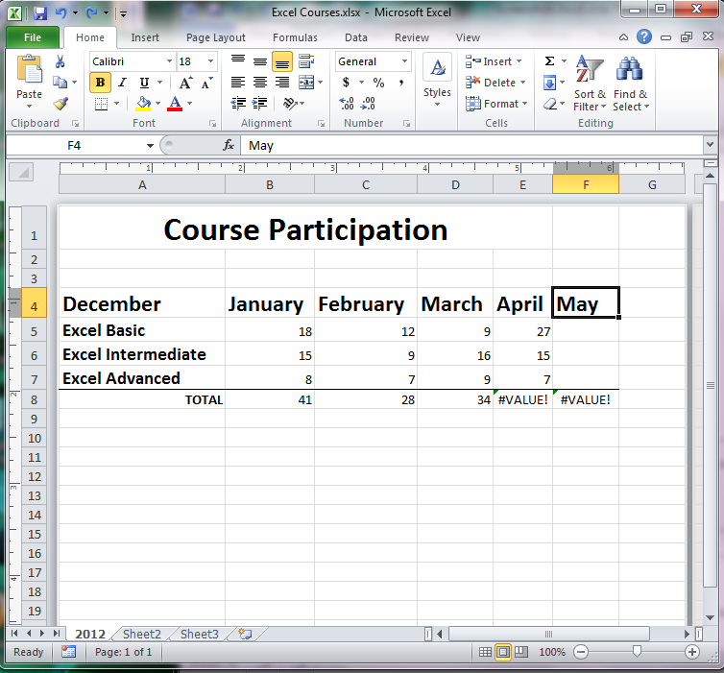

30. AutoFill Series
AutoFill Series
(hover over AutoFill handle, after at least one entry of a series, until a + appears, then click and drag to autofill)

Slide 23
31. Copy cells/formula (simple)
use copy and paste on the ribbon
or Ctrl+C to copy, then Ctrl+V to paste

Slide 24
32. Copy cell (with Drag-Drop)
get four headed (MOVE) arrow
press/hold Ctrl
drag-drop to copy to a new cell(s)

Slide 25
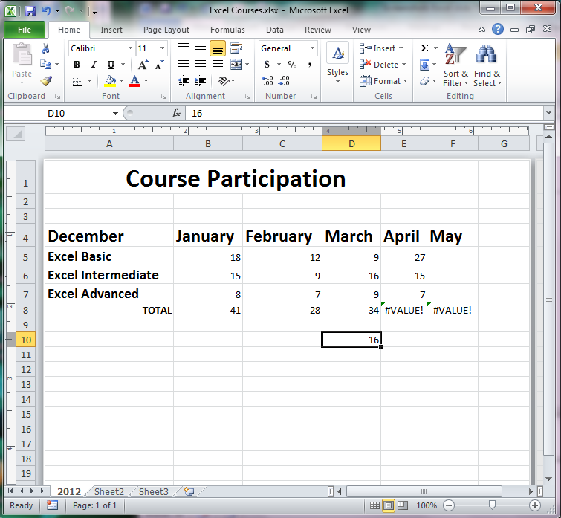
32. Copy Cells (drag)
Drag + Drop to copy
(hover over cell edge, until a appears, press/hold Ctrl and click and drag to where the copy should be)

Slide 26
38. Delete key empties !
Delete does not remove the row or column

Slide 27
39. Undo
back arrow at upper left above ribbon
or Ctrl+Z

Slide 28
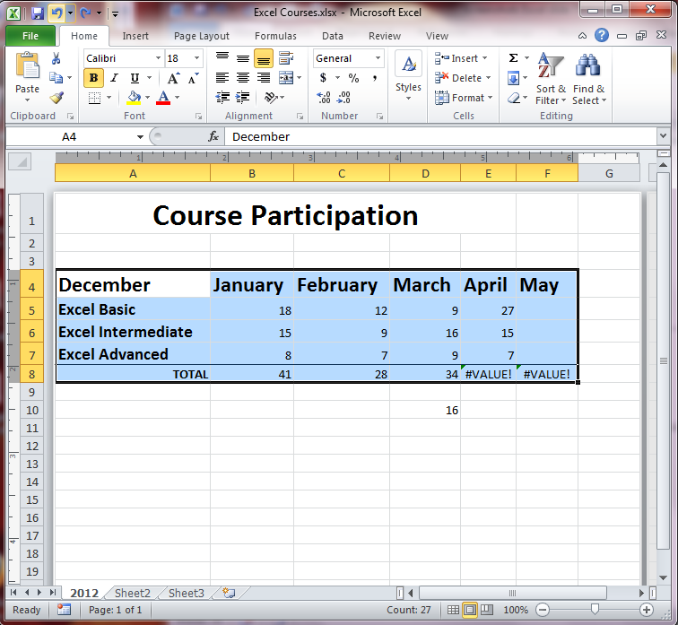
39. Undo
Undo Key (upper left)
(or Ctrl+Z)

Slide 29
formatting
40. Wrap Text
41. Format $
45. Format Zip code
46. Format Phone #
47. Format Date
48. Format Text

Slide 30
40. Wrap Text in Cell
on the Home Tab, Alignment Group
Wrap Text
(automatically changes row height to show all)

Slide 31
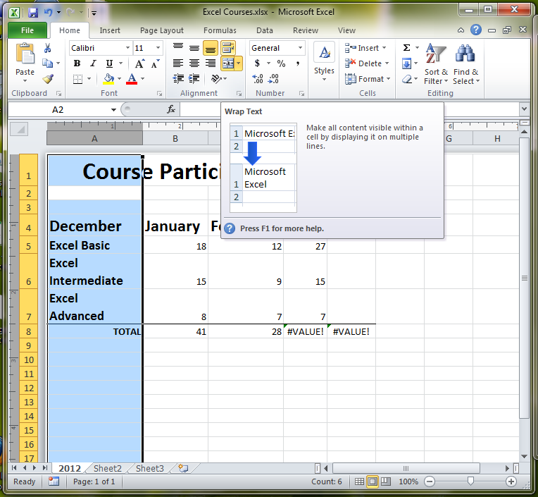
40. Wrap Text in Cell
Home Tab, Alignment Group, Wrap Text
(can do the column)

Slide 32
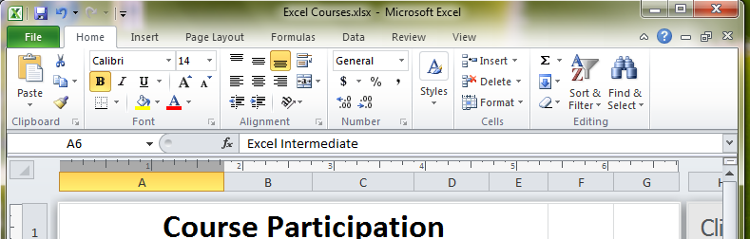
41. Format numbers -- $ sign
Home Tab, Number Group, $

Slide 33
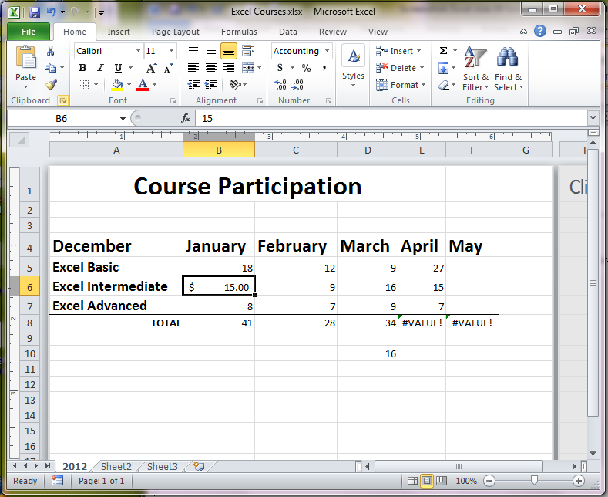
41. Format $
Select cell(s),
Click $ symbol

Slide 34
45. Format cell for Zip Code
Home Tab, Number Group
Click the dialog box arrow, choose Special
(or use dropdown beside current number format; choose more)
choose Zip Code

Slide 35
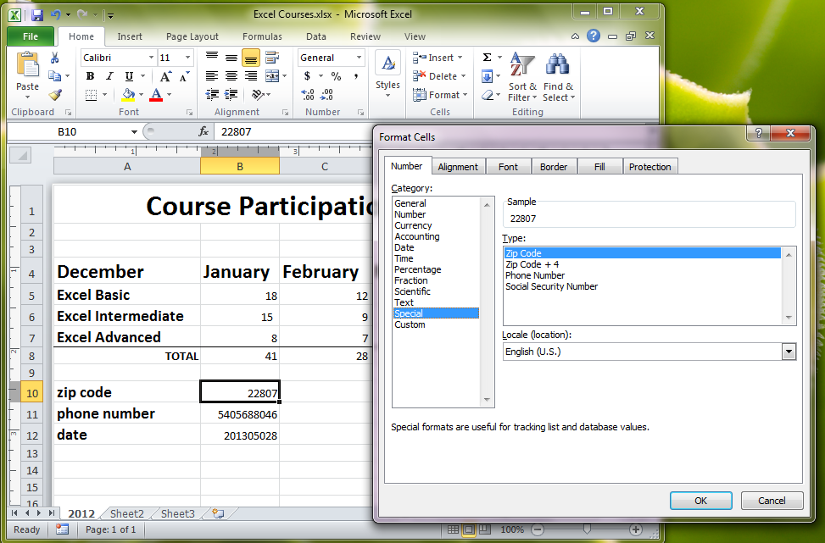
45. Zip Code
Select cell(s),
Click dialog box
Click Special
Choose Zip Code

Slide 36
46. Format for Phone Number
Home Tab, Number Group
Click the dialog box arrow, choose Special
(or use dropdown beside current number format; choose more)
choose Phone Number

Slide 37
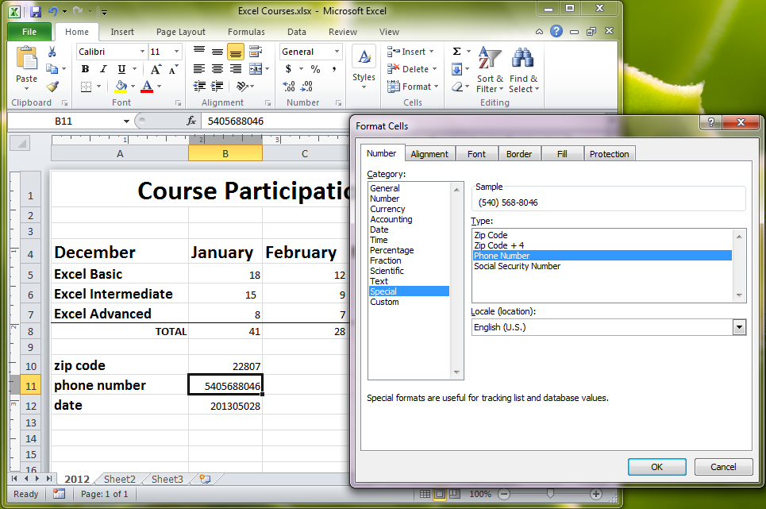
46. Phone Number
Select cell(s),
Click dialog box
Click Special
Choose Phone
Number

Slide 38
47. Format cell for Date
Home Tab, Number Group
Click the dialog box arrow
(or use dropdown beside current number format; choose date)
choose Date

Slide 39
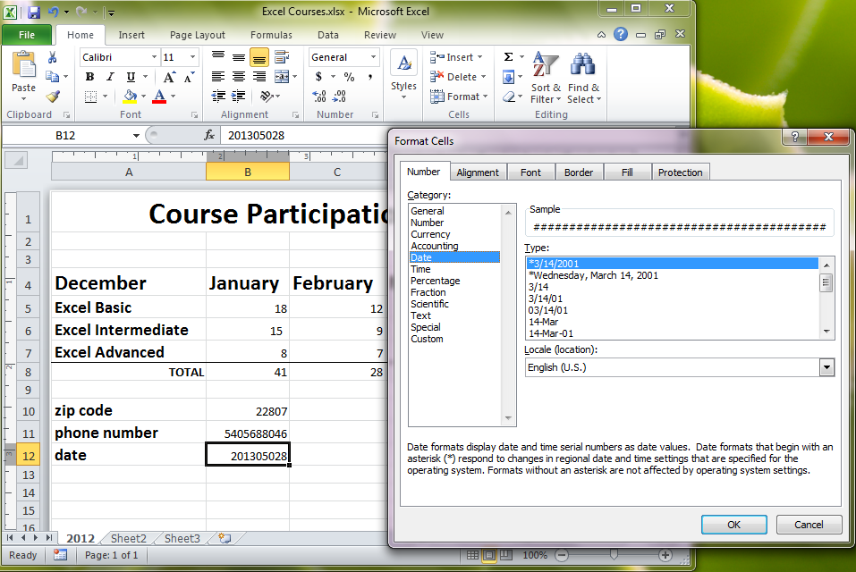
47. Date
Select cell(s),
Click dialog box
Click Date
Choose a format

Slide 40
48. Format cell as Text
Home Tab, Number Group
Click the dialog box arrow
(or use dropdown beside current number format; choose more)
choose Text

Slide 41
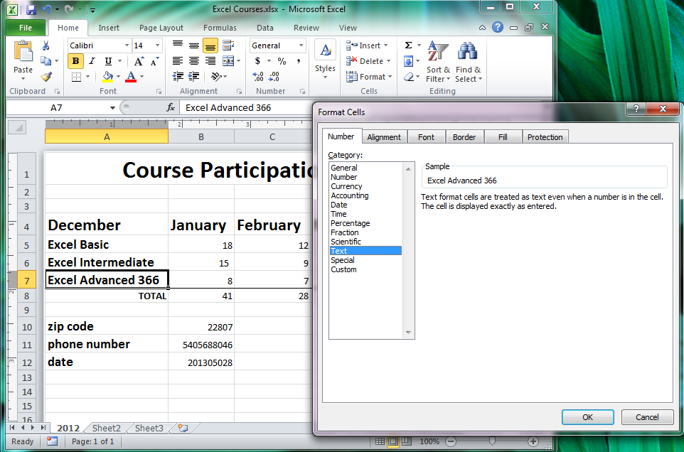
48. Text
Select cell(s),
Click dialog box
Click Text

Slide 42
formulas
Formula Basics
Formula Syntax
Copying Formulas
Automatic Formulas

Slide 43
49. Formula in Bar or cell
Formula Bar will accept a formula
The Cell will accept a formula

Slide 44
49. Formula in Bar or cell
Formula Bar will accept a formula
The Cell will accept a formula

Slide 45
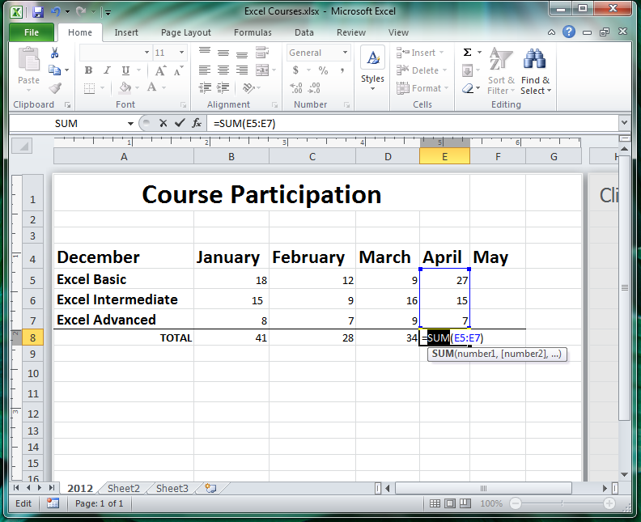
49. Formula Bar
Type in the cell OR in the Formula Bar

Slide 46
50. Operators: + - * / % ^
+ plus (=A1+A2+A3)
- minus (=A2-A3)
* multiply (=A1*A2)
/ divide (=A1/A2)
% percent (20% -- which will calculate as .2)
^ exponent (A2^2)

Slide 47
51. Order of operations, NO ( )
without parentheses order is % ^ * / + -
Percent, Exponent, Multiply, Divide, Add, Subtract
Please Excuse My Dear Aunt Sally

Slide 48
52. Order for sets
Sets are ‘read’ – ordered, left to right
* (multiply) and / (divide) are a set
+ (add) and – (subtract) are a set {also referred to as + (plus) and – (minus)}

Slide 49
53. Use of Parentheses to set order of operations
if A5 is 1, B5 is 2, C5 is 3
Excel calculates: A5+B5+C5*4= _16_
Excel calculates: (A5+B5+C5)*4= _24_

Slide 50
54. Formula syntax =
always start with =
(even if an online formula does not show it)
after a function is typed, always use ( )
FUNCTION is another word for a formula
fx is another ‘word’ for function/formula

Slide 51
55. Relative reference
means the cell IDs in the formula change to correspond/relate to the new location’s ‘related’ cells
relative reference is the default in Excel
Excel assumes you want the copied formula to be relative to the new location (relate to cells near to where you copied it)

Slide 52
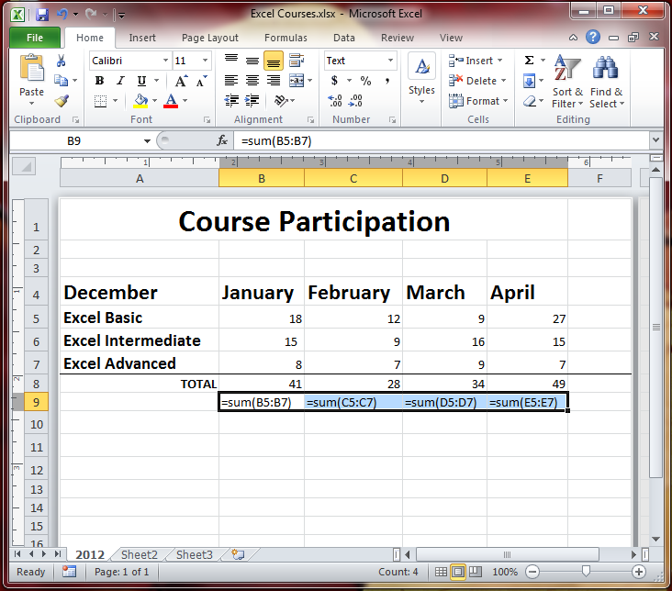
55. Relative Reference
Cell references change to match the new row / column IDs
(they “relate” to the new column/rows)

Slide 53
56. Absolute reference
the way to always use the same cell in a formula (whether copied, moved, or linked)
requires $ before Column and $ before Row of Cell ID ($A$1 means always use value in cell A1)
either one can stay relative (without $)

Slide 54
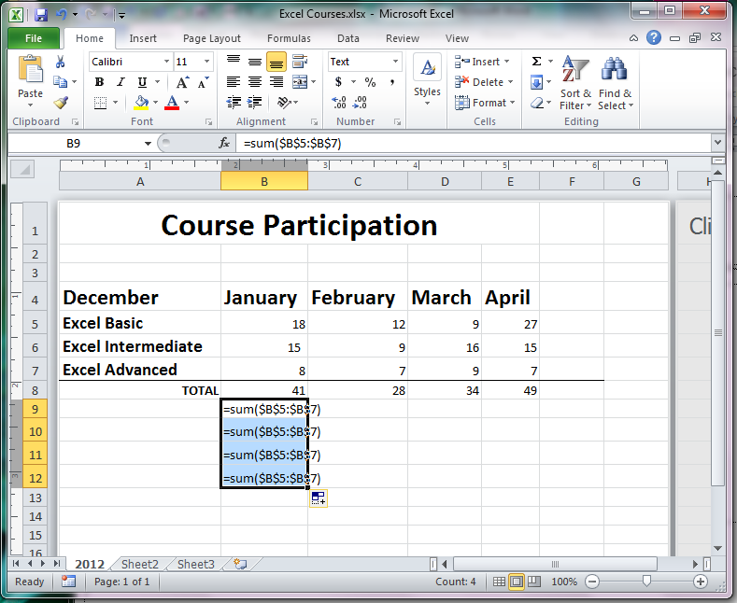
56. Absolute Reference
Cell references STAY the SAME row/column IDs if the $ is there

Slide 55
57. Mixed reference
mixed means either the column or the row is relative, but not both
e.g column relative, cell absolute -- A$5
e.g. column absolute, cell relative -- $A5

Slide 56
58. Absolute Reference - F4
type the formula,
click F4 to make absolute reference
(click F4 repeatedly to cycle through choices of absolute, mixed, and relative references)

Slide 57
59. Copy formula – Ctrl+V
Select the Formula
press Ctrl+C (together) to copy
Select the new cell to receive the formula
press Ctrl+V (together) to paste
(this formula does not update automatically)

Slide 58
A CtRL+c, THEN Ctrl+V
formula does not update automatically
it is only a copy without any link

Slide 59
60. Copy Formula - Paste Link
Click Copy
Select new cell
Right-Click and choose Paste Special
Choose Paste Link

Slide 60
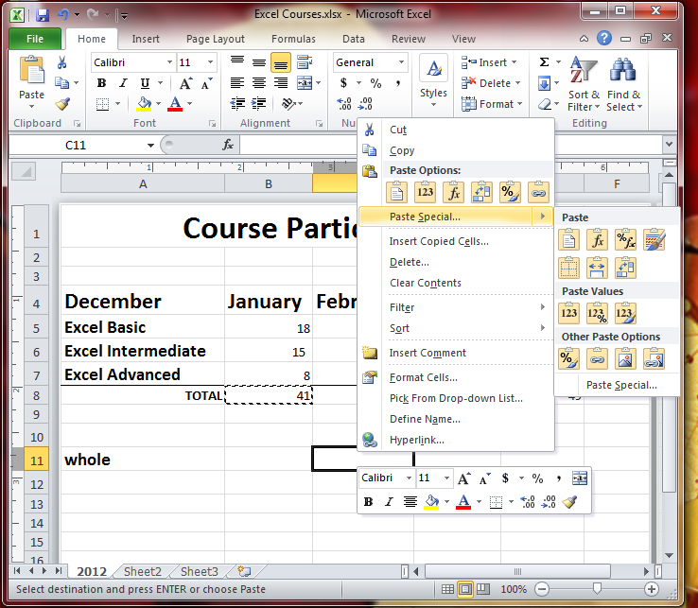
60. Copy - Paste Link
Select the cell
Click Copy icon
Right Click new cell
Choose Paste Special
Choose Paste Link

Slide 61
61. Copy Formula – Auto-fill
Select the cell with the Formula
use the Fill handle to drag down or across
(references will be relative unless an absolute is within the original Formula)

Slide 62
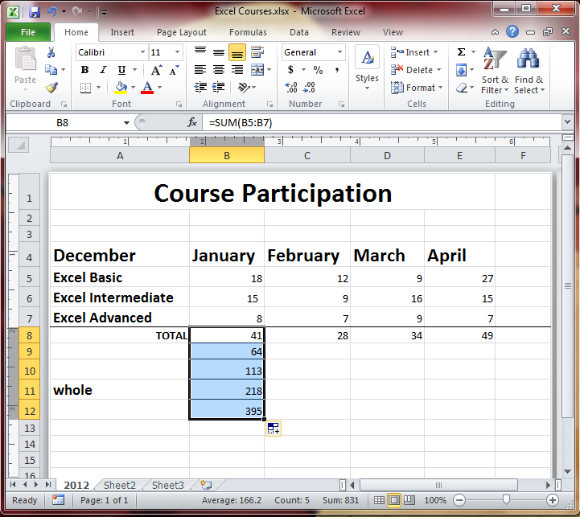
61. Auto-Fill Formula
Click the Fill handle (at lower right of cell)
Drag down/across
(Relative reference starts with first ID in the formula being copied)

Slide 63
62. AutoSum button
Sigma symbol is AutoSum
Select the cells/range
Click Sigma
Sum appears in cell to right/below of range

Slide 64
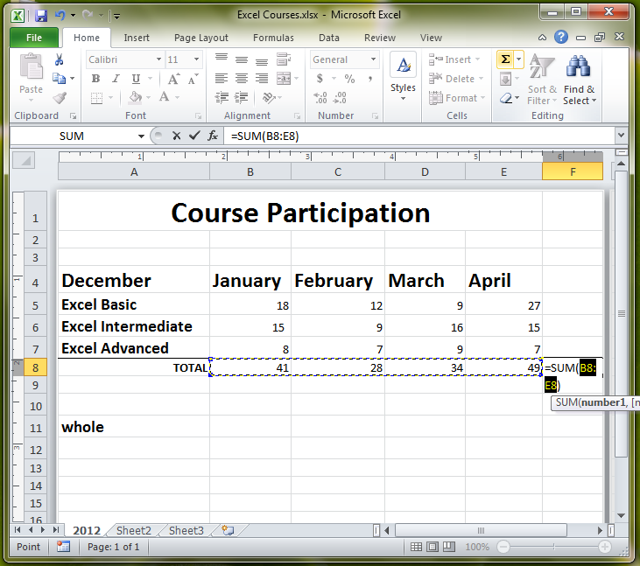
62. Sigma button
Click the Sigma itself to Sum a selected range of cells
(formula is entered by the software into the cell/formula bar)

Slide 65
63. AutoSum dropdown
Use the dropdown arrow to calculate something other than the sum of a range

Slide 66
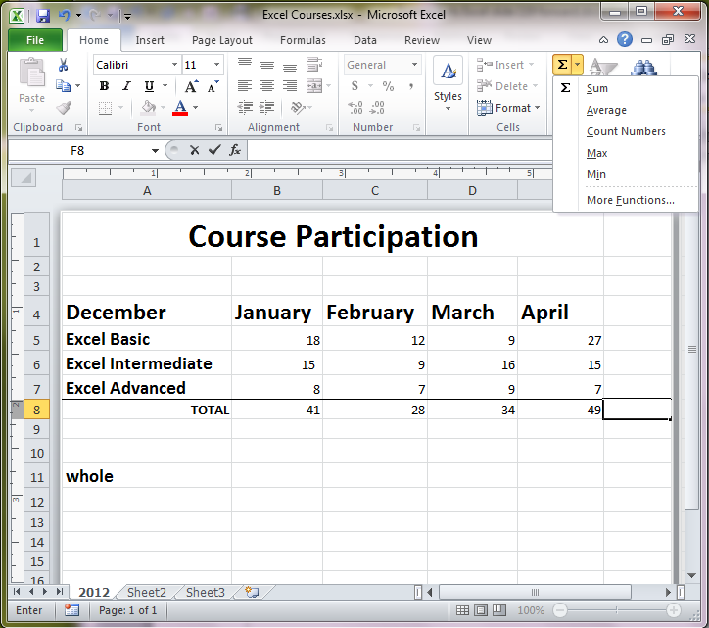
63. AutoSum dropdown
Click the dropdown arrow to access a list of formulas

Slide 67
64. SUM fx
adds the numbers in a selected range

Slide 68
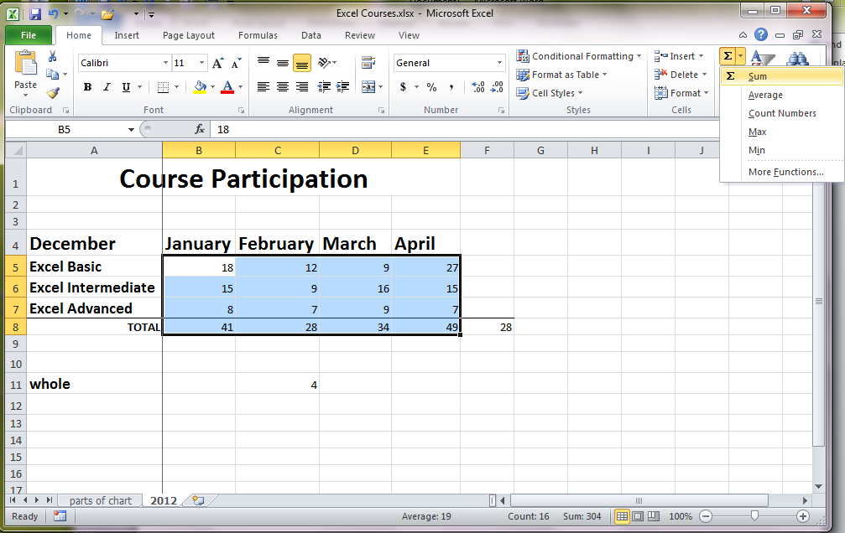
64. Sum Function
Click the dropdown
Choose Sum

Slide 69
65. AVERAGE fx
all numbers in a range added and divided by the “count” (#) of items gives you the AVERAGE value

Slide 70
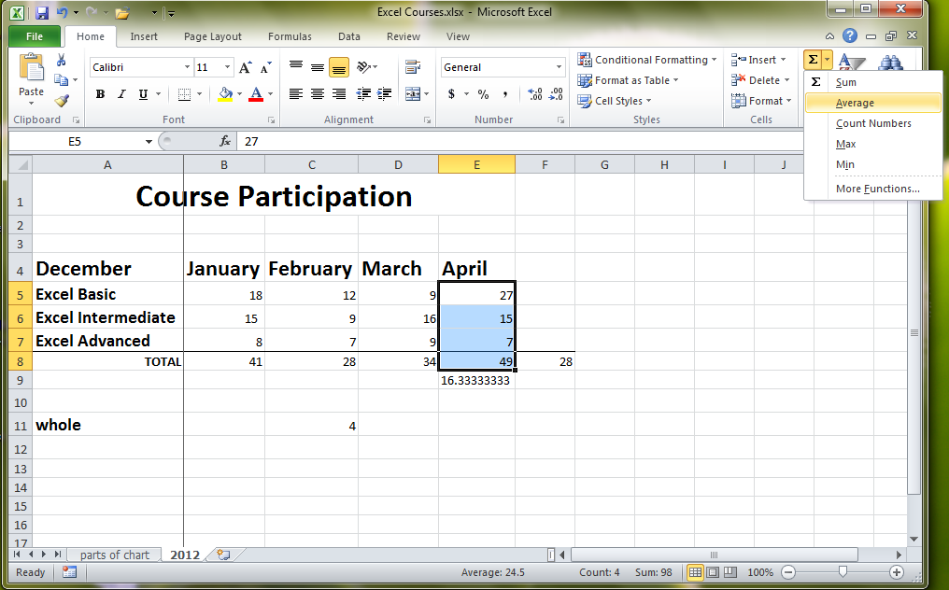
65. Average fx
Click the dropdown
Choose Average

Slide 71
66. MIN fx
lowest number in a range

Slide 72
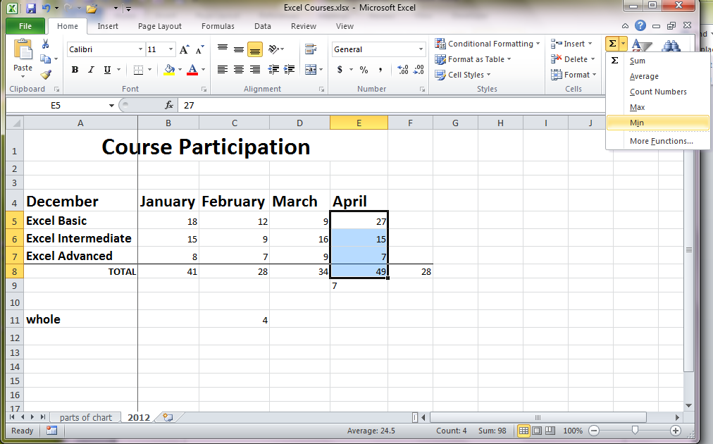
66. Min Function
Click the dropdown
Choose Min

Slide 73
67. MAX fx
highest number in a range

Slide 74
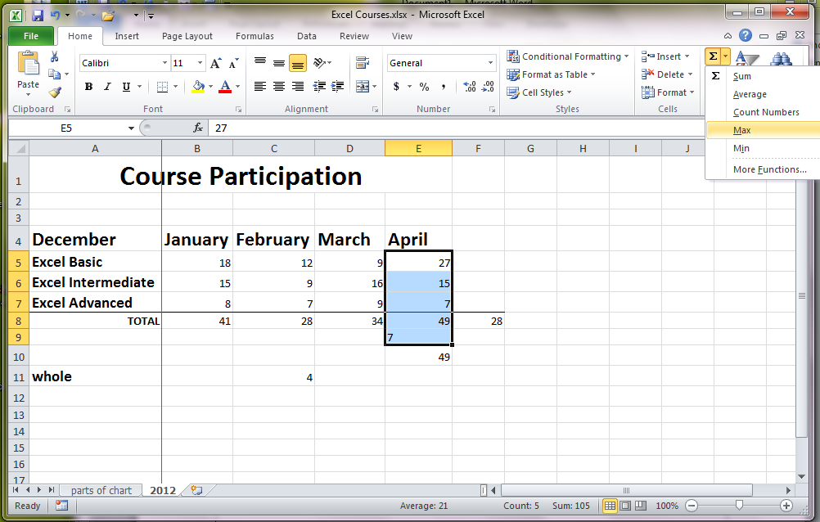
67. Max Function
Click the dropdown
Choose Max

Slide 75
68. COUNT fx
counts (a tally of) cells in a selected range that have numbers (not text) in them
(excludes empty cells from the count)

Slide 76
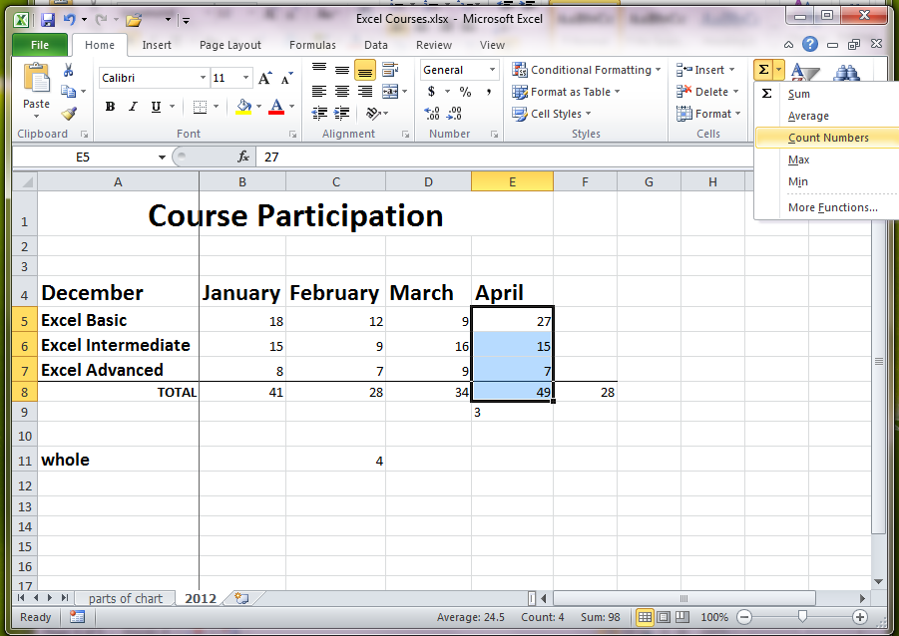
68. Count fx
Click the dropdown
Choose Count Numbers

Slide 77
69. COUNTA fx
counts cells of a selected range that have #s OR text in them

Slide 78
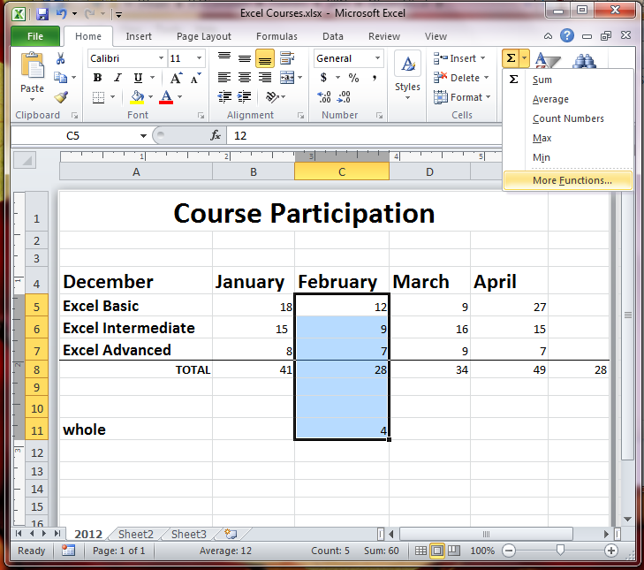
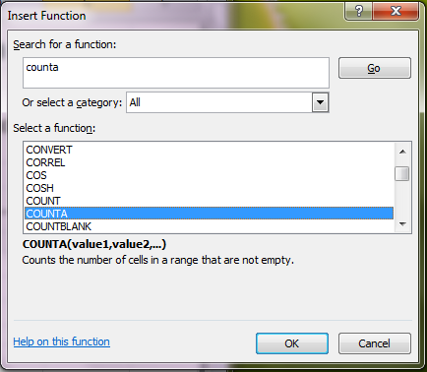
69. CountA fx
Click the dropdown
Choose More Functions
Choose CountA

Slide 79
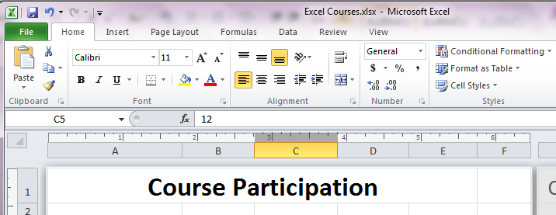
71. Alignment of cell contents
Align left (default), centered, right
Align to top (default), middle, bottom

Slide 80
72. cell borders
Home Tab, Font Group
Use dropdown beside border image
(can also open Format dialog box)

Slide 81
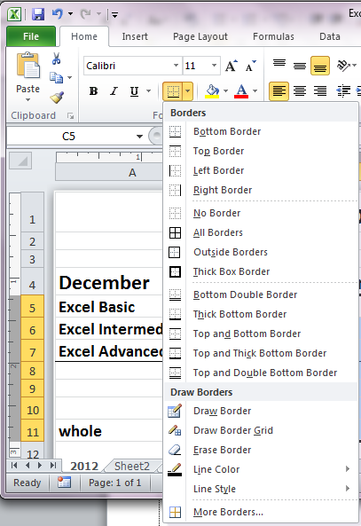
72. Cell Borders
Home Tab,
Font group
Use dropdown arrow
Beside border image

Slide 82
73. Column width & Row height
Use Format dropdown (Home Tab, Cells)
Auto-size column width by double-click @ right edge of it (use 2 lines/2arrows pointer)
Auto-size row height by double-click @ bottom edge of it (use 2 lines/2arrows pointer)

Slide 83
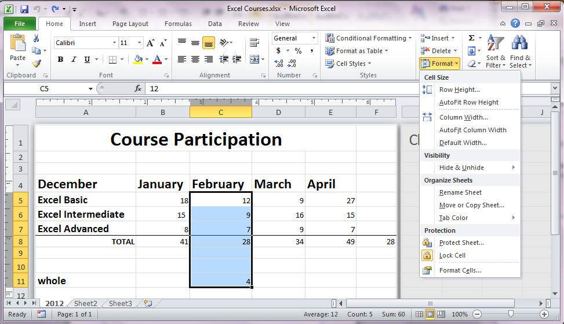
73. Width/Height
Home Tab, Cells group
Use dropdown arrow
Beside Format
Choose Row Height or
Column Width

Slide 84
74. Apply color to a cell
Use the Format Cells dialog box
(Home Tab, Cells Group), then Format Cells
Use Font Tab and choose a color or
Use Fill Tab and choose a color

Slide 85
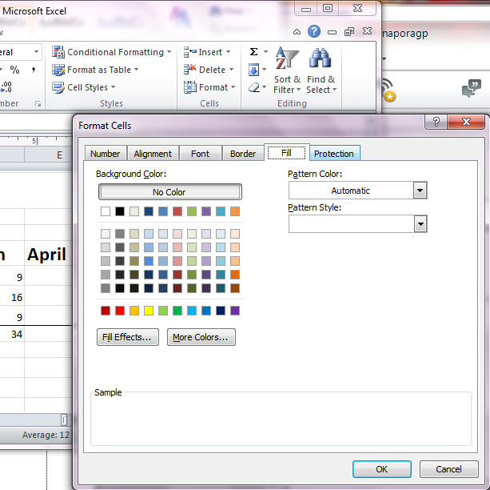
74. Apply Cell Color
Use Format Cells
Font Tab to color font
Fill Tab to color cell

Slide 86
77. Format painter
Select the already formatted cell/text
Click Format Painter (Home Tab, Clipboard Group)
Click on cell/text to receive format
(double click Format Painter to use repeatedly until Esc or re-click Format Painter to turn it off)

Slide 87
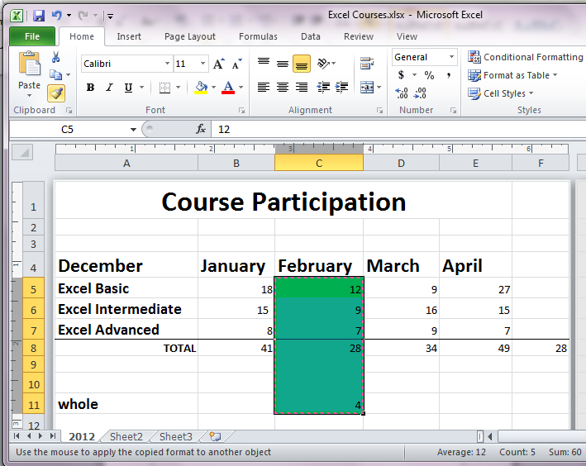
77. Format Painter
Choose already
formatted cell/range
Click Format Painter
Click-drag brush over
cell/range to receive
the formatting

Slide 88
78. Copying format with paste
Select the cell/text with the desired format
Copy (use Clipboard or Ctrl+C)
Select the cell/text to be formatted
Right Click -- Paste Special and choose Formatting

Slide 89
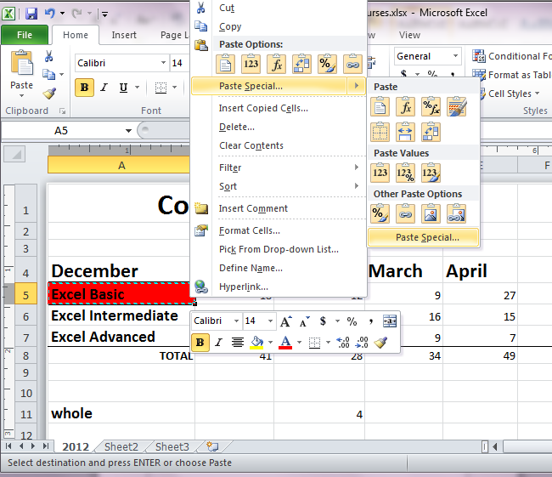
78. Paste Special
Copy the cell/range
Right-Click new cell
Paste Special –
Formatting

Slide 90
79. Apply Table-Styles
Select a range (include labels)
Click Format as Table (Home Tab, Styles Group)
Choose a Style
Verify the range
Check My table has headers
Click OK

Slide 91
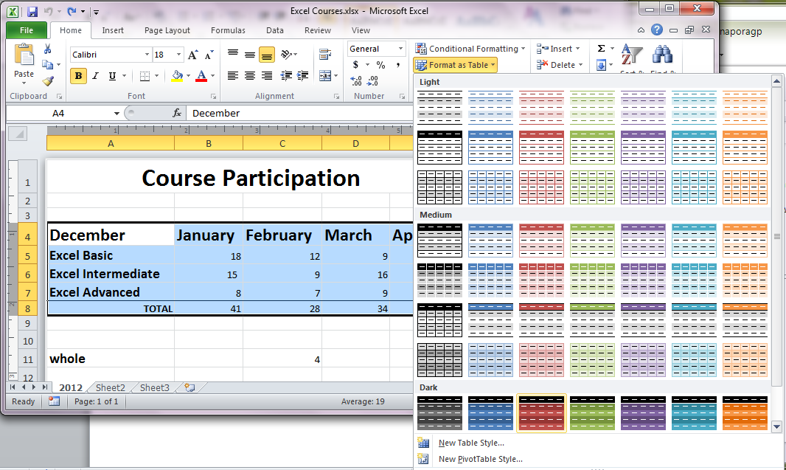
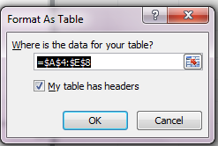
79. Table Style
Select a Range
Click Format as Table
Choose a Style
Verify the Range
Check My Table has. .
Click OK

Slide 92
80. Conditional Formatting to add color
Click Conditional Formatting (Home Tab)
Choose a Highlight Cells Rule type (> < = etc.)
Set the rule
Choose the color

Slide 93
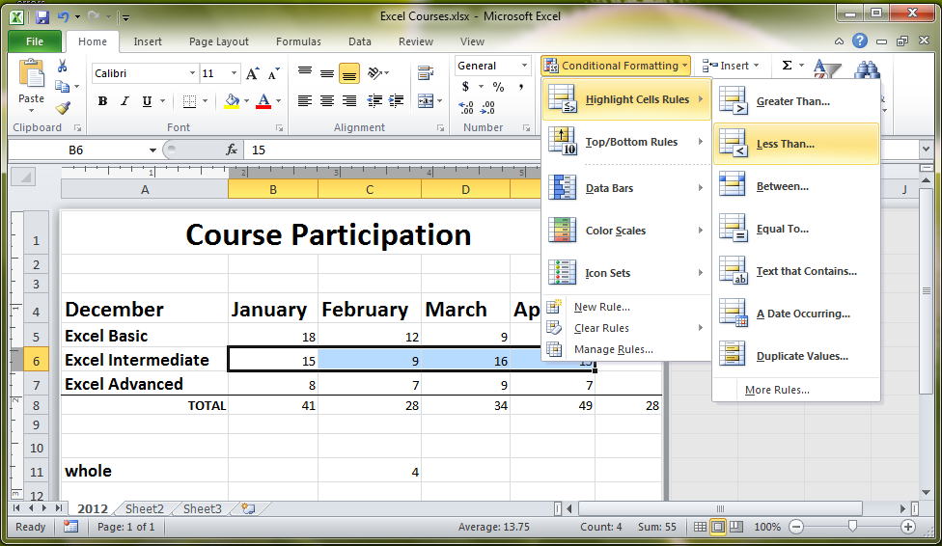
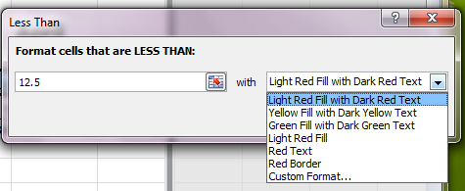
80. Conditional Color
Click Conditional
Formatting (Home Tab)
Choose a Highlight
Cells Rule type
Set the rule
Choose the color

Slide 94
81. Clear Formatting
Select the cell(s)
Click Eraser, then Clear Formats
(Home Tab, Editing Group)

Slide 95
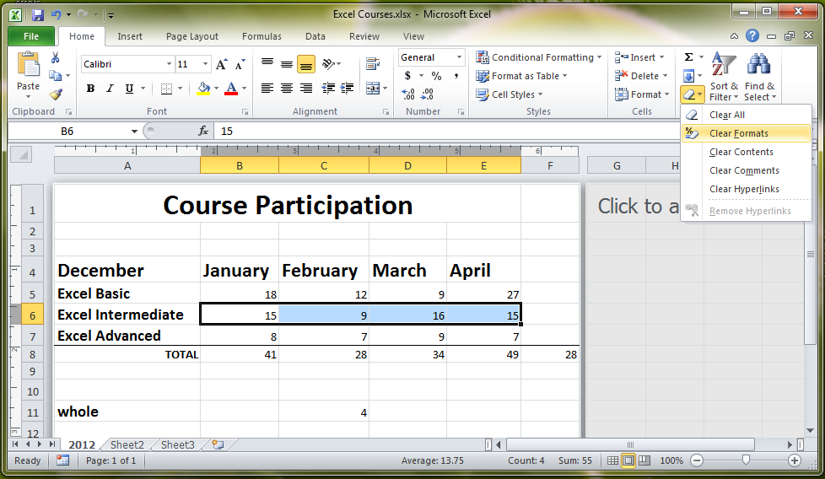
81. Clear Formatting
Select the cell(s)
Click Eraser
Select Clear Formats

Slide 96
82. Clear Conditional formatting
Click Conditional Formatting
Choose Manage Rules
or
Click Conditional Formatting, Clear Rules

Slide 97
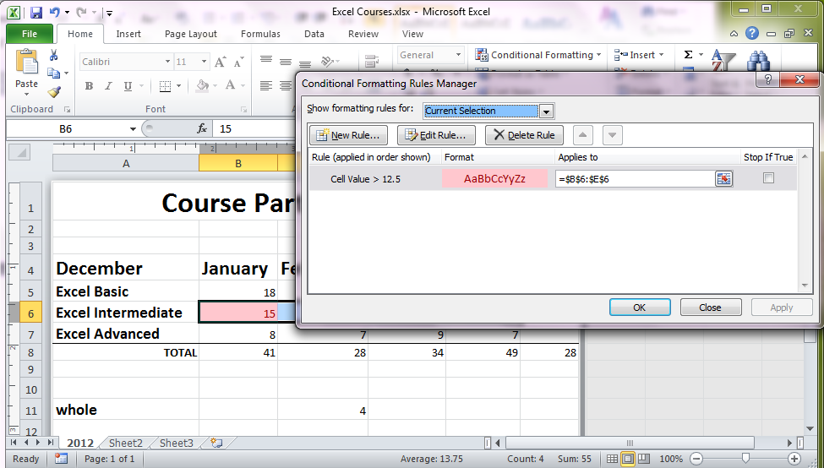
82. Clear Conditional
Click Conditional
Formatting (Home Tab)
Click Manage Rules
and Delete Rule
OR Click Conditional
Formatting and
Click Clear Rules

Slide 98
105. Freeze a Row
Click any cell in the row below what is to be frozen
Click View Tab
Use Freeze Panes dropdown
Choose Freeze Panes (or Freeze Top Row)

Slide 99
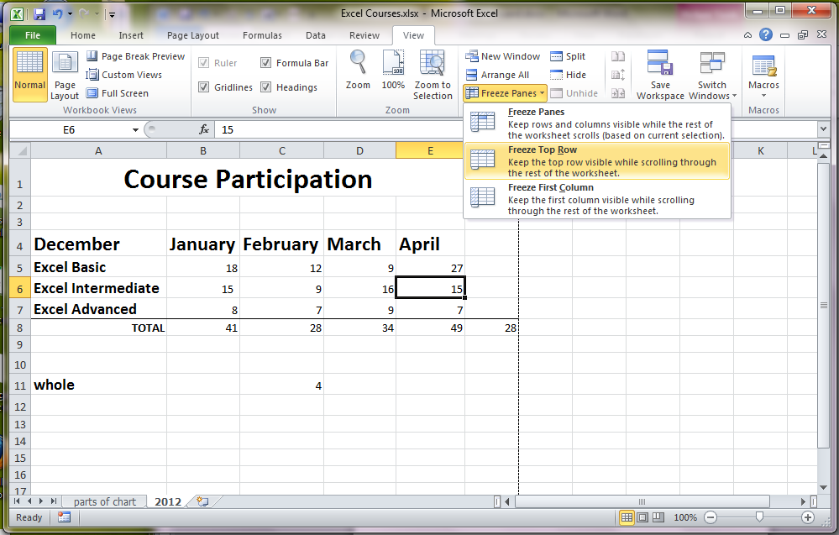
105. Freeze a Row
Click cell (below row being frozen)
View Tab
Freeze Panes
Choose Freeze Panes

Slide 100
106. Freeze a Column
Click a cell to the right of what is to be frozen
Click View Tab
Use Freeze Panes dropdown
Choose Freeze Panes (or Freeze First Column)

Slide 101
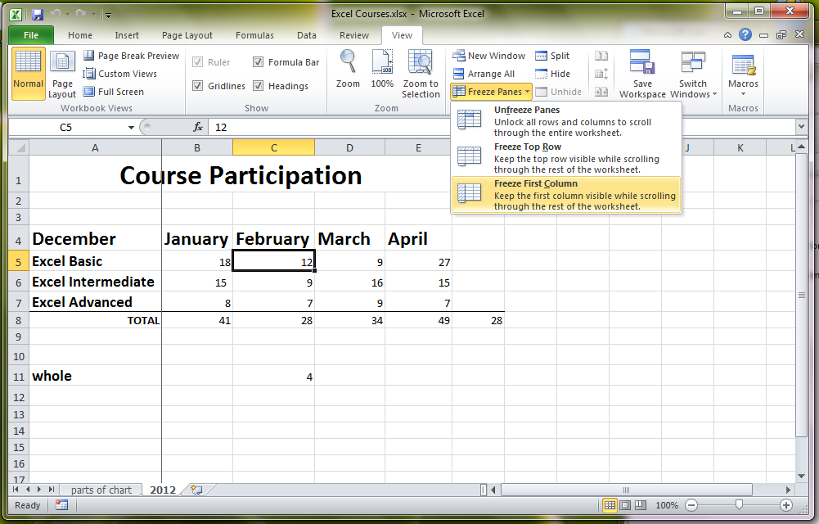
106. Freeze a Column
Click cell (right of to be frozen)
View Tab
Freeze Panes
Choose Freeze Panes

