Slide 1
Colonial Academic Alliance Debate for Civic Learning
Paul Mabrey, James Madison University
Mike Davis, James Madison University

Slide 2
Today’s Goals
Participants will make progress towards:
  Understanding how debate pedagogy can foster student civic learning in and beyond the classroom
  Identifying ways in which incorporating debate in the classroom and other learning spaces can add rigor and innovation
  Creating classroom learning outcomes, activities, and assessments that engage students in debate as part of a coherent pedagogical approach.

Slide 3
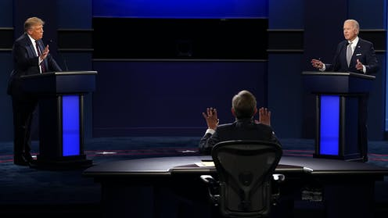
Need for debate-based pedagogy?

Slide 4
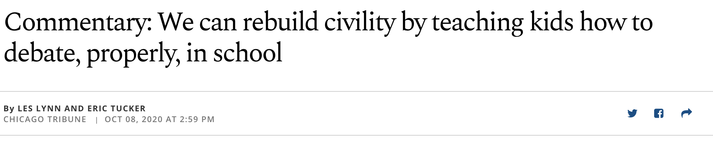
Need for debate-based pedagogy?

Slide 5
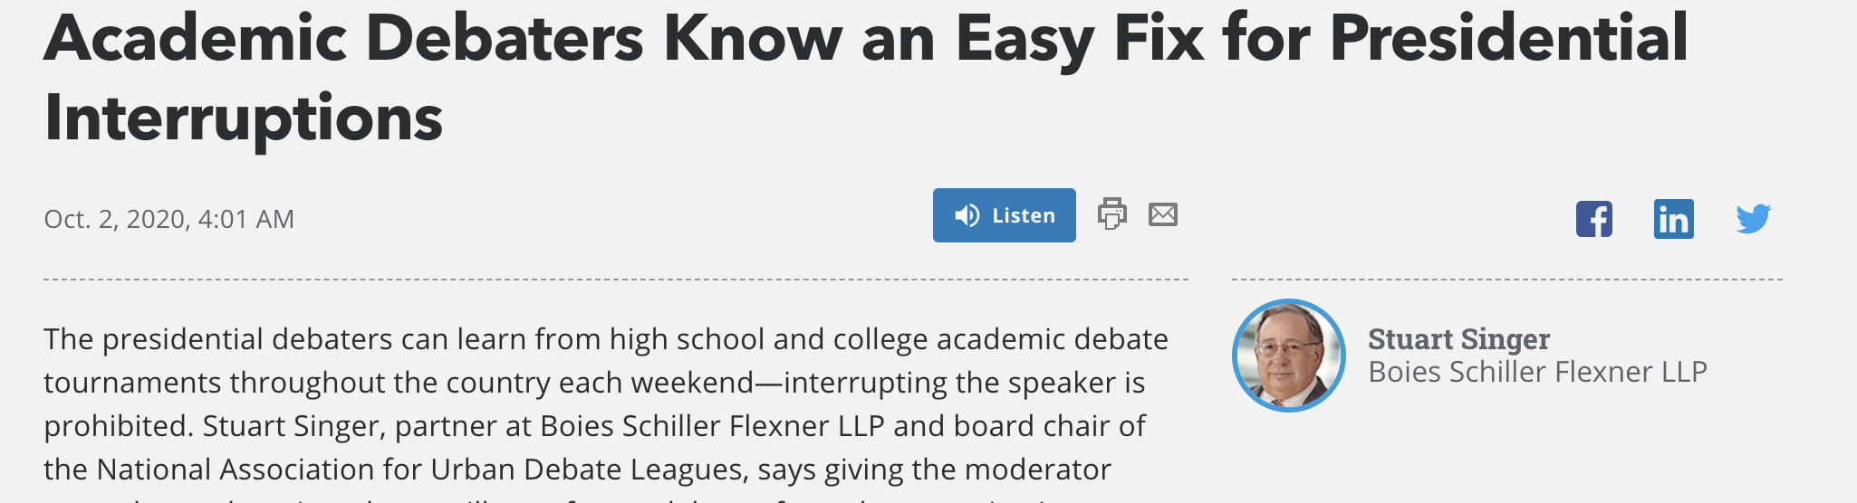
Need for debate-based pedagogy?

Slide 6
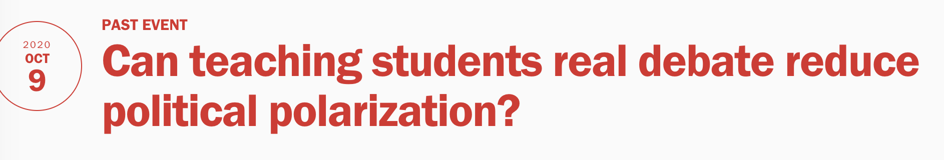
Need for debate-based pedagogy?

Slide 7
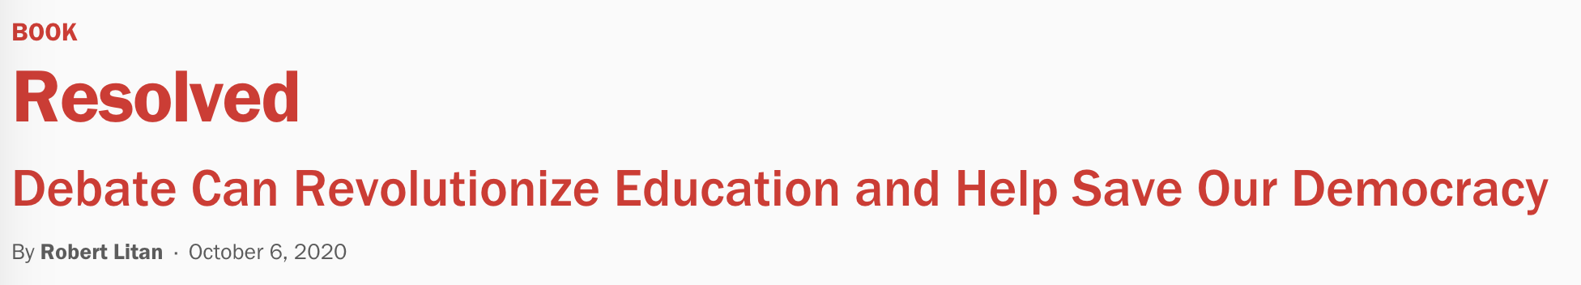
Need for debate-based pedagogy?

Slide 8
Debate-based pedagogy as civic learning
Open-minded inquiry that seeks relevant evidence to analyze & advocate within a given public controversy (Rowland, Gormley Jr., own experiences)
Reasoned advocacy
Evidence-based
Perspective-taking
Communicate clearly to knowledge/passions of audience

Slide 9
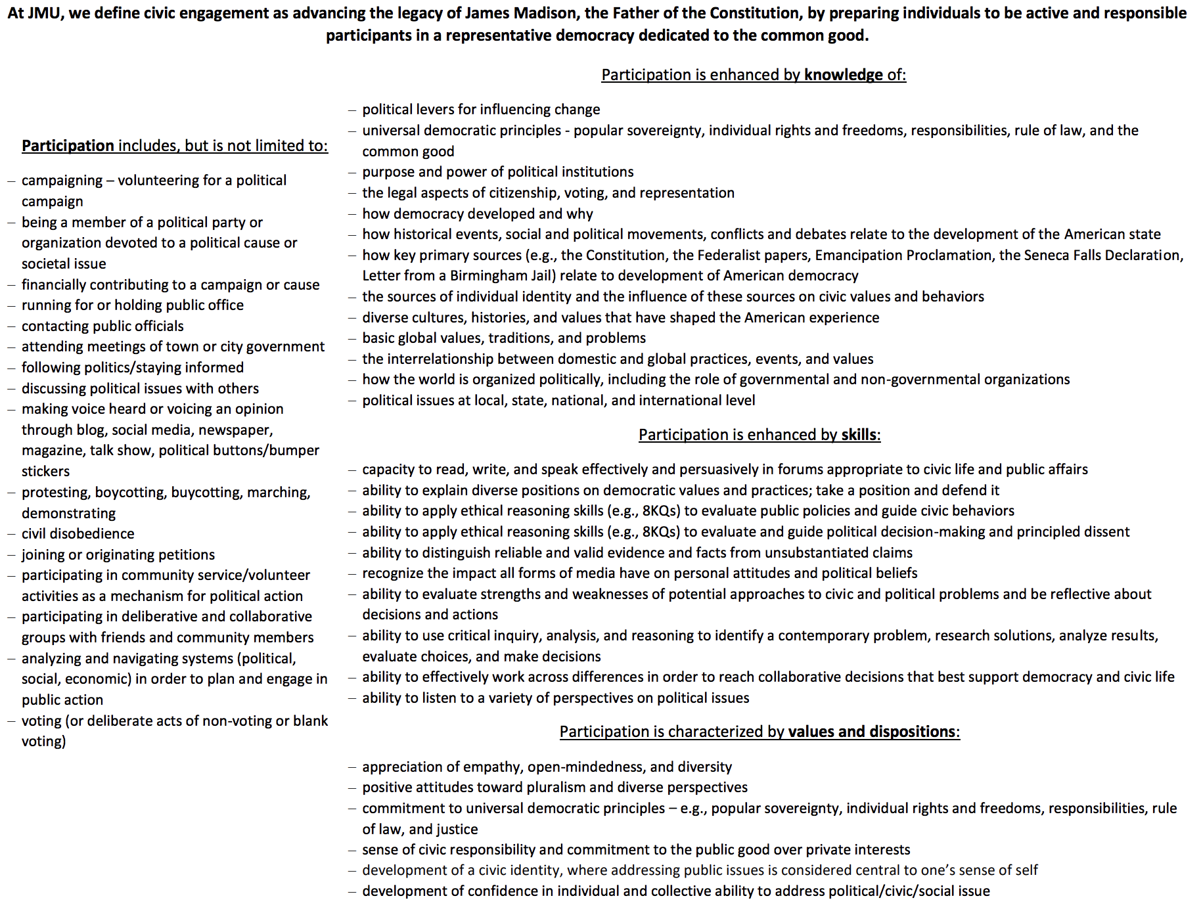
Civic learning & civic engagement

Slide 10
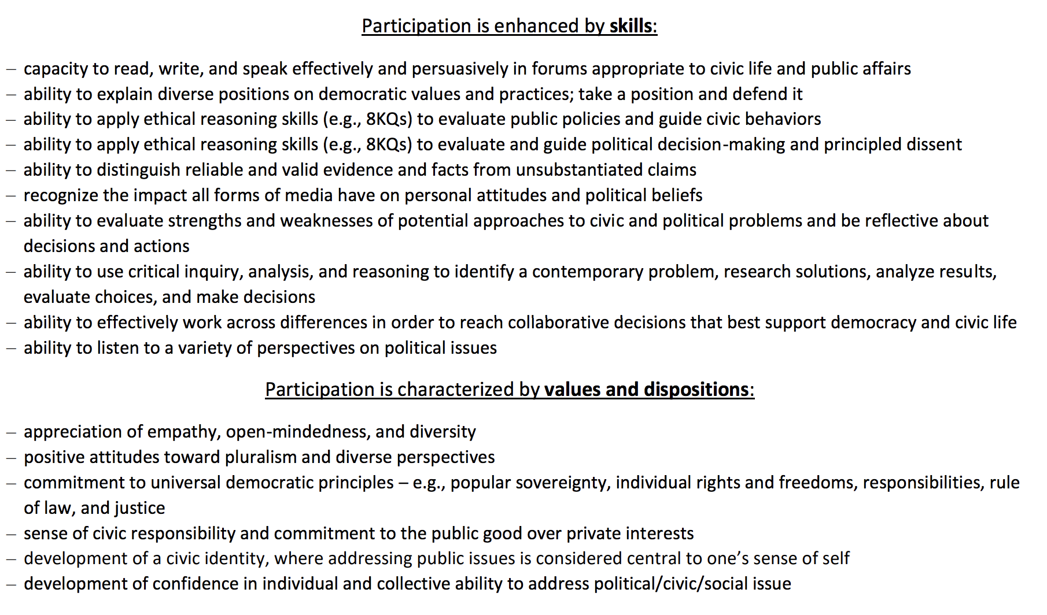
Civic learning & civic engagement

Slide 11
Civic learning & civic engagement
Spring 2019 assessment data for civic learning snapshot

Slide 12
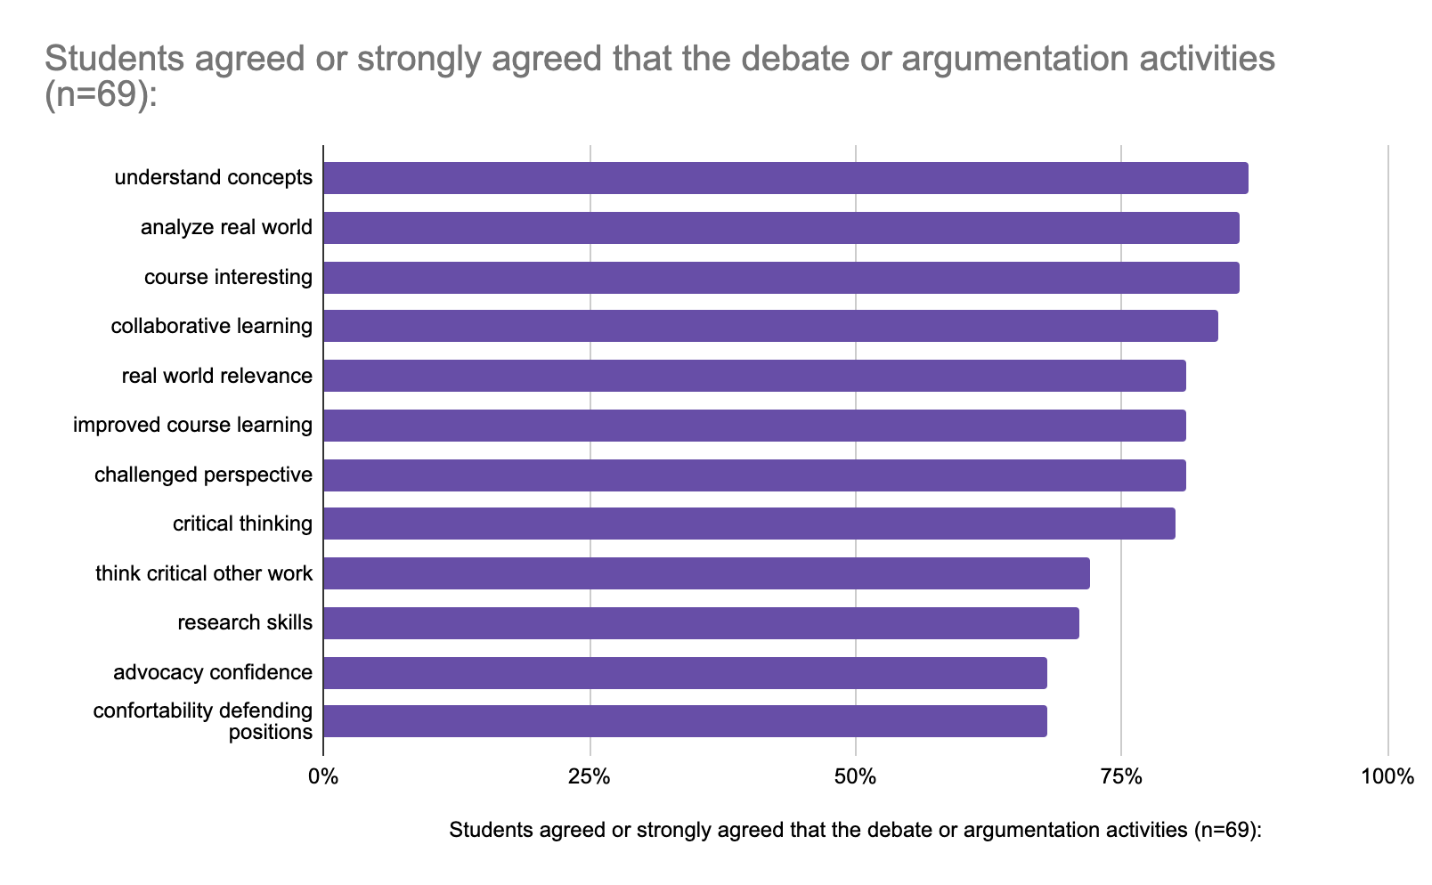
Spring 2020 student learning snapshot (n=69)

Slide 13
COVID-19 in Perspective Public Debate Activity
College sporting events should be suspended during the COVID pandemic.
Stakeholders
Student athlete (scholarship)
Fan
University medical director
Student athlete (non-scholarship)
Head football coach
Decision Makers
NCAA Board of Directors (4x)
Athletic Director (2x)
University President (2x)
Athletics booster
Conference Commissioner

Slide 14
COVID-19 public debate student reflection:
This assignment brought to my attention perspectives that I honestly never considered. I consider myself a pretty open minded person so I was kind of shocked that I had never considered the perspectives of individuals such as student athletes or even the people that are in charge of making these incredibly huge and difficult decisions….Overall, this assignment was a great learning tool to help people empathize with everyone throughout this pandemic crisis.
The majority of the words used I had seen before in other classes and know are relevant to this field, but I was never forced to really learn what they meant and how they interacted with one another and this assignment forced me to do that. I was also able to explain it to my parents in a way they understood which was informative to them and helped me further with the assignment. This is the first time in a while I have felt a homework assignment actuality helped me have a deeper understanding of the material and enjoyed it a lot. I think this concept should be used more often in science-related courses because it is a great way to not only memorize me truly learn the definitions that will be relevant in the field in future professions.
I feel as now that I am prepared for the future, if I ever need to have a public debate again in another course or just in life in general, so this debate was an awesome way to end the course and just bring together everything that we have learned in the past six weeks. Other courses at JMU should definitely consider implementing public debates, if appropriate to the class, because it really aids other people and challenges them to think critically, as well as see the perspectives of people with different opinions.

Slide 15
Introductions

Slide 16
Course design overview
L. Dee Fink’s Creating Significant Learning Experiences
Learning Objectives
Coursework
Assessment

Slide 17
Learning outcomes
Critical Thinking
Argumentation
Public Speaking
Advocacy
Information Literacy
Teamwork
Research
Writing Research Briefs
Civic Engagement
Empathy
Cultural Acceptance
Content Expertise

Slide 18
Sample learning outcomes
Demonstrate knowledge of controversial health issue from multiple perspectives
Identify, use and evaluate health information resources
Synthesize perspectives, information and relevant resources to make informed decisions
Demonstrate ability to advocate on behalf of one's self, their agency and/or a constituency
Compare and contrast approaches to research

Slide 19
Coursework
Lectures
Written exercises
In-class debates
Role-playing exercises
Student teaching
Simulations
Podcasts
Video debates
Community engagement
Blog posts

Slide 20
Assessment
Papers
Exams
Peer review
Ballots
Bibliographies
Reflection
Portfolios
Pre/post: knowledge
civic attitudes
public speaking
written communication
perspective taking
information literacy
argumentation

Slide 21
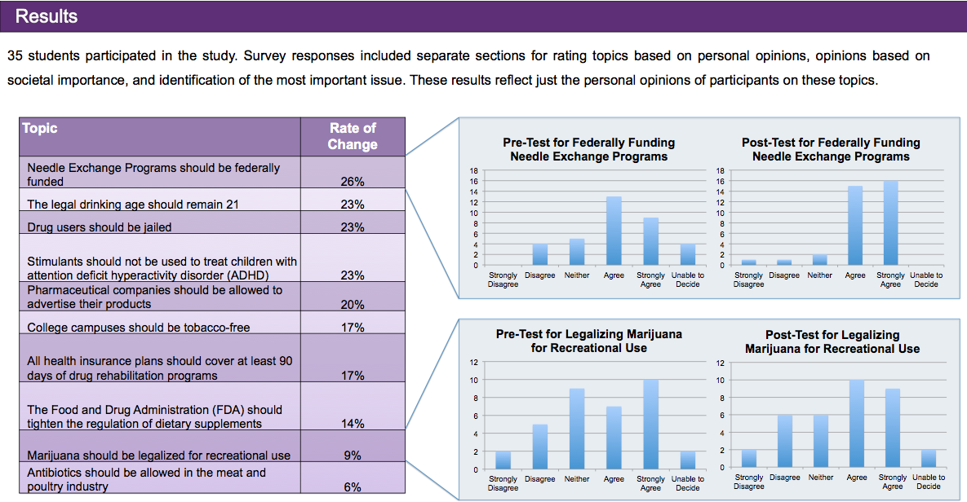
Assessment

Slide 22
Crucial Pivot Points
Meta-cognition
Curricular alignment
Scaffolding
Class-time
Group selection
Format
Topic selection
Team collaboration
Audience role
Instructional needs
Grading
Scholarship opportunities
Reflection

Slide 23
Resources
Debate Across Curriculum Faculty Associates
  Individual consultations
  Classroom lectures
Debate Across Curriculum Website
  Discipline specific scholarship
  Classroom examples
  Assessment examples
Communication Center
  Direct student support via consultations
  Faculty & course support via fellows
Debate Across Curriculum Faculty Cohort

Slide 24
Next Steps
Send bio information to Paul for communications
Schedule workshop for end of semester
Identify 1-2 times to check-in with institutional lead and JMU team
Begin course design & redesign
Fall 2020 design/redesign
Spring 2021 implement, assess, reflect
Fall 2021 Debate for Civic Learning Institute

