Slide 1


Jordan Case Study:
From Military to Civilian
NGO-led mine action
Mine Action Planning Workshop
Bogota, Colombia
10 June, 2009

Slide 2
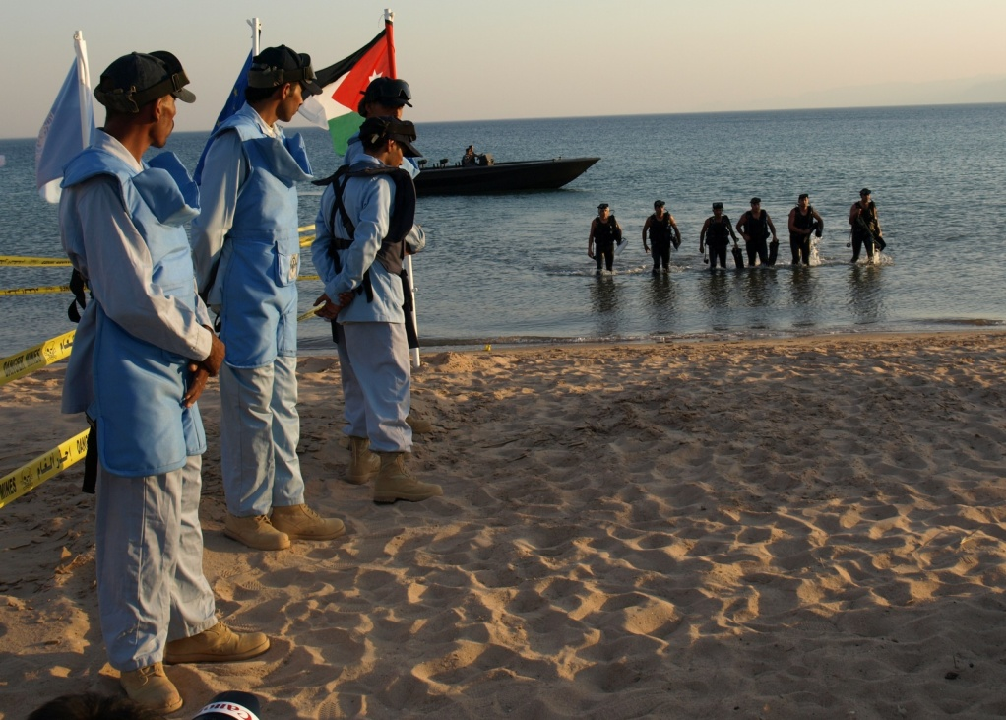
What is a Mine Action Partnership?
Mine Action Partners, in a spirit of cooperation, agree to carry out a mine action program; and contribute to it by combining resources, knowledge or activities; and share its achievements or failures.

Slide 3
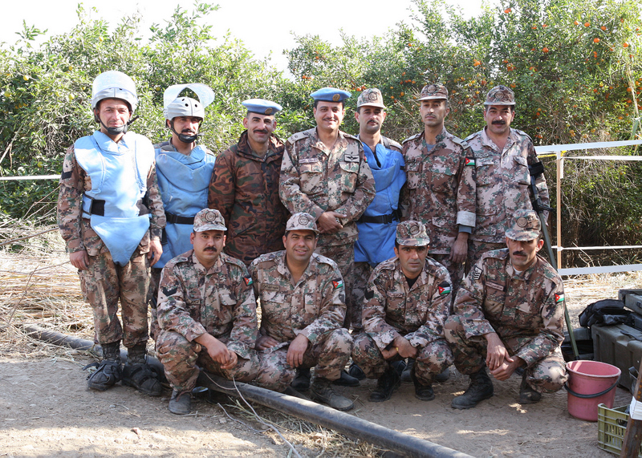
History of Mine Action in Jordan
H.M. King Hussein bin Talal tasked JAF with mine clearance in 1993
1 year before peace treaty with Israel
4 years before AP Mine Ban Convention
Military-led Mine Action
Humanitarian demining aim

Slide 4
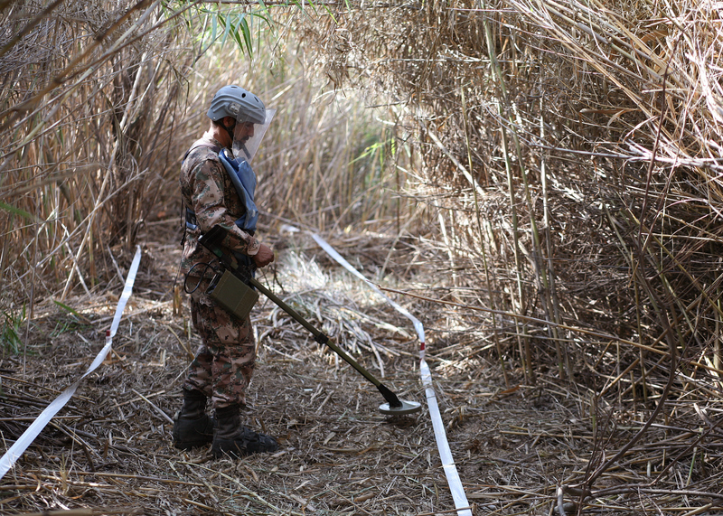
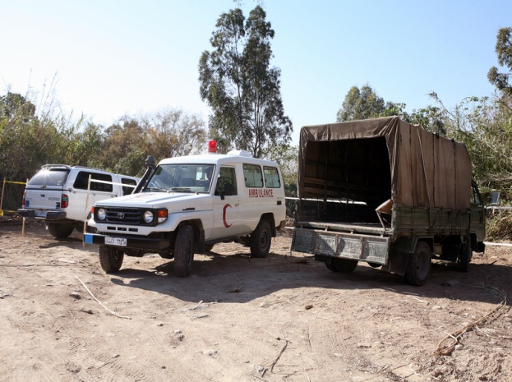
Challenges faced by Military-led Mine Action
Limited resources
(Funds, Machinery, Equipment, PPE …)
No capacity development
No access to international advancements in mine clearance
Limited support from International Community
Productivity slow
Article 5 Mine Clearance Deadline Approaching

Slide 5
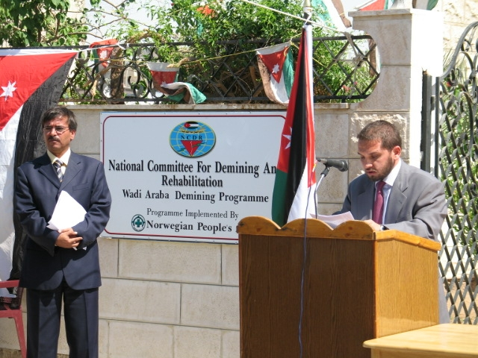
A New Approach
National Program
Local Ownership
Clear & Committed Leadership
Establish NCDR as National Mine Action Center (NMAC)
NCDR Law No. (34)

Slide 6
The Role of NCDR as NMAC
Overall Management
Planning & Coordinating
Supervising & Liaising
Government Support - Under Prime Minister’s Office
Focal Point for International and Domestic Stakeholders
Working Relationship with Key Line Ministries:
(Foreign Affairs, Planning, International Cooperation, Finance, Defense)

Slide 7
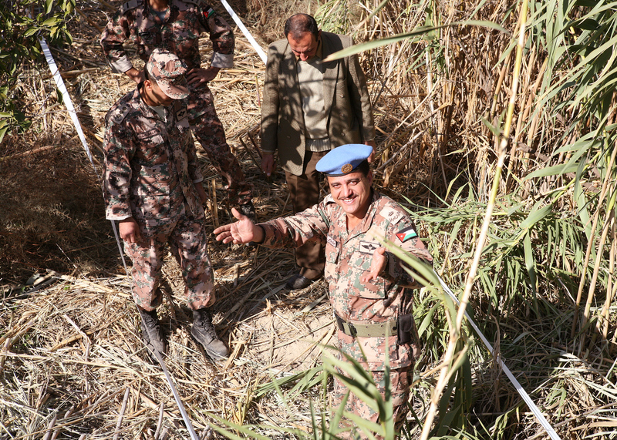
Key Points for Cooperation Between Military and NCDR
Communication
Involvement in planning
Coordination in clearance activities
Regular updates to REC Chief of Staff
Support work of REC: resources, equipment, training
Hire former REC officers
Quality Assurance/ Quality Control Role
Tasked with North Shuna Mine Clearance Project

Slide 8
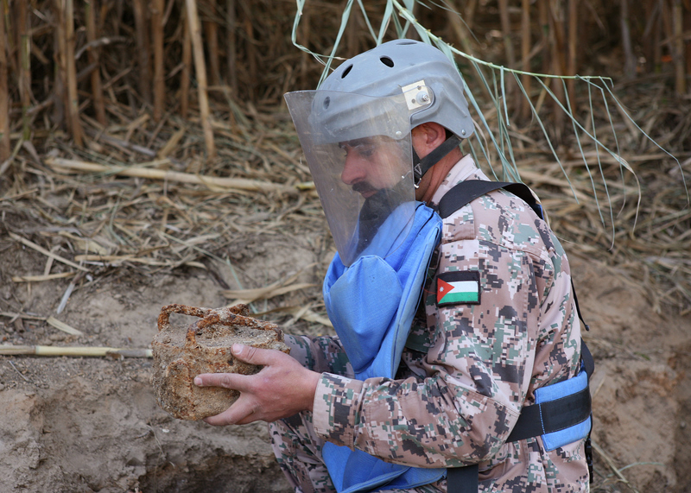
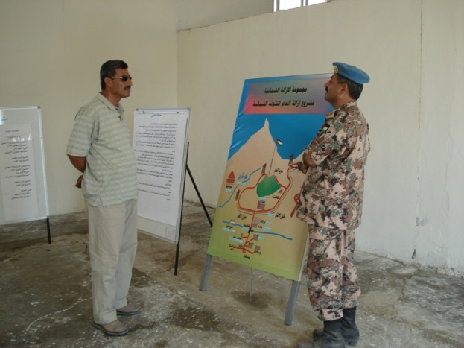
Military: Mine Clearance Partner
North Shuna Mine Clearance Project:
Retained Demining Role
Guidance and Supervision from NCDR
International & National Mine Action Standards
Increased credibility
Safer working environment
Increased resources through NCDR
Building trust
Completed ahead of schedule and under budget

Slide 9
Key Ingredients for Success
Determination
Ownership
Leadership
Vision
Confidence
Momentum
Success!

Slide 10
Planning & execution
of Mine Action projects
is easier and more predictable
with multi-year commitments
from donors

Slide 11
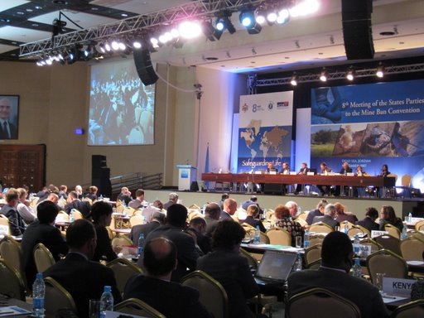
Network of Partnerships
Gov’t of Jordan
International Partners
Local NGOs
Military
Financial
Political

Slide 12
International Partnerships
Capacity Development Objective:
To develop key policy and strategic planning instruments that were limiting mine action's partnership base.
Identify Mine Action as development and humanitarian issue not engineering issue
Broad partnership base needed
  Ministry of Planning and International Cooperation
  UNDP

Slide 13
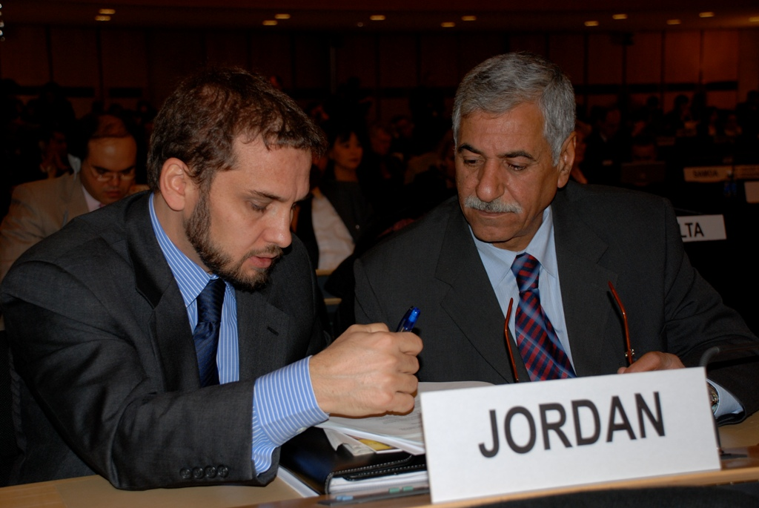
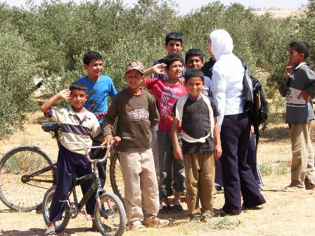
How to Increase Partnership Base
Lobbying
Explaining Mine Action
Bigger Issues:
More than demining
Address the pillars of Mine Action to reduce poverty and suffering:
  SVA
  MRE
  Universalization

Slide 14
National Mine Action Plan
2005 - 2009
First time for integrated national plan
Broader development and international legal obligations
Mine Ban Convention
Mine Action was clear for potential donors
Expanded International partners base
Mobilized funds doubled in 2 years
Greater domestic support from Government and Civil Society as a result

Slide 15
International Technical Partners & NGOs
UN Agencies: UNDP, UNICEF
Geneva International Centre for Humanitarian Demining (GICHD)
Implementation Support Unit (ISU)
James Madison University (JMU)
ICRC
Norwegian People’s Aid
Royal Engineering Corps
Mines Advisory Group
Other countries’ Militaries
(Belgium, Canada, Switzerland, France…)
Centre for Disease Control (CDC)
Cranfield University

Slide 16
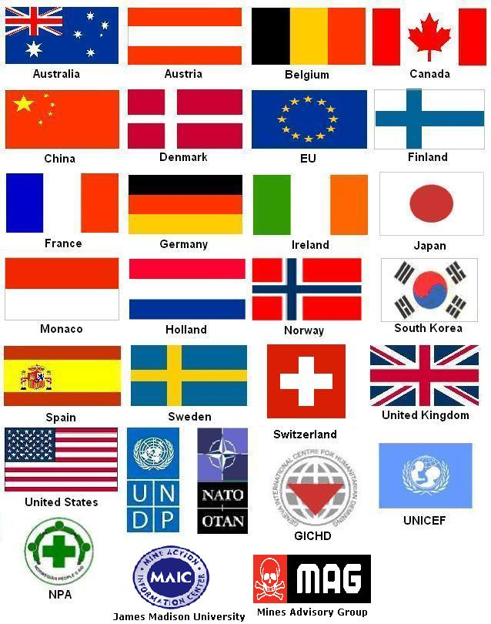
Domestic Partners
Survivor Corps
Royal Medical Services
Jordan Red Crescent Society
Hashemite Commission for Disabled Soldiers
Higher Council for the Affairs of Persons with Disabilities
Lifeline for Consultancy and Rehabilitation
Donors and Partners

Slide 17
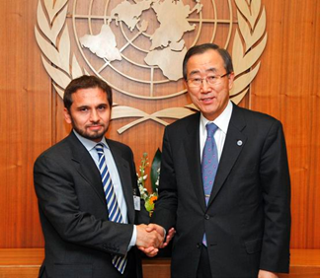
5 Key Things for Successful
Mine Action Partnerships
Strong local leadership
Political will
Bureaucratic Support
Clear vision and robust coordination
Transparency

Slide 18
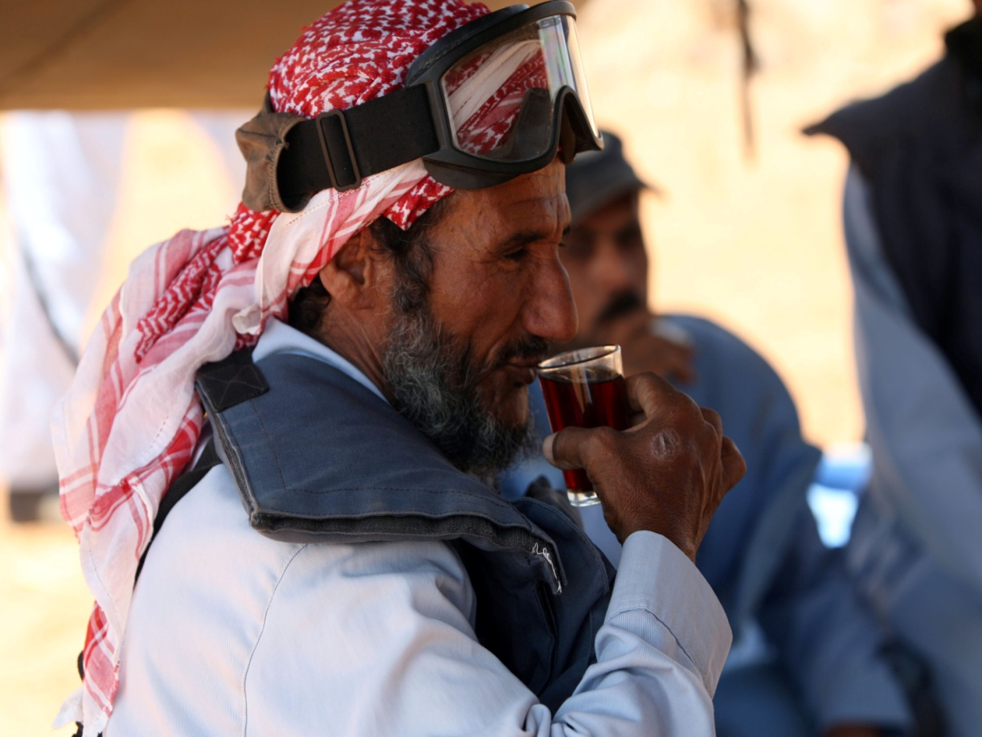
Thank You for Your Attention

