Slide 1

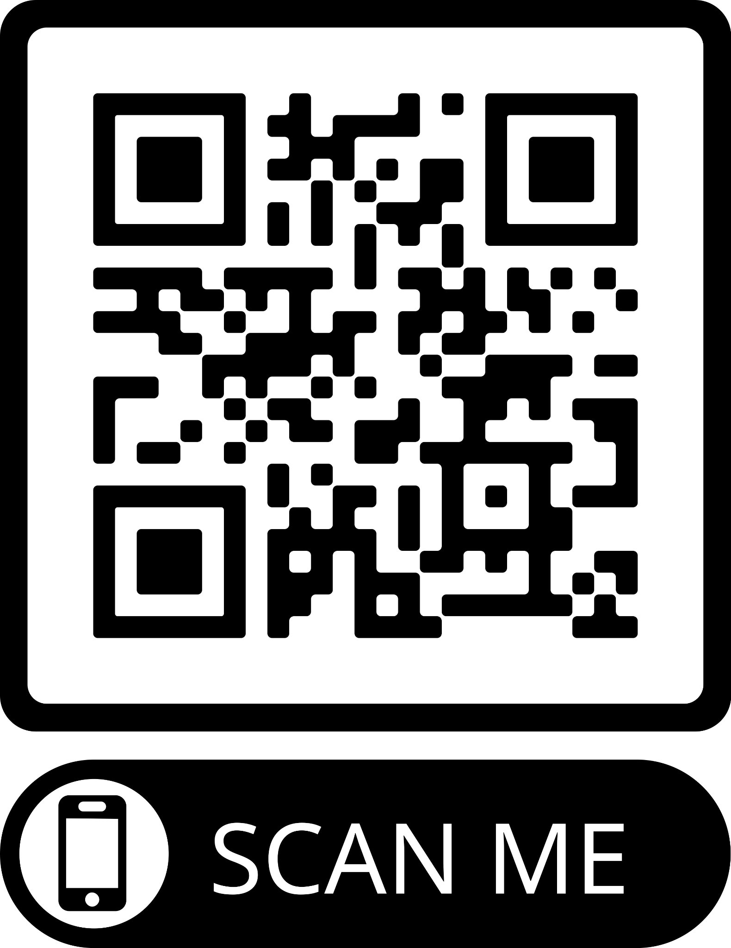

WELNET®: 21st Century Technology in PE
Jamie Wright
JWright@schoolhealth.com
@mrjdub23
Lei Dunn
LDunn@Schoolhealth.com
@leidunn_vb
Slide Deck
https://bit.ly/FFWelnetSH

Slide 2

Agenda
1. What is WELNET®?
2. What modules are available to me on WELNET®?
3. How to use WELNET®?

Slide 3
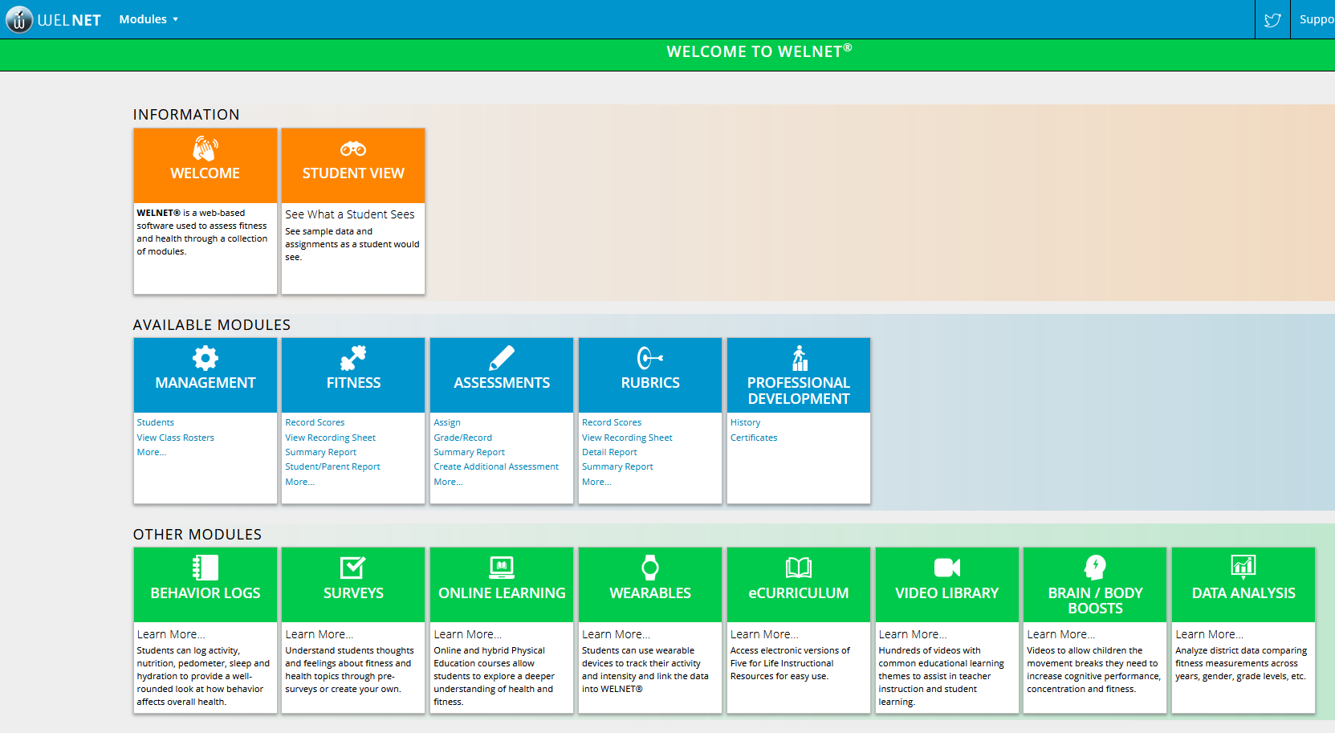
About WELNET®
  WELNET® is a web-based software program used to assess health & fitness, as well as motor skills, through a collection of modules.
Elevates your current program…
Exceeds the minimum state requirements, goals & objectives…
Engages students and stakeholders…
Notes:
Lei

Slide 4

WELNET®
Record and report the state mandated fitness measurements (Fitness)
Create cognitive assessments with question bank (Assessment)
Assess student’s mastery of motor skills (Rubrics)
Record student behaviors with HPE content (Behavior Logs)
Access to a video library of over 500 instructional videos to supplement teaching content (Video Library)
Notes:
Jamie

Slide 5
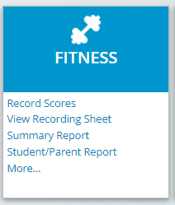
Fitness Module
  Fitness Module
Preloaded with fitness measurements (ie. FG/PYFP) plus additional if desired
Easy to use with First class support (minutes vs. days or weeks) with continual auto roster updates
Teachers have the flexibility to create additional phases
Notes:
Lei

Slide 6
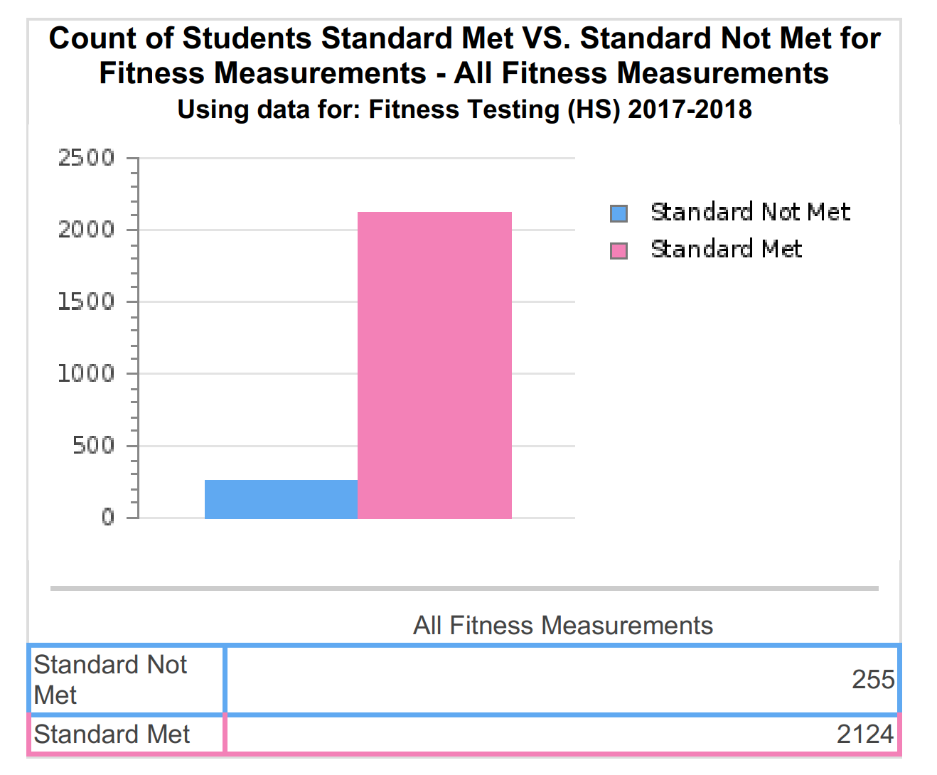
Data Analysis
Notes:
Lei

Slide 7
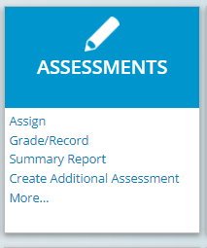
Assessment Module
  Assessment Module
  A bank of summative cognitive assessments that are Fitness, Health and Nutrition based
  Students can log in and access from any device and immediately for the teacher
  Question bank with an additional 2,000 questions
  Ability to create custom assessments
Notes:
Jamie

Slide 8
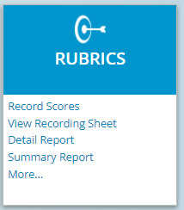
Rubrics Module
  Rubrics Module (aka Motor Skills Module)
  3 different ways to quickly score: Checklist, Holistic and Analytic
  Includes pre-loaded definitions, critical elements and descriptors for over 80+ motor skills
  District can map skills so teachers can see what they are supposed to assess
  Summary reports provide valuable info about progress students are making on mastering motor skills
Notes:
Lei

Slide 9
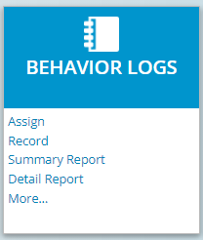
Behavior Logs Module
  Behavior Logs Module
  Demonstrates how daily choices & behavior affect fitness, nutrition, sleep and hydration.
  Supports creation of individual fitness plans and student portfolios.
  Teachers activate student access and length of availability for logs.
  Students can access from any device
Notes:
Jamie

Slide 10
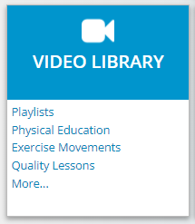
Video Library Module
  Video Library Module
  800 videos in the following categories: Exercise Movements, Fitness and Health Academic Content and Motor Skills
  Videos show proper technique for motor skills
  Teachers can create custom playlists and assign to classes
  Students can view from any device
e
Notes:
Lei

Slide 11
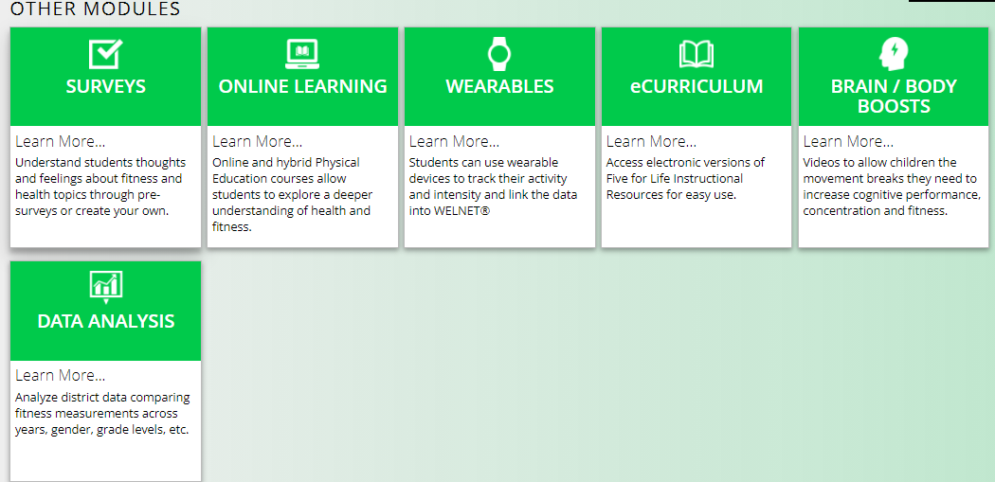
Additional Modules
Notes:
Jamie

Slide 12
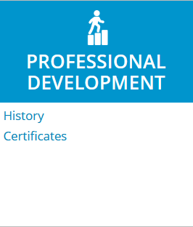
Professional Development Module
  Professional Development Module
  Easy access to pre-recorded instructional webinars
  Start, stop, and continue learning when it works best
  Reports and Certificates available upon completion of webinars
Notes:
Lei

Slide 13

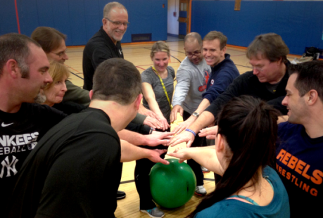
Professional Development
Face-to-Face and Virtual Trainings on:
  Nutrition
  Motor Skills Progression
  Health Ready®
  FIVE FOR LIFE® Program
  WELNET ®
  FAB 5® ELF
  FAB 5® After School
  FAB 5® Physical Activity
  Circuit Training
  Heart Rate Training
  +Customized Content and much more
Notes:
Jamie
Demo sites are available upon request

Slide 14



Curriculum
After School
Early Learner Fitness (ELF)
Classroom Activity
Character Education (PEACE)
K-12 Physical Education
Nutrition
Fitness
6th Grade-High School Health
Notes:
Lei

Slide 15
Q/A
Teacher and Student Login
  T - Classlink SSO
  S - UN/PW
Class Rosters
  State SIS
Support
  Chat, Email and Phone
Enhancements
Other
Notes:
Jamie

Slide 16
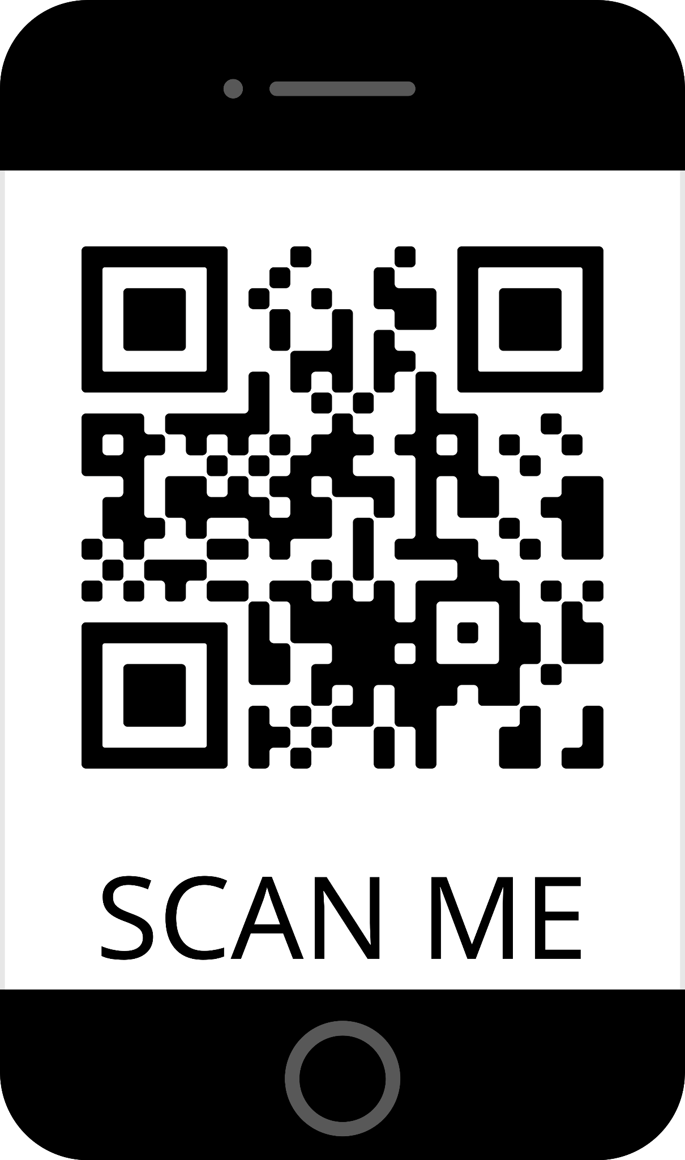

FREE WELNET® Demo Site:
Jamie Wright
JWright@schoolhealth.com
@mrjdub23
Lei Dunn
LDunn@Schoolhealth.com
@leidunn_vb
https://bit.ly/FreeWelnet

