Slide 1
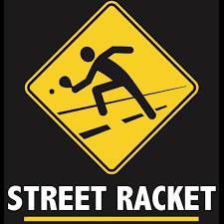
Street Racket: Anytime, Anywhere, Anyone!
Ron Trainum, Toano Middle School
ronald.Trainum@wjccschools.org

Slide 2
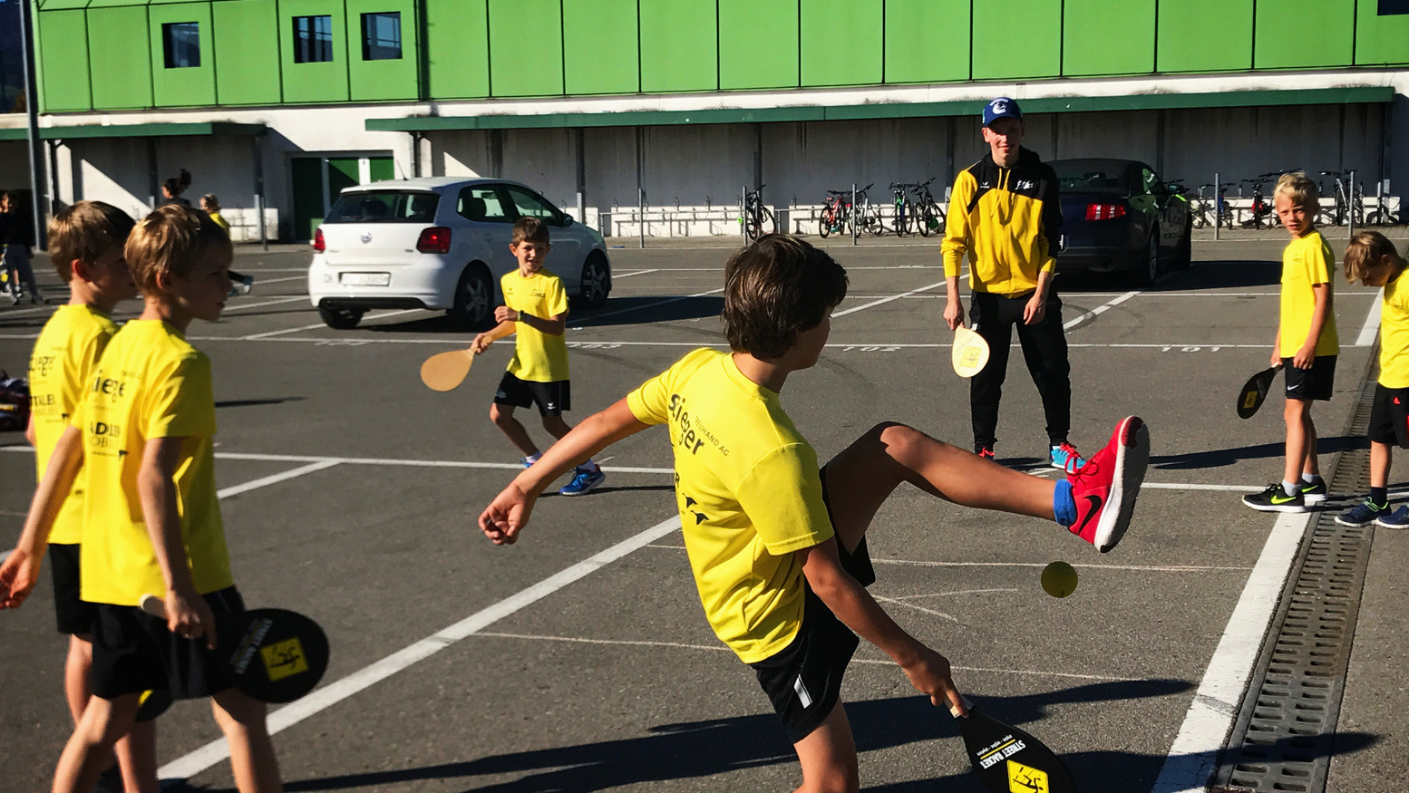
Skill Progressions (Individual)
Grip and Grip Check
Forehand Self-Volley (dominant and non-dominant)
Backhand Self-Volley (dominant and non-dominant)
Pancake Flip (dominant and non-dominant)
Double Paddle Self-volley
Forehand Single Bounce underhand (individual)
Backhand Single Bound underhand (individual)
Self-Rally over a line (single and double racket)

Slide 3
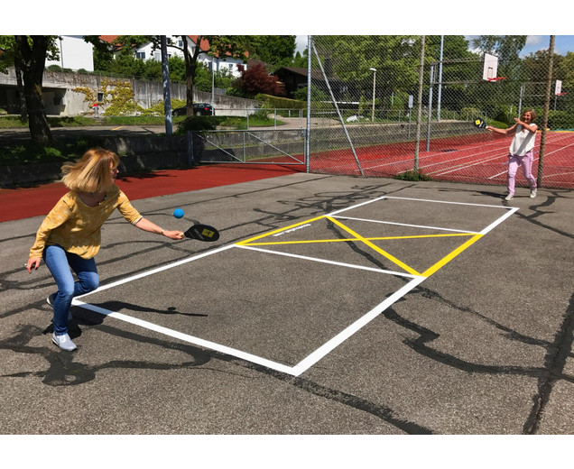
Skill Progressions (Partner) – Singles Court
Rally – Underhand with single bounce
Rally – Underhand single bounce over a line
Rally – Underhand single bounce on singles court
Challenges
  Successful hits in 2 minutes
  Consecutive hits in 2 minutes
4-Person
  Partners alternate hits
  On the Run Cross the Center
  Around the World

Slide 4
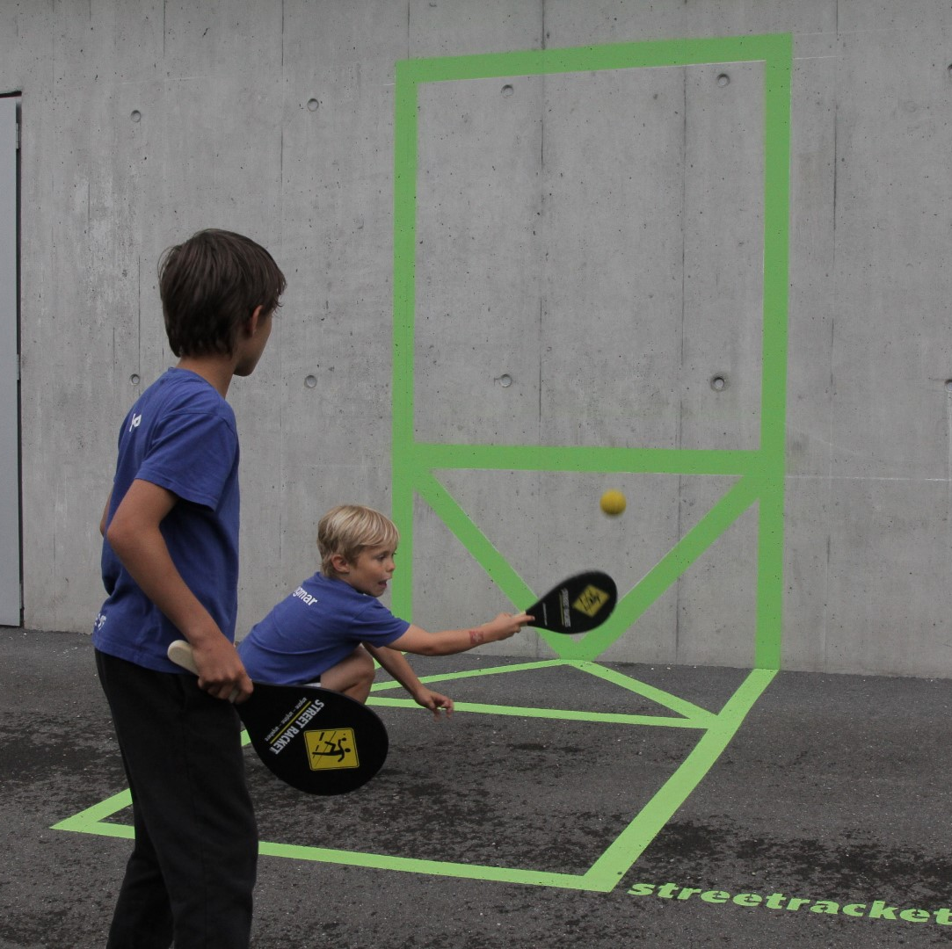
Skills Progressions – Wall Activities
Individual Self-Rally
  Forehand
  Backhand
  Alternating
Partner Rally Alternating Hit
  Challenges
    Successes in 2 minutes
    Consecutive in 2 minutes
Game Action

Slide 5
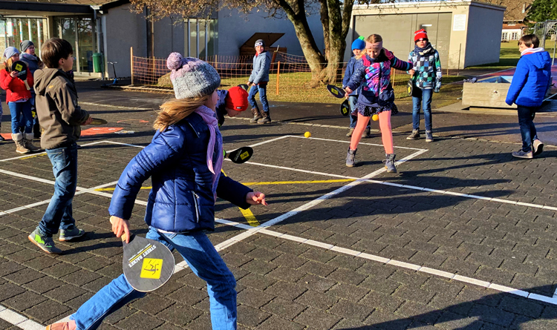
Skills Progression: 4-Player – Cross Court
4-player Around the World
4-Player Single Hit Rotate
4 Square

Slide 6
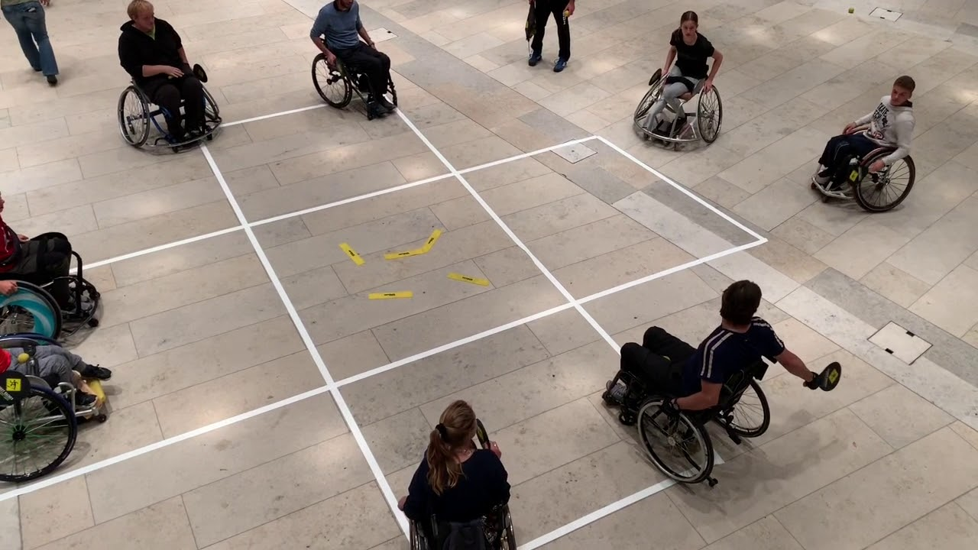
Game Play – 11 Points (Straight Up)
Singles Court
  Singles
  Doubles Alternate Hit
Cross Court
  Singles 2 ball
  Singles 1 ball
  Doubles 1 Ball

Slide 7
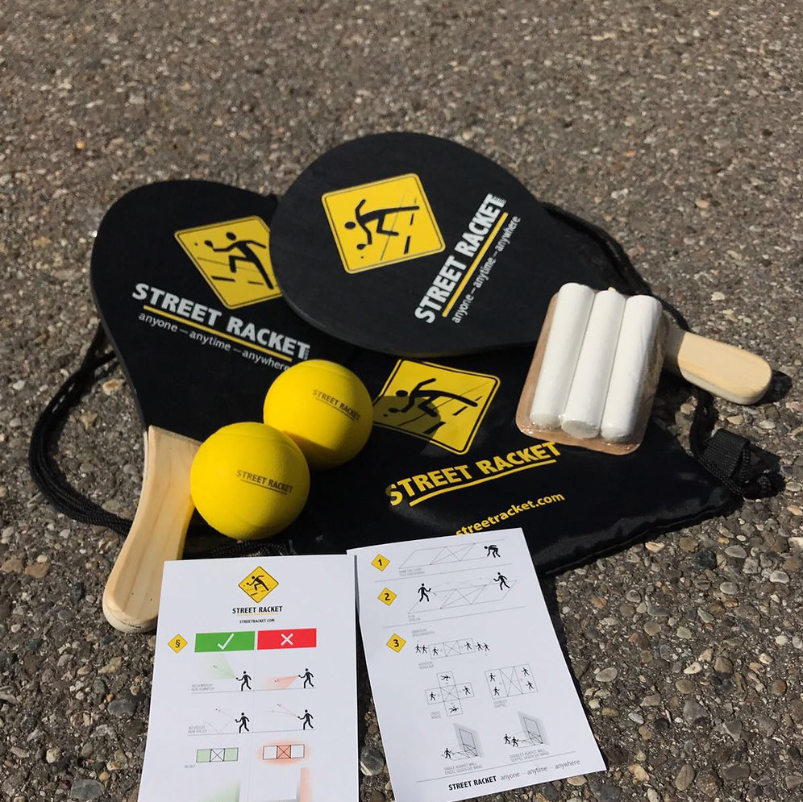
Ordering Your Gear
Order Link: https://streetracket.co/
Promo Code: Parker25

Slide 8
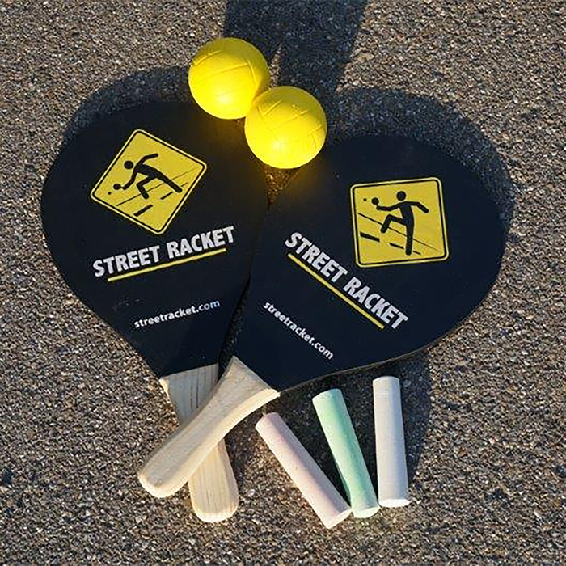
Background Information

Slide 9
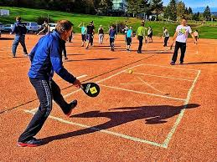
What You Need to Know to Play – Serve and Return:
Serve & return:
You can play the ball directly out of your hand or after one bounce on the ground (this option also helps to create good rallies from the start as the personal preference on how to start a rally changes from player to player). The ball is then hit with the racket from the first square to the opposite side (over the middle zone into the third square). After leaving the racket, the ball must move in an upward motion or horizontally at least briefly (no downplay / no smashing!).
The faceoff is determined by lottery and the server can choose the desired side of the game. The winner of a rally has the right to serve in the subsequent rally. The winner of a set opens the following set. After each set played, the sides are changed.
Positioning:
Street Racket wants to make racket sports accessible for all with as little complications as possible, and therefore the least possible amount of set rules. This is also the case with footwork/positioning.
A player can stand wherever he likes during the rallies. There is only one exception: When serving (first shot of each rally) the player mustn't touch the middle section / middle square or the line thereof.
*Source: Street Racket

Slide 10
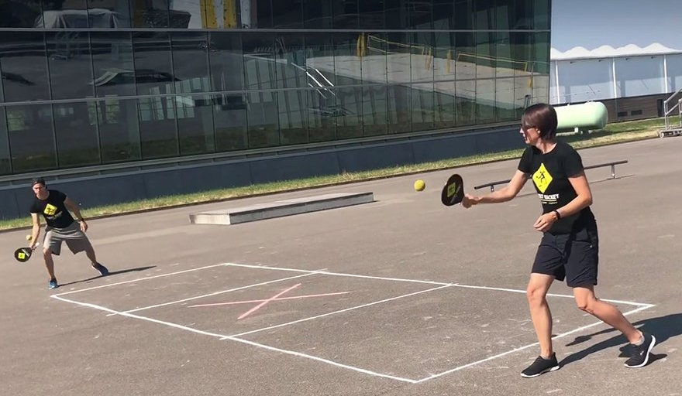
What You Need to Know to Play – Positioning:
Positioning:
Street Racket wants to make racket sports accessible for all with as little complications as possible, and therefore the least possible amount of set rules. This is also the case with footwork/positioning.
A player can stand wherever he likes during the rallies. There is only one exception: When serving (first shot of each rally) the player mustn't touch the middle section / middle square or the line thereof.
*Source: Street Racket

Slide 11
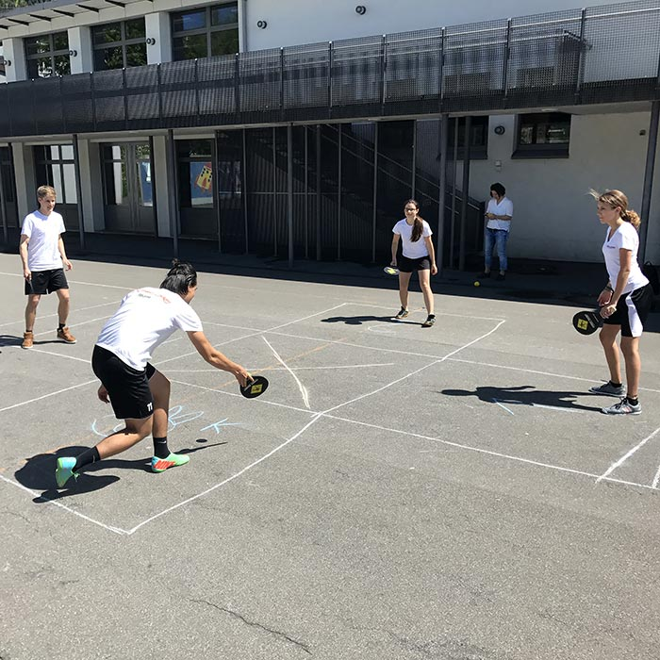
What You Need to Know to Play – Scoring
Valid point:
A valid point is described below as an example for a single game (1 player per side). Player A tries to score in the square of player B and vice versa. If the ball played by player A lands outside the target area /square of player B (and thus, for example, also in the middle zone), player B wins the point.
The ball must bounce on the floor / in the opponents' square once (and only once!) before it is played back (no direct hitting / volley!). The ball can only bounce once, two consecutive bounces off the ground result in a mistake. If the ball touches the lines of a target zone, the ball is valid and the game continues (as in tennis, table tennis and badminton but not as in squash). For all shots / hits, the ball must first move upwards or horizontally after contact with the racket (no downplay / no smashing!). If the ball moves in a downward motion when changing directions (upon contact with the racket), the point is awarded to the opponent.
Important: The two rules "no downplay" and "no volley" are the heart of the Street Racket concept. These rules ensure that the game becomes more controlled, and the actions become more successful. The focus of Street Racket is set on ball control, long rallies and the promoting of motor skills (hand eye coordination foremost) and successful racket sports in general. A player should be able to place the ball the way he wants at any given moment or the way the situation requires him to act. The basic rules ensure that there is enough time to do so, and that no player can dominate a game or a rally (for example with force / power and hard hitting) and ALL can play. Street Racket is a game for everyone, including beginners WITH professionals, young WITH old, women WITH men. The Street Racket rules ensure a very social, benevolent and motivating atmosphere and do not exclude anyone! The concept therefore also promotes INCLUSION and INTEGRATION. It's suited for all playing levels and age groups.
*Source: Street Racket

Slide 12
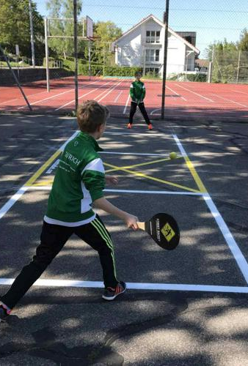
What You Need to Know to Play – Counting
Counting:
The winner of a rally gets one point. The player who wins 11 points first wins the set. There is no extension at 10:10, each set ends at 11 points. Normally the game is played "best of five", until one player has won three sets.
NOTE: Street Racket puts the focus mainly on cooperation before competition - and when played in groups the competition takes places as a team-challenge. Whichever team (or single player or pair) gets the longest rally / the most consecutive shots for any given exercises in a certain time frame wins the challenge.
*Source: Street Racket

Slide 13
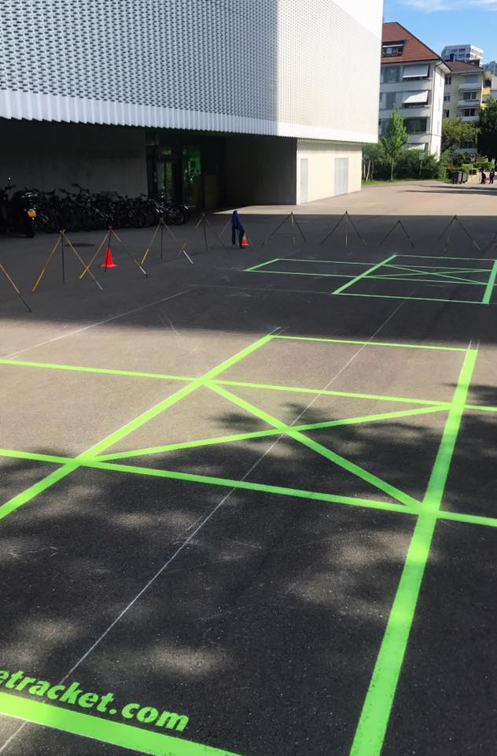
What You Need to Know to Play – The Court
Court(s):
The characteristic court (consisting of squares) can either be drawn on the floor (for example with chalk or paint) or marked in another way on the surface (for example with adhesive tape, masking tape or sports markers). Alternatively, the court can also be marked with flat objects.
A street racket court consists of three squares of the same size arranged in a row and can be scaled (basic recommendation and tournament size: 2m per square - overall size 2x6m for a single court). Thus, the movement game adapts flexibly to any available space and makes ideal use of the respective setting. The courts can really be used anywhere! Larger courts mean more and bigger movement / intensity, smaller courts increasingly train fine motor skills and ball control. Ideally players use different sizes to promote their motor skills even more and work on their differentiation skills.
The middle squares replaces the net, which separates the parties in most racket sports. This also means: No purchase of a net, no setting up of a net, no maintenance, no poles, no holes. Just draw the court and play!
*Source: Street Racket

Slide 14
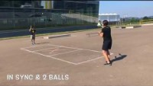
Singles Play: Multiple Versions

Slide 15
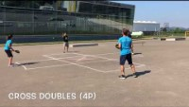
Cross Court: The sky is the limit!

