Slide 1
Drivers Ed- ABC’s
Adding tools to your tool box

Slide 2
Scavenger Hunt
Get a card, dry erase pen and a partner

Slide 3
This or that- choose one!
Car or truck
Diesel or gas
Electric vehicle or gas powered
Automatic transmission or stick shift
Motorcyle or car
Back roads or interstate
HOV lanes/HOT lanes or regular lanes
Angle parking or parallel parking
Traffic circle or 2 lane roads
Fog or snow
Passing on a broken line or wait

Slide 4
ABC’s
Get out a piece of paper and write down the letters of the alphabet
A
B
C
D

Slide 5
What do we need to teach and cover in Driver Education?
Write down skills you teach in class for each letter
Consider cognitive domain (knowledge attainment)
Psychomotor domain (neuromuscular skills)
Affective domain (emotional arena including beliefs, values and interests)

Slide 6
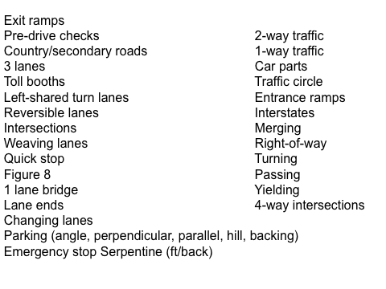

Slide 7
Pavement markings identification
Yellow lines vs. white lines
Broken lines vs. solid lines
Country roads, city streets, interstates,
downtown
1-way road w/ passing, 2-way road w/ passing, 2-way 1 side passing & other side no passing, 2-way no passing, traffic circle, 4-way intersection w/ staggered stops

Slide 8
Get a section of yellow string and white string
Measure out 5-6’ in length for each color (use your height as a reference point)
Take half of your yellow string and cut into 1” sections (use your pinky as a reference). . Do the same with your white string
Make a one-way 2 lane road with passing
Make a one-way 2 lane road with no passing (like in a tunnel)
Make a 2 lane back country road with no passing
Make a 2 lane back road with only one side passing and put your pencil down as a car on the side where passing is allowed
Traffic circle

Slide 9
Practical skills outside

Slide 10
Use poly spots to direct traffic and movement flow in the gym, tennis courts, etc.
School health https://www.schoolhealth.com/poly-traffic-sign-spot-markers
Wolverine sports https://wolverinesports.com/products/stop-go-slow-yield-poly-spots
Gopher SOFT domes https://gophersport.com/rainbow-protuff-dome-cones

Slide 11
Thanks for coming!
Cindy Ferek
pilotcferek@gmail.com
cindyferek.wordpress.com
Go to presentations to see these handouts

