Slide 1
Circus, Circus, CMO!
Five Rings of Fantastic!

Slide 2
Your Ringleaders Are
RINGMASTER
DATA DAREDEVIL
SMILES
Ron Malm
Chief Connector and Solution Specialist
Lei Dunn
Keeper of numbers, teacher of many; motto is “Do Hard Things!”
Jamie Wright
Jovial jolly ball of energy and movement coordinator
BIG RIG
SUPER STEVIE
COWGIRL KELLY
Amy Riggio
Driver and Navigator on the Activity Highway
Stevie Ray Gray
Sensational spectacle of spellbinding splendor
Kelly Clark
Master of Movement running the rodeo of life

Slide 3
WELCOME TO THE CIRCUS
Today you will:
Experience the CMO experience
Understand the benefits to many of different CMO initiatives
Learn the steps to bring the CMO experience back to a School Division near YOU!
We don’t want you to miss a thing! Listen for the special song to know when to rotate clockwise to the next ring.

Slide 4
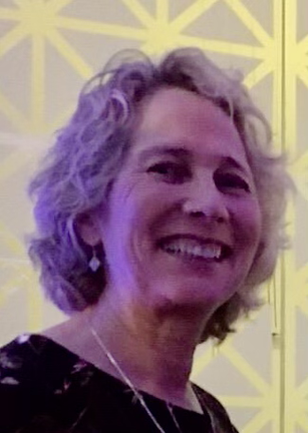
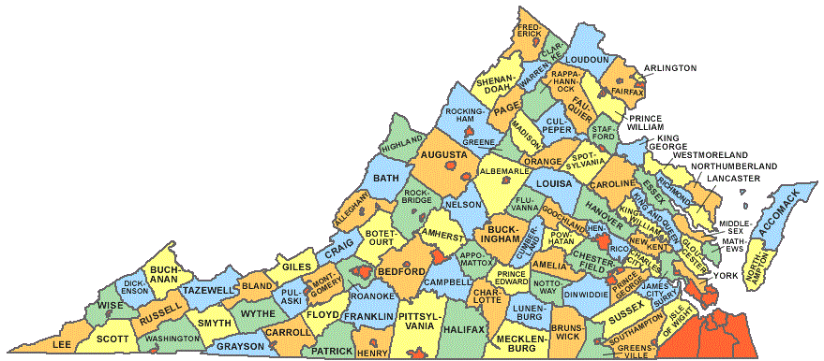
Vision to Reality
Vanessa Wigand
Virginia is for Movers!
Notes:
Vanessa Wigand, Coordinator, Health Education, Family Life Education, Physical Education, and Driver Education
Virginia Department of Education

Slide 5
SUPERSTAR STATIONS
DATA W/ LEI
ACADEMIC ACCELERATORS - SECONDARY
ACADEMIC ACCELERATORS - ELEMENTARY
BRAIN BOOSTS
CALMING & REFOCUSING

Slide 6
SUPERSTAR STATIONS
Dairy - DragonFruit- Jalapeno
Pineapple - Mango - Pumpkin
Strawberry - Pistachio - Rhubarb
PassionFruit - Sweet Potato - Water
Kumquat - Kiwi - Watermelon

Slide 7
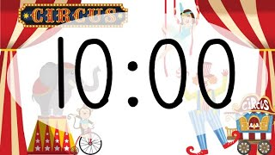
Big Top Fun…

Slide 8
CMO DATA
20-21 Recap
21-22 Recap
“About the CMO” Video

Slide 9
Academic Accelerators
Elementary
Short Vowel Long Vowel
Sight Word Challenge
Noun or Verb
Notes:
Stevie

Slide 10
Calming & Refocusing Strategies
Notes:
Calm & Refocus Slides: https://docs.google.com/presentation/d/1e2hYIt4QfQPXlKh4N4rbZ8d1xkHKkO0KLWeP33F1R-M/edit?usp=sharing

Slide 11
Brain Boosts
Roll the Dice Fitness
Suit up for fitness
Card Sharks
1-2-3 Show

Slide 12
ACADEMIC ACCELERATORS SECONDARY
SUIT UP FOR MATH
ALL AROUND THE WORLD
DIRECTIONAL DANCE

Slide 13
THANKS!
TO ALL VA EDUCATORS WHO
INSPIRE YOUTH TO MOVE!!

