Slide 1



Brainball™ and Budgeting: How to
Fund and Support Cross-Curricular
Brainball Use
Lei Dunn
LDunn@Schoolhealth.com
@leidunn_vb
Slide Deck
https://bit.ly/HPAIBRAINBall

Slide 2

Agenda
1. What is BRAINball™
2. The benefits of BRAINball™ for students and teachers
3. How to acquire BRAINball™ for your school

Slide 3
BRAINball™
SORT

Slide 4
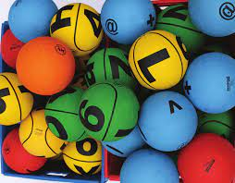
What is BRAINball™
  BRAINball™ is an innovative and unique physical
  education learning system that merges physical activity and academic learning through play.
Promotes health and physical literacy
Prepares students for higher level thinking
Partners cross-curricular stakeholders

Slide 5
BRAINball™
SPELLING TAG

Slide 6

BRAINball™
Developed by the University School of Physical Education in Poland
Over 20 years of research
Improvement in fine, motor and cooperation skills
Develop math and reading skills

Slide 7
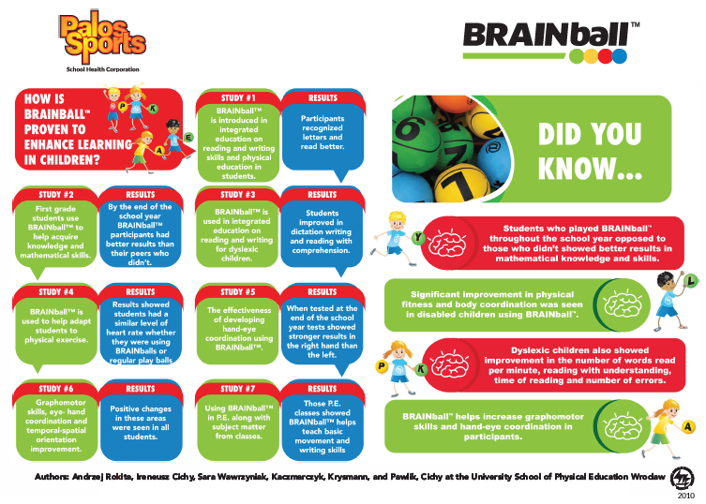
Notes:
https://www.palossports.com/media/pdf/BRAINball%20Research%20Info%20Graph_02.2022.pdf

Slide 8
BRAINball™
TIC-TAC-TOE

Slide 9
BRAINball™
TEAM HANDBALL

Slide 10
BRAINball™
Consider alternate funding sources
Title I for low and moderate income students
Title III for English Language Learners
Title IV for General Education
ESSER Funds and Grants
Notes:
Every Student Succeeds Act [ESSA] - https://www.ed.gov/essa?src=rn

Slide 11
BRAINball™
Title IV part A of the Every Student Succeeds Act [ESSA], Student Support and Academic Enrichment (SSAE) grants
Sub fund “Safe and Healthy Schools” (pages 24 – 27 of this document gives an overview) - specifically under the physical activities category.

Slide 12
BRAINball™
Math Triangle

Slide 13


MORE on BRAINball™:
Example lessons
Information on professional development
https://bit.ly/BRAINBallinfo

Slide 14
Thank you for your time, attention and participation!
Lei Dunn
LDunn@Schoolhealth.com
@leidunn_vb
Slide Deck
https://bit.ly/HPAIBRAINBall

