Slide 1
Please answer these 3 questions on a piece of paper; no discussion with your neighbor
True or False: An assessment includes a test, measurement and evaluation.
Which word means the process of collecting data on the property or attribute of interest?
  Test
  Measurement
  Evaluation
Which stages of program development might you use assessment?

Slide 2
The Value of Assessment
Lei Dunn, M.Ed., CHES
July 10, 2023

Slide 3


Muraho!
I am Lei Dunn
I am the K-12 Instructional Specialist in Health and Physical Education for Virginia Beach City Public Schools, adjunct faculty with the Darden School of Education at Old Dominion University and a doctoral student in Education Leadership at Liberty University
You can find me on Twitter at @leidunn_vb

Slide 4
We have 3 objectives today…
Understand the cycle of assessment
The Value of Assessment
Discuss different methods of assessment
Describe assessment fits in program planning

Slide 5

What does the word TEST mean to you?
Let us list some descriptive words.

Slide 6
BIG IDEA
An assessment (isuzumabumenyi) is made up of three parts - test, measure and evaluate.

Slide 7
ASSESSMENT is
Isuzumabumenyi
The process of gathering information,
analyzing the data or information,
and then making an evaluation based on these results.

Slide 8
ASSESSMENT is
Isuzumabumenyi
TEST
ibazwa
MEASURE
EVALUATE

Slide 9
Definitions
TEST
Ibazwa
A type of instrument or procedure that measures the attributes or properties of an individual.
MEASURE
Process of collecting data on the property or attribute of interest.
EVALUATE
Process of interpreting the collected measurement and determining some worth or value.

Slide 10
A TEST (ibazwa) IS A TOOL

Slide 11
Two Types of Measurement
QUANTITATIVE
Time to run a 5k
Grade on a classwork assignment
Score on an Ordinary Exam
QUALITATIVE
Level of friendship
Hygiene checklist
Speech

Slide 12

Evaluation should be shared with the student.

Slide 13
BIG IDEA
Within the assessment cycle, there are different types of tests to help us understand what our students know and still need to learn.

Slide 14
Within the Assessment Cycle, there is more detail to help us understand what our students know and still need to learn.
Pre-Assess
EVALUATE
Summative
TEST
MEASURE
Formative

Slide 15
Formative assessments, sometimes called checks for understanding or exit tickets, should be used throughout class time with little preparation time for the student.

Slide 16
SUMMATIVE ASSESSMENTS
Students should be notified about them ahead of time.
Do not have to be long, but should cover all concepts taught during the lessons.
Should be schedule based on completion of a particular unit, not certain school dates.

Slide 17
BIG IDEA
Assessment is an important part of program planning.

Slide 18
Program planning is how you decide what you are going to teach, why you are teaching it and how you will teach it.

Slide 19
Program planning is made up of 5 stages
1. Establishing a program philosophy
2. Developing goals
3. Planning activities*
4. Delivering lessons*
5. Evaluating and improving*
*Assessment in education is used during these last 3 stages.

Slide 20
Program planning is made up of 5 stages
1. Establishing a program philosophy
2. Developing goals
3. Planning activities*
4. Delivering lessons*
5. Evaluating and improving*
When planning activities you can use pre-assessments to decide if the activities will be appropriate for your students.

Slide 21
Program planning is made up of 5 stages
1. Establishing a program philosophy
2. Developing goals
3. Planning activities*
4. Delivering lessons*
5. Evaluating and improving*
When you are delivering lessons, checking for understanding (also called formative assessment) can tell you if your students are learning the material or if you need to try a different activity.

Slide 22
Program planning is made up of 5 stages
1. Establishing a program philosophy
2. Developing goals
3. Planning activities*
4. Delivering lessons*
5. Evaluating and improving*
When evaluating your program, summative (final) assessments tell you if your students learned what you intended for them to learn or if you or they need to make some changes.

Slide 23
Let’s talk about the elephant in the room.
Fitness testing can be an appropriate tool for assessment when used properly.

Slide 24
Consider the ethics of measuring a child’s fitness test scores.

Slide 25
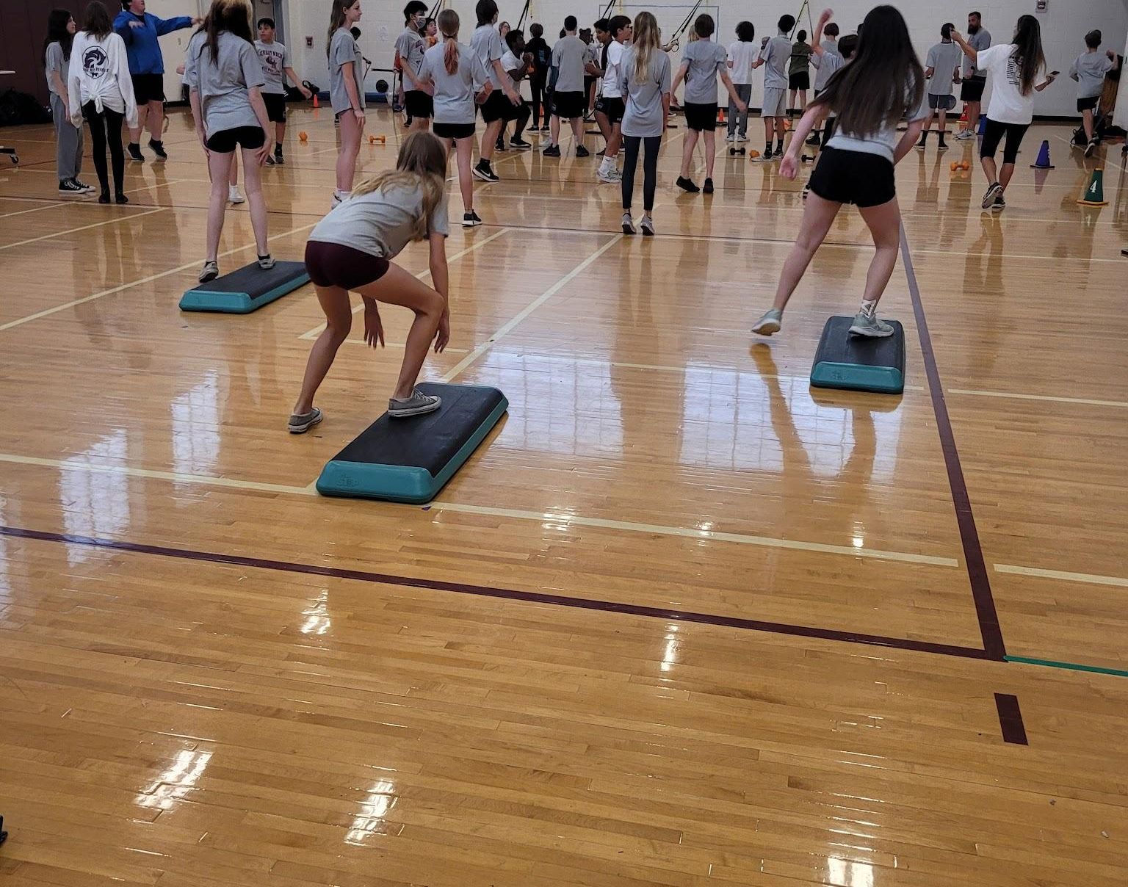
Consider your motives
What are your personal biases regarding fitness testing, positive or negative?

Slide 26
Description and Function
SMART Goals
should follow
VA Wellness Tests

Slide 27
BIG CONCEPT
SMART goals and fitness testing work together in reality and in grading.

Slide 28
Virginia Health AND PE SOL’s Relating to SMART Goals and FItness Testing
Fitness Testing
4.3.b, 5.3.a, 5.3.b, 6.3.e, 6.3.a, 7.3.b, 8.3.a, 11/12.3a
*Health SOL’s
SMART Goals
4.3.e, 5.3.b, 6.3.a, 7.3.b, 8.3.a, 9.3.f, 10.3.a, 11/12.3.e
6.3.f, 8.1.f, 8.3.g*
FITT Principle
4.3.f, 5.3.c, 6.3.f, 6.3.a, 7.3.c, 7.3.b, 8.3.c, 8.3.d, 9.3.a, 11/12.3.b, 11/12.3.c, 11/12.3.e
4.3.e, 8.3.h, 9.3.d; 10.3.b, 10.3.c*

Slide 29
These two cycles work in harmony throughout a health and PE course
Fitness Test
FITT Plan
Evaluate
Test
SMART Goal
Measure

Slide 30
BIG CONCEPT
Printed journals give students regular reminders of where they started and where they are going.

Slide 31
Benefits of Offline Journals
Fast
Simple to navigate
Easy summative or formative assessment
You do lose the ability to apply accomodations with paper and pencil, plus if it gets lost, the student would need to start over.

Slide 32
Most appropriate when
3rd grade through 8th grade The teacher is keeping the journal between classes
Students are completing the workouts during HPE class time
Students have HPE class 3 or more times per week

Slide 33
Link to Paper Journal
https://docs.google.com/document/d/1-5dTyogIXKRdbNxUlBBmsf12-naJLq6u/copy

Slide 34
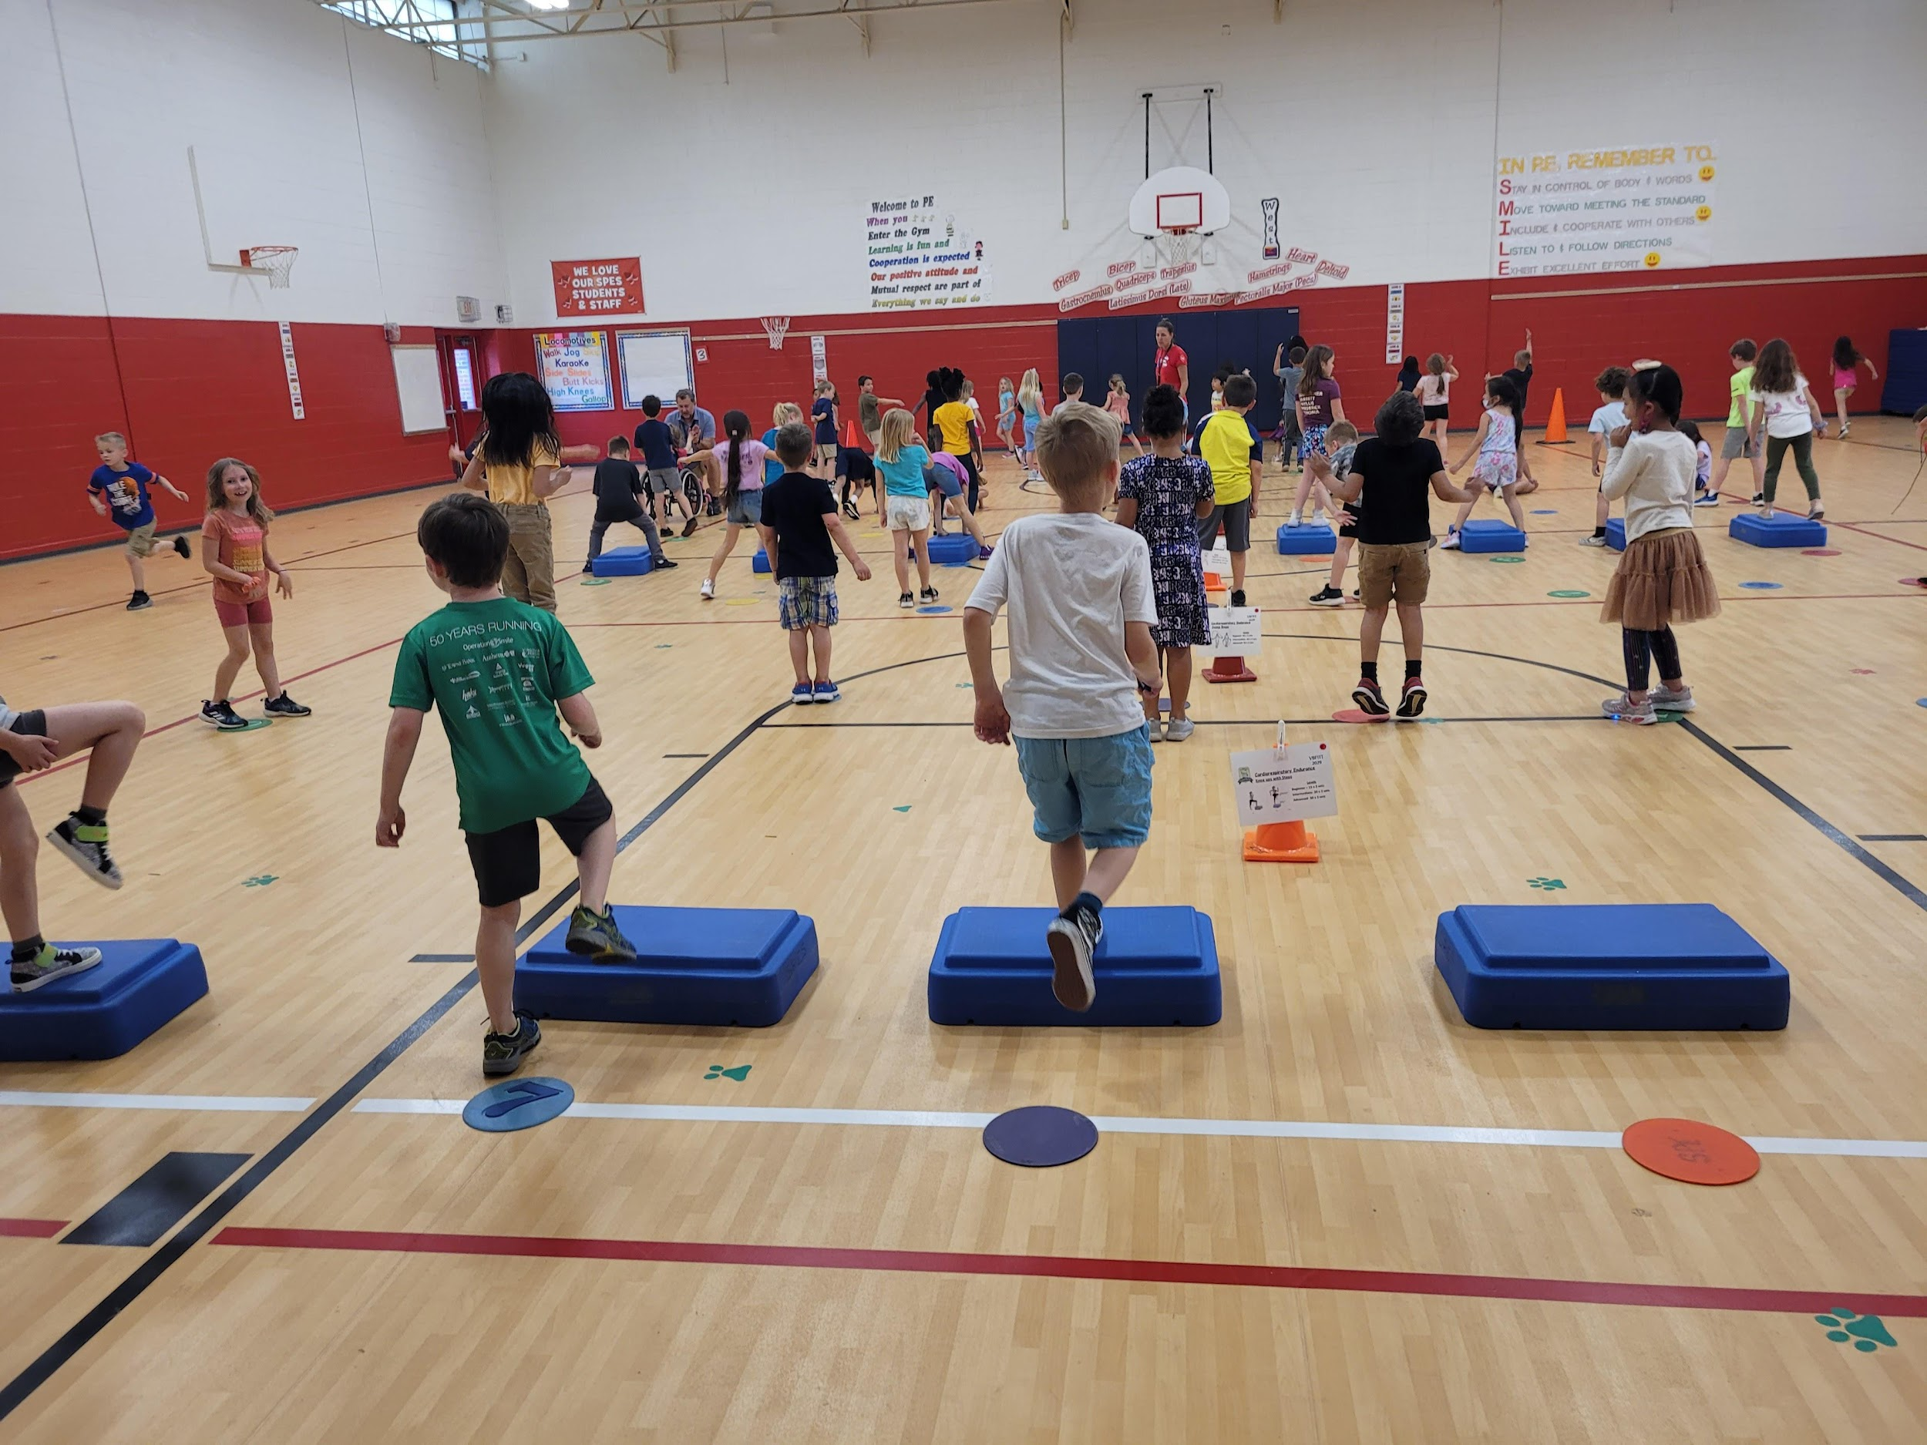
Plan to make
fitness a habit for your students.

Slide 35
Digital Goal Tracking
Portability
&
Accountability

Slide 36
BIG CONCEPT
Digital journals offer a real-world fitness experience.

Slide 37
Most appropriate when
6th grade through 12th grade The teacher is only checking journal periodically
Students are completing the workouts during HPE class or at home
Students have HPE class 1-3 times per week

Slide 38
Benefits of Digital Tracking
Accessible from a variety of settings
Adaptability
Most useful for summative assessment
You do lose the ability to tack your tracking to a variety of settings, outside for instance; this format also requires every student to have access to a device, sometimes out of school as well.

Slide 39
Place your screenshot here
Link to Online Journal
https://docs.google.com/forms/d/1X5ZmqiQQYoebWdeDiFlj6974zugQt6yZjsifv8WBXq0/copy

Slide 40
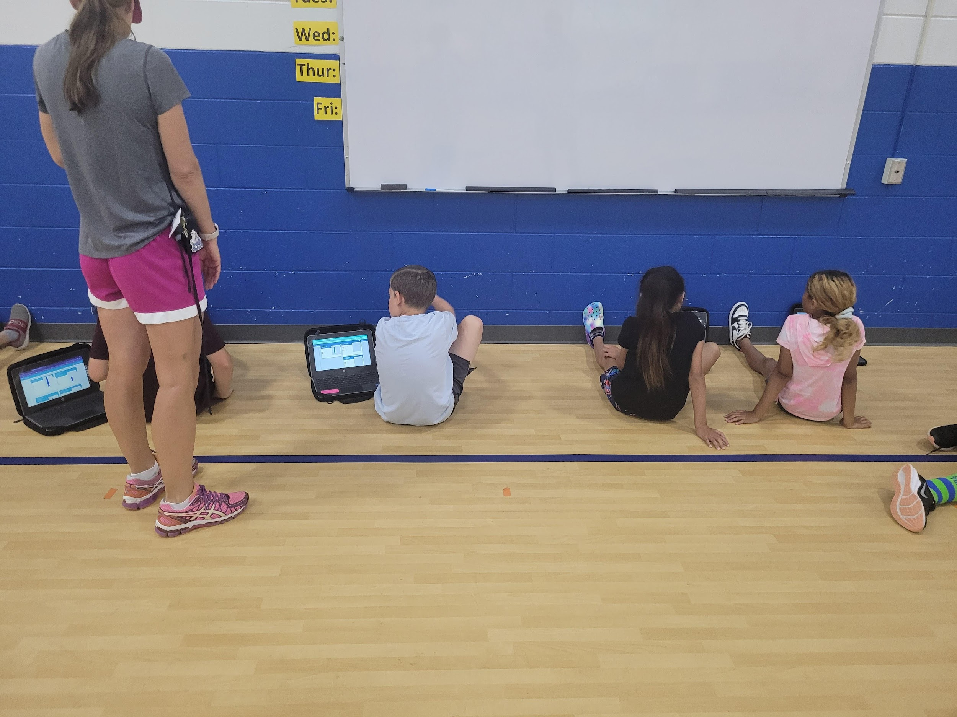
Remember to
give students agency of their scores and plans.

Slide 41

Other Digital Tracking Formats
If you have access to Welnet, you have access to digital tracking and assessment tools that will move with your student through each grade level.

Slide 42
To grade or not to grade
Yes
Ability to correctly perform the skills needed to test.^
Ability to correctly record scores including correct unit of measure
Ability to identify needed improvements including component of fitness
No
Scoring in the healthy fitness zone
Maybe
Improved score*
^ Must be adjusted for students with physical disabilities.
* Dependent on ability to track physical activity.

Slide 43
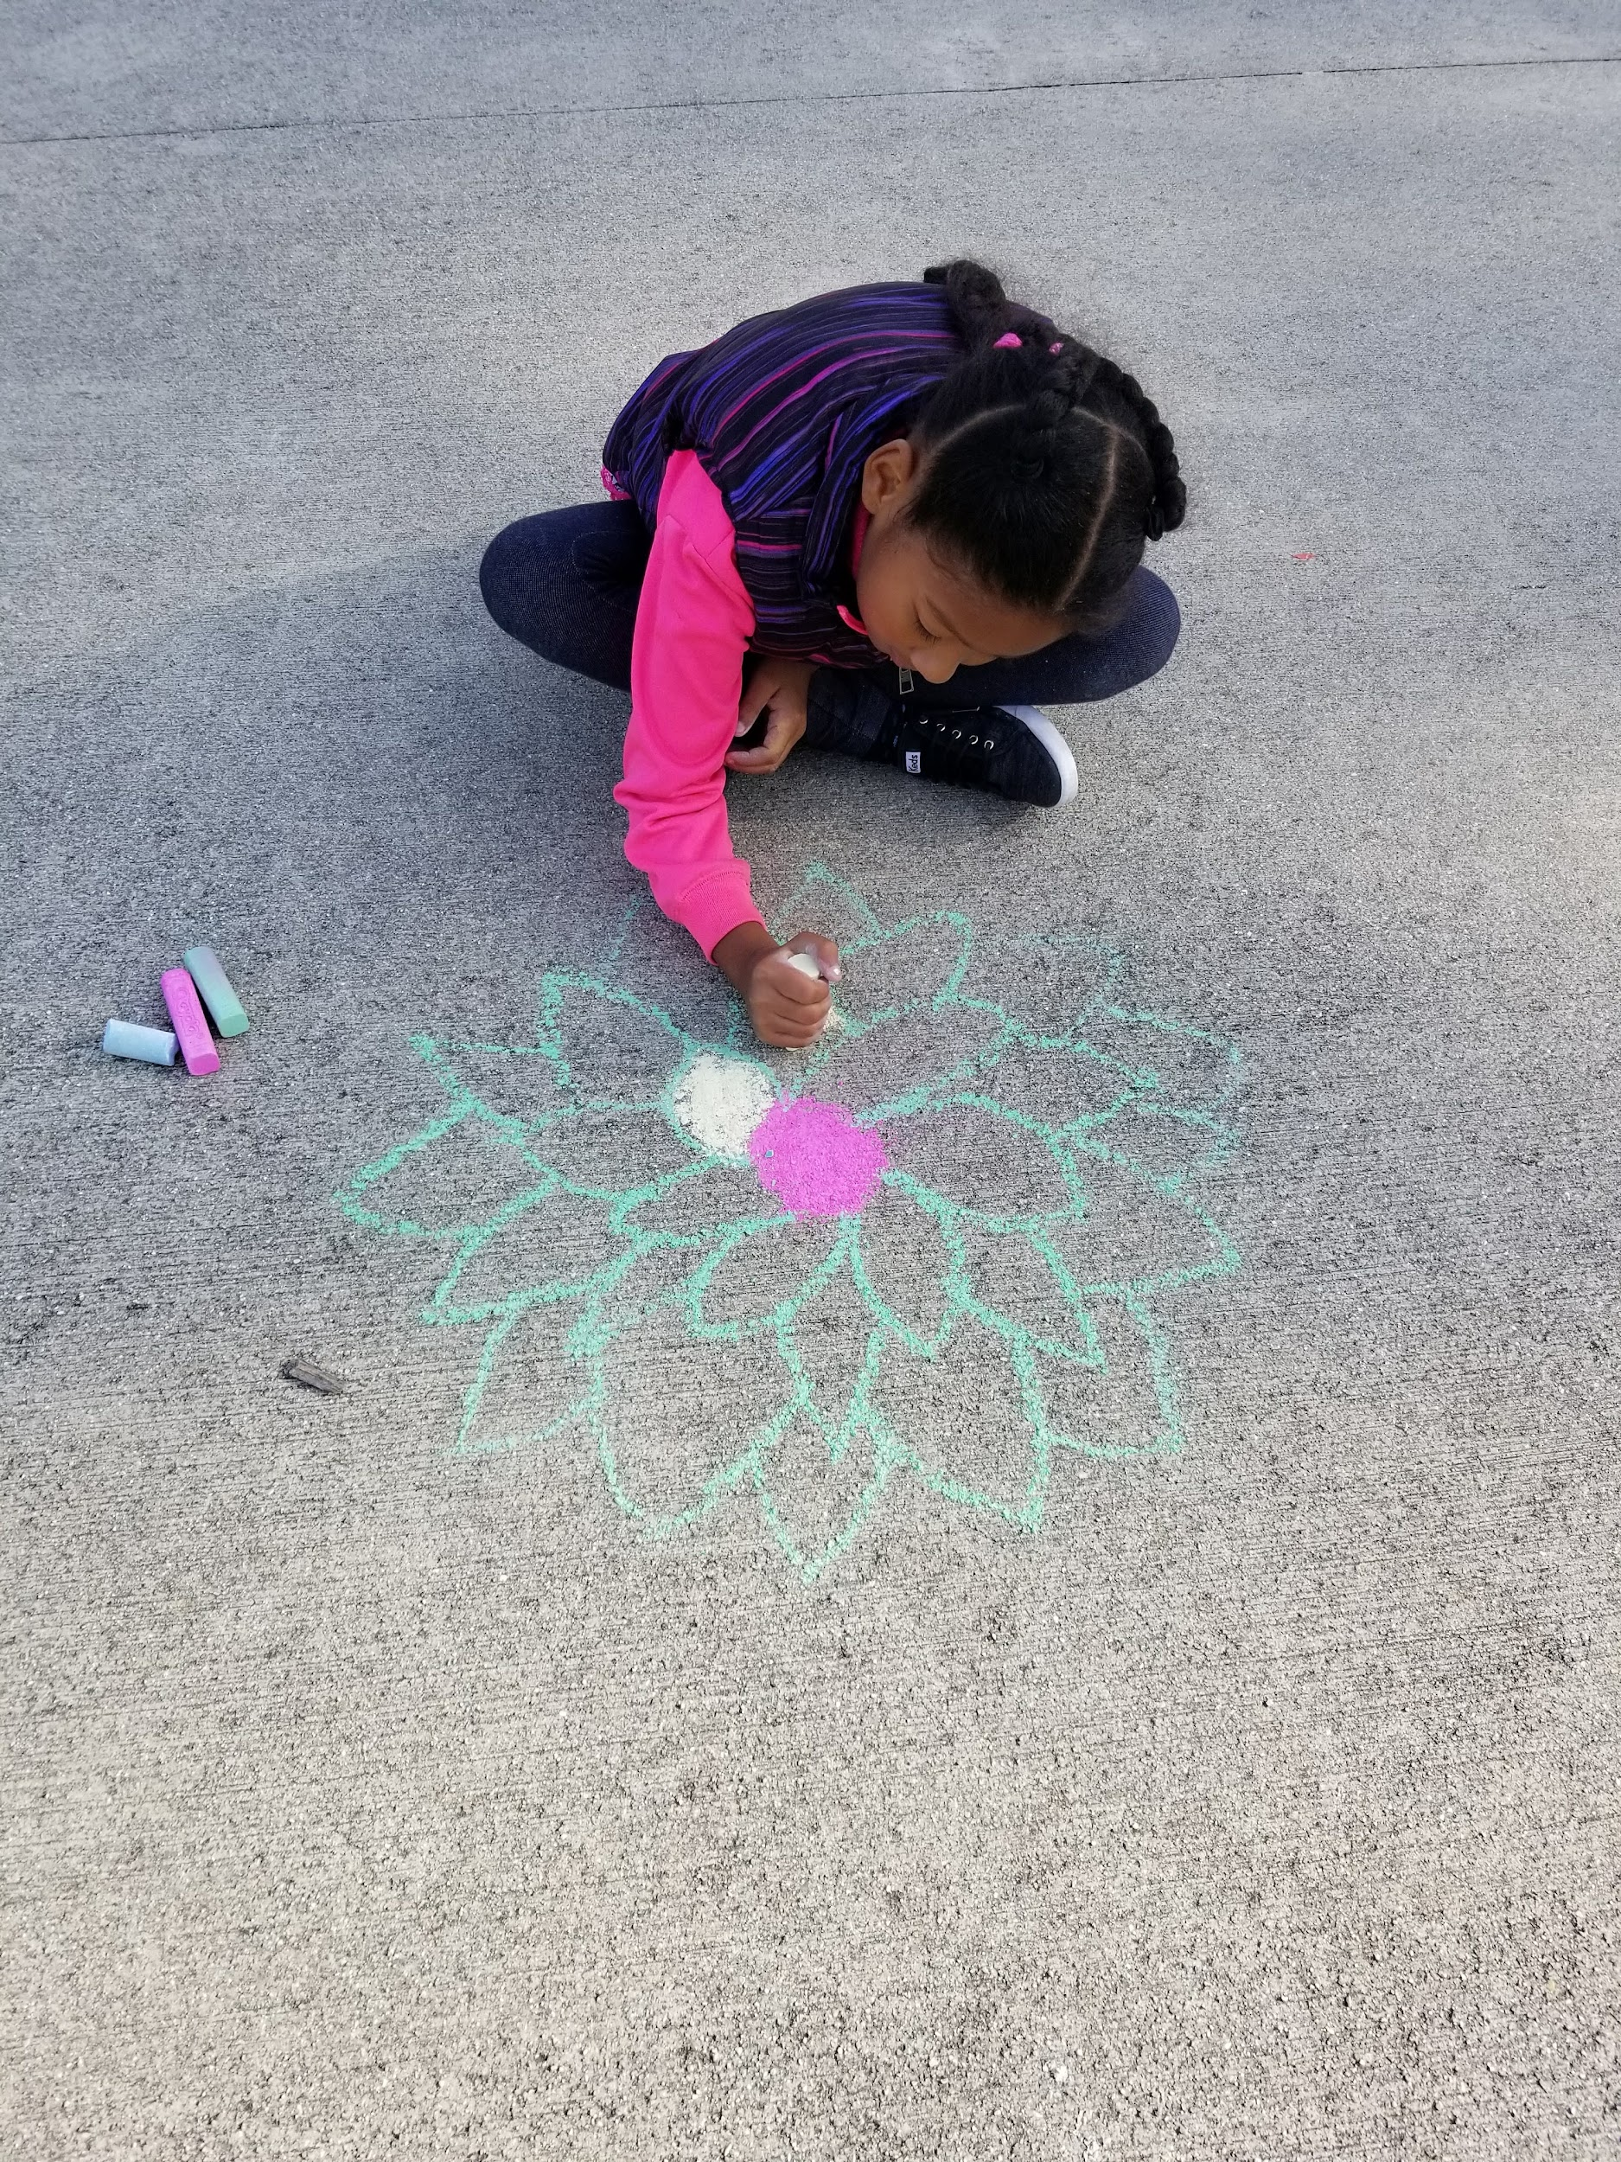
Remember to
Consider all students needs when creating assessments

Slide 44
Now let us try this again:
True or False: An assessment includes a test, measurement and evaluation.
Which word means the process of collecting data on the property or attribute of interest?
  Test
  Measurement
  Evaluation
Which stages of program development might you use assessment?

Slide 45
Check your answers.
True or False: An assessment includes a test, measurement and evaluation.
Which word means the process of collecting data on the property or attribute of interest?
  Test
  Measurement
  Evaluation
Which stages of program development might you use assessment? 3, 4 and 5

Slide 46
Thanks!
Any questions?
You can find me at @leidunn_vb & lcdunn@vbschools.com

Slide 47
Sources
Chappuis, S., & Stiggins, R. (2002, September 1). Classroom assessment for learning. ASCD. https://www.ascd.org/el/articles/classroom-assessment-for-learning
Lacy, A.C. & Williams S.M. (2018). Measurement and evaluation in physical education and exercise science (8th Ed.). Routledge. ISBN 9781138232341

