Slide 1
James Madison University
Class of 2025
First Destination
Career Outcomes Report
Notes:
Updated

Slide 2

Table of Contents
Content | Slide/Page Number
Executive Summary | 3
Class of 2025 Career Outcomes Overview | 4
Bachelor’s-Degree: Career Outcomes Overview | 6
Bachelor’s-Degree: Career Outcomes By College | 7
Bachelor’s-Degree: Working Graduates | 8-14
Bachelor’s-Degree: Continuing Education Graduates | 15-17
Bachelor’s-Degree Work Based Learning Experience Completion | 18-19
Graduate & Advanced-Degree: Career Outcomes Overview | 21
Graduate & Advanced-Degree: Career Outcomes By College | 22
Graduate & Advanced-Degree: Working Graduates | 23-28
JMU Graduates Impact Across Virginia | 30-31
Appendix: Outcomes Sources, Methodology & Definitions | 33-36

Slide 3
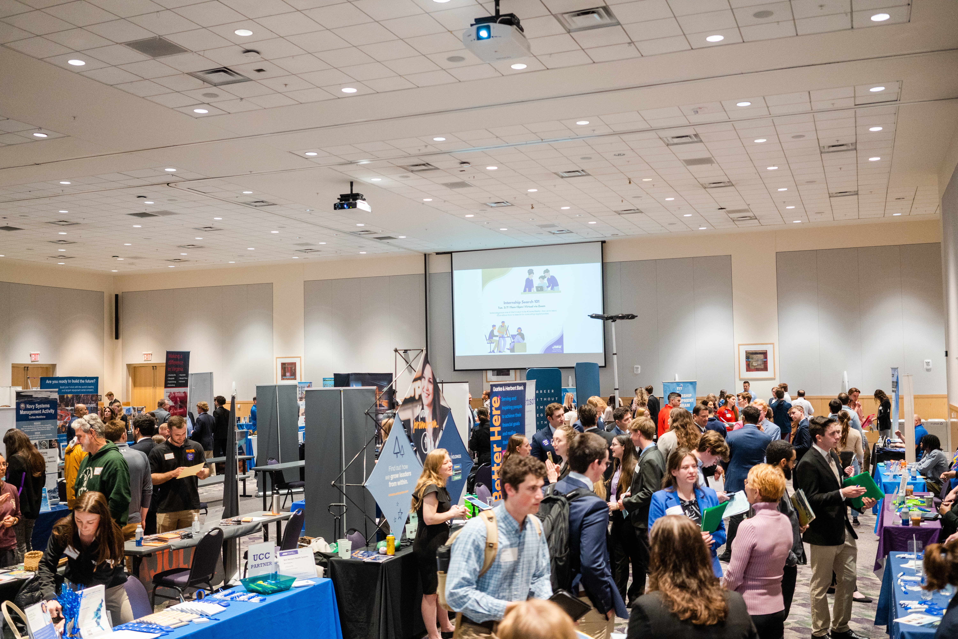

Executive Summary
Guided by National Association of Colleges and Employers (NACE) standards, the University Career Center (UCC) compiles data on the post-graduation pursuits of JMU graduates.¹ For the Class of 2025, the UCC collected data on 76.2% of bachelor's-degree recipients and 76.0% of advanced-degree recipients. Survey methodology is on slide 40.
Of bachelor’s-degree recipients in the Class of 2025, 94.9% achieved a career outcome. 73.7% of these graduates went to work, while 21.2% continued their education. For those without a career outcome, 5.0% were still seeking employment or education, and the remaining 0.1% were not engaged or not seeking. The most popular areas for work included Virginia, Washington, D.C., New York, New Jersey and Maryland. Of those graduates working in Virginia, 41.8% were working in Northern Virginia, 27.5% were in Central Virginia, and 17.6% were working in the Shenandoah Valley. Health professions, business/management, education, psychology and public administration were the most popular pursuits in continuing education programs.
For advanced-degree recipients in the Class of 2025, 98.6% achieved a career outcome. Of these, 82.9% were working and 15.7% were pursuing additional education. Of the 1.4% without a career outcome, all 1.4% were still seeking. Virginia, Washington, D.C., North Carolina, New York and Pennsylvania were the most popular areas for advanced-degree recipients to work. Of those working in Virginia, 38.0% work in the Shenandoah Valley, 30.0% work in Northern Virginia and 21.7% work in Central Virginia.
¹ www.naceweb.org/job-market/graduate-outcomes/first-destination/standards-and-protocols
3
Notes:
Sarah 6/5/23 at 4:30pm

Slide 4
Bachelor’s and Advanced-Degree Recipients
1
Class of 2025
Career Outcomes Overview
95.3% of Bachelor's and Advanced-Degree Recipients have a Career Outcome
The data reflects knowledge of 3,720 bachelor’s-degree recipients and 498 advanced-degree recipients, for a knowledge rate of 76.2%.
4
Notes:
Sarah Updated 6/5/23 3:15pm

Slide 5

Class of 2025
Bachelor’s-Degree Recipients
First Destination Career Outcomes

Slide 6
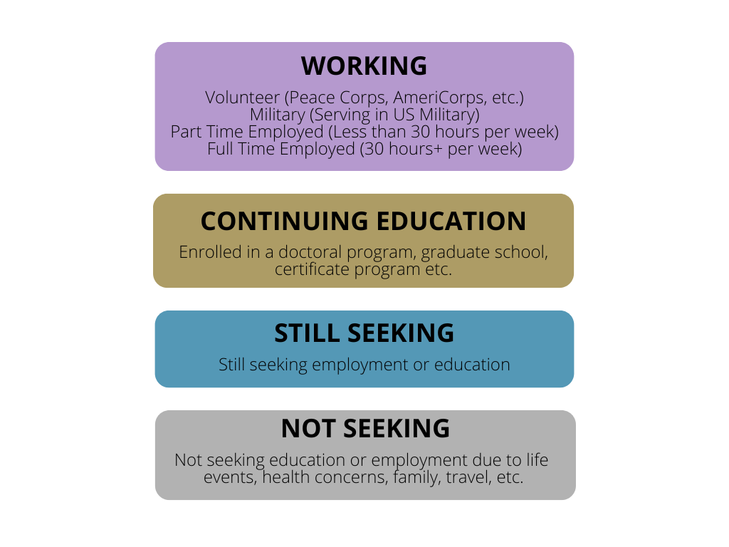
Bachelor’s-Degree Recipients
Career Outcomes Overview
94.9% of Bachelor’s-Degree Recipients Have a Career Outcome
Primary Activity
Volunteer (0.3%)
Military (1.0%)
Part Time (6.6%)
Full Time (65.8%)
Working
(73.7%)
Continuing
Education
(21.2%)
Still Seeking
(5.0%)
Not Seeking
(0.1%)
The UCC collected information on 3,720 of 4,884 bachelor’s-degree recipients, for a 76.2% knowledge rate.
6
Notes:
Sarah Updated 6/5/23 3:55pm

Slide 7
Bachelor’s-Degree Recipients
2025 Career Outcomes By College
N= 3,720 (Number of bachelor’s-degree recipients for whom we have career outcomes knowledge)
7
Notes:
Updated 6/8 3:45pm

Slide 8

Bachelor’s-Degree Recipients
Top Employers 2025
1,761 Unique Employers
8

Slide 9
Bachelor’s-Degree Recipients
Class of 2025: Salary Distribution
N= 1,063 (Full-time employed and military bachelor’s-degree recipients indicating a salary within 6 months of graduation)
N= 222 (Full-time employed and military bachelor’s-degree recipients indicating a bonus within 6 months of graduation)
9
Notes:
Updated 6/15 9:35am

Slide 10
Bachelor’s-Degree Recipients
1
Class of 2025
Salary Distribution By College
N=1,063 (Full-time and military bachelor’s-degree recipients indicating a salary within 6 months of graduation)
Note: results are suppressed when there are fewer that 5 data points, to protect the privacy of individuals.
10
Notes:
Updated 6/15 11:15am

Slide 11
Bachelor’s-Degree Recipients
Location of Working Graduates
Top 10 U.S. States or District
Graduates are working in 39 U.S. states, Washington, D.C. and 13 countries
11
Notes:
Updated 6/12 5:30pm

Slide 12
Bachelor’s-Degree Recipients
1
Location of Working Graduates in the U.S.
Connecticut: 13
Massachusetts: 42
Rhode Island: 1
New Jersey: 81
District of Columbia: 124
Maryland: 75
Delaware: 7
N = 2,468 (Number of undergrads who indicated an employment location in the U.S.)
12
Notes:
Updates 6/15 at 4:50pm

Slide 13
Bachelor’s-Degree Recipients
Location of Working Graduates
by U.S. Region
N= 2,468 (Number of bachelor’s-degree graduates who indicated a working U.S. region)
¹www2.census.gov/geo/pdfs/maps-data/maps/reference/us_regdiv.pdf
13
Notes:
Updated 6/12 5:35pm

Slide 14
Bachelor's-Degree Recipients
Location of Working Undergraduates in Virginia
36.7% of 2025 Working bachelor's-degree recipients in Northern Virginia, Washington, D.C. or Maryland.
N=1,690 (Undergraduates who indicated the city or county in Virginia where they are employed post-graduation)
14
¹https://www.virginia.org/places-to-visit/regions
Notes:
Updated 6/14 12:20pm

Slide 15
N=789 (Bachelor's-degree graduates who reported Continuing Education)
Bachelor’s-Degree Recipients
Top Institutions for Continuing Education
JMU graduates are pursuing continuing education at 220 unique institutions
James Madison University
234
29.7% of Continuing Education students are returning to JMU for their studies
15
Notes:
Updated 6/14 12:00pm

Slide 16
N=753 (Number of students who indicated a major or field of study for their continuing education)
Bachelor’s-Degree Recipients
Top Continuing Education Fields
¹ Fields of study reported by students have been coded using the State Council of Higher Education in Virginia (SCHEV) IP Coding System, to identify and categorize similar majors.
16
Notes:
Updated 6/14 12:40pm

Slide 17
Bachelor’s-Degree Recipients
Location of Graduates’ Continuing Education
Top 10 U.S. States and Territories
Graduates are studying in 34 U.S. states,
Washington, D.C.
& 6 Countries
N= 766 (Continuing Education with State/Territory location)
17
¹ These top 12 states represent 88.5% of the known location of Continuing Education graduates.
Notes:
Updated 6/14 12:10pm

Slide 18
Bachelor’s-Degree Recipients
Work Based Learning Experience By College
N=2,579 (Number of bachelor’s-degree recipients for whom we have internship completion knowledge)
¹Graduates responded to the question “How many internships did you complete during your time at JMU? (This can also include student teaching, fellowships, practicum, fieldwork, externships, clinicals.)” Additional information from LinkedIn Profiles with the job titles like “Internship” are included in this category.
18
Notes:
Updated 6/8 3:45pm

Slide 19
Bachelor’s-Degree Recipients
Class of 2025 Salary Data
by WBLE Completion
Salary data reflects undergraduate students who reported a full-time or military outcome.
19
Notes:
Updated 6/15 12:40pm

Slide 20
Class of 2025
Graduate and Advanced-Degree Recipients
First Destination Career Outcomes

Slide 21
Graduate and Advanced-Degree Recipients
Career Outcomes Overview
98.6% of Advanced-Degree Recipients have a Career Outcome
Primary Activity
Volunteer (0.0%)
Military (0.6%)
Part Time (4.0%)
Full Time (78.3%)
Working
(82.9%)
Continuing
Education
(15.7%)
Still Seeking
(1.4%)
Not Seeking
(0.0%)
The UCC collected information on 498 of 655 advanced degree graduates, for a knowledge rate of 76.0%
21
Notes:
Sarah Updated 6/5/23 4:00pm

Slide 22
Graduate and Advanced-Degree Recipients 1
Career Outcomes By College
N= 498 (Number of advanced-degree recipients for whom we have career outcomes knowledge)
22
Notes:
Updated 6/8 4:10pm

Slide 23
Graduate and Advanced-Degree Recipients
Top Employers
292 Unique Organizations
23
N= 412 (Number of advanced-degree working graduates who indicated their employer's name)
Notes:
Updated 6/14 4:00pm

Slide 24
Graduate and Advanced-Degree Recipients
Class of 2025 Salary Distribution
N= 169 (Number of full-time employed advanced-degree recipients who indicated their salary 6 months out from graduation)
N= 23 (Number of full-time employed advanced-degree recipients who indicated a monetary bonus 6 months out from graduation)
24
Notes:
Updated 6/15 9:50am

Slide 25
Graduate and Advanced-Degree Recipients
Class of 2025
Salary Data By College
N=167 (Number of employed advanced-degree recipients who provided salary data)
Note: results are suppressed when there are fewer that 5 data points, to protect the privacy of individuals.
25

Slide 26
Graduate and Advanced-Degree Recipients
Location of Working Graduates
Top 10 U.S. States and Territories
Advanced-Degree recipients are located in 29 U.S. States,
Washington D.C. & 2 countries
26
The top 10 locations represent 91.7% of the U.S. locations where advanced-degree graduates are employed. N=384
Notes:
Updated 6/14 4:20pm

Slide 27
Graduate and Advanced-Degree Recipients
Location of Working Graduates
U.S. Regions
N= 384 (Number of advanced-degree graduates who indicated employment region within the U.S.)
¹https://www2.census.gov/geo/pdfs/maps-data/maps/reference/us regdiv.pdf
27
Notes:
Updated 6/14 4:30pm

Slide 28
Graduate and Advanced-Degree Recipients
Location of Working Graduates in Virginia
N= 263 (Advanced-degree graduates who indicated an employment region within VA)
28
¹https://www.virginia.org/places-to-visit/regions
Notes:
Updated 6/14 4:00pm

Slide 29
2025 JMU Graduates
Impact in Virginia
First Destination Career Outcomes

Slide 30


Bachelor's, Graduate and Advanced-Degree Recipients
JMU Graduates Working in VA Schools
Top Employers of JMU Graduates Teaching in Virginia
257 JMU graduates indicated they are in a teaching profession and are employed in Virginia.
85.4% of JMU graduates who indicated they are employed in a teaching profession are teaching in Virginia.
30
Notes:
Updates 6/15 8:20am

Slide 31

Bachelor's, Graduate and Advanced-Degree Recipients
JMU Nursing Majors Working in Virginia
Top Employers of Nursing Graduates in Virginia
78.9% of JMU Nursing majors indicated they are employed in Virginia post-graduation.
150 JMU Nursing majors indicated they are employed in nursing post-graduation in Virginia.
31
Notes:
Updates 6/15 8:450am

Slide 32
Class of 2025
Appendix
First Destination Career Outcomes

Slide 33
JMU Career Outcomes Data Online
If you would like to explore Career Outcomes data beyond what is covered in this report, we recommend using the University Career Center website.
Visit the JMU Career Outcomes Webpage (www.jmu.edu/career/careeroutcomes) to:
search career outcomes data by major or graduate program
review past Career Outcomes Reports
view longitudinal data on career pursuits
Visit the Career Guide to JMU Majors website (https://www.jmu.edu/career/tools/career-guide) to:
see patterns of career outcomes for every major
explore possible industries for employment based on major
33
Notes:
Updated

Slide 34
Methodology and Quick Facts
Methodology
The University Career Center annually surveys each graduating class regarding their post-graduation destination. Data collection begins the semester before each class graduates. Additional follow-up is conducted for six months after graduation, for students who did not respond to the survey, reported they were still "seeking employment," or reported still "seeking admission to graduate school." The UCC uses a variety of data collection methods: direct survey responses from students (30.6%); phone calls made to students (21.7%); LinkedIn or other online searches (34.2%); National ClearingHouse Data (8.0%); and data retrieved from JMU faculty or staff (5.5%).
Class of 2025 Graduate Quick Facts
The Class of 2025 includes those who graduated in August 2024, December 2024 and May 2025.
There were 5,539 degree recipients for the Class of 2025:
  4,884 earning a Bachelor's degree
  655 earning an Advanced degree (Master's, PhD etc.)
The total count of students per academic program may vary slightly, because some students held double majors. Any graduate with two majors will be counted just once, included in these statistics by their primary major.
This report highlights the post-graduation pursuits of 4,218 degree recipients (76.2% of the total 5,539) for the Class of 2025. Thus, our “knowledge rate” of the First Destination Outcomes for the Class of 2025 cohort is 76.2%.
Reference: www.naceweb.org/job-market/graduate-outcomes/first-destination/standards-and-protocols
34
Notes:
Updated

Slide 35
Definitions
Career Outcome: Graduates are considered to have a career outcome if their primary activity is one of the following: employment (full or part-time), military, continuing education, or full-time service/volunteering.
Continuing Education: Pursuing additional education with an institution of higher education
Employment: Includes working full-time or part-time in an organization, fellowship, internship, volunteering, self-employed or freelance
First Destination Outcomes: Activities of graduates occurring within 6 months of graduation
Knowledge Rate: A term used to describe the percentage of graduates for which the University has reasonable and verifiable information--this includes graduates who responded to a UCC survey and those who the UCC was able to find using reputable sources. Sources include JMU faculty and graduate program representatives, employers, the National Clearinghouse dataset of continuing education, LinkedIn, etc.
Military: Actively serving within a branch of the U.S. Military
Not Seeking: Students who indicated they were not interested in seeking employment or education, because they were taking a gap year, traveling, etc.
Still Seeking: Students who indicated they are actively searching for employment or a graduate school program
Working: Graduates who are employed full-time, part-time, volunteering or active military
Source: www.naceweb.org/job-market/graduate-outcomes/first-destination/standards-and-protocols
35
Notes:
Updated

Slide 36
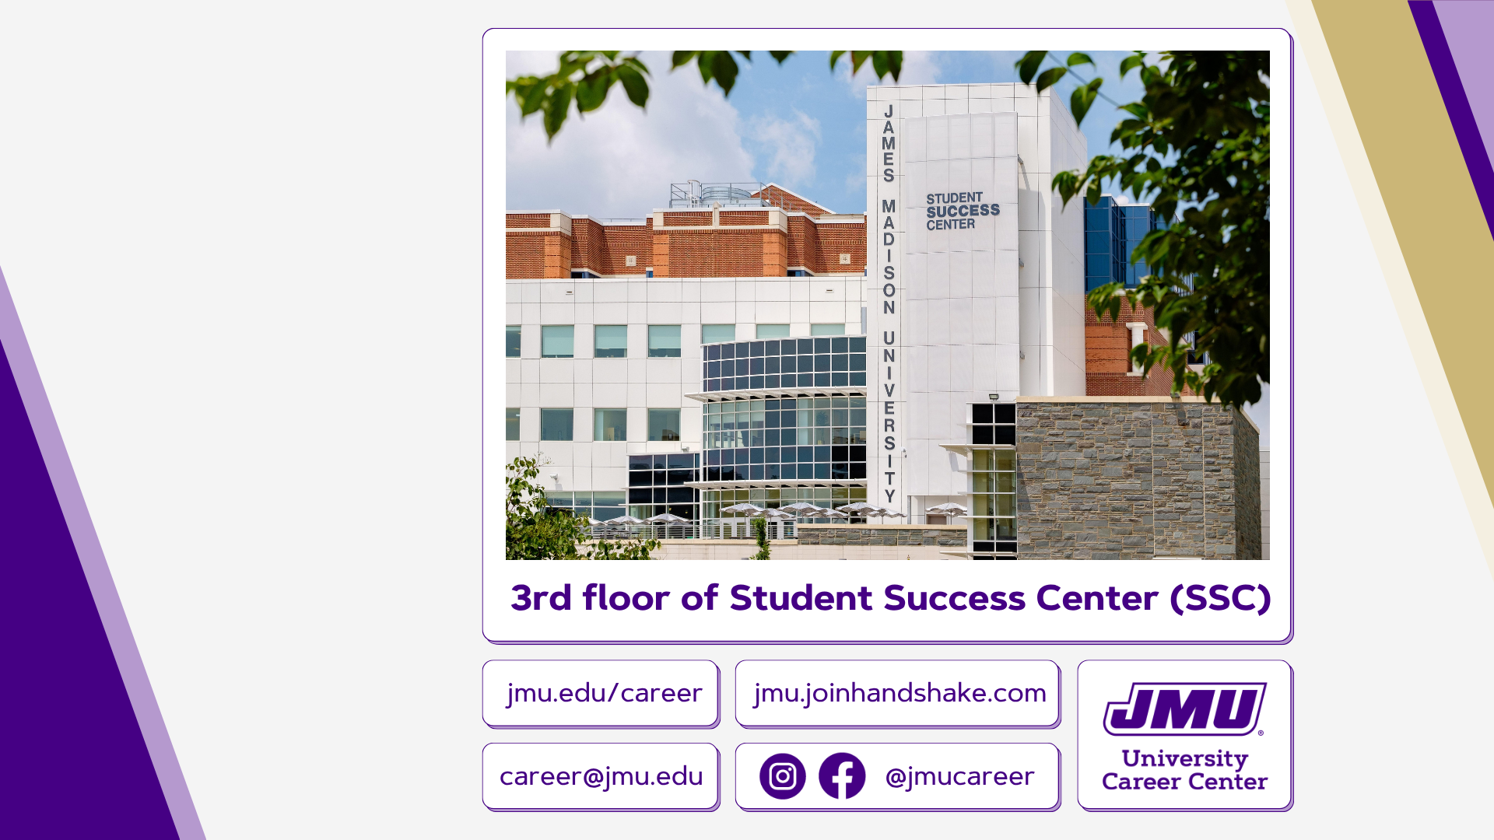
Contact
Any questions or requests for additional information from the First Destination report can be directed to:
Michael Dondzila
Assistant Director, Analytics and Assessment
dondzimr@jmu.edu
Libby Westley
Director, University Career Center
westleek@jmu.edu

