Slide 1



Slide 2


ICYJ Mission & Goals
Serve as an active shared learning collaborative that promotes interdisciplinary intellectual discourse and research in the field of youth justice, develops the next generation of youth justice professionals and leaders, and improves youth systems’ performance and outcomes
Goals:
Enhance student understanding & career readiness | Participate in new and existing research
Host Youth Justice and Child Welfare Symposia | Utilize evidence-based practices and the latest science
Produce literature and scholarship | Improve outcomes for youth and families

Slide 3
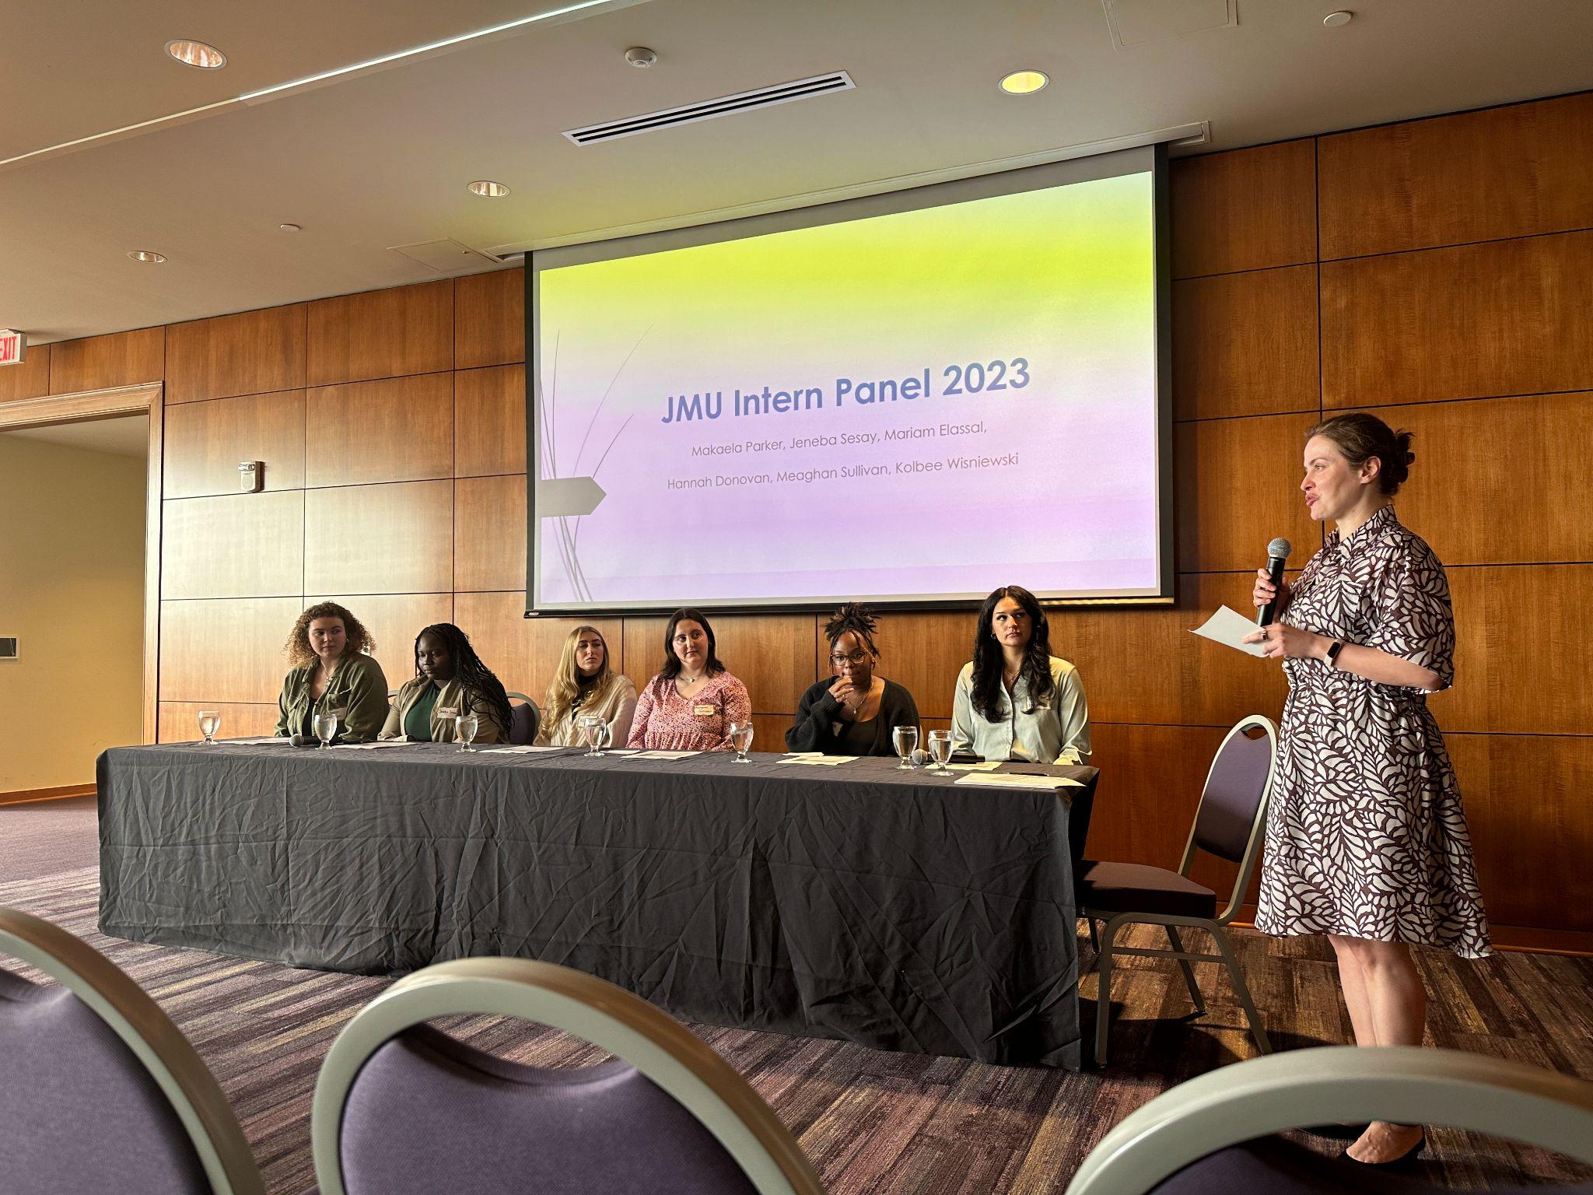
Youth Justice Minor Overview
Curriculum
Capstone course
Internships
Research

Slide 4


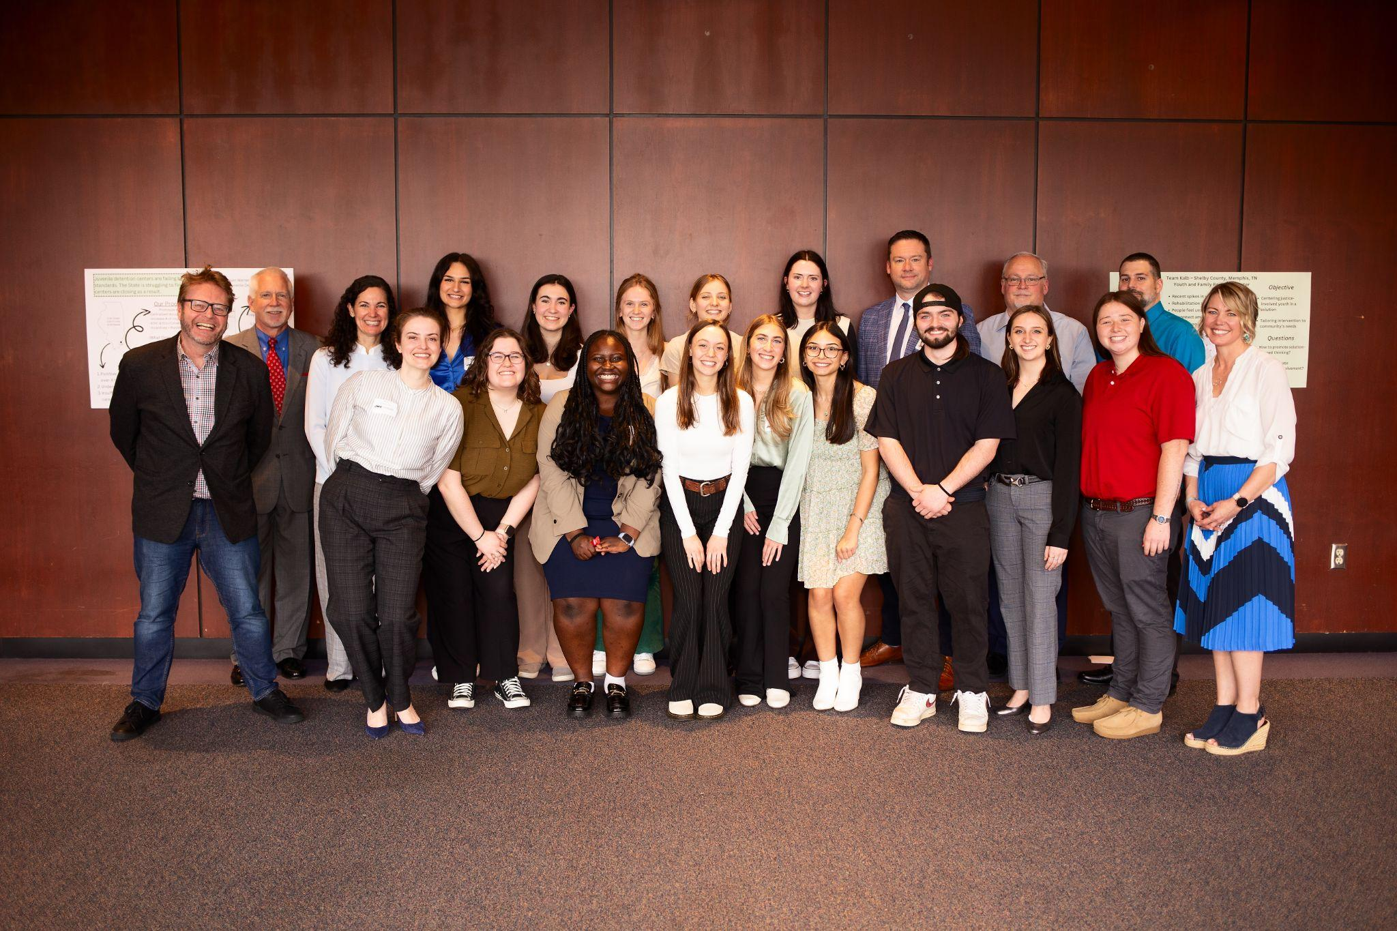
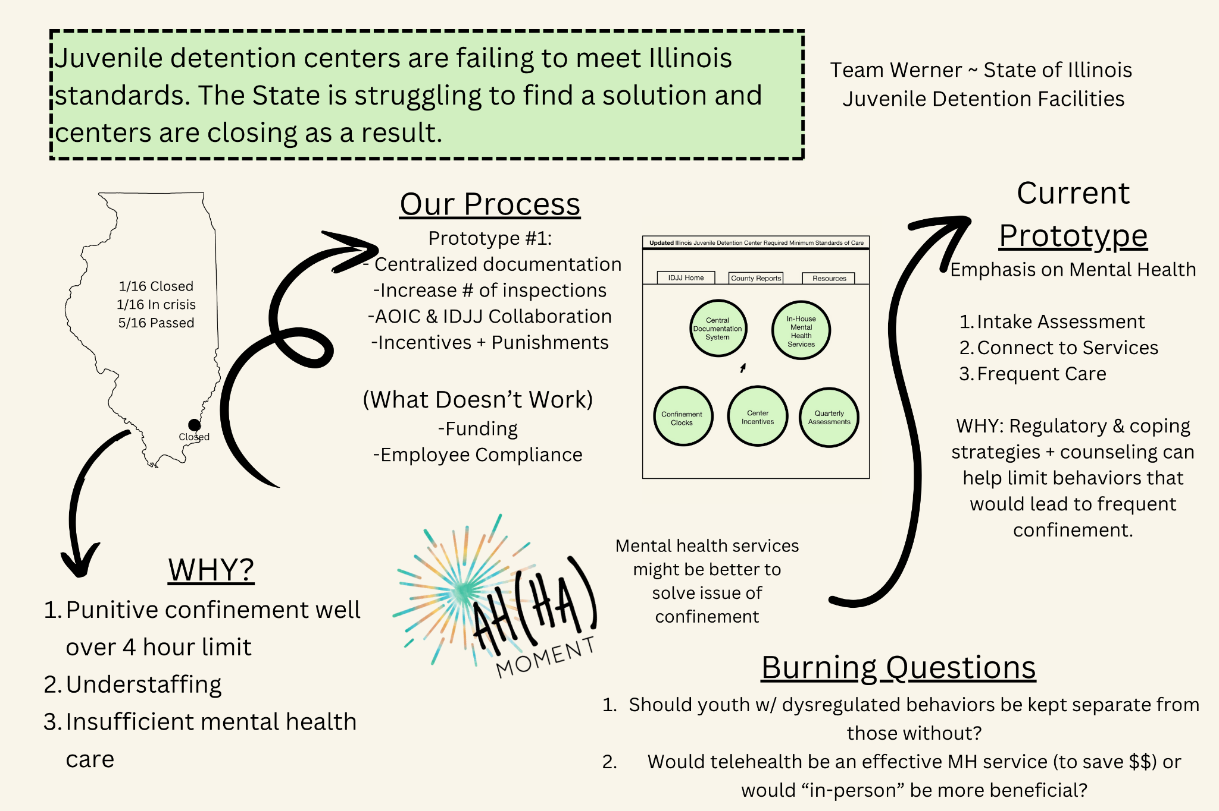


Youth Justice Capstone

Slide 5
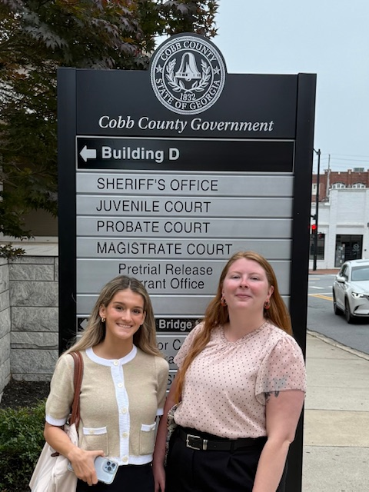
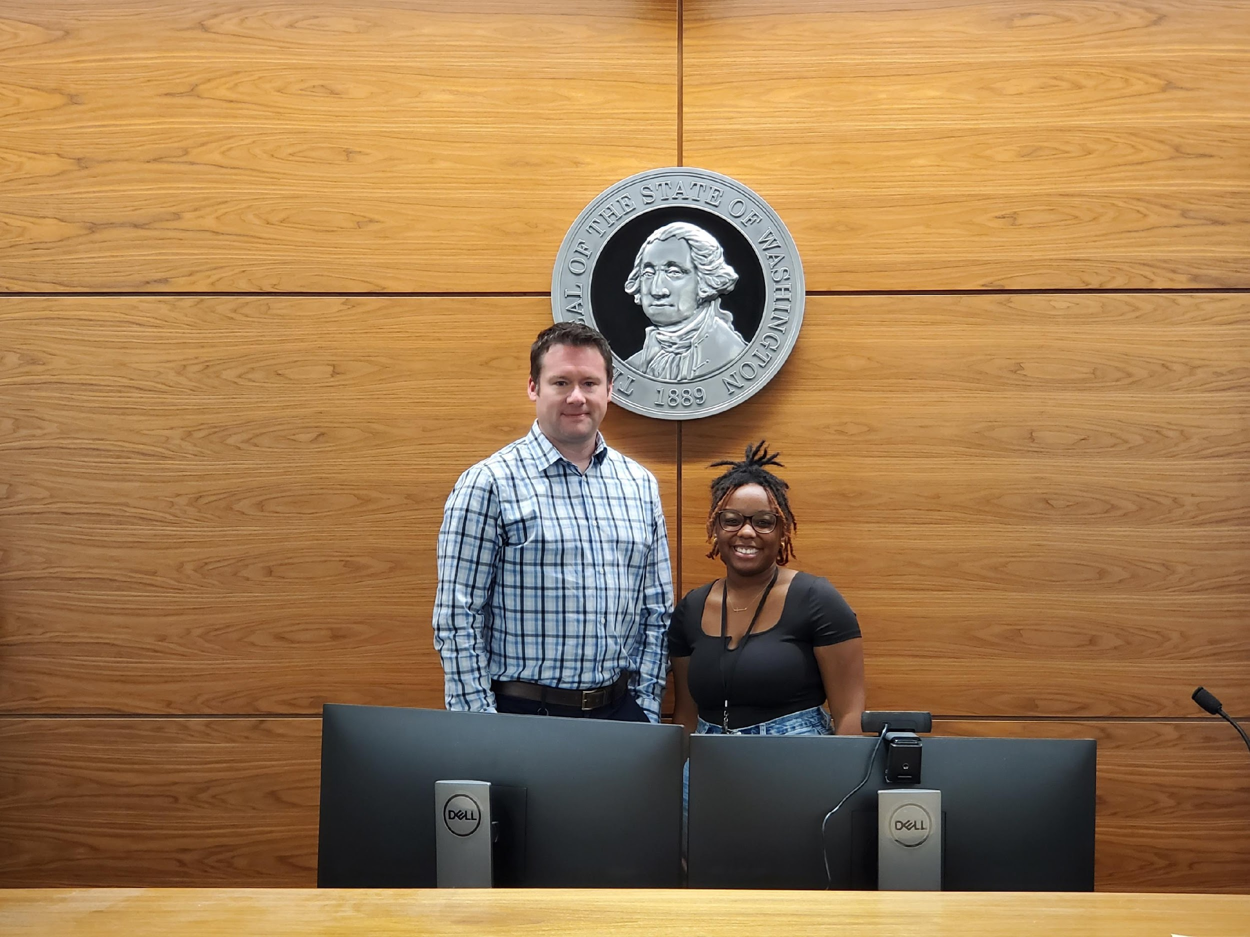
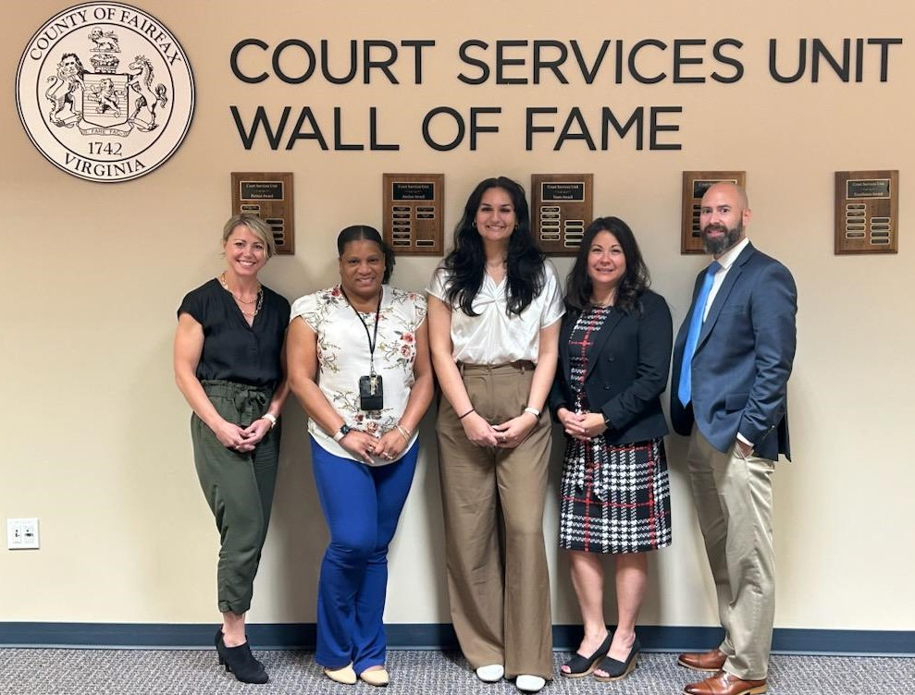
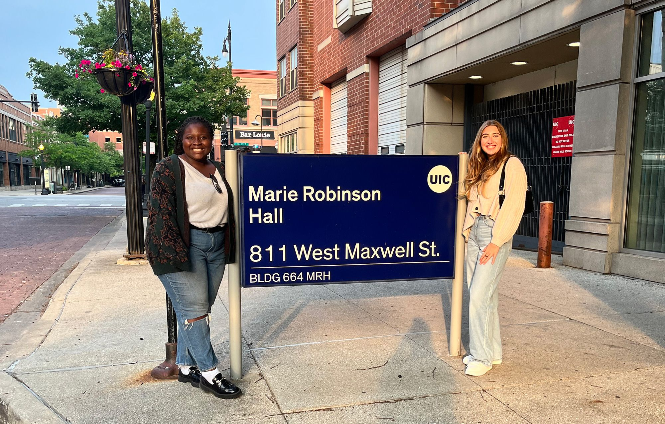
Internships

Slide 6
Going into this internship I hoped to learn not only more about youth justice, but more about myself. I hoped to get a better idea of what I wanted to do [career-wise] and how I could achieve those goals. I had hoped to learn more about the people I was going to be working with, their jobs, and what led them to those jobs.
I went into this experience extremely optimistic and ready to take in every ounce of information that they handed to me.
~ M.P.
We also talked about skills that you need to work there and he said that the main skill I would need would be passion for the kids and for the job, followed by
patience and kindness.
~ H.D.

Slide 7
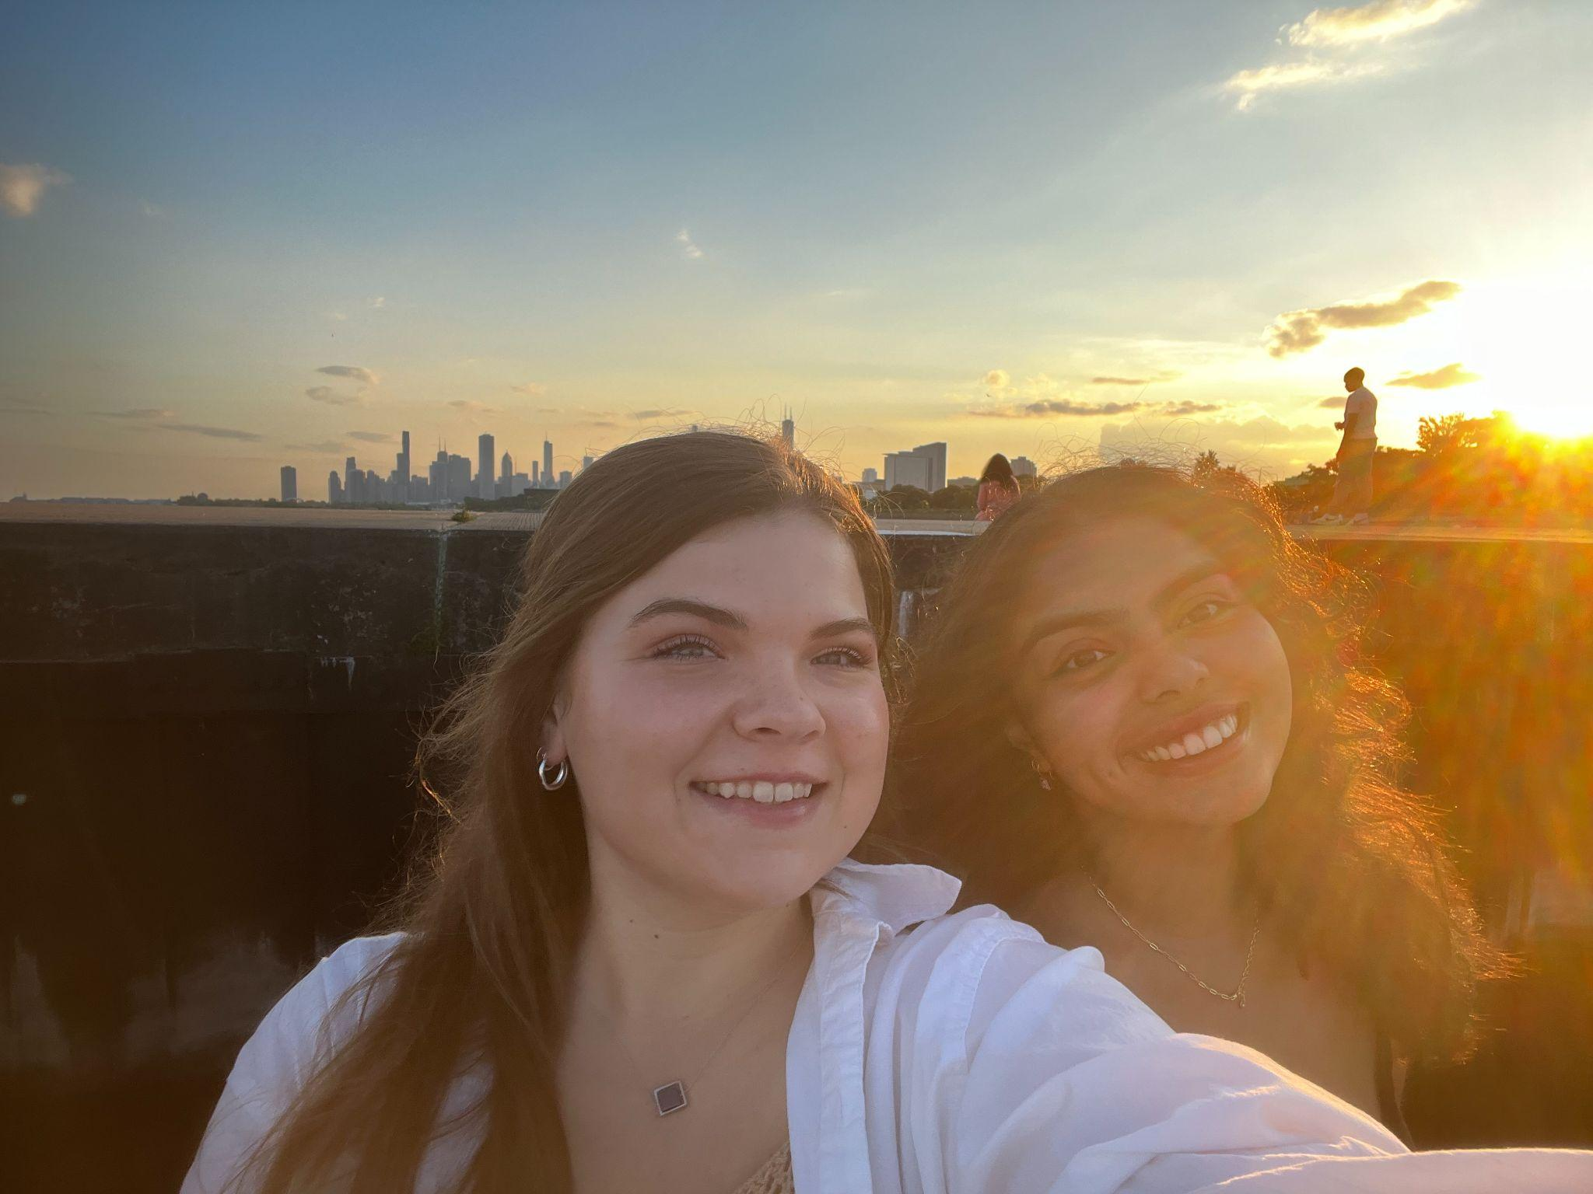
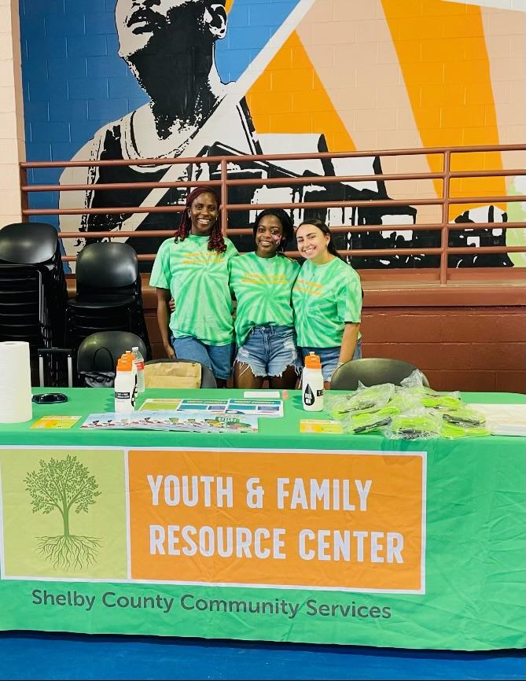
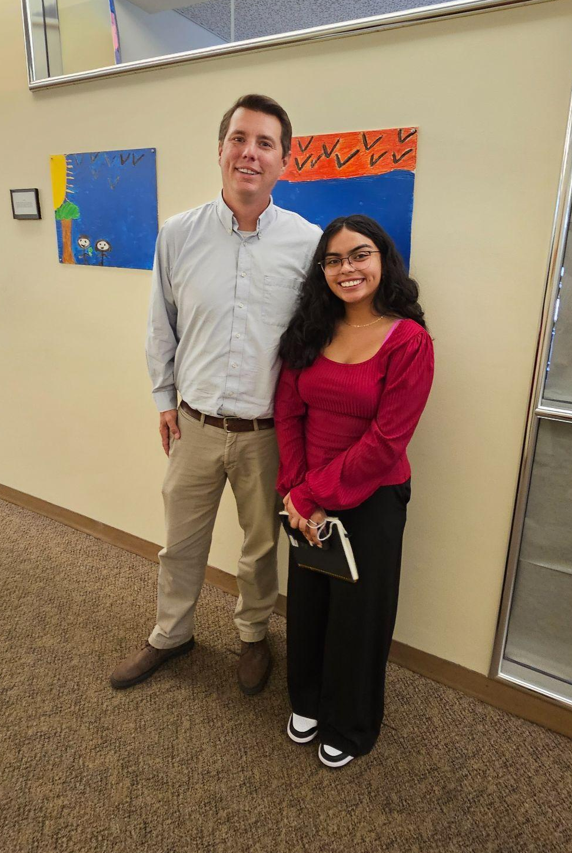
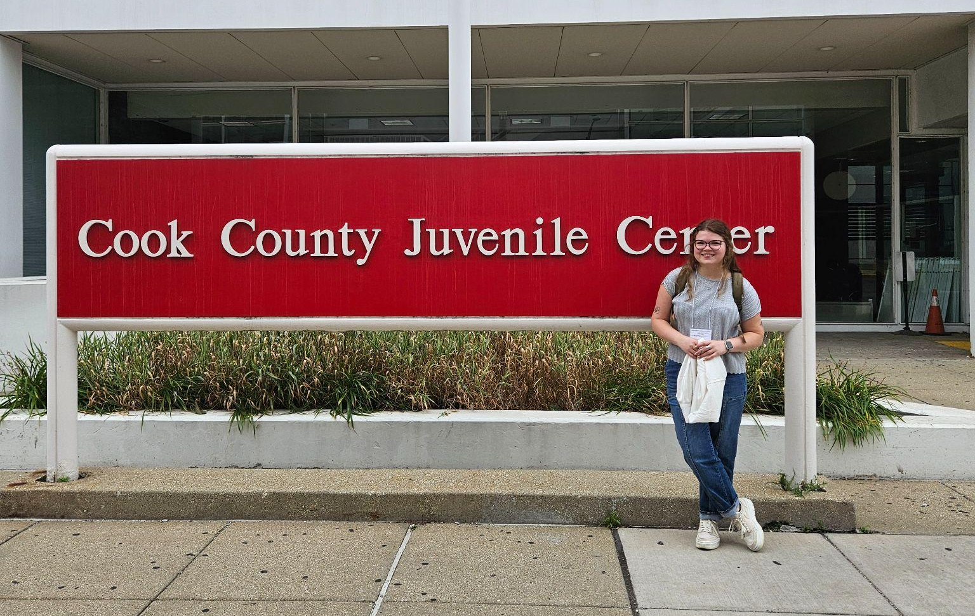
Internships

Slide 8
I’m grateful to have the opportunity to learn by doing this summer, with a focus on how the trauma experienced by these youth has played a role in their system involvement.
~M.S.
We went to the juvenile detention center and hung out with VX. He was in juvenile detention so he wasn't very happy. We were reflecting on life by playing this card game that asked us questions. We all played the game very truthfully and it allowed VX to relax and tell us the things that were going on.
~J.S.
I have been struggling with trying to understand what is fair and what isn't.
~J.S.

Slide 9
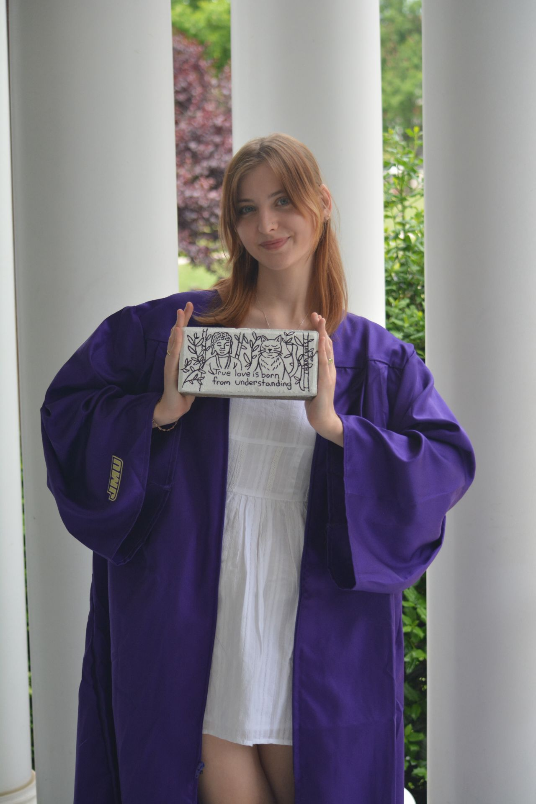
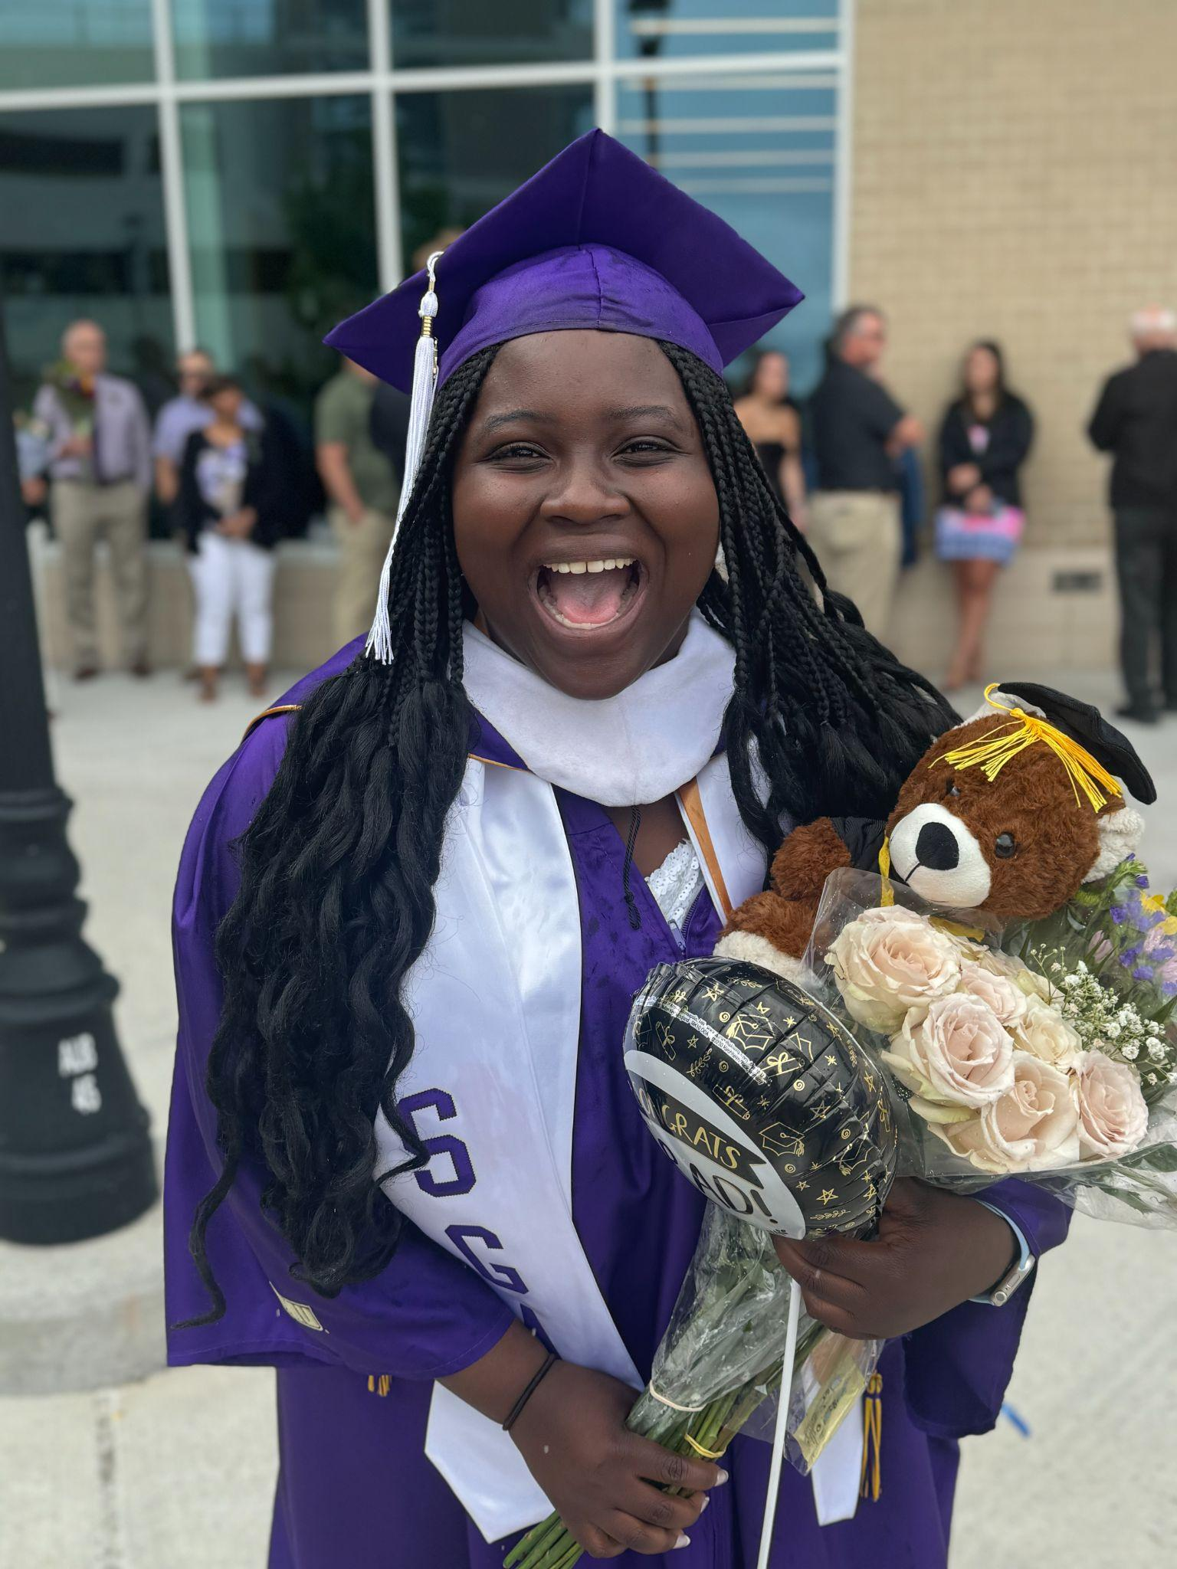
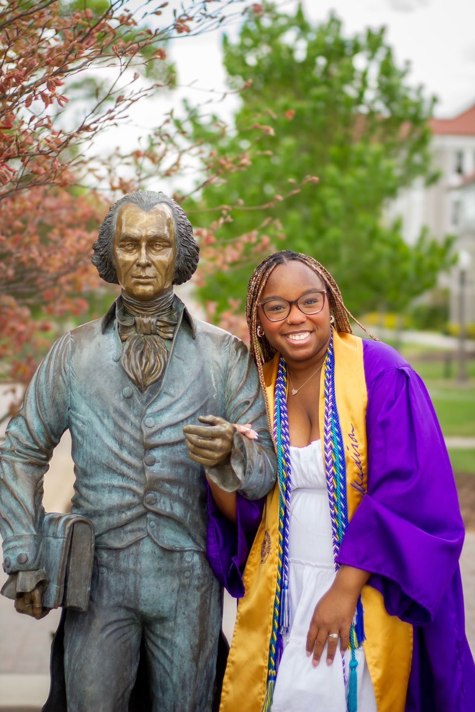

A few of our
Graduates
Makaela
Kolbee
Jeneba
Kayleigh

Slide 10
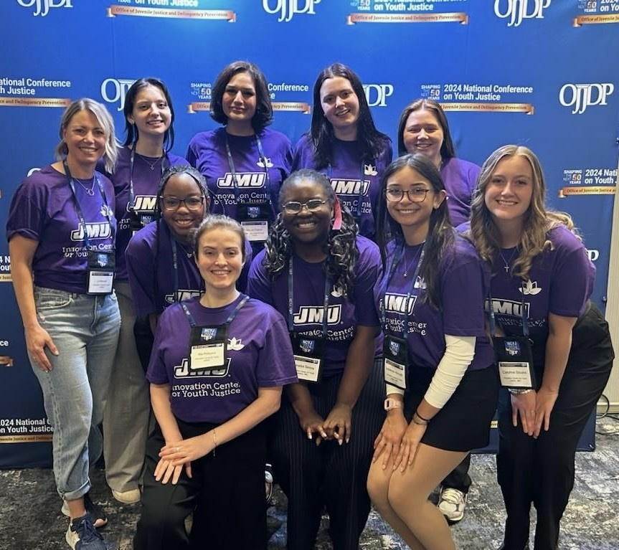
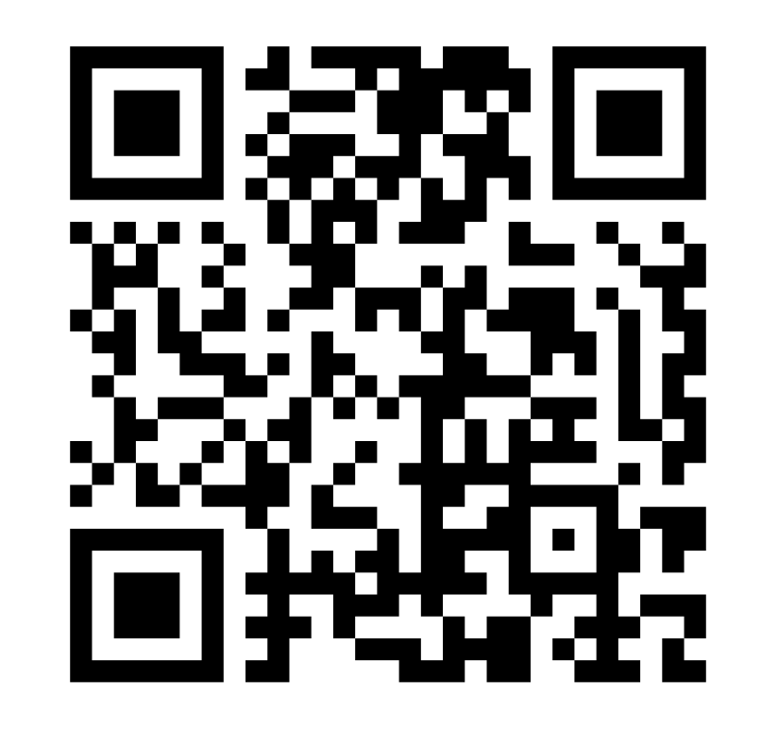

Learn More!

