Slide 1


College of Arts and Letters Career Readiness Conference
Alumni Bios

Slide 2

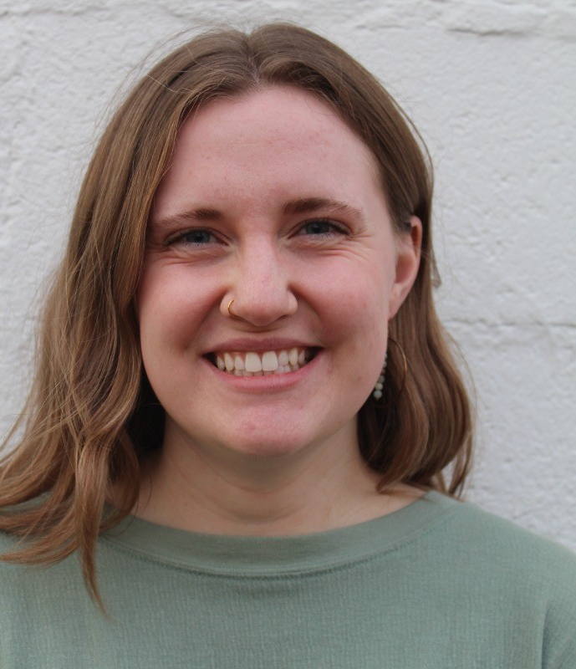
Sarah Akers
'20 Justice Studies
Employer: Appalachian Conservation Corps
Position: Recruitment and AmeriCorps Specialist
Sarah is a data-driven operations and Human Resource professional who uses analysis to refine systems related to payroll administration, hiring, member engagement, and grant compliance. She develops recruitment materials and processes, manages data across platforms such as UKG Ready and Salesforce, and coordinates compliance for AmeriCorps State and National grants, ensuring accurate and efficient operations.
https://www.linkedin.com/in/sarah-e-akers/
Notes:
Headshot of Sarah Akers

Slide 3
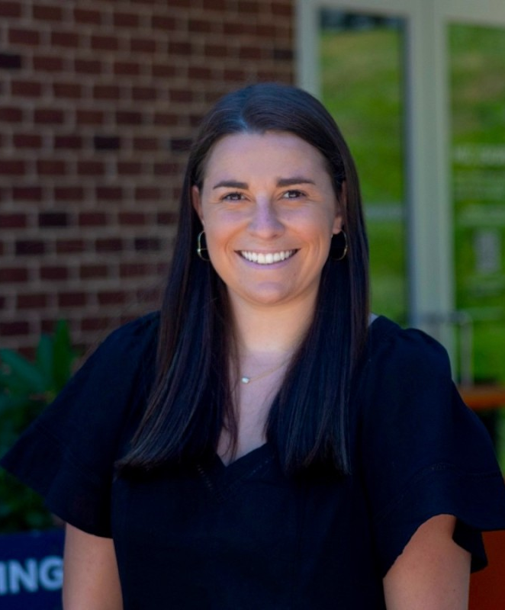
Madison Alley
'24 Communication Studies
Employer: University of Virginia
Position: Student Success Graduate Intern
Madison is a Graduate Student at the University of Virginia studying Student Affairs & Intercollegiate Athletics Administration. She is currently serving as a Student Success Graduate Intern for the office of Academic Athletic Affairs at UVA. Madison is passionate about forming lasting connections with others and ensuring excellence in everything she does.
https://www.linkedin.com/in/madi-alley-759633236/
Notes:
Headshot of Madison Alley

Slide 4
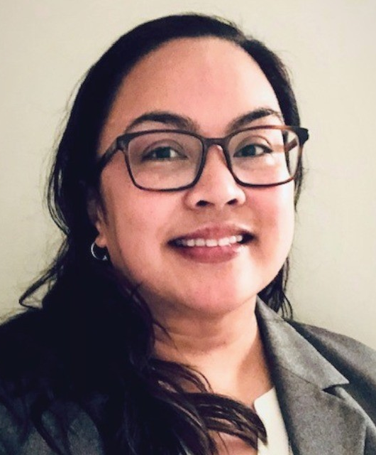
Arlyne Aranda
'95 Communication Studies, Political Science
Employer: Kids4Equity
Position: Director of Strategy, Bus Development, and Partnerships
Arlyne is an accomplished business advisor and strategist who has successfully delivered initiatives across the public, private, and non-profit sectors. She is a people-centric consultant who specializes in understanding and addressing stakeholder challenges, including engagement, adoption, and learning. As an organizational culture practitioner, she has had the honor of presenting and speaking at a range of forums, including ACMP Global, North Highland Worldwide, Mazars, LTEN, and the BLCK Street Summit.
https://www.linkedin.com/in/aearanda/
Notes:
Headshot of Arlyne Aranda

Slide 5
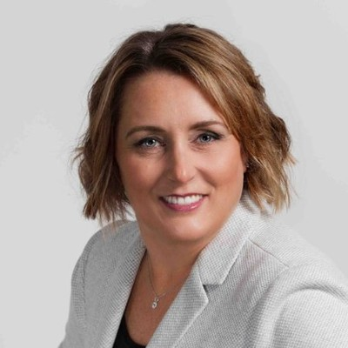
Susan Atkinson
Public Administration, Political Science
Employer: Atlantic Union Bank
Position: Vice President, Director
After obtaining her Bachelor of Science from James Madison University, Susan went on to obtain her J.D. from the University of Richmond and is now serving as Atlantic Union Bank's Vice President and Director. Susan focuses on strategic vision and operational excellence in managing the Compliance Assurance team to ensure effective identification and escalation of risks in this position. Committed to use all talents and abilities acquired on her journey, Susan strives to connect and learn from others, and to educate and empower others to find their own path.
https://www.linkedin.com/in/susanatkinson/
Notes:
Headshot of Susan Atkinson

Slide 6
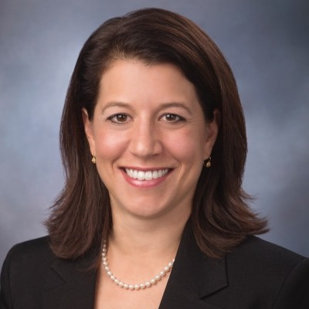
Christianna Lewis Barnhart
'00 International Affairs, Economics
Employer: Boulder Bridge Strategies
Position: Founder and Principal
Christianna Lewis Barnhart is a respected government affairs leader with 15+ years of experience shaping policy, driving impactful advocacy, and engaging in successful collaboration at Fortune 100 companies, federal agencies, trade associations, and Capitol Hill.
After graduating from JMU, Christianna went on to pursue her J.D. and M.B.A at American University and has since worked at numerous organizations—including the FCC, Charter Communications, the United States Senate, Entertainment Software Association, and now Boulder Bridge Strategies.
https://www.linkedin.com/in/christianna-lewis-barnhart-9338518/
Notes:
Headshot of Christianna Lewis Barnhart

Slide 7
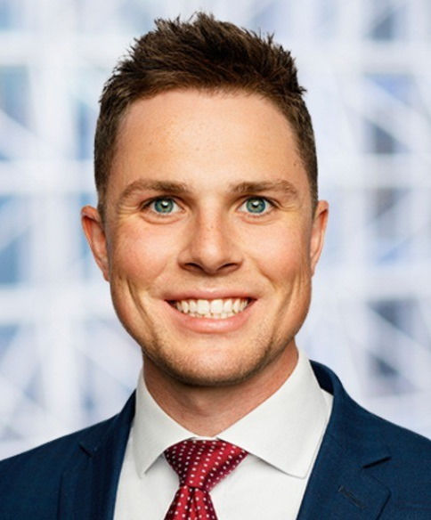
Carter Bowman
'21 Political Science
Employer: Hogan Lovells
Position: Associate
Carter is an associate at Hogan Lovells in Washington, D.C., where he practices in antitrust, competition, and economic regulation. His legal experience includes serving as a summer associate at Hogan Lovells and working as a law clerk with Lockheed Martin, where he supported complex regulatory, compliance, and corporate legal matters. In addition to his practice, Carter serves on the James Madison University Law Alumni Board, helping to foster connections and engagement within the alumni legal community. He brings a strong background in legal research, policy analysis, and strategic planning advocacy to his work, informed by academic and professional experience in law and public policy
https://www.linkedin.com/in/carter-bowman/
Notes:
Headshot of Carter Bowman

Slide 8
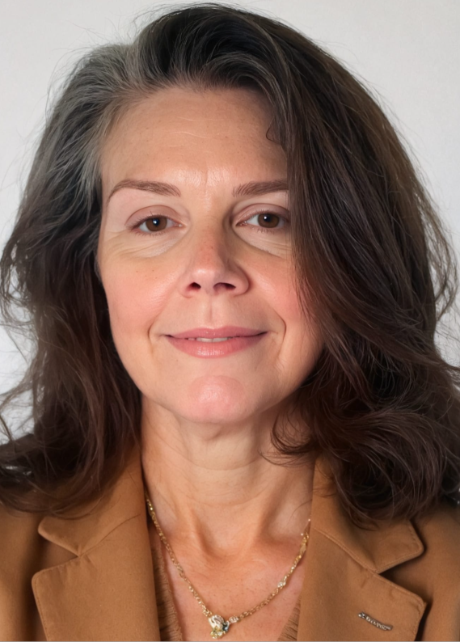
Lesley Boyd
'92 English and History
Employer: DSG Storbeck
Position: Vice President of Search Operations and Quality
Lesley brings extensive experience in executive search, coaching, and talent strategy. Formerly Vice President of Search Operations and Quality at DSG Storbeck, she led firmwide initiatives to strengthen search execution, enhance client experience, improve team performance, and drive cultural and operational change, contributing to a Net Promoter Score of 90. Previously a founding principal at Storbeck/Pimentel & Associates and a director at A.T. Kearney Executive Search, Lesley now supports educational organizations with executive talent strategy and helps individuals navigate change with clarity and integrity. Based in Montclair, New Jersey, she is active in volunteer work advancing education, access, and equity and serves on nonprofit boards focused on purposeful leadership.
https://www.linkedin.com/in/lesley-boyd/
Notes:
Headshot of Lesley Boyd

Slide 9
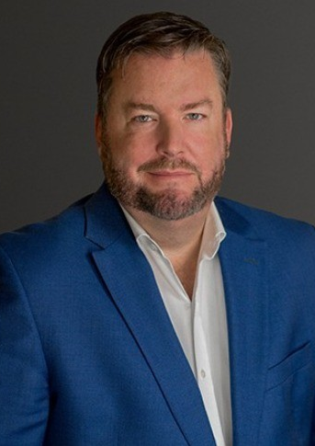
Ashley Burgess
'99 Public Administration
Employer: Sands Anderson PC
Position: Attorney; Shareholder and Member of the Board of Directors
Ashley is a business attorney and member of the Sands Anderson Board of Directors, where he helps guide the firm’s strategic vision, growth, and operations. He previously served for eight years as Group Leader of the firm’s Business Group, overseeing a wide range of practice areas including business transactions, employment, real estate, bankruptcy, health law, tax, and technology. Ashley regularly serves as outside general counsel to mid-market and emerging companies, advising on business formation, transactions, and disputes. His practice focuses on mergers and acquisitions, complex agreements, succession planning, commercial litigation, bankruptcy matters, and related real estate and trust and estate issues.
https://www.linkedin.com/in/ashleyburgess/
Notes:
Headshot of Ashley Burgess

Slide 10
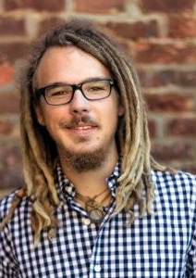
Zach Carlson
'14 Media Arts & Design
Employer: Sage Bird
Position: Owner
Zach owns & operates Sage Bird, a cidery, winery, & restaurant in downtown Harrisonburg. He graduated in 2014 with a SMAD degree and minors in art and music industry. Before opening Sage Bird in 2020, he worked as a graphic designer in Harrisonburg for seven years.
https://www.linkedin.com/in/zach-carlson-24201571/
Notes:
Headshot of Zach Carlson

Slide 11
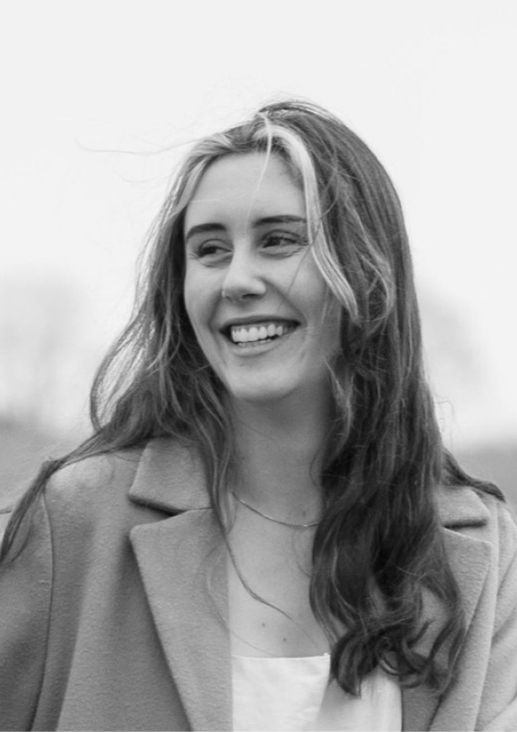
Catherine Carmichael
'21 Anthropology
Employer: Capitol One
Position: Principal Recruiter
Catherine is a principal recruiter specializing in technology and talent acquisition, currently working in tech recruiting at Capital One in the Washington, DC–Baltimore area. She brings several years of experience in technical recruiting, account management, and onboarding, with previous roles at Bright MLS and TEKsystems supporting financial services and software development teams. Known for her people-centered approach and strong negotiation and sourcing skills, Catherine focuses on connecting top talent with meaningful opportunities while delivering an excellent candidate and client experience.
https://www.linkedin.com/in/catherine-carmichaeldc/
Notes:
Headshot of Catherine Carmichael

Slide 12
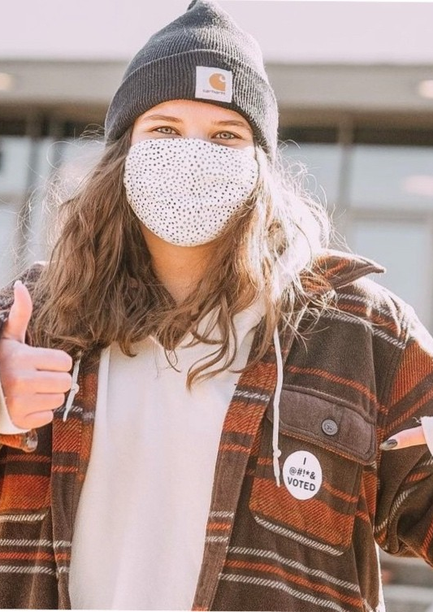
Angelina Clapp
'20 Political Science, '23 Public Administration, MPA
Employer: James Madison University
Position: Senior Associate Director for The Madison Center for Civic Engagement
Angelina is a civic engagement professional with experience in voter access, strategic engagement, and nonprofit leadership. She serves as Associate Director of the Madison Center for Civic Engagement and has held roles at Issue One and Rock the Vote, focusing on campaign strategy, civic technology, and election protection. Her work centers on expanding equitable participation for young people and marginalized communities, supported by skills in project management, research, and data analysis.
https://www.linkedin.com/in/angelina-clapp/
Notes:
Headshot of Angelina Clapp

Slide 13
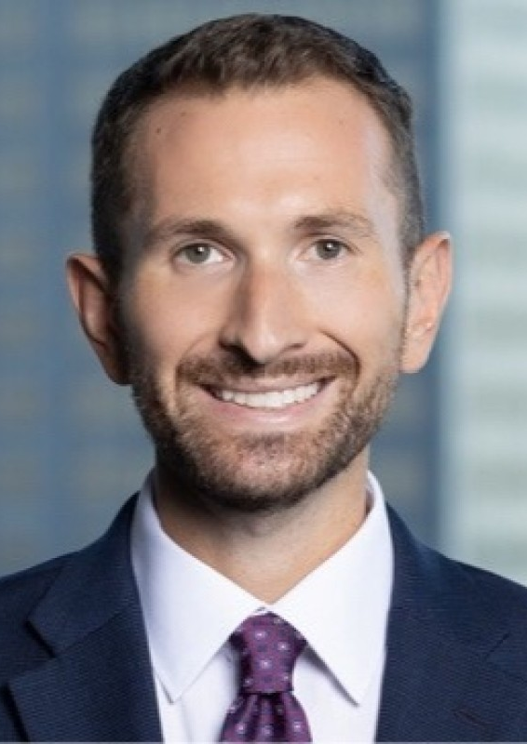
Jonathan Coleman
'18 Philosophy and Religion
Employer: Skadden, Arps, Slate, Meagher, and Flom LLP and Affiliates
Position: Associate
Jonathan is a Chicago-based attorney who practices litigation at the international law firm Skadden, Arps, Slate, Meagher & Flom LLP. He earned his J.D. from the University of Chicago Law School and his B.A. in Religion from JMU. Before law school, he taught humanities to eighth-grade students at a private school in Richmond. He has been selected to serve a one-year term as a law clerk to a United States District Court judge in Oklahoma, which he will begin next fall before returning to private practice.
https://www.linkedin.com/in/jonathan-t-coleman/
Notes:
Headshot of Jonathan Coleman

Slide 14
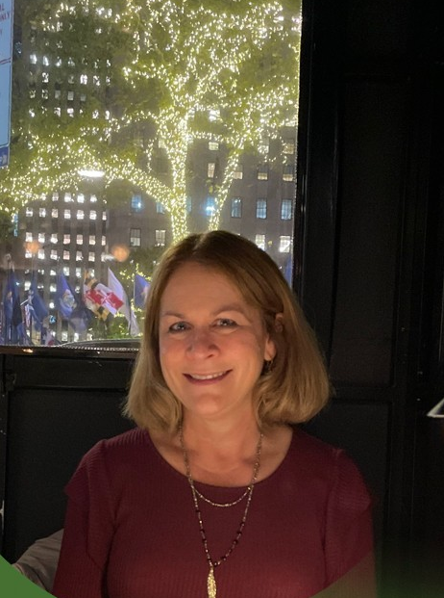
Beth Congbalay
'87 History and French
Employer: Congressional Summer Assembly
Position: Communications Coordinator
Beth is a communications professional with extensive experience in writing, public relations, special events, and content development for print and web. She currently edits a weekly newsletter and an annual publication and specializes in social media, event promotion, and creating content that strengthens organizations’ online presence across industries including government, nonprofits, manufacturing, restaurants, and fitness.
https://www.linkedin.com/in/bethcongbalay/
Notes:
Headshot of Beth Congbalay

Slide 15
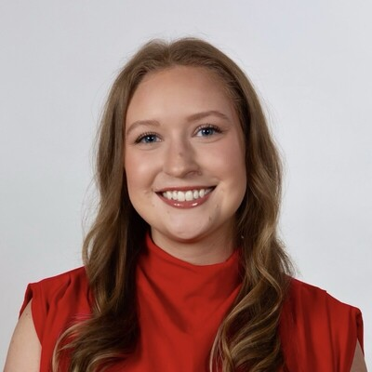
Delaney Crowe
'21 Communication Studies
Employer: Ruder Finn
Position: Senior Account Supervisor
Delaney Crowe is a senior account supervisor in Ruder Finn's corporate practice, primarily supporting clients' executive visibility and thought leadership. This includes strategizing and driving various earned, paid and social media tactics and campaigns, developing and coordinating owned events and podcasts, securing client participation in global events, and more. Notably, her work cinched her a recognition in PRWeek's 2024 Outstanding Young Professionals shortlist.
https://www.linkedin.com/in/delaneycrowe/
Notes:
Headshot of Delaney Crowe

Slide 16
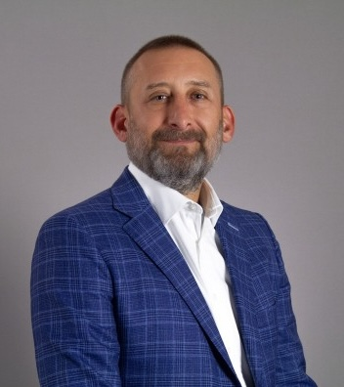
Dan Cuviello
'94 Communication Studies
Employer: ASRC Federal
Position: Chief Growth Officer
Dan is a seasoned executive with a proven record of delivering strategic value to organizations and partnering with executive teams to achieve mission success. A high-energy, results-oriented leader with extensive and diverse operational and business development experience, a consistent track record of delivering results, executing change, developing teams, driving double-digit growth/margins, and improving organizational positioning and competitiveness.
https://www.linkedin.com/in/daniel-cuviello-8bb016b/
Notes:
Headshot of Dan Cuviello

Slide 17
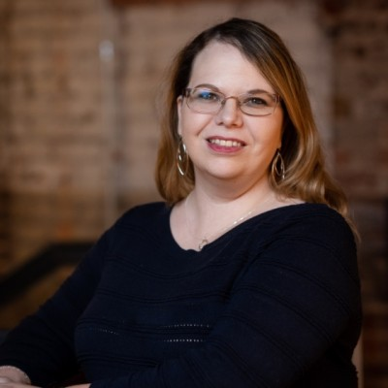
Holly Early
'09 Interdisciplinary Studies, ‘10 Secondary Education and Teaching, MAT
Employer: Silverchair
Position: Senior Business Analyst
Holly is a Senior Business Analyst at Silverchair, a leading Software-as-a-Service web platform provider serving scholarly publishers. Her present role focuses on requirements elicitation and coordination for new builds. During her time at Silverchair, she has worked on projects with publishers like Duke University Press, American Academy of Pediatrics, Oxford University Press, ASTM International, and The Royal Society to make scholarly research more accessible to users around the world. Prior to joining Silverchair, she worked for over a decade as a Government Information Specialist (Freedom of Information/Privacy Act Analyst) with the Federal Bureau of Investigation’s Information Management Division, where she handled and oversaw processing on high-profile and sensitive litigation requests.
Notes:
Headshot of Holly Early

Slide 18
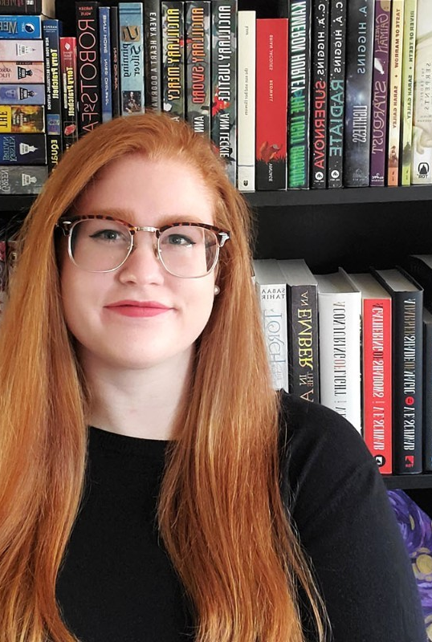
Becca Evans
'18 Writing, Rhetoric and Technical Communication, '20 WRTC MA
Employer: James Madison University
Position: Communications and Marketing Specialist
Becca joined the College of Arts and Letters Dean’s Office in 2021. She oversees college communication and branding strategies; writes, edits, and designs the Arts and Letters Review, a magazine published biannually that covers college news, students, events, alumni, and more; manages the college social media strategy and content; writes news stories; handles event promotion; and assists departments with content and marketing strategy.
Her master's degree was focused on studying and improving accessibility in digital publications, which she continues to work towards through volunteer work with Strange Horizons, a weekly speculative fiction magazine.
https://www.linkedin.com/in/becca-e-evans/
Notes:
Headshot of Becca Evans

Slide 19
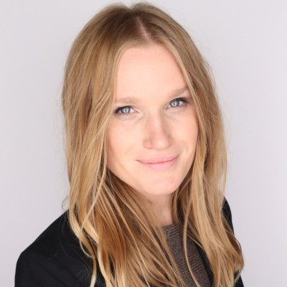
Sarah Featherstone
Arabic, English; Rhetoric and Composition MS
Employer: ECI Software Solutions
Position: Sr. Product Marketing Manager
Sarah helps brands find their voice and tell their story through clear messaging, compelling content, and GTM strategies that drive business results. With a background in journalism and a passion for storytelling, Sarah brings a unique lens to product marketing, using her experience in writing and brand messaging to help connect the dots between what a product offers and the real-world problems it solves, even in the most complex markets.​
As a product marketing leaders, she has developed positioning and messaging frameworks, led cross0fundtional launches, and crafted go-to-market strategies that elevate both brand and product visibility.
https://www.linkedin.com/in/sarah-featherstone-/
Notes:
Headshot of Sarah Featherstone

Slide 20
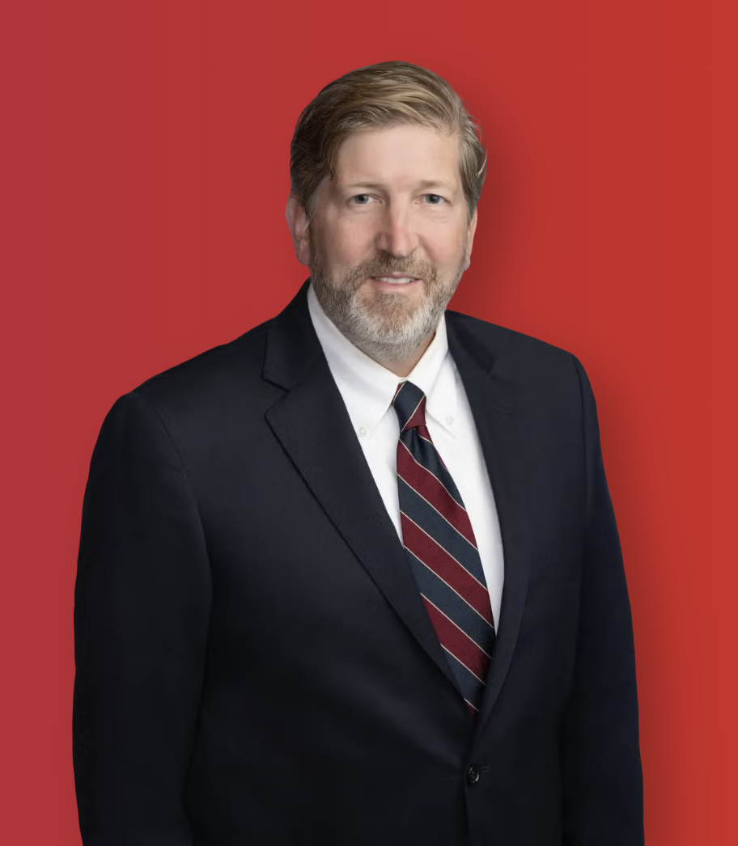
Chip Ferguson
'95 History
Employer: ArentFox Schiff LLP
Position: Partner
Chip advises clients in real estate, financing, and corporate transactions at ArentFox Schiff LLP's office in Washington, D.C. His practice involves a variety of commercial real estate transactions, including the acquisition, financing, and leasing of real property, condominium conversions, financing transactions, and related corporate matters. His experience includes the acquisition, ground leasing, and sale of individual properties (hotels, senior living facilities, office buildings, and shopping centers), as well as multi-state portfolio acquisitions and sales. He also has extensive experience in leasing transactions, including office leases, restaurant leases, and retail leases, and in assisting developers in establishing both vertical and horizontal condominium regimes, air rights regimes, and similar property reconfigurations. Chip received his J.D. from Emory University in 2000.
https://www.afslaw.com/attorneys/charles-ferguson
Notes:
Headshot of Chip Ferguson

Slide 21
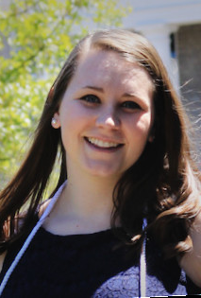
Isabelle Foley
'19 Justice Studies
Employer: Offender Aid and Restoration - Jefferson Area Community Corrections
Position: Senior Probation Officer
Isabelle is a criminal justice professional and Local Probation Team Lead at OAR–Jefferson Area Community Corrections, where she has worked since 2019. She previously led the Domestic Violence Unit, spearheaded community-based DV initiatives, and contributed to the agency’s Therapeutic Docket. Isabelle also serves as a Motivational Interviewing and Success Planning Coach and sits on the Legislative and Probation Advancement Committees for the Virginia Community Corrections Justice Association. She holds a bachelor’s degree in Justice Studies from James Madison University and a master’s degree in Criminal Justice from the University of Massachusetts Lowell. In her free time, she enjoys spending time with her cats and crocheting.
https://www.linkedin.com/in/isabelle-foley-357422129/
Notes:
Headshot of Isabelle Foley

Slide 22
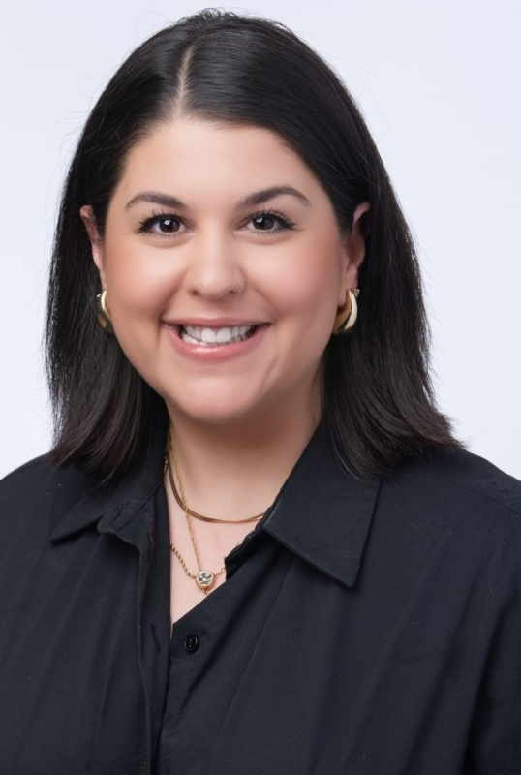
Kara Frank
'12 Communication Studies
Employer: Stratacomm
Position: Senior Vice President
Kara is a strategic communications leader with extensive experience managing high-impact, multi-channel campaigns for federal agencies, particularly in the transportation and public safety space. As Vice President at Stratacomm, she leads initiatives that combine policy fluency with creative execution, delivering measurable results for clients, including the National Highway Traffic Safety Administration and the Federal Motor Carrier Safety Administration. Kara thrives in fast-paced environments where strategy, storytelling, and systems thinking intersect, bringing clarity, collaboration, and a strong bias for action to every project.
https://www.linkedin.com/in/karalfrank/
Notes:
Headshot of Kara Frank

Slide 23
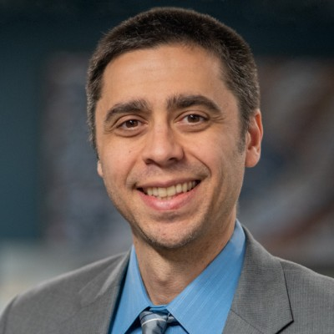
Khalil Garriott
'04 Media Arts & Design
Employer: American Bankers Association
Position: Vice President for Creative Content & Copywriting Strategy and Executive Editor, ABA
Khalil is a multi-award-winning digital content professional. Equal parts newsroom leader, sharp journalist and detail-oriented content strategist for multiple platforms.​
https://www.linkedin.com/in/khalilgarriott/
Notes:
Headshot of Khalil Garriott

Slide 24
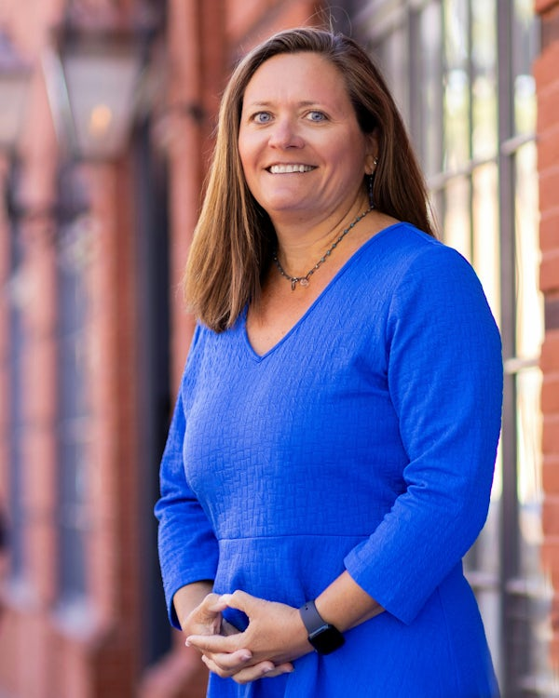
Mary Catherine Gibbs
'93 History
Employer: Wire Gill LLP
Position: Partner
Mary Catherine Gibbs is a partner in the firm Wire Gill, LLP in Alexandria, Virginia. Her areas of practice range from zoning, condemnation, and eminent domain, to juvenile law where she previously acted as a guardian ad litem in abuse and neglect cases, as well as representing parties in domestic abuse cases. After graduating from JMU, she earned her J.D. degree from T.C. Williams School of Law at the University of Richmond in 1997. Mary is a member of the Virginia Women Attorneys Association and is Past President of the Northern Virginia Chapter of that organization, as well as a member of the Alexandria Bar Association, the Virginia State Bar, and the Illinois State Bar.
https://www.wiregill.com/professionals/mary-catherine-gibbs
Notes:
Headshot of Mary Catherine Gibbs

Slide 25
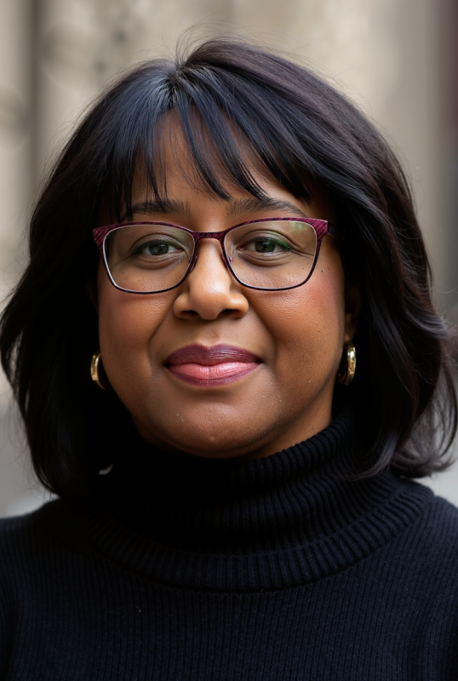
Donna Harris-Aikens
'90 Public Administration
Employer: Delaware Department of Education
Position: Associate Secretary for Government & External Affairs
Donna is a senior education policy and government affairs leader with decades of experience bridging policy, law, engagement, and implementation. She currently serves as Associate Secretary for Government and External Affairs at the Delaware Department of Education and has held executive leadership roles across federal, state, nonprofit, and consulting sectors, including the U.S. Department of Education and the National Education Association. Known for driving strategic policy initiatives and organizational change, Donna brings deep expertise in education policy, public affairs, and cross-sector collaboration.
https://www.linkedin.com/in/donna-harris-aikens-a95b054/
Notes:
Headshot of Donna Harris-Aikens

Slide 26
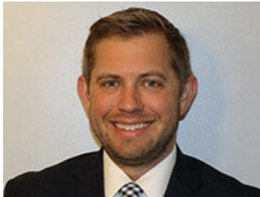
Pete Heindel
'07 Public Administration, Criminal Justice
Employer: Midland Credit Management
Position: Virginia Managing Attorney
Pete is the Virginia Managing Attorney for Midland Credit Management, the largest debt buyer in the United States. He practices in the area of debt collection and creditor's rights and earned his J.D. from Rutgers Law School. Previously, he was the Review Attorney Manager at UnitedLex Corporation and an Attorney at Abrams, Cohen & Associates. Peter's legal experience also includes work as a Pro Bono Assistant District Attorney at the Kings County District Attorney's Office and several internships at notable organizations such as the Burlington County Prosecutor's Office and Archer & Greiner, P.C.
Notes:
Headshot of Pete Heindel

Slide 27
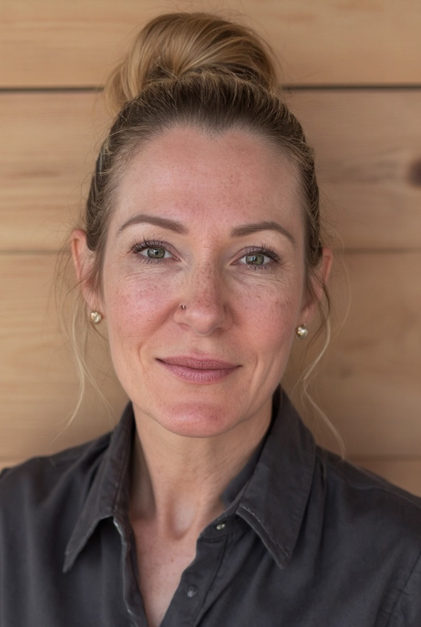
Allison Hoover
'07 Communication Studies
Employer: Chenega Corporation
Position: Senior Vice Presidents, Contracting & Business Services
Allison is a Certified Federal Contracts Manager with nearly 20 years of executive leadership experience spanning both public and private sectors. Her career reflects a deep commitment to excellence in contracting, business process improvement, and strategic operations across multiple departments. She is a dynamic and results-driven executive serving as Senior Vice President of Contracting & Business Services at Chenega Corporation.
https://www.linkedin.com/in/allisonhoover1/
Notes:
Headshot of Allison Hoover

Slide 28
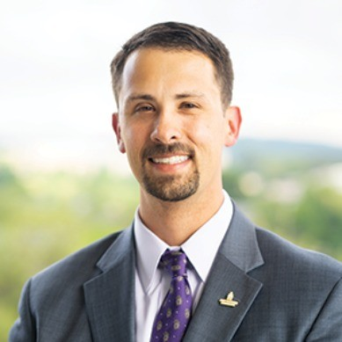
Tripp Hughes
'09 History
Employer: Midland Credit Management
Position: Senior Staff Counsel
Tripp Hughes graduated from JMU as an Honors Scholar in 2009, majoring in history and minoring in American Studies. Tripp then went on to graduate with his J.D. from the University of Richmond School of Law and now works as a Senior Staff Counsel at Midland Credit Management. Previously, Tripp has worked as an Attorney at MoneyGuidePro; an Associate at Cherry, Seymour & Baronian, P.C.; a Contract Attorney at Hire Counsel/UnitedLex Professional Services; and a Law Clerk at The Conrad Firm. Tripp has also served as the President of the JMU Alumni Association.
https://www.linkedin.com/in/johnhughesiii/
Notes:
Headshot of Tripp Hughes

Slide 29
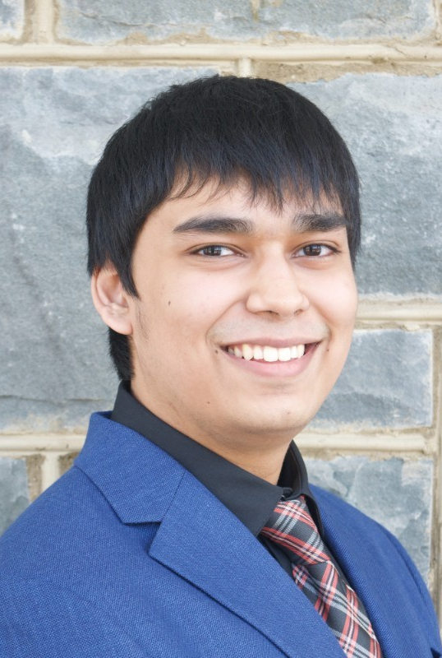
Yameen Ibrahim
'22 Public Policy and Administration
Employer: American Academy of Pediatrics
Position: Legislative Assistant
Yameen is a dedicated public affairs professional with experience across government and nonprofit sectors. He brings strong skills in policy research, legislative analysis, and strategic communications, and currently serves as a Legislative Assistant at the American Academy of Pediatrics (AAP).
https://www.linkedin.com/in/yameen-ibrahim-29269516b/
Notes:
Headshot of Yameen Ibrahim

Slide 30
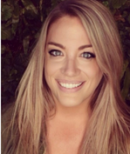
Kendra Kojcsich
'18 Communication Studies
Employer: Porter Novelli
Position: Senior Vice President
Kendra has over 15 years of experience developing and implementing integrated marketing and communication campaigns for a wide variety of clients. Kendra leads strategic communications and public education campaigns for government, coalition, association, non-profit, and private sector clients.
https://www.linkedin.com/in/kendrakojcsich/
Notes:
Headshot of Kendra Kojcsich

Slide 31
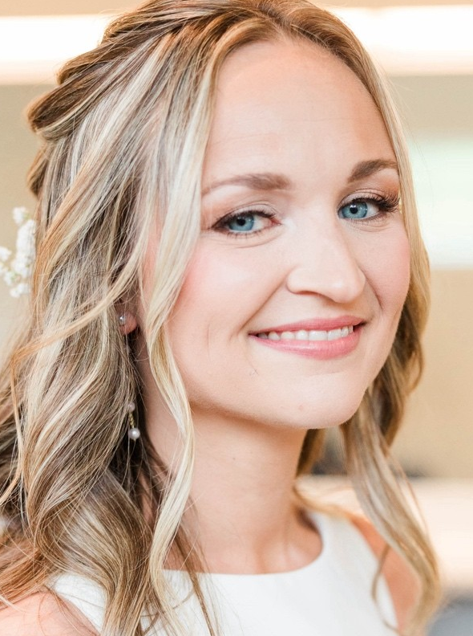
Delani Kraft
'18 Communication Studies
Employer: United States Courts
Position: Human Resources Specialist
Delani is an experienced human resources specialist with a demonstrated history in the HR field. She brings strengths in interviewing, background checks, social media, and digital tools, including Microsoft Word and Adobe, and is committed to supporting effective people operations and workplace practices.
https://www.linkedin.com/in/delani-farrar/
Notes:
Headshot of Delani Kraft

Slide 32
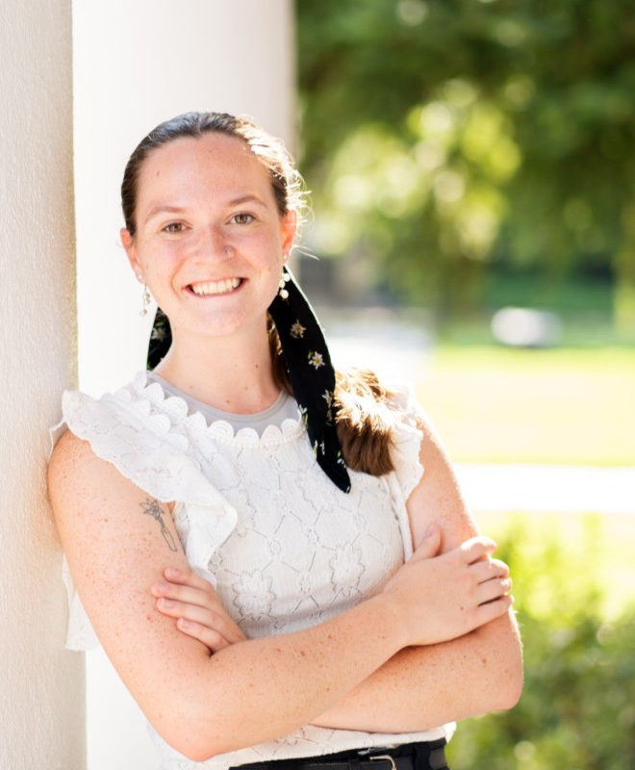
Brielle Lacroix
'25 Public Administration
Employer: Chesterfield County
Position: Stegmaier Fellow
Brielle is a 2025 Public Administration graduate currently employed with Chesterfield County as their 2025-27 Stegmaier Fellow. As part of the fellowship, Brielle rotates between county departments. So far, she has worked in Constituent and Media Services, preparing remarks, presentations and briefs for the county's Board of Supervisors. She is currently working in Intergovernmental Relations to advance Chesterfield's priorities on the state level and assisting a project in the county's Budget and Management department.
https://www.linkedin.com/in/brielle-lacroix-462590270/
Notes:
Headshot of Brielle Lacroix

Slide 33
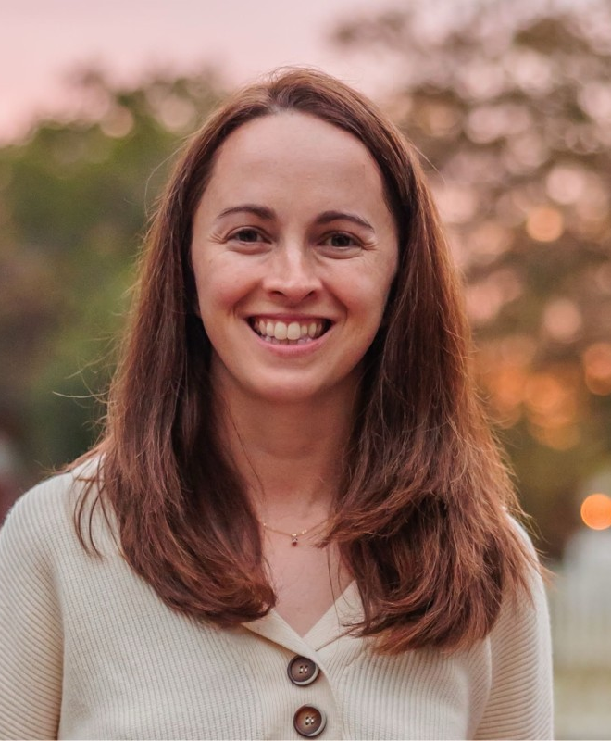
Shelly Laurenzo
'08 Philosophy and Religion
Employer: William and Mary
Position: Associate Dean for Undergraduate Education and Chief Transfer Officer
Shelly is a higher education professional with a strong background in student affairs and experience in academic affairs, driven by a deep belief in the value of a liberal arts education. She is proud to work at a public institution that emphasizes these principles and supports education at both the individual and institutional levels. In addition to her professional work, Shelly previously served as Vice Chair of the Waynesboro School Board, reflecting her commitment to education, civic engagement, and public service.
https://www.linkedin.com/in/shellylaurenzo/
Notes:
Headshot of Shelly Laurenzo

Slide 34
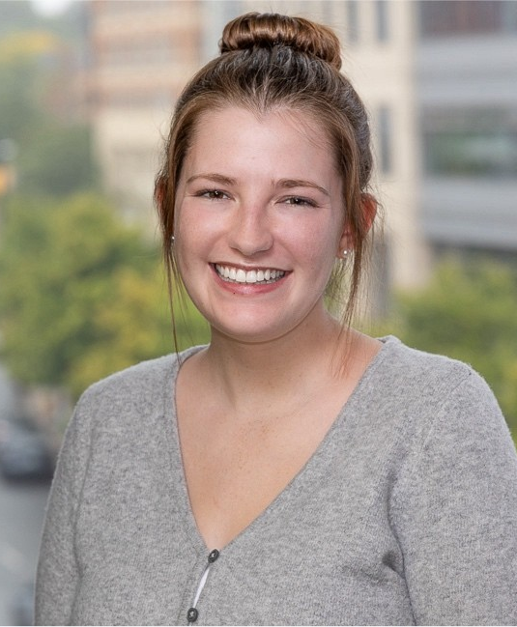
Sophie LeFew
'20 Modern Foreign Languages - Spanish
Employer: Accenture Federal Services
Position: Strategy and Consulting Consultant
Sophie has worked for Accenture Federal Services for 4 years in both change management and sales. She works with US Government clients to develop strategic initiatives such as communications, training, and outreach plans. Sophie graduated from JMU in 2020 with a degree in Modern Foreign Languages with a concentration in Spanish and a minor in Spanish-to-English Interpretation and Translation. When she’s not at work, she is busy reading, going to trivia nights, and giving back to her community.
https://www.linkedin.com/in/sophie-lefew/
Notes:
Headshot of Sophie LeFew

Slide 35
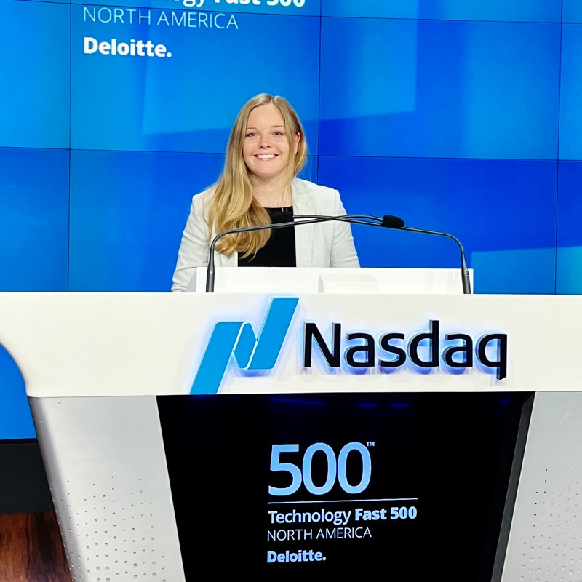
Keelyn Leonard
'20 Communication Studies
Employer: BerlinRosen
Position: Account Supervisor
Keelyn is a public relations professional with a dynamic background in sports, entertainment, and technology. In her current role as Account Supervisor on the Sports Business team at BerlinRosen, an Orchestra Company, she combines creative storytelling with thoughtful strategy to elevate the most powerful owners, teams, and organizations in sports. Keelyn’s experience spans major tech companies, where she supported thought-leadership initiatives, coordinated high-profile aerospace and technology campaigns, and helped teams navigate complex and evolving policy environments. Her earlier roles across Monumental Sports & Entertainment and the Washington Nationals deepened her expertise in partnerships, entertainment, and fan engagement. Keelyn is also the President of JMU’s School of Communication Studies Alumni Council, where she leads alumni engagement, mentoring initiatives, and strategic programming that connects students with industry professionals.
https://www.linkedin.com/in/keelyn-e-leonard/
Notes:
Headshot of Keelyn Leonard

Slide 36
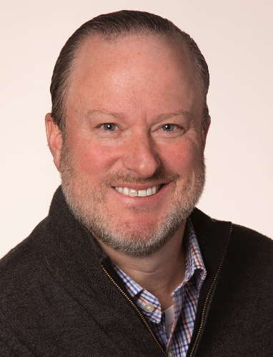
Will Macgill
'92 Mass Communications
Employer: Macy’s
Position: Senio Director of Video and Event Production
Will leads all video and event productions for Macy’s Inc as part of Enterprise Corporate Communications.
https://www.linkedin.com/in/willmacgill/
Notes:
Headshot of Will Macgill

Slide 37
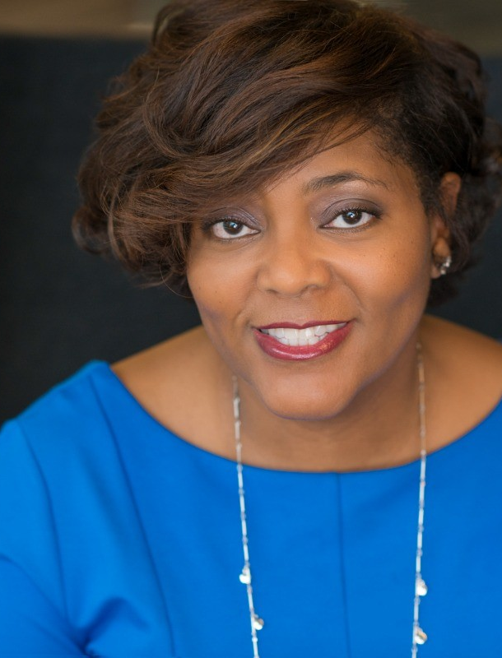
Felicia Farrar McLemore, APR
'95 Mass Communications, Public Relations
Employer: PepsiCo
Position: Head of Executive Communications and Visibility
Felicia is an accomplished, trusted communications leader with expert experience in corporate, government and agency settings. Creative problem solver and strategic thinker with a big picture focus and exceptional execution skills. Strong expertise in internal communications and change management, particularly during enterprise-wide transformation and crisis moments. Excellent verbal and written communication skills with the ability to tell stories, craft messages and deliver programs that resonate with key stakeholders and drive results. Natural collaborator and relationship builder with all levels. Respected, motivational team leader and mentor.
https://www.linkedin.com/in/feliciamclemore/
Notes:
Headshot of Felicia Farrar McLemore

Slide 38
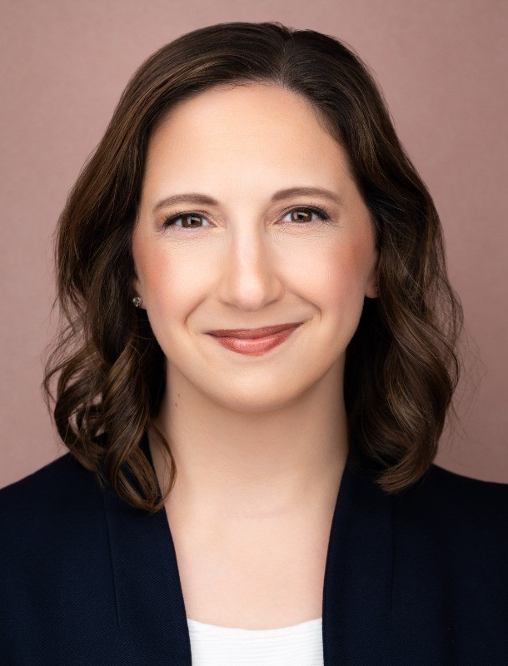
Lisa Mundt
'11 Media Arts & Design, and Writing, Rhetoric and Technical Communication, '13 WRTC M.A.
Employer: The Pulse of GovCon
Position: Co-Founder
Lisa is the Co-Founder of The Pulse, a research and advisory firm dedicated to the empowerment of Government Contractors. She helps manage the strategic business direction of The Pulse and works closely with clients to empower their growth efforts. She has 13 years of experience in Federal Proposal Development and procurement trend analysis and reporting, touching more than 200 proposal efforts totaling billions of dollars in wins across a multitude of government agencies and departments. She is also a renowned training facilitator experienced in training clients on business development, capture management, proposal management, and Orals Coaching. She has appeared in over 45 presentations and made 10 podcast appearances over the last 3 years. She sits on the board of the JMU Federal Dukes Alumni Chapter and is the President Elect of Women in Technology (WIT).
linkedin.com/in/lisasheamundt
Notes:
Headshot of Lisa Mundt

Slide 39
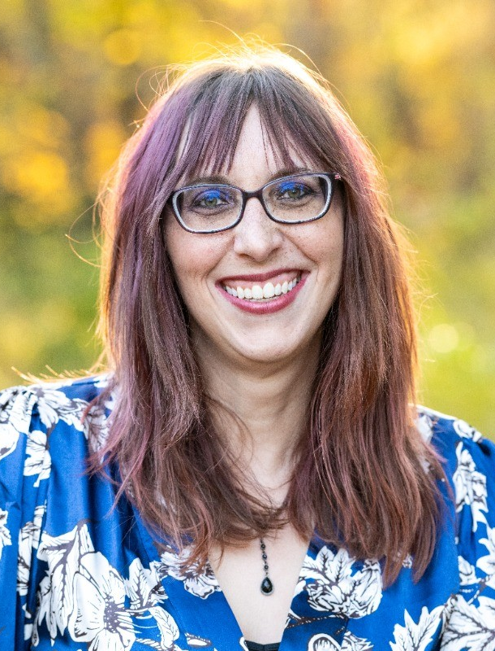
Rosanne North-Jack
'08 English
Employer: Prince William Public Libraries
Position: Youth Services Librarian
Rosanne is a Youth Services and Teen Librarian with the Prince William Public Library System, specializing in YA literature, graphic novels, and engaging teen programming. She designs interactive book displays, leads programs such as monthly D&D 5e sessions and Teen Advisory Group, and frequently presents at professional conferences on teen engagement and collaborative library programming.
https://www.linkedin.com/in/rnorthjack/
Notes:
Headshot of Rosanne North-Jack

Slide 40
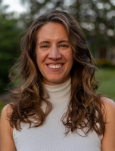
Dr. Rachel Palkovitz
'16 Anthropology and English
Employer: James Madison University
Position: Assistant Professor of Geography & ISAT
Rachel is an environmental scientist researching native plant genetics and conservation. After graduating from JMU English and Anthropology programs with a minor in Environmental Studies, she completed a Fulbright research fellowship in Tanzania for a year, followed by a master’s degree in Applied Biological Anthropology at the University of Cambridge. She then completed her Ph.D. at Penn State University in the Anthropological genomics laboratory. She is now an Assistant Professor of ISAT and Geography and a group fitness instructor at JMU. She is excited to connect with undergraduates and share how a JMU liberal arts education prepared her for a career in environmental research and teaching.
https://www.jmu.edu/cise/people/faculty/palkovitz-rachel.shtml
Notes:
Headshot of Dr. Rachel Palkovitz

Slide 41
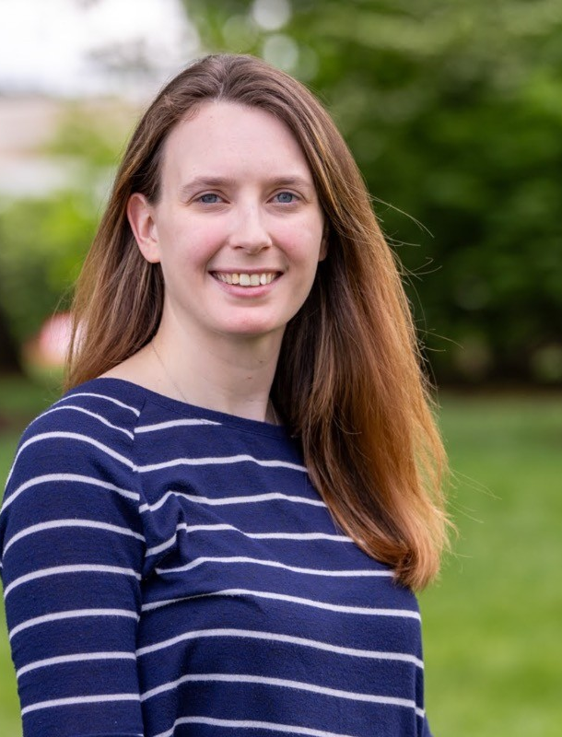
Jenna Polk
'14 Media Arts & Design, '21 Educational Technology, M.Ed.
Employer: James Madison University
Position: Assistant Director of Media Production and Makerspace Services
Jenna is the Assistant Director for Media Production and Makerspace Services, where she provides leadership and strategic direction for the development and delivery of media production initiatives across her department. She also serves as an Adjunct Professor in James Madison University’s College of Education, teaching in the Educational Media minor curriculum.
https://www.linkedin.com/in/jenna-fries-polk/
Notes:
Headshot of Jenna Polk

Slide 42
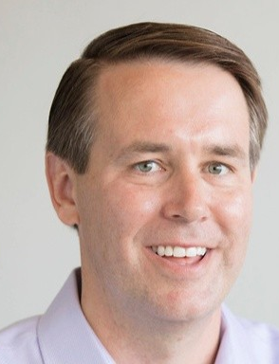
Jonathan Rhudy, APR
'95 Mass Communication, Journalism
Employer: Rhudy & Co. Strategic Communications
Position: Partner
Jonathan likes to run in road races and businesses. As a partner and chief operating officer of Rhudy & Co. Strategic Communications, Jonathan leads a Richmond, Va.-based team helping Fortune 500 companies, nonprofits, government agencies, and entrepreneurial ventures navigate their communications strategies. He is one of four former Breeze staffers on the Rhudy & Co. team, reinforcing a foundation built on storytelling, engagement, and communications. Jonathan’s career has spanned Fortune 500 companies, employee-owned agencies, and entrepreneurial ventures. He began as a Hotdogger for Oscar Mayer, crisscrossing the country in the iconic Wienermobile as a brand spokesperson. He later worked in internal communications at Capital One and led electronic employee communications at Dominion.
https://www.linkedin.com/in/jonathan-rhudy-apr-2838434/
Notes:
Headshot of Jonathan Rhudy

Slide 43
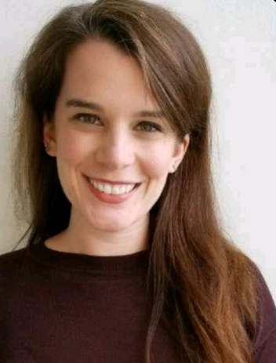
Kelsey Ruane
'14 Sociology
Employer: Mathematica
Position: Managing Consultant
Kelsey is a health policy professional focused on expanding healthcare access and using research to reduce barriers to care. At Mathematica, she leads research initiatives, manages key client relationships, and supports business development for the state health team. Previously, she advised state leaders at the National Governors Association on issues such as telehealth expansion and virtual care. Kelsey is known for translating complex policy and research insights into clear, actionable solutions in a rapidly evolving health landscape.
https://www.linkedin.com/in/kelsey-ruane/
Notes:
Headshot of Kelsey Ruane

Slide 44
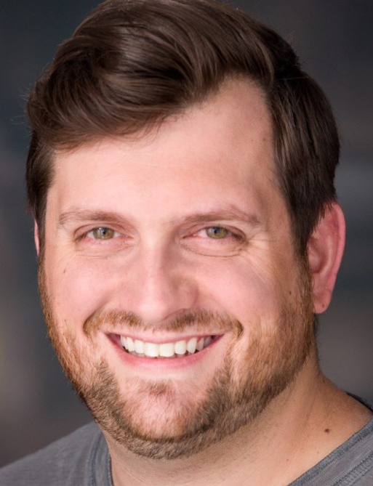
Chris Russo
'09 International Affairs
Employer: Publicis Sapient
Position: North America Energy Commercial and Alliances Director
Chris brings 13 years of energy experience to many of the world's largest oil/gas & utility companies. Publicis Sapient is a leading digital business transformation firm, delivering business results to the energy industry and its entire value chain for over 25 years, with a unique focus on energy trading and reducing tech debt through AI-enabled legacy modernization. Chris works with energy executives to identify and unlock additional value for its customers & shareholders. With previous stints at Accenture, Capgemini, and Gartner, he has been a part of multiple utility transformations, understanding what drives senior leadership. Prior to his professional services career, Chris began his post-academic journey with the WWE as a broadcaster & announcer; he is still actively involved with professional wrestling to this day. While also a graduate of Rollins College's MBA program, Chris fondly remembers his time at JMU, joining Theta Chi fraternity, supporting the WBB Lady Dukes as a practice player, and enrolling in the Washington Semester.
https://www.linkedin.com/in/christopherprusso/
Notes:
Headshot of Chris Russo

Slide 45
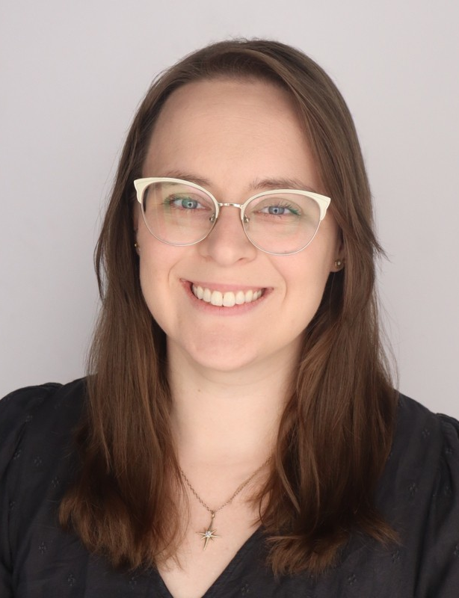
Ryan Silver
'14 Sociology and Philosophy and Religion, '22 Adult Education/Human Resource Development M.S.Ed.
Employer: Nuclear Energy and Maritime Industry Project Manager
Position: Virginia Works
Ryan is a human capital consultant and workforce strategist with extensive experience leading public-sector transformation, workforce strategy, and adult learning initiatives. She has worked across state agencies, higher education, and federal programs to align people, processes, and systems in ways that improve service delivery and advance equity. Previously at Deloitte, Ryan led statewide workforce redesign and strategic planning efforts, advised on organizational design and change readiness, and developed training programs for both clients and internal teams. Her work is grounded in data-informed decision-making, systems thinking, and inclusive strategy, with a focus on building practical, mission-driven solutions at the intersection of workforce development, human capital, and learning.
https://www.linkedin.com/in/ryan-j-silver/
Notes:
Headshot of Ryan Silver

Slide 46
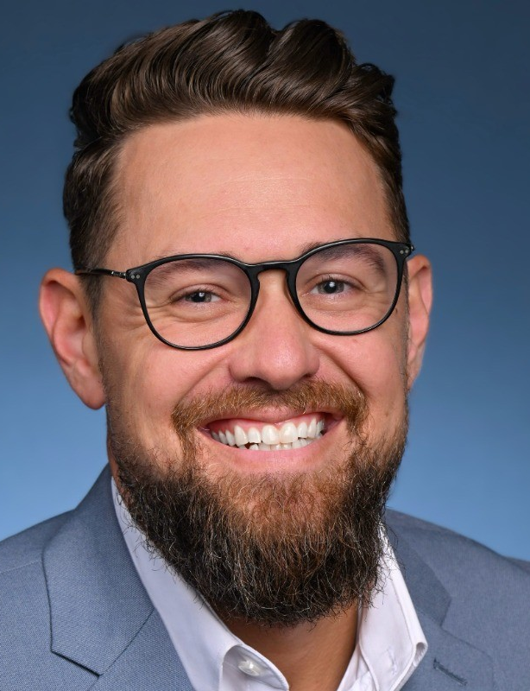
Dr. Dan St. John
'09 Justice Studies, '11 Counseling Psychology M.Ed.
Employer: Eastern Virginia Medical School
Position: Associate Professor in Psychiatry and Behavioral Sciences
Dan is the Director of Academic Development and an Associate Professor of Psychiatry and Behavioral Sciences at Eastern Virginia Medical School. With extensive experience in higher education, counseling, and student development, he has held faculty and leadership roles supporting academic success, advising, and program development. Dan’s work is grounded in student-centered practice, academic development, and behavioral health education.
https://www.linkedin.com/in/danielstjohn/
Notes:
Headshot of Dr. Dan St. John

Slide 47
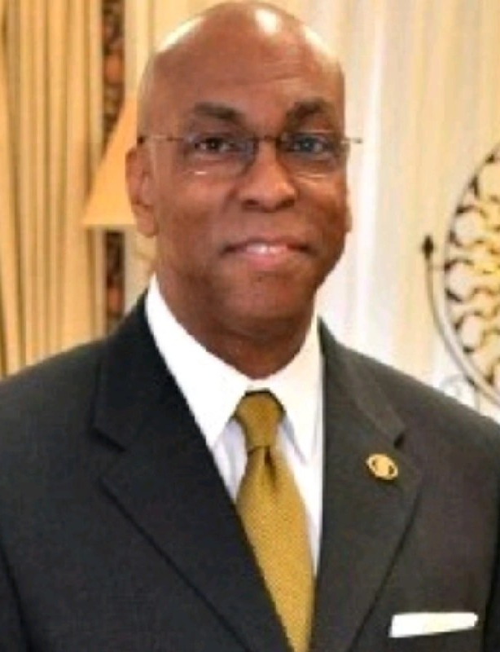
Malcolm Taylor
'82 Justice Studies
Employer: Virginia Department of Corrections
Position: Public Safety Administrator (Retired)
Malcolm worked in the human services field for 37 years. His work has included roles in non-profit and local government agencies. His early career included roles as a probation officer, senior probation officer, and regional manager, culminating in his being named chief of District 7 Probation and Parole in Petersburg, Virginia. In 2011, Taylor was appointed Acting Deputy Director of Probation and Parole System in Virginia. Later he was selected to be the first Regional Operations Chief of the Central Region of Virginia. He retired in 2019 as the Chief Executive Officer of Virginia Correctional Enterprises, the manufacturing division of the Virginia Department of Corrections, concluding a 30-year career with the agency.
https://www.linkedin.com/in/malcolm-taylor-a825732b/
Notes:
Headshot of Malcolm Taylor

Slide 48
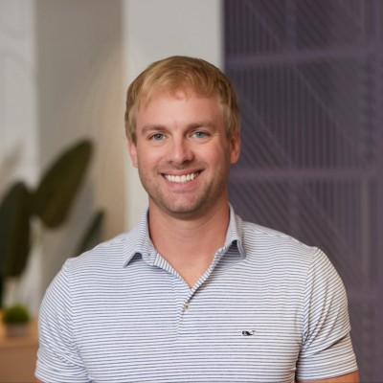
John Theobald
'07 Business Management, Business Law
Employer: UnitedLex
Position: Director of Business Development
John Theobald has spent the last 15 years at UnitedLex helping some of the world’s largest companies and top law firms simplify one of their toughest challenges: discovery. His role is to partner with corporate legal teams and elite trial firms to bring order, efficiency, and cost predictability to discovery. John helps clients reduce risk and control costs without sacrificing quality. After graduating from JMU in 2007 with a Bachelor of Arts degree in business management and business law, John obtained his J.D. from the University of Miami in 2010. Previously, John has worked as an Associate Attorney at LeClairRyan as well as Law Clerk at both the Henrico County Attorney's Office and at Hirschler Fleischer.
https://www.linkedin.com/in/john-theobald-21613442/
Notes:
Headshot of John Theobald

Slide 49
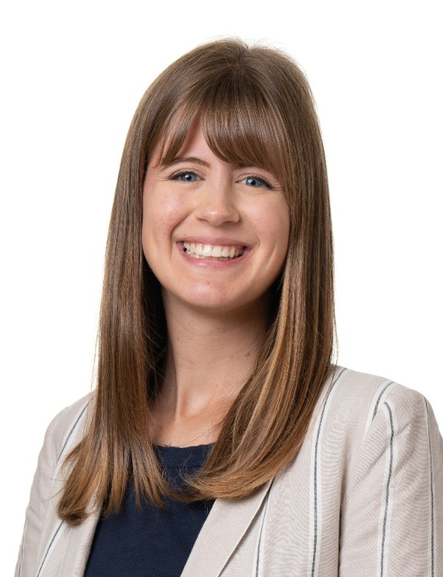
Abby Wallen
'21 Public Policy and Administration
Employer: American Enterprise Institute
Position: Research Associate - center on Opportunity and Social Mobility
Abby is a policy research professional and Research Associate at the American Enterprise Institute, where she focuses on opportunity, social mobility, and evidence-based policy analysis. She previously served as a Pathways Adviser with AmeriCorps, establishing college and career advising programs and mentoring students, and has experience in policy writing and communications through roles with national public service organizations. Abigail brings strong skills in research, writing, and public engagement to her work in the policy space.
linkedin.com/in/abigail-wallen-86b181166/
Notes:
Headshot of Abby Wallen

Slide 50
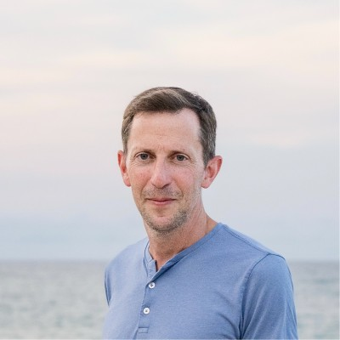
Brian Westley
'00 Media Arts and Design (Journalism)
Employer: Axios
Position: Senior Newsroom Counsel
Brian is a Senior Newsroom Counsel at Axios, an Arlington-based news company. He provides advice to journalists on a range of media law issues, including defamation, privacy, copyright, fair use, newsgathering, and access. He is also a communication law adjunct instructor at American University Washington College of Law, where he earned his J.D. and was Editor-In-Chief of the school's law reviews. Previously, Brian has worked as an editor and reporter at The Associated Press; a Trademark/Copyright Associate Attorney at Finnegan, Henderson, Farabow, Garrett & Dunner, LLP; a Senior Counsel at PBS, and an Adjunct Instructor at The Catholic University of America.
https://www.linkedin.com/in/brian-westley-46031713/
Notes:
Headshot of Brian Westley

Slide 51
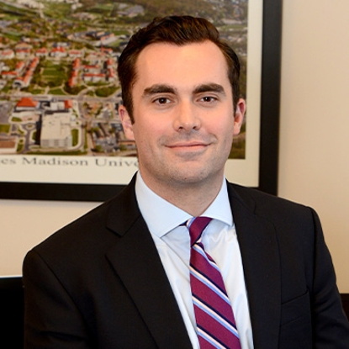
Justin Wolcott
'07 Political Science
Employer: Obenshain Law Group
Position: Litigation Attorney
Justin Wolcott has over a decade of experience handling a wide range of criminal and civil disputes. He now focuses his practice exclusively on helping individuals and families. After graduating from JMU he attended the University of South Carolina School of Law, graduating with honors and serving on the Law Review. Justin began his legal career as a criminal prosecutor, gaining extensive trial experience, trying cases to both bench and jury verdicts. Since joining Obenshain Law Group, Justin has represented plaintiffs in a wide variety of disputes including commercial disputes against some of the largest corporations and law firms in the world. Justin now uses his experience to represent individuals in serious injury and wrongful death cases from the negligence of motorists, nursing homes and health care providers.
https://www.obenshainlaw.com/about-us/justin-m-wolcott/
Notes:
Headshot of Justin Wolcott

