Slide 1
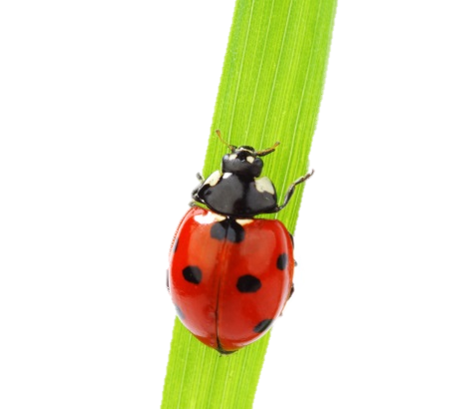
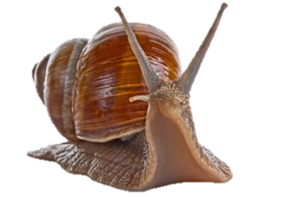
Department of Biology, Spring 2017 Upper Division Offerings
Course # | Title/Topic | Instructor | Animal Science | Ecology/ Evolution | Environmental Science | Genetics / Cell/ Molec. / Developmental Biology | Human Related Biology | Micro-biology | Plant Science | Fulfills Organismal Diversity Requirement | Fulfills Upper Division Lab Requirement
305 | Ornithology | Ziegenfus | X |  |  |  |  |  |  | X | X
309 | Marine & Freshwater Invertebrates | Wyngaard | X | X |  |  |  |  |  | X
320 | Comparative Anatomy of Vertebrates | Rose | X | X |  |  |  |  |  | X | X
342 | Mathematical Models in Biology | Ludwig |  | X | X | X |  | X |  |  | X
343 | Immunology | Lantz |  |  |  | X | X | X
343L | Immunology Lab | Roth |  |  |  | X | X | X |  |  | X
354 | Global Climate Change | Cocking |  | X | X |  | X
366* | Environmental Ecology and Evolution | Rentroe |  |  | X |  |  |  | X
370 | Animal Physiology | Daniel |  |  |  |  | X |  |  |  | X
386 | Field Botany | McMullen |  | X |  |  |  |  | X | X | X
395 | Comparative Animal Behavior | Baker | X | X | X
400 | Geology & Ecology of the Bahamas | Leslie |  | X | X |  |  |  |  |  | X
404 | Evolutionary Analysis | Cooper |  | X | X
405 | Vertebrate Paleontology | Fichter | X | X
410* | Advanced Human Anatomy | Strong/Kilkenny |  |  |  |  | X |  |  |  | X
420L | Medical Parasitology Lab | Lantz | X |  |  |  | X | X |  |  | X
426 | Galapagos Islands: Biodiversity | McMullen | X | X | X |  |  |  | X | X (possibly)
426 | Endocrinology | Velayudhan | X |  |  |  | X
426 | The JMU Fueled Project | Gabriele |  |  | X |  | X |  | X
426 | Bugs to Barcodes | Cresawn/Ludwig |  |  |  | X
427 | Herpetology: Amphibians/Reptiles | McLeod | X | X |  |  |  |  |  | X(possibly) | X(possibly)
445 | Neurobiology | Clelland | X |  |  | X | X |  |  |  | X
451 | Current Topics Human Development & Evolution | Rose |  | X |  | X | X
453 | Microbial Ecology & Evolution | Herrick |  | X | X |  |  | X
454 | Introduction to Biometrics | Wyngaard |  |  | X
455 | Plant Physiology | Monroe |  |  |  | X |  |  | X |  | X
457 | Biological Applications of GIS | Wiggins |  | X | X |  |  |  |  |  | X
460 | Plant Cell & Tissue Culture | Renfroe | X | X | X | X | X |  | X |  | X
480 | Advanced Molecular Biology | Enke |  |  |  | X |  |  |  |  | X
482 | Human Histology | Gabriele | X |  |  | X | X |  |  |  | X
483 | Bioinformatics | Cresawn |  | X |  | X |  |  |  |  | X
*By Instructor Permission
* IDLS & SEED
*Probably

