Slide 1
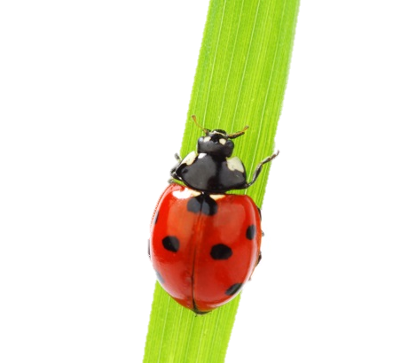
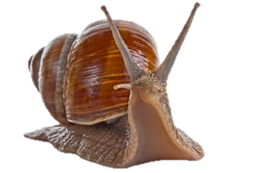
Department of Biology, Fall 2015 Upper Division Offerings
Courses relevant to:
Course # | Title/Topic | Instructor | Animal Science | Ecology/ Evolution | Environmental Science | Genetics / Cell/ Molec. / Developmental Biology | Human Related Biology | Micro-biology | Plant Science | Fulfills Organismal Diversity Requirement | Fulfills Upper Division Lab Requirement
226 | Research Readiness | Rose | l | l | l | l | l | l | l
301 | Introductory Neuroscience | Brown |  |  |  | l | l
312 | Animal Welfare | Chodrow | l
316 | Animal Development | Rose |  |  |  | l | l
316L | Animal Development Lab | Rose |  |  |  | l | l |  |  |  | l
324* | Human Genetics | Halsell |  |  |  | l | l
343 | Immunology | Roth |  |  |  | l | l | l
350 | Paleobiology | Leslie |  | l
360 | Plant Biology | Renfroe |  | l | l | l |  |  | l | l
364 | Human Uses of Plants | Renfroe |  |  |  |  | l |  | l
364L | Human Uses of Plants Lab | Renfroe |  |  |  |  | l |  | l |  | l
370 | Animal Physiology | Daniel | l |  |  |  | l |  |  |  | l
380 | General Microbiology | Vasudevan |  |  |  |  |  | l |  | l | l
395 | Comp. Animal Behavior | Baker | l | l | l
402 | Forest Ecology | Griscom |  | l |  |  |  |  | l |  | l
412 | Mammology | Gobetz | l |  |  |  |  |  |  | l | l
420 | Medical Parasitology | Lantz | l |  |  |  | l | l
420L | Medical Parasitology Lab | Lantz | l |  |  |  | l | l |  |  | l
426 | Protein Structure & Function | Storm |  |  |  | l
427 | Experimental Neurobiology | Cleland | l |  |  |  |  |  |  |  | l
427 | Environmental Microbiology | Steffen |  | l | l |  |  | l |  |  | l
427* | Biological Illustrations | Cooper | l | l |  | l | l | l | l
432 | Light Microscopy | Kubow | l |  |  | l | l | l | l |  | l
448 | Medical Microbiology | Seifert |  |  |  |  | l | l |  |  | l
452 | Population Ecology | Ludwig |  | l |  |  |  |  |  |  | l
456 | Landscape Ecology | Cocking |  | l | l |  |  |  |  |  | l
457 | Biol. Applications GIS | Wiggins |  | l | l |  |  |  |  |  | l
459 | Freshwater Ecology | May |  | l | l |  |  |  |  |  | l
465 | Environmental Toxicology | Wiggins |  | l | l | l | l |  |  |  | l
470 | Morphology Non-Vascular Plants | McMullen |  |  |  |  |  |  | l | l | l
477 | Cancer Genetics | Bloss |  |  |  | l | l
480 | Advanced Molecular Biology | Rife |  |  |  | l |  |  |  |  | l
481 | Genomics |  |  |  |  | l | l |  |  |  | l
* Will Not Be Offered Fall 2016 * Second Block Course

