Slide 1
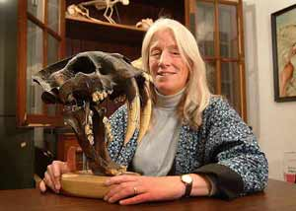
Other Worlds: the view from the Pleistocene Dr. Blaire Van Valkenburgh UCLA Department of Ecology and Evolutionary Biology
Dr. Van Valkenburgh will explore the late Pleistocene period, approximately 10 to 50 thousand years ago. This is a time of huge herbivores, such as mammoths, mastodons, woolly rhinos, and giant ground sloths, accompanied by over-sized predators including short-faced bears, sabertooth cats, giant spotted hyenas and lions. Moreover, this is the interval in which modern humans, Homo sapiens, first appear and acquire more sophisticated weapons.
Thursday, March 17
Bioscience 1007
3:30: Reception
4:00: Seminar

