Slide 1
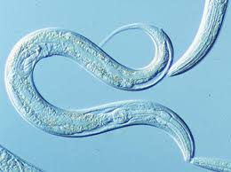
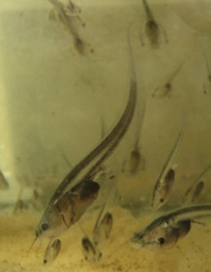
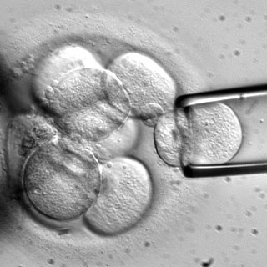
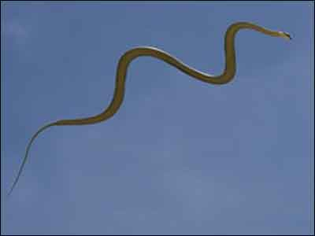
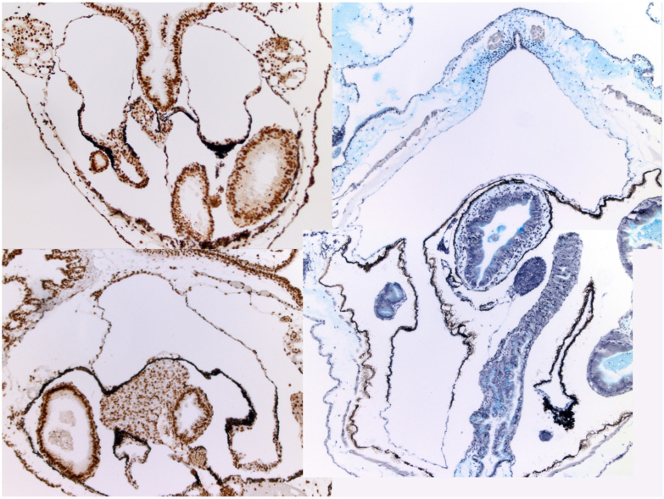
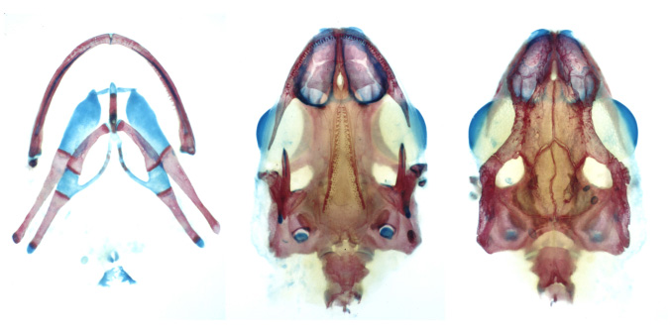
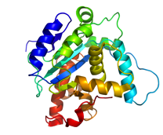
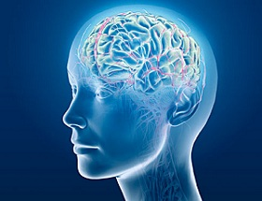
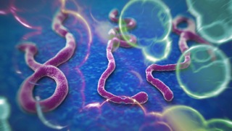
Do you want to learn how to read and write scientific papers, prepare scientific talks and posters, and write grants to get research money?
Do you want to know what kinds of research opportunities and careers are available in biology?
Bio 226: Research Readiness
Do you want to learn how to do research in different areas of biology?
Do you want to learn about ethics, fraud and politics in biological research?
Would you like to engage in discussion and learning exercises about any of the above?
If you answered yes to any of these questions, then this course is for you.
This course is directed at freshmen and sophomores but also open to juniors and seniors.
Email rosecs@jmu.edu or see syllabus at http://www.jmu.edu/biology/undergraduate/course-websites.shtml for more information.

