Slide 1

Leveraging Intervention Mapping to Guide Innovative & Effective Programming in Higher Ed
Sara Finney & Riley Herr
James Madison University
October 28, 2025
Keynote address at Assessment Institute, Indianapolis, IN
Notes:
From textbook but should be explained up front:
Purpose of Intervention Mapping: to provide health promotion program planners with a framework for effective decision making at each step in intervention planning, implementation, and evaluation. (a process is needed for any program planner even if not health promotion so we can see if this can be generalized to any type of program to change what people know and do).
Health promotion defined as: “Any combination of education, political, regulatory and organizational supports for actions and conditions of living conducive to the health of individuals, groups or communities” (Green & Kreuter, 2005, p. G-4), and health education is a subset of health promotion strategies that are primarily based on education. We recognize this distinction but also the fact that many people in the health field practice health promotion; some of them specialize in health education. Often the boundaries are quite blurred. This book uses the terms health educator, health promoter, and program planner interchangeably when a subject is needed to mean someone who is planning an intervention meant to produce health outcomes. (they are clearly noting that this approach is used to create health education programs—which any college campus has!)
An intervention can be designed to change environmental or behavioral factors related to health, but the most immediate impact of an intervention is usually on a set of well-defined determinants
of behavior and environmental conditions. (they are getting at distal vs proximal outcomes in program theory).
A difficulty that planners may encounter is delineating tasks for the development of health promotion or education programs that are based on theory, empirical findings from the literature, (this is program theory)and data collected from the at-risk population. (this is outcomes assessment)
Existing literature, appropriate theories, and additional research data are basic tools for any health educator; but often it is unclear how and where these tools should be used in program planning. In Intervention Mapping, these tools are systematically applied in the steps of program development. (exact same issue in higher education programming so why not use this approach to guide our way and see how much it overlaps with what we already advocate for).
To understand a problem, the planner begins with a question about a specific health or social issue (Veen, 1985; Kok et al., 1996). The planner then accesses social and behavioral science theories and research evidence of causation at multiple levels. These or other theories may also suggest intervention points and methods, and the planner proceeds to accumulate evidence for the effectiveness of these methods. By the term evidence, we mean not only data from research studies as represented in the scientific literature but also opinion and experience of community members and planners. In this way theoretical and empirical evidence are brought to bear on meeting a health or social need. Intervention Mapping provides a detailed framework for this process.

Slide 2
Session Learning Outcomes
Describe the six steps of Intervention Mapping.
Apply the Intervention Mapping framework to a relevant higher education assessment scenario.
Compare & contrast Intervention Mapping with the traditional outcomes assessment cycle.

Slide 3
Intervention Mapping: Overview
IM: an approach for developing effective behavior change programs.
Our end goal is often to change how students behave/engage with world.
We may hope our academic & student affairs programs change behaviors such as: increase civic engagement, leadership, safer-sex practices, ethical use of AI, scholarly engagement in field via pubs, managing teams…
Completion of IM steps serves as a BLUEPRINT for designing, implementing & evaluating a program based on a foundation of theoretical, empirical and practical evidence.
If you're involved in program development, this IM is designed to take a lot of the guesswork out.
It helps you build programs that actually work.
It is a systematic step-by-step process for developing programs that are firmly rooted in solid theory & actual empirical evidence.
About translating what we know into concrete actionable steps.
Our Mission: unpack IM approach to programming, implementation & evaluation and show how higher education outcomes assessment can borrow from it to create, implement & improve educational and developmental programs on our campuses.

Slide 4


Intervention Mapping Approach
STEP 1: Needs Assessment
Identify what, if anything, needs to be changed and for who
🎯 STEP 2: Proximal Program Objectives
Create matrices linking performance objectives with determinants
💡 STEP 3: Theoretical Methods & Practical Strategies
Select theory-based methods that match determinants and create practical strategies
⚙️ STEP 4: Program Production
Operationalize strategies and develop materials to create an organized program
STEP 5: Adoption & Implementation Plan
Develop plan for program adoption, quality implementation and sustainability
🔍 STEP 6: Evaluation & Monitoring
Develop an evaluation plan to assess both effect and process
Core Components: Theory & Research
Community Engagement

Slide 5
What was the scene like in health education program planning before intervention mapping arrived?
Imagine trying to assemble some complicated IKEA furniture.
You've got the picture, you've got the parts, but no step-by-step instructions.
You have dedicated people, great intentions, but also a lot of frustration, wasted effort.

Slide 6

That was the reality for many in health education planning.
People were trying to build something really complex with maybe a good idea, some materials, but no actual blueprint.
Notes:
.

Slide 7
Intervention Mapping Approach
STEP 1: Needs Assessment
Identify what, if anything, needs to be changed and for who
There were good, clear models to follow to conduct a Needs Assessment: figuring out the “problem”, the area of “concern”, the “need” in the population.
For example: Should we be concerned about STI rates of our students?
Is there a need for safer sex programs given STI levels?
🎯 STEP 2: Proximal Program Objectives
Create matrices linking performance objectives with determinants
💡 STEP 3: Theoretical Methods & Practical Strategies
Select theory-based methods that match determinants and create practical strategies
⚙️ STEP 4: Program Production
Operationalize strategies and develop materials to create an organized program
STEP 5: Adoption & Implementation Plan
Develop plan for program adoption, quality implementation and sustainability
For example: Should we be concerned about incoming students ethical use of AI?
Is there a need for formal AI literacy gen ed programming?
🔍 STEP 6: Evaluation & Monitoring
Develop an evaluation plan to assess both effect and process
Core Components: Theory & Research
Community Engagement
Notes:
University X: one of our main outcomes is to develop students who engage in sustainability actions in order to address climate change.
First question—do students engage in sustainability actions now? Is there a need for intentional programming to increase these actions?
University Y: one of our main outcomes is to develop students who are civically engaged.
First question—do student engage in civic actions now? Is there a need for intentional programming to increase these actions.
JMU Health example: Should we be concerned about STI’s on campus? Is there a need for safer sex training given STI levels? At JMU, the answer is yes after data showed high STI rates and low sex ed training in high school.
Step 1: Logic Model of the Problem
In Step 1, before beginning to actually plan an intervention, the planner assesses the health problem, its related behavior and environmental conditions, and their associated determinants for the at-risk populations. This assessment encompasses two components: a scientific, epidemiologic, behavioral, and social perspective of an at-risk group or community and its problems; and an effort to “get to know,” or begin to understand, the character of the community, its members, and its strengths. The product of this first step is a description of a health problem, its impact on quality of life, behavioral and environmental causes and determinants of behavior and environmental causes.
In Step 1, the planner completes the following tasks:
Establish and work with a planning group
Conduct a needs assessment to create a logic model of the problem
Describe the context for the intervention, including the population, setting, and community
State program goals

Slide 8
There were good, clear models of Measuring Outcomes of Programming: assessing if the programming “worked” after the fact.
For example: Did ethical use of AI increase after students experience AI training in Information Literacy 101?
Intervention Mapping Approach
STEP 1: Needs Assessment
Identify what, if anything, needs to be changed and for who
🎯 STEP 2: Proximal Program Objectives
Create matrices linking performance objectives with determinants
💡 STEP 3: Theoretical Methods & Practical Strategies
Select theory-based methods that match determinants and create practical strategies
⚙️ STEP 4: Program Production
Operationalize strategies and develop materials to create an organized program
STEP 5: Adoption & Implementation Plan
Develop plan for program adoption, quality implementation and sustainability
🔍 STEP 6: Evaluation & Monitoring
Develop an evaluation plan to assess both effect and process
Core Components: Theory & Research
Community Engagement
Notes:
We have masters and phd programs that focus on how to measure student learning, development and behavioral outcomes along with how to appropriately analyze that information whether quantitative, qualitative or mixed in nature. Moreover, we know how to interrogate the inferences we make from the data—what can we really say about the programming vs simply about the levels of these outcomes. Often limited inferences about program or intervention effectiveness can be made given what data are collected and how. But we know that!

Slide 9
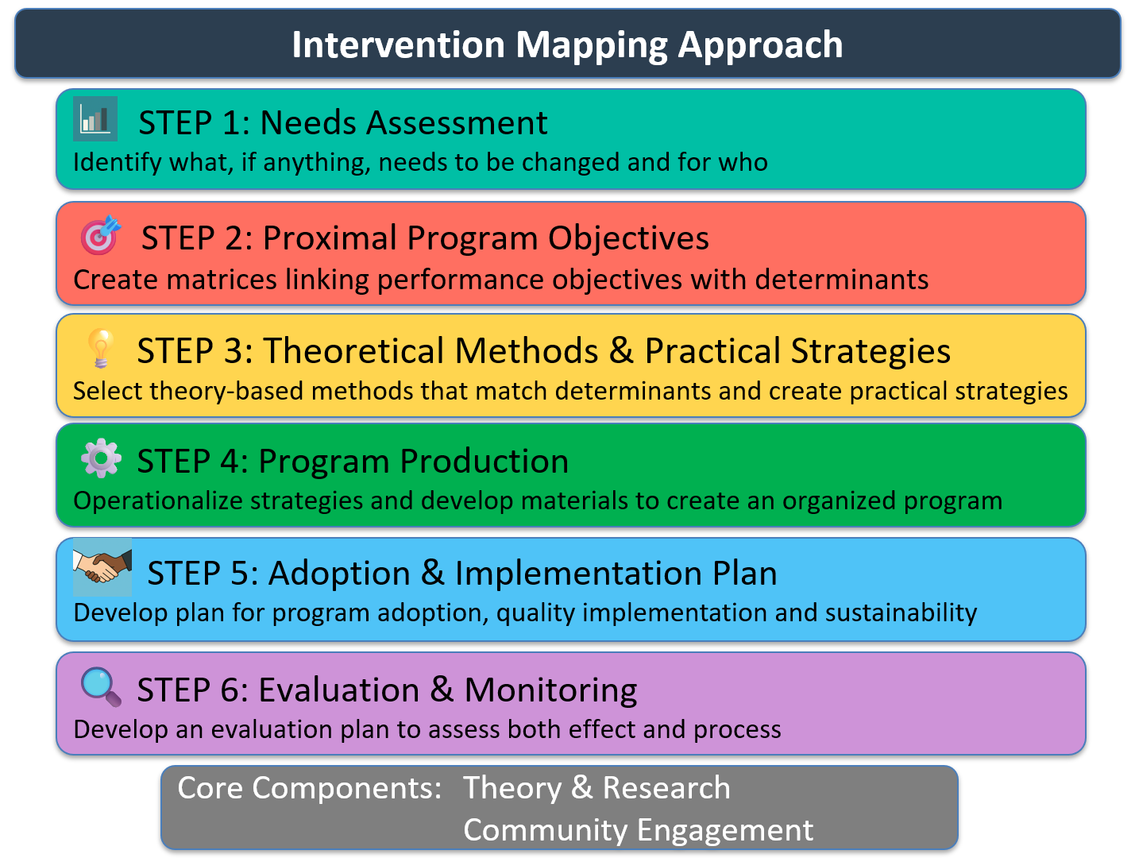
But there was often this huge theoretical leap needed for the actual design & implementation part.
Based on our needs assessment we know there is problem related to STI’s or ethical use of AI.
We also know how to assess STI rates and ethical use of AI after “some intervention”.
Educators & Program Designers were asking things like:
When do I use theory in this process of designing, assessing & improving interventions?
Which theory should I pick?
The Big One: How do I get from this broad distal outcome like decrease STI’s to the specific “things” individuals need to do, feel, know to achieve the outcome?
That lack of clear guidance was a real problem.
Notes:
So practitioners were asking things like: When exactly do I use theory in this process of designing, assessing and improving interventions? Which theory should I pick? And the big one, How do I get from this broad goal like improve community health down to the specific things participants need to do day-to-day? That lack of clear guidance was a real problem.

Slide 10
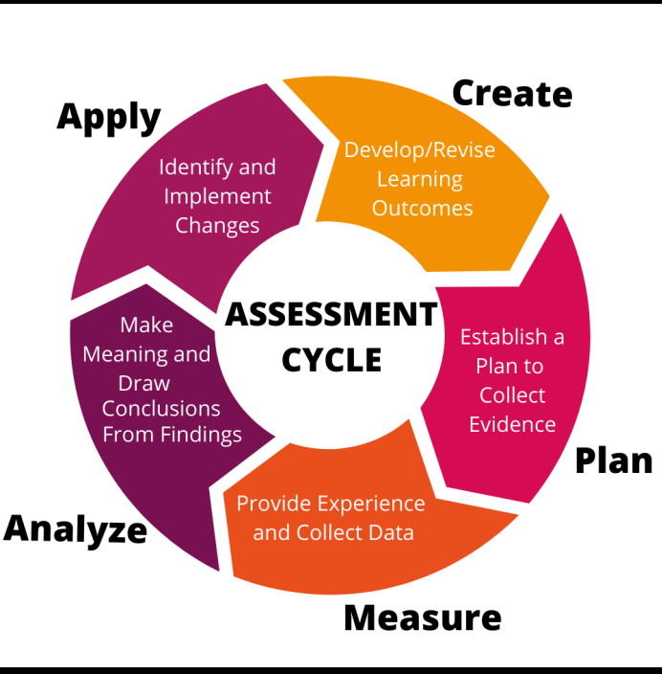
Notes:
These are the SAME questions that SA professionals and faculty ask me when designing, assessing and improving their educational interventions (e.g., courses, programs of study, study abroad experiences, bystander interventions, safer sex education, ethical reasoning programming)
When exactly do I use theory in this process of designing, assessing and improving interventions? Which theory should I pick? How do I get from this broad goal to the specific outcomes participants need?
We can borrow from Intervention Mapping to have a better mechanism to design, assess and improve our intentional educational and development programs.

Slide 11
Intervention Mapping Approach
STEP 1: Needs Assessment
Identify what, if anything, needs to be changed and for who
🎯 STEP 2: Proximal Program Objectives
Create matrices linking performance objectives with determinants
Core metaphor for IM → geographic mapping.
Programmer figures out where they are, specifies the desired destination, plans a route & mechanisms, & implements plan.
IM process always kicks off with thorough needs assessment.
Not just a quick check, as this is the basis for this work.
You need to know where you are regarding outcomes before you can map the route precisely.
You can't chart a course without knowing your starting point & your desired destination in detail.
💡 STEP 3: Theoretical Methods & Practical Strategies
Select theory-based methods that match determinants and create practical strategies
⚙️ STEP 4: Program Production
Operationalize strategies and develop materials to create an organized program
STEP 5: Adoption & Implementation Plan
Develop plan for program adoption, quality implementation and sustainability
🔍 STEP 6: Evaluation & Monitoring
Develop an evaluation plan to assess both effect and process
Core Components: Theory & Research
Community Engagement
Notes:
The core metaphor for IM is geographic mapping.
The planner figures out where they are, specifies the desired destination, plans a route, and execute the plan.
Process always kicks off with a really thorough needs assessment.
That's not just a quick check. It's the foundation.
You need to know where you are before you can map the route precisely.
You can't chart a course without knowing your starting point and your desired destination in detail.

Slide 12
Intervention Mapping Approach
STEP 1: Needs Assessment
Identify what, if anything, needs to be changed and for who
🎯 STEP 2: Proximal Program Objectives
Create matrices linking performance objectives with determinants
💡 STEP 3: Theoretical Methods & Practical Strategies
Select theory-based methods that match determinants and create practical strategies
Get laser focused on who needs to do what specific action & why aren't they doing it now? What's stopping them?
ASK: How is a specific problem/issue (unethical use of AI, high STI rates, low civic engagement, quitting STEM, not engaging in sustainability) produced & maintained?
To decrease STIs, (all) students need to engage in specific actions like using condoms or saying “no” if worried about partner’s status.
These are specific performance objectives → observable actions (measurable).
What are the determinants of behavior (using a condom or saying “no”)?
Personal Determinants: What personal knowledge, beliefs (values, perceptions, self-efficacy) & skills influence the behavior?
Need to know STI’s exist & how transmitted; need to believe they are susceptible & effects of STI’s are serious; need skill using condoms in addition to negotiation skills.
External Determinants: access to condoms, social support (bystanders)
Purpose of Articulating Determinants: identify factors you need to impact via programming
⚙️ STEP 4: Program Production
Operationalize strategies and develop materials to create an organized program
STEP 5: Adoption & Implementation Plan
Develop plan for program adoption, quality implementation and sustainability
🔍 STEP 6: Evaluation & Monitoring
Develop an evaluation plan to assess both effect and process
Core Components: Theory & Research
Community Engagement
Notes:
Step 2: Creating matrices of proximal program objectives. This is foundational.
It's where you move beyond vague hopes like improve decrease STI rates, increase the ethical use of AI, decrease the dropout rate for females in STEM majors or increase sustainability actions of our students.
You get laser focused on who (students) needs to do what specific action (use condoms) and crucially why aren't they doing it now? What's stopping them?
If they aren’t engaging in sustainability actions and that’s a major outcome of the institution to build, why aren’t they? You need to understand why in order to program to those “whys”.
There are two types of theory that inform this step and the next step:
Explanatory Theory: sheds light on the nature of the problem (not engaging in safe sex practices, unethical use of AI, not engaging in sustainability, can’t lead) and helps to identify the determinants or factors that influence that problem and thus the determinants/factors (we would say proximal outcomes) that educator would seek to modify. That is what we are focused on at THIS step. This is the “Theory of the Problem”—how is the specific problem/issue produced and maintained? What do we know about the intrapersonal, interpersonal, organizational and community factors affecting this problem/issue. Purpose of Asking These Questions: pull together what we know about the problem/issue and identify potential points of intervention/programming.
Change Theory: informs the development and implementation of the intervention/program strategies, activities, pedagogy, experiences. That is the NEXT step. This is also called the “Theory of the Intervention”
First example (co-curricular: students affairs with some training in courses)
To decrease STIs, students (I would say all) need to engage in specific actions like using condoms or saying “no”.
This is a specific performance objective that is an observable action (which could be measured).
What are the determinants of the behavior of using condoms? (FYI these are the proximal/intermediate outcomes in our outcomes assessment model)
That is, what are the factors influencing that behavior of using a condom.
Personal Determinants: What personal knowledge, beliefs (values, self-efficacy) and skills influence the behavior?
Providing young people with information about condoms will have little effect unless they have the skills to obtain and use condoms, they are able to be assertive in negotiating condom use with their partners, and condoms are available.
That is, yes, students need to know STI’s exist and how they are transmitted but they also they need to believe they are suspectable, they need to believe the effects of STI’s are serious and they need skills using condoms in addition to negotiation/communication skills.
External Determinants: access to condoms, social support (bystanders)
Second Example (academic):
We want to decrease the irresponsible use of AI in coursework (e.g., full papers written with no checking of information, using it when prohibited).
To decrease irresponsible use of AI, students (I would say all) need to engage in specific actions like checking AI for accuracy.
This is a specific performance objective that is an observable action (which could be measured).
What are the determinants of that behavior?
That is, what are the factors influencing that behavior of checking AI for accuracy.
Personal Determinants: What personal knowledge, beliefs (values, self-efficacy) and skills influence the behavior?
Students need AI literacy (understand how it is generating text), they need to believe that AI produces inaccurate information, and they need skills to critique AI produced products for accuracy.
Another example:
The output here are these detailed tables, these matrices that force you to connect concrete behaviors with their underlying drivers, the determinants.
Let's clarify performance objectives because the source says eat more fruits and vegetables isn't specific enough (too broad). What does a good one look like? A good performance objective breaks it down into observable actions. So for that fruit and vegetable example, maybe substitute fruits or vegetables for junk food snacks after school. That's specific. You can measure it. Or thinking environmentally, the school cafeteria manager will increase the fruit and vegetable choices available in the school lunch menu each school day. Again, very specific, observable.
And then the determinants. What are those? Determinants are the factors influencing that behavior. They can be personal things like knowledge, beliefs, skills, self-efficacy or they can be external social support, access, policies, physical environment. So in the cystic fibrosis program example (CF program), they hypothesize determinants like behavioral capability. Do people have the skills? Self-efficacy, did they believe they could do it? Reinforcement, outcome expectations.
And it's also really important here to differentiate your target population if needed. How? Well, in the CF program, they knew the needs of a young child with CF are very different from an adolescence. So, they differentiated objectives and determinants based on developmental stage. They also made separate matrices for the patients themselves, their parents, and even the healthcare providers because each group had different roles and needed different things.

Slide 13
How do you get from a general method to something tangible you actually use in a program?
It involves brainstorming potential general methods first.
Then you dive into the research literature. You look for empirical evidence of what “works”. Does this method actually influence the specific determinant you're targeting & what are the working parameters.
Working parameters: under what conditions does this method work best with which audience? Is “modeling” more effective via video or in person for this particular group? Then you translate that into practical strategies.
Intervention Mapping Approach
STEP 1: Needs Assessment
Identify what, if anything, needs to be changed and for who
🎯 STEP 2: Proximal Program Objectives
Create matrices linking performance objectives with determinants
💡 STEP 3: Theoretical Methods & Practical Strategies
Select theory-based methods that match determinants and create practical strategies
⚙️ STEP 4: Program Production
Operationalize strategies and develop materials to create an organized program
Methods: the general techniques derived from theory or empirical evidence known to influence those determinants we discussed (evidence-informed practices).
Think of things like role modeling, skill development, persuasive communication, empowerment.
These are broad approaches.
Strategies: the practical concrete ways you actually deliver those methods.
They are the specific activities, tools, materials you use.
Behavior of communicating “no” after gathering information from a partner:
Method is “role modeling”: showing them how others access necessary information about their partner’s health status and then make a decision on if to engage.
Strategy is delivering that role modeling via online videos instead of live in-person.
When offered live in-person, some students were embarrassed to watch, some wanted to see it again, or some were disruptive. Strategy of using videos made the method (watching another student's model behavior) more accessible because it could be watched in private, re-watched, and practiced alone.
So, the strategy is how you package the method for your specific audience and context.
STEP 5: Adoption & Implementation Plan
Develop plan for program adoption, quality implementation and sustainability
🔍 STEP 6: Evaluation & Monitoring
Develop an evaluation plan to assess both effect and process
Core Components: Theory & Research
Community Engagement
Notes:
So our map now has a very precise destination (from needs assessment), the performance objectives to get there, and we've identified the key terrain features (determinants that influence getting there). What's next?
How do we choose the actual route? Selecting theory-based intervention methods, and practical strategies.
Called “Intervention Theories” or “Intervention Models”—statements or summaries of what we know about the relative success of different intervention methods and strategies with particular groups.
IM experts make a really useful distinction here between methods and strategies.
Methods are the general techniques derived from theory or empirical evidence and they're known to influence those determinants we talked about (evidence-informed practices and pedagogy).
Think of things like role modeling, skill development, persuasive communication, community empowerment.
These are broad approaches.
Strategies then are the practical concrete ways you actually deliver those methods.
They are the specific activities, the tools, the materials you use.
How do you get from a general method like you said modeling to something tangible you can actually use in a program?
It involves brainstorming potential methods first.
Then you really dive into the research literature. You look for evidence. Does this method actually work for influencing the specific determinant you're targeting and critically you look at the working parameters.
Working parameters--under what conditions does this method work best with which audience? Is modeling more effective via video or in person for this particular group? Then you translate that into practical strategies.
Behavior of saying “no”.
Determinant of being able to say “no”: skill in collecting necessary information and negotiating with a partner
The method is role modeling--showing them how others access necessary information about their partner’s health status and then making a decision on if to engage.
The strategy became delivering that role modeling via online videos instead of live in person. When offered live in person, some students were embarrassed to watch, wanted to see it again, or were disruptive. The strategy of using videos made the method (watching another student's model behavior) more accessible because it could be watched in private, re-watched, and practiced alone.
So, the strategy is how you package the intervention method for your specific audience and context.
Behavior of saying “no”.
Determinant is the perception of the social norm of not simply complying with request for sex: belief that others in social group ask questions and negotiate behavior.
The method is sharing information about normative behaviors and normative expectations (others ask these questions and others expect you to ask these questions)
The strategy became communicating this information via flyers in the bathroom, videos on TV screens, messaging on the university buses.
So, the strategy is how you package the intervention method to that specific audience in that context.

Slide 14
For the role modeling videos:
Who are the actors: what age, gender, gender pairs.
What is the content of each video: partner is easy to talk with, discloses info, accepts answer vs. partner is offended by questions, don’t provide response, and tries to engage sexually.
At the end of the role modeling, is there an explanation or debrief of what they just saw. For example, how person adapted when the partner didn’t want to answer.
How many videos do the students watch?
How long are the videos?
Intervention Mapping Approach
STEP 1: Needs Assessment
Identify what, if anything, needs to be changed and for who
🎯 STEP 2: Proximal Program Objectives
Create matrices linking performance objectives with determinants
💡 STEP 3: Theoretical Methods & Practical Strategies
Select theory-based methods that match determinants and create practical strategies
⚙️ STEP 4: Program Production
Operationalize strategies and develop materials to create an organized program
STEP 5: Adoption & Implementation Plan
Develop plan for program adoption, quality implementation and sustainability
Actually build “the thing”! Take those strategies & operationalize them.
Design the actual program components: figure out their scope, choose the delivery channels, sequence what comes first, & how long should each component last (FYI, all this needs to be specified to check for implementation fidelity in next step).
Now is when you're creating the actual learning materials, handouts, videos, website content because you first needed to specify the proximal outcomes & identify evidence-based practices & pedagogy.
Now you can design scenarios, scripts, storyboards, powerpoints, whatever it might be.
Critical piece: after producing/choosing materials, they should be pre-tested.
Pre-test with new people from your target audience, not the faculty, staff or students on your development team.
Why not the team? They know it best--too well, potentially.
They may overlook jargon, confusing instructions, or things that just don't resonate because they're so close to it. You need fresh eyes, unbiased feedback to make sure materials are clear, engaging, & actually usable by the people they're intended for.
🔍 STEP 6: Evaluation & Monitoring
Develop an evaluation plan to assess both effect and process
Core Components: Theory & Research
Community Engagement
Notes:
Step 4: Program Production--designing and organizing the program.
Now, you're actually building the thing.
You take those strategies and operationalize them. You design the actual program components, figure out the scope, and sequence what comes first, how long does it last, and you choose your delivery channels (FYI, all this needs to be specified to check for implementation fidelity in next step).
This is where you're creating the actual learning materials, handouts, videos, website content.
Designing scenarios, scripts, storyboards, powerpoints, whatever it might be.
In the role modeling videos:
Who are the actors: what age, gender, gender pairs.
What is the content of each video: partner is easy to talk with, discloses information, accepts answer vs. partner is offended by questions, don’t provide response, and tries to engage sexually.
At the end of the role modeling, is there an explanation or debrief of what they just saw. For example, how the person adapted when the partner didn’t want to answer.
How many videos do the students watch?
How long are the videos?
A really critical piece here: after producing/choosing materials, they are pre-tested.
Pre-test with new people from your target audience, not the faculty, staff or students on your development team.
Why not the team? They know it best, don't they? They know it too well, potentially. They might overlook jargon, confusing instructions, or things that just don't resonate because they're so close to it. You need fresh eyes, unbiased feedback to make sure the materials are clear, engaging, and actually usable by the people they're intended for.

Slide 15
Intervention Mapping Approach
Okay, so we've designed this great program, pre-tested materials, it looks good “on paper”, but how do we make sure it gets used effectively & how do we check this?
Does the programming “on paper” match the programming students experience?
As we all know….
You can have the best program design in the world, but if no one picks it up or if they implement it poorly, it's useless.
Thus, this step focuses on the diffusion process.
How does the program get disseminated?
How do units or individuals decide to adopt it?
Is it implemented well?
How will it be maintained over time?
STEP 1: Needs Assessment
Identify what, if anything, needs to be changed and for who
🎯 STEP 2: Proximal Program Objectives
Create matrices linking performance objectives with determinants
💡 STEP 3: Theoretical Methods & Practical Strategies
Select theory-based methods that match determinants and create practical strategies
⚙️ STEP 4: Program Production
Operationalize strategies and develop materials to create an organized program
STEP 5: Adoption & Implementation Plan
Develop plan for program adoption, quality implementation and sustainability
Involve the people who will eventually adopt & implement the program early in the planning process (faculty, SA pros, department heads, RAs, advisors, health center staff)
Develop an implementation fidelity checklist
Take the program-outcomes mapping and next to each program component indicate its major aspects, delivery method & length; then examine if what occurs “on the ground”
Evaluate student responsiveness & the coherence/clarity of the programming
🔍 STEP 6: Evaluation & Monitoring
Develop an evaluation plan to assess both effect and process
Core Components: Theory & Research
Community Engagement
Notes:
We have laid out:
Theory of the Problem/issue (step 2) that summarizes our knowledge of what determinants and proximal outcomes impact the distal outcome/problem/issue.
Theory of the Intervention (step 3 & 4) that summarizes the evidence-informed programming known to impact the determinants and proximal outcomes and operationalized these into actual on-the-ground programming.
But…knowledge of the problem/issue and knowledge of potential interventions/programming may not necessarily lead to more effective programs on your campus.
That is, after we designed this great program (we may have even pre-tested the materials and it looks good on paper), how do we make sure it actually gets used effectively and how do we check this?
That seems like a common, huge failure point.
Programs can fail due to mismatch with their setting and resources.
For example, we know that programs are more likely to be adopted and implemented well when they are consistent with existing or “normal” organizational practices.
And that's exactly what Step 5 “specifying adoption and implementation plans” is all about.
This step focuses squarely on the diffusion process.
How does the program get disseminated?
How do organizations or individuals decide to adopt it?
How is it implemented well? And how is it maintained over time?
The insight here is you need to plan for this diffusion right from the start. How do you plan for that early on?
A key task is developing a linkage system.
Basically, involve the people who will eventually adopt and implement the program, clinic managers, teachers, community leaders, whoever, early in the planning process.
Get them on the team or consult with them regularly. This builds ownership. They become partners, not just people you dump a program on later.
Like the CF example with the caregivers. Caregivers were on the planning team and they also trained regional coordinators to be program champions. These champions then helped health centers adapt the program locally and create their own tailored implementation plans. It wasn't one-sizefits-all implementation. This step also involves spelling out what the implementers actually need to do. What skills do they need? What resources? How will they coordinate? It's about paving the way for the program to actually happen in the real world. Planning for use, not just design.

Slide 16
Intervention Mapping Approach
Products created in earlier steps (proximal objectives, determinants, strategies)
aren't just for building programming→ they become tools for evaluating it.
You are building the assessment framework as you go.
Proximal program objectives from Step 2 are blueprints for your measurement tools. The proximal performance objectives tell you exactly what behavioral outcomes to measure (e.g., using a condom) in addition to the distal outcome (lower STI rates).
Determinants from Step 2 tell you which knowledge, skills & beliefs (e.g., perceptions of susceptibility & severity, knowledge of STI’s, communication skills) to assess. FYI, greater change is expected & typically found for determinants than proximal program outcomes & for proximal outcomes than distal outcomes. Thus, it is important to assess all these outcomes to make an accurate statement about program effectiveness.
So, the IM steps makes evaluating the impact of programming much more systematic & tied directly to the program's logic.
STEP 1: Needs Assessment
Identify what, if anything, needs to be changed and for who
🎯 STEP 2: Proximal Program Objectives
Create matrices linking performance objectives with determinants
💡 STEP 3: Theoretical Methods & Practical Strategies
Select theory-based methods that match determinants and create practical strategies
⚙️ STEP 4: Program Production
Operationalize strategies and develop materials to create an organized program
STEP 5: Adoption & Implementation Plan
Develop plan for program adoption, quality implementation and sustainability
🔍 STEP 6: Evaluation & Monitoring
Develop an evaluation plan to assess both effect and process
Want to collect data to not only answer “Does it work?” but also: “How does it work?” “What program components are necessary to achieve change in which outcome?” “Can it be implemented in this context?” “Who is it not working for?”
Core Components: Theory & Research
Community Engagement
Notes:
And what's elegant about intervention mapping is how all this work feeds directly into the final step, step six, generating program evaluation plans.
Products created in the earlier steps, those detailed objectives, determinants, strategies, they aren't just for building the program, they become your tools for evaluating it.
You are building the evaluation framework as you go.
Those matrices of proximal program objectives from step 1, they're basically blueprints for your measurement tools. The performance objectives tell you exactly what behaviors or environmental changes to measure.
The determinants tell you which underlying factors like self-efficacy or knowledge you need to assess. And the specific change objectives can even give you content ideas for survey questions or observation checklists. So it makes evaluation much more systematic and tied directly to the program's logic.
If you ONLY measure the distal outcome, you may conclude your programming was ineffective whereas it actually changed the determinants and the proximal outcomes. This may indicate some other supports are necessary beyond this programming to achieve the distal outcome. In short, avoid designing assessment/evaluation processes that are insufficiently sensitive to detect change in students, which may be because you aren’t focusing on all appropriate variables that are impacted by the program (determinants, proximal outcomes, distal outcomes).
--should probably show a couple logic models at this point: safe sex? Sustainability (lots of good theory on that students need to know things, but also need to value/believe thing, and then have skills, etc).
It really facilitates thoughtful formative evaluation too. That's the evaluation you do during the program roll out.
Are people actually understanding the key messages? Are the activities engaging?
Formative evaluation lets you check your assumptions and make adjustments along the way using real-time feedback. It also helps you set realistic timelines.

Slide 17
Intervention Mapping Approach: Advance Environmental Sustainability
Environmental Learning/Knowledge Outcomes
JMU Undergraduates will:
Recognize the interdependence of humans and the environment.
Understand the interconnection between the health, ecological, socio-economic and ethical aspects of issues.
Identify elements of natural systems that are pertinent to environmental problems and potential solutions.
Understand how environmental stewardship is and can be integrated into our lives.
Step 1
NEEDS ASSESSMENT:
Administer sustainability surveys, identify barriers & social norms about sustainable behavior
Step 2
PROXIMAL PROGRAM OBJECTIVES:
Increase recycling consistency, reduce water use, choose alternative forms of transportation
Step 3
THEORETICAL METHODS/PRACTICAL STRATEGIES:
Identify evidence-based methods that address determinants identified in step 2
JMU President Key Goal:
“The university will be an environmentally literate community whose members, individually and collectively, advance environmental sustainability.” Environmental literacy is defined by the Virginia Department of Education as “having the knowledge, skills and dispositions to solve problems and resolve issues individually and collectively that sustain ecological, economic and social stability.”
Step 4
PROGRAM PRODUCTION:
Informational/ educational campaigns to increase recycling, reduce water waste, increase alternative forms of transportation
Step 5
ADOPTION & IMPLEMENTATION PLAN
Identify facilitators and stakeholders/partners, determine when the program will occur, promote the program
Step 6
EVALUATION & MONITORING
Administer surveys after the intervention has occurred; assess changes from step 1
Notes:
Thanks so much for that detailed overview, Sara. Now, let’s walk through two examples of intervention mapping, step by step, using concrete, real issues that exist on higher education campus . First, let’s Suppose the university wants to students to advance environmental sustainability.
Sustainability is a key outcome/behavior at our campus. It’s one of the presidents key goals of the academic year!
As function of JMU programming, students behaviors, attitudes and knowledge of sustainability should be changed to advance environmental sustainability. For example, here are JMU’s knowledge/learning outcomes.
Our leadership wants students to engage in sustainability which necessitates a co-curricular approach...but also learned in classes.
Bring up learning community/residence hall. On our campus, sustainability is an important outcome. students are assessed on their Environmental Stewardship Reasoning and Knowledge on a university-wide assessment day.
Environmental sustainability can be defined in a multitude of ways, but for the purposes of this example we are focusing on changing 3 behaviors: increasing recycling, reducing water usage (wasteful water overconsumption), and using alternative forms of transportation (as opposed to commuting alone in a vehicle).

Slide 18
Intervention Mapping Approach: Advance Environmental Sustainability
Step 1
NEEDS ASSESSMENT
What, if anything, needs to be changed and for who?
Assess students knowledge, perceptions, values, and engagement in environmental stewardship
JMU university-wide assessment day: Pro-environmental behaviors survey and Environmental Stewardship Reasoning & Knowledge Assessment (ESRKA)
Survey students to assess water usage^{1,2}, recycling habits^{2,3}, and transportation choices⁴.​
Are all students equally sustainable?
What barriers contribute to un-sustainable environmental behavior?
Identify common misconceptions about sustainability⁵.
What do students believe about environmental sustainability?
How well do their beliefs align with reality?
¹Reddy, R. A., Sengupta, R., Jackson, B. M., & Lewis, C. (2023). Development of a new measure to check attitude towards water conservation✰. MethodsX, 10, 101992.
²García-Valiñas, M., Arbués, F., & Balado-Naves, R. (2023). Assessing environmental profiles: An analysis of water consumption and waste recycling habits. Journal of Environmental Management, 348, 119247.
³Ojala, M. (2008). Recycling and Ambivalence: Quantitative and Qualitative Analyses of Household Recycling Among Young Adults. Environment and Behavior, 40(6), 777-797. https://doi.org/10.1177/0013916507308787 (Original work published 2008)
⁴Redding, C. A., Mundorf, N., Kobayashi, H., Brick, L., Horiuchi, S., Paiva, A. L., & Prochaska, J. O. (2014). Sustainable transportation stage of change, decisional balance, and self-efficacy scale development and validation in two university samples. International Journal of Environmental Health Research, 25(3), 241–253. https://doi.org/10.1080/09603123.2014.938025
⁵Robelia, B., & Murphy, T. (2011). What do people know about key environmental issues? A review of environmental knowledge surveys. Environmental Education Research, 18(3), 299–321. https://doi.org/10.1080/13504622.2011.618288
Notes:
JMU conducts a needs assessment by asking incoming students about their sustainability behaviors and perceptions and assessing their incoming sustainability knowledge. This needs assessment aligns with the president’s goal of to advance environmental sustainability! Results showed that students do not understand the actual impact of sustainability actions on the climate (they over or under estimate the impact of each action). They also could not meet the following (knowledge outcomes ~65% on average):
Recognize the interdependence of humans and the environment.
Understand the interconnection between the health, ecological, socio-economic and ethical aspects of issues.
Identify elements of natural systems that are pertinent to environmental problems and potential solutions.
Understand how environmental stewardship is and can be integrated into our lives.
But, at your campus, you may want to administer surveys on recycling, water usage, and transportation choices (these surveys already exist and surveys that assess these behaviors are cited below)
In general at any campus, a needs assessment might include surveys on water use, recycling, or transportation habits. We could also examine campus operations—waste reports, recycling data—and identify common misconceptions about sustainability. Again, the question is: What needs to be changed, and for whom? These needs assessments will provide valuable insights and answer questions such as – how sustainable are the students at your school? Are all students equally sustainable? What barriers contribute to un-sustainable behavior? (this question could be answered via focus groups). All studies cited contain scales that include the full list of items that measure recycling, water usage, and/or transportation. I’m providing multiple measures to indicate to attendees that they do not need to create these materials themselves – many people have studied and measured determinants/antecedents of recycling behavior.

Slide 19
Intervention Mapping Approach: Advance Environmental Sustainability
Step 2
PROXIMAL PROGRAM OBJECTIVES
Create matrices linking performance objectives with determinants
Determinants
Performance Objectives
What influences the performance objective (e.g., knowledge, skills, attitudes, or social norms)?
What do we want the target population to be able to do in order to advance environmental sustainability?
Change Objective
What needs to change in each determinant to achieve the specific performance objective?
Notes:
In Step 2, we move to proximal program objectives. Here, we first want to identify our performance objectives – or the things that we want our target population to be able to do as a result of our intervention in order to achieve the distal/ultimate outcome of advancing environmental sustainability. To achieve increased sustainability lifestyles, performance objectives might include things such as wanting students to recycle consistently or reduce water overconsumption. Next, we want to specify our determinants – or the knowledge, attitudes, skills, social norms – that influence the performance objectives. Finally, we have our change objectives. Change objectives specify what needs to change in each determinant to achieve the performance objective. Here, we're specifying how students' knowledge needs to change to achieve the performance objective, or how students attitudes or social norms need to change.
I'm showing these three components in a process format here, but it is typically organized in a matrix format

Slide 20
Intervention Mapping Approach: Advance Environmental Sustainability
Step 2
PROXIMAL PROGRAM OBJECTIVES
Create matrices linking performance objectives with determinants
Ajzen’s Theory of Planned Behavior¹
Perceived Behavioral Control
Behavior
Attitude Toward the Behavior
Subjective Norms about the Behavior
Behavioral Intention
¹Ajzen, I. (1991). The theory of planned behavior. Organizational Behavior and Human Decision Processes, 50, 179-211.
Notes:
We are going to create the matrix, which I will show in two slides, but I want to show a theory/model that helps explain the specific targeted behaviors/performance objectives (recycling, reducing water or overconsumption). In order to engage in the behavior, they need to....
In order for students to advance environmental sustainability (distal/ultimate outcome), we need to have students engage in particular proximal behaviors like recycling. So, here's a theory that's often applied to help us understand why people do or do not engage in a particular behavior which is one step towards engaging in sustainable behavior
Here, Ajzen’s Theory of Planned Behavior is especially relevant. This theory posits that the occurrence of a particular behavior is primarily determined by behavioral intention. Moreover, the intention of an individual to perform that particular behavior is in turn determined by three conceptually distinct constructs: attitudes toward the act (evaluation of positive or negative outcomes of performing a specific behavior), perceived normative pressure (beliefs about whether people would approve of the behavior being performed), and perceived behavioral control (individual’s perception of how challenging it is to perform a specific behavior).

Slide 21
Intervention Mapping Approach: Advance Environmental Sustainability
Step 2
PROXIMAL PROGRAM OBJECTIVES
Create matrices linking performance objectives with determinants
Ajzen’s Theory of Planned Behavior^{1,2,3}
Perceived Behavioral Control Towards Recycling
Recycling
Attitude Toward Recycling
Subjective Norms about Recycling
Intention to Recycle
¹Ajzen, I. (1991). The theory of planned behavior. Organizational Behavior and Human Decision Processes, 50, 179-211.
²Cheung, S. F., Chan, D. K.-S., & Wong, Z. S.-Y. (1999). Reexamining the Theory of Planned Behavior in Understanding Wastepaper Recycling. Environment and Behavior, 31(5), 587-612. https://doi.org/10.1177/00139169921972254 (Original work published 1999)
³Gibson, K. E., Lamm, A. J., Lamm, K. W., & Holt, J. (2023). Integrating the theory of planned behavior and motivation to explore residential water-saving behaviors. Water, 15(17), 3034.
Notes:
For example, we can use TOPB to discuss a proximal behavior like recycling. If we can change their reyclying behavior, we are closer to our main goal of students advancing environmental sustainability. So, let’s focus on that proximal outcome of recycling.
According to the TOPB, the biggest predictor of recycling is increasing students’ intentions to recycle. And, their intentions are impacted by three things: they need to perceive that recycling is beneficial for the environment/reducing their carbon footprint, they need to perceive that other students approve of/endorse recycling, and they need to perceive that recycling is easy/feasible/not too much of a hindrance on their daily lives
Using the example of recycling, but we then can substitute the behavior with reducing water usage or using alternative forms of transportation like walking, biking, carpooling, or using the bus—whatever behaviors we need to change to meet our ultimate goal of students advancing environmental sustainability.
There are two studies I cite in the bottom of this slide that have use TOPB to increase recycling and reduce water usage!

Slide 22
Intervention Mapping Approach: Advance Environmental Sustainability
Step 2
PROXIMAL PROGRAM OBJECTIVES
Create matrices linking performance objectives with determinants
Performance Objective #1: Students will recycle consistently
Determinant | Change Objective
Attitudes | Students will believe that recycling is important and beneficial⁴.
Social Norms | Students will perceive that their peers support recycling⁵.
Perceived Control | Students will believe they can engage successfully in recycling^{3.}
Knowledge | Students will Identify what materials can be recycled¹. Recognize the interdependence of humans and the environment. Understand the interconnection between the health, ecological, socio-economic and ethical aspects of issues. Identify elements of natural systems that are pertinent to environmental problems and potential solutions. Understand how environmental stewardship is integrated into our lives.
Skills | Students will learn how to sort waste and recyclables^{1,2}.
¹Xia, Z., Gu, Y., Li, J., Xie, J., Liu, F., Wen, X., ... & Zhang, C. (2023). Do behavioural interventions enhance waste recycling practices? Evidence from an extended meta-analysis. Journal of Cleaner Production, 385, 135695.
²Samaranayake, D. I. J., & Thennakoon, R. S. (2021). Could behavioural nudges improve the accuracy of waste sorting? An experimental survey. Environment and Pollution, 10(1), 1-14.
³Noh, M. (2024). Investigating the Relationship between Recycling/Reuse Knowledge and Recycling/Reuse Intention: The Moderating Role of Self-Efficacy. Sustainability, 16(14), 6099.
⁴McCarty, J. A., & Shrum, L. J. (1994). The recycling of solid wastes: Personal values, value orientations, and attitudes about recycling as antecedents of recycling behavior. Journal of business research, 30(1), 53-62.
⁵Nigbur, D., Lyons, E., & Uzzell, D. (2010). Attitudes, norms, identity and environmental behaviour: Using an expanded theory of planned behaviour to predict participation in a kerbside recycling programme. British journal of social psychology, 49(2), 259-284. https://doi.org/10.1348/014466609X449395
Notes:
That model I showed in the prior slide (TOPB) can be layed out in a matrix like this... attitudes, social norms, and perceived control are components of TOPB and the behavior is recycling...we also believe that skills/attitudes are important.
What IM does is it takes model and puts in in a matrix and adds additional components (knowledge/skills).
Set perceived control/attitudes/social norms in a diff color (TOPB helped us lay these out). But, in order to recycle they need to have knowledge/skills (stuff that's taught in science courses). These (point) are JMU’s knowledge/learning outcomes pertaining to environmental sustainability that were shown on the first slide of this example! – Part of president’s key goals!
There would be a matrix like this for each proximal performance objective (water consumption, etc.). I could/should have included as well but I won’t include here in the interest of time.
Let’s say one of our performance objective is that we want students to consistently recycle. We would then articulate the determinants and change objectives. Just like in the STI example, we map out what influences the targeted behavior. In order for students to recycle consistently, they need to know....learn...feel....etc.

Slide 23
Intervention Mapping Approach: Advance Environmental Sustainability
Step 3
THEORETICAL METHODS/PRACTICAL STRATEGIES
Select theory-based methods that match determinants and create practical strategies
Successful methods & strategies for all proximal outcomes
Embed curriculum into Physical and Natural Science courses
Students who met Physical/Natural Science Gen Ed requirement demonstrate higher environmental stewardship compared to those who have not taken courses
Method = Project-Based Learning; Strategy = design zero-waste campus initiative
Method = Simulation; Strategy = simulation to model sustainability tradeoffs
Method = Experiential Learning; Strategy=contribute to local conservation projects
Co-curricular Approaches
Method = Access to Options to Increase Sense of control; Strategies = Make recycling bins easily accessible, make alternative transportation inclusive and explain benefits of carpooling, show routes for walking, cycling, and taking bus⁴.
Method = Re-calibrate Social Norms; Strategies= display informational posters/send pro-environmental messages to promote recycling, water conservation, and alternative forms of transportation
Discussion
Align successful methods with the determinants identified in step 2 (increase self-efficacy, demonstrating correct recycling behavior)
Invite sustainability/environmental professors to share & discuss techniques
¹Cheung, T. Y., Fok, L., Cheang, C. C., Yeung, C. H., So, W. M. W., & Chow, C. F. (2018). University halls plastics recycling: a blended intervention study. International Journal of Sustainability in Higher Education, 19(6), 1038-1052.
²Gherheș, V., & Cernicova-Buca, M. (2025). Reducing Water Consumption on a Student Campus Through Communication Campaigns. Sustainability, 17(2), 680.
³ Zhou, J. (2016). Proactive sustainable university transportation: Marginal effects, intrinsic values, and university students’ mode choice. International Journal of Sustainable Transportation, 10(9), 815–824. https://doi.org/10.1080/15568318.2016.1159357
⁴Rose, G. (2008). Encouraging sustainable campus travel: Self-reported impacts of a university TravelSmart initiative. Journal of Public Transportation, 11(1), 85-108.
Notes:
What types of existing sustainability programs are effective?
Recycling behavior is increased when recycling bins are easily accessible to students (i.e., placed in their residence hall) and when informational posters are used to promote and encourage recycling¹
A communication campaign was effective in impacting college students’ intentions to waste water (e.g., pro-environmental messages delivered via text messaging and displayed on TV monitors in residence halls/reception halls)²
Additionally, providing information (e.g., via flyers) that (1) explain the benefits of carpooling, (2) show routes for walking, cycling, and taking the bus, and (3) provide bus vouchers, may impact students’ intentions of using alternative forms of transportation⁴.
& determine which methods we can feasibly implement
-Recycling – poster campaigns were effective as well as increasing access to recycle bins
-Water waste -
Sustainable transportation – a study conducted at a university in LA (a car-dominated city) found that reliable, accessible, and affordable transit services can directly entice more students to use such services. Female students are less likely to walk or bike to campus for understandable safety concerns. Thus, it is encouraged for them to bike with other trusted students to campus.
Then, discuss….

Slide 24

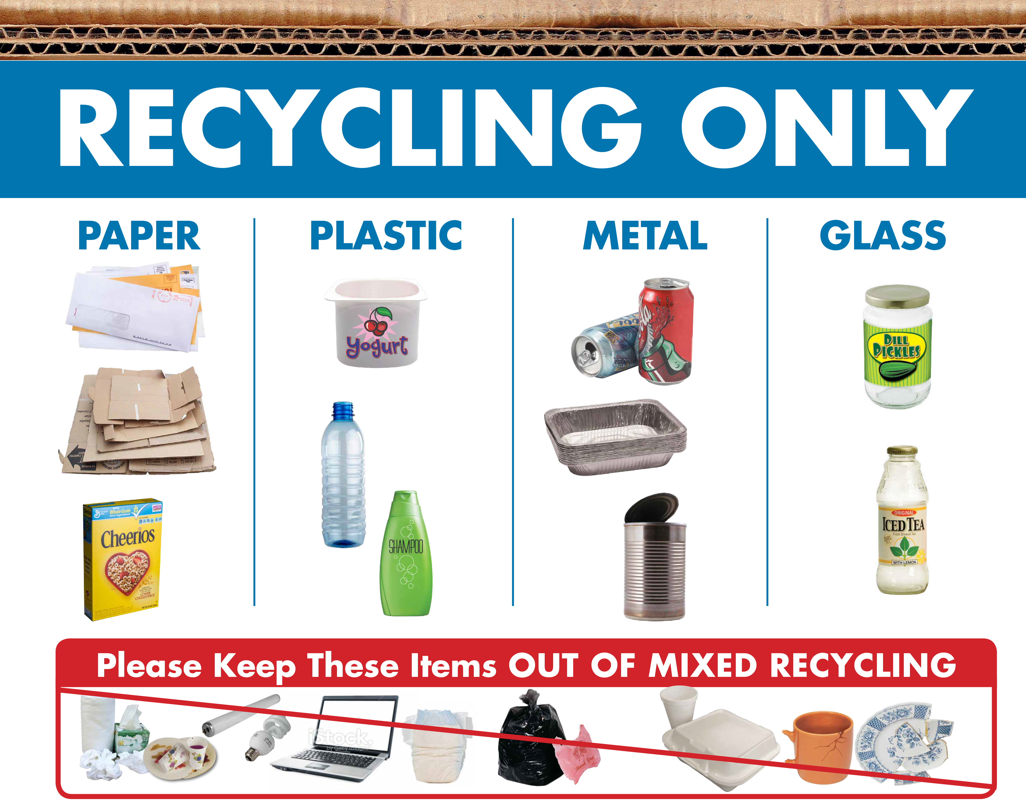
Intervention Mapping Approach: Advance Environmental Sustainability
Step 4
PROGRAM PRODUCTION
Operationalize strategies and develop materials to create an organized program
Create Program Components:
Physical/Natural Science Courses: faculty create syllabi, course packets, activities, projects & materials for in-class & out-of-class experiences
Co-Curricular approaches: Informational poster(s), pro-environmental messages/push notifications, recycling bins, flyers promoting carpooling/alternative forms of transportation
Pilot-test Phase
Recruit undergraduate students to provide feedback on the efficacy of program features & curriculum
Notes:
In Step 4, we develop materials to create our program: designing posters, distributing bins, creating flyers for carpooling, drafting pro-environmental messages. And again, we pilot-test with students to refine materials and check how well our intervention resonates with our intended audience.

Slide 25
Intervention Mapping Approach: Advance Environmental Sustainability
Step 5
ADOPTION & IMPLEMENTATION PLAN
Develop plan for program adoption, quality implementation and sustainability
Before the program can be implemented, it is essential to determine…
Who are the stakeholders or partners that support the program (e.g., faculty of natural/physical sciences courses, RAs of environmental stewardship learning communities, campus sustainability offices, philanthropic student organizations)?
When and how often will the program occur?
Course-embedded material – required gen ed courses in Physical/Natural Sciences
Embedded into yearly first-year student orientation
How will the program sustain funding?
Important to have faculty and leadership buy-in
Notes:
Need to bring the faculty aspect here—we have courses that target these outcomes(faculty need to coordinate their messaging and concepts covered in their courses). Step 5, again, asks how the program will be adopted and sustained. Here, we’d involve campus sustainability offices, student orgs, and faculty allies early in the process. We’d also plan when interventions occur—perhaps orientation, then mid-semester reminders. And of course, we’d consider how to sustain funding and leadership buy-in.
Include learning outcome about sustainability.

Slide 26
Intervention Mapping Approach: Advance Environmental Sustainability
Step 6
EVALUATION & MONITORING
Develop an evaluation plan to assess both effect and process
It is important to measure determinants, proximal (i.e., performance) objectives/outcomes, and distal outcomes
Determinant | Change Objective
Attitudes | Students will believe that recycling is important and beneficial⁴.
Social Norms | Students will perceive that their peers support recycling⁵.
Perceived Control | Students will believe they can engage successfully in recycling^{3.}
Knowledge | Students will know what materials can be recycled¹.
Skills | Students will learn how to sort waste and recyclables^{1,2}.
Performance Objective #1: Students will recycle consistently
Notes:
Finally, Step 6 is evaluation. We must assess not only distal outcomes, but also proximal outcomes. Measuring across levels gives us insight into whether the program is working, how it’s working, and for whom it’s working.
The measures were designed by JMU faculty. Both the Environmental Stewardship Reasoning and Knowledge Assessment items and the Environmental Behavior items were derived from the literature and match the courses textbooks and curriculum.

Slide 27
University-wide Initiative to Increase Environmentally Sustainable Behavior
Step 1 (Needs Assessment): Surveys administered to students to better understand behaviors (recycling habits, water usage, transportation choices) and perceptions (attitudes towards environmental conservation) would reveal the extent to which students engage in and value environmental sustainability.
Step 2 (Matrices). A key proximal outcome for promoting sustainable behavior is consistent recycling. Relevant determinants include students’ accuracy identifying recyclable materials and recycling processes, ability to explain the environmental benefits of recycling, perceived social norms regarding peer behavior, and attitudes toward recycling. Change objectives might involve increasing students’ knowledge of how to sort recyclables from waste, strengthening positive attitudes toward recycling, and shifting social norms so that students perceive recycling as popular and valued among peers.
Step 3 (Methods & Strategies): Educators select evidence-based methods of change and translate them into concrete strategies that influence determinants and performance objectives. For example, in Physical and Natural Science courses, project-based learning strategies (e.g., designing zero-waste campus initiatives) and simulation methods (e.g., modeling sustainability tradeoffs) help students practice applying concepts. Faculty might also apply experiential learning methods via strategies like involving students in local conservation projects. Beyond the classroom, educators can recalibrate social norms (a method) to shift students’ perceptions of what is typical and expected on campus. This method can be operationalized through strategies such as displaying informational posters about recycling or sending messages highlighting campus commitments to water conservation.
Step 4 (Design). Educators now develop the materials explicated in Step 3 and pre-test materials to ensure clarity, relevance, and alignment with targeted performance objectives. Faculty teaching Physical and Natural Science courses design the course materials that integrate sustainability concepts. In the co-curricular space, materials such as informational posters, pro-environmental messages, and flyers promoting alternative transportation (e.g., carpooling) are created and tested.
Step 5 (Implementation). Successful implementation requires collaboration and buy-in among faculty, campus sustainability offices, and student affairs professionals. Before implementation, it is essential to identify stakeholders (e.g., faculty of science courses, staff in sustainability offices, residence hall staff working in the environmental sustainability learning community) and determine program frequency and timing. For instance, programming can be embedded into key touchpoints such as first-year orientation and required general education courses. Fidelity checklists can then be used to monitor whether the programming is delivered as intended in both curricular and co-curricular contexts.
Step 6 (Evaluation). Evaluation involves collecting data on determinants (e.g., knowledge & attitudes about recycling), proximal outcomes (e.g., self-reported recycling), and distal outcomes (e.g., campus waste management reports). Early findings can guide adjustments to course-embedded curriculum, orientation programs, or messaging strategies to improve program effectiveness.
Notes:
IM can be summarized on 1-page for a university-wide initiative!!

Slide 28
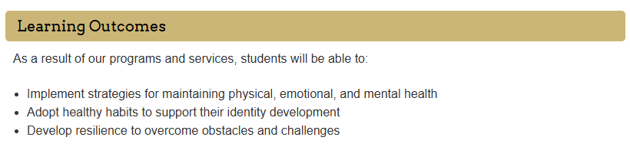
Intervention Mapping Approach: STI Reduction
Step 1
NEEDS ASSESSMENT:
Identify STI prevalence, consult with campus health center
Administer risk survey, conduct focus group
Step 2
PROXIMAL PROGRAM OBJECTIVES:
To decrease STI rates (distal outcome), need to increase STI knowledge, increase availability of protection
Step 3
THEORETICAL METHODS/PRACTICAL STRATEGIES:
Identify evidence-based methods that address determinants identified in step 2
Step 4
PROGRAM PRODUCTION:
Create & pilot-test program components (videos, scenarios) with members of intended audience group
Step 5
ADOPTION & IMPLEMENTATION PLAN
Identify facilitators & stakeholders/partners, determine when the program will occur, promote the program
Step 6
EVALUATION & MONITORING
Administer risk survey and determine STI prevalence after the intervention; assess changes from step 1
Notes:
Another key outcome is that students will engage in behaviors that will promote their physical /mental well-being including sexual health. One thing that groups on our campus is focused on is STIS. The sti rate on our campus was shocking (20% test positivity rate). So, we need effective programming to meet that outcome and improve this problem. Part of the student affairs strategic plan is focused on physical health, which involves sexual health/wellness
Several studies (including Wolfers et al (2007) and Bertens et al (2009) have developed IM for reducing STI rates. So, this is really not new, but we are using different theoretical models/needs assessments than the prior studies.

Slide 29
Intervention Mapping Approach: STI Reduction
Step 1
NEEDS ASSESSMENT
What, if anything, needs to be changed and for who?
Consult with campus health center/local medical provider to identify the prevalence of STI rates among undergraduate students
Administer surveys (e.g., course-embedded needs assessment) to measure:
Frequency of risky sexual behaviors¹ and
Knowledge of sexually transmitted diseases²
Conduct focus groups with students to better understand their knowledge/perceived risk of STIs and why they may avoid or delay using sexual health services³
¹Turchik, J.A., Garske, J.P. Measurement of Sexual Risk Taking Among College Students. Arch Sex Behav 38, 936–948 (2009). https://doi.org/10.1007/s10508-008-9388-z
²Jaworski, B. C., & Carey, M. P. (2007). Development and psychometric evaluation of a self-administered questionnaire to measure knowledge of sexually transmitted diseases. AIDS and behavior, 11(4), 557–574. https://doi.org/10.1007/s10461-006-9168-5
³Cassidy, C., Bishop, A., Steenbeek, A., Langille, D., Martin-Misener, R., & Curran, J. (2018). Barriers and enablers to sexual health service use among university students: a qualitative descriptive study using the Theoretical Domains Framework and COM-B model. BMC health services research, 18(1), 581. https://doi.org/10.1186/s12913-018-3379-0
Notes:
Step 1 is the needs assessment. Here, we would partner with the campus health center to identify the current STI prevalence among students at our school. We’d also administer surveys to measure things like sexual risk-taking behaviors and STI knowledge, and hold focus groups to better understand perceptions about STIs and potential barriers to using health services. The key question at this step is always: What, if anything, needs to be changed, and for whom?"
Step 1: Needs Assessment
Identify health problems, determinants, and target populations. Guidance: - Conduct surveys, focus groups, and interviews with the target population to identify prevalent health issues. - Review existing health data and literature to understand determinants of the identified health problems. - Define the target population based on demographic, geographic, and behavioral characteristics. Example (STI Prevention):
Conduct surveys and focus groups with college students to identify the prevalence of STIs and risky sexual behaviors. Review health data from campus health services and existing literature to understand determinants such as lack of knowledge about safe sex practices, peer pressure, and alcohol use. Define the target population as college students aged 18-24 who are sexually active.

Slide 30
Intervention Mapping Approach: STI Reduction
Step 2
PROXIMAL PROGRAM OBJECTIVES
Create matrices linking performance objectives with determinants
Health Belief Model (HBM)
Perceived Susceptibility
Perceived Severity
Perceived Benefits
Perceived Barriers
Students need to perceive that they are susceptible to contracting STIs
Students need to perceive that STIs can cause severe negative consequences if left untreated
Preventing and treating STIs must be perceived as effective and feasible
Cost-benefit analysis: is preventing/treating STIs perceived as inconvenient, expensive, or unpleasant?
¹Janz, N. K., & Becker, M. H. (1984). The Health Belief Model: A decade later. Health Education Quarterly, 11(1), 1–47. https://doi.org/10.1177/109019818401100101
²Rosenstock IM. Historical Origins of the Health Belief Model. Health Education Monographs. 1974;2(4):328-335. doi:10.1177/109019817400200403
³Downing-Matibag, T. M., & Geisinger, B. (2009). Hooking up and sexual risk taking among college students: a health belief model perspective. Qualitative health research, 19(9), 1196–1209. https://doi.org/10.1177/1049732309344206
⁴Champion, V. L., & Skinner, C. S. (2008). The health belief model. Health behavior and health education: Theory, research, and practice, 4, 45-65.
Notes:
Just like with the sustainability example, there is a theoretical model that can help explain why or why not students may engage in a desired behavior. The health-belief model contains several dimensions that explain the perceptions an individual must endorse in order to engage in a health-related behavior (for example, preventing STIs)
Specifically, in order to engage in safe sex practices, students need to perceive that they are susceptible to contractiting STIs, they need to perceive that STIs can cause severe negative consequences if left untreated, they need to perceive that preventing/treating STIs is effective and feasible, and they need to perceive that preventing/treating STIs is worth the ‘inconvenience’ or expense.

Slide 31
Intervention Mapping Approach: STI Reduction
Step 2
PROXIMAL PROGRAM OBJECTIVES
Create matrices linking performance objectives with determinants
Performance Objective #1: Students will use condoms consistently¹
Determinant | Change Objective
Perception of Susceptibility | Students will perceive they are susceptible to contracting STIs
Perception of Severity | Students will perceive that STIs can cause severe consequences
Perception of Benefits | Students will believe that using condoms is important and beneficial
Perception of Barriers | Students will believe that preventing/treating STIs is ‘easy’/simple
Social Norms | Students will perceive that their peers endorse condom use^{3,4}
Knowledge | Students will know how STIs are transmitted and prevented²
Skills | Students will demonstrate correct condom use²
Self-Efficacy | Students will feel confident in their ability to use condoms correctly²
¹Marfatia, Y. S., Pandya, I., & Mehta, K. (2015). Condoms: Past, present, and future. Indian journal of sexually transmitted diseases and AIDS, 36(2), 133–139. https://doi.org/10.4103/0253-7184.167135
²Whiting, W.S., Pharr, J.R., Buttner, M.P., & Lough, N. (2019). Behavioral Interventions to Increase Condom Use Among College Students in the United States: A Systematic Review. Health Education & Behavior, 46, 877 - 888.
³O’Grady, M.A., Wilson, K. & Harman, J.J. Preliminary Findings from a Brief, Peer-Led Safer Sex Intervention for College Students Living in Residence Halls. J Primary Prevent 30, 716–731 (2009). https://doi.org/10.1007/s10935-009-0195-7
⁴Sanderson, C. A., & Yopyk, D. J. A. (2007). Improving condom use intentions and behavior by changing perceived partner norms: An evaluation of condom promotion videos for college students. Health Psychology, 26(4), 481–487. https://doi.org/10.1037/0278-6133.26.4.481
Notes:
Our performance objective is consistent condom use, because, unsurprisingly, consistent condom use is associated with reduced STI rates. We have determinants (point at determinants) and change objectives (point at determinants) in our matrix table presented under the performance objective.
What do students need to know to use condoms effectively? – They need to know how STIs are transmitted & how condoms prevent transmission
What skills do students need to have to use condoms consistently? – They need to know how to put them on/use them
Moving down the row, Increased self-efficacy regarding using condoms correctly is also linked with using condoms more consistently
Students also need to feel that using condoms is important and beneficial
Finally, if students perceive that their peers endorse condom use, they are more likely to use condoms consistently.
State that there are other performance objectives I could/should have included as well (e.g., students will communicate with their partners about using protection and boundaries) but I won’t include here in the interest of time.

Slide 32
Intervention Mapping Approach: STI Reduction
Step 3
THEORETICAL METHODS/PRACTICAL STRATEGIES
Select theory-based methods that match determinants and create practical strategies
Inventory of successful methods & strategies
Embed curriculum into general education Health courses
Method = Simulation to correct social norms and teach negotiation skills; Strategy 1 = students create educational videos of acceptable normative behavior; Strategy 2 = role-playing techniques for negotiation and discussion
Method = correct misconceptions about susceptibility; Strategy = administer quiz on STI risks, myths, and knowledge – then provide immediate feedback
Method = Skills-Based Intervention; Strategy = students practice correct condom application
Co-Curricular Approaches
Method = overcoming barriers to change; Strategy = make condoms freely and widely available on campus
Discussion
Align successful methods with the determinants identified in step 2 (increase self-efficacy, demonstrating correct condom use)
¹Wolfers, M. E., van den Hoek, C., Brug, J., & de Zwart, O. (2007). Using Intervention Mapping to develop a programme to prevent sexually transmittable infections, including HIV, among heterosexual migrant men. BMC public health, 7, 141. https://doi.org/10.1186/1471-2458-7-141
²Bertens, M. G., Eiling, E. M., van den Borne, B., & Schaalma, H. P. (2009). Uma Tori! Evaluation of an STI/HIV-prevention intervention for Afro-Caribbean women in the Netherlands. Patient education and counseling, 75(1), 77–83. https://doi.org/10.1016/j.pec.2008.09.002
Notes:
In Step 3 of intervention mapping, we move from specifying determinants to selecting theory-based methods and strategies that can help us achieve our ultimate goal. First, we comb through the literature to find studies showing interventions or techniques that have shown evidence of being effective in reducing STI rates or leading to safer sex practices. Things like training students – in person- on how to correctly apply a condom and subsequently providing them feedback, or creating and implementing a role-playing activity where students are having an open discussion and negotiating with a hypothetical partner who does not want to use condoms, or something as simple as making condoms freely and widely available. These are evidence-based strategies that can lead to safer sex practices and ultimately lower STI rates on college campuses.
***State that my health professor showed us how to apply condoms during our unit on sexual health!!!!!!!
Once we identify several evidence based strategies, we want to match or align them with the determinants we specified in step 2. Here, we also think about which of the theoretical methods and practical strategies are feasible given our audience and any time, finance, or resource constraints we may be facing.

Slide 33
Intervention Mapping Approach: STI Reduction
Step 4
PROGRAM PRODUCTION
Operationalize strategies and develop materials to create an organized program
Create Program Components
Faculty of Health courses create syllabi, student learning outcomes, curriculum, lectures, & homework assignments
Collaborate with campus Health Center staff members to create in-class activities involving: role-playing scenario, educational video about social norms, risks/myths assessment
Pilot-test Phase
Recruit students (e.g., student workers in campus health center or TAs of health gen ed courses) to provide feedback on the efficacy of program components and course curriculum
¹Globerman, J., Mitra, S., Gogolishvili, D., Rueda, S., Schoffel, L., Gangbar, K., Shi, Q., & Rourke, S. B. (2017). HIV/STI Prevention Interventions: A Systematic Review and Meta-analysis. Open medicine (Warsaw, Poland), 12, 450–467. https://doi.org/10.1515/med-2017-0064
²Covey, J., Rosenthal-Stott, H.E.S. & Howell, S.J. A synthesis of meta-analytic evidence of behavioral interventions to reduce HIV/STIs. J Behav Med 39, 371–385 (2016). https://doi.org/10.1007/s10865-016-9714-1
³Henderson, J. T., Senger, C. A., Henninger, M., Bean, S. I., Redmond, N., & O'Connor, E. A. (2020). Behavioral Counseling Interventions to Prevent Sexually Transmitted Infections: Updated Evidence Report and Systematic Review for the US Preventive Services Task Force. JAMA, 324(7), 682–699. https://doi.org/10.1001/jama.2020.10371
Notes:
Step 4 is production. This is where we actually build the program. That means writing role-playing scripts, creating and producing educational videos, designing quizzes, and training facilitators. Importantly, we also pilot-test with members of the target audience. Why? Because as program designers we may overlook jargon or assumptions. Fresh feedback helps ensure materials are usable and engaging.
A systematic review/meta-analysis assessed the effectiveness & quality of evidence of prevention interventions
Effective intervention types included: group-level health education interventions and comprehensive risk counseling & services
A synthesis of meta-analyses revealed that interventions are effective their design is informed by a well-established theory and when the intervention provides factual information and teaches students how to use condoms
Interventions are effective when their design is informed by a well-established theory (e.g., Health Belief Model)²
Additionally, providing factual information (statistics) and teaching students how to use condoms²

Slide 34
Intervention Mapping Approach: STI Reduction
Step 4
PROGRAM PRODUCTION
Operationalize strategies and develop materials to create an organized program
What features of STI prevention programs help to make them more effective?
Group-level health education interventions and comprehensive risk counseling & services^{1,3}
Thus, program can be delivered to large class without sacrificing effectiveness
STI prevention programs may be more effective if the facilitator is the same race/gender as the participants²
In-person facilitators and actors in education videos should represent a breadth of identities
No difference in effectiveness when interventions are led by peers or experts²
Course-embedded activity: students can learn by facilitating activities and teaching their peers about various sub-topics regarding STI treatment and prevention
¹Globerman, J., Mitra, S., Gogolishvili, D., Rueda, S., Schoffel, L., Gangbar, K., Shi, Q., & Rourke, S. B. (2017). HIV/STI Prevention Interventions: A Systematic Review and Meta-analysis. Open medicine (Warsaw, Poland), 12, 450–467. https://doi.org/10.1515/med-2017-0064
²Covey, J., Rosenthal-Stott, H.E.S. & Howell, S.J. A synthesis of meta-analytic evidence of behavioral interventions to reduce HIV/STIs. J Behav Med 39, 371–385 (2016). https://doi.org/10.1007/s10865-016-9714-1
³Henderson, J. T., Senger, C. A., Henninger, M., Bean, S. I., Redmond, N., & O'Connor, E. A. (2020). Behavioral Counseling Interventions to Prevent Sexually Transmitted Infections: Updated Evidence Report and Systematic Review for the US Preventive Services Task Force. JAMA, 324(7), 682–699. https://doi.org/10.1001/jama.2020.10371
Notes:
The literature also gives us clues about what features make STI interventions most effective. Group-based education often works well (which is a plus and means we can reach a lot of students at one time). ADditionally, tailoring facilitators or video actors to represent various identities of participants is also effective. Interestingly, studies show no consistent difference in effectiveness between peer-led and expert-led interventions, so we have flexibility there.

Slide 35
Intervention Mapping Approach: STI Reduction
Step 5
ADOPTION & IMPLEMENTATION PLAN
Develop plan for program adoption, quality implementation and sustainability
Before the program can be implemented, it is essential to determine…
Who are the stakeholders or partners that support the program (e.g., faculty who teach health and wellness courses, campus health services, student organizations)?
When and how often will the program occur?
Course-embedded material – required gen ed courses for all students in Health and Wellness
Embedded into yearly first-year student orientation
Included as part of Greek life or other extra-curricular membership orientation
How will the program sustain funding?
Notes:
In Step 5, we develop a plan for adopting and implementing our program. Even the best-designed program will fail if no one adopts it or if it’s poorly implemented. So we ask: Who are our key stakeholders that will support the program—health services, student orgs, Greek life, faculty? When and how often should programming occur—should it be embedded at orientation, in courses, through extra credit? And importantly, how will the program be sustained over time, financially and structurally?
Stakeholders:

Slide 36
Intervention Mapping Approach: STI Reduction
Step 6
EVALUATION & MONITORING
Develop an evaluation plan to assess both effect and process
It is important to measure determinants, proximal (i.e., performance) objectives/outcomes, and distal outcomes
Determinant | Change Objective
Perception of Susceptibility | Students will perceive they are susceptible to contracting STIs
Perception of Severity | Students will perceive that STIs can cause severe consequences
Perception of Benefits | Students will believe that using condoms is important and beneficial
Perception of Barriers | Students will believe that preventing/treating STIs is ‘easy’/simple
Social Norms | Students will perceive that their peers endorse condom use^{3,4}
Knowledge | Students will know how STIs are transmitted and prevented²
Skills | Students will demonstrate correct condom use²
Self-Efficacy | Students will feel confident in their ability to use condoms correctly²
Performance Objective #1: Students will use condoms consistently
Notes:
Finally, Step 6: evaluation. Just like with sustainability, we measure determinants and performance objectives. This layered evaluation allows us to say not just ‘did it work?’ but also ‘how did it work, and why?’—which is essential for improving programs over time
Now that we've provided an overview of intervention mapping and provided 2 examples, Sara is going to round us out and discuss how intervention mapping is similar to the outcomes assessment cycle, which many of you may be familiar with!

Slide 37
Notes:
These are the SAME questions that SA professionals and faculty ask me when designing, assessing and improving their educational interventions (e.g., courses, programs of study, study abroad experiences, bystander interventions, safer sex education, ethical reasoning programming)
When exactly do I use theory in this process of designing, assessing and improving interventions? Which theory should I pick? How do I get from this broad goal to the specific outcomes participants need?
We can borrow from Intervention Mapping to have a better mechanism to design, assess and improve our intentional educational and development programs.

Slide 38
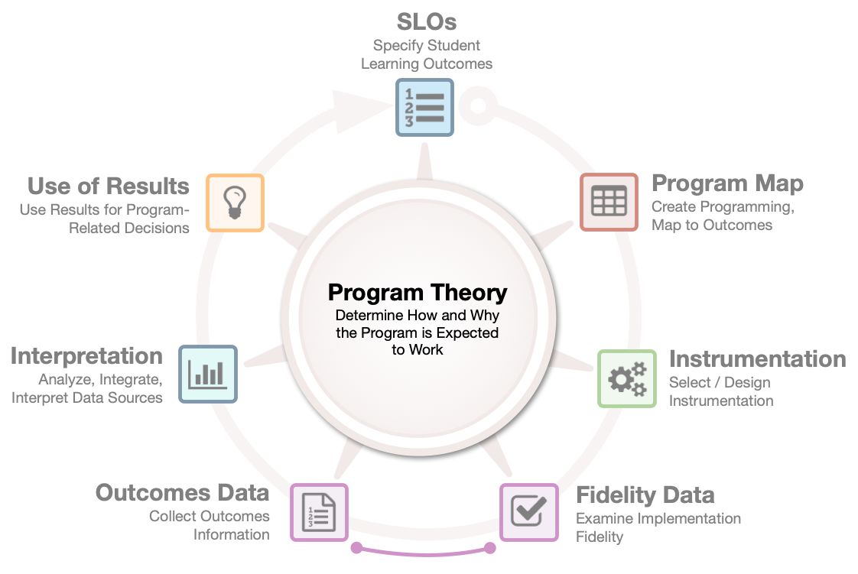
Notes:
This is the programming and assessment cycle I currently use.
Instead of focusing on the gathering of data, the focus is on the program—in particular gathering data in order to understand where the program is working and not so that it can be improved.
Notice that Needs Assessment is not explicitly included
I think it the cycle should be adapted to include it.
Honestly, there is a lot of needs assessment that occurs on our campuses even for incoming students but its not explicitly stated.
For example at JMU, we assess incoming students ethical reasoning, quantitative and scientific reasoning, and now AI literacy to get a baseline that supports the need for all the programming that currently exists or that should be built.

Slide 39
Program Theory allows faculty & staff to…..
Specify the Distal Outcome: “Students can engage ethically with AI tools.”
Specify Proximal Outcomes: what students need to know, perceive/value, and do to achieve distal outcome of using AI tools ethically.
Design interventions specific to proximal outcomes: programming to increase AI literacy (cognitive outcome), programming to change perceptions/value related AI tools, programming to change behaviors or skills using AI.
Provides faculty & staff with useful data so they know which programming to adjust given which outcomes aren’t met or which implementation issue to address.
Design measures to assess proximal outcomes in addition to distal so they know what parts of programming are working & which aren’t
Gather outcomes in a timely fashion to make changes more quickly than the distal outcome.
Design implementation fidelity checklists to evaluate if intentional programming is actually implemented & students receive it. One can’t check if programming is being implemented with high fidelity if the programming isn’t clearly specified.
Notes:
Distal outcome:
Students can engage ethically with AI tools.
Program theory will do the following:
Allow one to specify the proximal outcomes (what students need to know, perceive/value, and do) in order to achieve the distal outcome of using AI tools ethically.
Allow faculty and staff to design interventions specific to the proximal outcomes: programming to increase AI literacy (cognitive outcome), programming to change perceptions or value related AI tools, programming to change behaviors or skills using AI.
Allow faculty to design measures to assess the proximal outcomes in addition to the distal outcome so educators know what parts of the programming are working and which aren’t
Allow faculty to design implementation fidelity checklists to evaluate if the intentional programming is actually implemented and students receive it. One can’t check if the programming is being implemented with high fidelity of the programming isn’t clearly specified.
Allows faculty to gather outcomes in a timely fashion to make changes more quickly than the distal outcome.
Provides faculty with useful data so they know which programming to adjust given which outcomes isn’t met or which implementation issue to address.
This not innovative. All of this comes from Intervention Mapping (which borrows from general program evaluation models).
So, lets walk through Intervention Mapping.

Slide 40
Intervention Mapping | Outcomes Assessment in HE | Notes on Alignment
Step 1: Needs Assessment | Articulate Distal Outcome | Both begin with identifying problem or desired long-term outcome (GPA, retention, civic engagement).
Step 2: Proximal Program Objectives & Matrices of Change Objectives | Specify the Proximal and/or Intermediate Outcomes | IM’s “determinants” = OAHE’s “intermediate outcomes” (proximal outcomes). The knowledge, attitudes, and skills that influence the distal outcome.
Step 3: Theory-Based Methods & Strategies | Articulate Theory-Based Programming | IM’s “methods” and “strategies” = OAHE’s “program components” and “delivery approaches” informed by theory and research.
Step 4: Program Development/Production | Explicit Specification of Curriculum/Program Components and Map to Outcomes | IM’s development of materials and protocols = OAHE’s explicit mapping of intentional programming to intermediate outcomes.
Step 5: Adoption, Implementation, Sustainability | Implementation Fidelity | IM’s focus on adoption & sustainability = OAHE’s emphasis on if programming delivered as intended
Step 6: Evaluation & Monitoring | Gather Data & Interpret Results Use of Results for Improvement | Both frameworks stress the importance of assessing outcomes and using data to improve programming.
Key Concept Equivalencies
Logic Models | Program Theory Models | Visual map of how programming leads to distal outcome via determinants/intermediate outcomes
Determinants | Intermediate Outcomes | IM’s determinants (e.g., self-efficacy, norms) are the same constructs OAHE targets for change.
Cultural Competence & Equity Considerations | Equity-Centered Assessment Practices | Both emphasize the importance of tailoring interventions & assessments to diverse populations and ensuring inclusive practices.
Measure Development (e.g., logic model-based indicators) | Outcome Measures Aligned with Various Outcomes | Both require valid, reliable, and aligned measures to assess change in targeted outcomes.
Process and Outcome Evaluation | Pairing of Implementation Fidelity Data & Outcomes Data to Support Accurate Interpretation | Both emphasize collecting implementation (process) data and outcomes data to understand program effectiveness & guide decision-making.
Iterative Refinement Based on Evaluation | Use of Results for Improvement | Both frameworks stress using findings to refine programming and improve outcomes.

Slide 41
Intervention Mapping Approach
STEP 1: Needs Assessment
Identify what, if anything, needs to be changed and for who
🎯 STEP 2: Proximal Program Objectives
Create matrices linking performance objectives with determinants
💡 STEP 3: Theoretical Methods & Practical Strategies
Select theory-based methods that match determinants and create practical strategies
⚙️ STEP 4: Program Production
Operationalize strategies and develop materials to create an organized program
STEP 5: Adoption & Implementation Plan
Develop plan for program adoption, quality implementation and sustainability
🔍 STEP 6: Evaluation & Monitoring
Develop an evaluation plan to assess both effect and process
Core Components: Theory & Research
Community Engagement

Slide 42
Thank you
finneysj@jmu.edu
herrrk@jmu.edu

