Slide 1
The following materials were prepared for use by CARS and SASS consultants.

Slide 2
Objectives
The Foundation for Assessment

Slide 3
Make Assessment Meaningful
Think about why you go to work everyday
How do you want your students to be transformed as a result of your program?
State objectives first, then develop programming to meet these objectives
Program does NOT drive the objectives; this is backwards and very difficult
Objectives drive creation of programming; thus, you ensure programming aligns with desired outcomes

Slide 4
Why Does My Program Need Objectives?
Objectives should:
Provide focus for your program
Highlight learning and development priorities
Bring clarity and focus to instruction and programming
Help learners understand expectations, focus their attention, and estimate how well they are doing.
Provide a basis for assessing student learning and development by describing the performance to be measured. This provides a means for assessing program success

Slide 5
Establishing Objectives
What is an Objective?
Objectives refer to specific and observable student learning and/or developmental outcomes
Knowledge, skills, behaviors, or attitudes that students are expected to achieve as a function of your program
Thus, the terms “objectives” and “intended outcomes” are often used interchanged
In order to create a successful program, clear program objectives must be established and agreed upon by all those involved in facilitating the program.

Slide 6
Goals and Objectives
Goals can be seen as the broad, general expectations for the program
Objectives can be seen as the means by which those goals are met
Objectives are measurable and thus are written in a manner that facilitates measurement
PROBLEM: Some program “objectives” are really broad and unmeasurable goals

Slide 7
Goals vs. Objectives
General expectations of student outcomes
Can be broad and vague
Example: Students will see themselves as part of the JMU community
Statement of exactly what students should be able to do, or how they should change developmentally, as a result of instruction or program
More specific; measurable
Example: Upon completion of the orientation program, students will a) demonstrate a significant increase in sense of belonging to JMU, and b) choose to participate in JMU organizations

Slide 8
Goals and Objectives: Example
Goal: Students will understand the concepts that contribute to career decision-making.
Objective 1: Upon completion of the career and life planning course, students will be able to match a list of JMU majors to appropriate career choices.
Objective 2: Upon completion of the career and life planning course, students will be able to state their own “work personality” as measured by the Work Abilities, Values, and Interests (WAVI) Inventory.
Notes:
Hilary’s up next with some rules for writing objectives.
ABCD
1:
A = students from IS 202
B = match
C = upon completion of career and life planning course
given a list of JMU majors and appropriate career choices
D =
2:
A = students from IS 202
B = state work personality
C = upon completion of career and life planning course
using the WAVI
D =

Slide 9
Classification of Objectives
Cognitive (typically right or wrong)
Knowledge, comprehension, application, analysis, synthesis, evaluation of X
Affective, attitudinal, developmental
Usually abstract constructs: emotions, attitudes, values (i.e., body shame, conscientiousness, appreciation for diversity)
Behavioral
Assembles, volunteers, engages in, shares, avoids, attempts
Ease in assessment and impacting change follows the above order (easier to impact student knowledge than student behavior)
Notes:
Before I show you some tools for writing objectives, I want to draw a distinction between subject matter objectives and developmental objectives. This is important for Student Affairs because many of your objectives will be developmental.
In general, subject matter objectives are written to assess student learning by addressing discipline-related material the student learns – like vocabulary and theories.
Developmental objectives, on the other hand, are written to assess student development by addressing change in cognitive, or higher order thinking, skills OR by addressing affective change – like changes in attitudes, beliefs, values that are fostered by the college experience.
Examples of higher-order thinking: critical thinking, intellectual development

Slide 10
Developmental Objectives
Can be difficult to assess
Constructs are unobservable and thus may be vaguely defined at the start of objective writing
What is “mattering”? What is “entitlement”? What is “leadership”? What is “civic responsibility”?
This can take a great deal of time to work through
Usually takes longer than one semester for people to change developmentally
No change in developmental objectives doesn’t mean no change in knowledge
Notes:
Vague construct examples – enlightened citizen, sense of community

Slide 11
Using Objectives to Design Assessments
Objectives dictate the type of assessment to conduct
Looking at the action verb in the objective should indicate the appropriate means of measuring that objective
Example: “recognize”: may indicate matching, multiple choice, etc.– lower-level thinking
Example: “demonstrate”: may indicate a performance assessment, or higher-level demands

Slide 12
Assess ALL Objectives
EVERY objective MUST be measured
All of the objectives need not be assessed each year though.
If you consistently aren’t assessing an objective, ask yourself if that truly is an intended outcomes of your program.
If it’s not: drop it
If it is: then start assessing it

Slide 13
Characteristics of *good* objectives
Student-focused
Reasonable
Measurable
Define success

Slide 14
Characteristics of an Objective: STUDENT-FOCUSED
Objectives should be worded to express what the student will learn, know, or do as a result of program or how the student will change developmentally as a result of program – NOT what the instructor or program will do for the student
BAD Objective: Provide students with knowledge about how to write resumes.
BETTER Objective: After taking the Resume-Building Workshop, students will be able to effectively create a resume that accurately reflects their education and experience.

Slide 15
Characteristics of an Objective: REASONABLE
Objectives should be reasonable; that is, they should reflect learning or development that the student can accomplish as a function of the program.
BAD Objective: Students will demonstrate open-mindedness for all cultures by strongly agreeing with all of the items on the Open-Mindedness Inventory (OMI).
BETTER Objective: Upon completion of the Study Abroad program, participants will show an increase in open-mindedness through a 10-point increase on the OMI.

Slide 16
Characteristics of an Objective: MEASURABLE
Student learning and development should be represented by observable, measurable objectives.
Objectives such as “know” and “understand” are not observable.
BAD Objective: Students will know about JMU’s alternative spring break program.
BETTER Objective: Students will be able to describe JMU’s ASB program.
OR: Students will be able to evaluate the impact of the ASB program.

Slide 17
Characteristics of an Objective: DEFINES SUCCESS
Objectives should specify acceptable student performance (“criteria for success”).
BAD Objective: The student will learn how to take better notes.
BETTER Objective: Students from the Study Skills program will demonstrate mastery of note-taking techniques by correctly using at least three different note-taking methods for classroom lectures.

Slide 18
How do I do this? The ABCD Method
A = Audience
What population are you assessing?
B = Behavior
What is expected of the participant?
C = Conditions
Under what circumstances is the behavior to be performed?
D = Degree
How well must the behavior be performed? To what level?
From “How to Write Clear Objectives”
Notes:
Give examples
Audience: resident students, students in a class, members of a club, participants in a workshop
Behavior: remember, observable and measurable – demonstrate, select, categorize, participate
Conditions: upon completion of the program, at the end of the semester, given a calculator
Degree: this is how you know if the student succeeded – might include how many times or a cut score on a test.

Slide 19
The ABCD Method: Example 1
Audience | Residence hall freshmen
Behavior | Develop a greater sense of belonging to CNU
Condition | As a function of living on campus
Degree | Compared to off-campus freshmen
Objective: As a function of living on campus, residence hall freshman students will develop a greater sense of belonging to CNU compared to off-campus freshman students.

Slide 20
The ABCD Method: Example 2
Audience | Incoming students
Behavior | List General Education clusters
Condition | Upon completion of orientation
Degree | All
Objective: Upon completion of orientation, incoming students will be able to list all five of the General Education clusters.
Notes:
Degree: What is the change you want to see to be satisfied that the program had the intended impact?
YOU, in the department, must decide this!

Slide 21
The ABCD Method: Example 3
Audience | Undeclared students
Behavior | Match JMU majors to appropriate career choices
Condition | Upon completion of the Career and Life Planning program
Degree | 80%
Objective: Upon completion of the Career and Life Planning program, undeclared students will be able to match 80% of JMU majors to appropriate career choices.
Notes:
Degree: What is the change you want to see to be satisfied that the program had the intended impact?
YOU, in the department, must decide this!

Slide 22
The ABCD Method: Example 4
Audience | Offenders
Behavior | Volunteer toward proactive campus improvement activities
Condition | Upon completion of the Civic Responsibility JA program
Degree | 10 hours per semester
Objective: Upon completion of the Civic Responsibility Judicial Affairs program, offenders will volunteer 10 hour per semester toward proactive campus improvement activities.

Slide 23
Common Mistakes
Vague behavior
Example: Have a thorough understanding of the university honor code.
Gibberish
Example: Have a deep awareness and thorough humanizing grasp on…
Not Student-Focused
Example: Train students on how and where to find information.

Slide 24
“Isn’t it just different wording?”
“I already wrote out my program mission, purpose, philosophy, curriculum, and instructional component descriptions. Isn’t that good enough? I feel like objective writing is just saying the same thing in a different way”
Other program information may tell you how or why learning or development is expected to occur, but objectives describe what learning or development should occur. This information IS different:
The objectives are the “ends” not the “means”
What the facilitators will do conveys the instructional process.
If it was the same information – Obj. wouldn’t be so hard to write!

Slide 25
“I don’t have objectives”
“I know my program is good. Students will learn something & develop. Can’t I just measure a bunch of things and see what they learned or how they developed? Or can’t I just list the topics I teach?”
What is your prediction about what students will learn or how they will develop?
What is the purpose of your program? Why was it created?
Recall that the objectives drive the creation of programming.
You must be able to pinpoint the programming that produces EACH outcome.
Identifying the programming that is responsible for student learning and development is essential to understanding the impact of a program. This process will help to determine if an objective is truly important to the program
Mapping objectives to programming is directly related to resource allocation. Helps you identify where changes need to made.
There shouldn’t be a program focused on student learning and development that doesn’t have intended outcomes (then how was the programming developed?).

Slide 26
“Objectives can’t fully capture my program”
“My program focuses on broad abstract concepts. Stating them as observable behaviors forces me to trivialize my goals. Focusing on objectives cramps my style.”
It is always possible to write objectives that capture your true desired learning and development outcomes.
To achieve objectives that truly reflect your vision requires time, effort, and careful thought.
Objectives are not the same as goals. True, you can’t measure those abstract goals – don’t try!
Articulating your intuitively held goals as measurable objectives allows you to see if your goals are being met! If you can’t do this, one would question the utility of your program.

Slide 27
Summary: Use Objective Formula
Writing objectives isn’t creative writing: Just follow a formula!
Given [Conditions] the [Audience] will [Behavior] by [Degree].
[Audience] will [Behavior] to [Standard] when provided [Conditions].
The [Audience] will [Behavior]. The task must be performed under the following conditions: [Conditions]. The following standards must be met: [Standards].

Slide 28
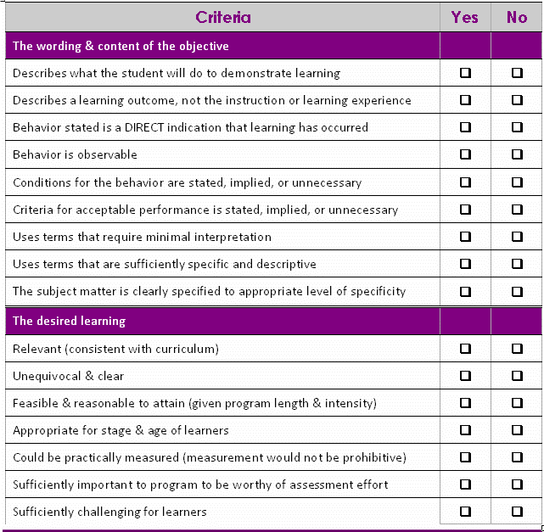
Summary: Check Each Objective

Slide 29
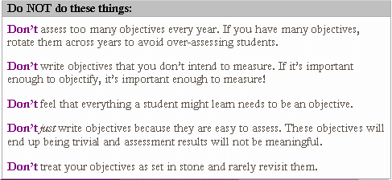
Summary: Objective Writing is a Process

